Slide 1
ESCAPE WP3
21/03/2022, Thomas Vuillaume, Enrique Garcia

Slide 2
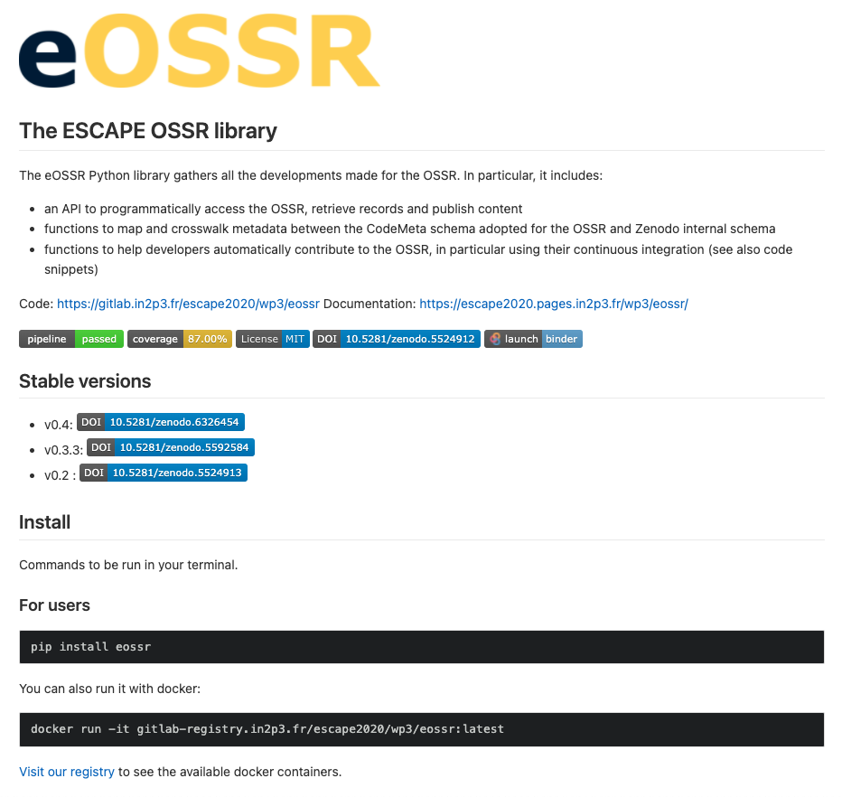
v0.5 released
This release introduces some bug fixes and a simplification of the upload of repositories (API break for users).
Full changelog: https://gitlab.in2p3.fr/escape2020/wp3/eossr/-/releases/v0.5

Slide 3
OSSR: https://zenodo.org/record/6352039
pypi : pip install eossr==0.5
docker run gitlab-registry.in2p3.fr/escape2020/wp3/eossr:v0.5
mybinder: https://mybinder.org/v2/git/https%3A%2F%2Fgitlab.in2p3.fr%2Fescape2020%2Fwp3%2Feossr/HEAD

Slide 4
gammapy OSSR onboarding
gammapy onboarding in the OSSR should be finalised with their next release (in a few weeks)
a lot of exchanges with them to prepare it in the best way
https://github.com/gammapy/gammapy/pull/3833
https://github.com/gammapy/gammapy/issues/3847

Slide 5
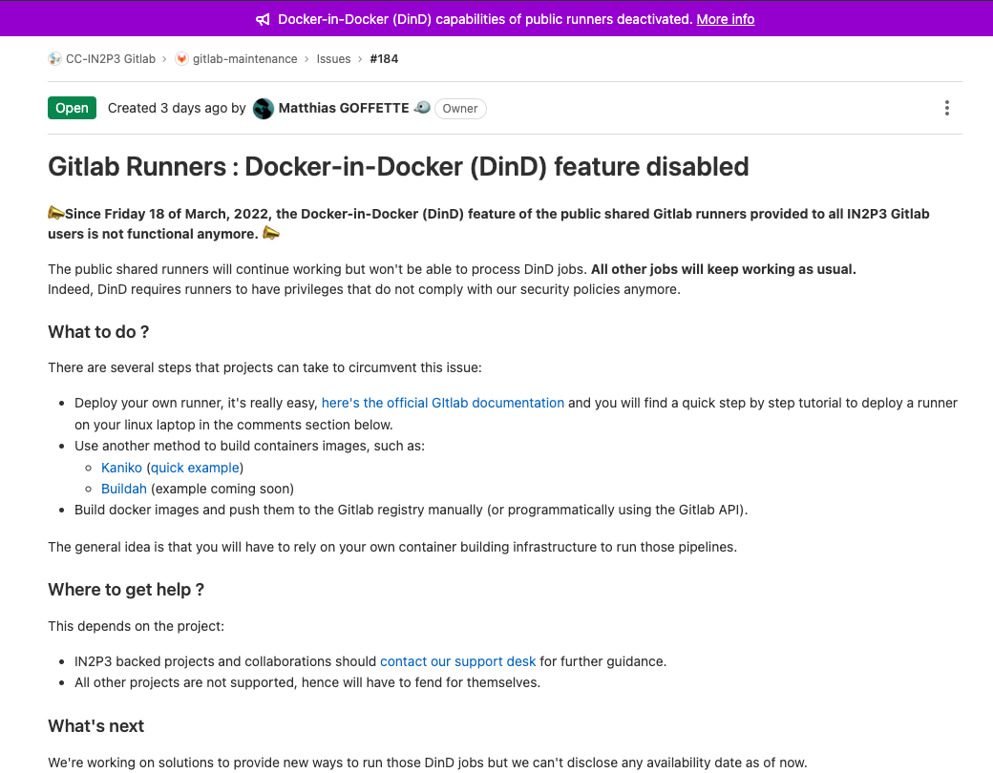
Docker-in-Docker & gitlab in2p3 💔
https://gitlab.in2p3.fr/cc-in2p3-gitlab/maintenance/-/issues/184
Affects several of our repositories and breaks or workflows
Working on solutions
If you are in the same situation, let us know so we can work on it together

Slide 6
EDASS2022
Organisation meetings with LOC: Corinne, Julie, Nicolas, Hélène, Enrique, Marie, Maud, Thomas (thank you all!!!)
Date is set to June 19-24
Jean XXIII confirmed
Programme under construction
Some regular tutors contacted (and already replied by the positive)

Slide 7
Google Summer of Code
Google summer of code student to work on the eOSSR
API to do a Repository as a Service
In relation with HSF
5 replies from students
Pre-selection based on tests prepared by Enrique
2 weeks before the deadline
Final acceptance by Google

