Slide 1

Top quark production at FCCee

Slide 2
Step 1: Event generation with Whizard
Step 2: Pass the particles through a detector
Step 3: Using other model and seeing new vertex impact

Slide 3

Whizard =collision simulation
Process e⁺e⁻
SM (relativistic perturbative calculation)
SM_tt_threshold (non-relativistic physics)
Study the beam energy spread (BES) and no-beam effects

Slide 4
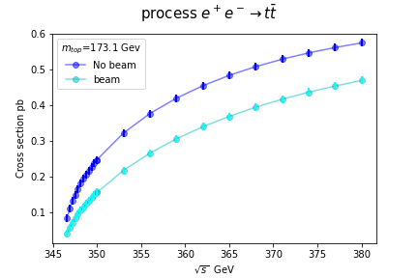
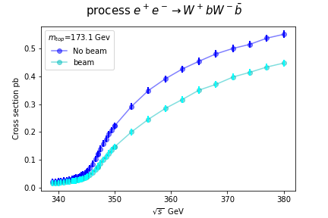
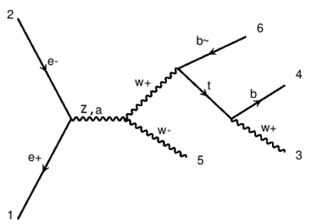
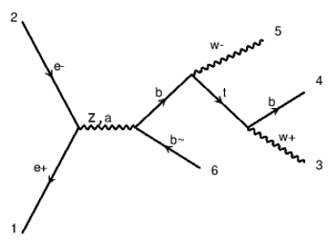
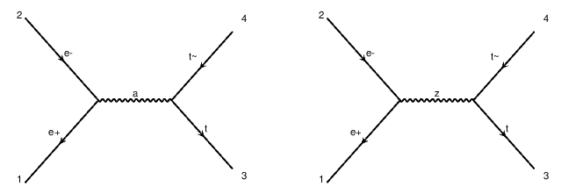
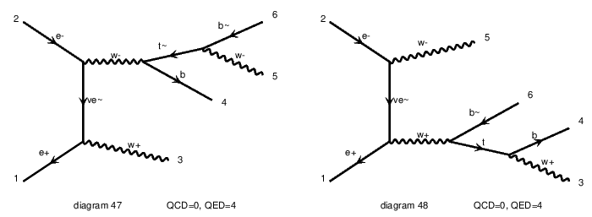
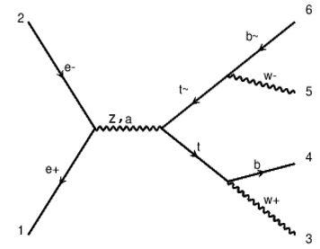
SM

Slide 5
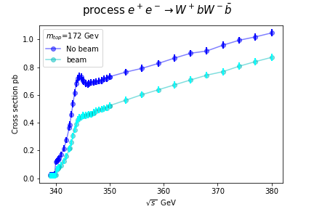
SM
SM_tt_threshold
Including low perturbative effects
Including non-perturbative effects

Slide 6
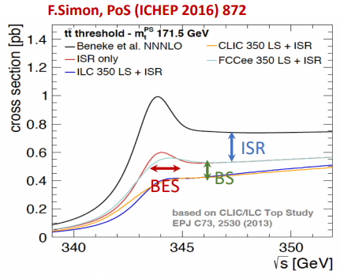
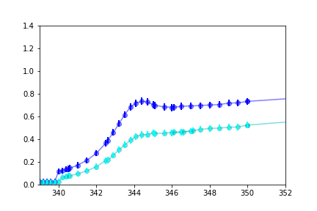
Comparison with a study
Not exactly the same, higher order development ?

Slide 7
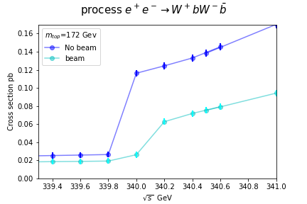
Discontinuity problem at 340 GeV
?
Origin of the discontinuity ?

Slide 8
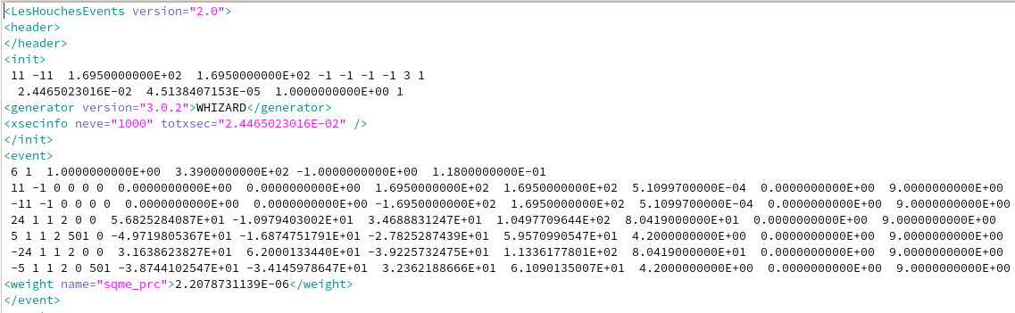

LHE file
Energy
PDGID
Initialization section
Number of events
Cross section
One
event
PDGID
px
py
pz
Energy
m

Slide 9
Conclusion
Influence of the study process
SM_tt_threshold allows to see the resonance
Unknown discontinuity origin

