Slide 1
Essentials of Digital Forensics
Daniel Kouřil
kouril@ics.muni.cz

Slide 2
Digital Forensics
Methods to collect, preserve and analyze digital evidence
Three main phases
Acquiring the primary data
Analysis and evaluation (establishing the evidence)
Reporting
The first phase is most crucial
Must make sure the data is complete, authentic and its integrity can be checked
The other phases can be repeated/corrected/scrutinized any time

Slide 3
Data Acquisition

Slide 4
Basic principles
The collected data must be complete and accurate
“We want to get the most evidence we can with the least amount of alteration”
The quality of the data and the soundness of the acquisition process determines the utility of the evidence
Every investigation should be scoped (questions formulated, at least internally)
Only start the acquisition process if you’re authorized!

Slide 5
Risks of low quality of evidence
If the evidence is incomplete, it cannot yield relevant outcome
If the acquisition process doesn’t guarantee the integrity and authenticity of the data, results can be disputed
If you don’t know what to do, do not interact with the system at all
No commands typed, no programs started, no new logins, …

Slide 6
Data analysis

Slide 7
Analysis environment
The analysis does not depend on the system where we got data from
Artifacts related to MS Windows architecture can be analyzed on Linux-based environment and vice versa
A Linux environment based on CLI will be used thorough the course
Many tools are common commands or are available from distribution packages
Always keep the primary data intact and work only with its copies

Slide 8
Live Analysis

Slide 9
Live capture
Accessing a live, running system and collecting volatile information
The goal is to capture information for off-line analysis, not doing analysis on the host
Data capture should follow the order of volatility
Data is volatile (either frequently changing and/or available only for a limited time)
Most volatile data needs to be captured first
e.g., list of open connections is more volatile than disk contents

Slide 10
Things to remember during live capture
Minimize all activities on the system
(every action leaves/modifies traces)
A running system persistently modifies itself even without investigation activities
keeps producing logs, performing SW updates, …
Remember the capturing is always mediated by the system that is being investigated
Don’t trust the programs on the system
Be prepared the collected information might be distorted/hidden
Imagine a kernel rootkit hiding certain processes or connections

Slide 11
Perils of live acquisition
Inherently a thin line between investigation and acquisition
The system needs to be investigated to establish potential sources of evidence
It’s important to document the process
E.g., using video/image records, a log of performed actions, etc.
In serious investigations work in a pair (investigating + documenting steps)

Slide 12
Areas of Live Analysis
Obtaining volatile information available from kernel and applications
Obtaining content of memory
A complete host memory or memory of selected processes
contains pristine information, including sensitive data
Recovering data that would be lost
Deleted, still open files on Linux

Slide 13
Linux specifics

Slide 14
Getting process information
Process may have multiple file-descriptors opened
Used executable, libraries
Particular files on file system
Network sockets
Information on processes can be accessed using standard system commands
lsof –p PID

Slide 16
/proc filesystem
Linux kernel exposes some internal structures in the /proc virtual file
System commands mostly use data from /proc
/proc can be useful to access data that is not available through commands (or spot anomalies)

Slide 17
Deleted files
Deleted files are available until they are closed
If a file is open by a process, it’s removed from the filesystem but its content can still be accessed
“symbolic links” in /proc can be used to recover the data
cp /proc/$PID/exe /tmp/exe
The process must be alive (even stopped)
Holds for both executable and open files (see the fd directory)

Slide 18
Notes:
Pridat cp suspicious /tmp

Slide 19
Network
Getting information on network status
netstat -tnp
ss -tnp
Check the /proc virtual filesystem
All should yield the same information (in different formats though)
tcpdump might be handy to check live traffic

Slide 20
Dumping process memory
gcore –o dump PID
Part of the GDB package
Some (soft) errors might be triggered
Outputs an ELF file containing the process memory

Slide 21
Analysis of executable files

Slide 22
Executable files
Scripts
List of commands, script constructs
Easily readable by human (if not obfuscated)
Binary executables
Machine code (produced by compiler)
byte code (Java)
ELF, PE formats
Libraries
Static / dynamic
Library functions, variables (internal / exported)
Export interface (ABI/API)

Slide 23
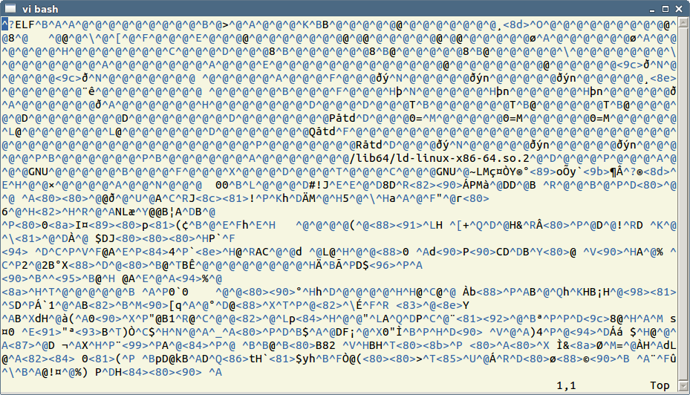
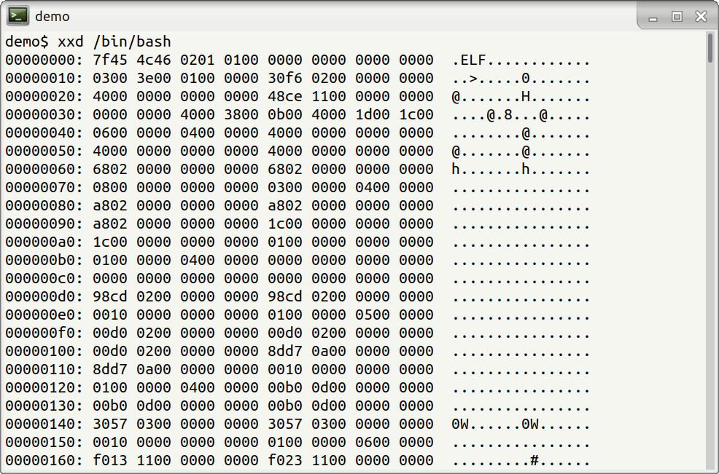
Binary executable files
System specific formats
Dynamic vs. static analysis

Slide 24
ELF

Slide 25
A quick look inside an ELF executable
https://binvis.io/
file exe
exe: ELF 64-bit LSB executable, x86-64, version 1 (GNU/Linux), for GNU/Linux 2.6.32, statically linked, stripped
strings –a exe
Reveals human-readable strings

Slide 26
File metadata
Metadata information
Owner identifier
Group identifier
Permissions / ACL
Addresses of data blocks (content)
Important timestamps
No need to access content
Smaller space needed
Less privacy issues

Slide 27
File timestamps
Common types of timestamps (POSIX)
m-time (modification time) – the last time the content was changed
a-time (access time) – the time of last access (content)
c-time (change time) – the last time metadata was changed
Additional timestamps on some file systems
d-time (deletion time)
b-time (creation time) (sometimes cr-time)
Timestamps only refer to the very last action performed

Slide 28
A malicious PHP file (backdoor) shell.php was found on a web server. Examine the time stamps of archive.php, upload.php, gallery.php and determine which file was likely used to store the malicious payload and select timestamp when the backdoor was used for the last time.

Slide 29
Timelines
Common analysis technique important for many objectives
Timeline provides a simple overview of events that happened on the system
Can be constructed from any data where timestamps is recorded
Logs, events (users logins)
Application data (mail/document manipulations)
File metadata (file utilizations)

Slide 30
Fimetis by CSIRT-MU (https://github.com/CSIRT-MU/fimetis)

Slide 31
Working with file timestamps
Executing a file changes its a-time
The precision of a-time depends on configuration
m-time and a-time can be easily changed by file owner
happens when copying/moving files, or deploying software from packages
c-time can’t be changed easily
Pay attention to time zones and granularity
FAT uses system time, NTFS uses UTC
Precision is among days (FAT), secs (ext3), and nanosecs (ext4)

Slide 32
Obtaining metadata
fls and mactime commands (only for supported FS)
Simple ’find’ command (recursive walk through the filesystem)
find / -xdev -print0 |
xargs -0 stat -c "%Y %X %Z %A %U %G %n"
Leif Nixon’s timeline-decorator.py to format
Be prepared for a lot of data (hundreds thousands of records)

Slide 33
Hands-on

