Slide 1
Costing and Safety
EUROν Special Topics
Outline
Costing workshop summary
  Workshop’s aims
  Highlights from the presentations (my selection!)
  Costing Roadmap
Safety
      What it means and how to deal with it – next steps
Ilias Efthymiopoulos – CERN

Slide 2
(1st) EURONU Costing Workshop - Aims
The cost evaluation of the proposed facilities is part of the design study.
This two days workshop would introduce the cost management techniques to the EURONu participants towards defining a strategy for what needs to be done within the design study.
The workshop will be more of a tutorial and open discussion basis, where the experience from past and present/future HEP accelerator projects will be presented along with methods, techniques and tools used in cost evaluation of big projects.

Slide 3
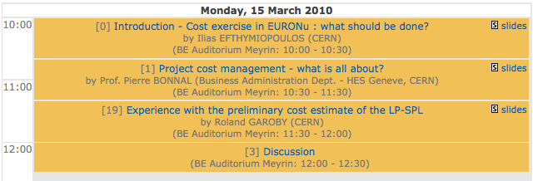
Workshop program
http://indico.cern.ch/event/EuroNuCostingMar2010

Slide 4
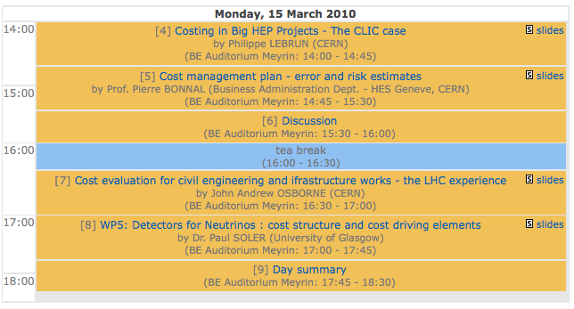
Workshop program

Slide 5
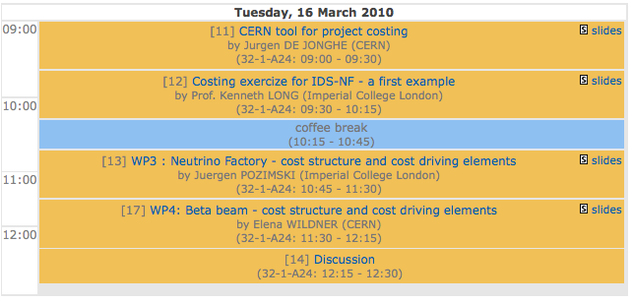
Workshop program

Slide 6
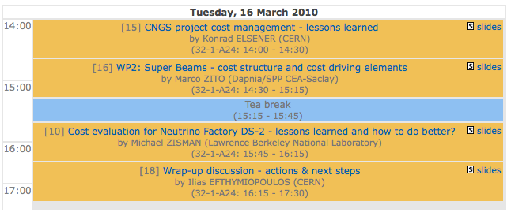
Workshop program
Very interesting presentations – the ones marked worth going through
Good attendance (~25 people) and lively discussions…

Slide 7
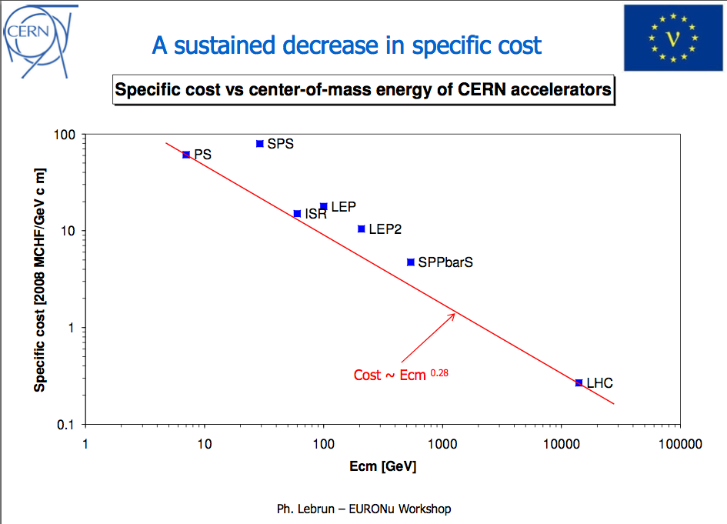
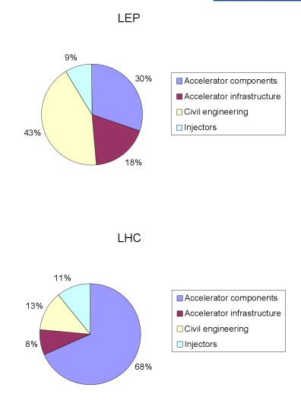
Highlights – Ph.Lebrun “Costing in big HEP projects –the CLIC case”

Slide 8
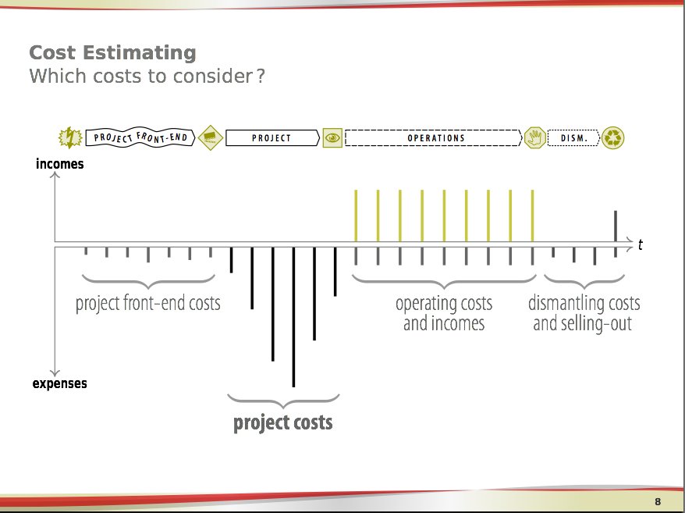
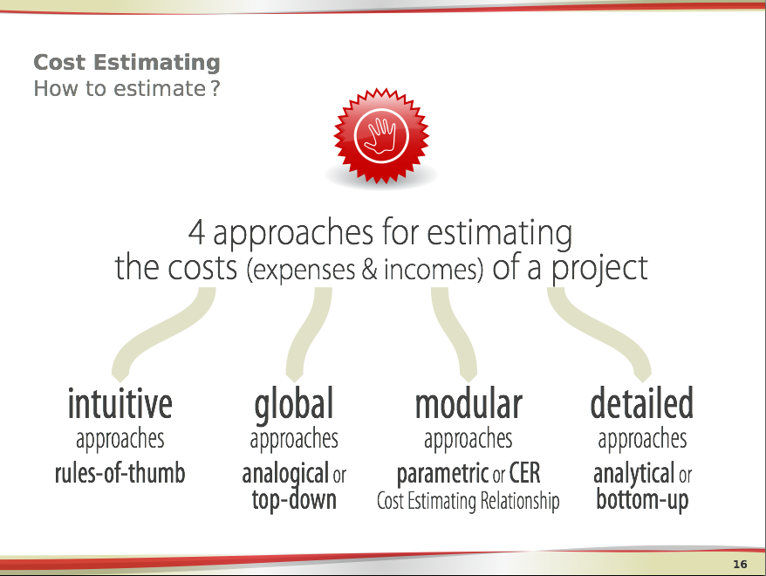
Highlights – P. Bonnal “Project Cost Management – what is all about?”

Slide 9
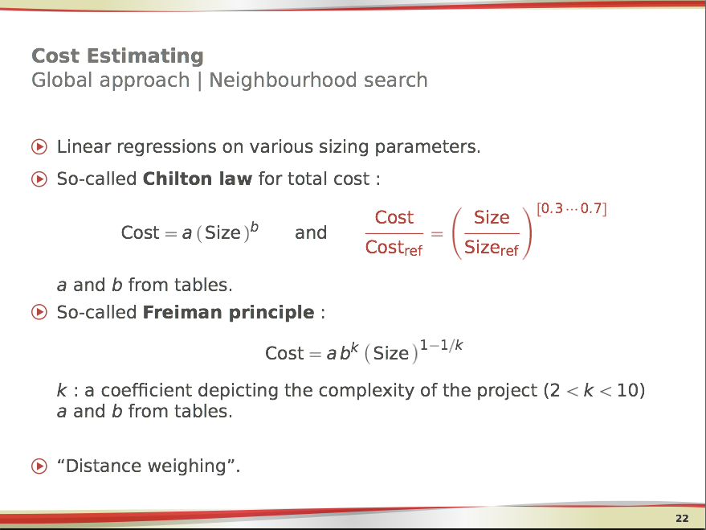
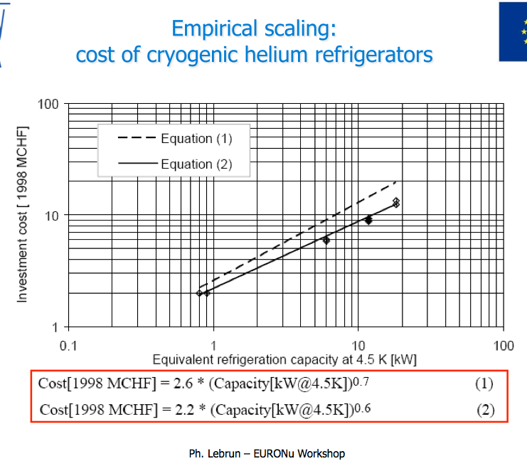
Highlights – P. Bonnal “Project Cost Management – what is all about?”

Slide 10
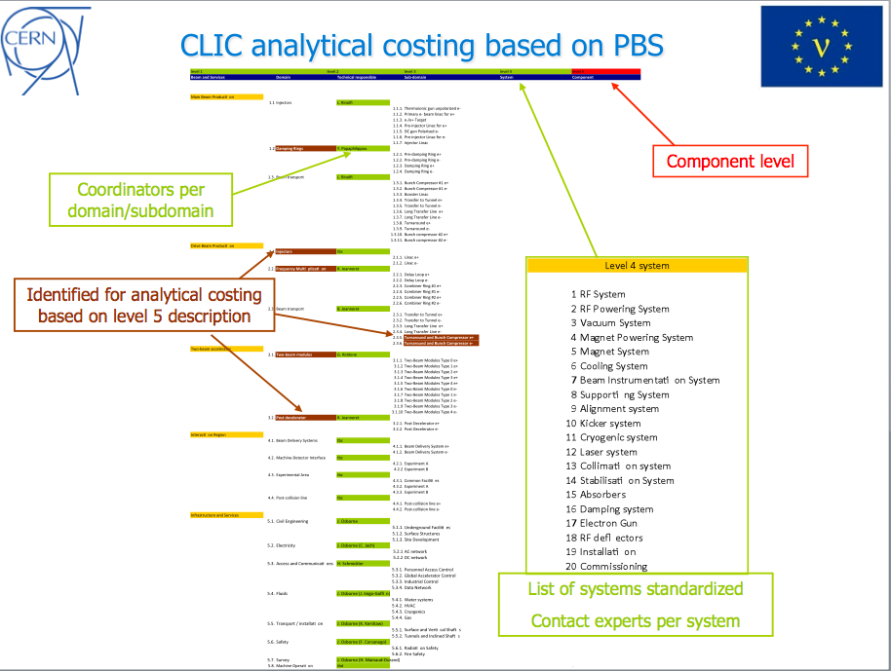
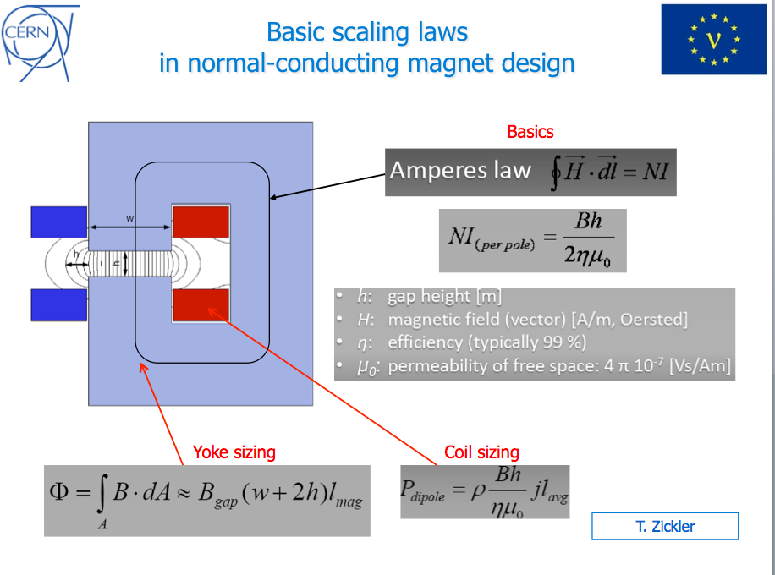
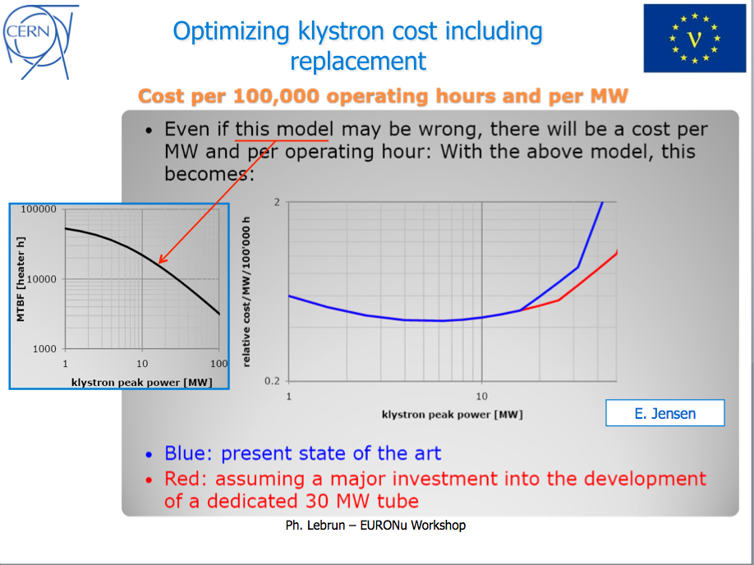
Highlights – Ph.Lebrun “Costing in big HEP projects –the CLIC case”

Slide 11
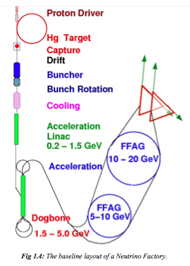
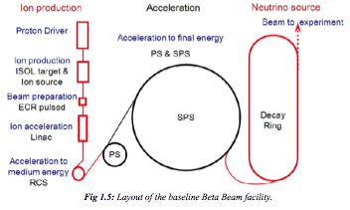
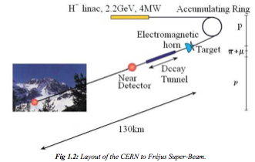
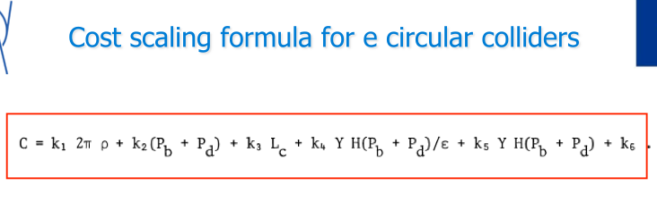
Highlights – Cost optimization
Can we imagine a similar “cost optimization formula” for a Neutrino Factory?

Slide 12
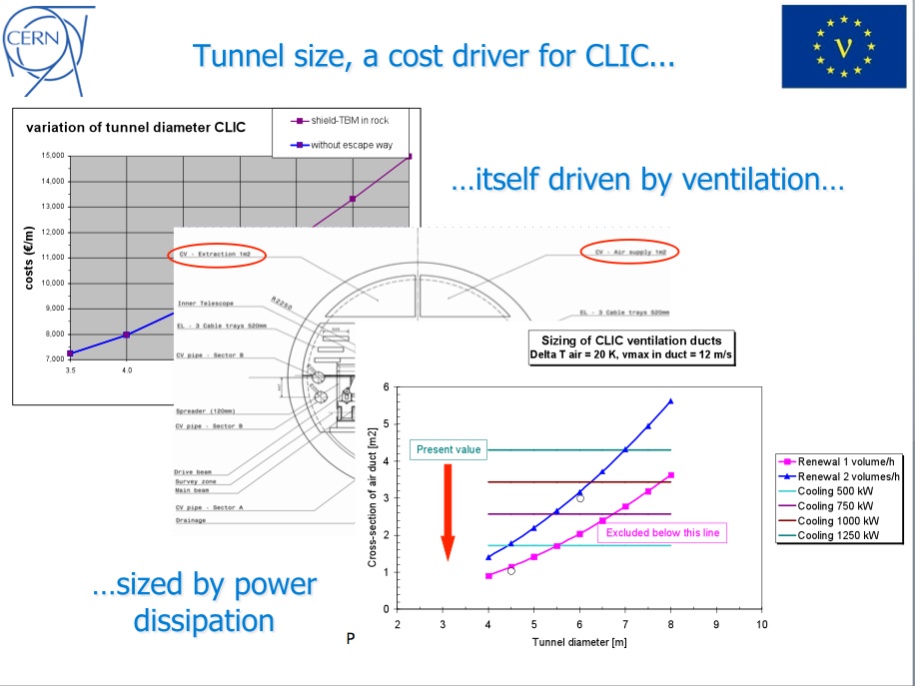
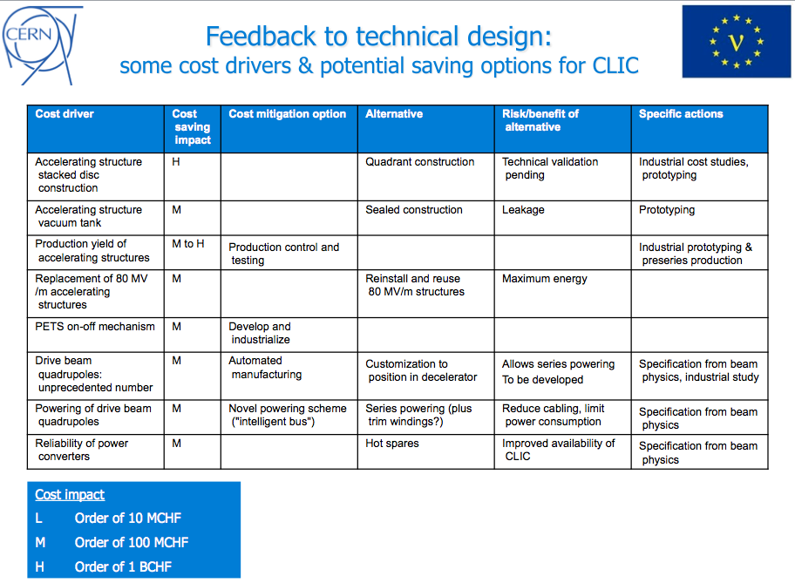
Highlights – Cost optimization
Need to define cost optimization cycles, and continuous follow-up as the design progresses…

Slide 13
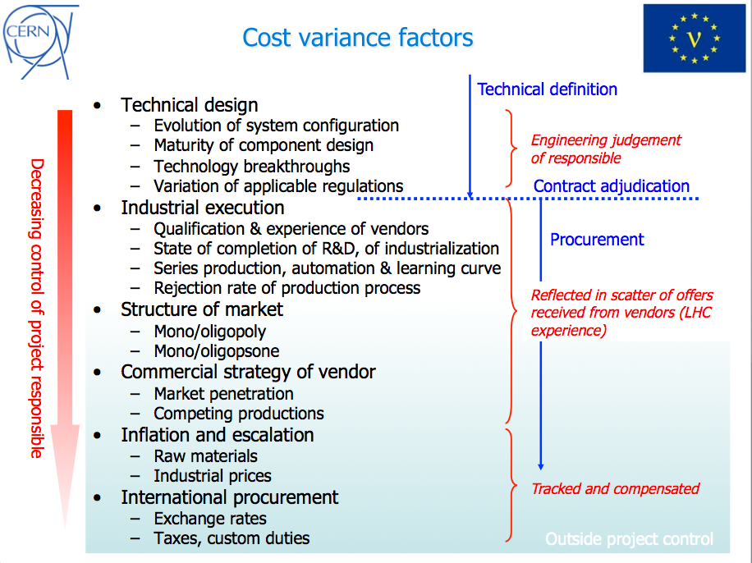
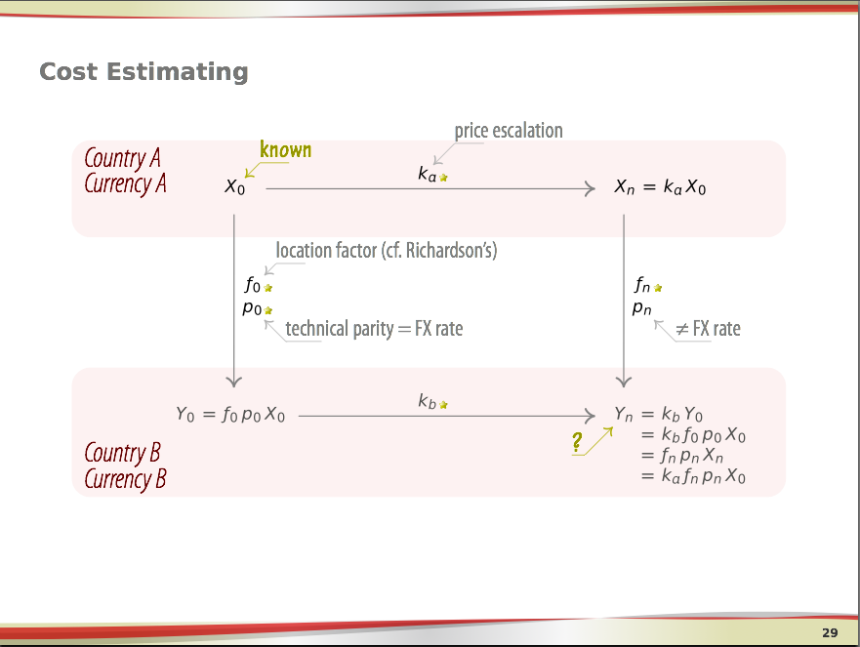
Highlights – Cost estimate and variance

Slide 14
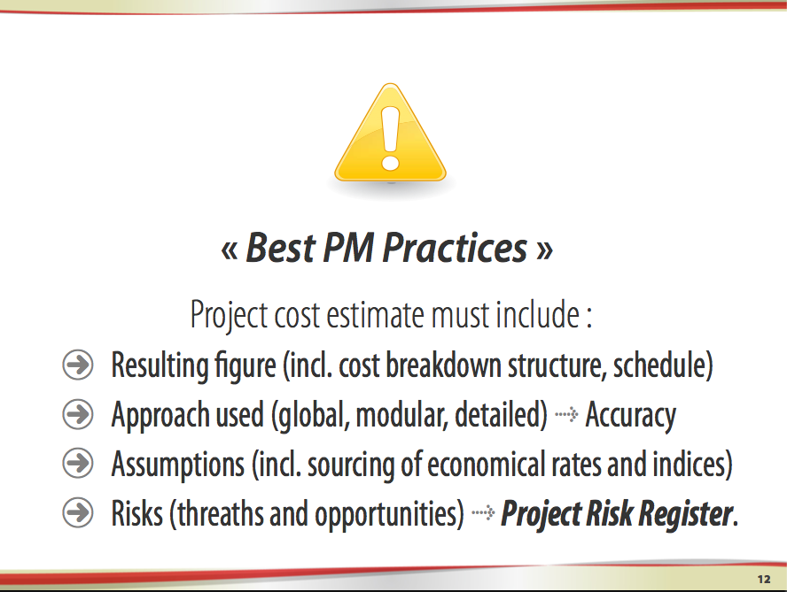
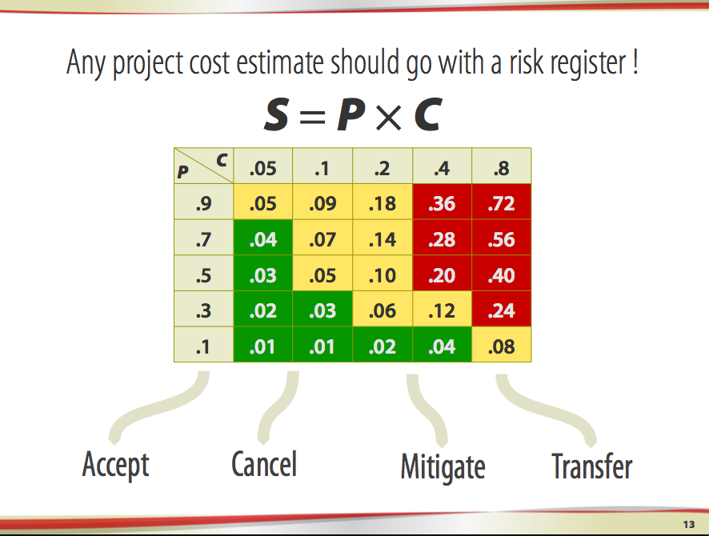
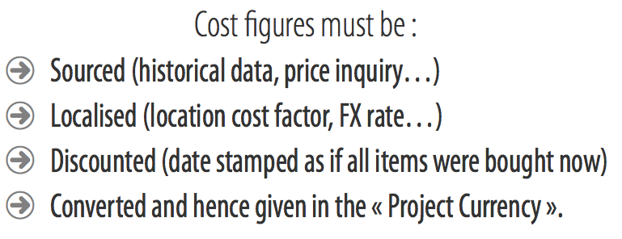
Highlights – P. Bonnal “Project Cost Management Plan – error and risk estimates “

Slide 15
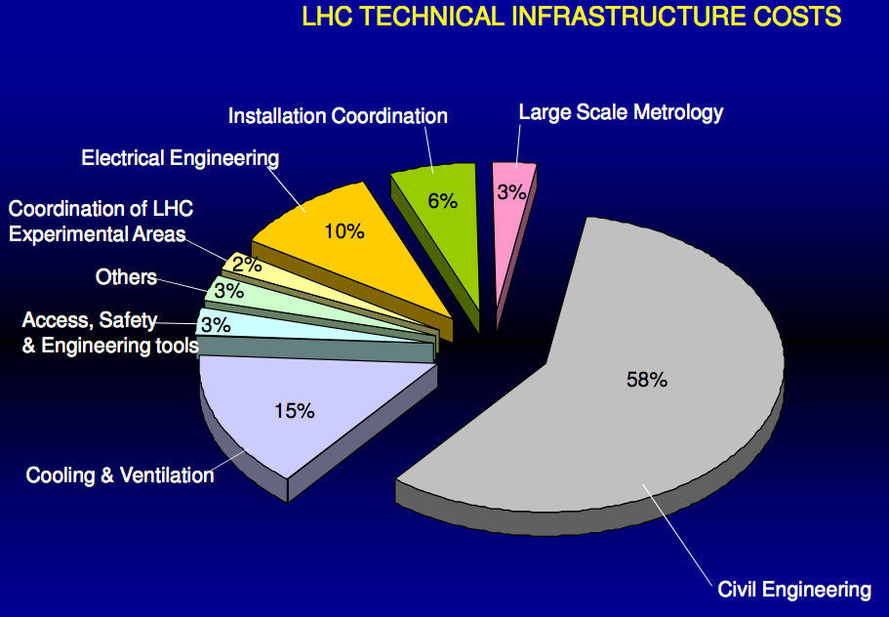
Highlights – J Osborne “Cost evaluation for civil engineering and infrastructure works - the LHC experience”

Slide 16
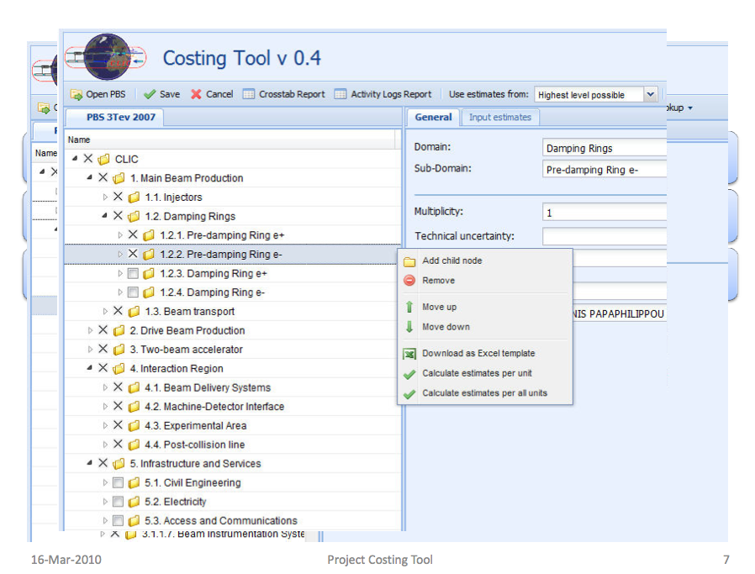
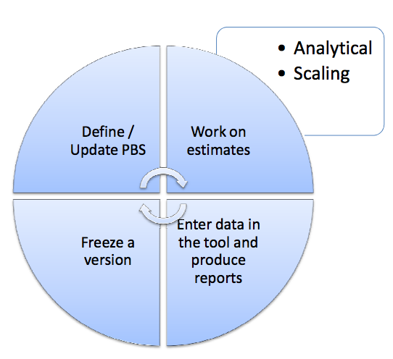
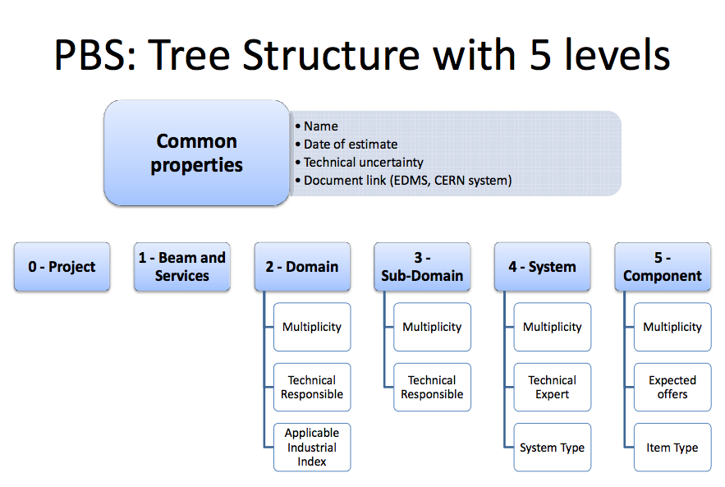
Highlights – J. De Jonghe “CERN tool for project costing”

Slide 17
Highlights – K. Elsener “CNGS project cost management - lessons learned”
Contingency
  CNGS got a few percent of contingency, clearly not enough
Civil engineering
  CE drawings were ready in time before tendering -> no change requests, no extra cost
  CE consultancy services -> very detailed track record of work progress andproblems, 24h every day of CE works -> huge claim by contractor had no chance to succeed
  Underground Civil Engineering: a (under-)world of its own !
Infrastructure
  Industrial standards are not, generally, sufficient for areas with high intensity beams
Safety matters
Special and in-kind contributions
  Follow-up through project lifetime, maintenance once delivered to the final site?

Slide 18
Costing workshop – What we learnt
The Work Breakdown Structure (WBS) of each facility is the key element
  Should be as complete and accurate as possible
  Include infrastructure and services (CE ~30% of the total budget)
Construction cost only or include R&D?
  Include it in the costing tables but not in the final estimate?
Would maintenance & operation, spares and dismantling costs be included?
  Yes! – up to some point ….
Manpower estimates and associated cost?
  Manpower should be included in FTEs – reporting possibility in real cost
How to estimate the cost of components before the R&D (and prototyping) is fully completed ?
  Need to perform risk analysis and impact on cost estimates
Involve the engineers responsible for the major cost driving elements to assure fast information flow during performance optimization modifications
    Additional resources or ability to approach expertise in particular at CERN would be essential

Slide 19

Costing workshop - Outcome
CERN has to be the reference site for all: Neutrino Factory, Beta-Beam, Super-Beam
Using the CERN costing tool is the agreed way to go
  Profit from the available structure, support
  Some work is required to customize it to our needs
  How can we profit from existing knowledge from various projects ???
    Synergies with CLIC, return experience from LHC, LEP, NF Design studies → create a HEP project cost database?
Handling of options – the “lego” game
  Combine options between facilities & detectors & localization
  Would be possible to define a Facility optimization formula for the cost ???
    F = f (performance, ν-source, detector, localization)
  EUROnu should remain as the master project to assure sharing of information and studies between the options
IDS-NF agreed to use the same tool for the cost evaluation
  However this involves additional options on sites/detectors
  Can this also provide additional help and knowledge for costing issues – engineering manpower?

Slide 20
EUROnu Costing exercise – Roadmap
Costing panel
reps from each WP as cost contact persons
EURONU MB
Tasks:
  Trained to use the costing tool
  Responsible for collecting information and cost update in the tool
CERN support
Project Office support: costing tool, consultancy
Streamline requests and collaboration via the EUROnu Costing Panel

Slide 21
EUROnu Costing exercise – Challenges ahead
The manpower will be the limiting factor
  Several parts of each facility NOT included in the EURONU
  Parts are only designed not fully engineered
  Balance of available manpower between physics (design/simulation) and engineering
  Available expertise in infrastructure estimates?
  Localization exercises
    would need local experts to get estimates – CERN?
    include safety issues and impact on cost
Final target for cost estimate in the final report?
  ± 50 % (±30)? – what is realistic and “politically correct” at this stage?
  Aim for better precision on the relative cost between facilities – ±30 or less??

Slide 22
safety

Slide 23
EUROnu Safety – What it means?
Identify safety issues in the project
  Safety of personnel during installation, operation, maintenance and dismantling actions
  Safety to materials/equipment – assure their operation as required by the specs
  Impact to the environment during installation, operation and dismantling of the facility
Do risk analysis for each identified safety issue
  Ways to mitigate the risk → incorporate in the design, include in the cost estimate
  Classify the risks → setup the project risk register

Slide 24
EUROnu Safety – What it means?
Identify safety issues in the project during:
  installation
  operation
  maintenance
  .. and dismantling
Risk analysis:
Identify risks (wrt safety)
Ways to mitigate the risks
  incorporate in the design
  include in the cost estimate
Classify the risks
  setup the project risk register

Slide 25
EUROnu Safety – Roadmap
Safety panel
reps from each WP as cost contact persons
EURONU MB
Tasks:
  Collect information on safety issues
  Organize risk analysis reviews
Safety = Costing Panel???

