Slide 1
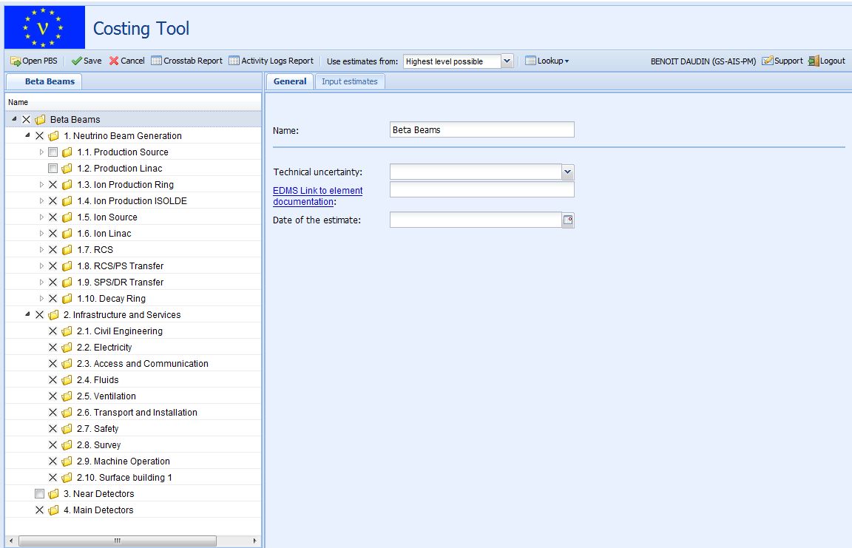
Project Costing Tool
EUROnu Annual Meeting – 3rd June 2010
Jurgen De Jonghe / Benoît Daudin – CERN, GS-AIS-PM

Slide 2
Agenda
Tool functionalities
Further improvements
Main objectives
EUROnu setup planning

Slide 3
Main objectives
Centralize costing data
Standardize calculation methods
Compare the various EUROnu configurations
Collaborative tool (web application)

Slide 4
Tool functionalities
Project Breakdown Structure
Estimates on PBS nodes
Calculations
Reports

Slide 5
PBS Edition
Basic operations
PBS selection according your access rights
PBS Status : Active, Frozen or Test

Slide 6
PBS: Tree Structure with 6 levels
Level 0 - Project
Level 1 - Beam and Services
Level 2 - Domain
Level 3 - Sub-Domain
Level 4 - System
Level 5 - Component
Level 6 – Sub-component

Slide 7
PBS: node edition – UI interface
Create
Delete
Re-order

Slide 8
PBS: node edition – Excel file
Initial setup
Large modifications
No user interface to directly upload data

Slide 9
PBS: node properties
Common
Name
Date of estimate
Document link (EDMS, CERN system)
Technical uncertainty
Level specific
Multiplicity
Technical responsible and expert
Expected offers
Industrial index

Slide 10
Estimates on PBS node (1/2)
3 phases : Industrialisation and tendering, Procurement, Reception
Start date and duration
Manpower
Proportional Cost
Material
Fixed Cost
Proportional Cost
Currency
Notes:
Currency choice

Slide 11
Total cost of a PBS node
Cost at the current date
Multiplicity applied to Proportional Estimates
One Reference Currency
Exchange rate at the estimate date
Escalation factors
Current version:
Material costs calculated in CHF
Manpower costs calculated in Men Years

Slide 12
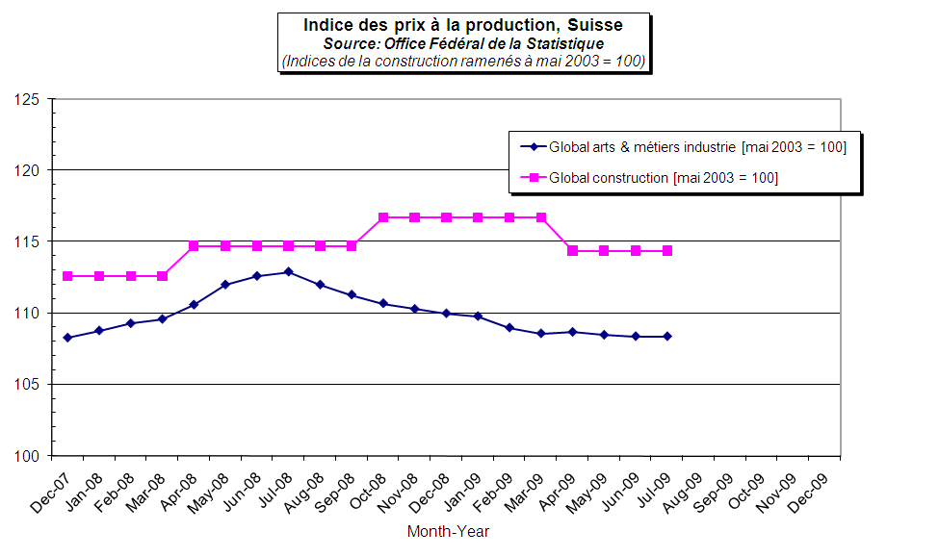
Escalation factors – CLIC example
Machine and Construction indexes

Slide 13
The total cost Cp (t) of an item p of the PBS
Cp(t) = Sum { n_{i} ∙ [e_{i} (t)/ e_{i} (t_{i})] ∙ r_{i} (t_{i}) ∙ X_{i} (t_{i})}
i the types of the items composing p
n_{i} the multiplicity of the item i if proportional estimate
r_{i} the exchange rate at the estimate date
X_{i} the estimate amount of the item i
e_{i} the escalation factor of the item i
t the calculation date
t_{i} the estimate date of the item i

Slide 14
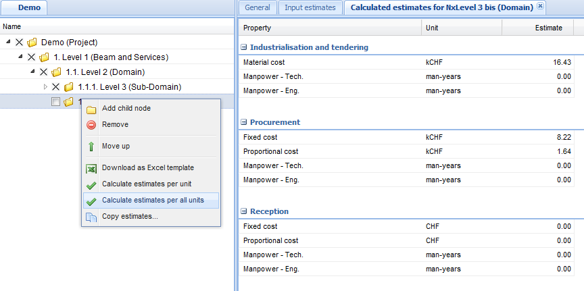
Estimation extractions (1/2)
Calculation feature from the PBS view

Slide 15
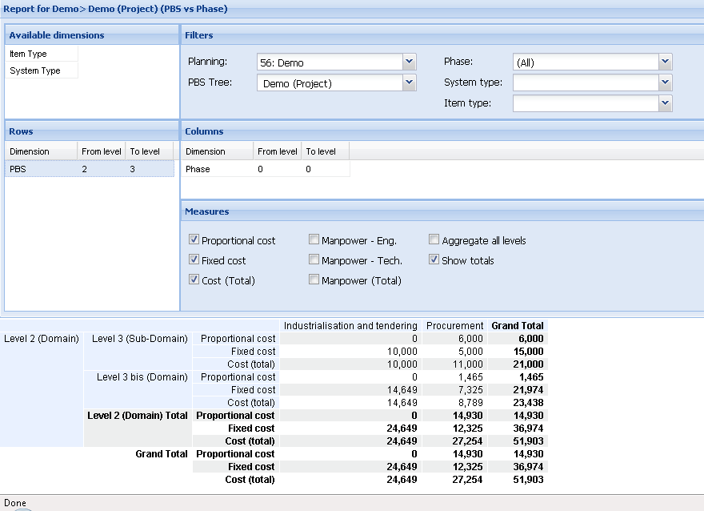
Estimation extractions (2/2)
Excel Export
Filters and dimensions
Crosstab report

Slide 16
Uncertainties – CLIC example
Technical uncertainty
Price uncertainty
Total uncertainty
σ_{design}
Known technology | 0.1
Extrapolation from known technology | 0.2
Requires R&D | 0.3
σ_{industry}
0.5/expected offers
σ_{total}
r.m.s of σ_{design} and σ_{industry}

Slide 17
Further improvements
EUROnu projects
PBS content configuration (levels, fields,...)
Calculation methods
Compare different configs/scenarios
Costing Knowledge Base (parameterized?)

Slide 18
Work process
Define / Update PBS
Work on estimates
Analytical
Scaling
Enter data in the tool and produce reports
Freeze a version
Notes:
Costing for project phase and not for maintenance phase
Analytical : bottom-up
Synthetic : top-down, estimations from historical data (scaling factors)

Slide 19
EUROnu setup planning
PBS definition in an Excel file
Easier to start with
Faster for large amount of data
Template will be sent to Work Packages second week of June
User and access rights – based on CERN Nice account – June
Access to the application from July
Contact: costing-euronu-panel@cern.ch
Group responsible for collecting data and for loading them

