Slide 1
Review of CERN Proton Driver bunch compression studies
2nd EuroNu Plenary Meeting

Slide 2
Contents
Plans for possible future new LHC injectors (1st scenario)
Plans for Linac4 plus upgrade of existing LHC injectors (2nd scenario)
Potential extensions for Neutrino Factory with a high power SPL: SPL-Based Proton Driver
Summary

Slide 3
Credits
Masamitsu Aiba
  IDS-NF Meeting, 23 March 2009
  NuFact 08, June 30 - 05 July, 2008
  CERN-AB-2008-048 BI, CERN-AB-2008-060 BI
Elena Benedetto
  NuFact 09, July 20-25, 2009
Roland Garoby
  ECFA, EuCARD, NEU2012 Workshop, 1-3 October 2009, CERN, CH
  EuCARD Annual Meeting, 14-16 April 2010, STFC, UK

Slide 4
Plans for possible future new LHC injectors (1st scenario)
1. Reliability
The present accelerators get aged and operate far beyond their initial design parameters
Interest of upgraded/new accelerators fitted to the LHC and its future needs
2. Performance
Luminosity depends upon beam brightness N/ε*
Brightness limited by space charge at injector low energy
Call for increase the synchrotron injection energy
Present
Future
50 MeV
Linac2
Not suitable for a ν-Factory
Linac4
160 MeV
Plans for possible future new LHC injectors
1.4 GeV
PSB
LP-SPL
4 GeV
Output energy
ν-Factory needs LP-SPL upgrade + accumulator & compressor + target + muon accelerator & storage ring complex
26 GeV
PS
PS2
50 GeV
450 GeV
SPS
LHC /
sLHC
LP-SPL: Low Power SPL (kinetic energy 4 GeV)
PS2: High Energy PS (~ 5 to 50 GeV at 0.3 Hz)
sLHC: “Super-luminosity” LHC (up to 10³⁵ cm⁻²s⁻¹)
7 TeV

Slide 5
Block diagram of LINAC4
0 m
3 MeV
50 MeV
102 MeV
160 MeV
H⁻ source
RFQ
chopper
DTL
CCDTL
PIMS
Length ~80 m
Block diagram of LP-SPL
Plans for possible future new LHC injectors
0 m
0.16 GeV
110 m
0.73 GeV
186 m
1.4 GeV
427 m
4 GeV
From Linac4
Medium β cryomodule
High β cryomodules
Ejection
High β cryomodules
Debunchers
To PS2
9 x 6
β=0.65 cavities
5 x 8
β=1 cavities
TT6 to
ISOLDE
14 x 8
β=1 cavities
Length ~430 m

Slide 6
Linac 4 and LP-SPL beam characteristics
(βγ²)_{160MeV}/(βγ²)_{50MeV}=2 →
twice brightness in PSB
PSB H⁻ charge exchange injection
 | Linac4 | LP-SPL
Output kinetic energy [GeV] | 0.16 | 4
Av. linac pulse current [mA] | 40 (10¹⁴ H⁻/pulse) | 20
Pulsing rate [Hz] | 2 | 2
Beam pulse duration [ms] | 1.2 | 0.9
Beam power [MW] | 0.0051 | 0.14
Plans for possible future new LHC injectors
50 Hz max. pulsing rate for RF structures →
Power supplies and electronics well-proportioned for PSB and LP-SPL
structures and klystrons compatible with HP-SPL

Slide 7
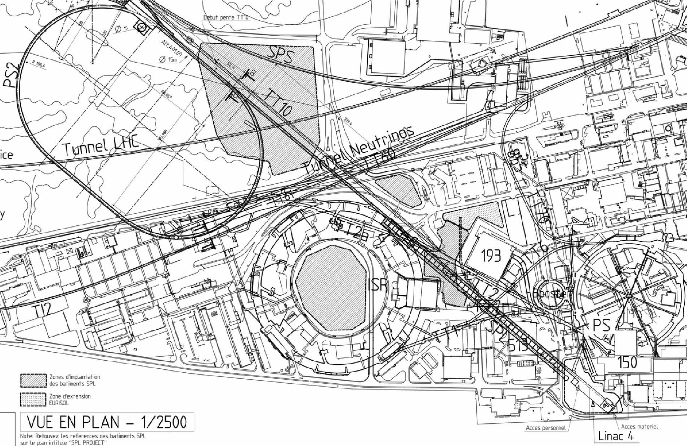
Site layout
SPS
PS2
ISOLDE
Plans for possible future new LHC injectors
PS
SPL
Linac4

Slide 8
Plans for Linac4 plus upgrade of existing LHC injectors (2nd scenario)
New 160 MeV Linac4 (under construction)
Increase the energy the PSB output energy to ∼2 GeV
Upgrade the PS for 2 GeV injection
Upgrade the PS and SPS to accelerate and operate beam with higher brightness and longitudinal density
R & D for a high power SPL
Maintain potential for Neutrinos physics programme
Future
160 MeV
Linac4
New
Plans for Linac4 plus upgrade of existing LHC injectors
2 GeV
PSB
Output energy
26 GeV
PS
HP-SPL
450 GeV
SPS
LP-SPL & PS2 not needed anymore
R & D
LHC /
sLHC
HP-SPL: High Power SPL (kinetic energy 5 GeV)
sLHC: “Super-luminosity” LHC (up to 10³⁵ cm⁻²s⁻¹)
7 TeV

Slide 9
HP-SPL beam characteristics
Twice more beam current requires twice more klystrons...
 | HP-SPL option 1 | HP-SPL option 2
Output kinetic energy [GeV] | 4 or 5 ª | 4 or 5 ª
Av. linac pulse current [mA] | 20 | 40 ^{b}
Pulsing rate [Hz] | 50 | 50
Beam pulse duration [ms] | 0.9 | 1.2 ^{b}
Beam power [MW] | 2.25 MW (2.5 GeV) or 4.5 MW (5 GeV) | 5 MW (2.5 GeV) and 4 MW (5 GeV)
ª needed for a ν-factory, ^{b} needed for 2 users of high beam power or for 5 MW at 2.5 GeV
Potential extensions for neutrino factory
Faster pulsing rate necessitate more supplies, cooling …
Faster pulsing rate necessitate more supplies, cooling …

Slide 10
Block diagram of HP-SPL
Upgrade of infrastructure (cooling water, electricity, cryogenics etc.)
Replacement of klystron power supplies,
Addition of 5 high β cryomodules to accelerate up to 5 GeV (for ν-Factory)
SPL [160 MeV → 4 (5?) GeV] with ejection at intermediate energy
Potential extensions for neutrino factory
110 m
0.73 GeV
0 m
0.16 GeV
291 m
2.5 GeV
500 m
5 GeV
lans for future LHC injectors
From Linac4
Medium β cryomodule
High β cryomodules
Ejection
High β cryomodules
Debunchers
To PS2 and Accumulator
9 x 6
β=0.65 cavities
11 x 8
β=1 cavities
13 x 8
β=1 cavities
to
EURISOL
Length ~500 m

Slide 11
ν-factory: SPL-Based Proton Driver
Parameters | Accumulator (6-bunches) | Accumulator (3 & 1-bunches)
Circumference [m] | 318.5 | 185.8
Nb. of accumulation turns | 400 | 640/1920
Nb. of bunches | 6 | 3 / 1
Nb. of protons per bunch | 1.67×10¹³ | 3.34×10¹³/ 10¹⁴
Gamma transition (γ_{t}) | 6.33
Slip factor (η= γ_{t}⁻²- γ⁻⁻²) | ∼0* (isochronous ring no RF system)
Potential extensions for neutrino factory
Parameters | Compressor (“6-bunches”) | Compressor (3 &1-bunches)
Circumference [m] | 314.2 | 200.0
Nb. of compression turns | 36 | 86
Nb. of bunches | 3 | 3 / 1
Nb. of protons per bunch | 1.67×10¹³ | 3.34×10¹³ / 10¹⁴
RF voltage on h=3 [MV] | 4 | 1.7
Gamma transition (γ_{t}) | 2.3 | 2.83
Slip factor (η= γ_{t}⁻²- γ⁻⁻²) | 0.16** | 0.10**
* To “freeze” the bunches longitudinally during accumulation so that no RF cavities are needed
** Large slip factor to do the phase rotation rapidly to fulfill the total burst duration requirement

Slide 12
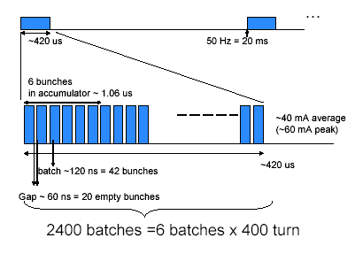
Bunch generation for a ν-factory
A ν-Factory Proton Driver must deliver a 4 MW beam power at 5-15 GeV, in 1-6 ns rms bunches (~2 ns) spaced by ~16 ms onto a production target, at a 50 Hz repetition rate.
Chopped SPL beam is accumulated in a few long bunches (120 ns) via H⁻ injection.
Accumulator is Isochronous to maintain the SPL beam time structure, no RF to minimize the impedance.
Singly bunch transfer to the compressor → bunch rotation → ejection to the target.
Potential extensions for neutrino factory
(1 turn)
: 6th bunch ejected
Target:
6 bunches of 2 ns
Bunch rotation 36 turns → 12 μs bunch spacing at ejection
6 bunches accumulation-compression scheme

Slide 13
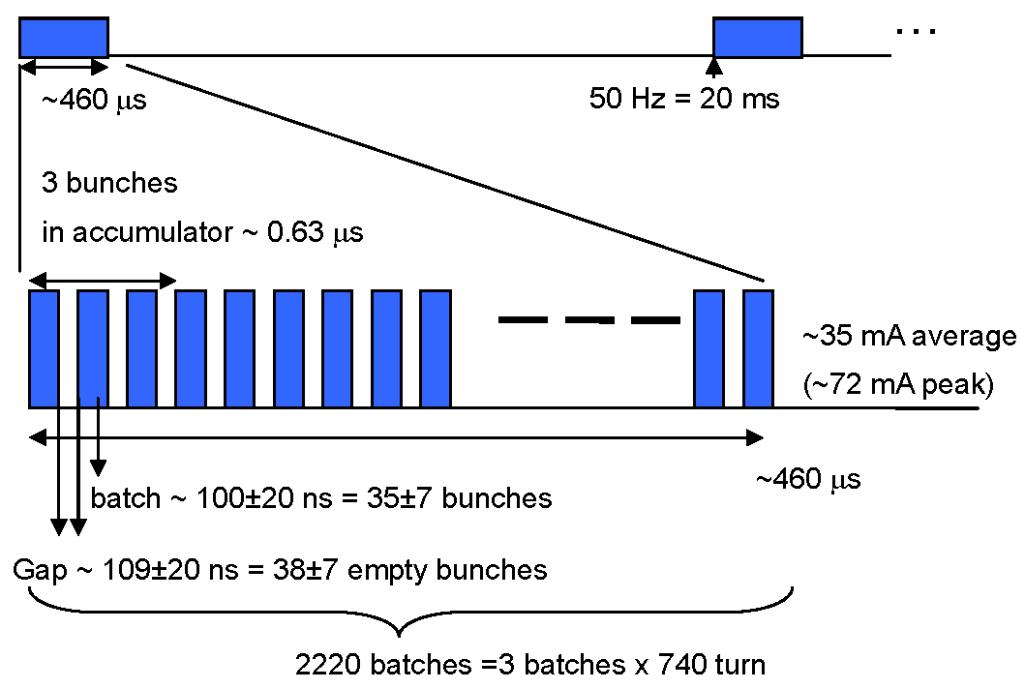
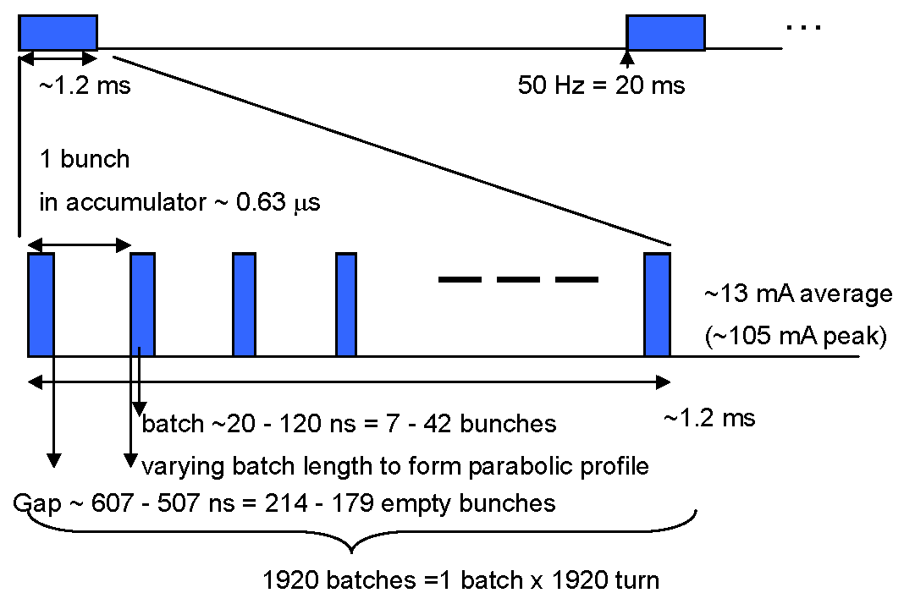
Bunch generation for a ν-factory
Nb. of accumuled bunches | 6 | 3 | 1
Peak/mean current [mA] | 60/40 | 72/35 | 105/13
Pulse duration [μs] | 400 | 460 | 1200
SPL beam for accumulation
Potential extensions for neutrino factory
(1 turn)
(1 turn)
3- bunches accumulation
1- bunch accumulation

Slide 14
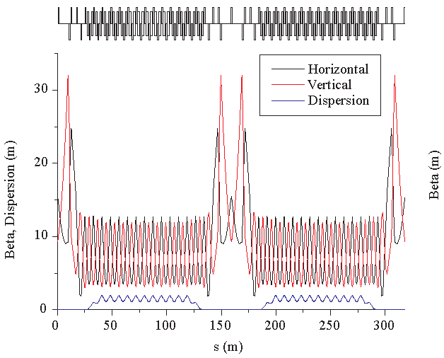
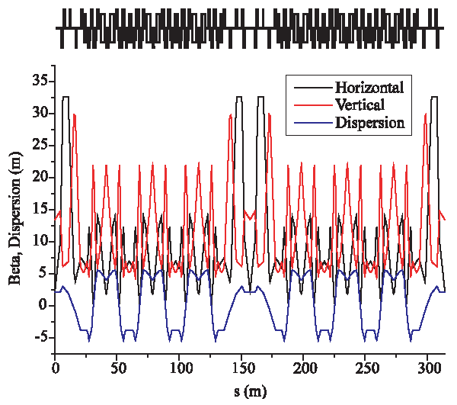
Accumulator and compressor lattices
Isochronous accumulator conserve the energy spread during accumulation (ring with barrier rf cavities was also investigated) → important to the bunch length compression
Potential extensions for neutrino factory
Accumulator lattice with insertion section (normal conducting magnets) (Q_{x}=7.77, Q_{y}=7.67, γ_{t}=6.33)
Compressor lattice with negative (superconducting) bending magnets (Q_{x}=10.79, Q_{y}=5.77, γ_{t}=2.3)
Accumulator and compressor lattices for the 6-bunches scheme

Slide 15
Compressor bunch rotation
3μm (rms physical) transverse emittances satisfy needs for foil heating, aperture, space charge and beam size on target
Beam expansion after rotation
Potential extensions for neutrino factory
ORBIT
simulations
2 ns bunch length
ΔQ ∼0.2 at bunch compression end
phase plane plots before and after bunch rotation

Slide 16
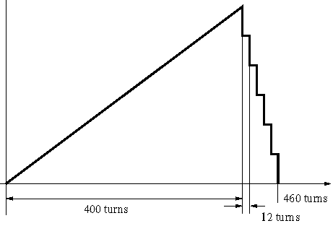
Accumulator impedance
Contributions
Transverse plane:
  Resistive wall: beam pipe resistivity
  Narrow-band resonators: not relevant since no RF cavities in the accumulator
  Broad-Band resonator: beam-pipe discontinuities
  Electron cloud: not an issue as no major electron build-up anticipated
Longitudinal plane:
  Narrow-band resonators: not relevant since no RF cavities
  Broad-Band resonator: kickers and other discontinuities
Mainly single-bunch instabilities (since narrow-band neglected)
Potential extensions for neutrino factory
Evolution of total accumulator intensity (1 turn ∼1μs)
PESSIMISTIC analysis:
  Full intensity assumed over the whole storage time whereas:
  accumulation takes place over 400 μs → the intensity growths from 0 to10¹⁴ protons
  bunch transfer to compressor lasts 60 μs
  bunch rotation and extraction process in the compressor lasts 96 μs (5×12 turns to empty the accumulator + 3×12 turns to complete rotation of the remaining bunch and ejection)
accumulator intensity
10¹⁴ p
460 turns
400 turns
12 turns

Slide 17
Transverse Broad-Band Impedance
Can be cured by introducing a quantity of tune spread
Accumulator 6-bunches
Accumulator 6-bunches
Q’_{x}=0
Q’_{x}=±6
τ~28μs
Strongest instability
σ_{x} (m)
Q’_{x}=±8
Potential extensions for neutrino factory
HEADTAIL
simulations
Q’_{x}=±10
Q’_{nat,x}= -8.4
Horiz. beam size vs turns for various chromaticities (BB resonator : 1MΩ/m, Q_{R}=1, f_{R}=1GHz)
Horiz. beam size and position vs with octupoles
BBI cured with sextupoles (by chromaticity)
Positive/negative values of Q’ are OK (η~0)
Need chromaticity |Q’|>10 tu cure the instability → ΔQ_{rms}~0.01 for (Δp/p)_{rms}~10⁻³
BBI cured with octupoles (detuning vs amplitude)
Beam size is growing until it stops when detuning is effective
Q’’_{xx}~1200 (-2000) required to cure instability → ΔQ_{rms}~0.006 (for σ_{x}~10 mm)

Slide 18
Longitudinal Broad-Band Impedance
Major contribution from the injection and ejection kickers (since no RF)
1. Isochronous ring
  No RF cavities → negligible narrow-band impedance, beam frozen longitudinally
2. Broad-Band impedance → microwave instability
3. If only η₀=0 considered: the instability threshold is zero and the rise time is infinity
Potential extensions for neutrino factory
Zl=10 kΩ
Accumulator 6-bunches
Zl=8 kΩ
Zl=6 kΩ
Zl=5 kΩ
Zl=4 kΩ
Zl=3 kΩ
Longitudinal emittance (eVs) vs turns for various values of broad-band resonator (Q_{R}=1, f_{R}=1GHz)
Z_{l} < 5 kΩ → Z_{l}/n < 5 Ω: a few Ω easily reached in recent machines

Slide 19
Transverse/Longitudinal Broad Band Impedances
Can be cured by introducing a quantity of tune spread
Accumulator 3-bunches
Accumulator 3-bunches
σ_{x} (m)
Q’_{x}=0
Zl=6 kΩ
Potential extensions for neutrino factory
5 kΩ
4 kΩ
Q’_{x}=-5
3 kΩ
Q’_{x}=-8
2 kΩ
1 kΩ
Q’_{nat,x}= -10
Q’_{x}=-10
0.5 kΩ
Horiz. beam size vs time for various chromaticities (BB resonator : 1MΩ/m, Q_{R}=1, f_{R}=1GHz)
Longitudinal emittance (eVs) vs turns for various values of broad-band resonator (Q_{R}=1, f_{R}=1GHz)
Transverse Broad-Band Instability:
cured by natural chromaticity
Longitudinal Broad-Band Instability :
Maximum allowed impedance is Z_{l} = 2 kΩ → (Z_{l}/n)_{max}~3.2 Ω: which is a acceptable value

Slide 20
Conclusion on accumulator
and compressor instability studies
6/3-bunch accumulator options is/seems feasible and under control
  Space charge okay → it guided in definition of emittance and bunch length & shape in the accumulator design
Accumulator impedance
  narrow-band component negligible → no RF-cavities
  resistive wall not an issue →long rise-time compared to accumulation time
  e-cloud not an issue → flat and long bunch, no multipacting
  longitudinal BB → Z_{l}/n < 5 Ω + error-bar (f_{R}) (∼few Ohm easily achieved in modern machines)
  transverse BB okay → fast rising instability damped by by chromaticity (|ξ|∼1.3) and/or amplitude-detuning induced by octupoles
    need ΔQ ~ 0.02 → okay for tune footprint/resonance
    assumed R_{t}=1MW/m → scaling laws with higher value of BB impedance
6/3-bunch compressor option should be feasible → beam stored for only ∼ 11% of the accumulator storage time
  Space charge okay → ΔQ ~ 0.2 at the end of bunch compression, horizontal beam expansion reduces space charge
Potential extensions for neutrino factory

Slide 21
Summary
Progress towards future pulsed proton drivers at CERN made:
1st scenario (early scenario)
  New LHC injectors (Linac4, LP-SPL, PS2) and SPS consolidation
2nd scenario (substitute scenario)
  Linac4 with consolidation (refurbishing) of existing LHC injectors (PSB, PS, SPS)
  High Power SPL R & D
SPL-based proton driver including
  High Power SPL
  Proton drivers accumulator and compressor rings

