Slide 1
Beta-Beam Costing Exercise
Elena Wildner, CERN
EUROnu Annual Meeting, 2-4 June 2010

Slide 2
Outline
The Beta Beam Scenario
Costing principles
The PBS
Cost Drivers
Questions
Conclusion
2

Slide 3
Beta Beam Options
Low Q Beta Beam (Baseline)
  6He and 18Ne ions (“low-Q”)
  Gamma boost 100
  Neutrino Energy ~ 3.5 *100 MeV
  Memphis WC detector, Frejus
High Q Beta Beam
  8B and 8Li ions (“high-Q”)
  Gamma boost 100
  Neutrino Energy ~ 16.0 *100 MeV
  Argon (?) detector, Gran Sasso
Several options to take into account for costing

Slide 4
Beta Beam scenario 6He/18Ne
ν-beam to Frejus
SPL
Linac 4
Decay ring
Bρ ~ 500 Tm
B = ~6 T C = ~6900 m L_{ss}= ~2500 m
⁶He: γ = 100 ¹⁸Ne: γ = 100
Ion production
6He/18Ne
ISOL target
SPS
Existing!!!
Neutrino Source
Decay Ring
60 GHz pulsed ECR
Linac, 100 MeV
PS
RCS

Slide 5
Beta Beam scenario 8Li/8B
Ion Linac 25 MeV
ν-beam to GranSasso/Canfranc
PR
8B/8Li
Ion production
Decay ring
Bρ ~ 500 Tm
B = ~6 T C = ~6900 m L_{ss}= ~2500 m
⁸Li: γ = 100 ⁸B: γ = 100
ISOL target, Collection
SPS
Existing!!!
Neutrino Source
Decay Ring
60 GHz pulsed ECR
Linac, 100 MeV
PS
RCS

Slide 6
First Steps to Costing
First steps
  PBS/WBS
  Cost Drivers
PBS
  Infrastructures Separate, safety has to be included
Cost Drivers
  Difficult to know before costing (loose arguments used)
  Probably Tunnel and SC magnet systems for the Decay Ring
  Technical Challenges (multiply production systems…)
Limited information as of today
  Several options
  Not yet technically qualified
Some costing items not included in exercise (eg. SPL, detectors)

Slide 7
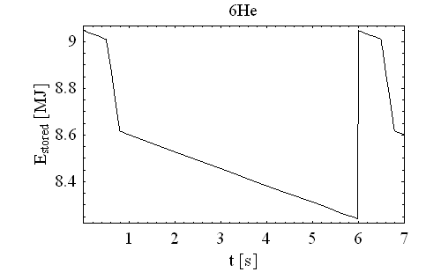
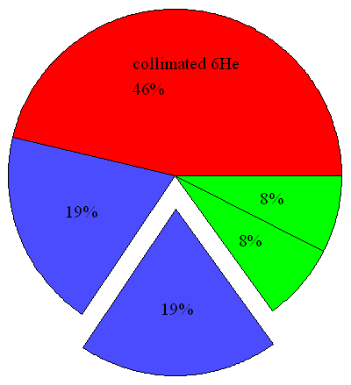
Radioactive losses ?
Momentum
collimation
merging
p-collimation
injection
decay losses
Arc
Straight section
Arc
Limited shielding solutions taken into account,
no real solution exists yet
Straight section
Momentum collimation
~5*10¹² ⁶He ions to be collimated per cycle
Decay: ~5*10¹² ⁶Li ions to be removed per cycle
Dump at the end of the straight section will receive 30kW
Dipoles in collimation section receive between 1 and 10 kW (masks).

Slide 8
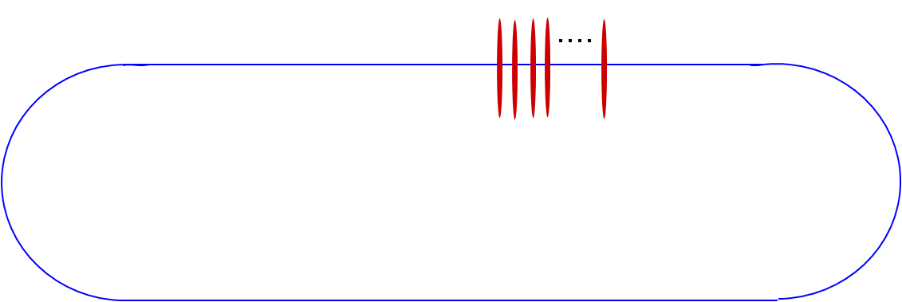
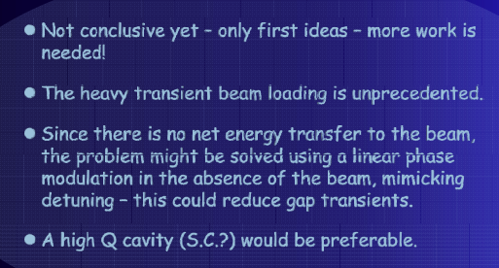
Cavities for small duty factors ??
~10¹⁴ ions, 0.5% duty (supression) - factor for background suppression !!!
20 bunches, 5.2 ns long, distance 23*4 nanosseconds filling 1/11 of the Decay Ring, repeated every 23 microseconds
Erk Jensen, CERN
R&D & prototyping
unknown
Cockcroft Institute Collaboration ?
8

Slide 9
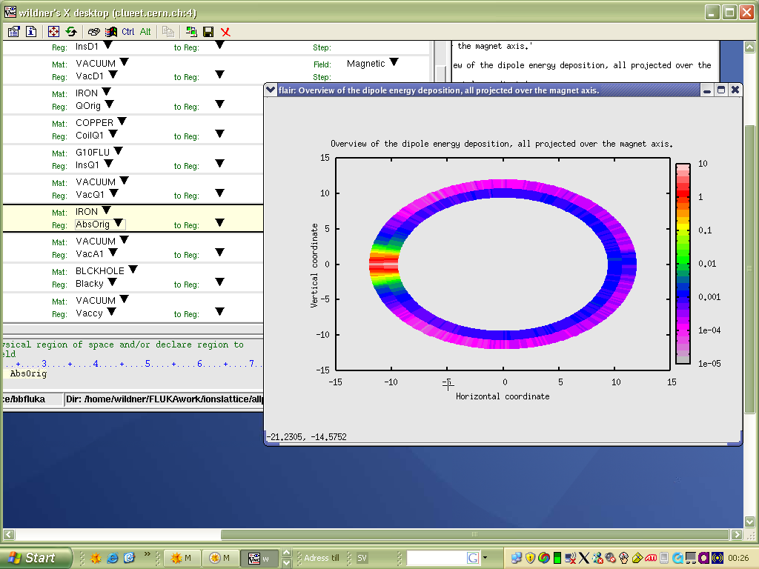
Cost Driver: SC Magnets for DR?
Cosθ design: open midplane magnet
Manageable (7 T operational) with Nb -Ti at 1.9 K
Closed midplane, with liners: ~ same price
Scale as LHC even if single bore?
86 magnets, 6 m, 8 T per arc: 192 magnets
1232/192/2 ~= 27km/2km
Meter Dipole
J. Bruer, E. Todesco, E. Wildner, CERN
9

Slide 10
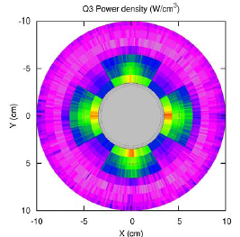
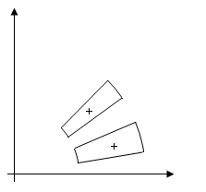
Open mid-plane Quadrupole
Parametric Approach!!
Acknowledgments (magnet design):
F Borgnolutti, E. Todesco (CERN)
Opening angle
10

Slide 11
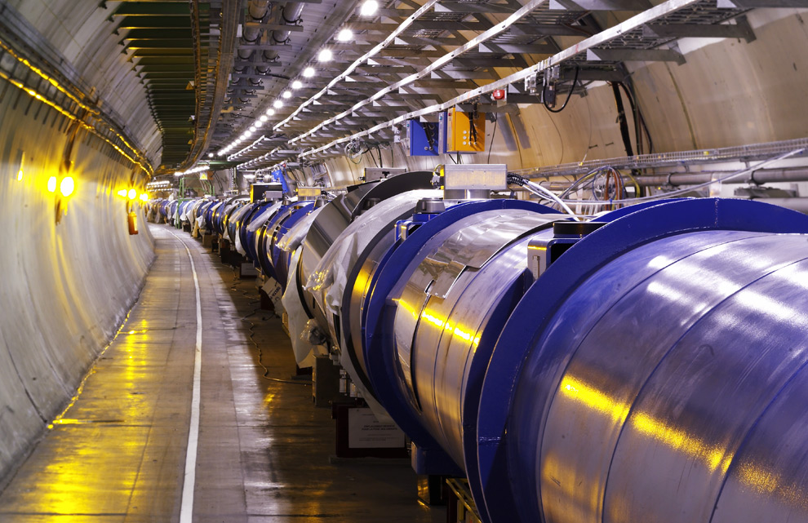

Cost Driver: Decay Ring Tunnel, Shafts
By Experience Tunnel and shafts: 30 % of Project Cost
Tunnel 4.5 m diameter 10 MChF / kilometer
-> 70 M ChF
Two Shafts: 20 MChF
Extra Galleries for electronics?
11

Slide 12
The rest of DR…
Magnet system:
Scale with LHC or
Cost the magnets after a realistic design?
Beam Instrumentation (Scaling not appropriate)
Control System…
12

Slide 13
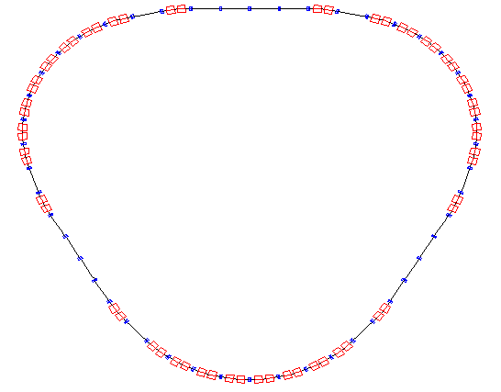
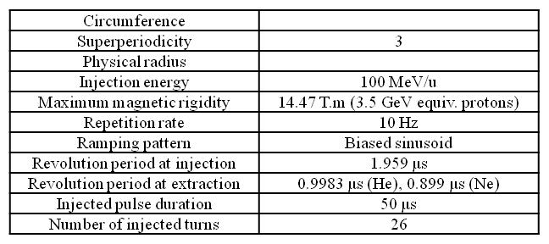
RCS
Costing from a first PBS approach exists
13

Slide 14
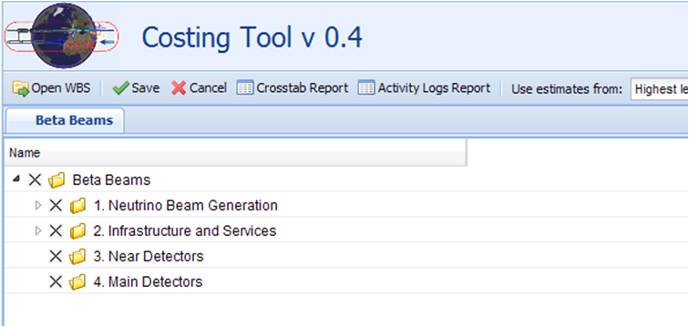
Project Beta Beam Level 1
Separate costing (price has been indicated by detector specialists)
Detectors up one level (Level 0),
Not costed by WP4 (maybe cost driver…)

Slide 15
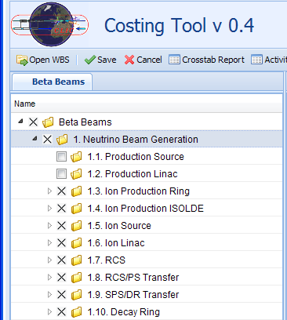
Project Beta Beam Level 2
Options, see tool developers for this
Ion Production
  not yet evaluated
  ISOLDE, shared infrastructure ?

Slide 16
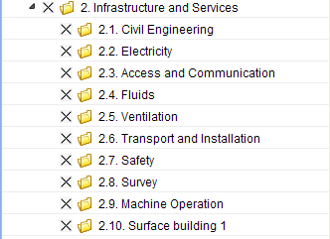
Infrastructure Services
Decay Ring Tunnel

Slide 17
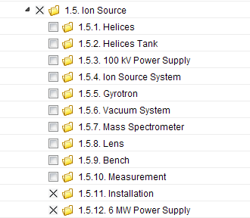
Project Beta Beam Ion Source
Courtesy T. Lamy

Slide 18
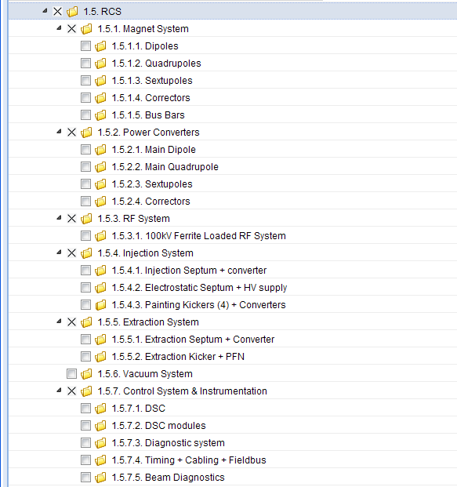
RCS

Slide 19
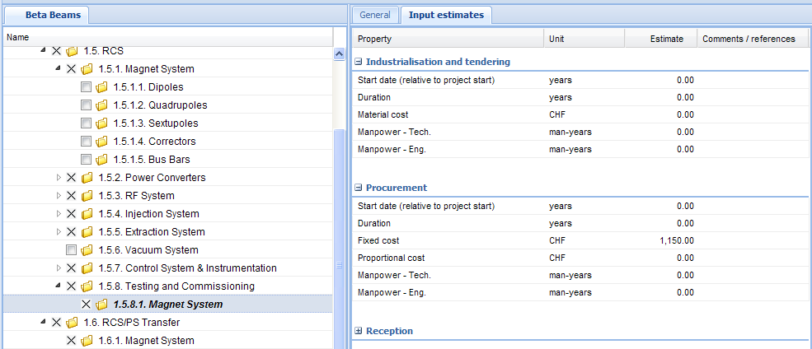
Structuring…
Principles to adopt
“Testing and Commissioning”: not clear how to represent
Need to repeat the systems (May not be a major problem if not too detailed structures)
But systems may be coupled… Similar for safety?
“Magnet System” and “Power Converters”
etc.

Slide 20
Not in PBS & Costing (yet)
Person-power
Running Costs
Maintenance
Dismantling
Existing machines: specific upgrades
Sharing of existing infrastructure
Contingency (30% ???)
Surface buildings (3000 ChF/m2 in Geneva)
Etc.
Production part not included yet

Slide 21
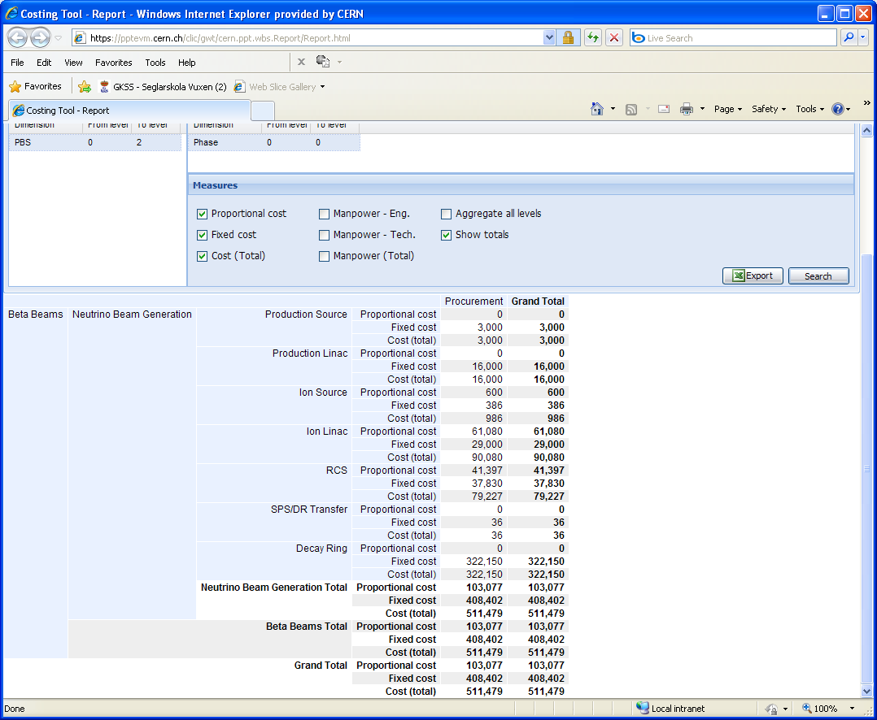
Reporting
Scaling Existing Linacs ?
Cost Driver
Tunnel and magnets scaling LHC ?

Slide 22
Safety & RP
Two cases: New machines - Existing machines
Existing machines:
The case for beta beams has to be integrated
Machines equipped differently ?
Safety in general:
  Integration would not, to first order, change the safety system
RP:
  Absorber & Collimators may need to be added
  Not the same activation, new calculations and considerations
  The PS, the RCS and the Decay Ring are looked at (ok), not collimation
  Absorber & Collimators may need to be added
New machines: see next slides

Slide 23
Safety, what is needed
Safety systems for warm machine:
  Access system
    Access control system
    Access safety system
  Fire detection system
  Evacuation alarm system
  Gas detection
Safety systems for cold machine
  Access system
    Access control system
    Access safety system
  Fire detection system
  Evacuation alarm system
  Gas detection
  Oxygen deficiency hazard detection system
Electrical risks are not covered by these systems. Powering systems may be interlocked with the access system.
Cryogenic risks are only covered in the case of accidental release inducing oxygen deficiency.
Add a general alarm monitoring system that collects all level 3 alarms (life threatening) to the Safety control room."

Slide 24
RP, what is needed
Environment:
  Stray radiation -> dose to public
  Releases of radioactivity by air into the environment - > dose to public Releases of radioactivity by water into the environment -> dose to public Incident and accident scenarios -> dose to public
Workers:
  Shielding -> prompt ionizing radiation -> dose to worker
  Air activation -> dose to workers
  Water activation (infiltration water, cooling water), -> dose rates around beam pipes and ion exchangers
Induced radioactivity in accelerator components
  Activated fluids and contamination risk (closed circuits, etc.)
  Optimized design of components (material composition, optimized design for maintenance and repair)
  Optimized handling of devices, remote handling
  Ventilation and pressure cascades
Estimate of doses to workers and total, collective dose....
Remote Control
Interlocks and access, common to general safety
Radiation monitoring System (like RAMSES)
Buffer Zones for Cool Down
Closed systems (cooling water?)
Dismantling and Radioactive waste treatment (high costs!)
D. Forkel, M. Magistris

Slide 25
How to do a PBS for safety
Monitoring devices and security systems are part of the PBS
Many systems need a separate PSB
Strategy:
New machine (DR)
  Copy LHC experience and other new machines existing or planned with information on previous slides in mind
For the existing machines:
  Adding another beam
  Add additional equipment if needed
  Check how new beam can be integrated in the existing system
Do calculations

Slide 26
How make it work…
Man power needed for serious costing is high
Therefore (depending on how serious…)
  We need a clear mandate to knock on doors
  …and access to the HW experts
  …and the help to cost objects, assemblies
  …and evaluate R&D part ?
  …and help to cost “integration” (existing infrastructure)
  …and/or help to do modeling for parametric costing
  Access to safety experts and radiation calculations
  Clear guidelines, similar for all 3 facilities
  It would be good to have costing experts for all 3 facilities working together on similar objects (devices in accelerators are often similar)
  One person is needed for the costing, costing was not foreseen in manpower plan. “There is a significant discrepancy between what should be done and what can be done”
  Challenge: How to prioritize…

