Slide 1
Status of the magnet studies in the ARCS (FLUKA)
E. Bouquerel, A. Mereghetti, V. Vlachoudis
& FLUKA Team, CERN (EN-STI-EET)
EUROν, WP4 - Beta Beam Task Meeting
03rd June 2010, IPHC, Strasbourg

Slide 2
Losses in the Decay Ring
-> Aim of the Decay Ring: Store high intensity and high energy beams of β radioactive ions until their decay.
-> 3 main loss sources identified for the Beta-beam:
Losses due to the RF merging
-> occur after the injection and where the momentum acceptance is the lowest
Losses due to collimation
-> occur in the straight section
Losses due to the β-decay of the radioactive ions
-> occur continuously & anywhere within the ring

Slide 3
Losses in the Decay Ring
What we know:
The superconducting magnets are very sensitive to the beam losses: the losses in the superconducting coils must be estimated carefully (quenching issues).
Assumptions:
-> when 1 ion decays, its momentum variation is negligible (Energy taken by the electron and the (anti-)neutrino low compared to the energy of the secondary ion) whereas its charge number increases or decreases by 1 -> Therefore, its magnetic rigidity changes.
-> the secondary ion coming from the decay of ⁶He²⁺ (or ¹⁸Ne¹⁰⁺) is considered here:

Slide 4
FP6 → FP7 updates
Within the FP6, Decay Ring dimensions were:
-> 994 m long for the arcs
-> 2468 m long for each straight section
To optimize the Decay Ring, the solution retained implies (from the previous FP7 meetings)
-> An increase of the magnetic field in the dipoles, 8T (instead of 6T): higher field in the dipoles. Same kick.
-> Shorter dipoles: 4.28 m (5.7 m).
-> Shorter quadrupoles: 1m (2m) – bigger gradient: 69.5 T/m (45.4 T/m).
-> More compact arcs: 674m (994m)
-> Ratio between long straight section and total length: 40.2% (35.6%)
-> Increase by 12% of the neutrino flux
New Lattice developped (A. Chancé, CEA)
What effects on the power deposited in the magnets of the arcs?
FLUKA …

Slide 5
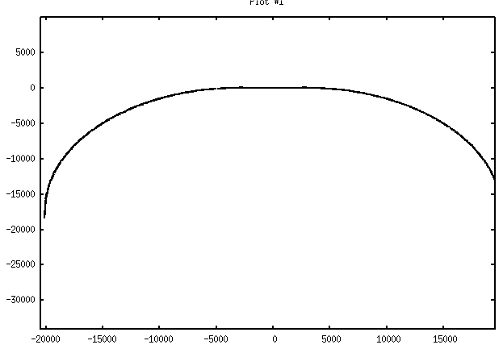
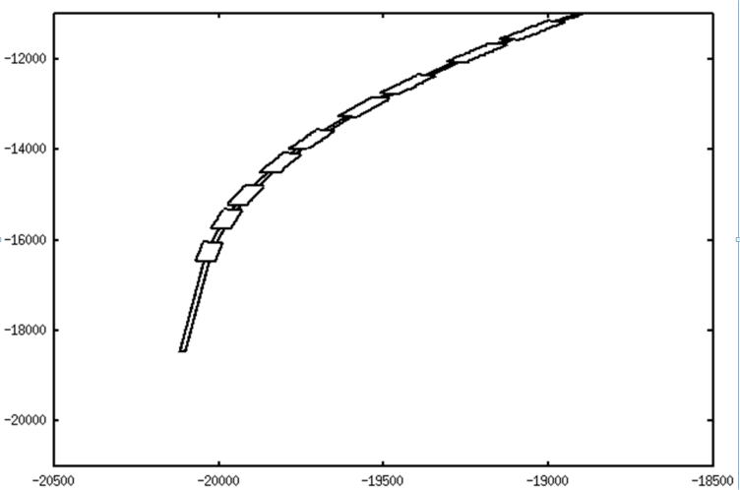
Design of the Arc in FLUKA
Geometry:
Use of a Python script (A. Mereghetti, CERN/EN-STI-EET):
-> generation of the S-line of the arc from the TWISS file (*.mdx) containing all coordinates and angles of each element located in the decay ring)
-> transcription of the magnetic fields for each dipole/quadrupole; use of Fortran routines.
Empty regions where dipoles/quadrupoles stand
Geometry + fields checking -> precision of 2nm for a single isotope ⁶He²⁺ trajectory circulating through the arc USERDUMP card).
x axis (cm)
z axis (cm)

Slide 6
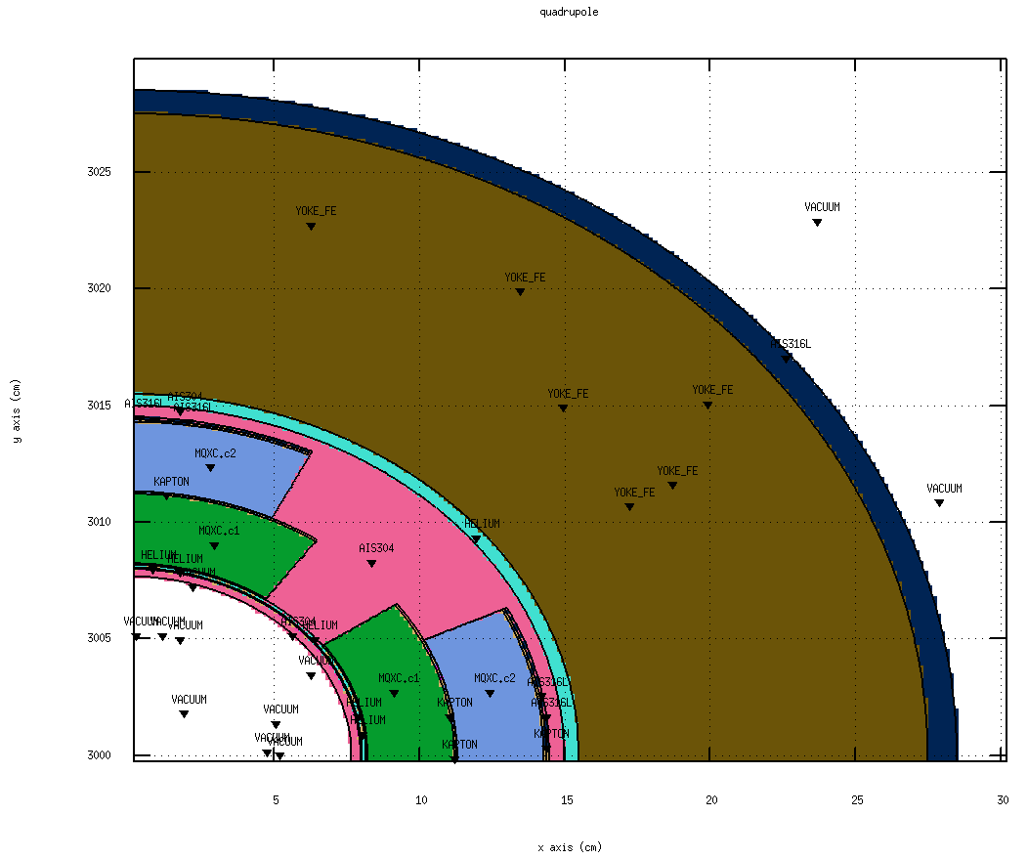
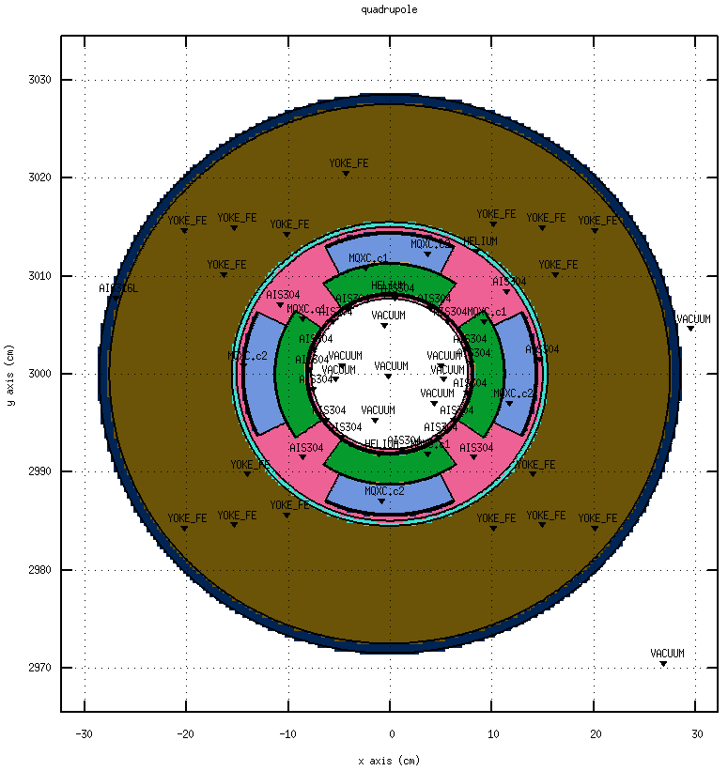
Magnets implemented in FLUKA
Empty regions filled with 144 Quadrupoles and 86 SC-Dipoles (replication of prototypes)
Magnets very similar to the ones used for LHC Upgrade:
-> same philosophy
-> same materials
-> different dimensions: lengths/coils
quadrupoles
Length: 100cm
Ext. radius: 28cm
Aperture: 16cm
Gradient: 70T/m
Coil: NbTi

Slide 7
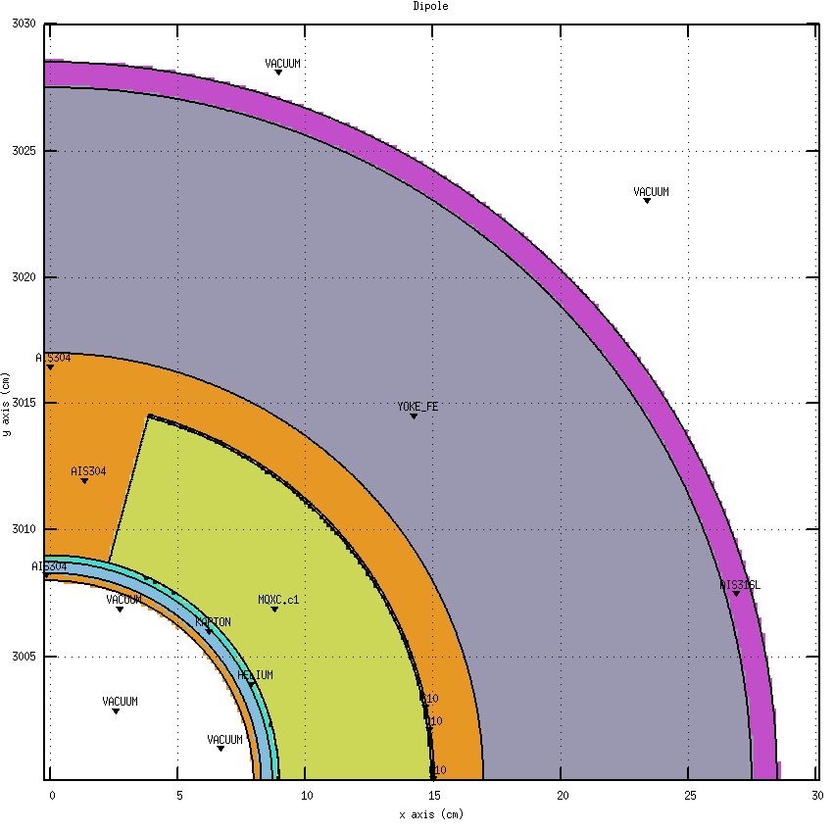
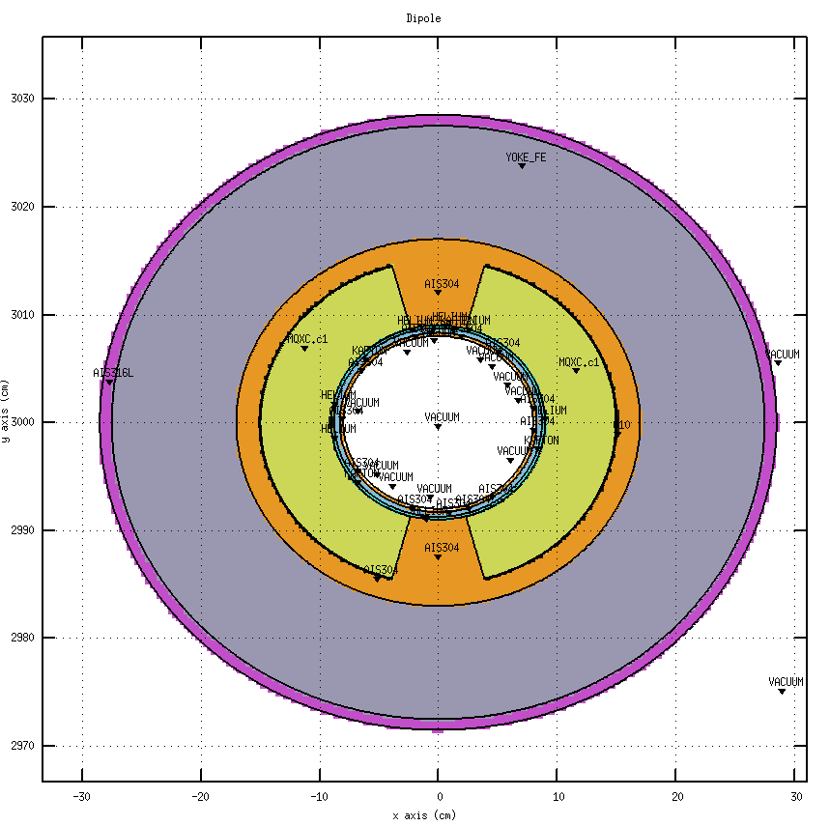
Magnets implemented in FLUKA
Empty regions filled with 144 Quadrupoles and 86 SC-Dipoles (replication of prototypes)
Magnets very similar to the ones used for LHC Upgrade:
-> same philosophy
-> same materials
-> different dimensions: lengths/coils
dipoles
Length: 425cm
Ext. radius: 28cm
Aperture: 18cm
Field: 8T
Coil: NbTi

Slide 8
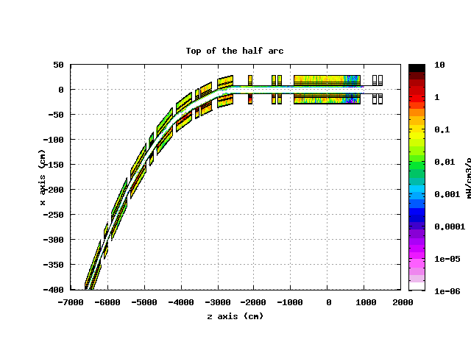
Power depositions with FLUKA
Simulations performed for ⁶Li³⁺ (daughter of ⁶He²⁺) on half of the arc
Present studies done using a routine as a source distributing the particles isotropically upstream along half of an arc
56.7% of the incoming energy deposited in half of the arc
Highest power deposited in the magnets
9.66x10¹³ particles of ⁶He²⁺ accumulated in the Decay Ring*
*Eurisol report study, Nov. 2009

Slide 9
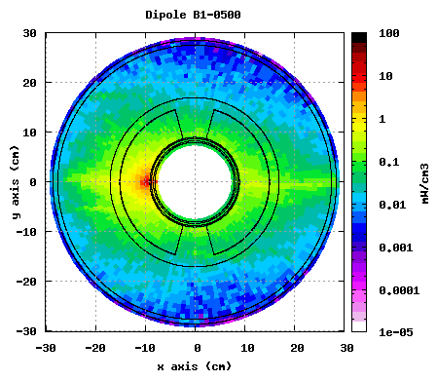
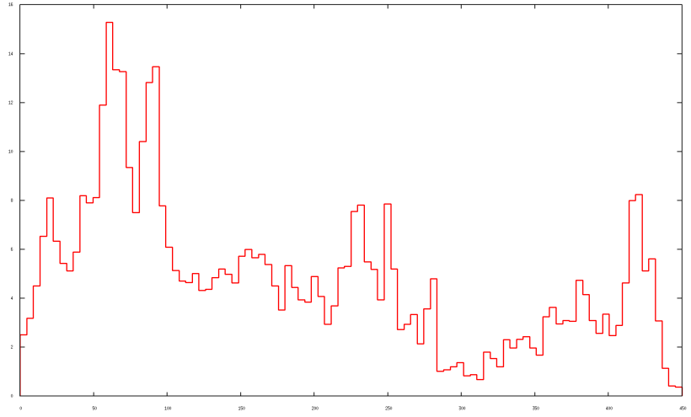
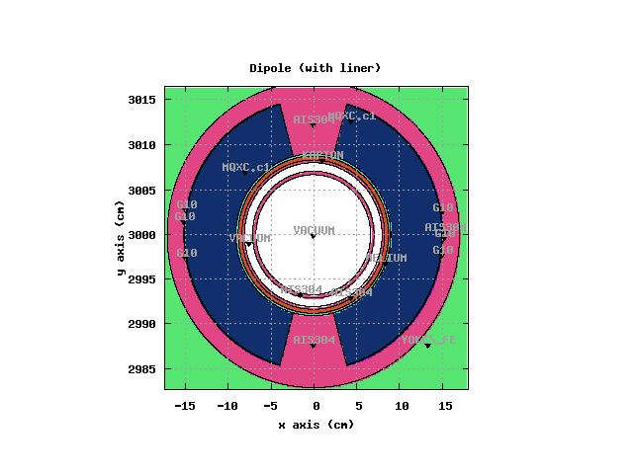
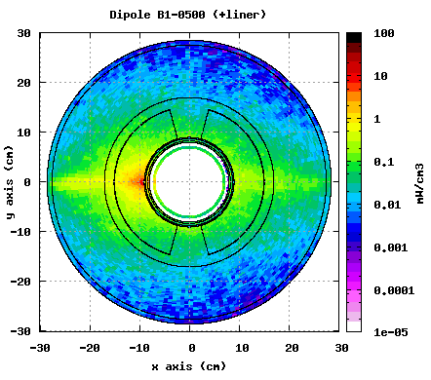
Power Depositions & Peaks:
first estimations
Decay losses concentrated on the horizontal plane
Normalized to a decay rate in half of the arc:
He: 3.74x10¹⁰ decay.s⁻¹
16
14
12
10
8
6
4
2
0
Power deposited (mW/cm³)
dipoles
z axis (cm)
Max. peak of power deposited in the coils: ~15mW/cm³ for 4 dipoles.
-> Above the quench limit (~4mW/cm³)
Similar peaks when using 1cm thick liner
(stainless steel)

Slide 10
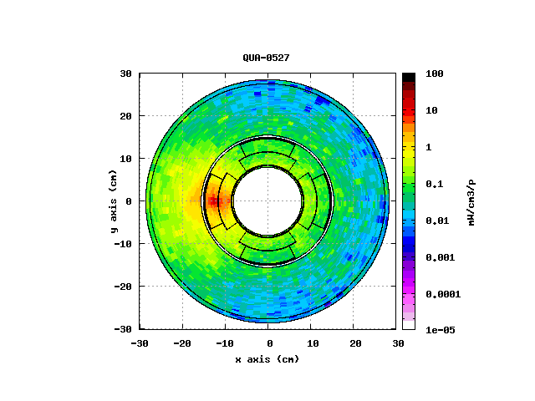
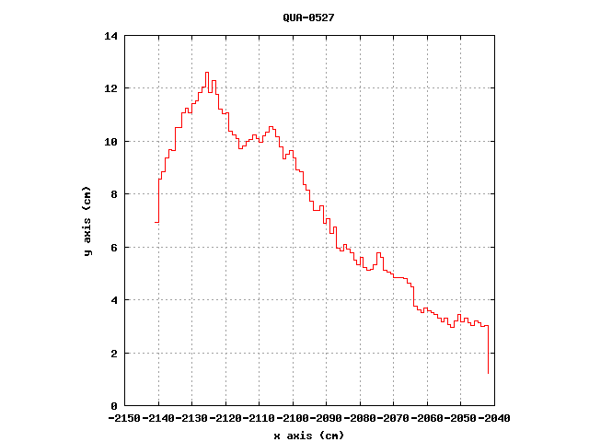
Power Depositions & Peaks:
first estimations
Decay losses concentrated on the horizontal plane
Normalized to a decay rate in half of the arc:
He: 3.74x10¹⁰ decay.s⁻¹
Power deposited (mW/cm³)
quadrupoles
z axis (cm)
Max. peak of power deposited in the coils: ~13mW/cm³ for 3 quadrupoles.
-> Above the quench limit (~4mW/cm³)

Slide 11
Simulation Accuracy
Sources of errors:
Physics modeling:
Uncertainty in the cross sections
Uncertainty in the modeling used
-> Factor ~1.3 on integral quantities like energy deposition (peak included) while for multi differential quantities the uncertainty can be much worse
Layout and geometry assumptions
It is difficult to quantify, experience has shown that a factor of 2 can be a safe limit
Safety factor for the source term: Factor ~1.2
Safety factor to be applied ~2-3

Slide 12
What next?
Use of a decay loss map generated with ACCSIM (F. Jones, A. Chance) (-> kinematics)
Approaches to decrease the peak of the power deposited:
-> Increase the aperture of the magnets?
-> Use of thicker liners?
-> Absorbers?

