Slide 1
Integrating EGI as a compute facility in ESAP
Susana Sánchez, Sara Bertocco, Dave Morris, Manuel Parra
21 April 2022
ESAP Busy Week

Slide 2
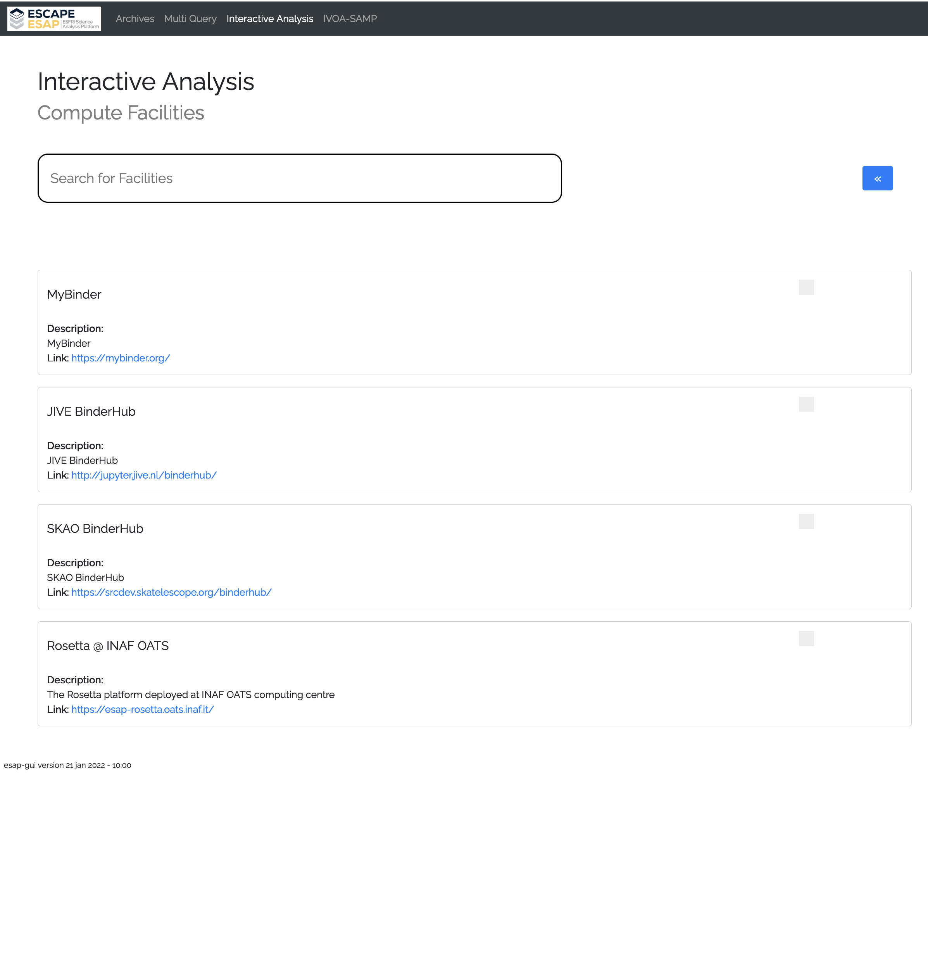
ESAP + EGI
EGI is an European e-infrastructure, providing computing services in the EOSC ecosystem.
It is a federation of 21 cloud providers (heterogeneus providers: OpenStack, OpenNebula)
The Access to the resources is based on Virtual Organisations: users needs to belong a Virtual Organisation
The VO vo.access.egi.eu facilitates the access to the newcomers
A&A:
In the past X.509
Now more flexible with EGI Check-in
Access to cloud resources based on tokens
FedCloud CLI is a high-level Python package for a command-line client designed for interaction with the OpenStack services in EGI
EGI Cloud platform
Description
EGI is an e-infrastructure that provides advanced computing services for research.
Link: https://www.egi.eu/

Slide 3
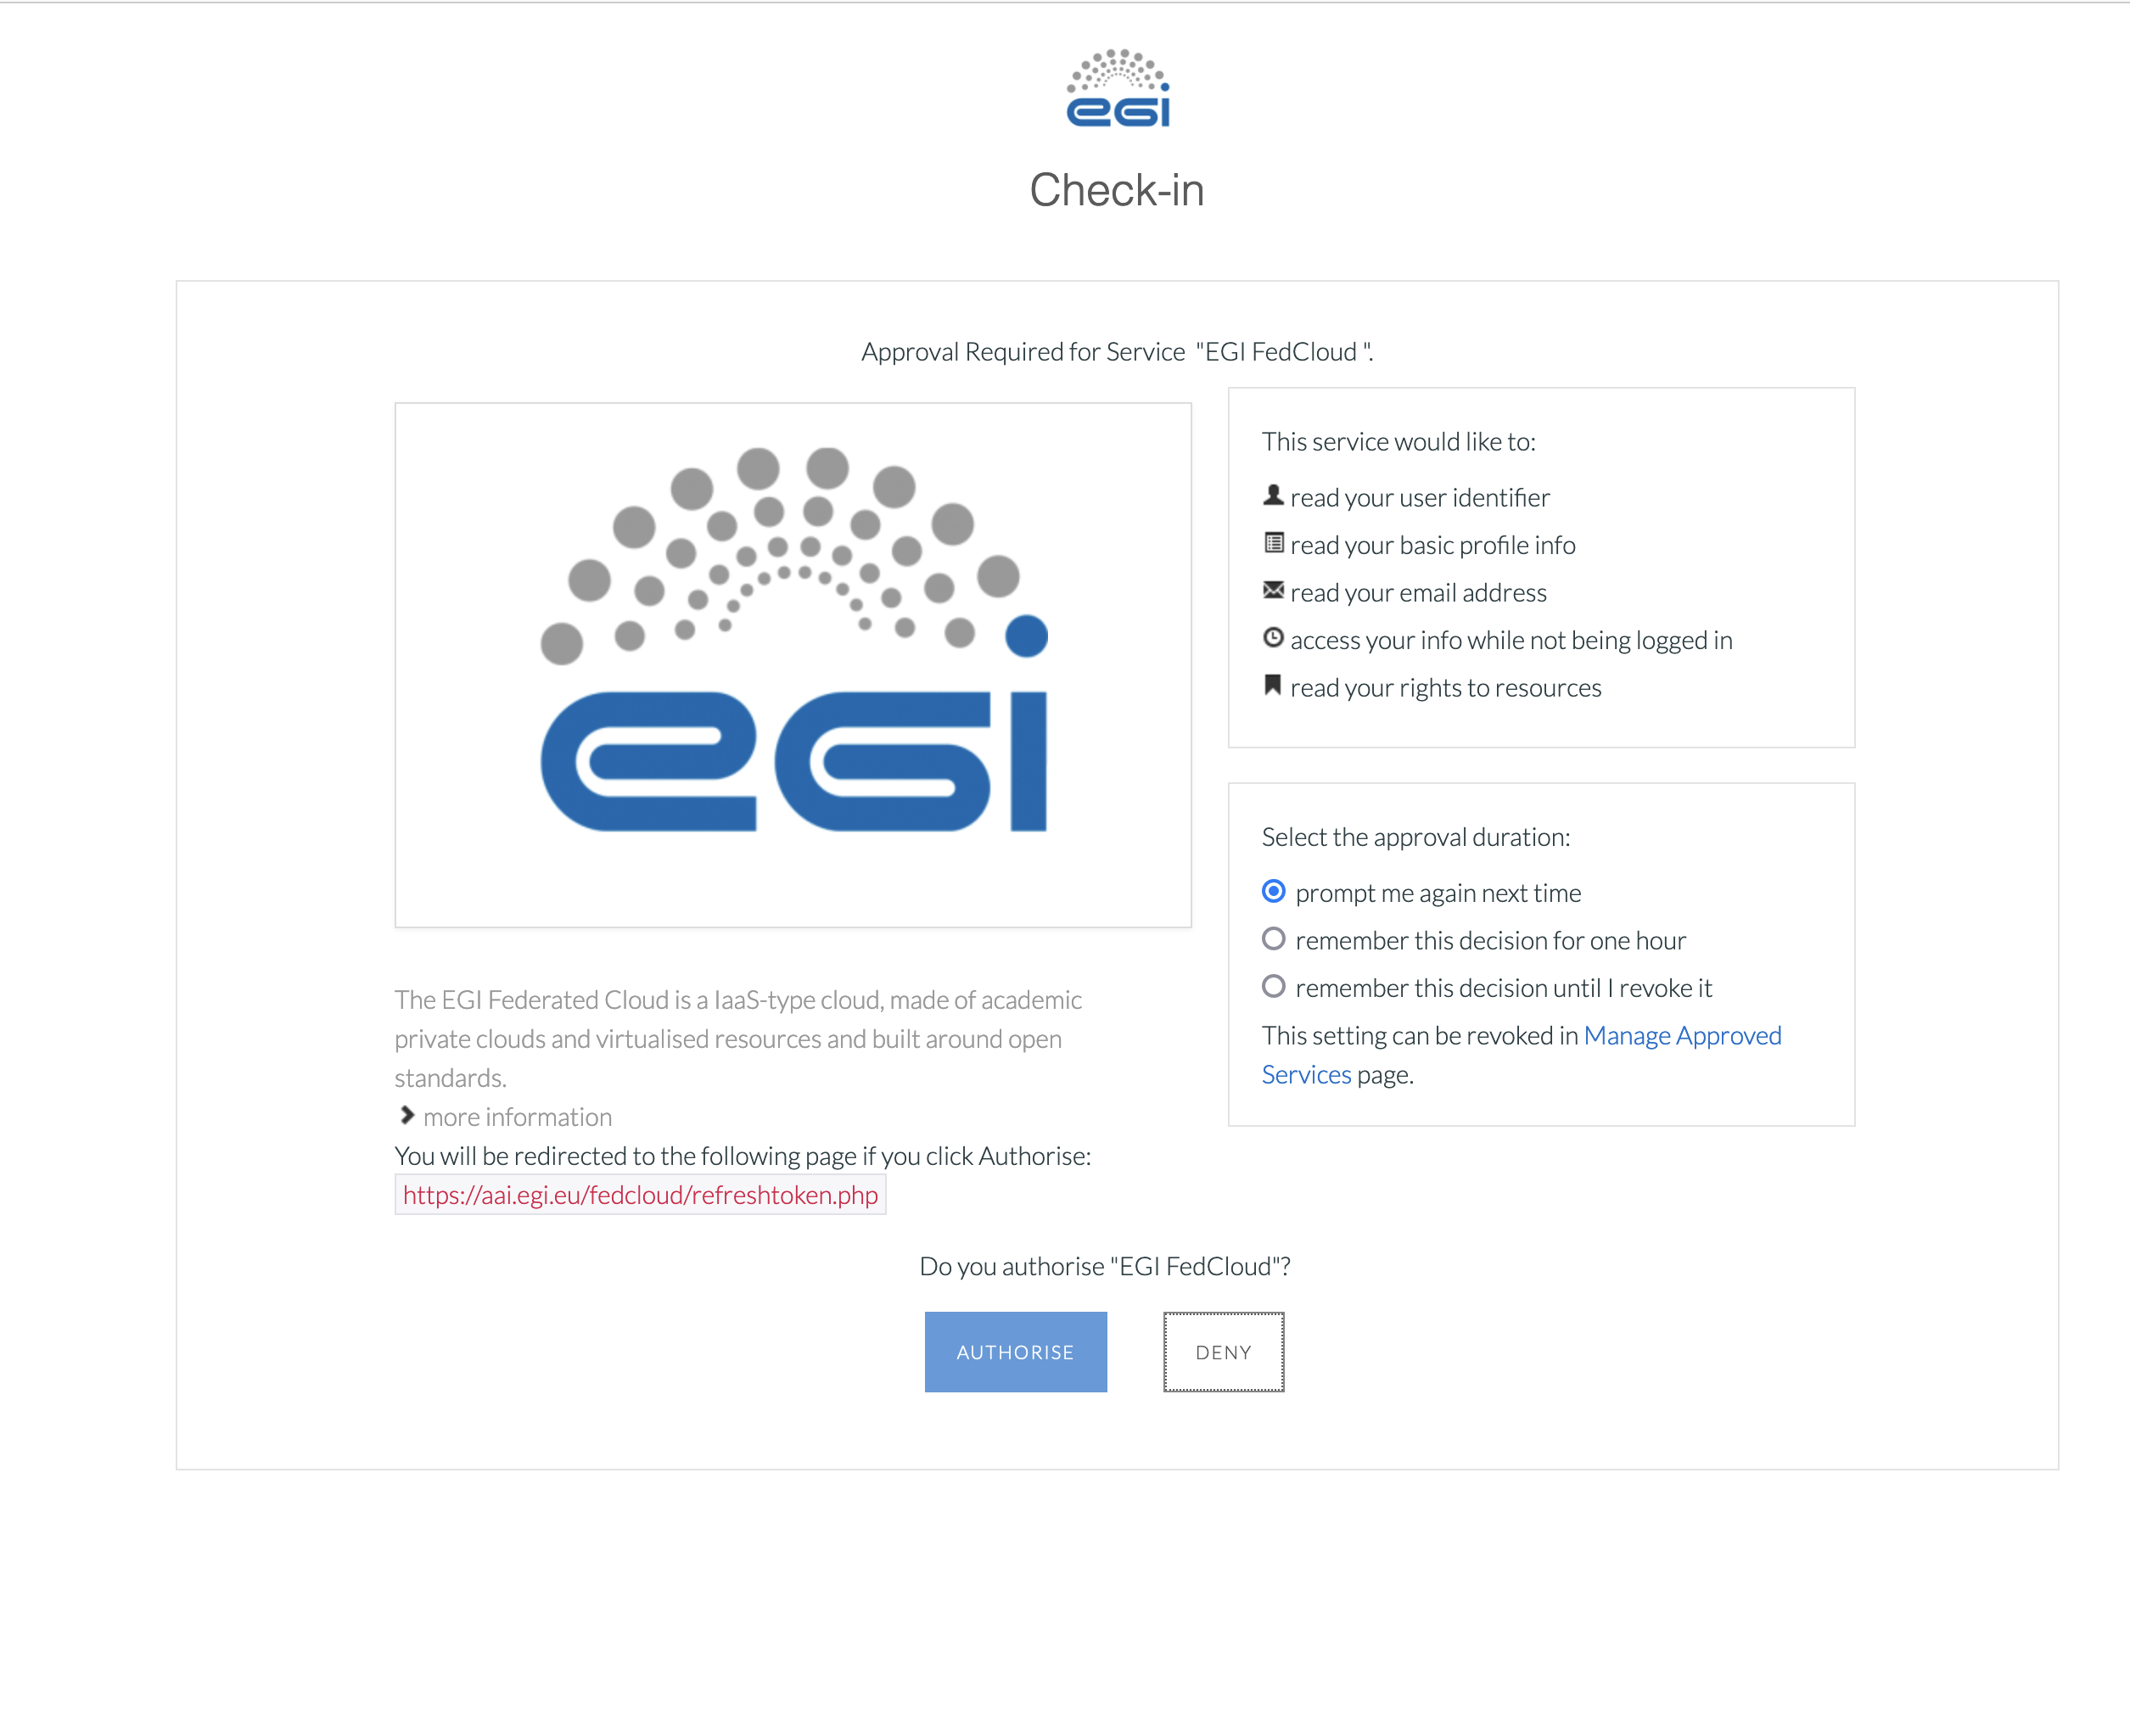
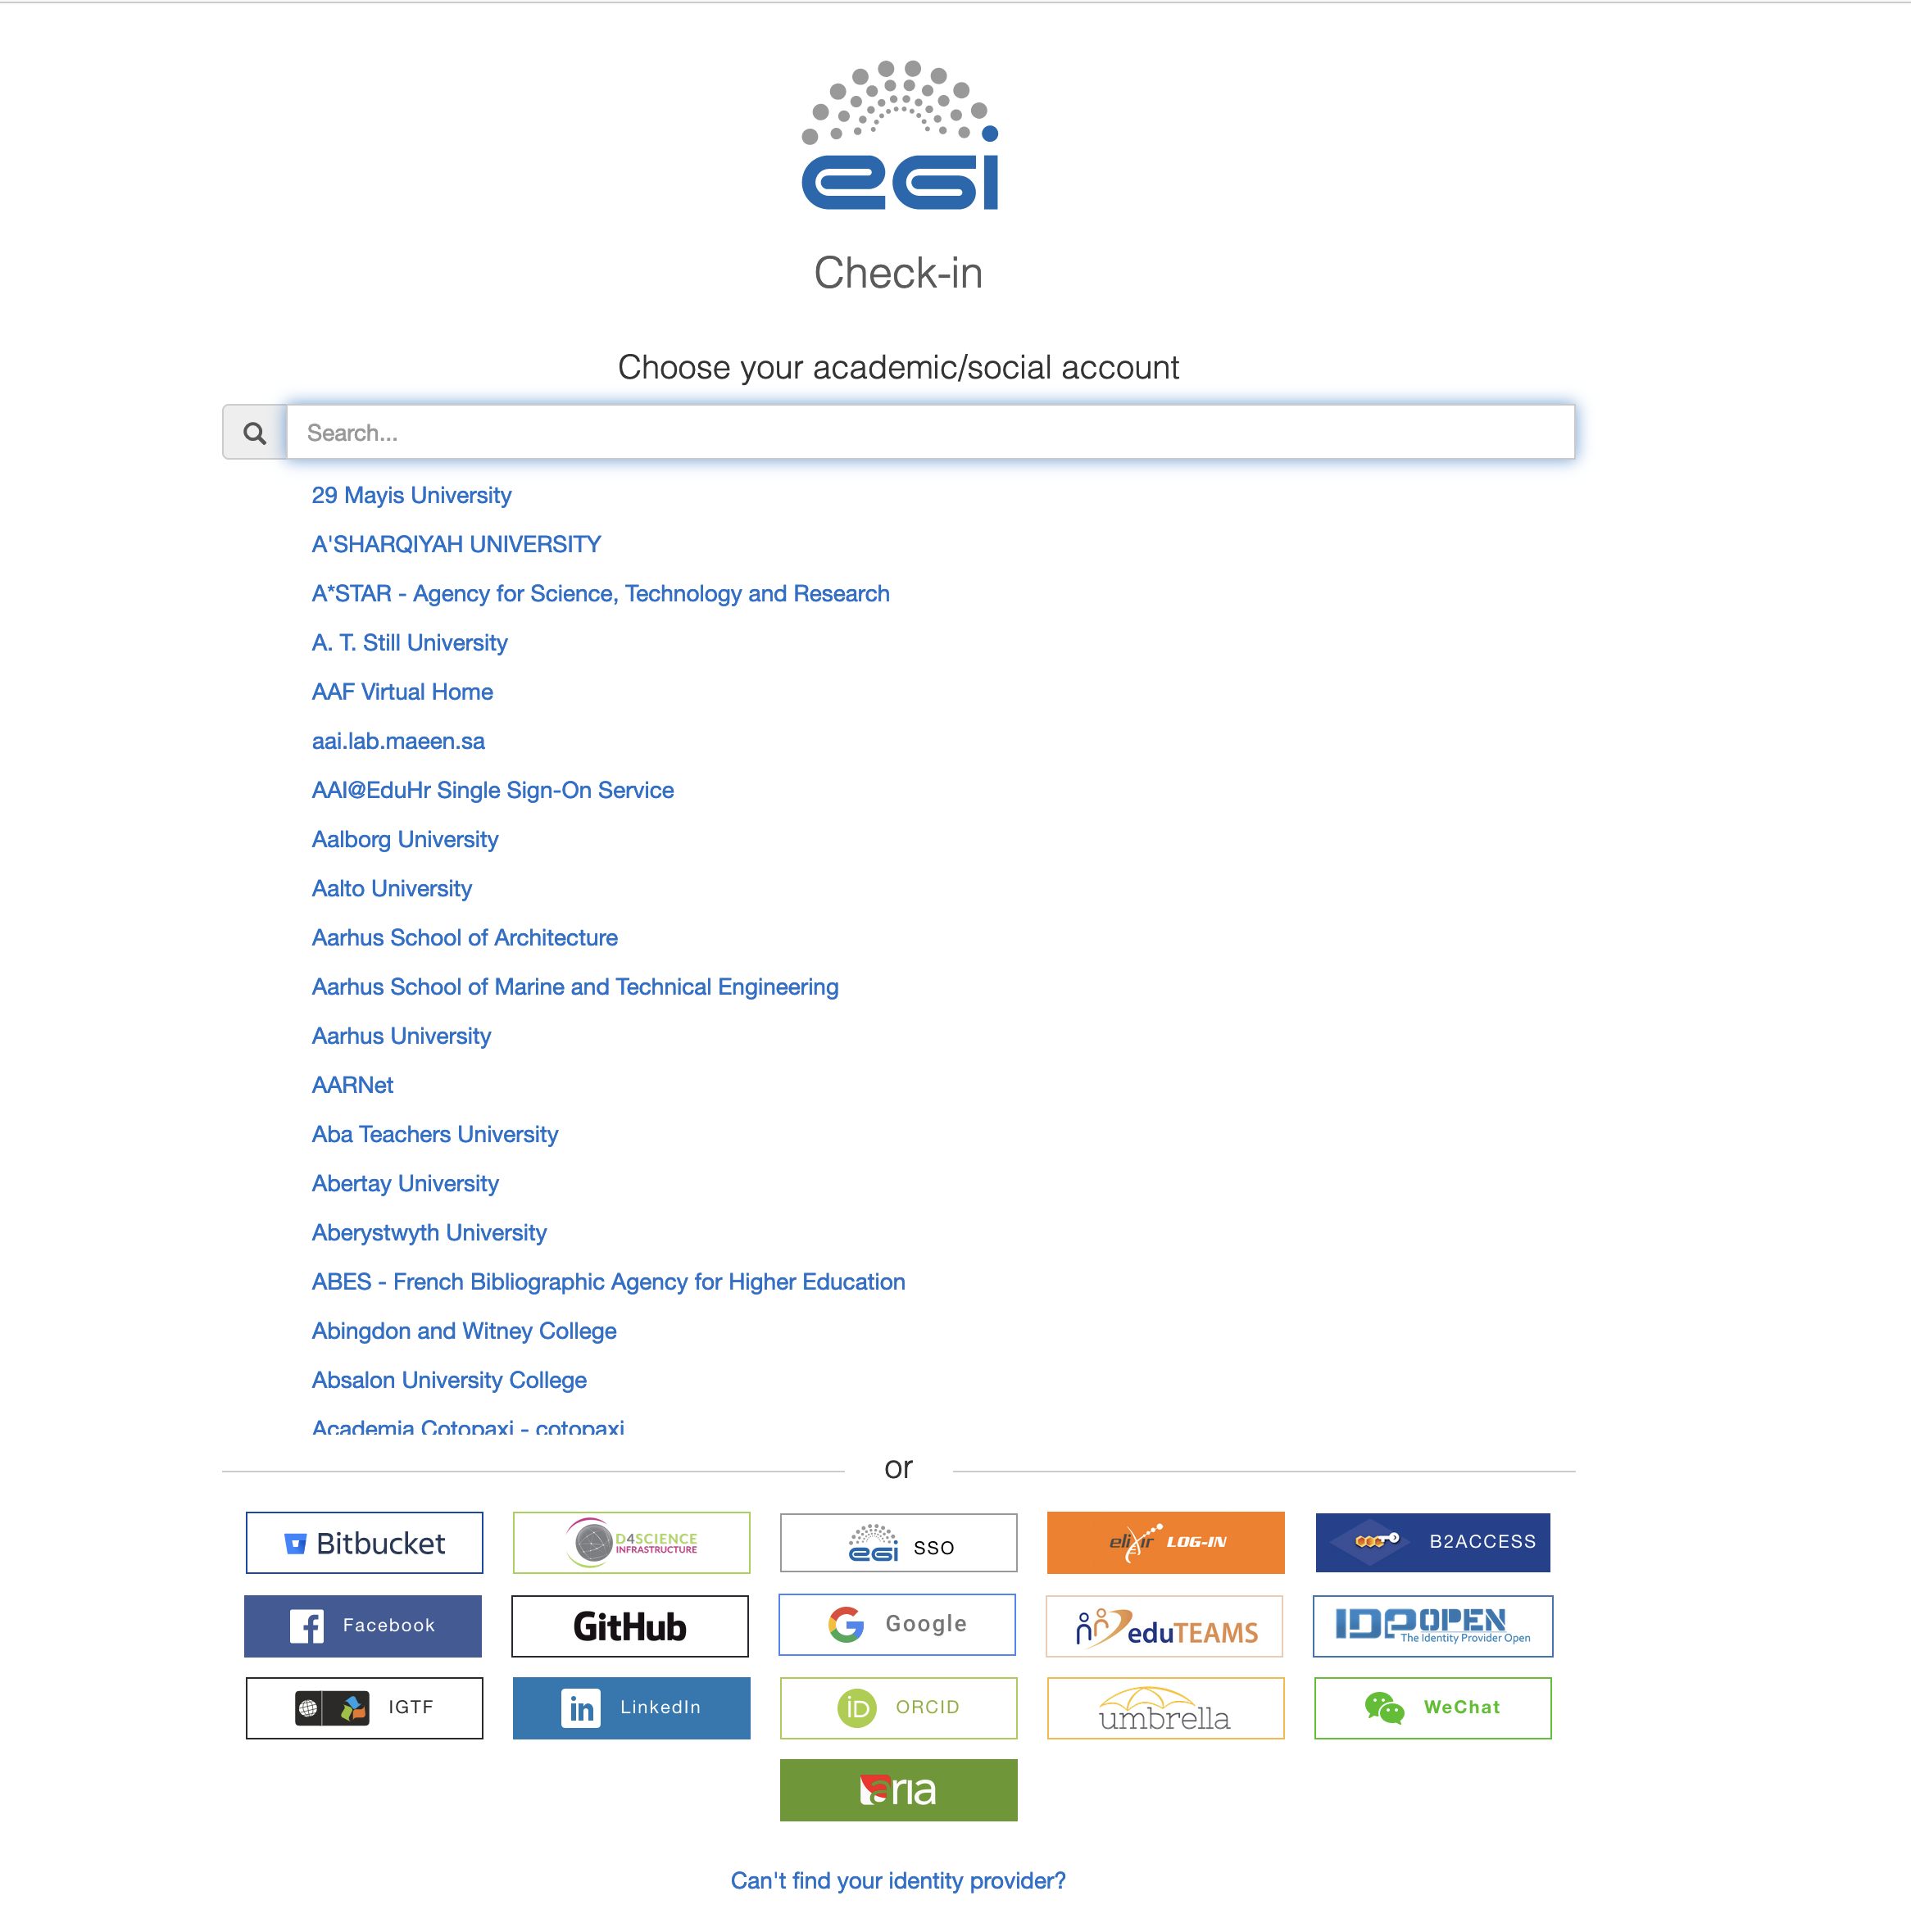
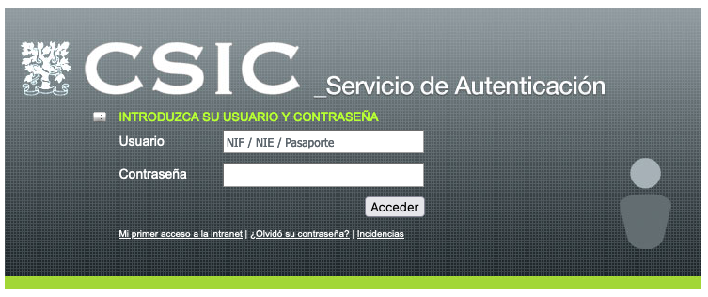
How to create a VM
1st step: Generate tokens - https://aai.egi.eu/fedcloud/

Slide 4
How to create a VM
1st step: Generate tokens - https://aai.egi.eu/fedcloud/
From the ”Refresh Token” you can generate “Access tokens”
Refresh tokens expires in 13 months
Access tokens expire in 1 hour
Problem: Tokens generation can not be done from command line, it requires interacting with a web page

Slide 5
How to create a VM
1st step: Generate tokens – “Command line version” – OIDC-agent
Using oidc-agent (https://indigo-dc.gitbook.io/oidc-agent/user/oidc-agent/start )
a set of tools to manage OpenID Connect tokens and make them easily usable from the command line
included in the FedCloud CLI took
Create an Refresh token (valid for 13 month):
oidc-gen --pub --issuer https://aai.egi.eu/oidc --scope "email eduperson_entitlement eduperson_scoped_affiliation eduperson_unique_id" susana_token
Renew Access token (valid for 1 hour):
oidc-token susana_token
Problem: it also requires interacting with a web page!!

Slide 6
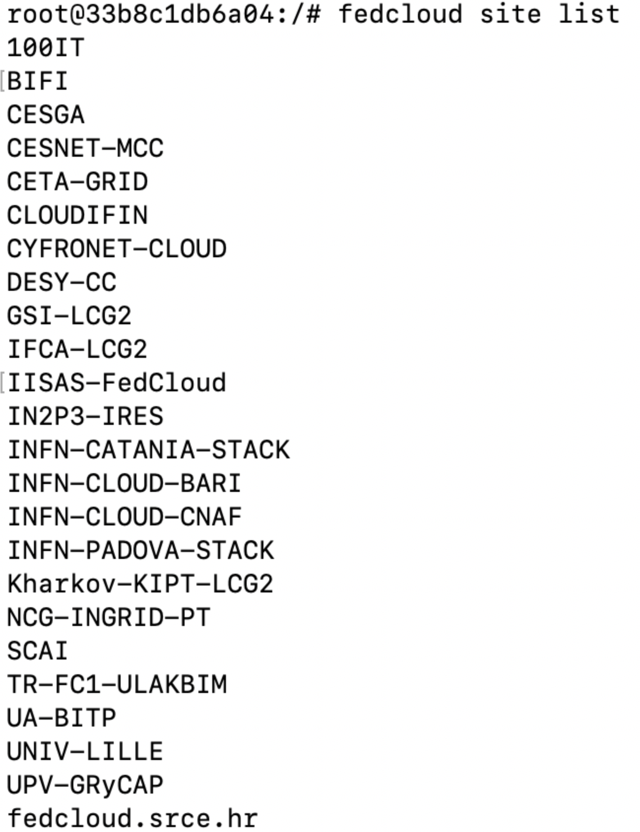
How to create a VM
2st step: Select a EGI Fedcloud SITE
Not all sites support the vo.access.egi.eu
I did not find a command which:
tells which sites support vo.access.egi.eu
provides information that can help you to decide which site is better (e.g. number of public IP available)
I have used CESGA and IFCA-LCG2

Slide 7
How to create a VM
3rd step: Select the flavor, the image and the network that you want for your VM
Flavor list:
fedcloud openstack --oidc-access-token $OIDC_ACCESS_TOKEN flavor list --vo vo.access.egi.eu --site CESGA
Image list:
fedcloud openstack --oidc-access-token $OIDC_ACCESS_TOKEN image list --vo vo.access.egi.eu --site CESGA
Network list:
fedcloud openstack --oidc-access-token $OIDC_ACCESS_TOKEN network list --vo vo.access.egi.eu --site CESGA
Do we need to provide a dialogue to show the options to ESAP users, so they can select the site/flavor/image/…?
Let’s start with the easiest way…
In this step you need to identify the public network to connect your VM, so the VM will get a public IP address
Public IP is a limited resource

Slide 8
How to create a VM
4th step: Create a keypair
It requires that ESAP users provide their public keys (we need a dialog for this in ESAP- GUI)
I was not successful when I tried to access the VM using my public key

Slide 9
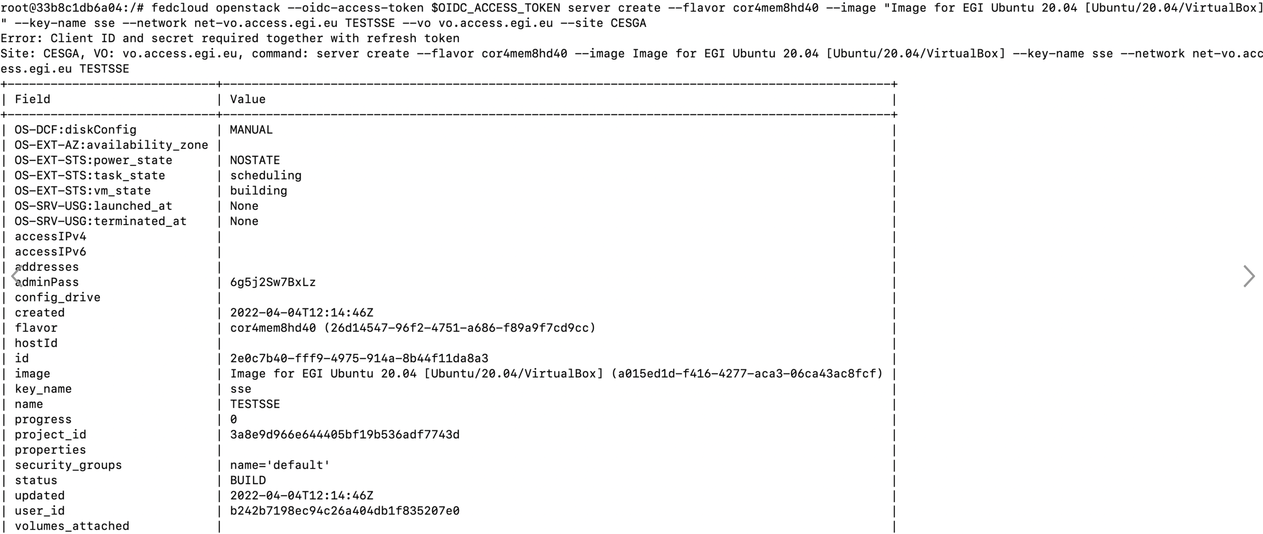
How to create a VM

Slide 10
Is it doable?
Token generation requires interacting with a web page -> Can we overcome this?
Pending to check if it is possible the access to the VM via the key pair.
Problems getting public IPs (vo.access.egi.eu has limited resources)
FedCloud CLI is a high-level Python package, can be integrated in ESAP backend? How much effort requires?

Slide 11
Other options
No problems related to tokens but problems authorising external users for Creating/Managing VMs
Allocate 1-2 “permanent” VMs, so ESAP would not need to create VMs
This would solve our problems ?
SPSRC Cloud platform @ IAA-CSIC
Description
SPSRC platform provides users with VMs with enough resources to carry out data análisis
Link: https://spsrc-user-docs.readthedocs.io/en/latest/

Slide 12
Can VMs be useful to integrate desktop tools in ESAP?
Is this already solved by using containers?
Debian desktop running in an OCI container with TopCat and Aladin installed. https://github.com/ivoa/Oligia
In general, any desktop tool can be accessed through a container
BUT
is there any restriction?
What about performance?

Slide 13
Discussion points
Can we overcome the problems? In particular the token generation one.
Integrate EGI vs Integrate IAA-CSIC SPSRC Cloud platform
What about Value vs Effort?
Still assessing the effort
Value:
Integrate an e-Infrastructure as EGI, part of EOSC
Increase variety in the ESAP compute facilities (currently only binderHub (JupyterHub) & Rosetta (containers, more?)

