Slide 1


Etat d’avancement de la conception des ASICs RD53
Mohsine MENOUNI
CPPM - Aix-Marseille Univ, France
Journées R&T IN2P3 –17-19 octobre 2022 - IP2I - Lyon

Slide 2
Outline
Introduction : RD53 collaboration project and specifications
RD53 chip architecture
  RD53B floorplan
  Data flow
RD53B-ATLAS testing
Radiation hardness
  TID testing
  SEE strategy and testing
Digital Verification work
Summary and Conclusion

Slide 3
RD53 collaboration and specifications
Design and develop pixel chips for ATLAS/CMS phase 2 upgrades
24 collaborating institutes - ~20 designers
Extremely challenging requirements for HL-LHC
  Radiation : 500 Mrad - 10¹⁶ neq/cm² over 5 years
  Hit rates: 3 GHz/cm²
  Large chips : ~2cm × 2cm, Small pixels: 50 x 50 µm²
  Data readout : up to 5.12 Gbps per FE chip
Technology : 65nm CMOS
RD53A chip
  Large scale demonstrator
  Submitted in August 2017
  Tested in an intense way
RD53B chip
  ITkPixV1 (ATLAS chip) submitted March 2020 and received June 2020
    High digital current because of an issue in the ToT (Time Over Threshold) latches
    But the main functionalities are working as expected
    The issue was solved by a patch in metal layers : ITkPixV1.1
  CROC_V1 (CMS chip) received from the foundry the end of August 2021
    Functional and TID tests are still in progress
    No particular big issues
RD53A
Size: 20 x 11.5 mm²
submitted in August 2017
RD53B-ATLAS (ITkPix_V1)
size: 20 x 21 mm²
submitted in March 2020
RD53B-CMS (CROC_V1)
size: 21.6 x 18.6 mm²
Submitted in May 2021
ITkPixV1 test board

Slide 4
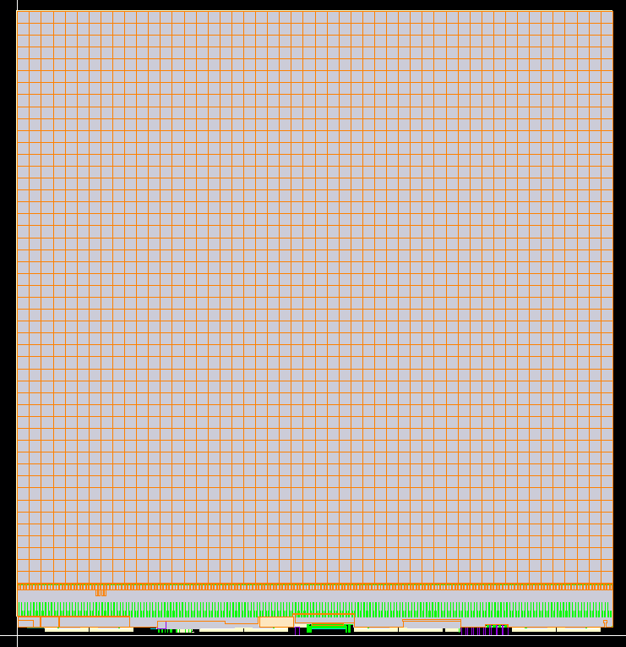
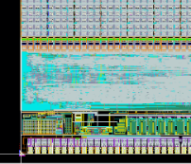
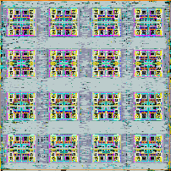

RD53B Floorplan
Core : 64 pixels
Chip Bottom (Periphery)
  Analog Chip Bottom (ACB):
    analog and mixed/signals building block for Calibration, Bias, Monitoring and Clock/Data Recovery (CDR)
  Digital Chip Bottom (DCB):
    synthesized digital logic containing communication to/from the chip and the readout of the Pixel matrix and global configuration.
  Pad frame
    I/O blocks with ESD protections, ShuntLDO for serial powering
    Readout via serial links (1-4 x1.28Gbit/s) using Aurora64/66 encoding
Chip Bottom
Pixel array
  384 x 400 pixels of 50 x 50 µm²
  153 600 pixels organized in 2400 identical cores
  1 core → 16 analog islands : 64 fronts ends
    Analog FE are embedded in a flat digital synthesized “sea”
    All digital logic local memory needed to operate the FE is shared in a single core
  Implementation
    Time Over Threshold (ToT) digitization
    Shared Pixel Region buffer : Hit storage during Trigger latency
Pixel : 50 µm×50 µm

Slide 5
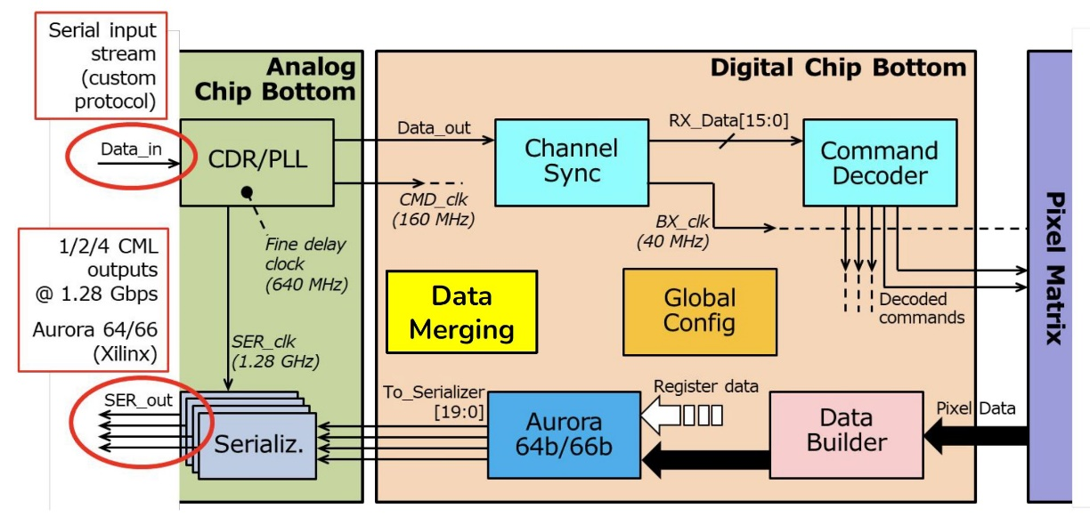
Data Flow
Hits in the Pixel matrix are stored locally
The memory is shared between 4 pixels
Token based readout of hits is done in parallel for each core column when a valid Trigger is received
Multiple level of data processing :
  event building
  data buffering and formatting
Building an Aurora frame based data stream to be send to the high speed serializers
Command Control and Timing:
  One single 160 Mbit/s differential control link with a custom protocol
CDR/PLL recovers Data and Clock.
Readout: 4 x 1.28 Gb/s using the Aurora 64/66 encoding.
Multi chip data merging :
  One chip can be configured as “primary” to aggregate serial data coming from one or more “secondary” chips and merge them with its own output.
  Allows to reduce the number of links to read out data.

Slide 6
  Test Results

Slide 7
ITkPixV1 test results
Before tuning:
Threshold: ~ 1860 e-
Thresh. dispersion: ~ 300 e-
Noise: 41 e-
After tuning:
Threshold: ~ 700 e-
Thresh. dispersion: ~ 80 e-
Noise: 40 e-

Slide 8
RD53 TID test activities
CERN ATLAS
Bonn
Oxford
Extensive radiation campaigns (since 2015) have been
carried out to test and qualify :
  CM0S 65 nm devices, Prototypes of IPs and Front-ends , DRAD test chip to study TID effects on standard cells
  The process suffers from reverse annealing and low dose rate effects
Rules followed in RD53 chip
  Avoid minimum size digital cells and use large area devices for the analog
  RD53 chips are designed to meet specifications at 500 Mrad when operating at low temperature (-15 °C)
  The chip should be maintained powered off during shut down (room temperature)
RD53 collaboration treats radiation damage as one of the IC design corners
  100 Mrad, 200 Mrad and 500 Mrad simulation
  @ -30°C, 0°C, 25°C models were used to simulate the TID effect on analog and digital designs
CERN EP/ESE
Marseille
LBL
Multiple irradiation campaigns for the RD53A/B done at low temperature (-10 to -20 °C)
  X-ray machine for high and low dose rate irradiation
  60 Co for low dose rate irradiation
  Kr-85 sources for low dose rate irradiation at -15°C (550 Mrad reached in almost 3 years)
  Tested chip in proton irradiations at Birmingham (SCCs) and at CYRIC (quads)

Slide 9
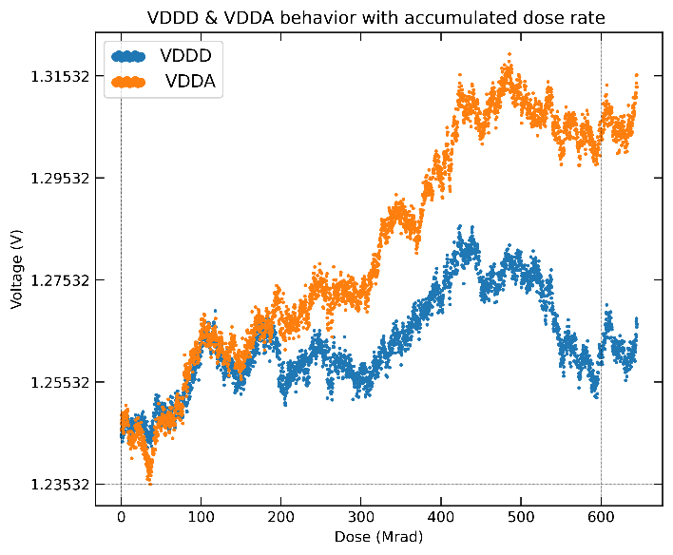
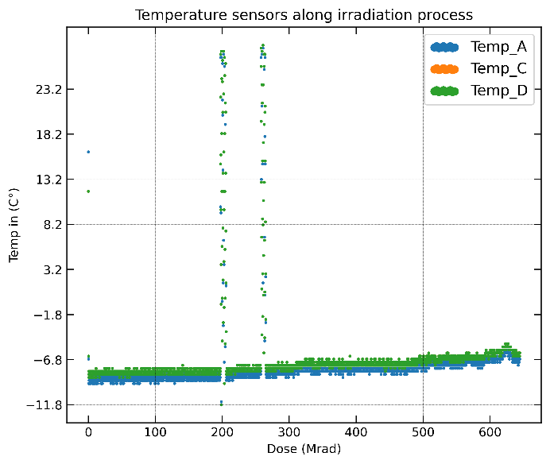
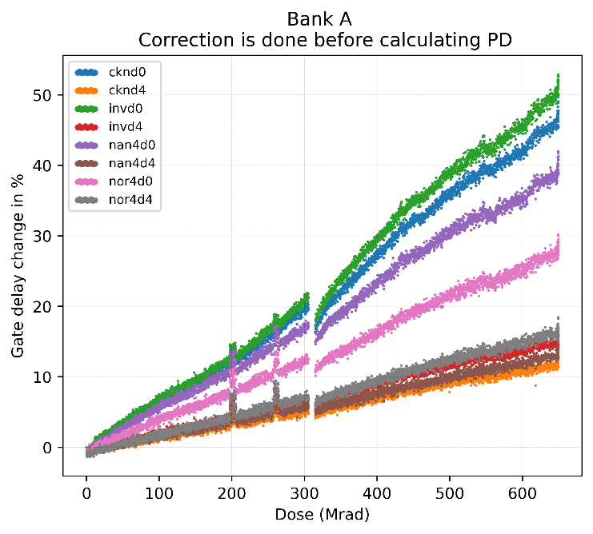
TID test results (@IN2P3)
The TID tests were conducted in strong collaboration IJCLab/CPPM
  The temperature is well controlled and stable around -8°C
  The chip ITkPixV1 in LDO mode
    VDDD and VDDA generated inside the chip
  Dose rate of 1.2 Mrad/hour
  Tested up to 650 Mrad
  Drift of VDDD/VDDA due to the reference voltages VREFA/VFEFD shift
On chip Ring Oscillators
  Designed by IJCLab and used intensively for dose monitoring
  Absolute VDDD correction applied using Freq vs VDDD slopes
  Delay increase for strength 0 gates up to 45%
    Not used in the chip
  Delay increase for strength 4 up to 28%
The results obtained are compatible with those obtained by other institutes
Ring Oscillator | 650 Mrad
cknd 0 | 42 %
cknd 4 | 12 %
invd 0 | 45 %
invd 4 | 16 %
nand4d0 | 36 %
nand4d4 | 15 %
nor4d0 | 28%
nor4d4 | 18 %
Yahya Khwaira ( IJCLab) : RD53 test meeting

Slide 10
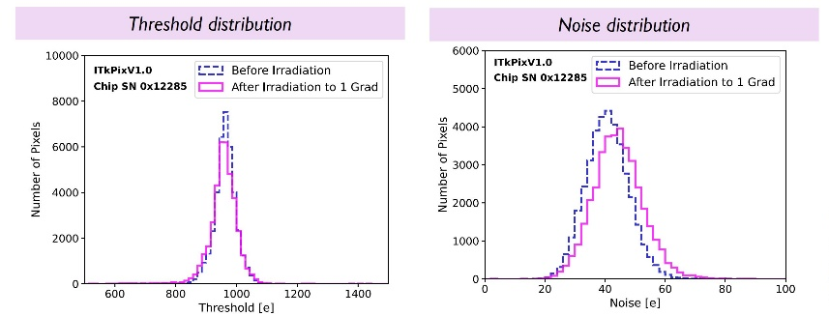
TID test results
Analog FE irradiation
  ITkPixV1 is operational up to 1 Grad even for VDDA=1.0 V
  Number of failed pixels <5%
Voltage References: Drift of reference voltages (up to +15% for VDDA)
→ Use VREF trimming
SLDO: Start-up without issues after 1 Grad TID
ADC: Operation is very stable with irradiation
Low Dose Rate effect
  Impact of low dose rate effects studied for low total doses in X-ray setups
  Damage increases for low dose rate by a factor 2-3
  Additional low dose rate effects observed in LDR irradiations using Kr-85 at high total doses Longest running → RD53A chip: 3 years

Slide 11
  SEE tolerance

Slide 12
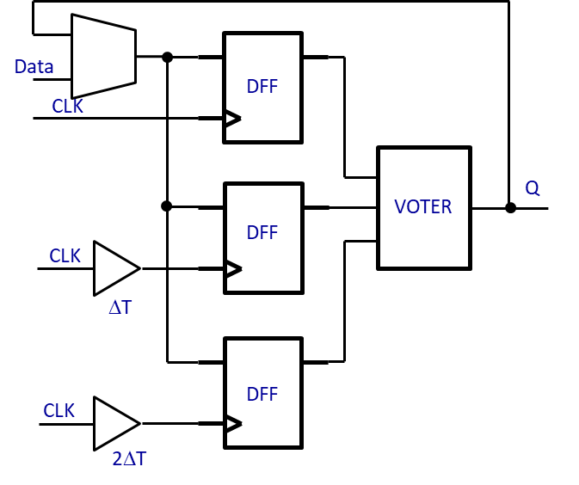
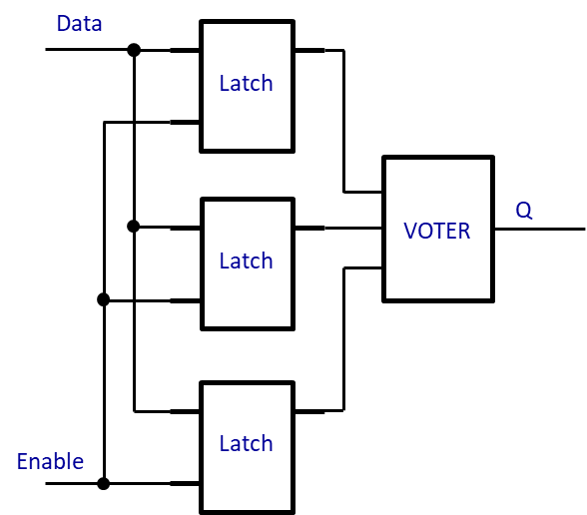
SEU mitigation in the RD53B chip
Chip Configuration
Pixel configuration
  Memory size : 8 bits per pixel -> 1.28 Mbit per FE chip
  Unprotected latch (single latch) used for 2 bits
  TMR latch without error correction implemented for 6 bits
Global configuration
  Memory size : 1.6 Kbit
  Located in the Digital Chip Bottom
  TMR with clock skew and error correction
The configuration registers (global and pixel) do not have a reset
  A re-configuration step is necessary to put them in a right state
TMR with correction
TMR with clock skew
ΔT is set to 200 ps
Filter SET glitches shorter than 200 ps
Implementation Challenges :
  Triplicated clock skews made by clock tree synthesis
  Timing closure (hold time)
  Delay variation with process, power supply, temperature and TID
TMR flip-flops are constrained to be placed with 15 µm distance
Data
Q
Enable
Latch
Unprotected single latch
TMR latch without correction

Slide 13
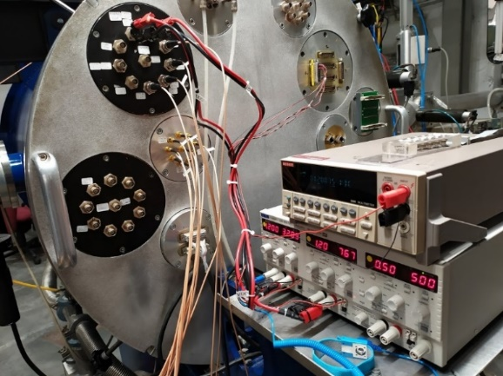
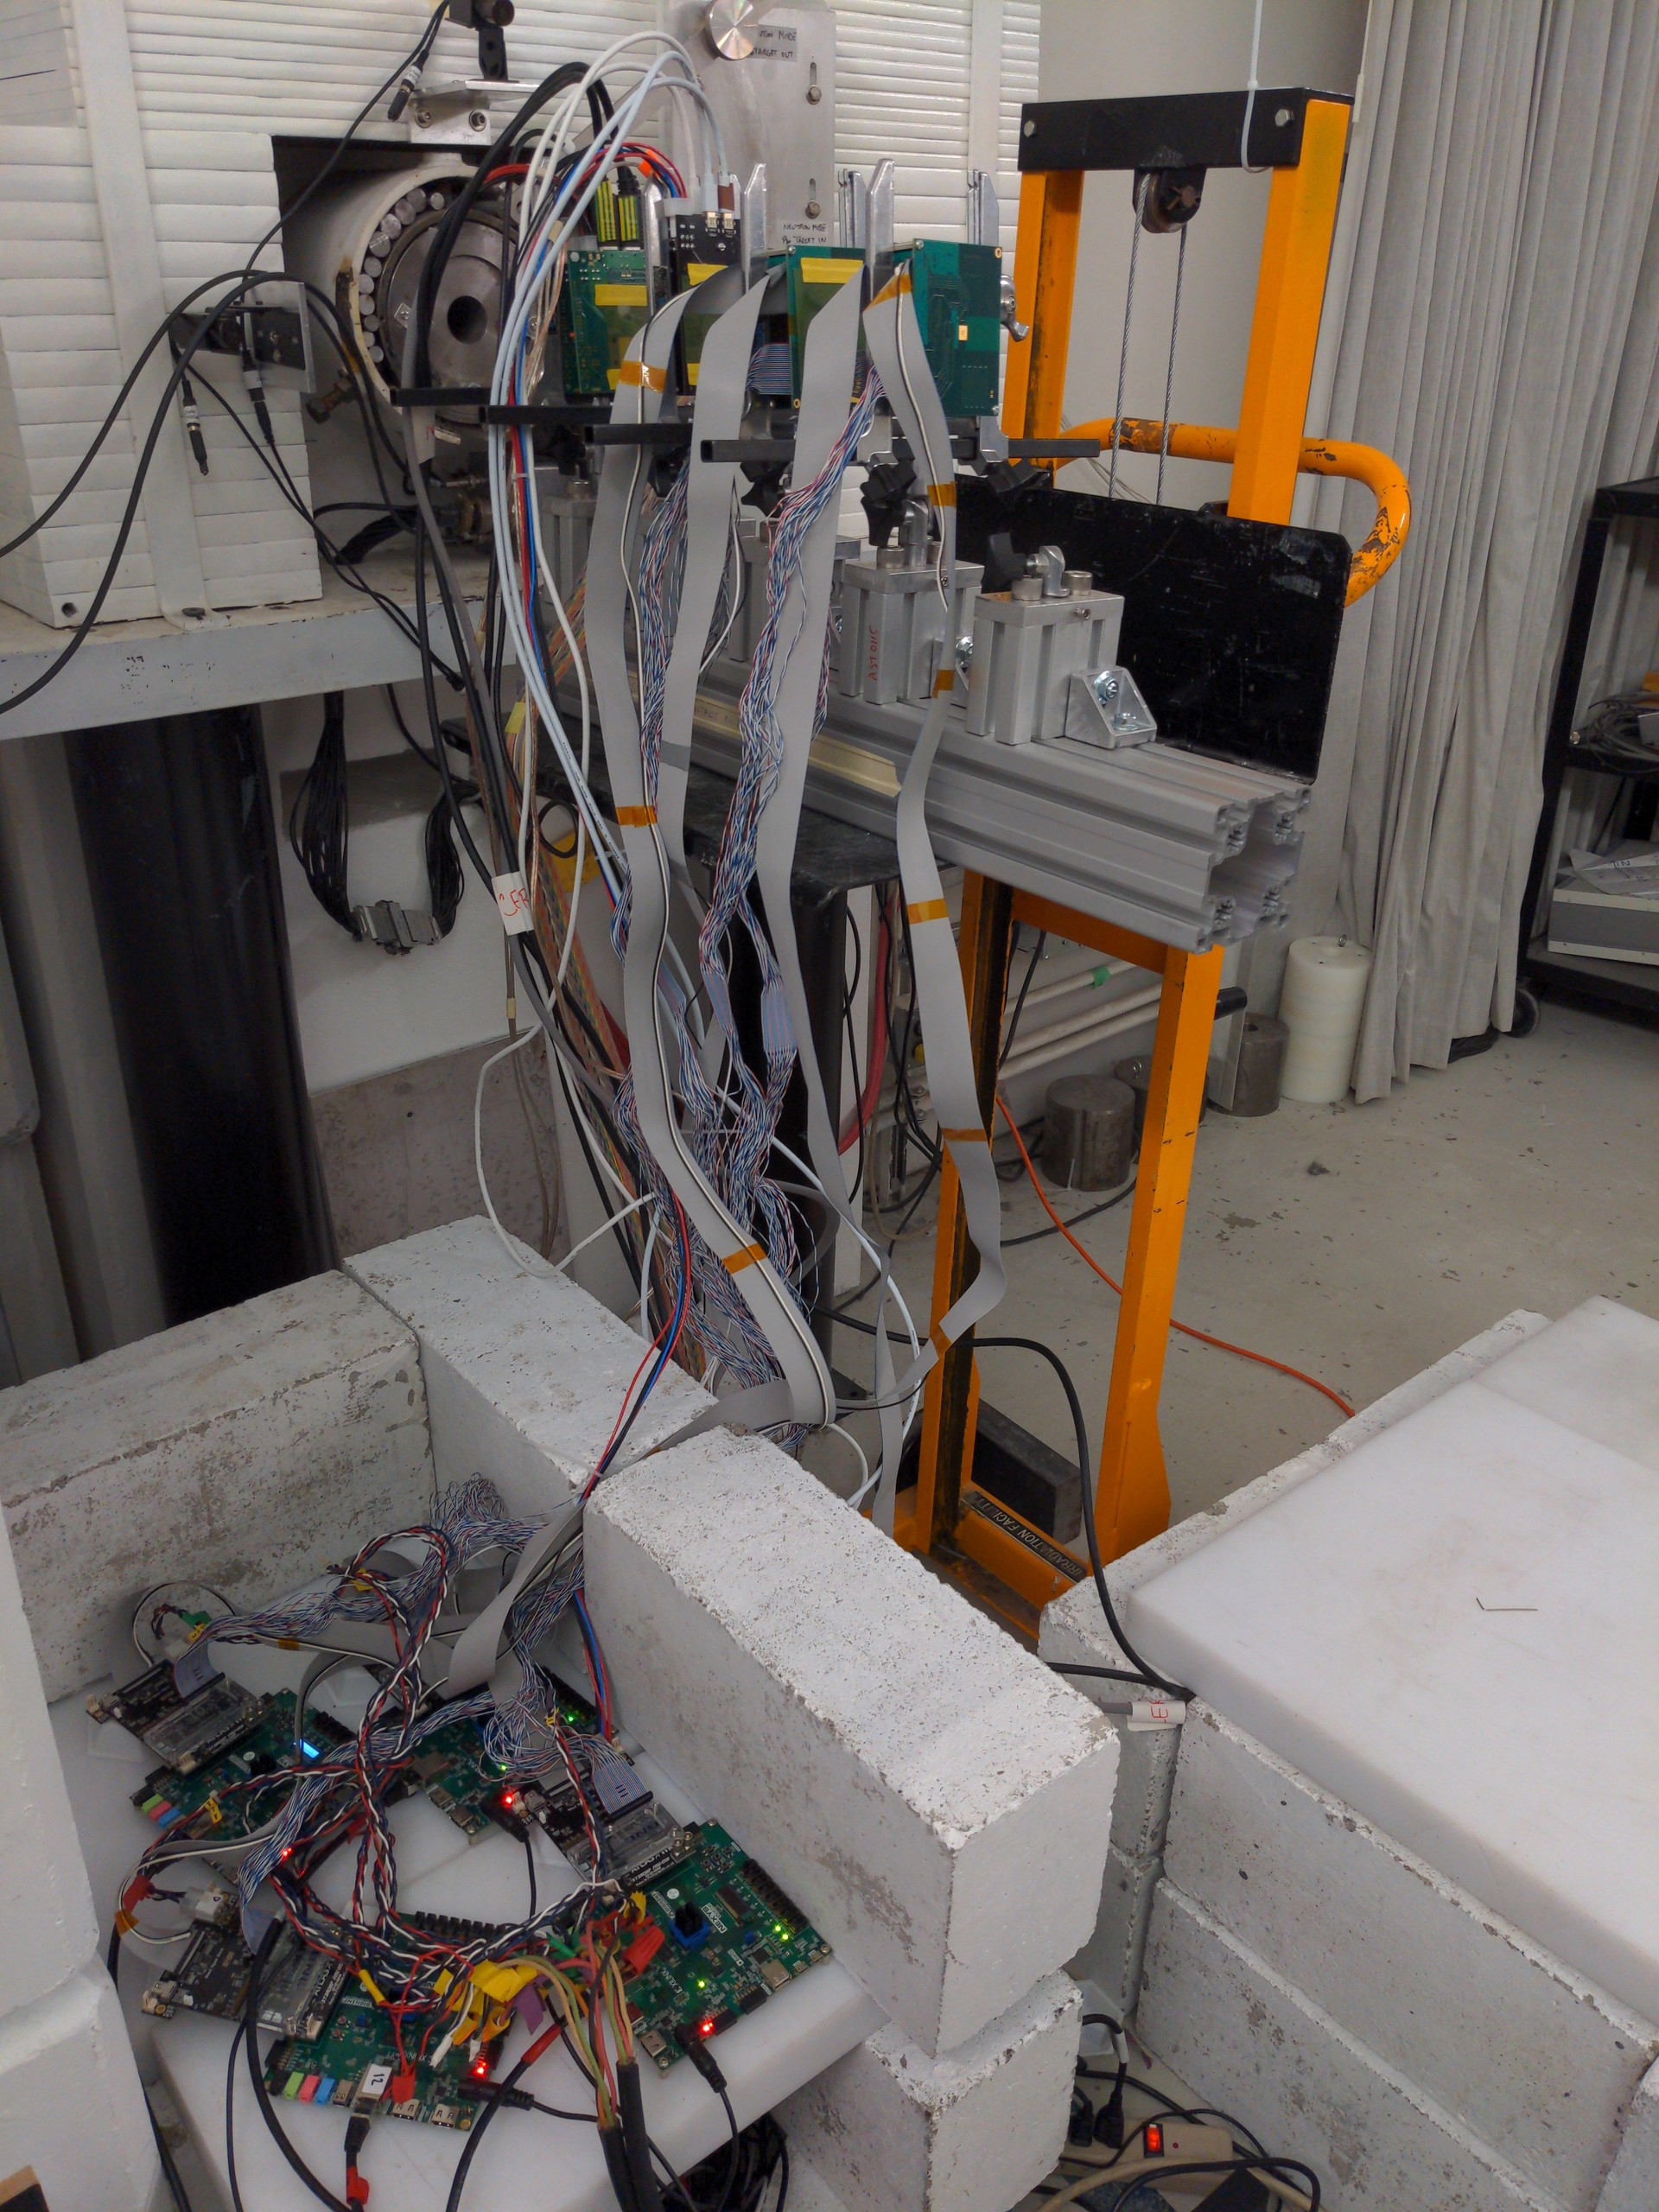
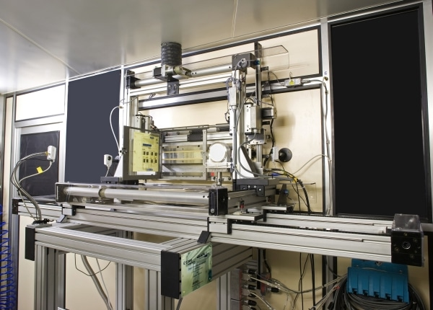
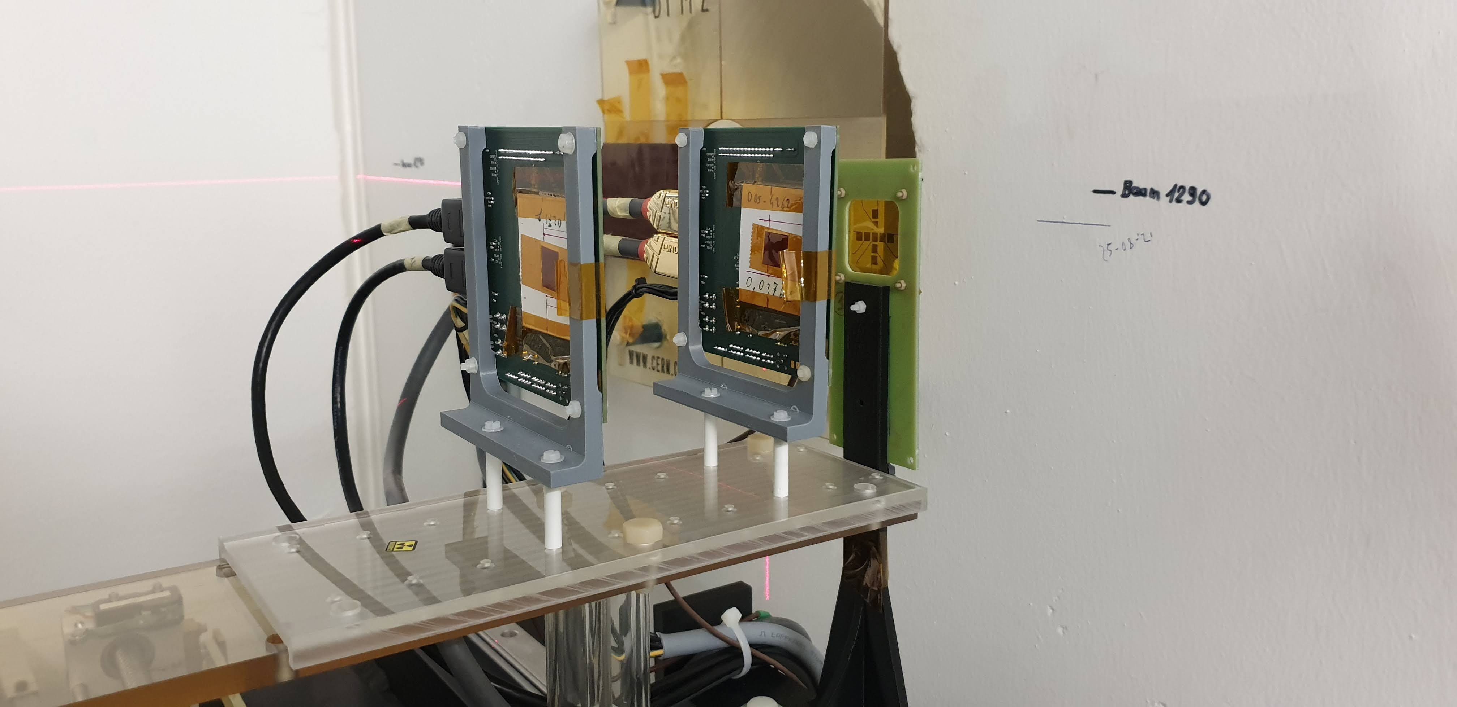
SEU Tests campaigns
CRC – Louvain la Neuve
TRIUMF
Centre de Ressources du Cyclotron (CRC) – Louvain la Neuve
  Two SEU test beam campaigns: October 8, 2020 and November 17, 2020
  The chip irradiated in vacuum with several heavy ions flavours (1.3 to 62.5 MeV.cm²/mg)
TRIUMF facility
  SEU tests campaign done remotely December 19-20, 2020
  480 MeV proton beam
  The chip tested under a proton flux of 1.5 10⁹ p/cm²/s similar to the hadron flux in the HL-LHC
GANIL – Caen
  SEU campaign in April 2021 and dedicated for CDR/PLL
  Test done with only 1 ion : ¹²⁹Xe : LET = 30 MeV.cm²/mg
KU Leuven-Campus Geel (PULSCAN)
  Laser SEU testing October 5, 2021
  2 photon absorption
  Pulse energy applied: 1 nJ
  Pulse frequency: 1 KHz
PS-CERN Facility
  24 GeV Proton testing : October 14 to November 4, 2021
  The flux is about 40 times higher than in HL-LHC
GANIL
The flux = 1.5 10⁹ p/cm²/s
PULSCAN - Leuven
PS-CERN

Slide 14
HL-LHC SEU rate estimation
SEE hadron flux of 10⁹ p/cm²/s assumed for the innermost layer of the pixel detector in the context of the HL-LHC
The TMR latch without correction implemented for pixel configuration
  The number of flip <10 (per FE chip) for the inner layer
    assume a re-configuration time interval of 50 sec
    FE chips on external layers need to be re-configured less frequently
The TMR cell with correction is 400 times more tolerant than the unprotected one
  Mean time between errors estimated to 5 hours for the inner layer (per FE chip)

Slide 15
SEE effects on the RD53B chip working
Extensive proton and heavy ion SEE testing identified 3 problems
  High rate link dropout
    link dropouts was located in the core bandgap
  Stuck hit readout state
    The clear command that resets the data paths solves this problem
    SEU verification at RTL identified 1 flip-flop that can cause stuck
    The flip flop is now triplicated
  SEL at high effective LET (Xenon at 45 tilt angle)
    More tests should be made in serial powering mode
Progress and perspectives
  SEU verification of the pixel array at RTL
  SEU/SET verification at Gate Level using the same methodology as for the RTL
    Verify that the correction is correctly implemented
    SET studies on critical nets (clocks, reset, etc.)

Slide 16
  Digital verification

Slide 17
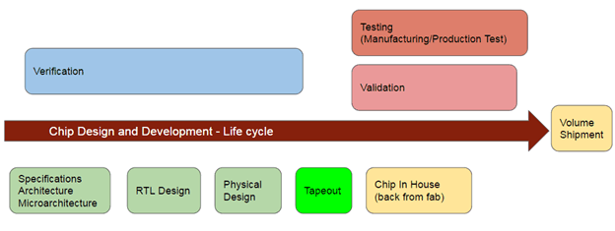
Digital Verification
Objective
Ensure that a digital design is correctly implemented according to requirements and specifications
  Requires more time and people than RTL design
  or analog IP design
Why ?
Increasing complexity in smaller nodes
More and more functionalities in single chip
Increasing submission costs
Methodology
Universal Verification Methodology (UVM) [IEEE 1800.2-2020]
  Currently supported System Verilog library
  Very well supported by EDA tool vendors
Used to build a Verification Framework
Goals
Tests use all lines of code and use all blocks of code
Did tests use the whole truth table of each Boolean expression?
Did tests cause all wires to toggle from 0 to 1 and from 1 to 0 at least once?
Did tests use all transitions and states of all FSMs in the design?
RD53 verification work
RD53 chip is a complex pixel digital chip
Verification work started since the beginning of RD53 project but suffered from lack of resources
The successive engineers have preferred to leave for the industry

Slide 18
RD53 Framework Development
Functions covered by the verification :
  HITS/TRIGGERS
  Clear/Reset
  Readout
    CRC can cause data loss
  Data Merging
  Event filtering
    Isolated hit removal causes data loss
  Test Features
Progress on RTL level verifications
  Reached coverage (end of September) of :
  75% code
  60% functional
Gate Level Verification Status
  First simulations are running
  Hold time violations found in simulations
  Debug ongoing

Slide 19
Critical Issues
Verification is critically understaffed
At least two features have been proven to corrupt data
  CRC
  Isolated Hit Removal
Several open bugs
SEE simulations missing at GL
  SEE at RTL can only evaluate effect of faults on non-triplicated nodes
  SET evaluations
Mixed Signal simulations with GL not yet started

Slide 20
Conclusion and summary
Verification is really critical in chip design
RTL bugs in RD53 chip
  Some bugs should be fully fixed
  Some bugs have been considered by ATLAS as non critical features and ATLAS does not plan to use them
    These bugs will be ignored for the ATLAS submission
SEU simulations, at RTL level, have been done
  One bug was found and has already been fixed and can explain all stuck state issues seen during SEE campaigns
All the planned “minor” modifications to analog IPs are implemented
Preliminary layout sent to IMEC on June 13 for initial checking
RD53C-ATLAS production chip submission is now planned for the end of November
  RTL must be frozen very soon
  2 weeks for chip implementation
  2 weeks for gate level and sign-off verifications
If these conditions are not met, the submission will be made in early 2023
In addition to the delays on the schedule, the fabrication of the masks will cost 7% more

Slide 21
  Backup

Slide 22
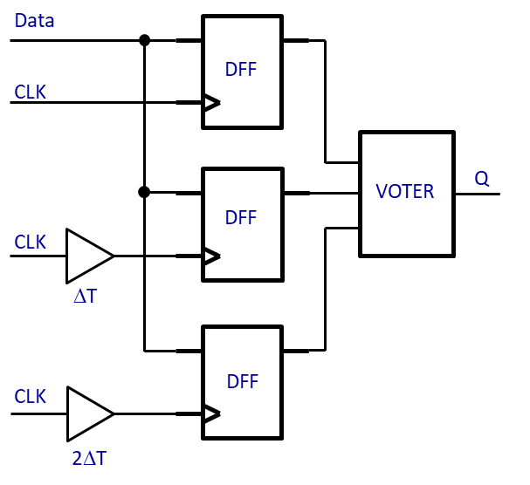
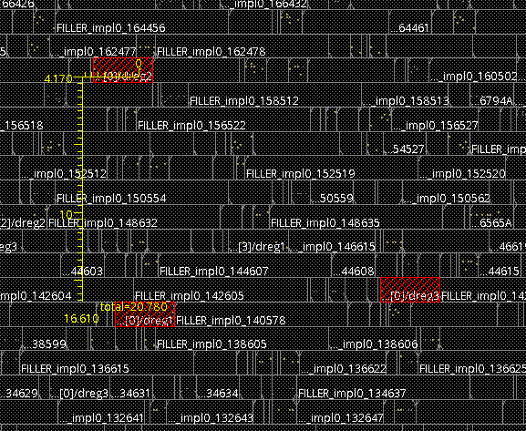
SEU mitigation in the RD53B chip
Single Event Effects (SEE) are a major challenge for the RD53B chip design
Triple Modular Redundancy (TMR) associated to the SET mitigation with clock spread is used in the Digital Chip Bottom to reduce the SEU rate in the RD53B
Mitigation of SEU concerns only the critical parts as the configuration memories, state machines, FiFo pointers
Data Paths are not protected
50% of the DFFs in the chip bottom are protected
All the reset signals are synchronous (avoid a global glitch effects caused by SET)
TMR is implemented during synthesis
  Simple FF replacement with TMR version
  TMR flip-flops are constrained to be placed with 15 µm distance
Cells Spacing in the same TMR latch
TMR+SET mitigation with clock spread

Slide 23
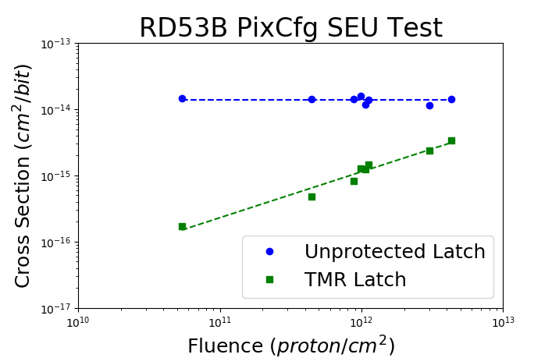
Pixel configuration test results
Memory size : 8 bits per pixel -> 1.28 Mbit per FE chip
  TMR without correction used for 6 bits
  Unprotected latch used for 2 bits
Several pixel configuration runs
  The flux set to the maximum : 1.5 × 10⁹ p/cm²/s
  5.4 × 10¹⁰ p/cm² to 4.3 × 10¹² p/cm²
Unprotected latch cross section σ_{SL} = 1.5 × 10⁻¹⁴ cm²
TMR latch cross section increases with the fluence because of errors accumulation
  The TMR is 100 times tolerant than the unprotected latch for low proton fluence
  (~5 × 10¹⁰ p/cm²) ,
  TMR is only 10 times tolerant than the unprotected latch for moderate proton fluence (~1.0 × 10¹² p/cm²)
TMR without correction is useful when considering a regular external re-configuration
  It helps to reduce the external re-configuration rate
1 | 2 | 3 | 4 | 5 | 6 | 7 | 8
TMR | STD | STD | TMR | TMR | TMR | TMR | TMR

Slide 24
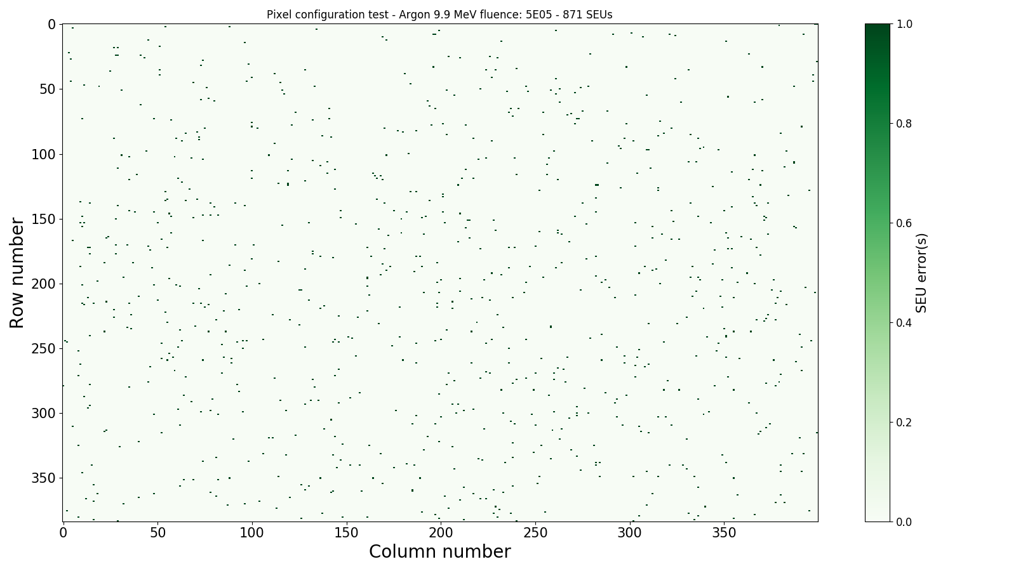
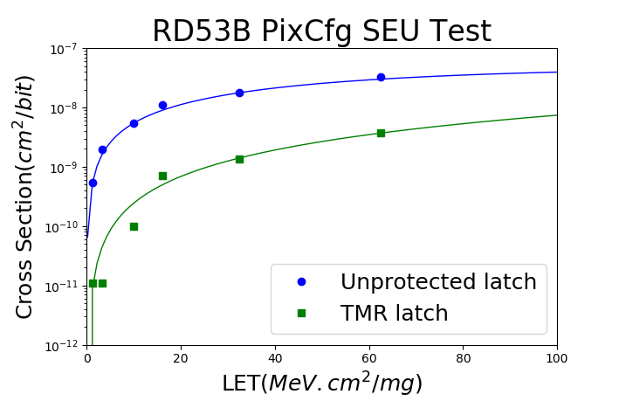
Pixel configuration tests
SEU Map for Argon (LET = 9.9 MeV.cm²/mg)
5 × 10⁵ p/cm²
Memory size : 8 bits per pixel -> 1.28 Mbit per FE chip
  TMR without error correction implemented for 6 bits
  Unprotected latch used for 2 bits
The SEU errors are randomly distributed -> No global signal effects
Unprotected latch :
  Saturation cross section : σ_{SAT} = 6.0 × 10⁻⁸ cm²
  Threshold LET LET_{th} < 1 MeV.cm²/mg
TMR latch (no correction)
  For a particle fluence of 2.0 × 10⁵ p/cm², the saturation cross section is improved by a factor 10
  The TMR w/o correction is very efficient for mitigation for low error rate
  The cross section increases with fluence because of errors accumulation
TMR without correction is useful to reduce the rate of configuration when considering a regular external re-configuration

Slide 25
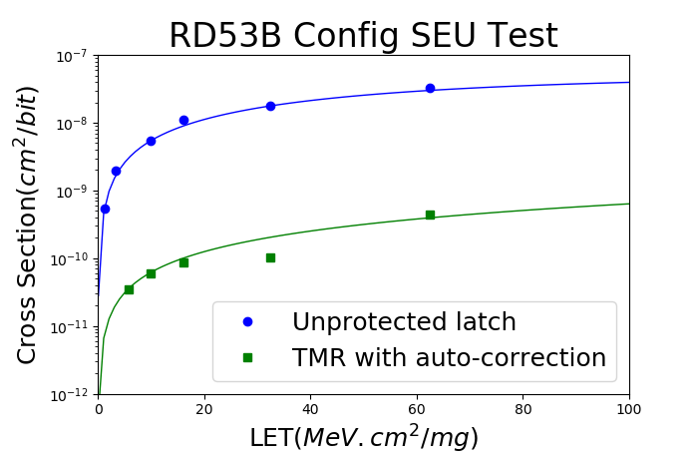
Global configuration test results
The RD53B chip contains 209 global registers : ~3 Kbit in total where a half is reserved only for tests
  TMR with correction
A high ion fluence required for this test, especially for the low LET
  More than 10⁷ p/cm² -> require an exposition time of 1 hour
  Only a few errors were observed for the low LET (5 errors for Aluminum)
  The measurement bar error is still high
TMR with correction
  Saturation cross section : σ_{SAT} = 9.0 × 10⁻¹⁰ cm²
  Threshold LET : LET_{th} < 1 MeV.cm²/mg
A ratio σ_{SL}/σ_{GR_TMR} of 100 is expected from the proton cross section calculation
A significant effect of self-correction was observed by testing the SEU effects with and without clock
 | Single latch cross section (cm²) | Global Register cross section (cm²)
calculation for 200 MeV proton based on heavy ion testing | 8.6 × 10⁻¹⁵ | 7.9 × 10⁻¹⁷
M. Huhtinen, F. Faccio : Computational method to estimate Single Event Upset rates in an accelerator environment

Slide 26
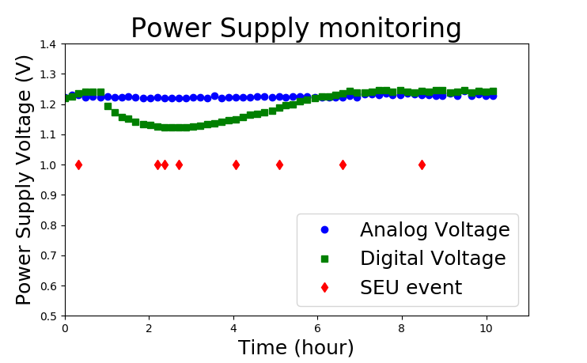
Global configuration results
Long duration global register run
  Duration : 10h30 , Total fluency : 7.2 × 10¹³ p/cm²
  SEU number : 8
Slow increase of V_{IND} from 1.7 V to 2 V
The internal V_{DDD} decrease limited to 8% (1.2 V to 1.1V)
The run Stopped because of a power supply issue
  Supply was placed inside the beam area
The TMR with correction show a gain of ~ 400 regarding the unprotected latch
Global Registers seem to be very tolerant to SEU
Results are compatible with what expected from heavy ion testing
 | Unprotected latch cross section (cm²) | Global Register cross section (cm²)
calculation for 200 MeV proton based on heavy ion testing | 8.6×10⁻¹⁵ | 7.9×10⁻¹⁷
Experimental value 480 MeV proton test | 1.5×10⁻¹⁴ | 3.6 ×10⁻¹⁷
Layer | Location | R (cm) | Z(cm) | SEE-Fluence (cm⁻²) Hadrons> 20 MeV | SEE-Flux (cm⁻².s⁻¹) Hadrons> 20 MeV | Pixel configuration Unprotected latch | Global Configuration Mean time between errors (per FE chip)
0 | L0 rings | 3.6 | 114 | 3.26 × 10¹⁶ | 1.0 × 10⁹ | 4.6 SEU/sec | 5 hours
2 | L2 rings | 15.6 | 286 | 2.66 × 10¹⁵ | 0.82 × 10⁸ | 0.38 SEU/sec | 58 hours
4 | Outer Endcap | 274.6 | 286 | 1.14 × 10¹⁵ | 0.35 × 10⁸ | 0.16 SEU/sec | 138 hours

Slide 27
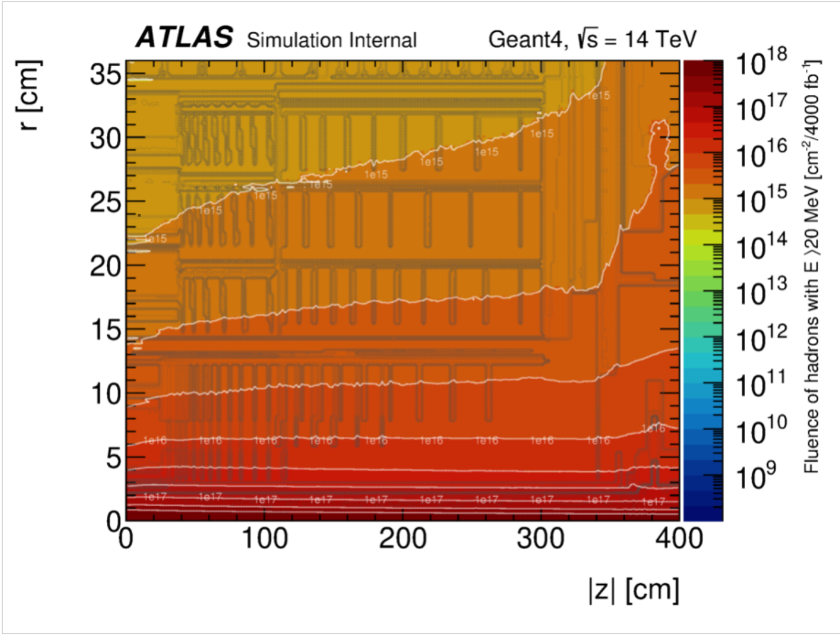
Fluence of Hadrons > 20 MeV (4000 fb-1)

Slide 28
Pixel Configuration

Slide 29
HL-LHC SEU rate estimation
SEE hadron flux of 10⁹ p/cm²/s assumed for the innermost layer of the pixel detector in the context of the HL-LHC
The TMR latch without correction implemented for pixel configuration
  The number of flip <10 (per FE chip) for the inner layer
    assume a re-configuration time interval of 50 sec
    it is obvious that FE chips on external layers need to be re-configured less frequently
The TMR cell with correction is 400 times more tolerant than the unprotected one
  Mean time between errors estimated to 5 hours for the inner layer (per FE chip)

Slide 30
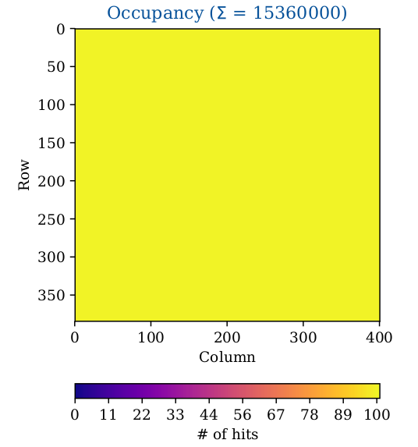
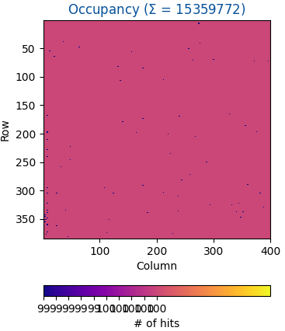
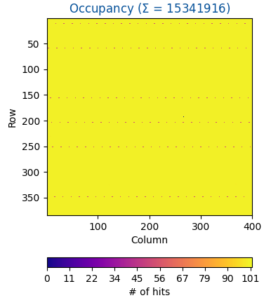
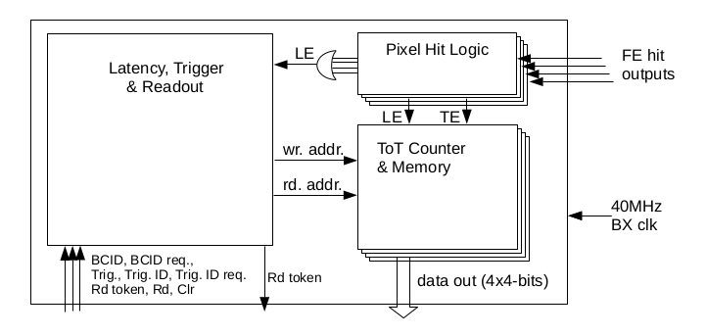
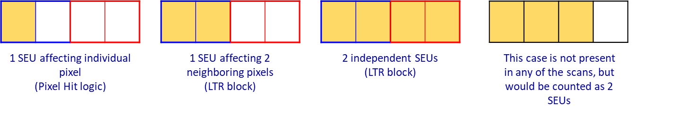
Digital scan
Standard procedure of digital scan:
  100 digital injections per pixel
For the digital scan test, Individual pixels can show bigger/lower amount of hits
This concern clusters of 4 pixels
  It is due to SEU in the digital part of the pixel
  This is explained by the digital architecture organized by regions of 4 pixels
  Fired pixels in the same cluster varies between 1 and 4
  SET or SEU on the common logic to these 4 pixels results as if 1,2,3 or 4 pixels were touched at the same time
No Beam
More/less hits are received (100 is injected)
Tests were done with:
  PLL mode : serializer and command clocks are provided by on-chip CDR
  Bypass mode : both clocks are provided externally
In PLL mode, synchronization issues with the BDAQ readout system have been identified
  Map where missing hits are not random
SEU tests campaign at GANIL facility carried out especially for the CDR/PLL block of the RD53B chip
(Injection and readout is always done separately in pixels border with blue and read)

Slide 31
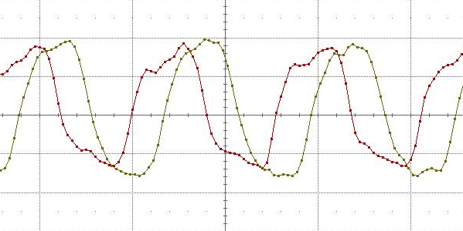
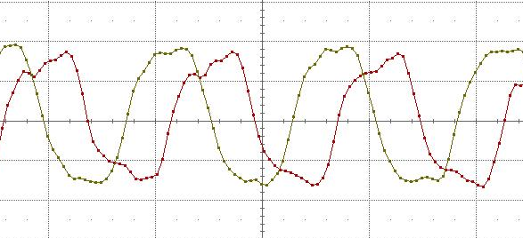
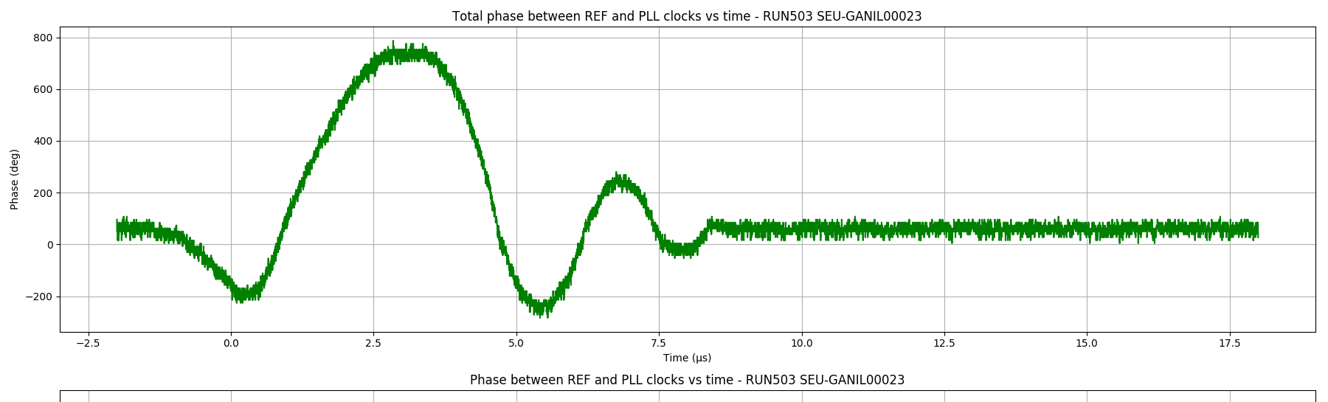
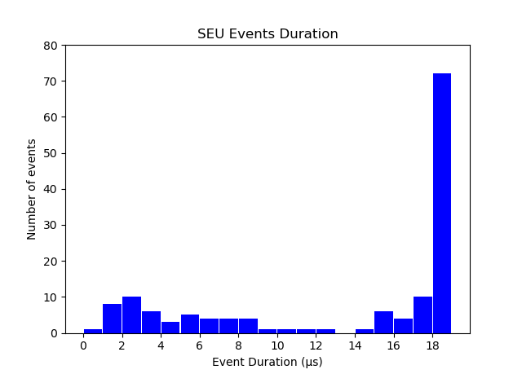
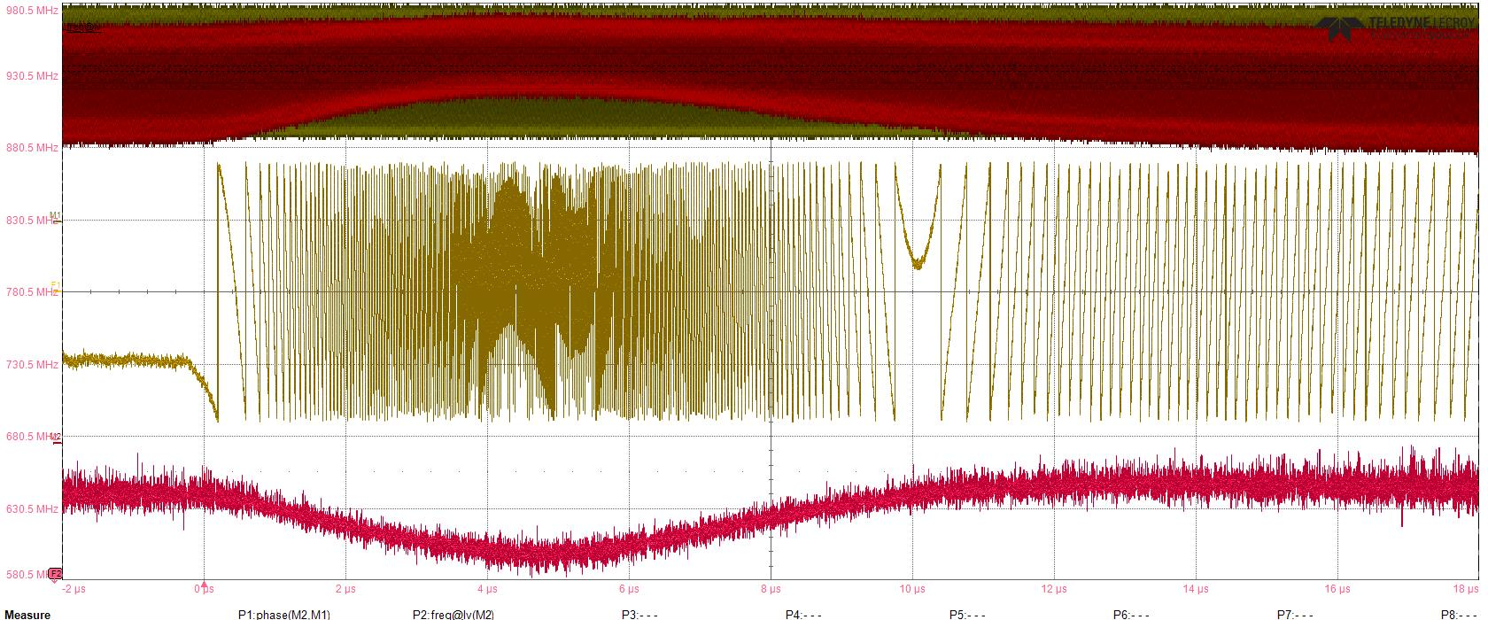
CDR testing at GANIL
640 MHz CDR clock
Tests done at GANIL with Xenon : LET = 30 MeV.cm²/mg
Scope trigger : CDR clock rising edge “moves” from the low level of the ref clock to the high level
Short event (<14µs)
  already observed during CDR prototype SEU testing
Long events (>14µs) showing a shift of phase and frequency
  Not observed when testing the CDR prototype
640 MHz reference clock
1 ns
Phase transient of CDR clock
Short event
Duration < 14 µs
Peak phase shift of 3.2 ns
1 ns
Cross section = 2.3 10⁻⁴ cm²/device
Equivalent to ~10⁴ unprotected DFF
Long event
Duration > 14 µs
0
5 µs
10 µs
15 µs
Long event
Duration > 14 µs
Short event
Duration < 14 µs
Phase

Slide 32
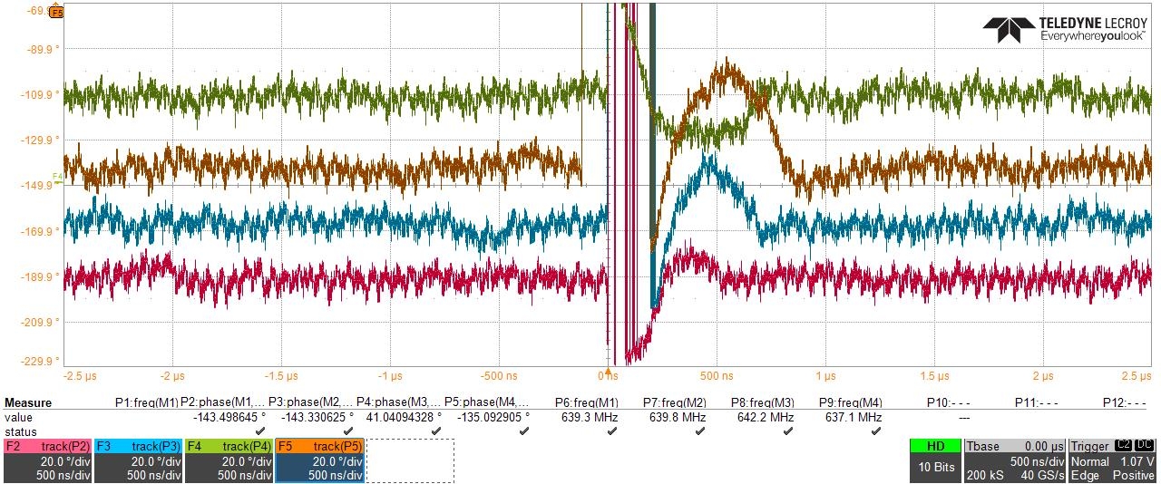
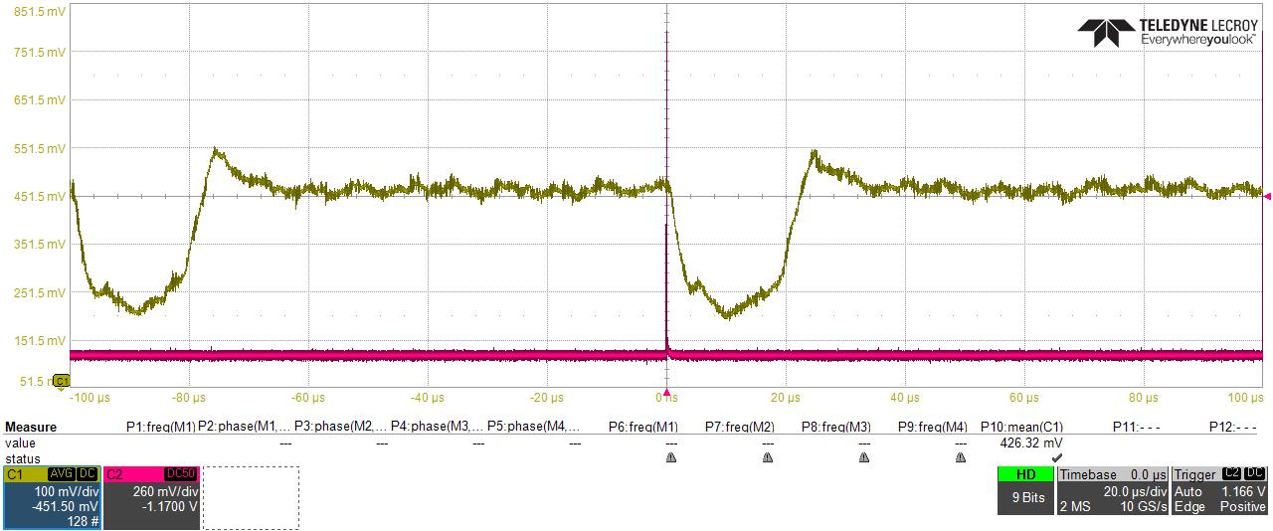
Laser SEU testing
CDR block
Bandgap
VCO
Laser energy: 1 nJ
Only short events were observed when shooting in the CDR or VCO blocks
Shooting green bordered area in VCO stages caused just small phase shifts of the serializer clock
Compatible with the group of short events seen in GANIL
Laser energy: 1 nJ
Shooting in core bandgap while monitoring VREF_A
Shooting some specific transistors showed sensitive behavior
VREF_A jumps in range of [20 us, 30 us]
Explains the long events observed in GANIL

Slide 33
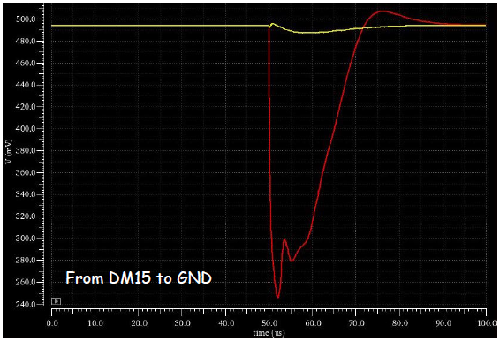
Laser SEU testing
Laser SEU tests confirmed the sensitivity of the bandgap core to the Single Event Transient (SET)
  Reproduces the long events (>20us) observed during heavy ions tests
  It allowed the identification of the devices responsible for this effect
Measurements well reproduced by simulations
Sensitive nodes were confirmed by simulations based on AFTU tool (Analog single event effects automatic analysis tool) from Sevilla
capacitance filters have been added for sensitive nodes to reduce the effect of SET
The modifications were added on the bandgap cells of the RD53-C chip
500 mV
Capacitance of 10pF
400 mV
Without filtering capacitance
300 mV
0
50 µs
100 µs

Slide 34
  Radiation Hardness

