Slide 1
CERN ECFA detector R&D roadmap implementation
Journées R&T IN2P3, IP2I 17-19 Oct. 2022
D. Contardo

Slide 2
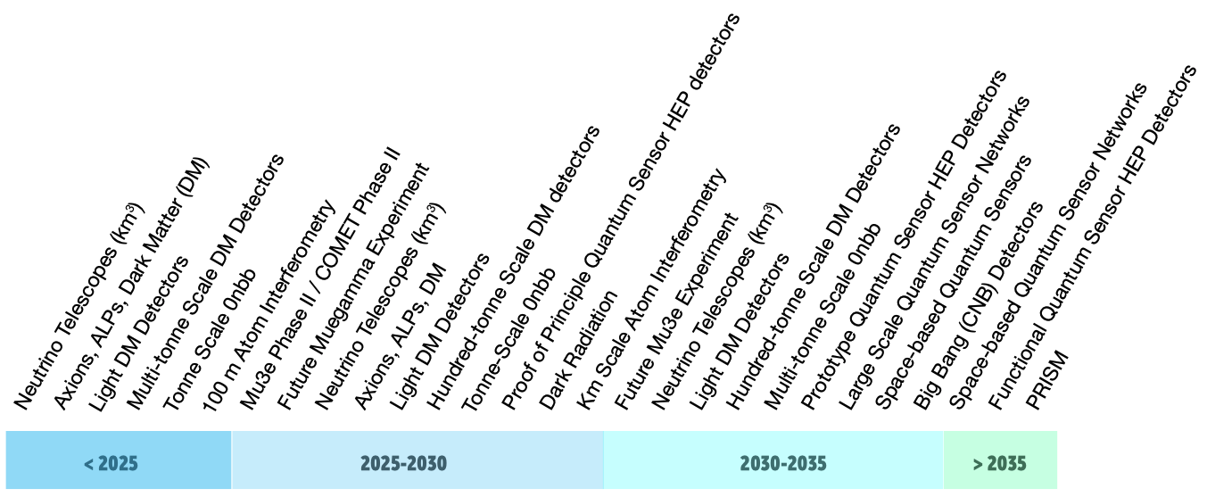
Following the recommendation of the European Particle Physics Strategy Update 2020 https://europeanstrategyupdate.web.cern.ch
CERN Council asked ECFA to prepare a Detector R&D roadmap* considering
Front view of the CMS detector barrel part
Timeline of future HEP experiments
Large accelerator and fixed target experiments
Small accelerators, nuclear reactors
and cosmic ray experiments
Test facilities, development infrastructures, networking structures
Overlaps with other fields (AstroParticle APPEC, Nuclear Physics NuPPEC…)
Industrial partnership
2
* Similar process for accelerators, see presentation of A. Lucotte

Slide 3
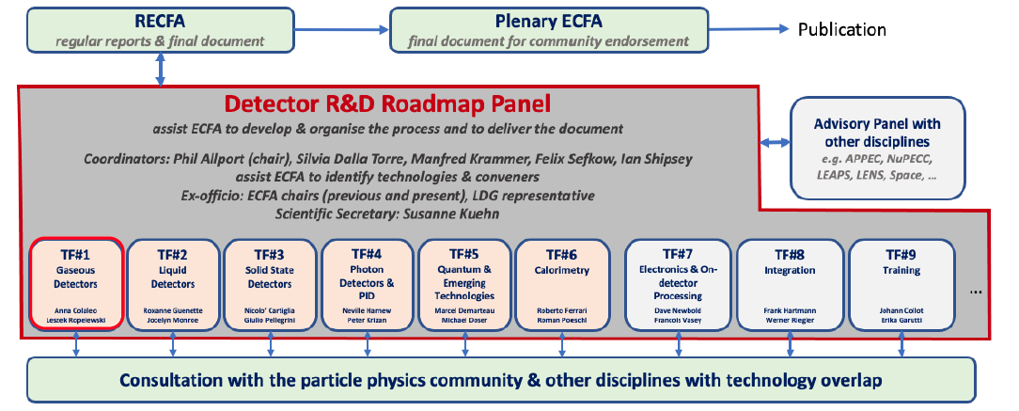
A panel organization was put in place for a wide consultation of the community
comprising 9 Task Forces, operating through questionnaires and symposia (S1-2021)
https://indico.cern.ch/event/957057/
Expert panel D. Contardo
also national contact
Co-convener
R. Poeschl
Expert panel
C. de la Taille
Co-convener
J. Collot
French contributions by actors in almost all TFs
3

Slide 4
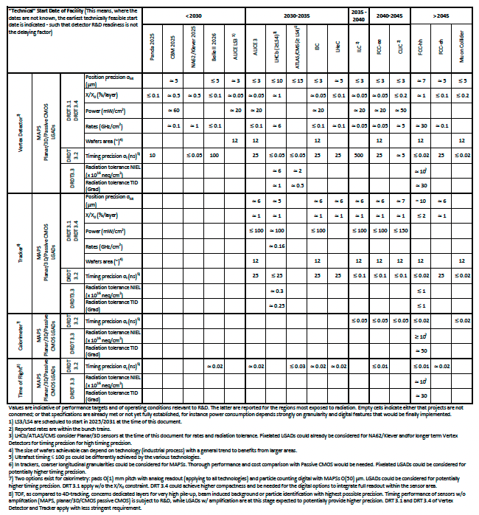
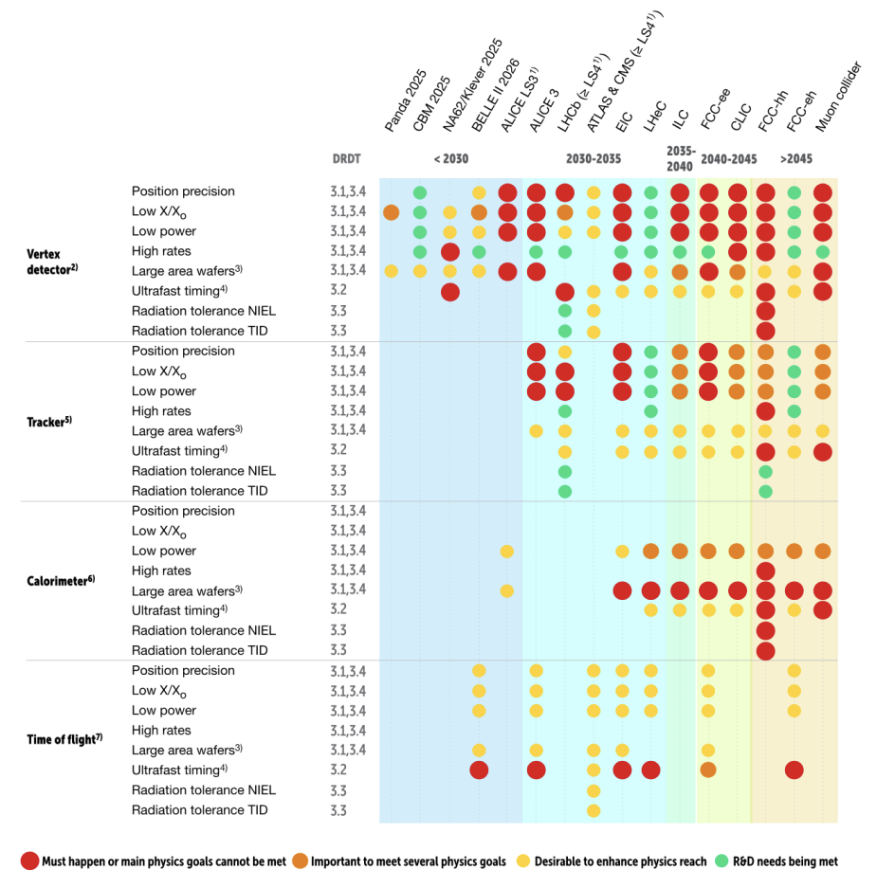
Roadmap was presented to CERN Council Dec. 2021 https://cds.cern.ch/record/2784893?ln=fr *
Great view of ongoing R&Ds, performance targets timeline and technology options
well structured and coherent presentation in all TF chapters
illustration based on TF3: Solid State Detector (case of accelerator experiment requirements)
Performance target as a function of experiment/time
Degree of needs/benefits to the physics program
Experiment requirements mostly set by state of the art ongoing R&Ds
(performance differently achieved so far by various technology options)
Systems and technology options
Systems
Attempt to set performance priorities/compromise
4
* Including also a synopsis for public usage

Slide 5
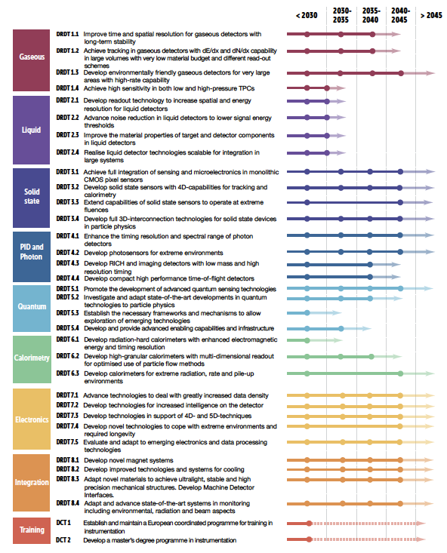
Roadmap was presented to CERN Council Dec. 2021 https://cds.cern.ch/record/2784893?ln=fr
2) Definition of Detector R&D Themes (DRDT) & recommendations
Front view of the CMS detector barrel part
Detector R&D Themes (DRDT) *
Establish high level areas of work for performance with stepping stone intermediate programs (dots) toward the longer-term programs (shaded regions for execution time)
10 recommendations to achieve the outlined goals (see back-up), among which:
Coordinating and organizing as a community
Establishing a long-term funding mechanism
Forming the basis toward implementation of the work
6 technology areas
3 transverse areas
* Description in https://cds.cern.ch/record/2784893?ln=fr
The roadmap doesn’t include an assessment of the efforts required to converge in time
5

Slide 6
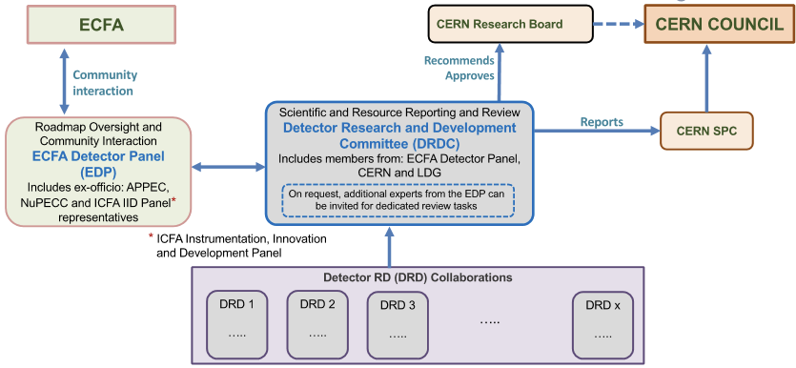
R&D implementation proposal approved by CERN Council Sep. 2022
https://indico.cern.ch/event/1172215/
Organize long-term strategic R&D effort in newly established DRD collaborations anchored at CERN
Engage Funding Agencies through MoUs and a dedicated Resources Review Board every two years
Strategic DRDs cover DRDTs to fulfil requirement of future given projects at a given time
there are boundaries upstream with “blue sky” R&D, and downstream with “experiment-specific R&D”
(usually more competitive & nationally organized for the first & within approved experiments for the second)
New review panel
yearly follow-up
Existing, hosted at DESY, vetting scope, R&D goals & milestones
https://ecfa-dp.desy.de/
5/6 technology areas*, transverse topics (electronics & integration) scope and structure to be considered in view of link to technology DRDT’s
* Case of “Quantum and Emerging Technologies” is under discussion
6

Slide 7
Overall process and timeline to form the DRD collaborations*
Through 2024 collection of Funding Agency MoU signatures, ramp-up in 2025 and steady state in 2026**
7
* Presentation of K. Jakobs at the SPSC on Sept. 27 (private communication), ** Considered as transition from HL-LHC Phase-2 production

Slide 8
Preparation of the new DRD proposals Q1-Q3 2023 is an important step
It will be again a community driven approach
Purpose is to define:
Initial “resource-loaded work plan” that can start in 2024
Expected DRDT medium-term achievements & milestones based on (current) community interests/resources
Cost scale estimates
Associated coordination/organization structure
The process will be supported by the existing ECFA Detector R&D roadmap panel (see slide 3)
With involvement of the management of the existing R&D collaborations** already covering DRDTs
ex. RD50, RD51, CALICE…
Likely the community will be asked to provide proposals matching the DRDTs and this will be followed with open meetings to build a coherent picture
* The CERN existing RD programs end in 2023 they will be replaced by/or integrated in the relevant technology DRD
8

Slide 9
Summary and way forward toward French contributions to the DRD proposals
New DRD collaborations should foster coherent and efficient efforts toward future HEP experiments
Inspired from successful CERN RD programs, offering:
A collaborative framework with world wide expertise, networking, training…
Opportunities to access technologies & facilities, to share work on common tools…
They will be raised to a status similar to that of experiments in the CERN organization model with:
Dedicated review process
Engagement of Funding Agencies & acknowledgment of their contributions
One important aim is to give the area greater visibility at National and European levels
to make the case for additional resources
The French interests need to be well incorporated in the DRD plans
We need to prepare inputs early next year (IN2P3 and CEA)
Based on ongoing activities & the medium-long term plans, considering resources available/needed
Some R&T projects discussed in this meeting could become “strategic” ?
Light coordination could ensure good consistency of inputs
ex. gathering the proposals by DRDTs of the different technology areas…
9

Slide 10
Back-up
10

Slide 11
ECFA Detector R&D roadmap recommendations
11

Slide 12
ECFA Detector R&D roadmap recommendations
11

Slide 13
ECFA Detector R&D roadmap recommendations
11

Slide 14
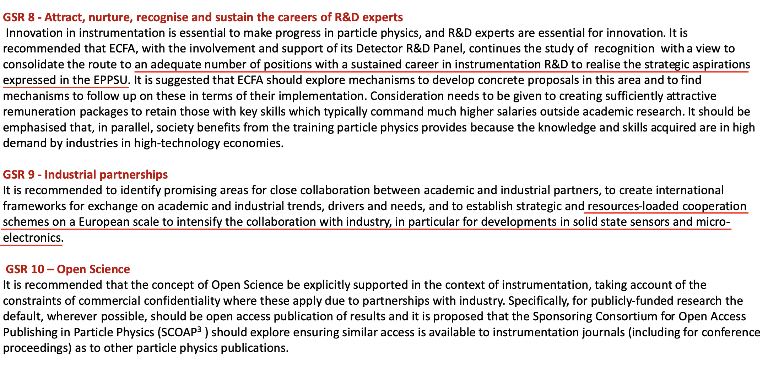
ECFA Detector R&D roadmap recommendations
11

Slide 15
ECFA Detector R&D roadmap recommendations
11

Slide 16
Plans for training (TF9)
* Presentation of K. Jacobs at the SPSC on Sept. 27 (private communication)
12

Slide 17
Links to relevant documents
https://indico.cern.ch/event/957057/page/21633-mandate (Panel Mandate document) https://indico.cern.ch/event/957057/page/21653-relevant-documents https://home.cern/resources/brochure/cern/european-strategy-particle-physics
https://arxiv.org/abs/1910.11775 (EPPSU Briefing Book)
https://science.osti.gov/media/hep/pdf/Reports/2020/DOE_Basic_Research_Needs_Study_on_High_Energy_Physics.pdf
https://ep-dep.web.cern.ch/rd-experimental-technologies (CERN EP R&D)
https://aidainnova.web.cern.ch (linking research infrastructures in detector development and testing)
https://attract-eu.com/ (ATTRACT: linking to industry on detection and imaging technologies)
https://ecfa-dp.desy.de/public_documents/ (Some useful documents from the ECFA Detector Panel)
12

