Slide 1
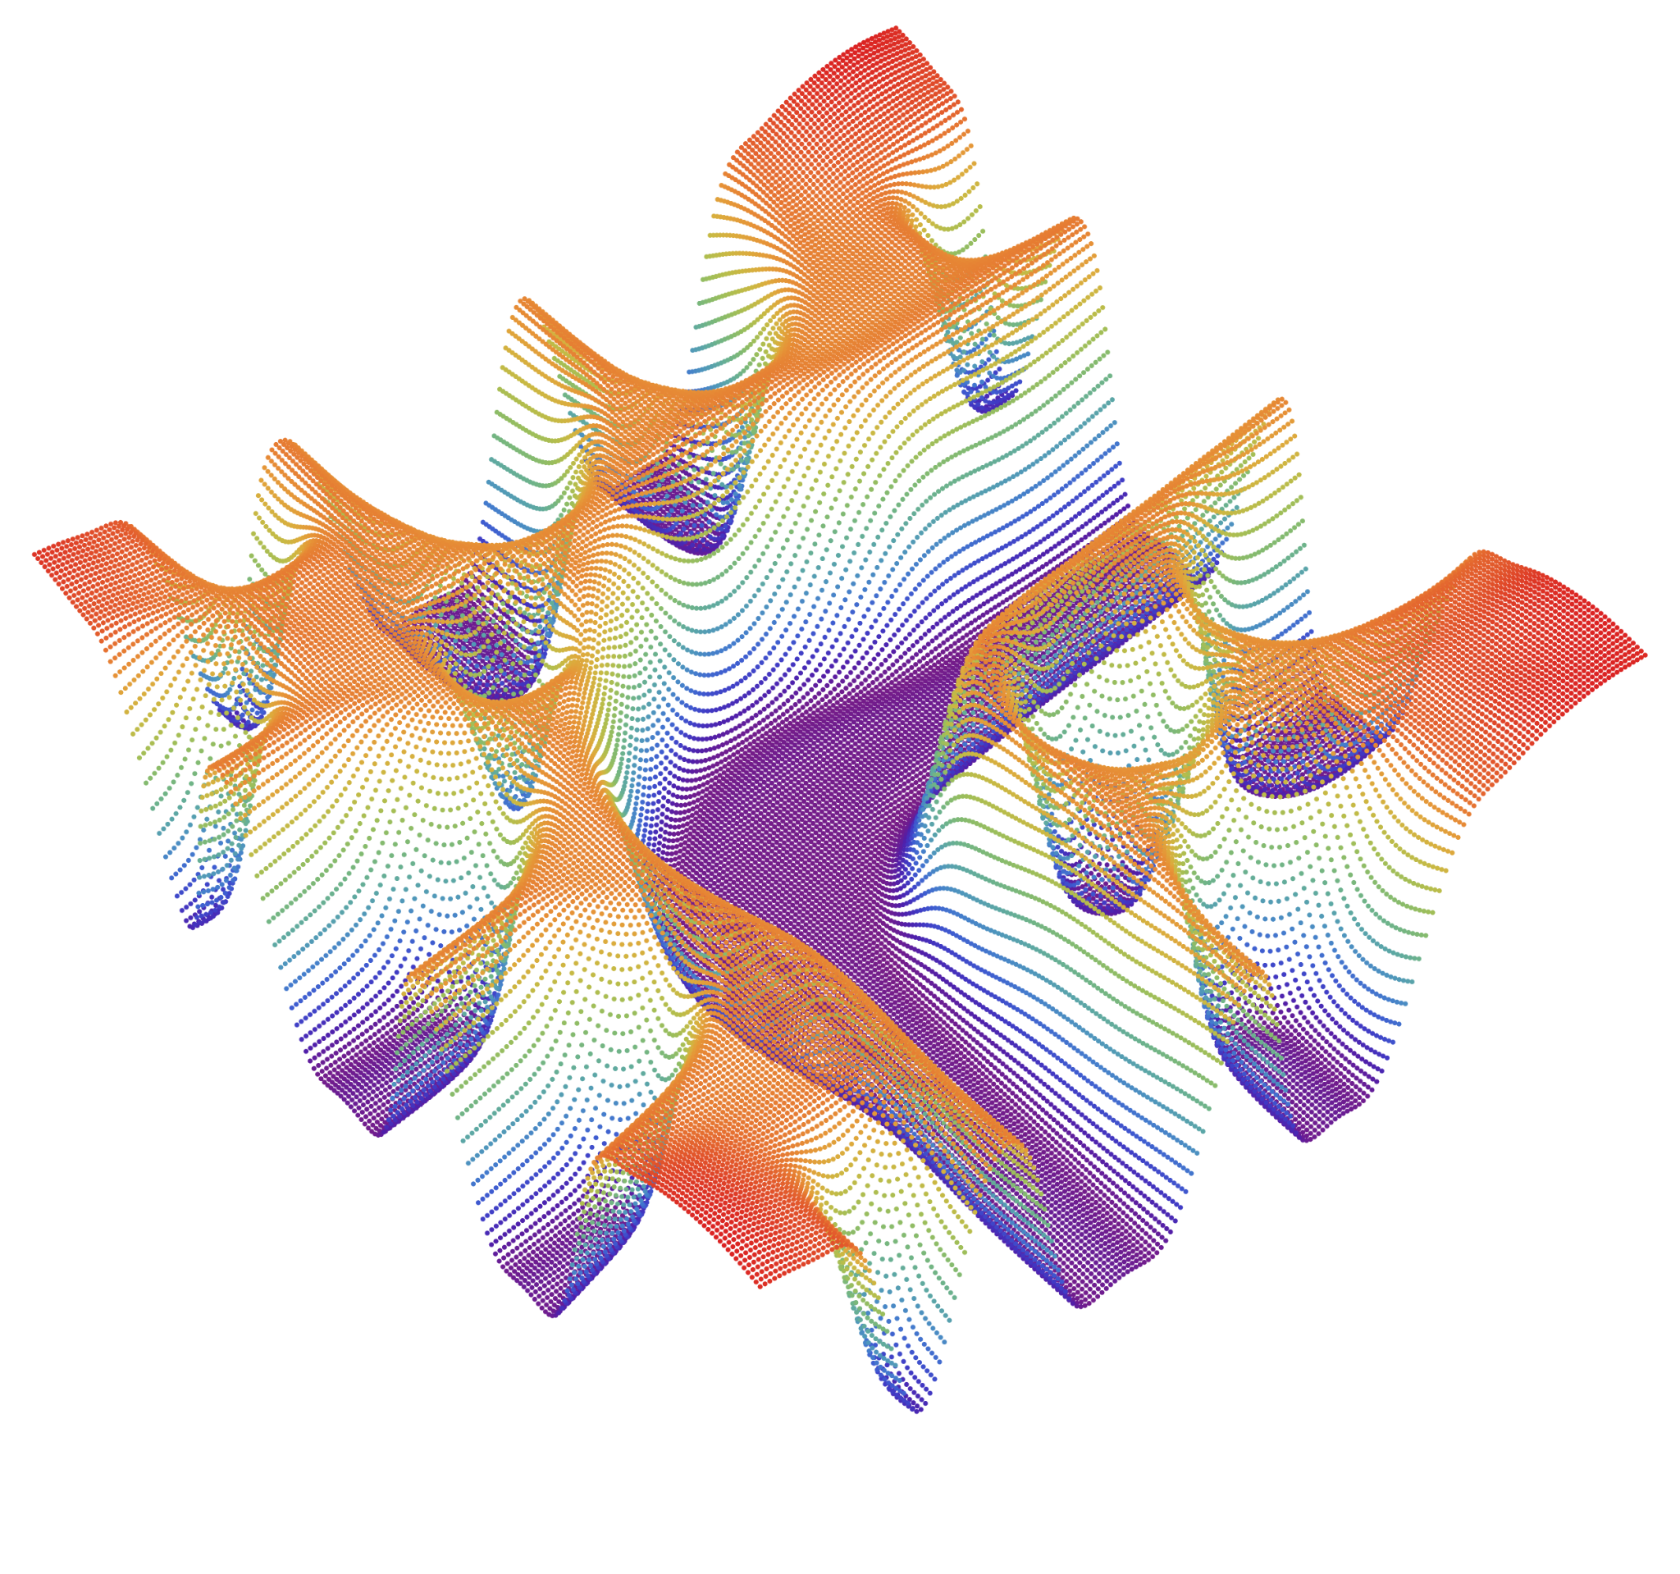
Spinodal Gravitational Waves
Mikel Sanchez Garitaonandia

Slide 2
Yago Bea
(UB)
Jorge Casalderrey
(UB)
Thanasis Giannakopoulos
(IST Lisbon)
Aron Jansen
(eScience)
Sven Krippendorf
(LMU)
David Mateos
(UB)
Alex Serantes
(UB)
Miguel Zilhão
(Aveiro U)

Slide 3
Motivation
LISA will open the door to a range of unexplored frequencies
GW from several sources are expected
Need an understanding of all possible sources
1st order Phase Transitions are assumed to proceed via bubble nucleation and collisions
Possible alternative mechanism for GW production in 1st order Phase Transitions?

Slide 4
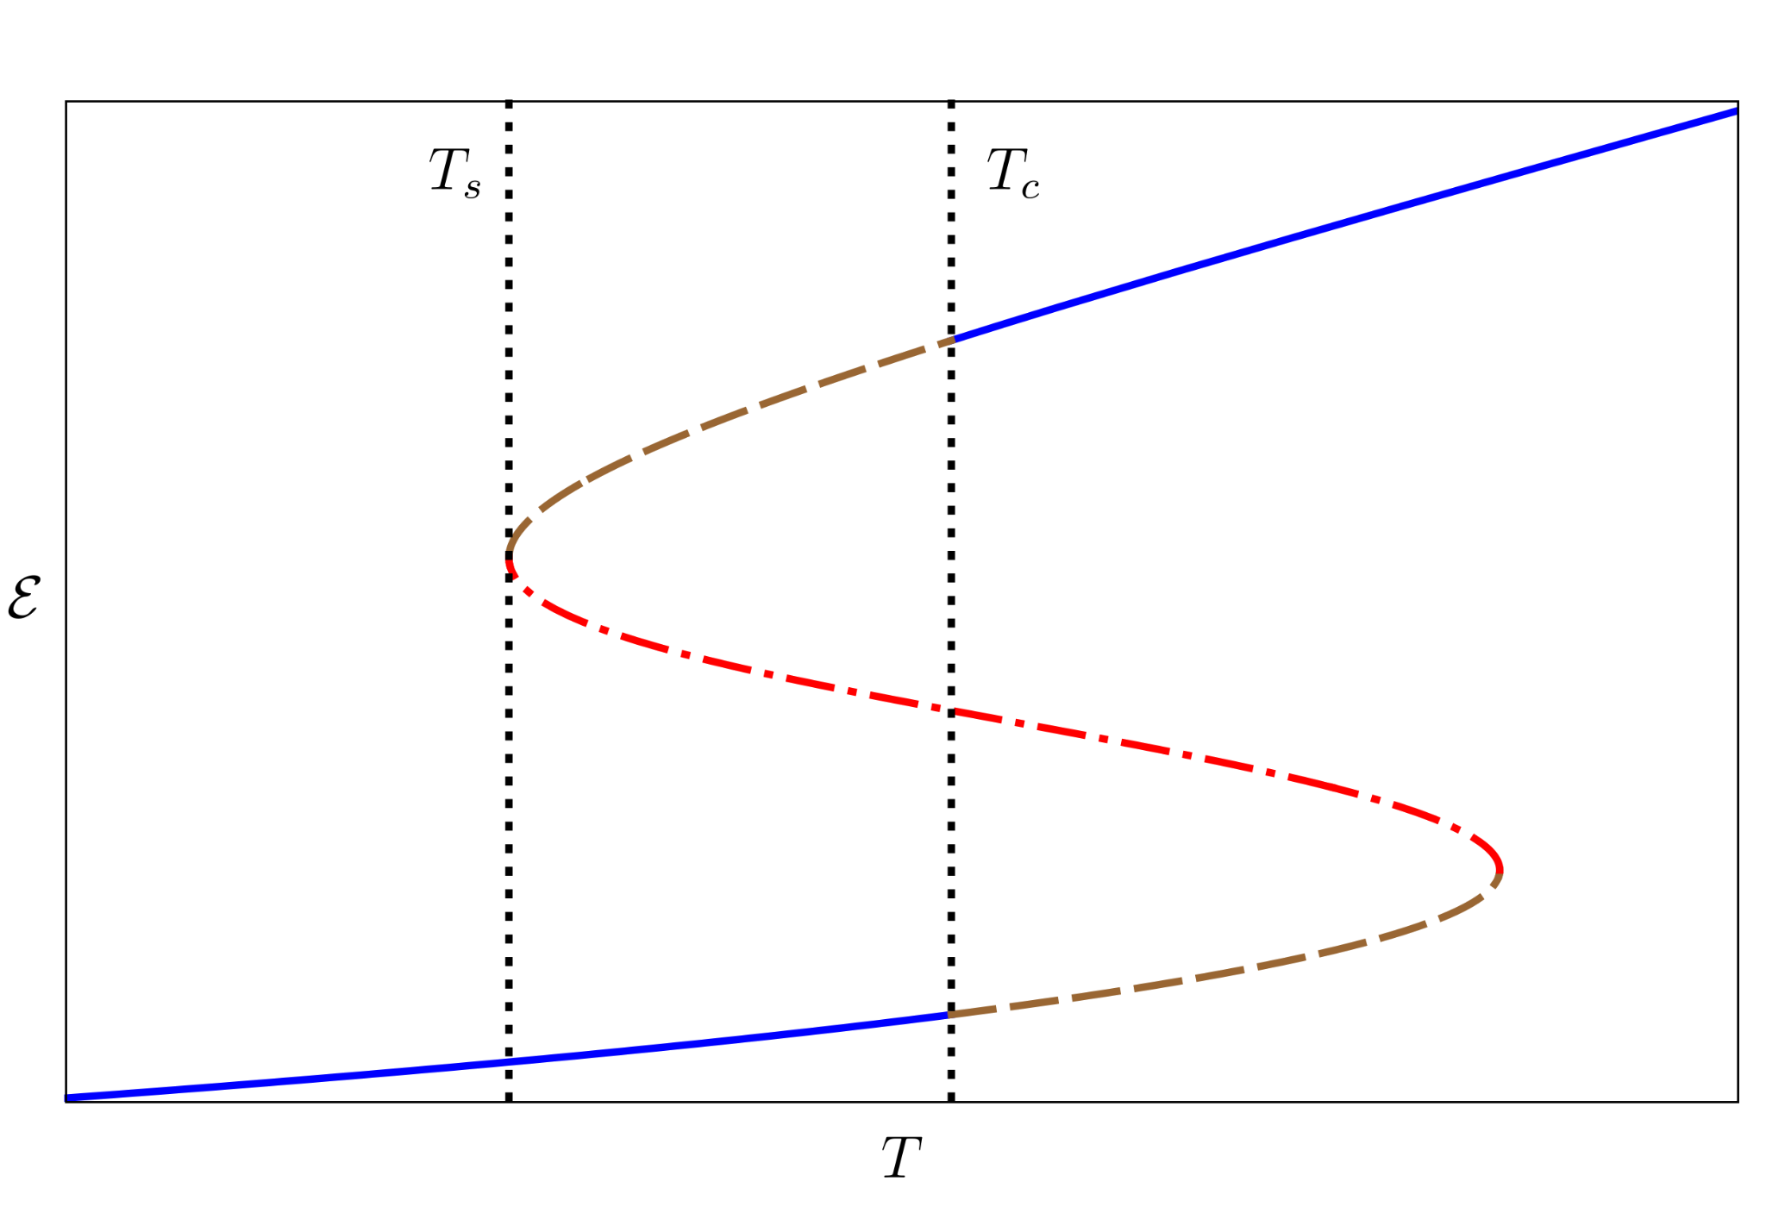
Evading Bubbles
When nucleation rate ~ H bubble nucleation has to start being considered
If too close to T_{S}, not enough time to undergo the transition
The case if nucleation is largely suppressed
Examples:
Large-N theories P ~ exp(-S_{E}) ~ exp(-N²)
Dark sectors with T < T_{rad}
Metastable
Favored
Unstable
Favored
Metastable

Slide 5
New Dynamics
The universe would enter the spinodal branch
States suffer from a instability where perturbations grow exponentially fast
System will be driven away from equilibrium – GW emission
How does the spectrum look like? Could it be distinguished from the bubble collision one?
Metastable
Favored
Unstable
Favored
Metastable

Slide 6
Holography
Duality between large-N strongly coupled QFT and Classical Gravity
Out-of-equilibrium problems are reduced to time evolving Einstein’s Equations
Powerful for strongly coupled and/or out-of-equilibrium problems
We consider a simple model that exhibits a 1st order thermal phase transition

Slide 7
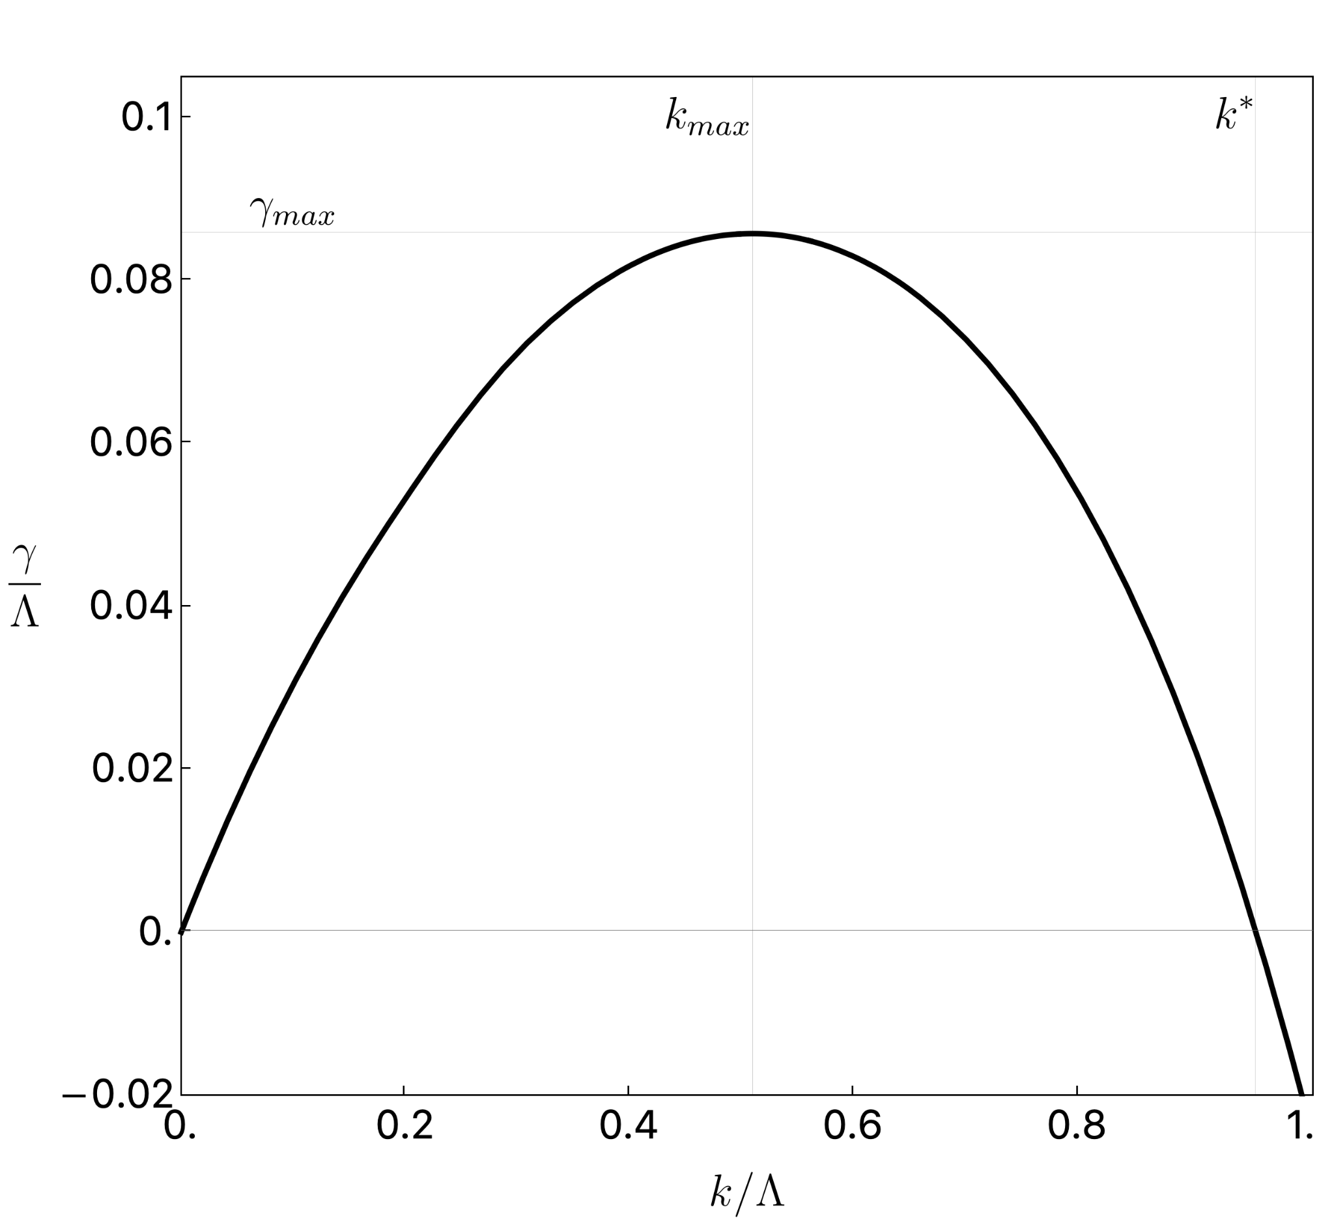
Linear Regime
Perturbations grow exponentially
When they become large linear regime is exited
By the end of the linear regime 𝛾_{max} modes dominate
Analytical results by performing saddle point approximations
From this moment on a full non-linear analysis is required

Slide 8
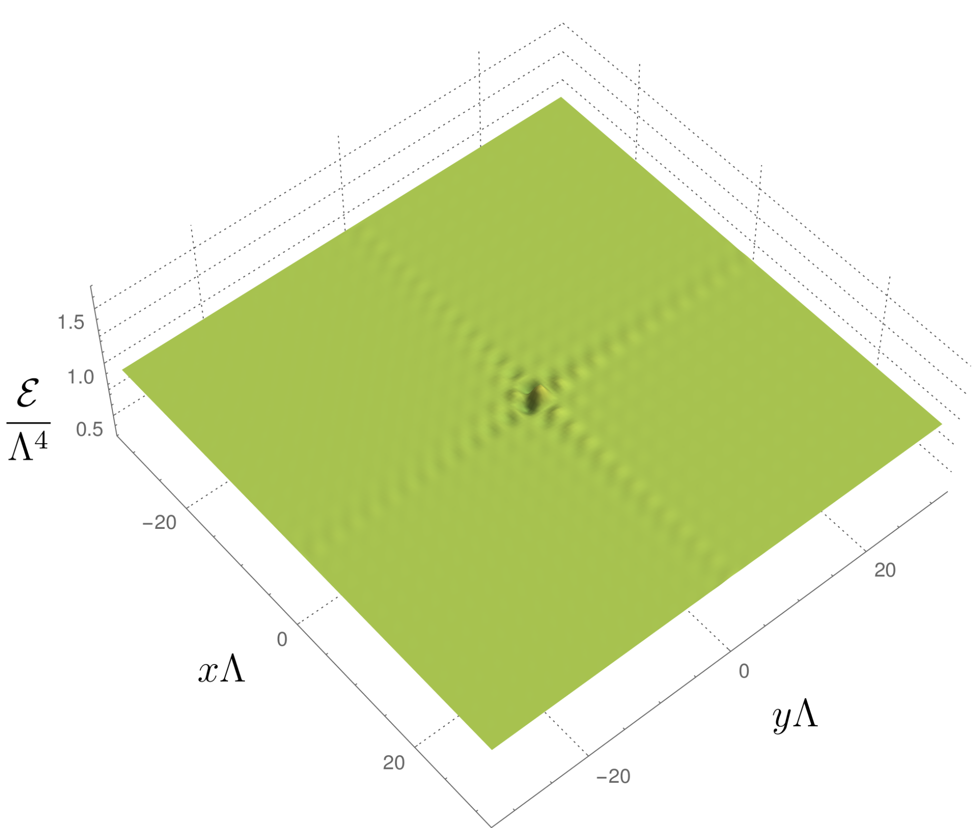
Metastable
Favored
Unstable
Favored
Metastable

Slide 9
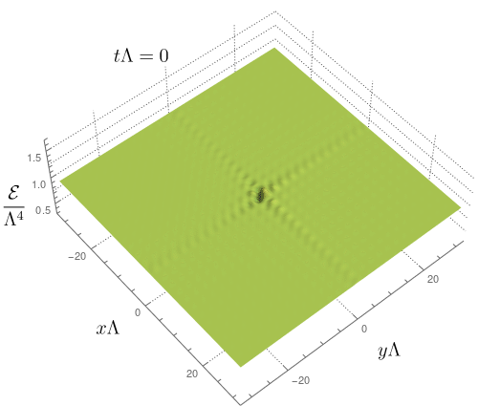

Slide 10
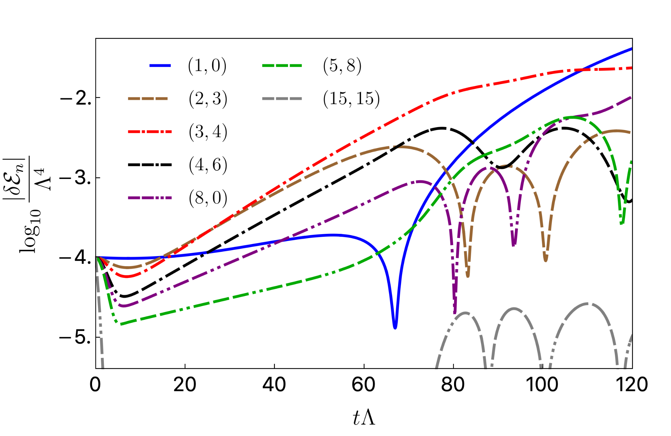

Slide 11
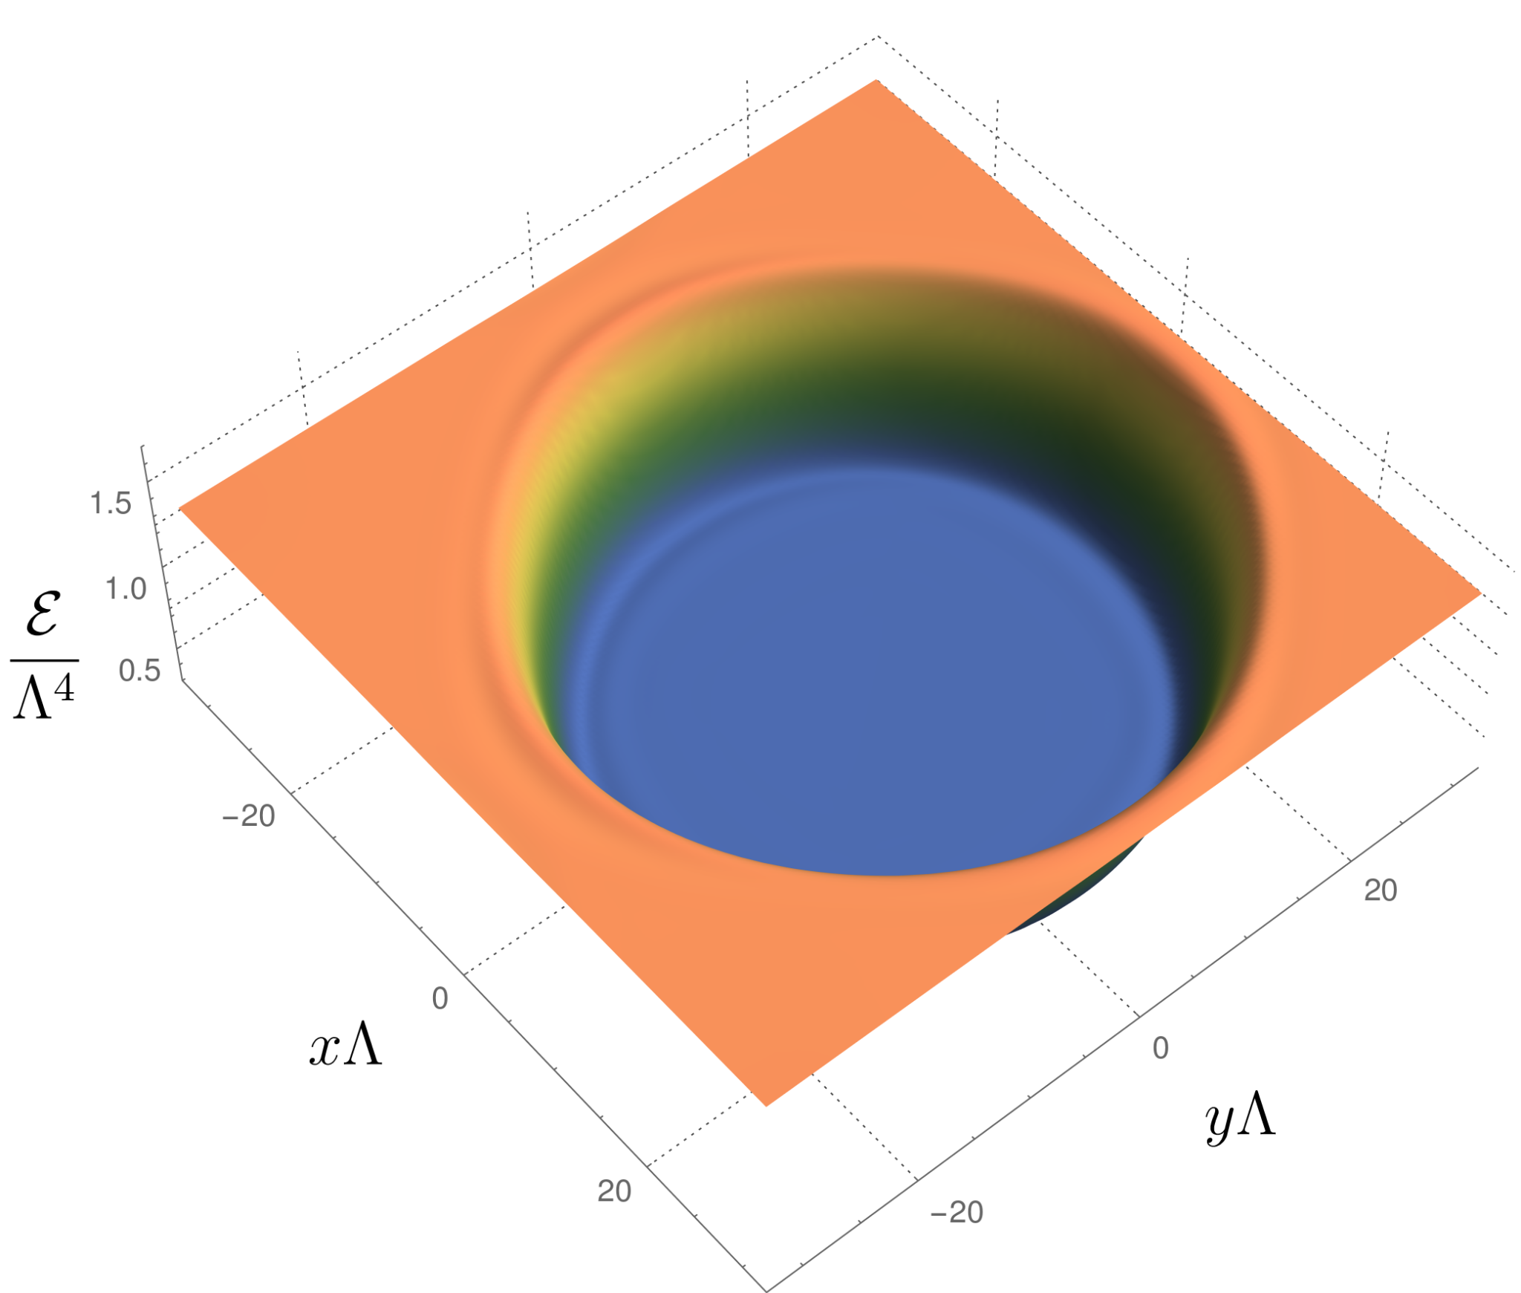
End State: Phase Separation

Slide 12
GW Emission
Holography provides us with the microscopic boundary stress tensor as a function of time
During the linear regime we can understand the emission analytically
In the non-linear regime a numerical analysis is required

Slide 13
Linear Regime
Interaction of pairs of unstable modes radiate
𝛾_{GW} = 𝛾₁ + 𝛾₂ and k_{GW} = k₁ + k₂
Dominating modes from 𝛾₁ = 𝛾₂ = 𝛾_{max}
This is possible for 0 < k_{GW} < 2k_{max} and ⍴_{GW} ~ ḣ² ~ exp(4𝛾_{max}t)
For k_{GW} > 2k_{max} subdominant modes have to be combined
“Flat” spectrum for 0 < k_{GW} < 2k_{max} and exponential suppression for k_{GW} > 2k_{max}

Slide 14
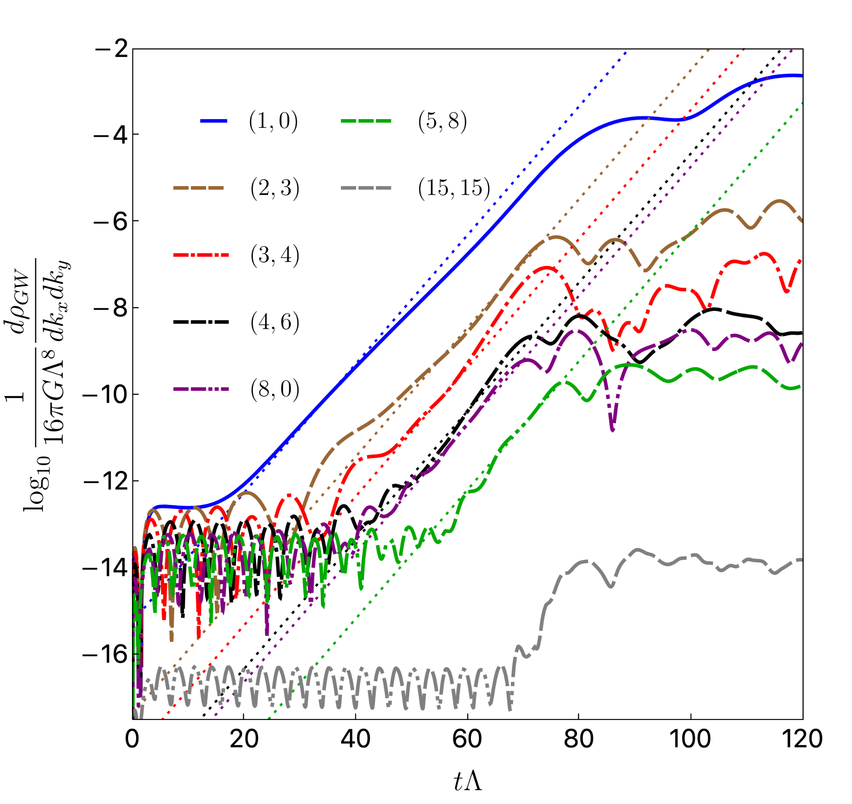

Slide 15
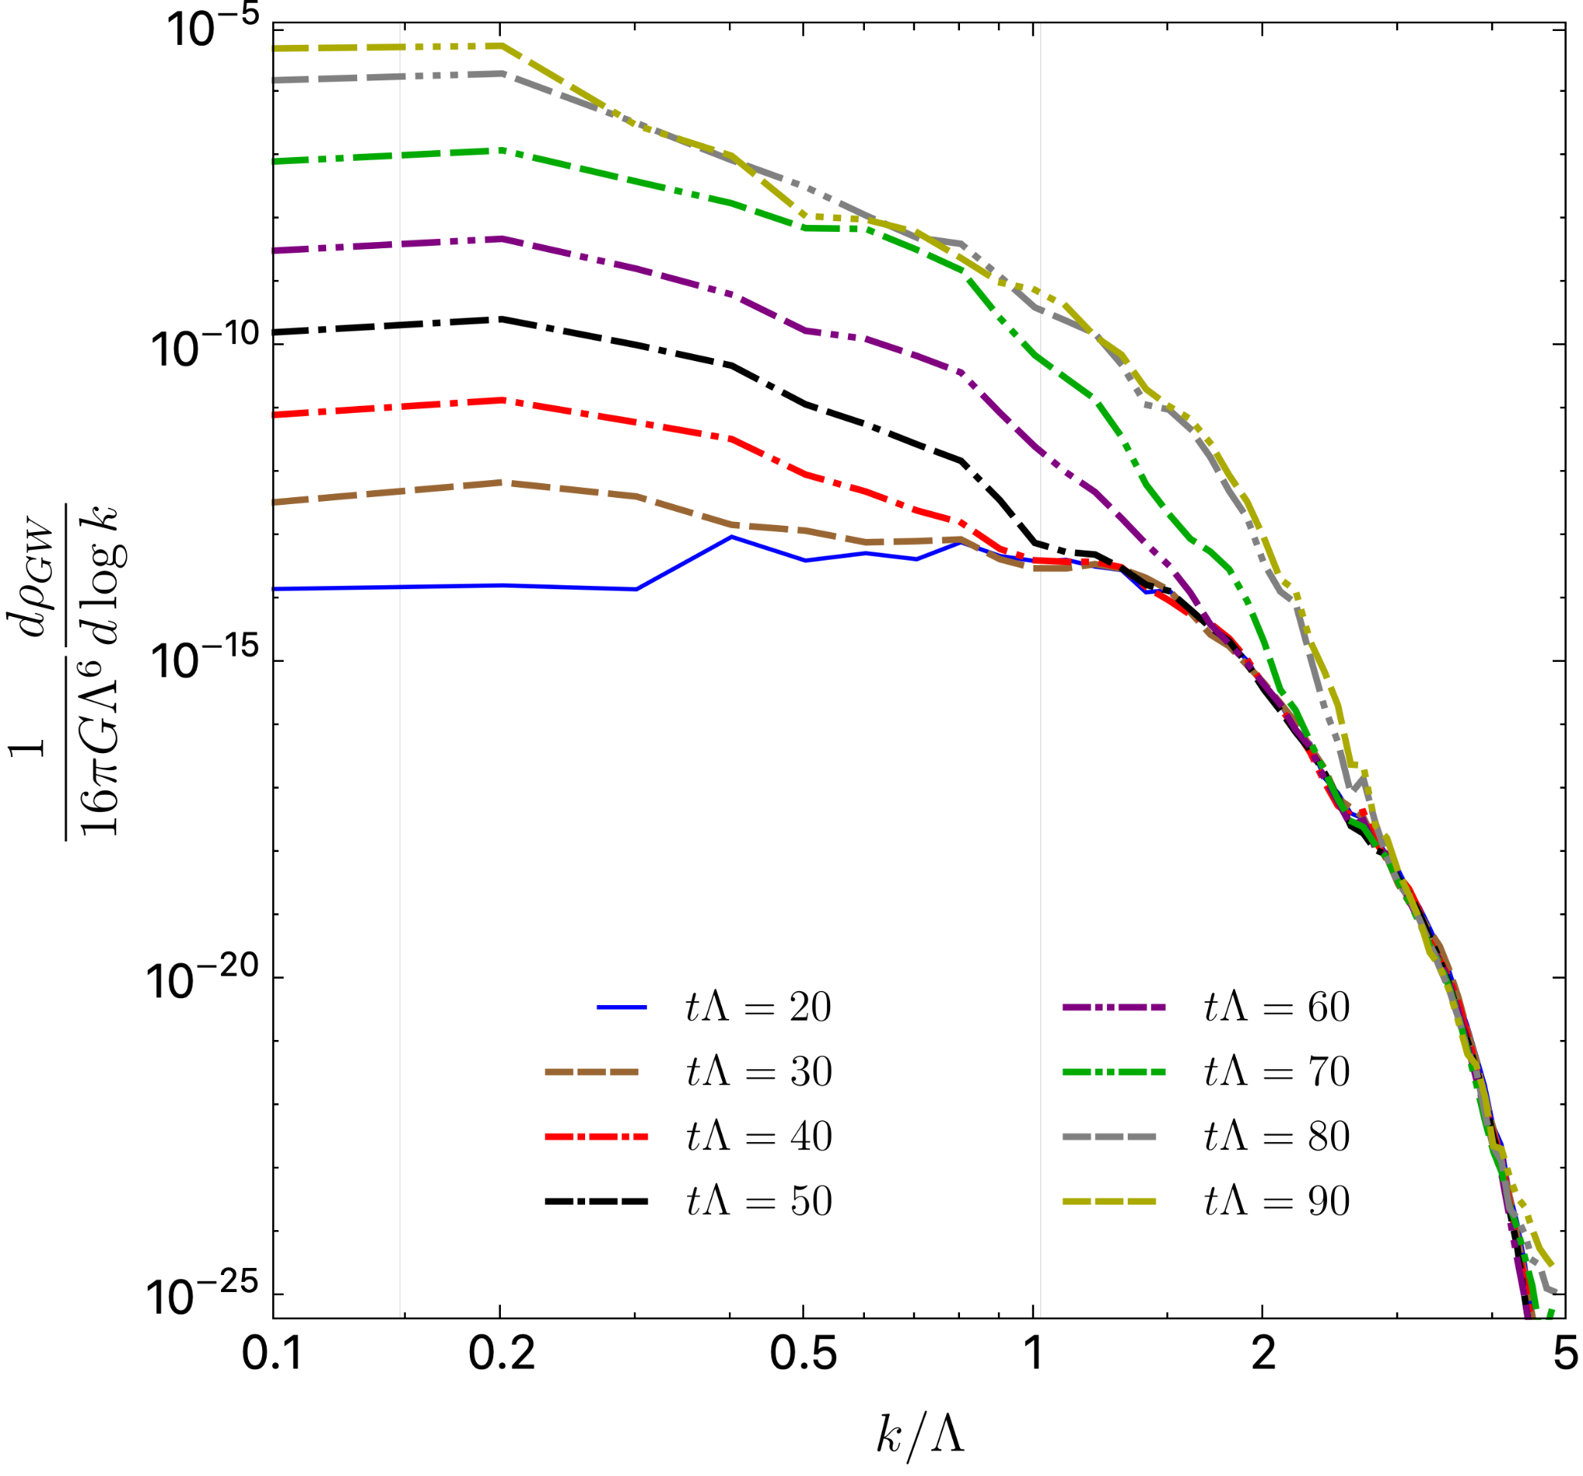
2k_{max}

Slide 16
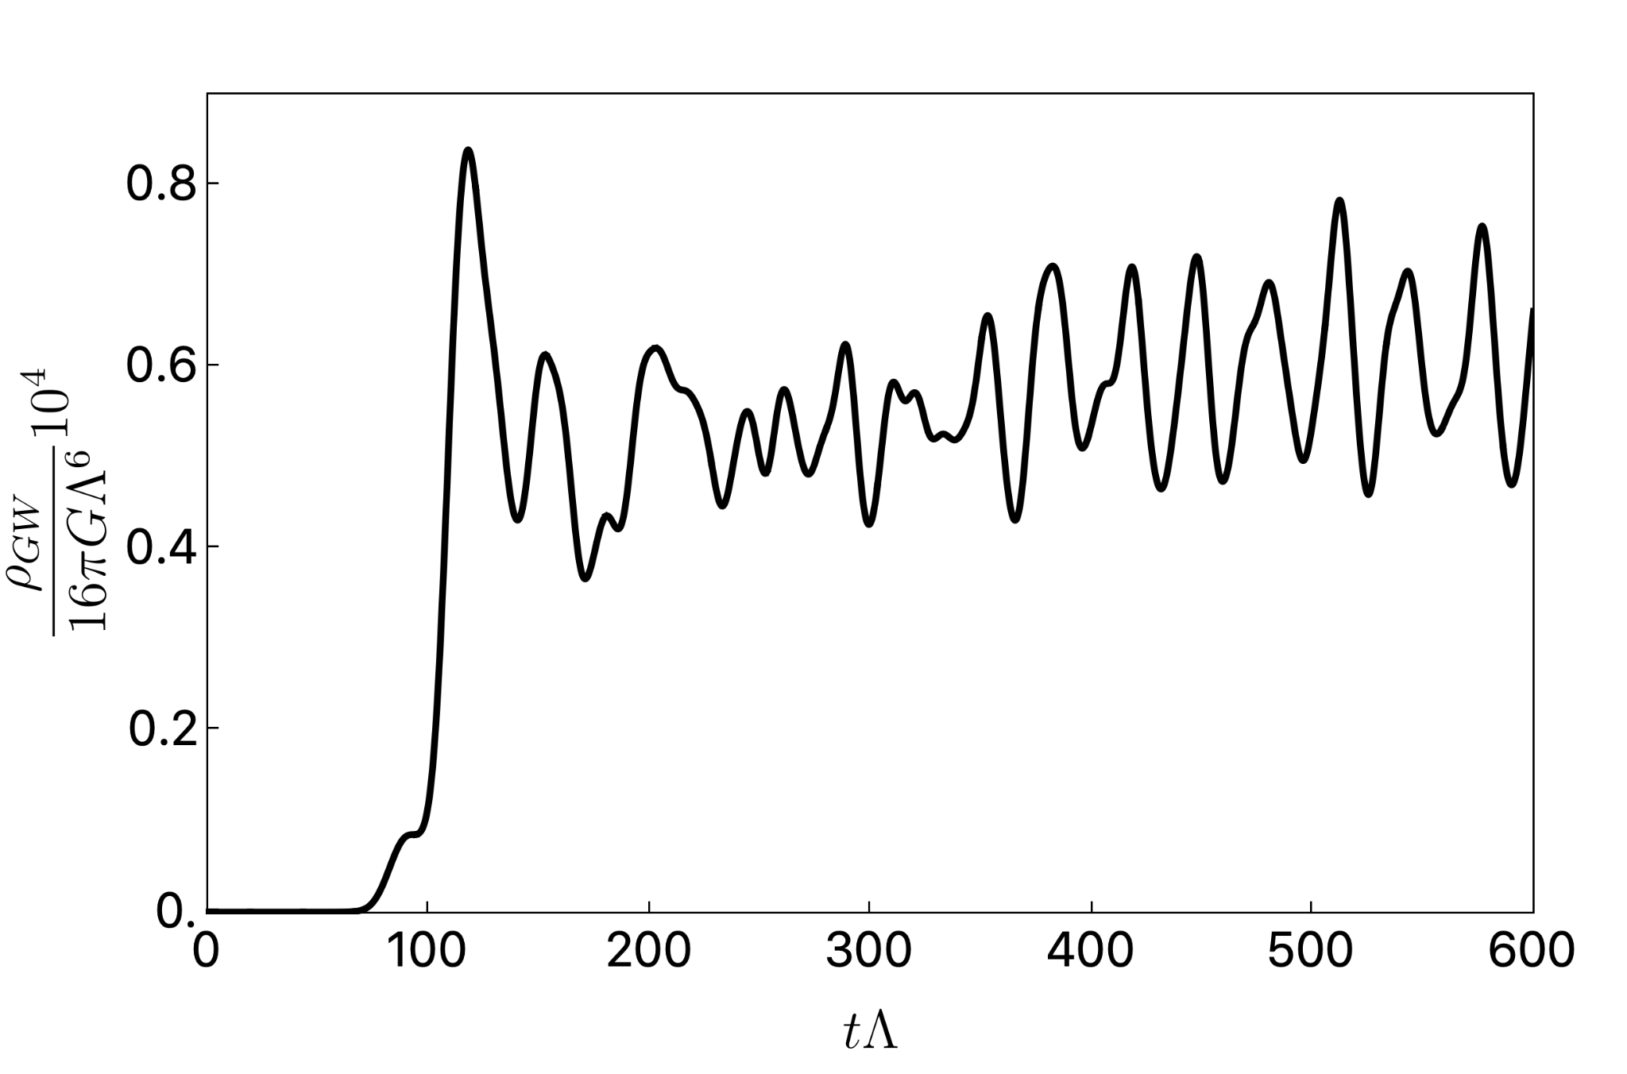
Linear
Non-linear

Slide 17
Cosmological scale physics
The end state of our simulation is not the end of the story
Our system had L ~ 1⁄T_{C} << 1⁄H (for T_{C} << M_{P})
A whole Hubble patch is now filled with plenty of phase domains that will merge
Slow dynamics of huge mass over very long times – largely contribute to GW?
Presumably the expansion of the universe can no longer be neglected

Slide 18
Cosmological scale physics
Possible scaling laws from our simulations?
Slow mergers of phase domains are well captured by linear physics Bea, Casalderrey-Solana, Giannakopoulos, Mateos, MSG, Zilhao 21’
Study oscillations of perturbed spherical domains on an expanding background
Work to be done to understand the GW spectrum!
Estimate signal frequency and strength as a function of T_{c} – what falls in LISA window?

Slide 19
Spinodal Instability is an alternative mechanism for GW production…
Is it an alternative mechanism for Baryogenesis?

Slide 20
Thank you!

