Slide 1
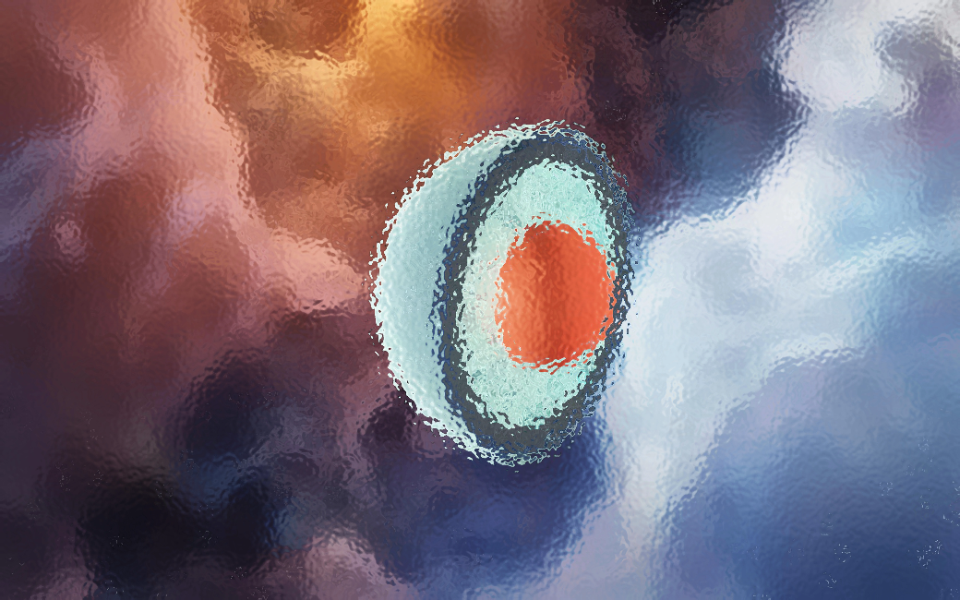
From Hard Thermal Loops to neutron-star cores: recent advances in the study of dense QCD matter Aleksi Vuorinen University of Helsinki & Helsinki Institute of Physics
Perturbative QCD at high density:
1) Gorda, Kurkela, Paatelainen, Säppi, AV, PRL 127 (2021), 2103.05658
2) Gorda, Kurkela, Österman, Paatelainen, Säppi, Schicho, Seppänen, AV, 2204.11893
Neutron-star applications:
3) Annala, Gorda, Kurkela, Nättilä, AV, Nature Phys. (2020), 1903.09121
4) Annala, Gorda, Katerini, Kurkela, Nättilä, Paschalidis, AV, PRX 12 (2022), 2105.05132
+ Ongoing work with AGKN & Hebeler, Hirvonen, Komoltsev, Schwenk
Strong and Electroweak Matter
Sorbonne University, 23 June 2022

Slide 2
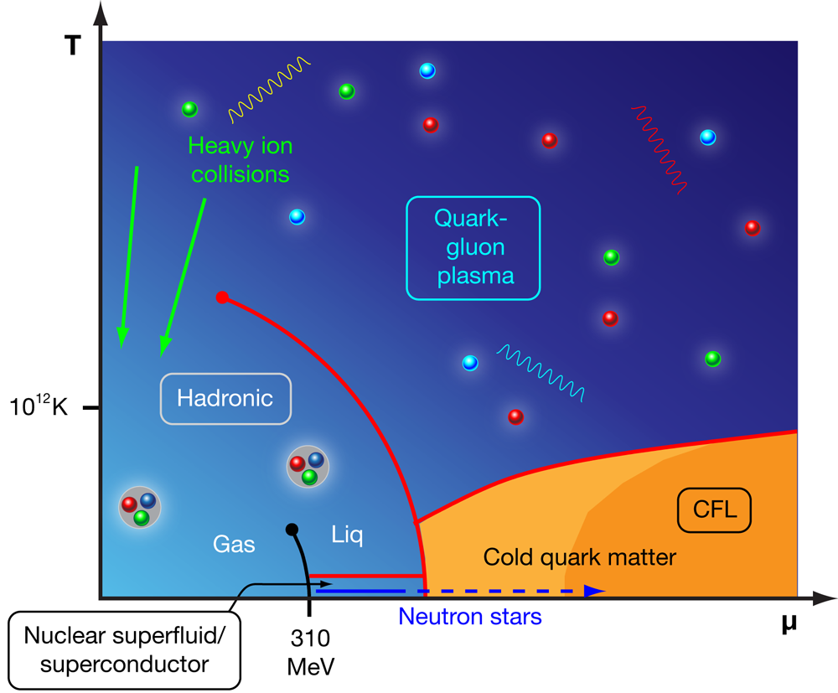
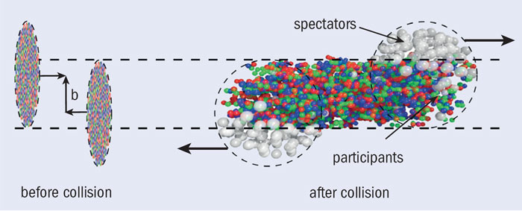
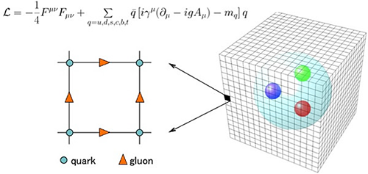
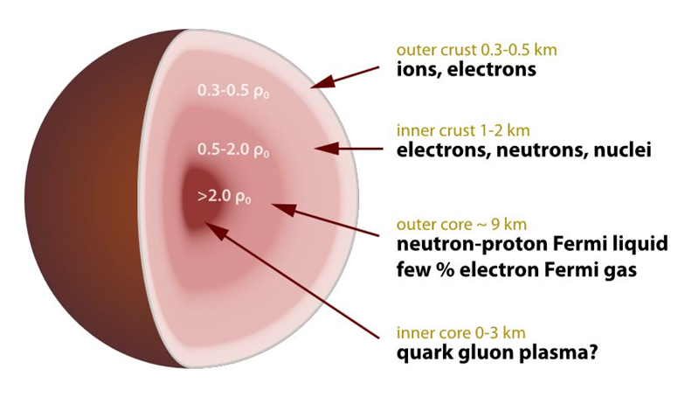
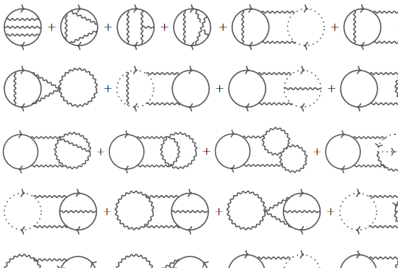
Fundamental prediction from the structure of QCD: Due to asymptotic freedom, at high enough energy densities one enters the deconfined phase, with quarks and gluons as the degrees of freedom
?

Slide 3
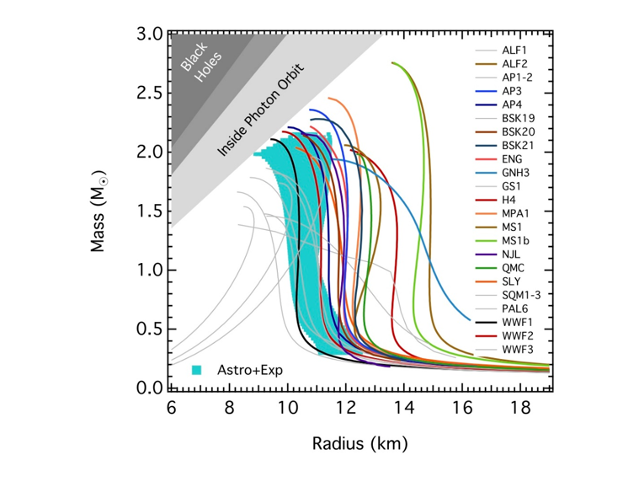
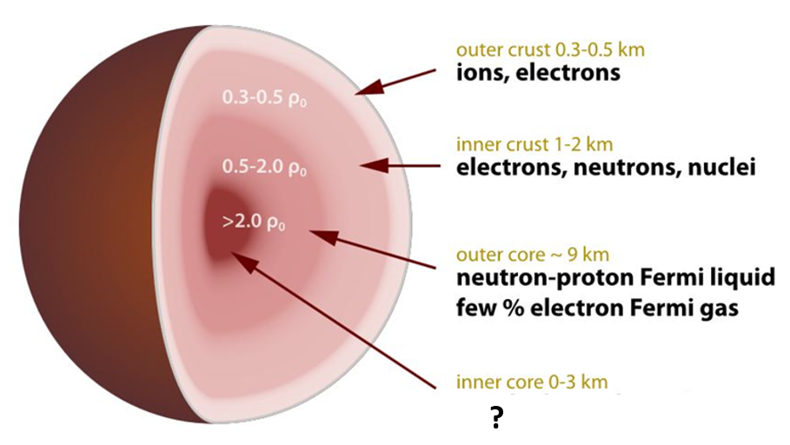
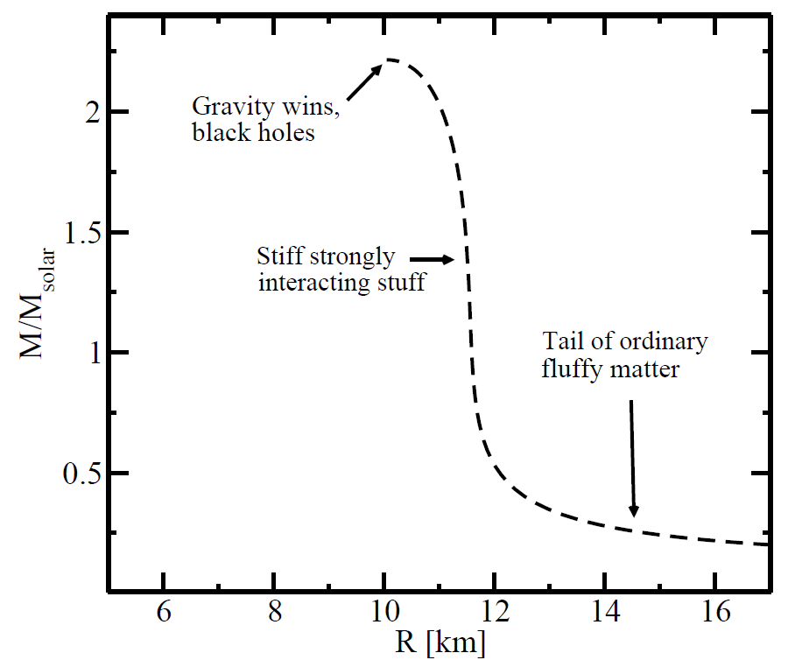
Dense QCD challenge: can we understand the composition and macroscopic properties of NSs using only first-principles field theory tools and robust observational data?
Link between micro and macro from GR and Equation of State (EoS):
[Ozel et al., ApJ 820 (2016)]

Slide 4
Clear need for systematic and model-independent approach to the microphysics of neutron stars, with EoS playing a special role

Slide 5
NS matter: from dilute crust to ultradense core

Slide 6
Proceeding inwards from the crust:
$μ_{B}$ increases gradually, starting from $μ_{Fe}$
Baryon/mass density increase beyond saturation density $≈0.16/{fm}^{3}$
Composition changes from ions to nuclei to neutron liquid and beyond
Good approximations: $T≈0≈n_{Q}$

Slide 7
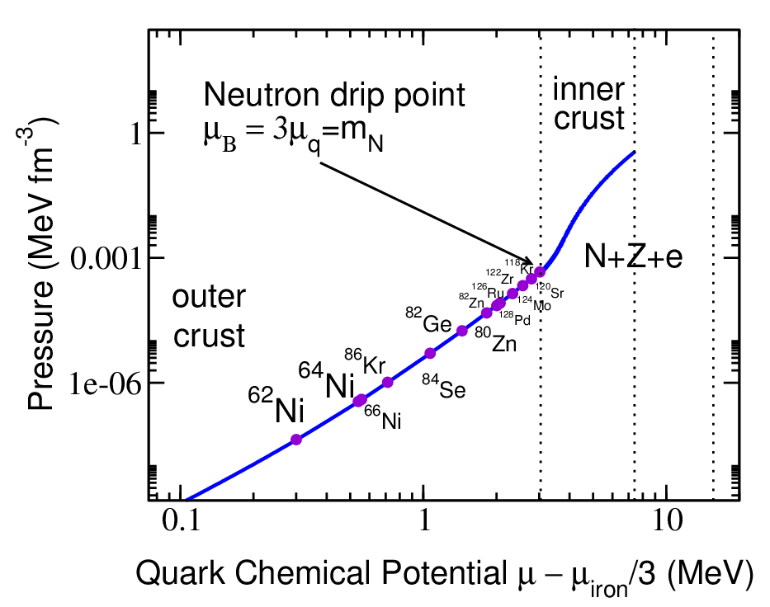
Proceeding inwards from the crust:
$μ_{B}$ increases gradually, starting from $μ_{Fe}$
Baryon/mass density increase beyond saturation density $≈0.16/{fm}^{3}$
Composition changes from ions to nuclei to neutron liquid and beyond
Good approximations: $T≈0≈n_{Q}$
Beyond neutron drip point NN interactions important; then 3Ns, boost corrections, etc.

Slide 8
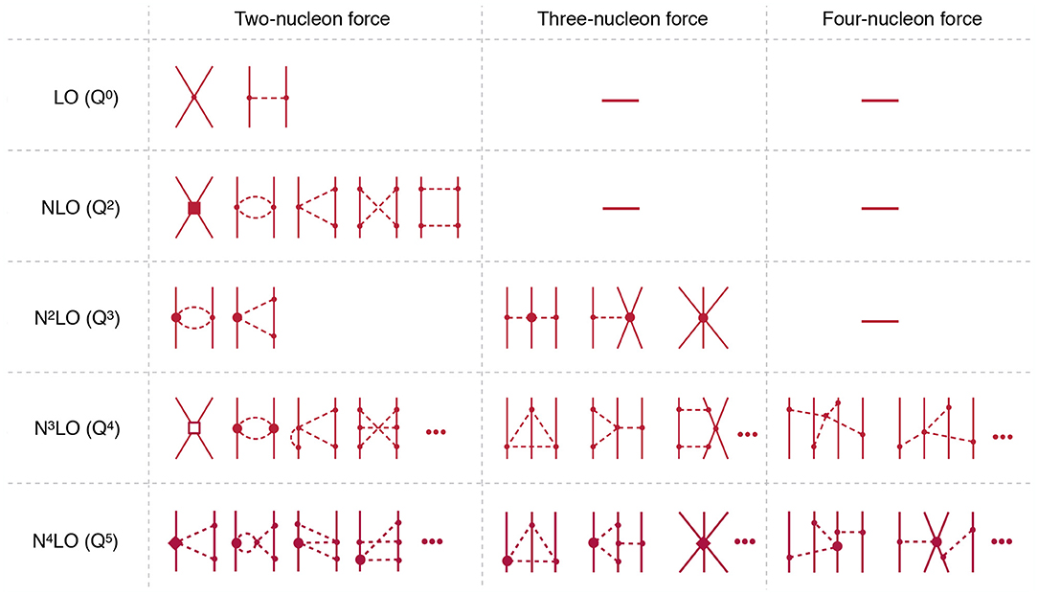
Proceeding inwards from the crust:
$μ_{B}$ increases gradually, starting from $μ_{Fe}$
Baryon/mass density increase beyond saturation density $≈0.16/{fm}^{3}$
Composition changes from ions to nuclei to neutron liquid and beyond
Good approximations: $T≈0≈n_{Q}$
Beyond neutron drip point NN interactions important; then 3Ns, boost corrections, etc.
Systematic effective theory framework: Chiral Effective Theory (CET)

Slide 9
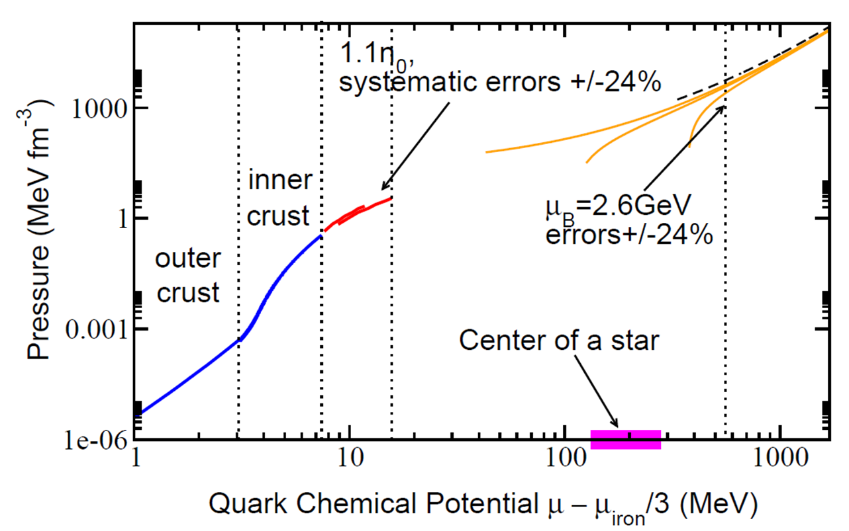
Proceeding inwards from the crust:
$μ_{B}$ increases gradually, starting from $μ_{Fe}$
Baryon/mass density increase beyond saturation density $≈0.16/{fm}^{3}$
Composition changes from ions to nuclei to neutron liquid and beyond
Good approximations: $T≈0≈n_{Q}$
Beyond neutron drip point NN interactions important; then 3Ns, boost corrections, etc.
Systematic effective theory framework: Chiral Effective Theory (CET)
State-of-the-art CET EoSs NNNLO in $χ$PT power counting but still long way from stellar centers [e.g. Tews et al., PRL 110 (2013)]

Slide 10
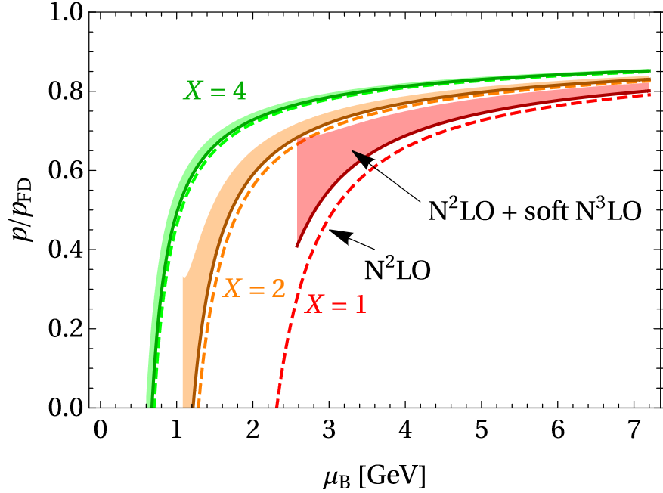
Proceeding inwards from the crust:
$μ_{B}$ increases gradually, starting from $μ_{Fe}$
Baryon/mass density increase beyond saturation density $≈0.16/{fm}^{3}$
Composition changes from ions to nuclei to neutron liquid and beyond
Good approximations: $T≈0≈n_{Q}$
At high density, asymptotic freedom $⇒$ weakening coupling and deconfinement
State-of-the-art perturbative EoS partial NNNLO in $α_{s}$ [Gorda et al., PRL 127 (2021), 2103.05658]
Still remaining: “purely hard” and “mixed” contributions (see later + Säppi’s talk)

Slide 11
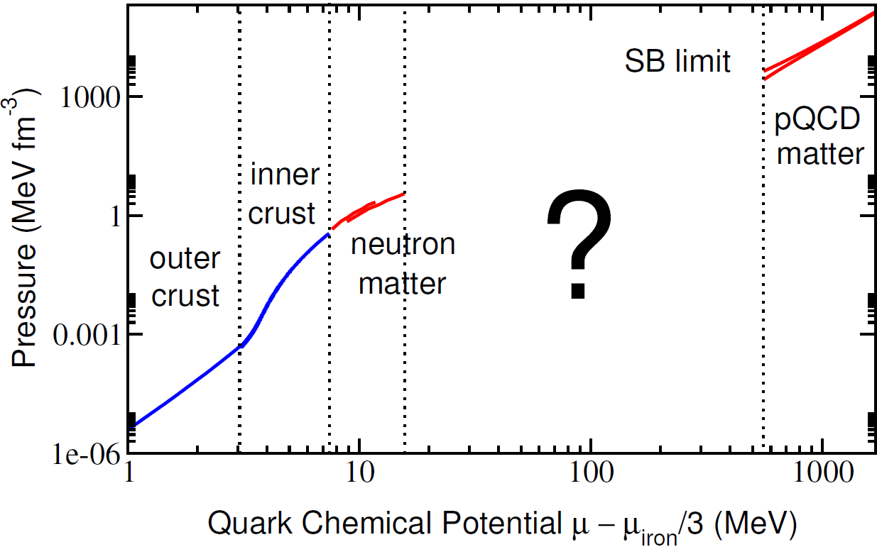
Proceeding inwards from the crust:
$μ_{B}$ increases gradually, starting from $μ_{Fe}$
Baryon/mass density increase beyond saturation density $≈0.16/{fm}^{3}$
Composition changes from ions to nuclei to neutron liquid and beyond
Good approximations: $T≈0≈n_{Q}$
$∴$ Low- and high-density limits under control but in between extensive no-man’s land. Have to work with:
Astrophysical observations
Thermodyn. relations (Komoltsev’s talk)
Physical expectations: EoS subluminal, at most one first-order transition,…

Slide 12
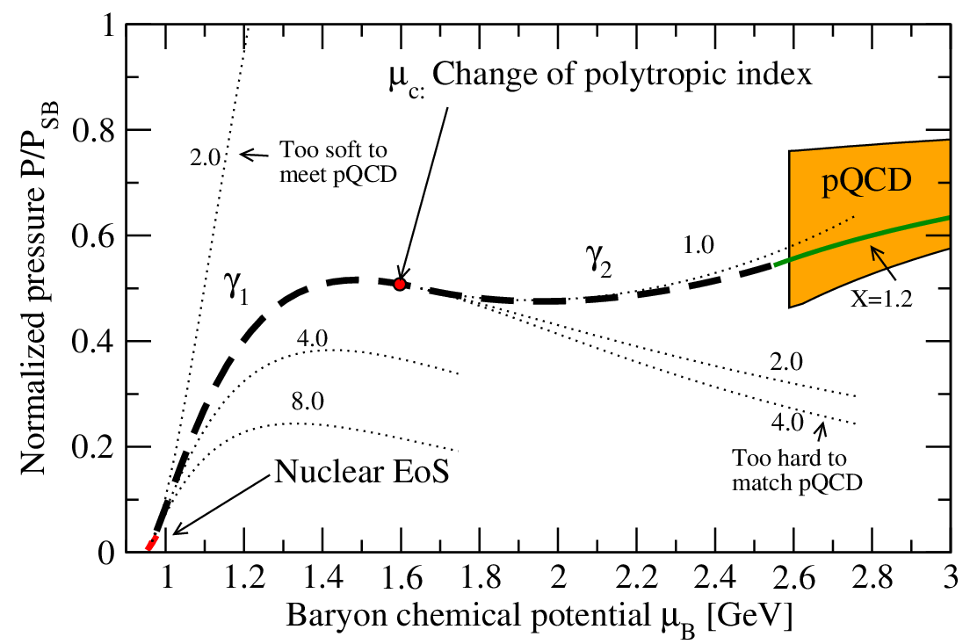
Possible way to proceed: build large ensembles of randomly generated interpolators with piece-wise basis functions

Slide 13
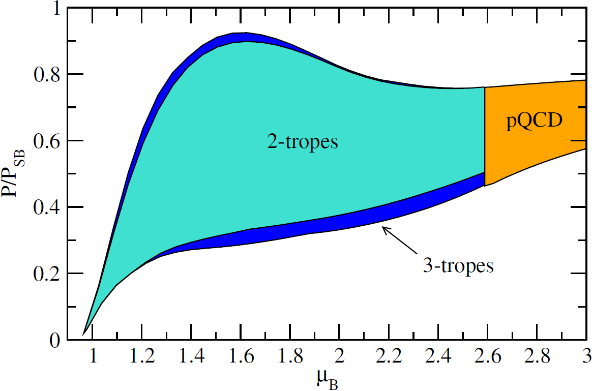
Possible way to proceed: build large ensembles of randomly generated interpolators with piece-wise basis functions
Require for all individual EoSs:
Smooth matching to nuclear and quark matter EoSs
Continuity of $p$ and $n_{B}$ with at most one exception (1st order transition)
Subluminality: $c_{s}<1$
Stellar models constructed with interpolated EoSs agree with robust measurements of NS properties
[Kurkela et al., ApJ 789 (2014), Gorda et al., PRL 120 (2018); etc.]

Slide 14
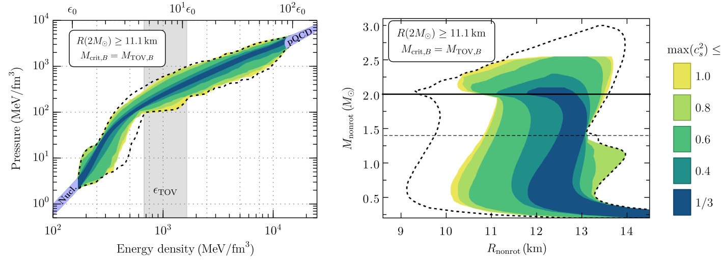
In the remainder of this talk, 3+1 topics:
What is the current status of pQCD calculations at high density?
How can astrophysical measurements help the EoS determination?
How well do current interpolation studies constrain the EoS?
+1) What can we say about the phase of matter inside NS cores?

Slide 15
pQCD at high density: Hard Thermal Loops & dense quark matter

Slide 16
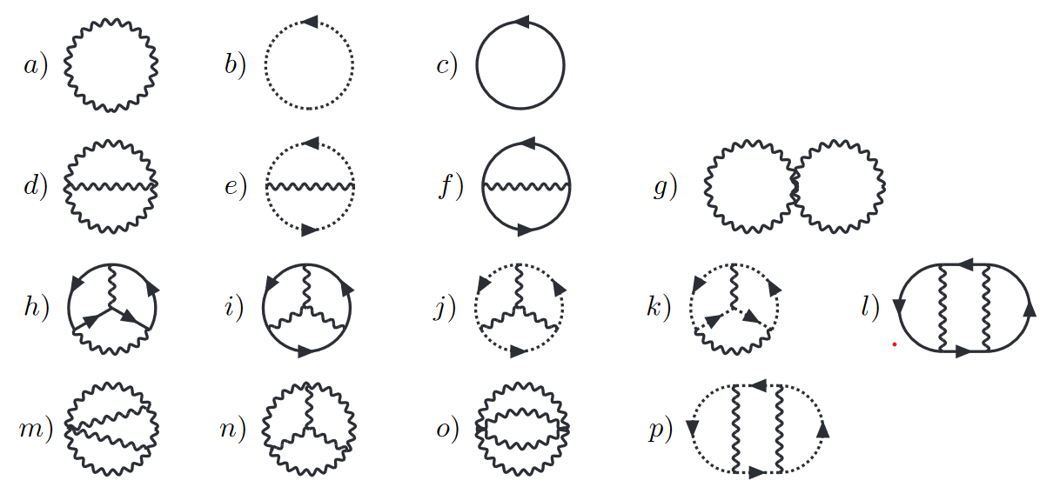
+ proper resummation of static bosonic modes (at nonzero $T$)

Slide 17
At high $μ$ and $T→0$, several changes:
Sum-integrals get replaced by four-dimensional continuous integrals, with fermionic $p_{0}→p_{0}−iμ$
Simplification from vanishing of diagrams with no fermion loops
Technical challenge: how to deal with fermionic $p_{0}$ integrals in a systematic manner?
IR sensitive modes no longer three-dimensional: all bosonic (Euclidean) four-momenta satisfying $\left|P\right|≲m_{E}\sim gμ_{B}$ need special treatment
Correct effective theory for IR modes: Hard Thermal Loops (HTL)

Slide 18
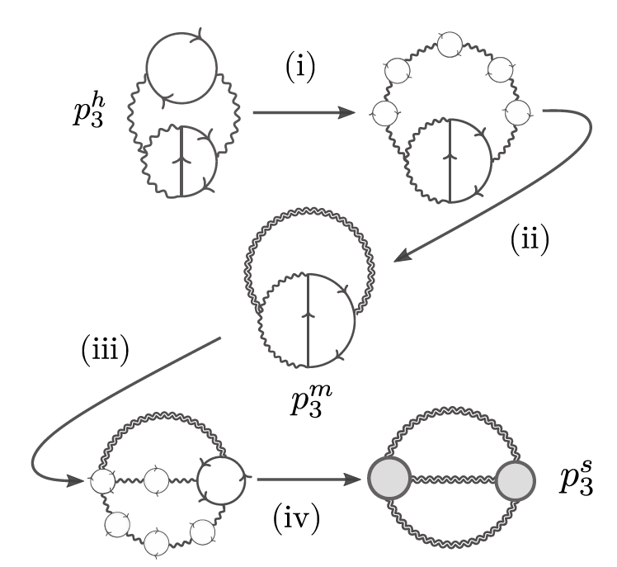
Up to state-of-the-art $O(α_{s}^{3})$, three types of contributions to the pressure:
Hard modes (scale $μ_{B}$) and their interactions: naïve loop expansion up to and including four loops
Soft modes (scale $m_{E}\sim gμ_{B}$) and their interactions: one- and two-loop graphs in HTL effective theory
Mixing of soft and hard modes
1
3
2

Slide 19
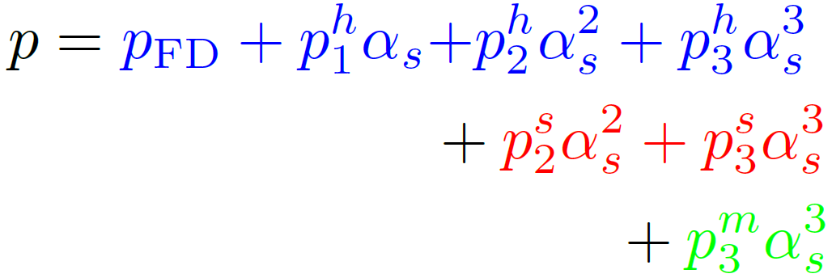
Up to state-of-the-art $O(α_{s}^{3})$, three types of contributions to the pressure:
Hard modes (scale $μ_{B}$) and their interactions: naïve loop expansion up to and including four loops
Soft modes (scale $m_{E}\sim gμ_{B}$) and their interactions: one- and two-loop graphs in HTL effective theory
Mixing of soft and hard modes
1
3
2

Slide 20
Up to state-of-the-art $O(α_{s}^{3})$, three types of contributions to the pressure:
Hard modes (scale $μ_{B}$) and their interactions: naïve loop expansion up to and including four loops
Soft modes (scale $m_{E}\sim gμ_{B}$) and their interactions: one- and two-loop graphs in HTL effective theory
Mixing of soft and hard modes
1
3
2
Known since 1970’s [Freedman, McLerran, PRD 16 (1977)]

Slide 21
Up to state-of-the-art $O(α_{s}^{3})$, three types of contributions to the pressure:
Hard modes (scale $μ_{B}$) and their interactions: naïve loop expansion up to and including four loops
Soft modes (scale $m_{E}\sim gμ_{B}$) and their interactions: one- and two-loop graphs in HTL effective theory
Mixing of soft and hard modes
1
3
2
Leading log from Gorda, Kurkela, Romatschke, Säppi, AV, PRL 121 (2018)

Slide 22
Up to state-of-the-art $O(α_{s}^{3})$, three types of contributions to the pressure:
Hard modes (scale $μ_{B}$) and their interactions: naïve loop expansion up to and including four loops
Soft modes (scale $m_{E}\sim gμ_{B}$) and their interactions: one- and two-loop graphs in HTL effective theory
Mixing of soft and hard modes
1
3
2
Gorda, Kurkela, Paatelainen, Säppi, AV, PRL 127 (2021); Fernandez, Kneur, 2109.02410

Slide 23
Up to state-of-the-art $O(α_{s}^{3})$, three types of contributions to the pressure:
Hard modes (scale $μ_{B}$) and their interactions: naïve loop expansion up to and including four loops
Soft modes (scale $m_{E}\sim gμ_{B}$) and their interactions: one- and two-loop graphs in HTL effective theory
Mixing of soft and hard modes
1
3
2
QED: Gorda, Kurkela, Österman, Paatelainen, Säppi, Seppänen, Schicho, AV, 2204.11893
QCD: Underway; results in 2022

Slide 24
Up to state-of-the-art $O(α_{s}^{3})$, three types of contributions to the pressure:
Hard modes (scale $μ_{B}$) and their interactions: naïve loop expansion up to and including four loops
Soft modes (scale $m_{E}\sim gμ_{B}$) and their interactions: one- and two-loop graphs in HTL effective theory
Mixing of soft and hard modes
No concrete promises; extensive calculation underway
1
3
2

Slide 25
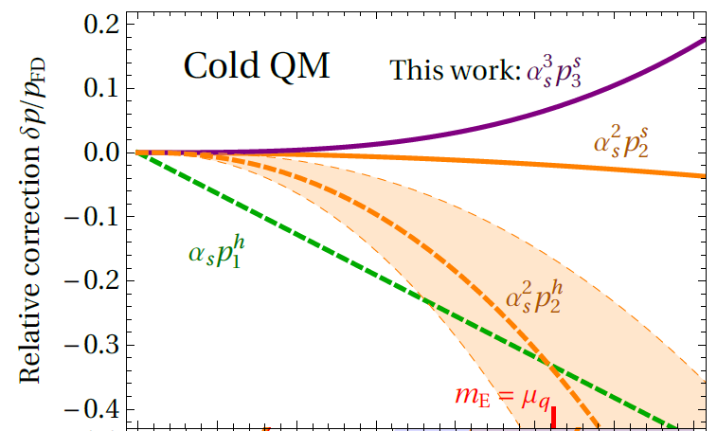
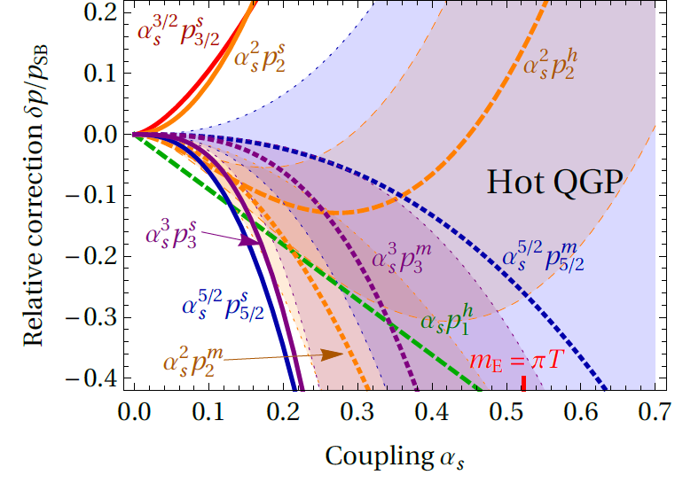
Up to state-of-the-art $O(α_{s}^{3})$, three types of contributions to the pressure:
Hard modes (scale $μ_{B}$) and their interactions: naïve loop expansion up to and including four loops
Soft modes (scale $m_{E}\sim gμ_{B}$) and their interactions: one- and two-loop graphs in HTL effective theory
Mixing of soft and hard modes
Comparison of convergence at zero vs. high temperature:

Slide 26
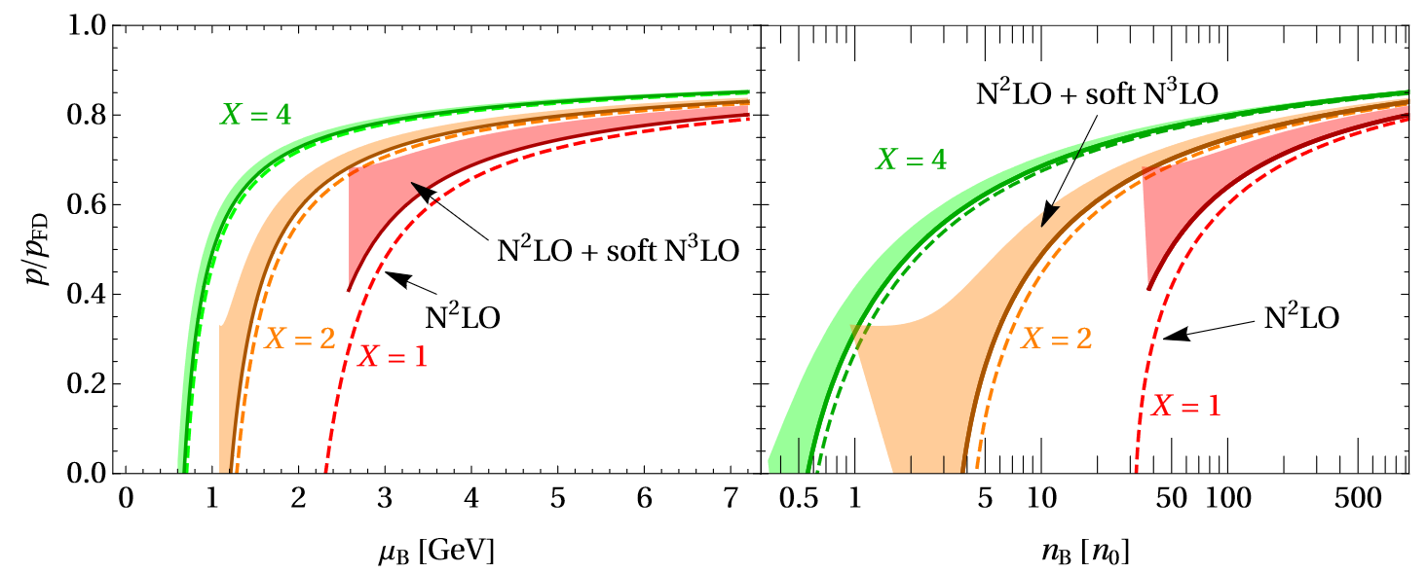
Up to state-of-the-art $O(α_{s}^{3})$, three types of contributions to the pressure:
Hard modes (scale $μ_{B}$) and their interactions: naïve loop expansion up to and including four loops
Soft modes (scale $m_{E}\sim gμ_{B}$) and their interactions: one- and two-loop graphs in HTL effective theory
Mixing of soft and hard modes
Effect of soft contributions on the EoS (more in talks by Säppi and Fernandez):

Slide 27
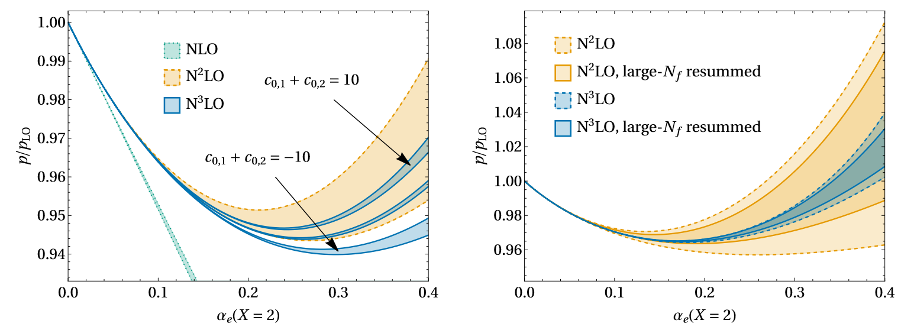
Up to state-of-the-art $O(α_{s}^{3})$, three types of contributions to the pressure:
Hard modes (scale $μ_{B}$) and their interactions: naïve loop expansion up to and including four loops
Soft modes (scale $m_{E}\sim gμ_{B}$) and their interactions: one- and two-loop graphs in HTL effective theory
Mixing of soft and hard modes
Effect of mixed contributions and large-$N_{f}$ resummation on EoS of cold and dense QED:

Slide 28
What do we know from NS observations?

Slide 29
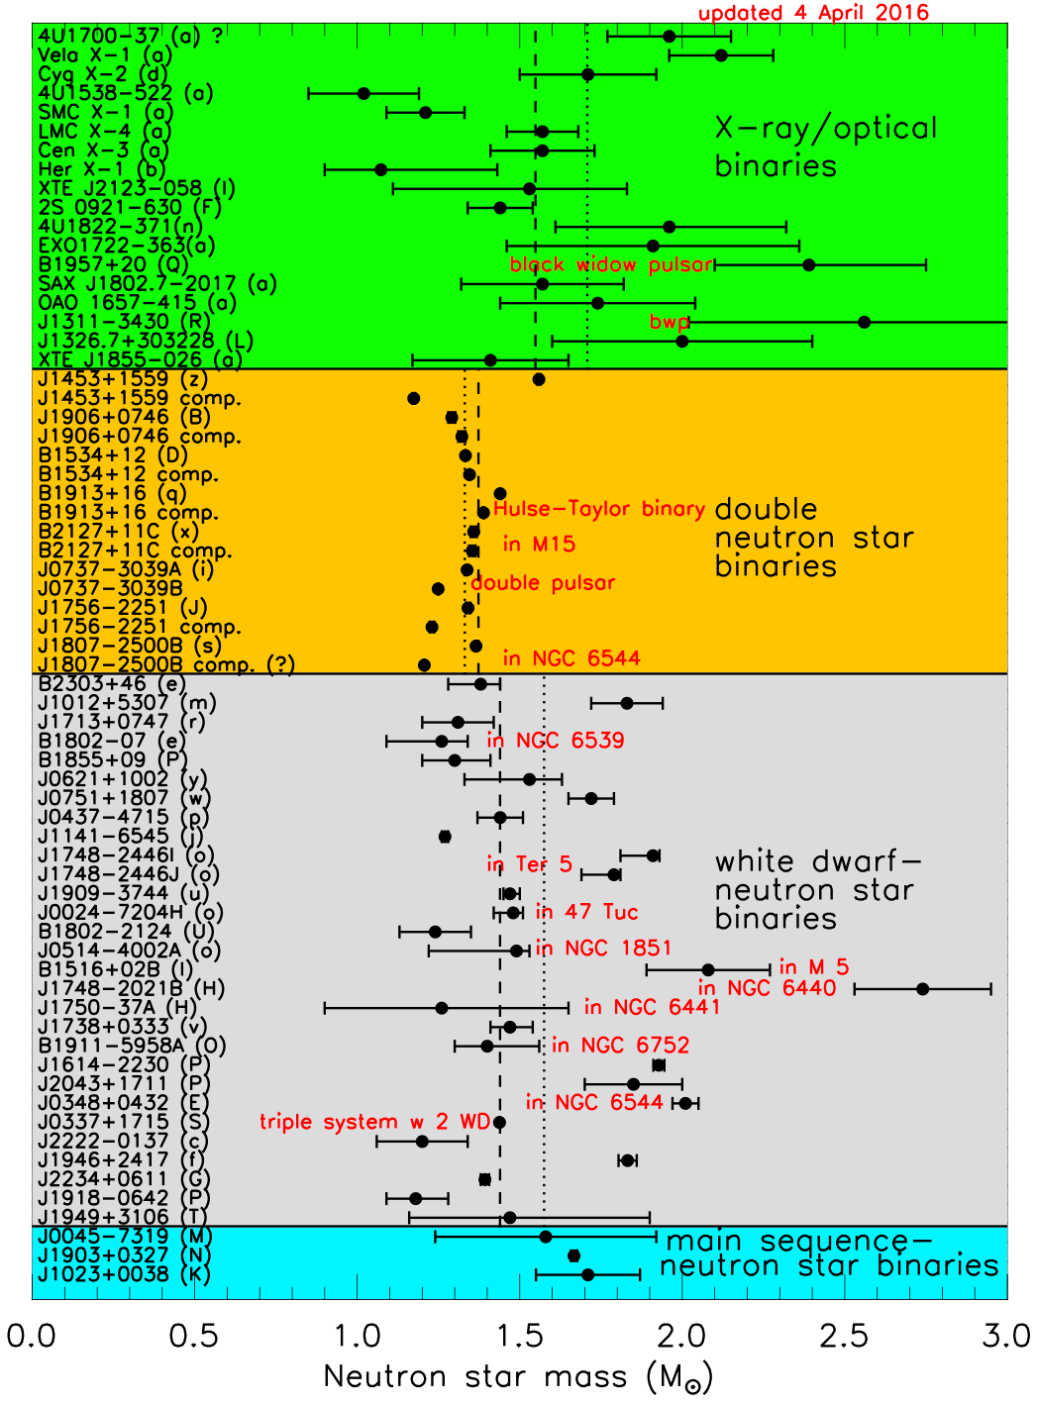
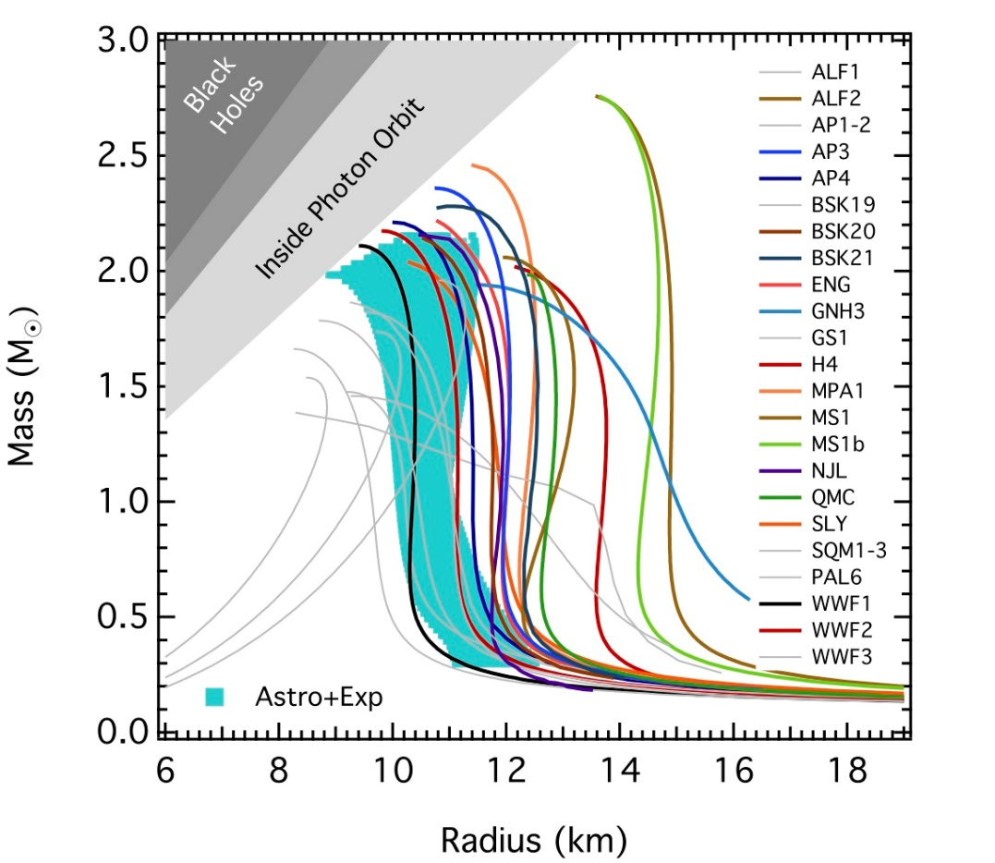
By now, three accurate Shapiro delay measurements of two-solar-mass neutron stars:
Demorest et al., Nature 467 (2010)
Antoniadis et al., Science 340 (2013)
Cromartie et al., Nature Astronomy 4 (2019)
$$∴ M_{max}>2M_{⊙}$$
Fig: J. Lattimer

Slide 30
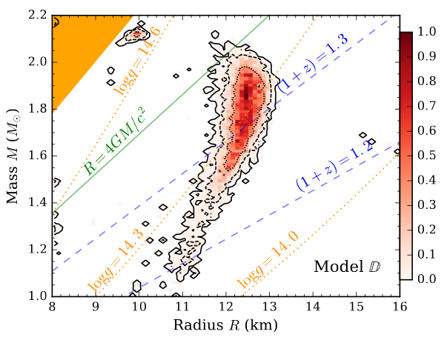
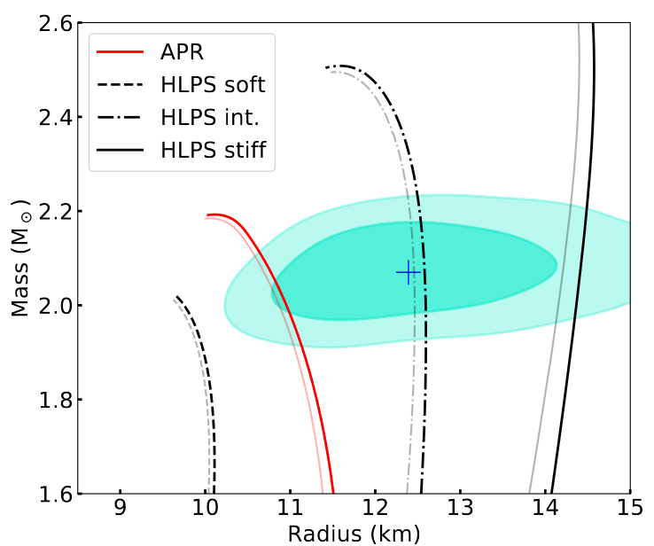
Radius (and combined $MR$) measurements more problematic, but recently important progress through X-ray observations:
Cooling of thermonuclear X-ray bursts provide radii to $\sim ±400$m [Nättilä et al., Astronomy & Astrophysics 608 (2017), …]
Pulse profiling (NICER) $⇒$ nontrivial lower bounds for two stellar radii, including PSR J0740+6620 with $M≳2M_{⊙}$ [Miller et al., Astrophysical Journal Letters 918 (2021),...]

Slide 31
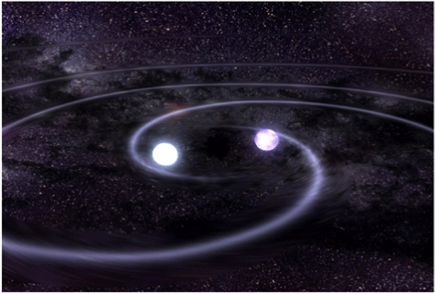
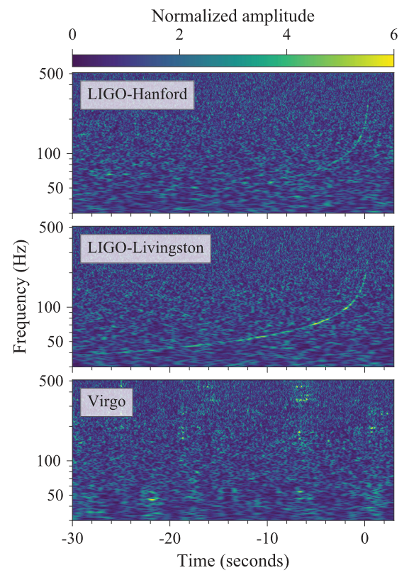
Gravitational wave breakthrough: First observed binary NS merger GW170817 by LIGO & Virgo in 2017 (and many since then)
Three types of potential inputs:
Tidal deformabilities of the NSs during inspiral – good measure of stellar compactness
Ringdown pattern – sensitive to EoS (also at $T≠0$), but frequency too high for LIGO/Virgo
EM counterpart: indirect information on merger product
Gravitational wave breakthrough: First observed binary NS merger GW170817 by LIGO & Virgo in 2017 (and many since then)
Three types of potential inputs:
Tidal deformabilities of the NSs during inspiral – good measure of stellar compactness
Ringdown pattern – sensitive to EoS (also at $T≠0$), but frequency too high for LIGO/Virgo
EM counterpart: indirect information on merger product
[LIGO and Virgo collaborations, PRL 119 (2017), PRL 121 (2018)]

Slide 32
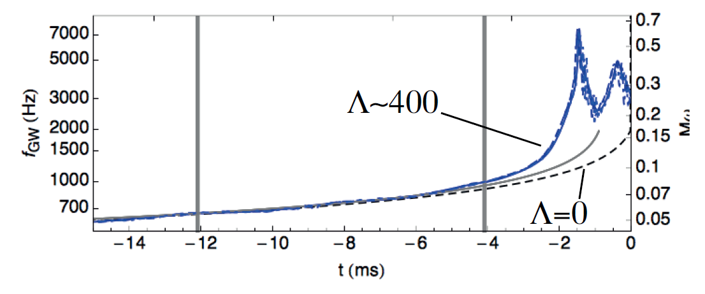
Tidal deformability: How large of a quadrupolar moment a star’s gravitational field develops due to an external quadrupolar field
$$Q_{ij}=−Λℰ_{ij}$$
Substantial effect on observed GW waveform during inspiral phase
Tidal deformability: How large of a quadrupolar moment a star’s gravitational field develops due to an external quadrupolar field
$$Q_{ij}=−Λℰ_{ij}$$
[Read et al., PRD 88 (2013)]

Slide 33
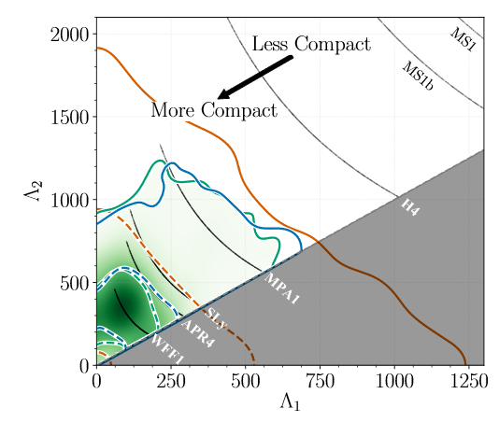
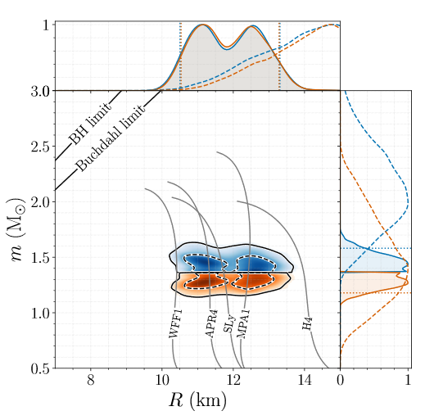
Tidal deformability: How large of a quadrupolar moment a star’s gravitational field develops due to an external quadrupolar field
$$Q_{ij}=−Λℰ_{ij}$$
LIGO & Virgo bound $70<Λ(1.4M_{⊙})< 580$ at 90% credence using low spin prior [LIGO and Virgo, PRL 121 (2018)]: useful test for EoSs

Slide 34
Gravitational wave breakthrough: First observed binary NS merger GW170817 by LIGO & Virgo in 2017 (and many since then)
Three types of potential inputs:
Tidal deformabilities of the NSs during inspiral – good measure of stellar compactness
Ringdown pattern – sensitive to EoS (also at $T≠0$), but frequency too high for LIGO/Virgo
EM counterpart: indirect information on merger product
[LIGO and Virgo collaborations, PRL 119 (2017), PRL 121 (2018)]

Slide 35
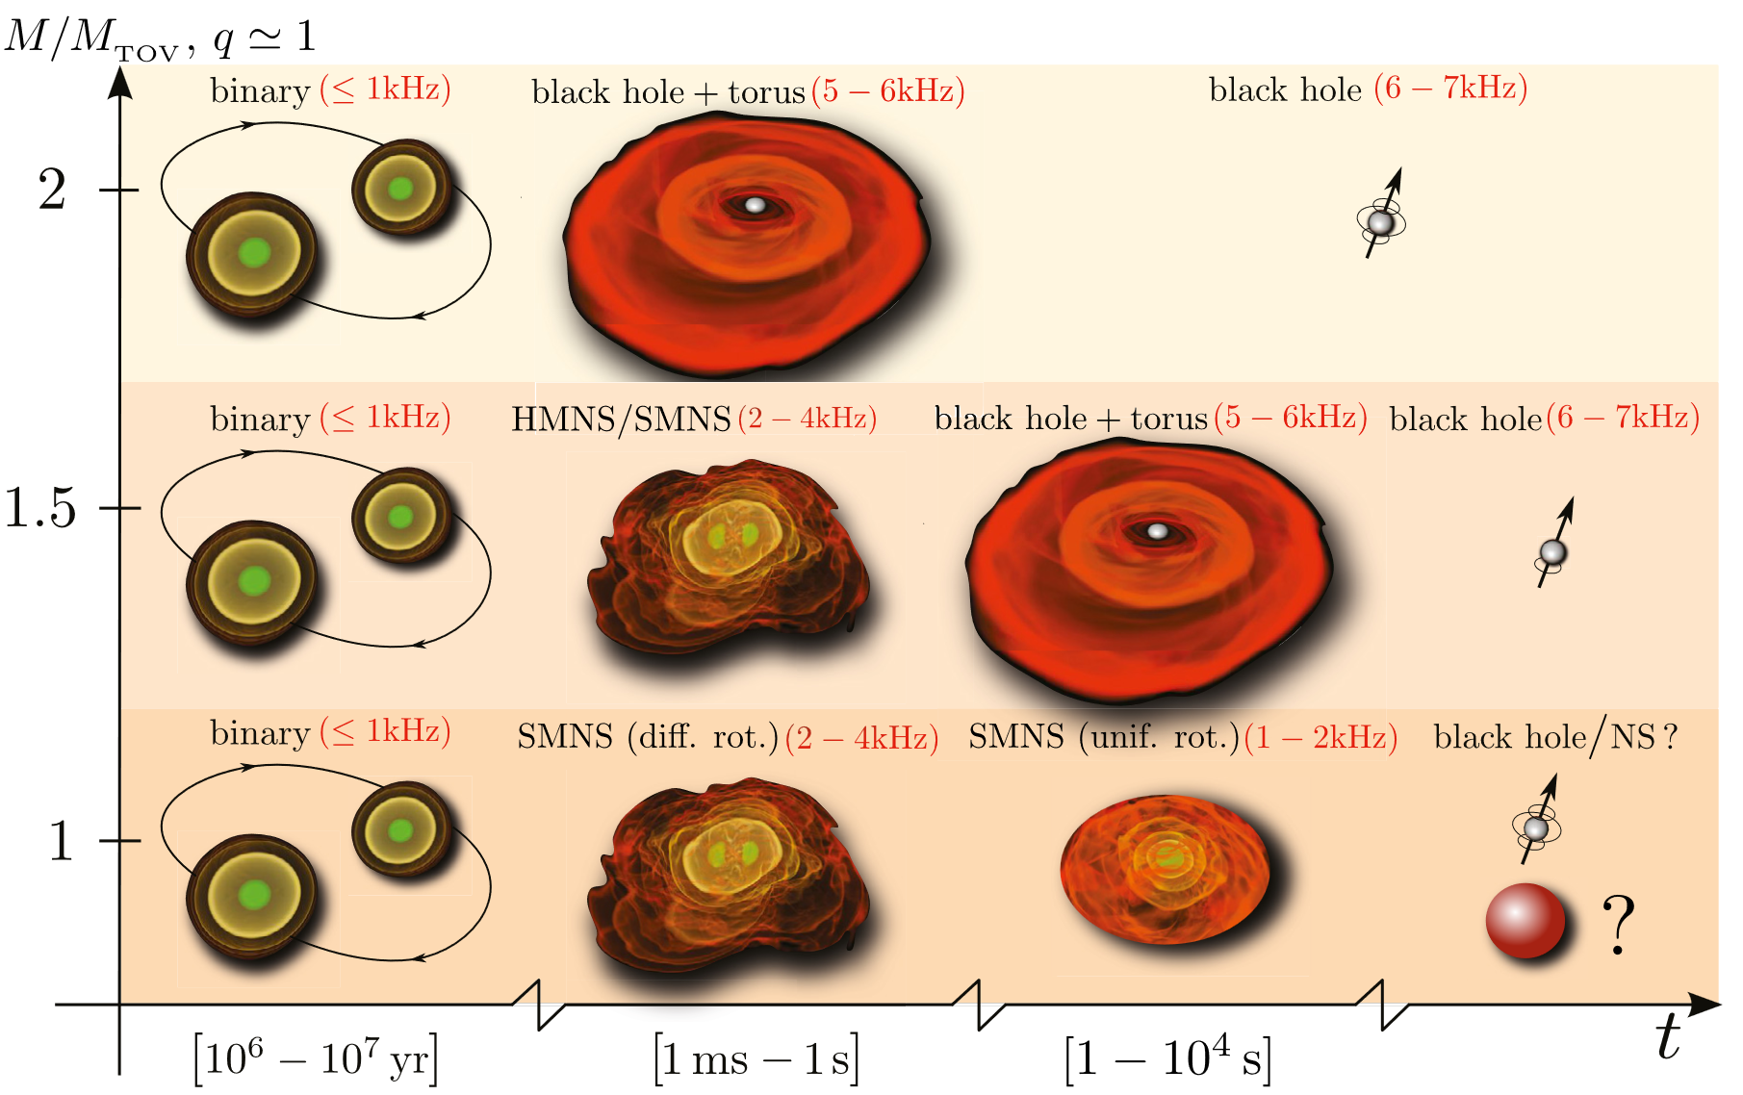
Ringdown pattern: Unlike in BH mergers, binary NS mergers expected to feature complex period of relaxation characterized by GW spectrum sensitive to both initial NS masses and the EoS
Scenario 1: propmpt collapse
Scenario 2: collapse during hypermassive phase (differential rotation)
Scenario 3: collapse during supramass. phase (unform rot.)
Scenario 4: no collapse
[Baiotti, Rezzolla, Rept.Prog.Phys. 80 (2017)]

Slide 36
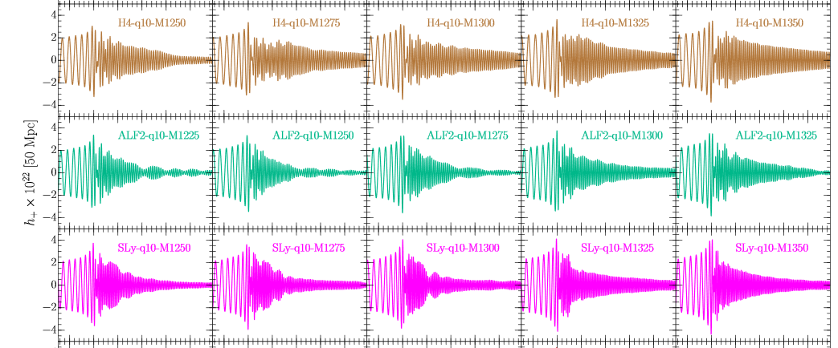
Post-merger dynamics can be studied with relativistic hydrodynamics siulations, showing marked sensitivity to first-order phase transitions, but frequency range (currently) too high for LIGO and Virgo
[Takami, Rezzolla, Baiotti, PRD 91 (2015)]

Slide 37
Gravitational wave breakthrough: First observed binary NS merger GW170817 by LIGO & Virgo in 2017 (and many since then)
Three types of potential inputs:
Tidal deformabilities of the NSs during inspiral – good measure of stellar compactness
Ringdown pattern – sensitive to EoS (also at $T≠0$), but frequency too high for LIGO/Virgo
EM counterpart: indirect information on merger product
[LIGO and Virgo collaborations, PRL 119 (2017), PRL 121 (2018)]

Slide 38
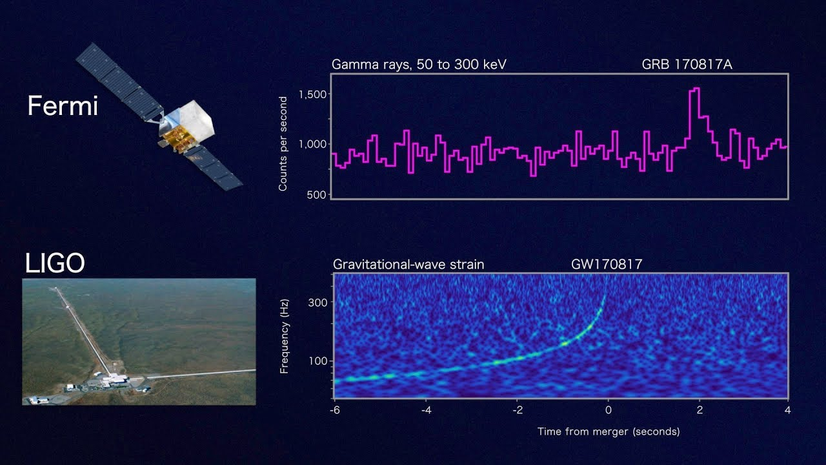
In GW170817, short gamma-ray burst 1.7s after GWs, followed by optical signal: delayed collapse to a BH

Slide 39
In GW170817, short gamma-ray burst 1.7s after GWs, followed by optical signal: delayed collapse to a BH
Constraints for maximal (TOV) mass of stable NSs from scenarios 2 and 3:
Differentially-rotating hypermassive NS: $M_{remnant}≥M_{crit}=M_{supra}$ (HMNS-hyp below)
Uniformly-rotating supramassive NS: $M_{remnant}≥M_{crit}=M_{TOV}$ (BH-hyp)

Slide 40
In GW170817, short gamma-ray burst 1.7s after GWs, followed by optical signal: delayed collapse to a BH
Constraints for maximal (TOV) mass of stable NSs from scenarios 2 and 3:
Differentially-rotating hypermassive NS: $M_{remnant}≥M_{crit}=M_{supra}$ (HMNS-hyp below)
Uniformly-rotating supramassive NS: $M_{remnant}≥M_{crit}=M_{TOV}$ (BH-hyp)
HMNS-scenario more likely due to short delay between GW and EM signals; gives stronger constraints [Rezzolla et al, ApJ 852 (2018)]

Slide 41
Interpolation: combining available information, what can we say about the EoS and the composition of NSs?

Slide 42
Useful strategy: Implement interpolation starting from speed of sound and classify results in terms of maximal value $c_{s}^{2}$ reaches at any density [Annala et al., Nature Physics (2020) and PRX (2022)]

Slide 43
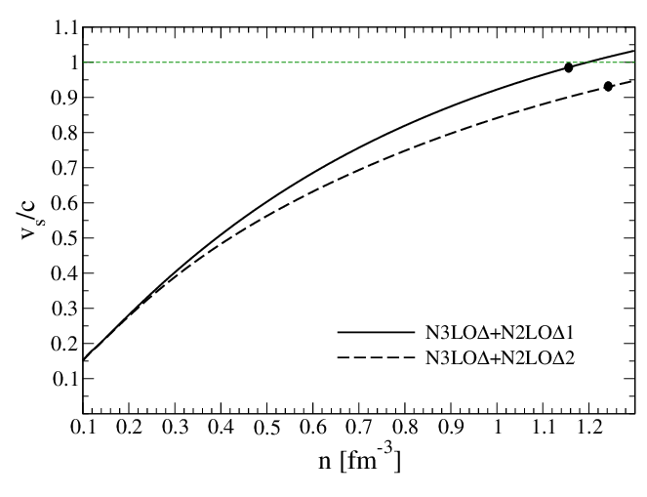
Useful strategy: Implement interpolation starting from speed of sound and classify results in terms of maximal value $c_{s}^{2}$ reaches at any density [Annala et al., Nature Physics (2020) and PRX (2022)]
Interesting because of tension between standard lore in nuclear physics and experience from other contexts

Slide 44
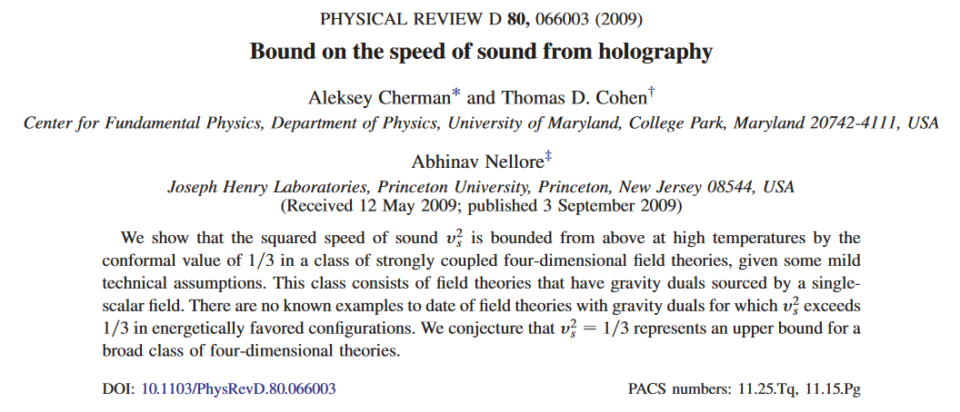
Useful strategy: Implement interpolation starting from speed of sound and classify results in terms of maximal value $c_{s}^{2}$ reaches at any density [Annala et al., Nature Physics (2020) and PRX (2022)]
Interesting because of tension between standard lore in nuclear physics and experience from other contexts
$$c/\sqrt{3}$$

Slide 45
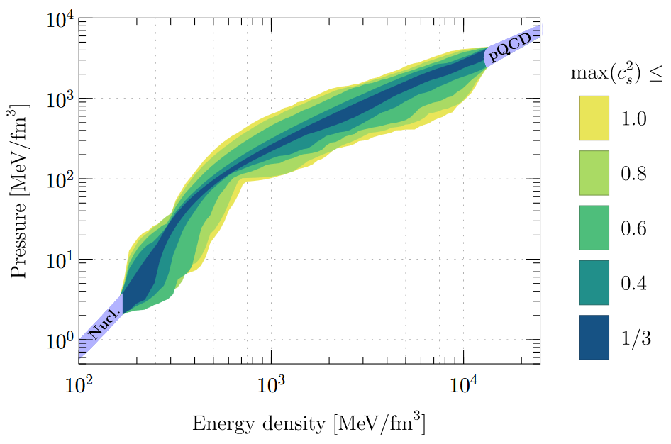
In addition to the usual low- and high-density limit, always require:
EoS must support $2M_{⊙}$ stars
LIGO/Virgo 90% tidal deformability limit must be satisfied
[Annala et al., Nature Physics (2020)]

Slide 46
In addition to the usual low- and high-density limit, always require:
EoS must support $2M_{⊙}$ stars
LIGO/Virgo 90% tidal deformability limit must be satisfied
[Annala et al., Nature Physics (2020)]
In recent work, also take into account:
NICER data for PSR J0740+6620:
$R\left(2M_{⊙}\right)>11.0$km (95%)
$R\left(2M_{⊙}\right)>12.2$km (68%)
BH formation in GW170817 via
Supramassive or hypermassive NS
[Annala et al., PRX 12 (2022)]

Slide 47
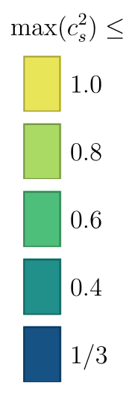
In addition to the usual low- and high-density limit, always require:
EoS must support $2M_{⊙}$ stars
LIGO/Virgo 90% tidal deformability limit must be satisfied
[Annala et al., Nature Physics (2020)]
In recent work, also take into account:
NICER data for PSR J0740+6620:
$R\left(2M_{⊙}\right)>11.0$km (95%)
$R\left(2M_{⊙}\right)>12.2$km (68%)
BH formation in GW170817 via
Supramassive or hypermassive NS
[Annala et al., PRX 12 (2022)]

Slide 48
In addition to the usual low- and high-density limit, always require:
EoS must support $2M_{⊙}$ stars
LIGO/Virgo 90% tidal deformability limit must be satisfied
[Annala et al., Nature Physics (2020)]
In recent work, also take into account:
NICER data for PSR J0740+6620:
$R\left(2M_{⊙}\right)>11.0$km (95%)
$R\left(2M_{⊙}\right)>12.2$km (68%)
BH formation in GW170817 via
Supramassive or hypermassive NS
[Annala et al., PRX 12 (2022)]

Slide 49
In addition to the usual low- and high-density limit, always require:
EoS must support $2M_{⊙}$ stars
LIGO/Virgo 90% tidal deformability limit must be satisfied
[Annala et al., Nature Physics (2020)]
In recent work, also take into account:
NICER data for PSR J0740+6620:
$R\left(2M_{⊙}\right)>11.0$km (95%)
$R\left(2M_{⊙}\right)>12.2$km (68%)
BH formation in GW170817 via
Supramassive or hypermassive NS
[Annala et al., PRX 12 (2022)]

Slide 50
In addition to the usual low- and high-density limit, always require:
EoS must support $2M_{⊙}$ stars
LIGO/Virgo 90% tidal deformability limit must be satisfied
[Annala et al., Nature Physics (2020)]
In recent work, also take into account:
NICER data for PSR J0740+6620:
$R\left(2M_{⊙}\right)>11.0$km (95%)
$R\left(2M_{⊙}\right)>12.2$km (68%)
BH formation in GW170817 via
Supramassive or hypermassive NS
[Annala et al., PRX 12 (2022)]

Slide 51
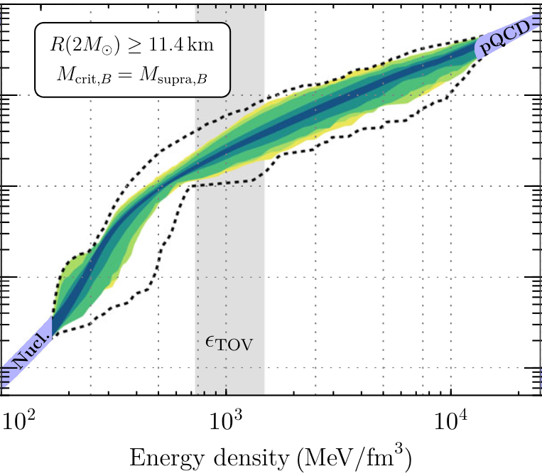
In particular the low-$c_{s}$ EoSs suggest a two-phase structure
Distinguishing feature between phases: polytropic index (logarithm. slope) $γ≡\frac{d\ln{p}}{d\ln{ε}}≈1$ in nearly conformal QM, $\sim$2.5 in sub-$n_{s}$ nuclear matter

Slide 52
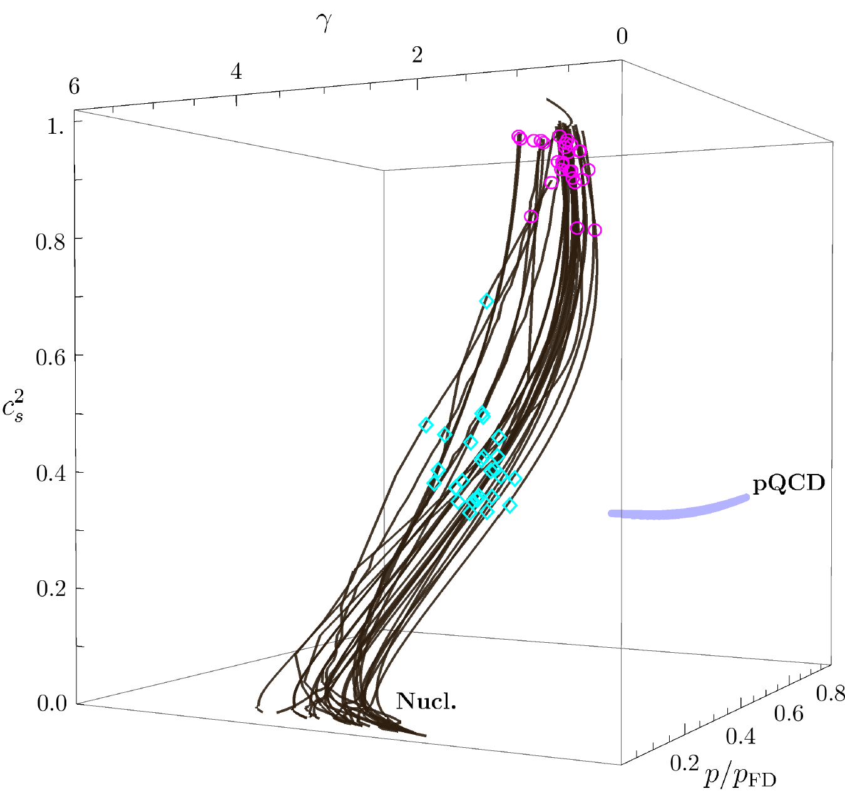
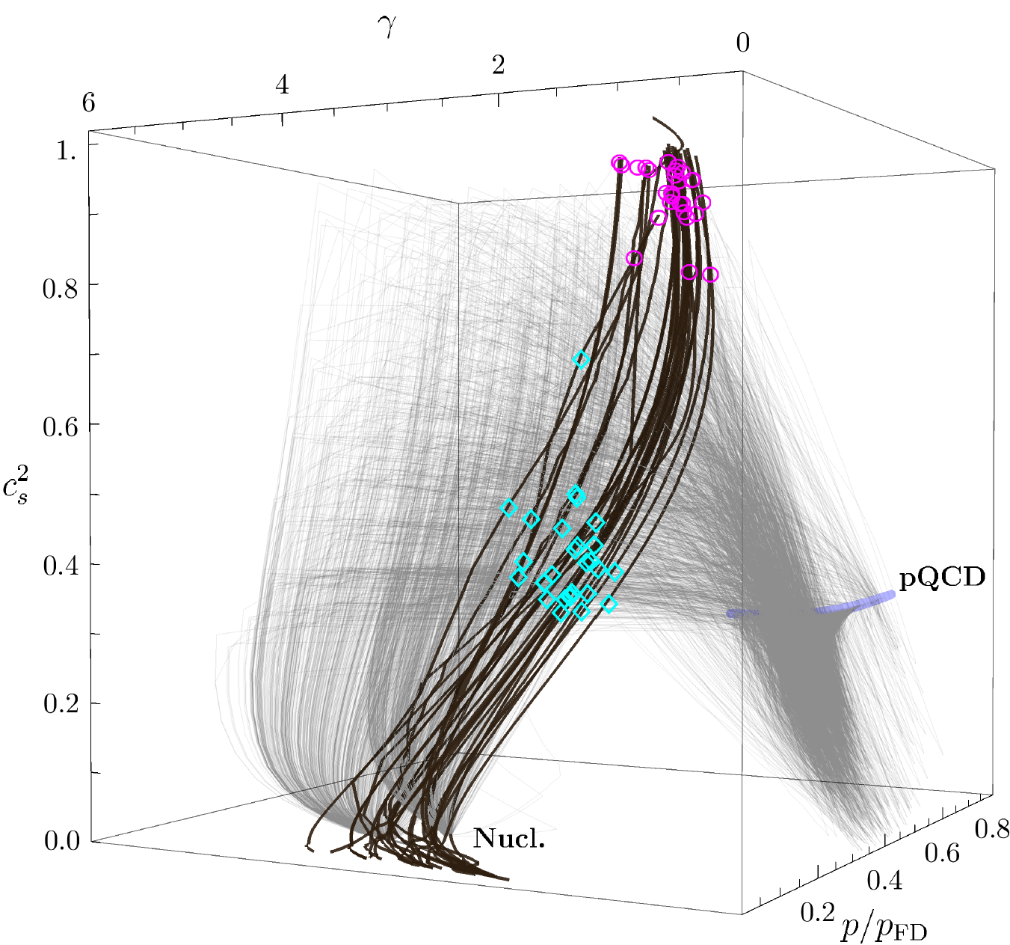
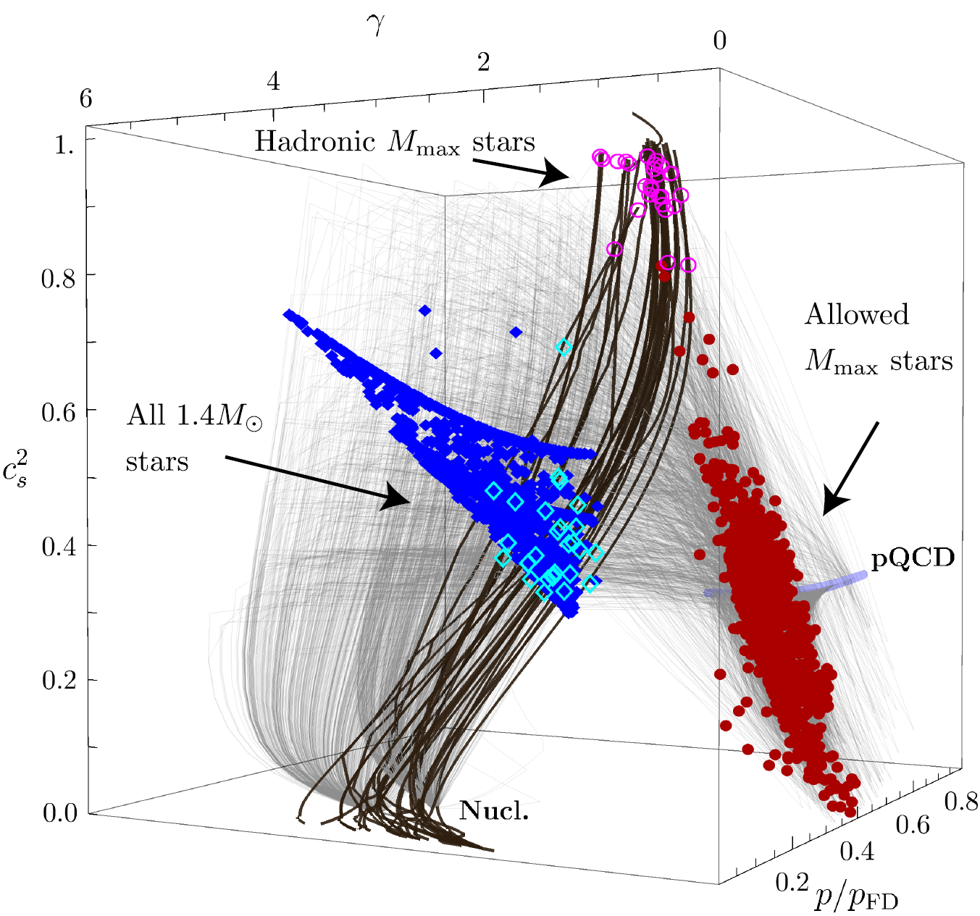
Detailed comparison of interpolated EoSs with nuclear matter models and pQCD limit reveals $M_{max}$ centres to reside closer to quark than nuclear-matter limit. Large QM-like cores for moderate latent heats and max($c_{s}^{2}$).
Inclusion of new data strengthens the conclusions; more to follow.
[Annala et al., Nature Physics (2020); Annala, Gorda, Hirvonen, Komoltsev, Kurkela, Nättilä, AV, In progress]
52

Slide 53
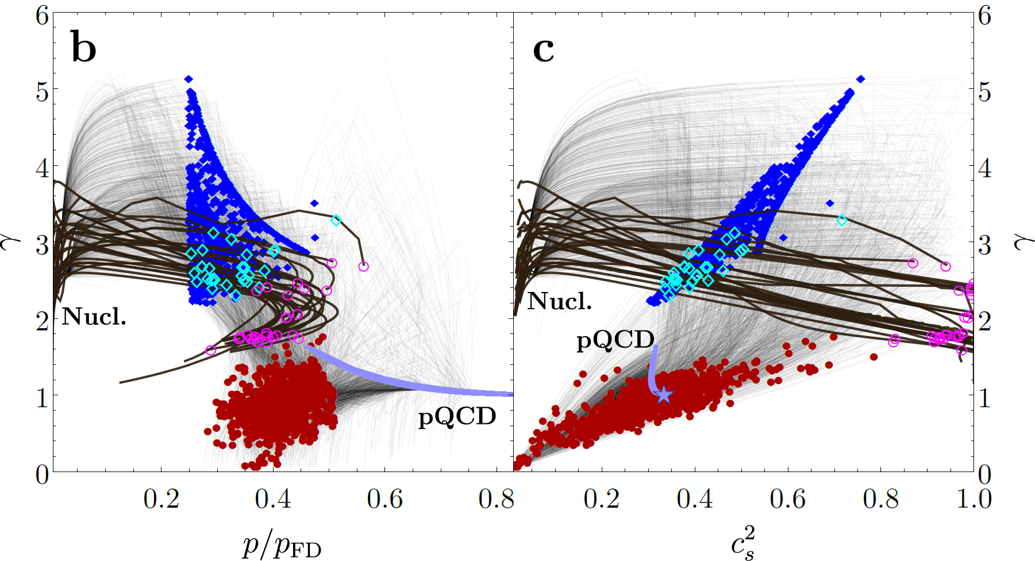
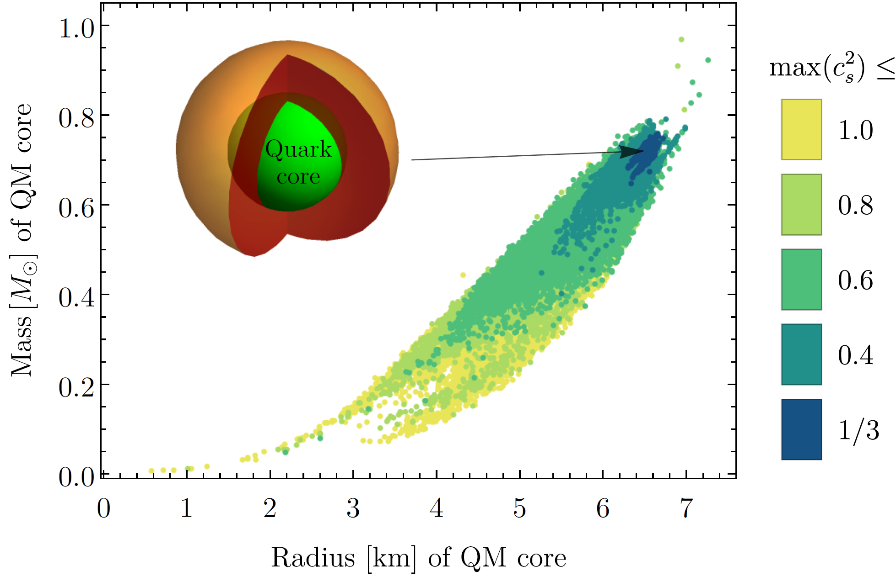
Approximative criterion for the onset of QM
Detailed comparison of interpolated EoSs with nuclear matter models and pQCD limit reveals $M_{max}$ centres to reside closer to quark than nuclear-matter limit. Large QM-like cores for moderate latent heats and max($c_{s}^{2}$).
Inclusion of new data strengthens the conclusions; more to follow.
[Annala et al., Nature Physics (2020); Annala, Gorda, Hirvonen, Komoltsev, Kurkela, Nättilä, AV, In progress]
53

Slide 54
Future directions?

Slide 55
In near future, expect major advances from multiple fronts:
In pQCD studies of cold QM, qualitative progress from inclusion of mixed contributions and resummations (talks by Säppi, Fernandez)
Coming up: transport in dense QM
Within CET, impressive efforts towards $2n_{s}$ limit
Astrophysical observations coming up:
GW observatory KAGRA started in 2020; Einstein Telescope in 2030s
On X-ray front NICER, to be complemented by eXTP around 2025
Model-independent EoS studies:
More robust use of pQCD results at low densities (Komoltsev’s talk), being implemented by several groups
Bayesian studies, enabling probabilistic statements and the use of more measurements (Gorda’s talk; also in progress)

