Slide 1



Nuclear physics at the Electron-Ion Collider: an experimental perspective
Salvatore Fazio
Università della Calabria & INFN Cosenza
Strong and Electro-Weak Matter 2002 (SEWM 2022)
Saclay & La Sorbonne Univ. – Paris, June 20-24, 2022

Slide 2
Plan of the Talk
Introduction
The EIC project and goals
Physics Highlights
  Spin Physics
  Partonic Imaging
  Structure of Nuclei
  Gluon Saturation
EIC Community and Project timelines

Slide 3

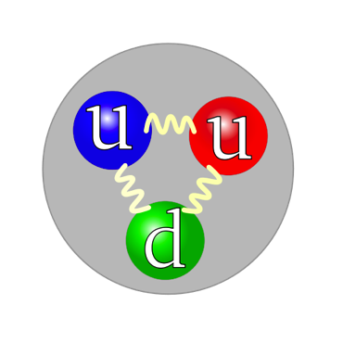
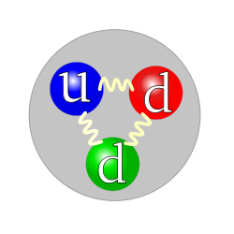
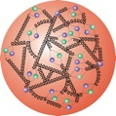
The quest for the elementary constituents of matter
NUCLEUS
A major goal of physics is to investigate the basic building blocks of all matter
  pieces that make up atoms, nuclei...
    and the pieces that make up those pieces…
Nucleus made of nucleons: protons and neutrons
Proton
Neutron
But the nucleons are very complex objects!!
Nucleon made of quarks bonded by gluons
Properties of quarks and gluons combine to for the total properties of the nucleon (electric charge, mass…)
Description of interactions via strong nuclear force
→ the birth of Quantum Cromo-Dynamics (QCD)

Slide 4
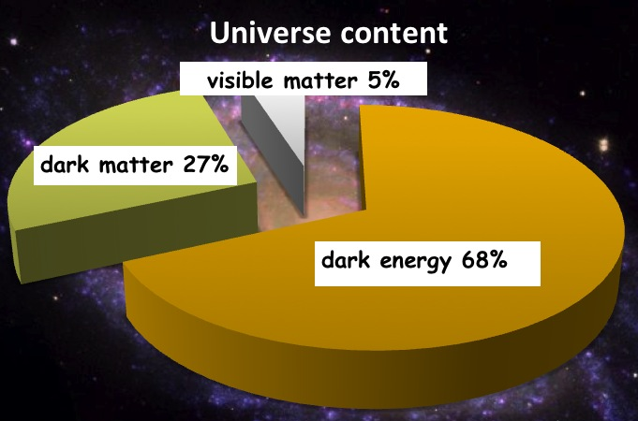
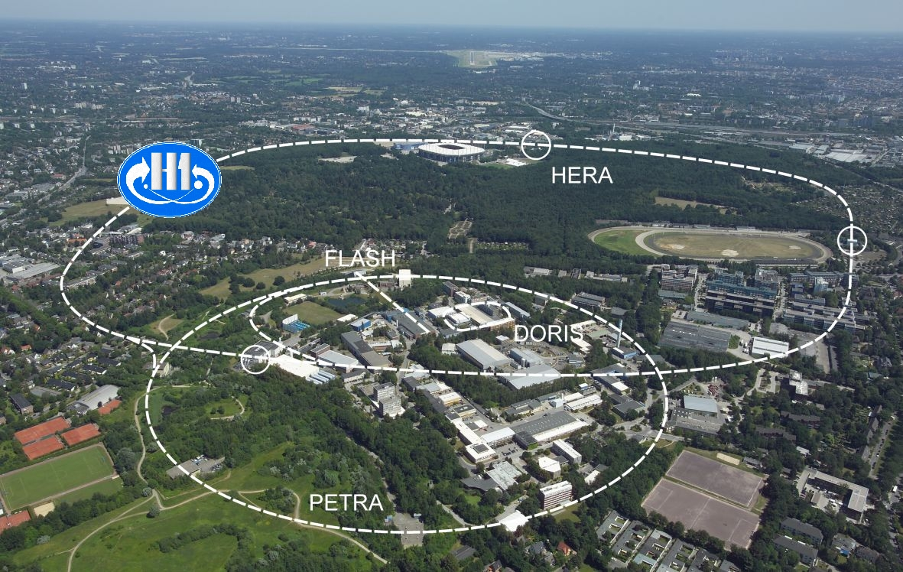

Understanding the properties of visible matter
This is us !!! (protons, neutrons, electrons)
Nucleon:
The Higgs mechanism is responsible for quarks mass
Quark-Masses: ~1-5% M_{p}
All strongly interacting matter is an emergent consequence of many-body quark-gluon dynamics in QCD
To investigate the nucleon’s partonic structure, HERA, the previous and only
electron (projectile beam) → proton (target beam) collider, was built

Slide 5

What did HERA found?
HERA studied in detail the one-dimensional picture of a free proton
higher
√s
Density of partons
?
HERA discovery:
Gluon density dominates at x < 0.1
Limits of HERA: Low luminosity; no nuclei; no polarization of the proton beam
Relative momentum of partons
Need a high lumi, highly polarized e+p(A) collider to resolve quark and gluon spatial, momentum and spin structure in multi-dimensions in both protons and nuclei → EIC

Slide 6

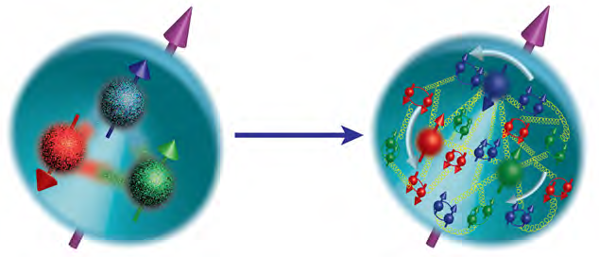

Most compelling physics GOALS
How are sea quarks and gluons, and their spins, distributed in space and momentum inside the nucleon?
How do the nucleon properties emerge from them and their interactions?
What happens to the gluon density in nuclei?
gluon
emission
gluon recombination
Does it saturate at high energy?
?
Does this saturation give rise to a gluonic matter with universal properties in all nuclei, even proton?
=
How does a dense nuclear environment affect the quarks and gluons, their correlations and interactions?
How do color-charged quarks and gluons, and colorless jets, interact with a nuclear medium?
How do the confined hadronic states emerge from these quarks and gluons?
How do the quark-gluon interactions create nuclear binding?

Slide 7
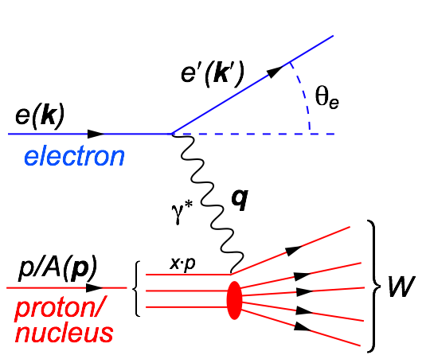
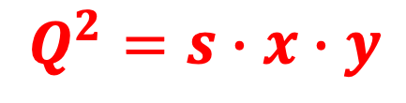
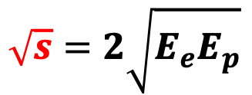
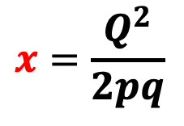
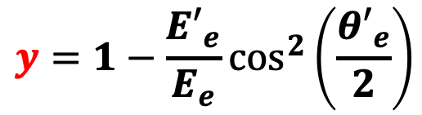
Our Tool – Deep Inelastic Scattering
Kinematics:
$$Q^{2}=2E_{e}{E′}_{e}\left(1−\cos{θ_{e′}}\right)=−{\left(k−k^{′}\right)}^{2}=−q^{2}$$
Measure of resolution power
$$y=1−\frac{{E′}_{e}}{E_{e}}\cos^{2}\left(\frac{{θ′}_{e}}{2}\right)$$
$$x=\frac{Q^{2}}{2pq}$$
$$\sqrt{s}=2\sqrt{E_{e}E_{p}}$$
Measure of inelasticity
Measure of momentum fraction of struck quark
Center-of-mass energy of electron-hadron system
All variables are correlated:
$$Q^{2}=s∙x∙y$$
DIS:
As a probe, electron beams provide unmatched precision of the electromagnetic interaction
Direct, model independent, determination of kinematics of physics processes
Indirectly probes gluons with high precision

Slide 8
Ingredients for a high resolution “femtoscope”
Large center-of-mass coverage:
Access to wide kinematic range in x and Q²
Polarized electron and hadron beams:
access to spin structure of nucleons and nuclei
Spin vehicle to access the 3D spatial and momentum structure of the nucleon
Full specification of initial and final states to probe q-g structure of NN and NNN interaction in light nuclei
Nuclear beams:
Accessing the highest gluon densities → amplification of saturation phenomena
High luminosity:
Detailed mapping the 3D spatial and momentum structure of nucleons and nuclei
Access to rare probes
All these requirement can be addressed by the future Electron-Ion Collider

Slide 9
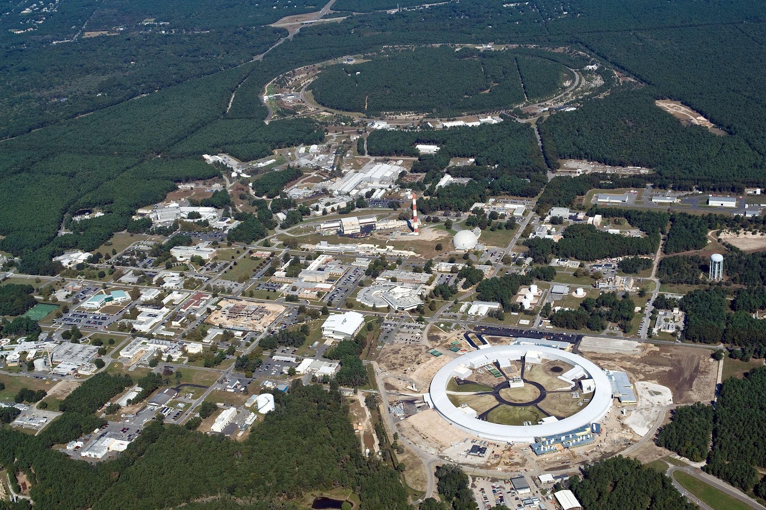
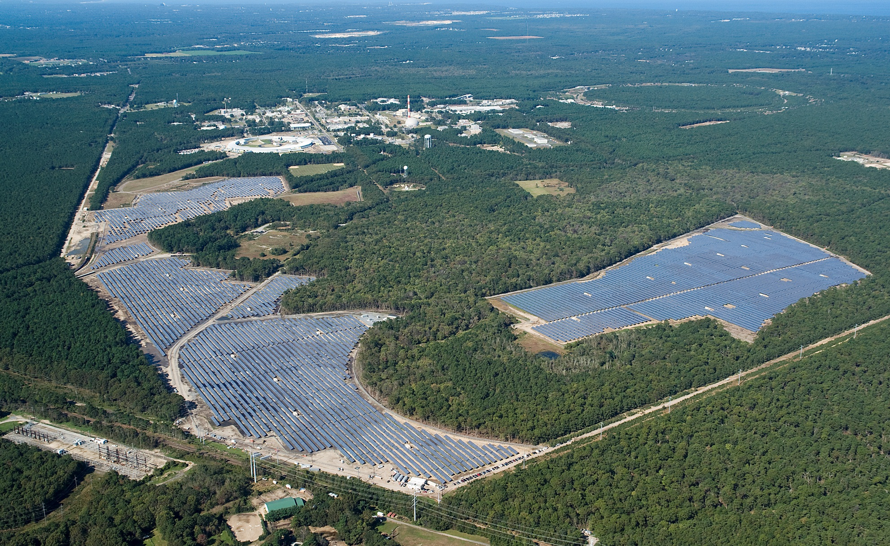
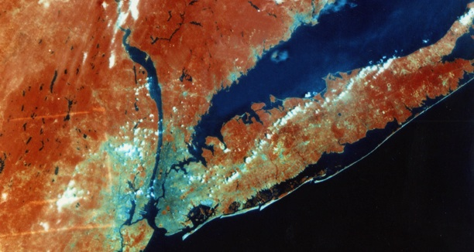
Brookhaven National Laboratory
as seen from space
RHIC
RHIC
NSLS-II
Solar Farm
Long Island
New York City
NSLS-II
S. Fazio - Brookhaven National Lab
9

Slide 10
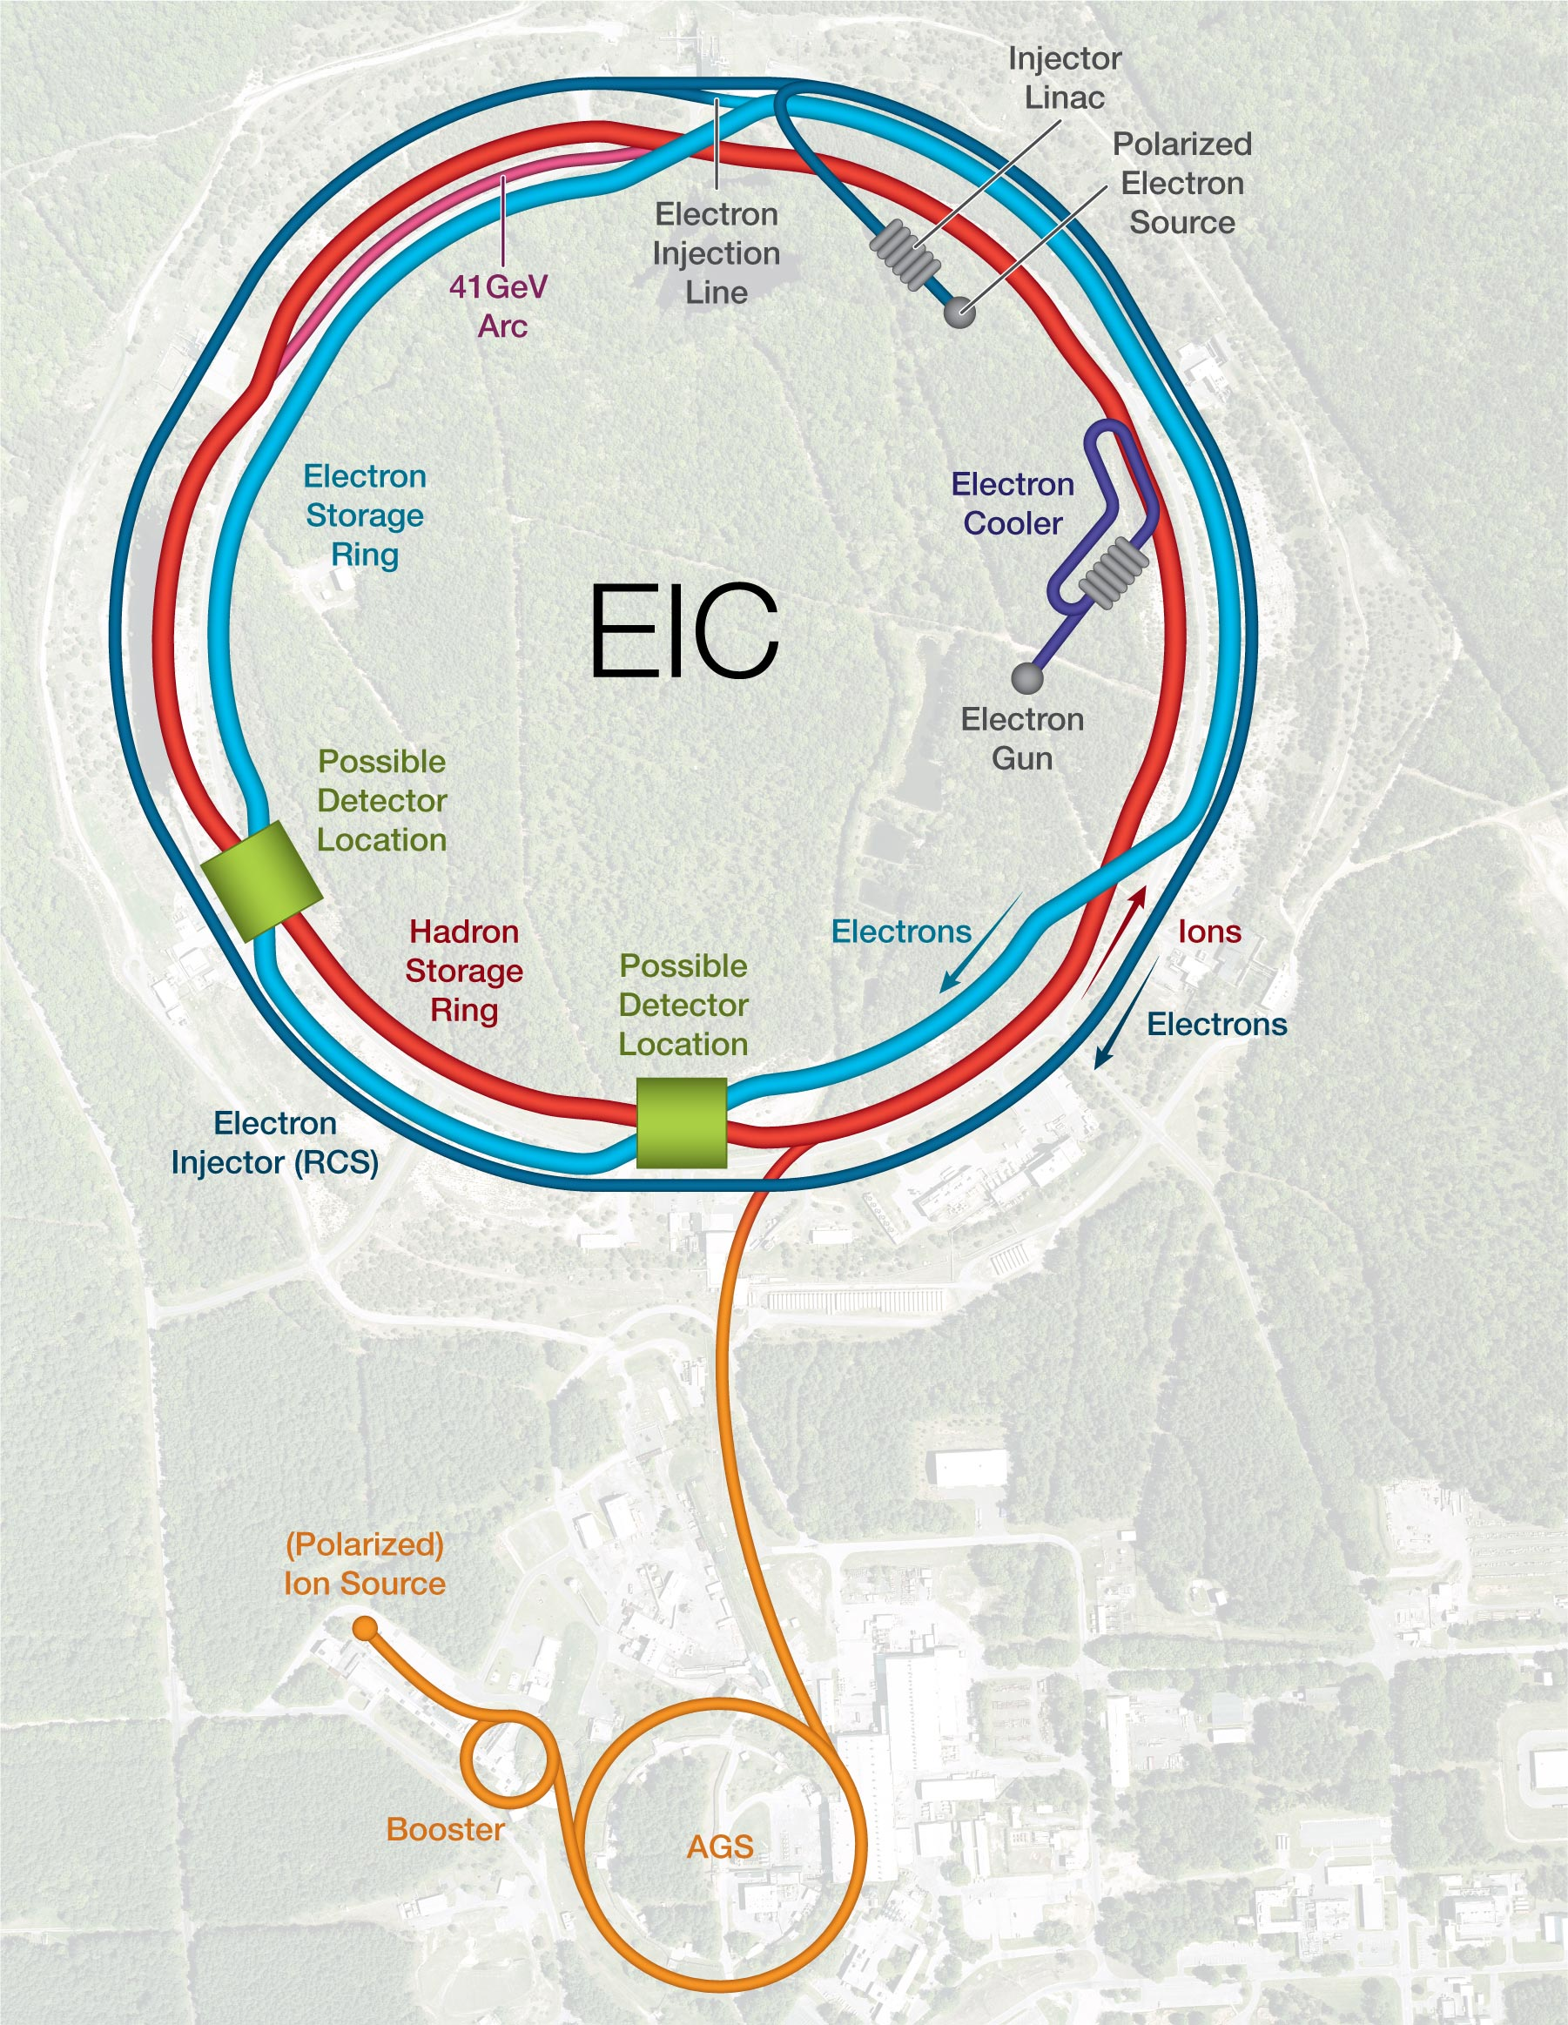
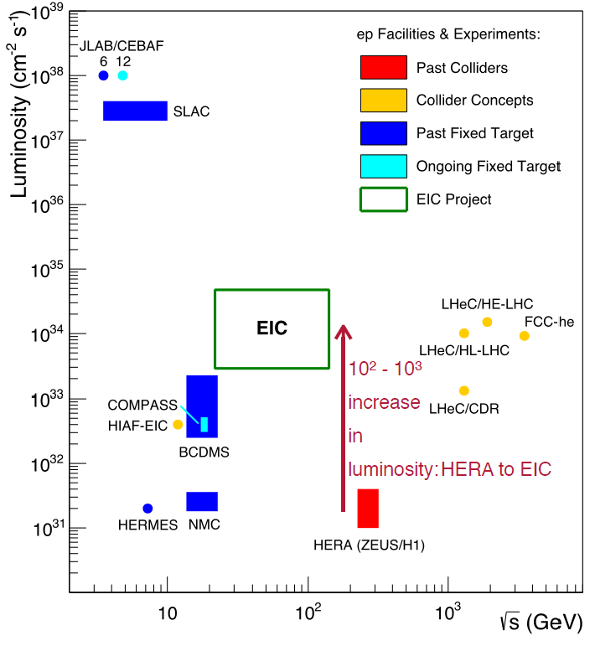

The Electron-Ion Collider
For e-N collisions at the EIC:
High Luminosity: up to 10³⁴ cm⁻²sec⁻¹
100-1000 times HERA
Flexible √s = 30-140 GeV (per nucleon)
Highly polarized beams: e (80%); p, D/³He (70%)
Wide range of nuclear beams: (D to Pb/U)
World’s first
Polarized electron-proton/light ion and electron-Nucleus collider

Slide 11
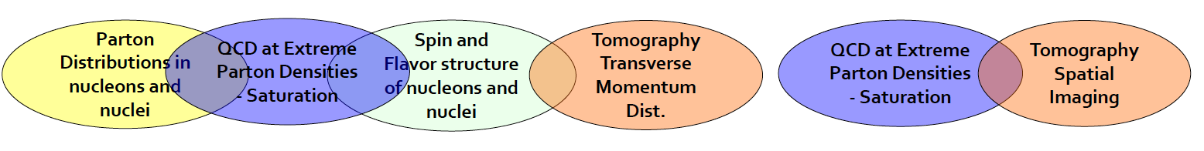
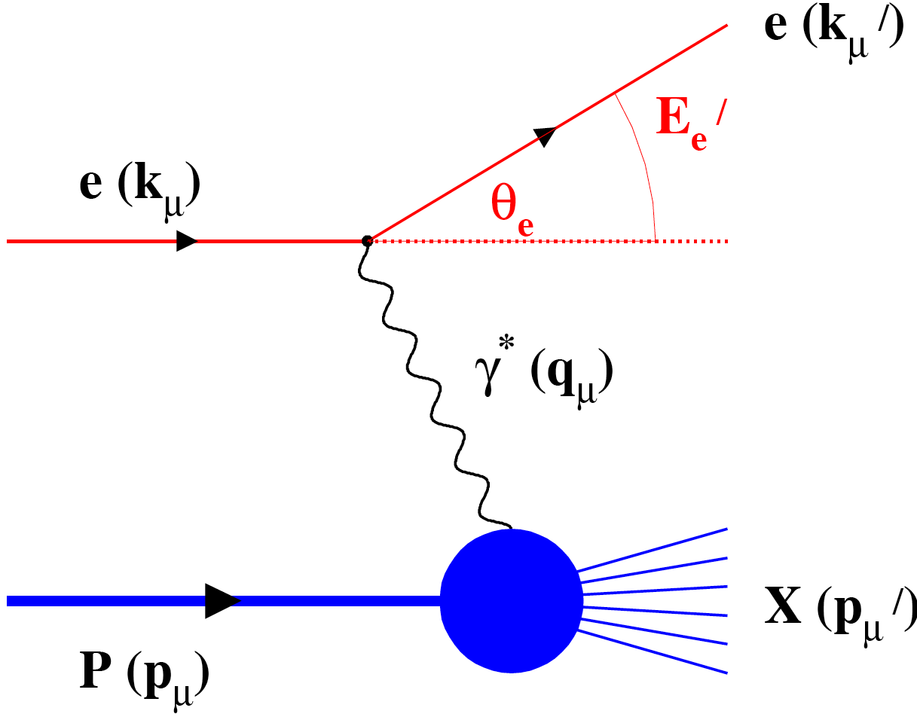
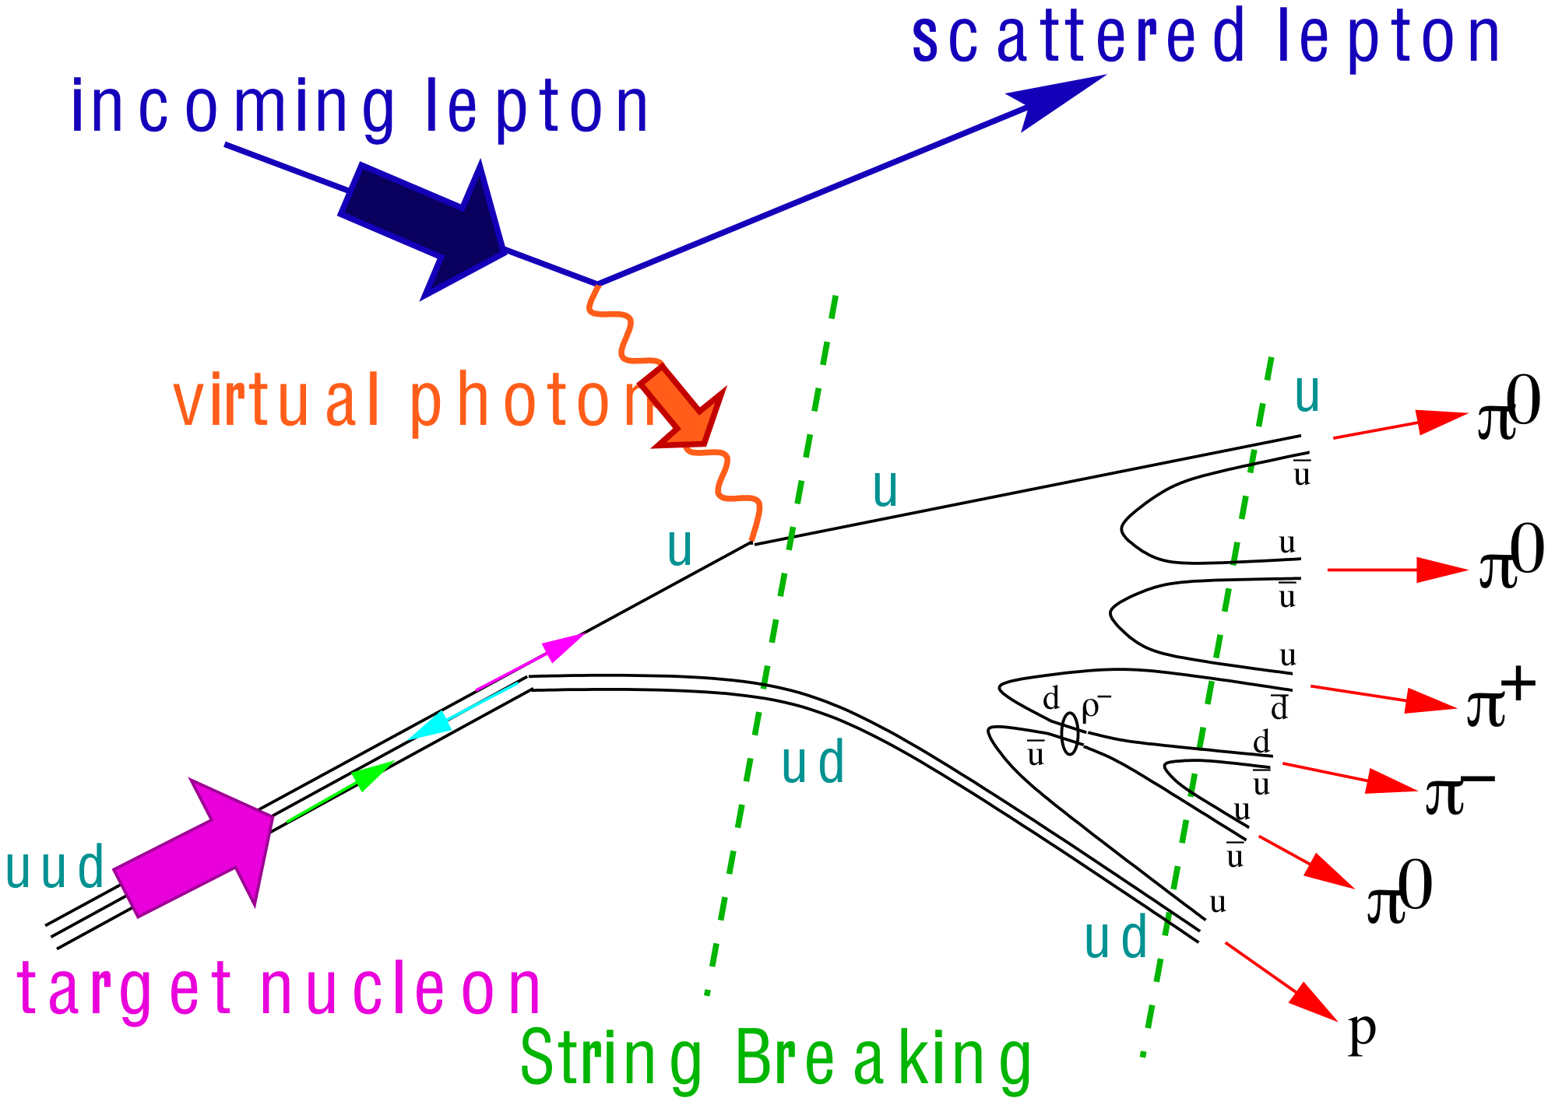
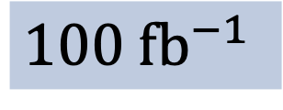
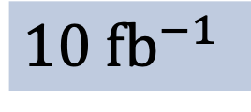
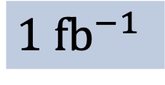
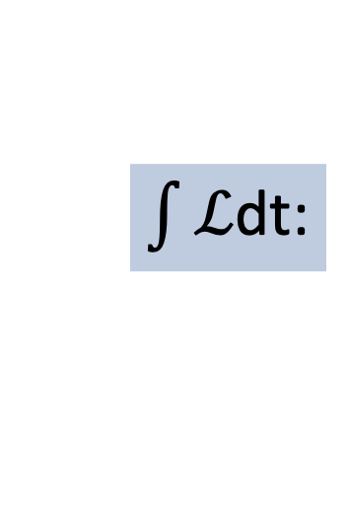
What process must be measured?
e’
γ, π,J/Ψ
e
γ_{L}*
(Q²)
x+ξ
x-ξ
~
~
H, H, E, E (x,ξ,t)
p
p’
t
Inclusive DIS
Semi-Inclusive DIS
Exclusive Reactions
$\int{ℒ}$dt:
$1 \text{f}{\text{b}}^{−1}$
$10 \text{f}{\text{b}}^{−1}$
$100 \text{f}{\text{b}}^{−1}$

Slide 12


Pathway to an EIC
Institute for Nuclear Theory – 2010 Seattle
Workshop:
Gluons and the quark sea at high energies: Distributions, polarization, tomography
arXiv: 1108.1713 [nucl-th] – 547 pages
INT 2010 / 1108.1713
The EIC White Paper - 2015
Eur. Phys. J. A (2016) 52: 268

Slide 13


Pathway to an EIC
In the 2015 Long Range Plan, the American National Science Advisory Committee (NSAC) recommended the realization of an EIC as top priority
“We recommend a high-energy high-luminosity polarized EIC as the highest priority for new facility construction following the completion of FRIB”
http://science.energy.gov/~/media/np/nsac/pdf/2015LRP/2015_LRPNS_091815.pdf
In July 2018, a Report by National Academy of Science (& Engineering & Arts) unanimously concluded that an EIC will be:
“... a unique facility in the world that would answer science questions that are compelling, fundamental, and timely”.
https://www.nap.edu/catalog/25171/an-assessment-of-us-based-electron-ion-collider-science
The U.S. Department of Energy (DOE) started its “critical decisions” with CD0 in December 19 and selected Brookhaven National Lab as the host lab.

Slide 14

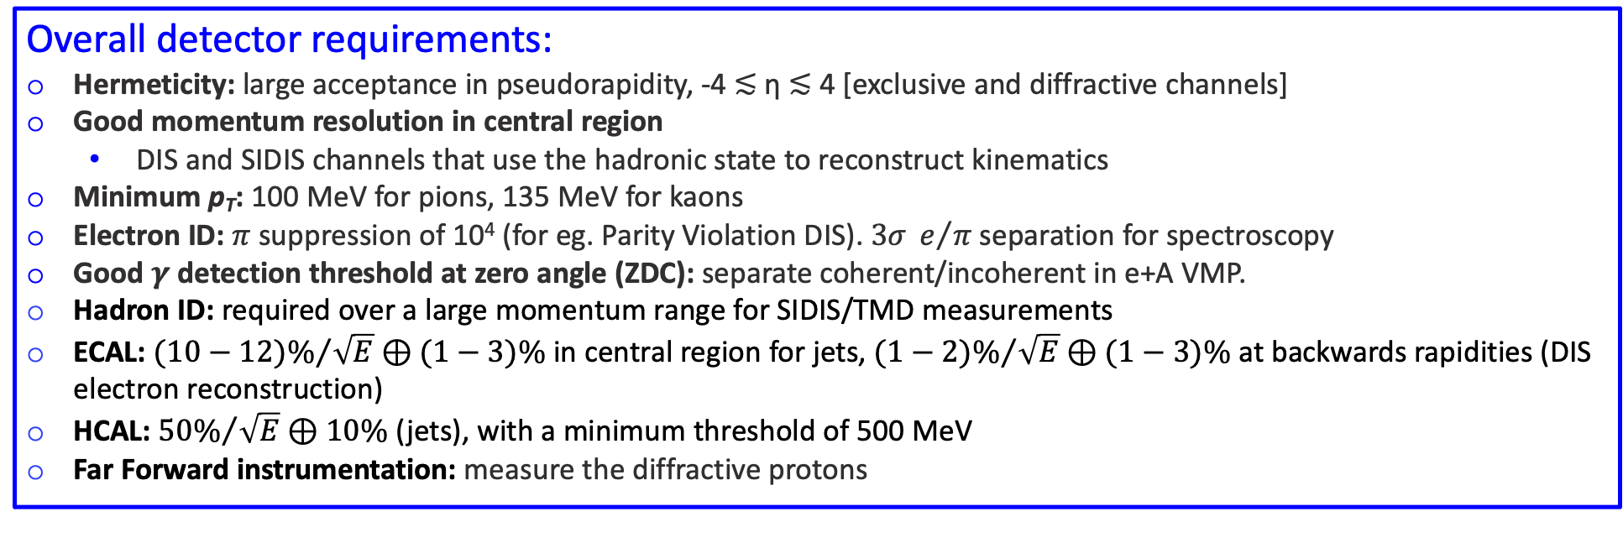
Requirements for a “general-purpose” detector
The Yellow Report Initiative (Jan-Dec 2020) – to advance the state of the documented physics studies (W.P., INT Reports) and detector concepts in preparation for the realization of the EIC.
Report released in March 2021: arXiv:2103.05419
Enormous community effort: 902 pages, 415 authors, 151 institutions
Overall detector requirements:
Hermeticity: large acceptance in pseudorapidity, -4 ≲ η ≲ 4 [exclusive and diffractive channels]
Good momentum resolution in central region
  DIS and SIDIS channels that use the hadronic state to reconstruct kinematics
Minimum p_{T}: 100 MeV for pions, 135 MeV for kaons
Electron ID: $π$ suppression of 10⁴ (for eg. Parity Violation DIS). $3σ{ e}/π$ separation for spectroscopy
Good $γ$ detection threshold at zero angle (ZDC): separate coherent/incoherent in e+A VMP.
Hadron ID: required over a large momentum range for SIDIS/TMD measurements
ECAL: ${(10−12)\%}/{\sqrt{E}}⊕(1−3)\%$ in central region for jets, ${(1−2)\%}/{\sqrt{E}}⊕(1−3)\%$ at backwards rapidities (DIS electron reconstruction)
HCAL: ${50\%}/{\sqrt{E}}⊕10\%$ (jets), with a minimum threshold of 500 MeV
Far Forward instrumentation: measure the diffractive protons

Slide 15

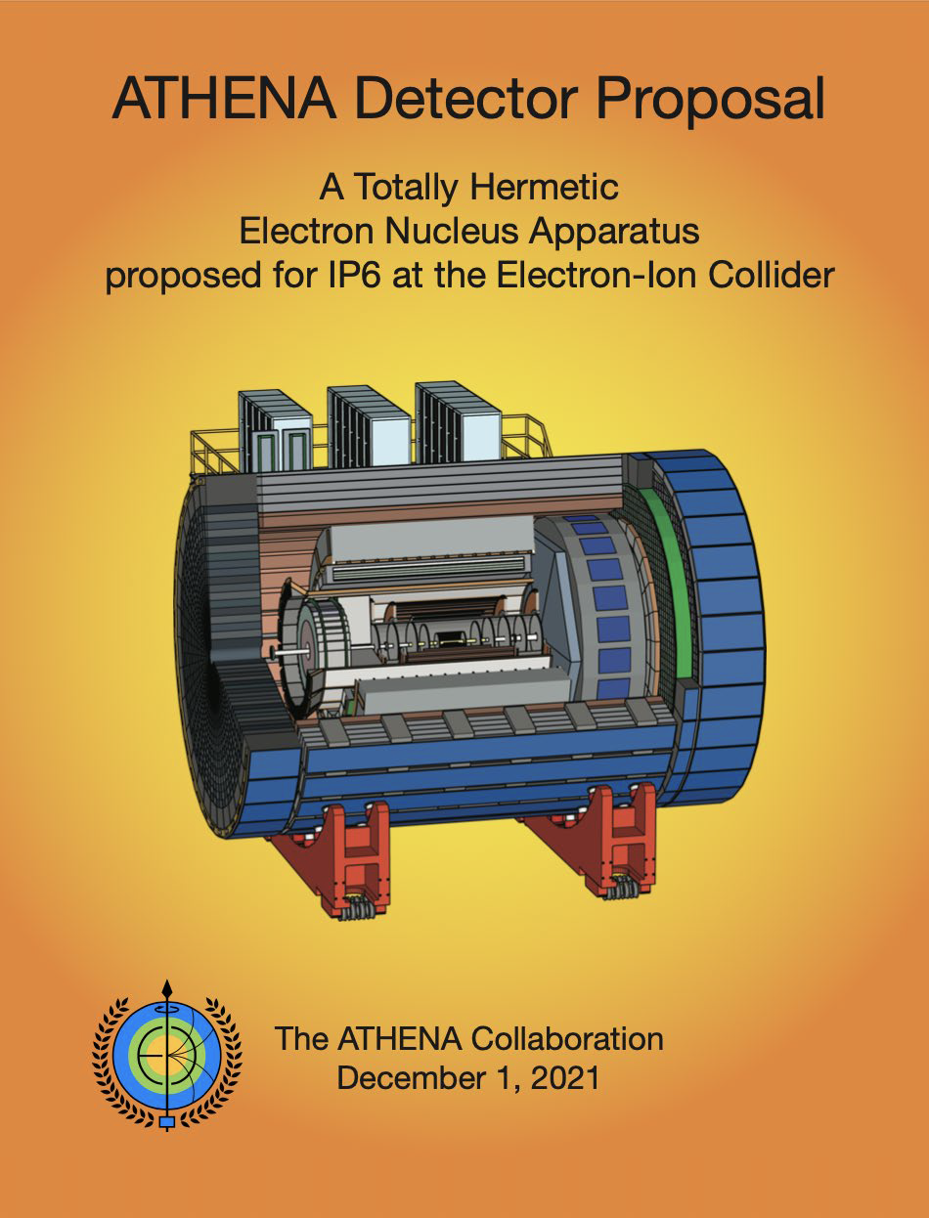
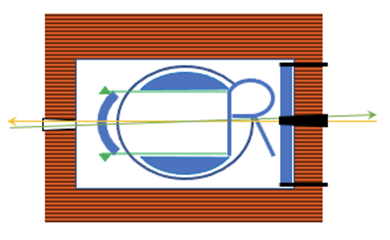

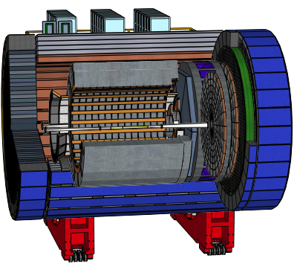
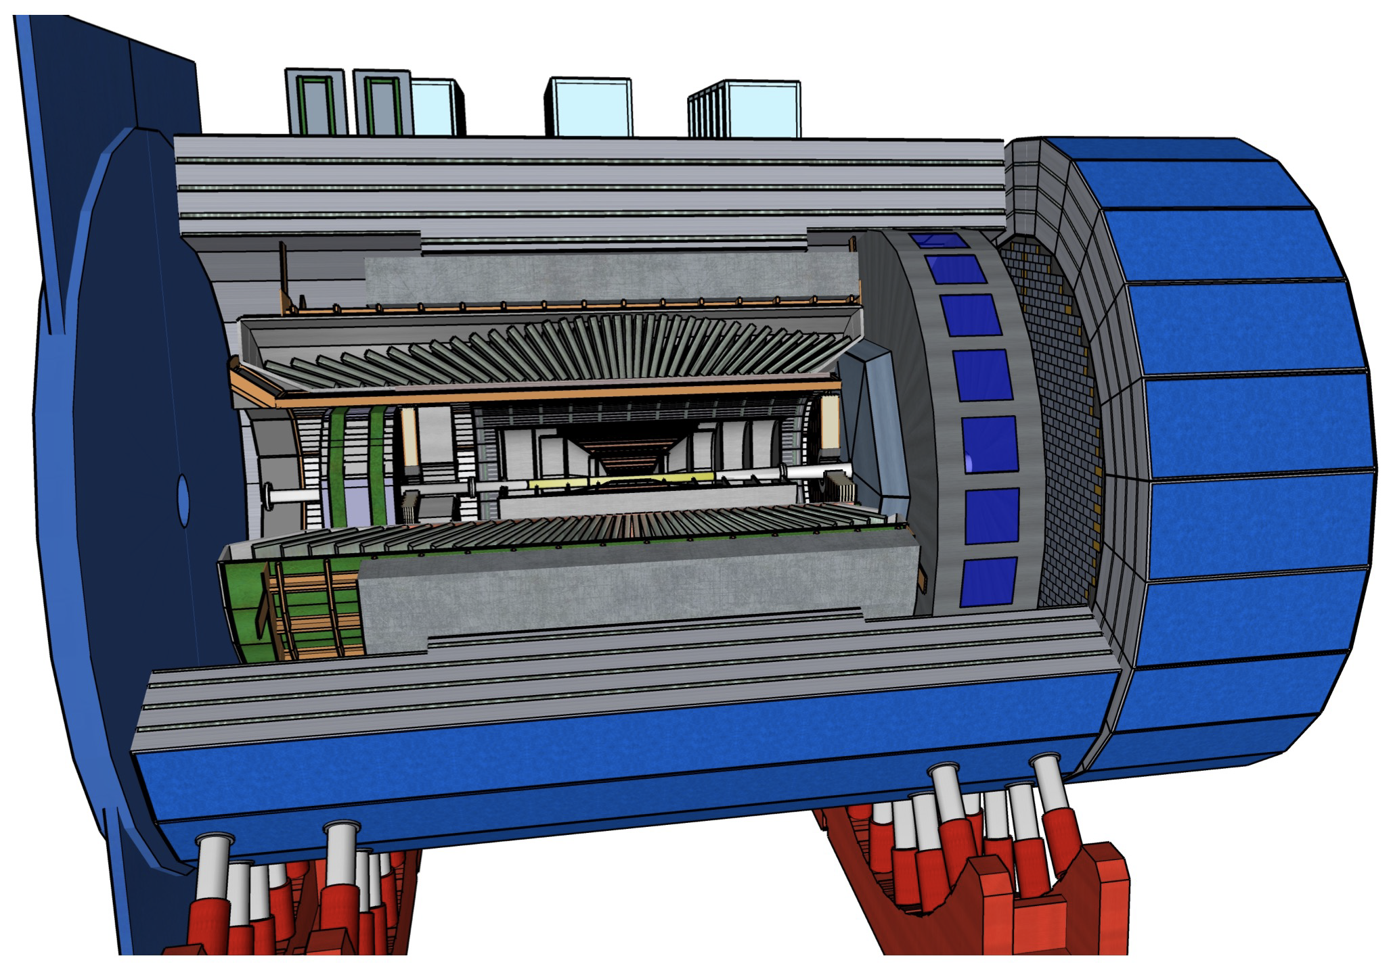
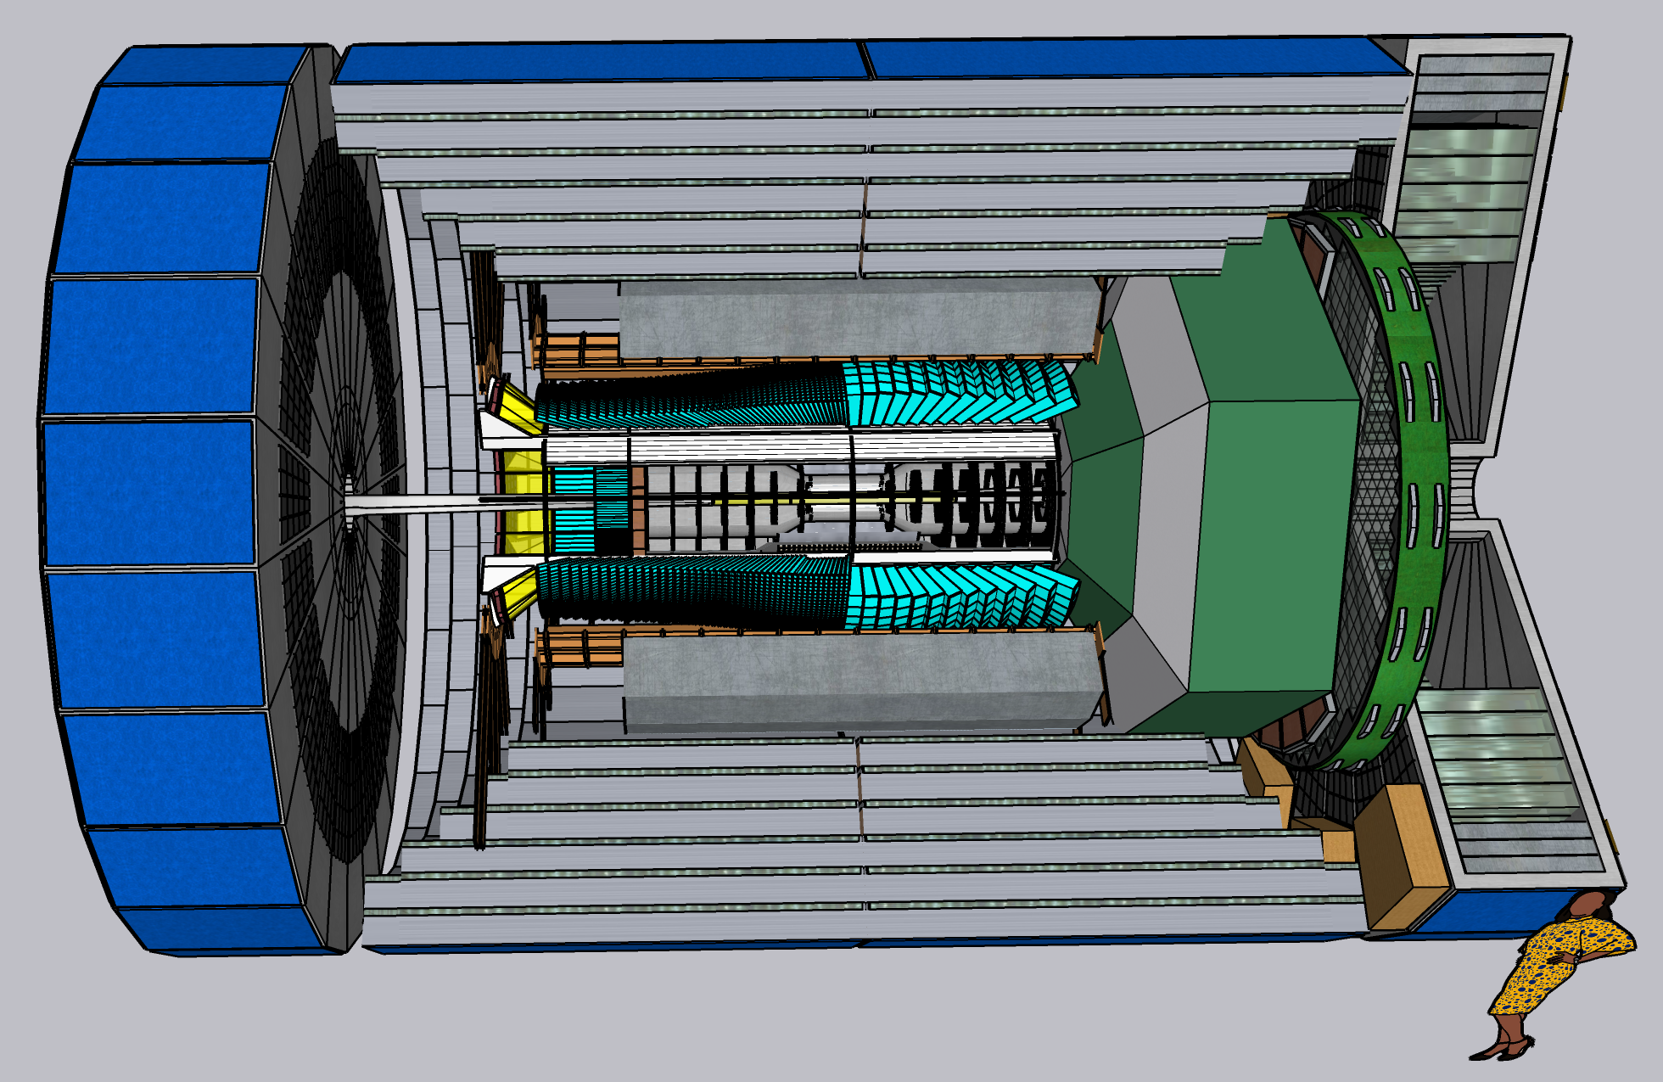
Proposed EIC detectors
March 2021: Call for detector proposals: https://www.bnl.gov/eic/CFC.php
Two proposals for a general purpose
«project detector»
A proposals for a
(still general purpose) complementary detector
I will often show «performance plots» based on these proposals!

Slide 16
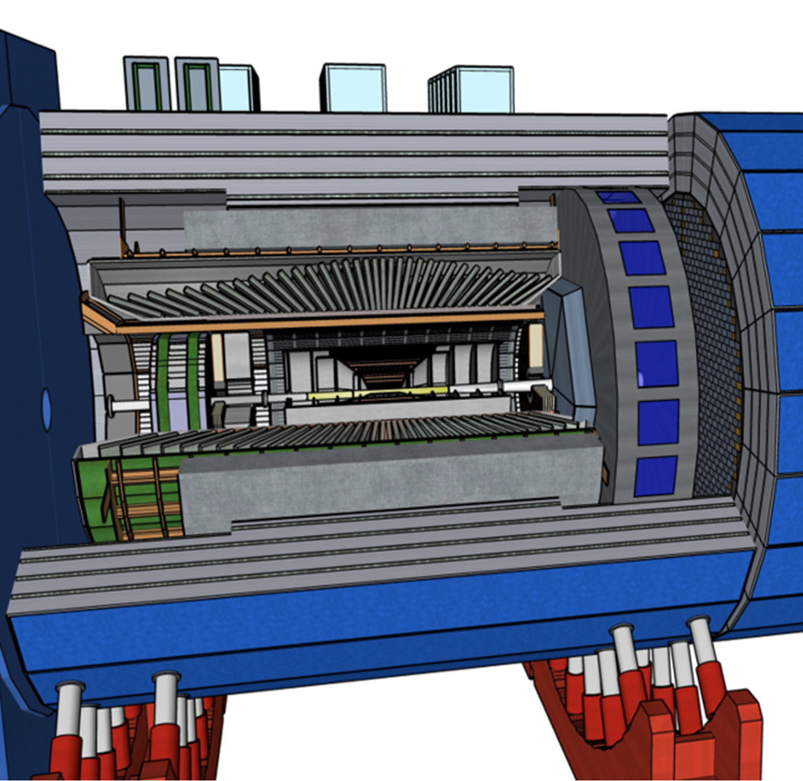
“Project Detector 1”
ECCE as reference design (1.5 T solenoid)
Design will be optimized (ATHENA expertise and beyond)
Collaboration forming process will start at the EIC Users’ Group meeting on July 26-30 at the Stony Brook University of NY
Goal is to form a new collaboration by the end of the current year
Process for including a second detector into the project scope can start soon.

Slide 17
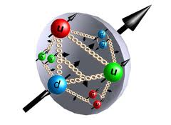

Spin Physics
what is the polarization of gluons at small x where they are most abundant?
what is the flavor decomposition of the polarized sea depending on x?
The Holy Grail
Determine quark and gluon contributions to the proton spin
The Spin Sum Rule

Slide 18
Proton’s helicity structure
Σ_{q}Δq
L_{g}
Jaffe and Manohar “sum rule” [Nucl. Phys. B337, 509 (1990)]
Σ_{q}L_{q}
δq
gluon spin
ΔG
total u+d+s
quark spin
angular
momentum
What we know:
DIS (fixed targ.) + RHIC (till 2009)
[Phys. Rev. Lett. 113, 012001 (2014)]
First time a significant
non-zero Δg(x)
RHIC: All data until 2015 factor 2 reduced uncertainties at x ~ 10⁻³
Expected impact of the EIC:
The x-range will be extended by two orders of magnitude, allowing an extremely precise measurement in the earlier poorly known area

Slide 19
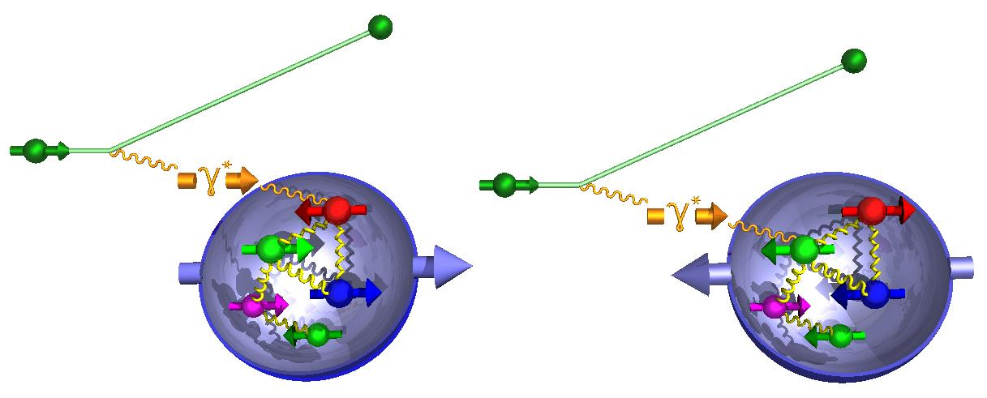
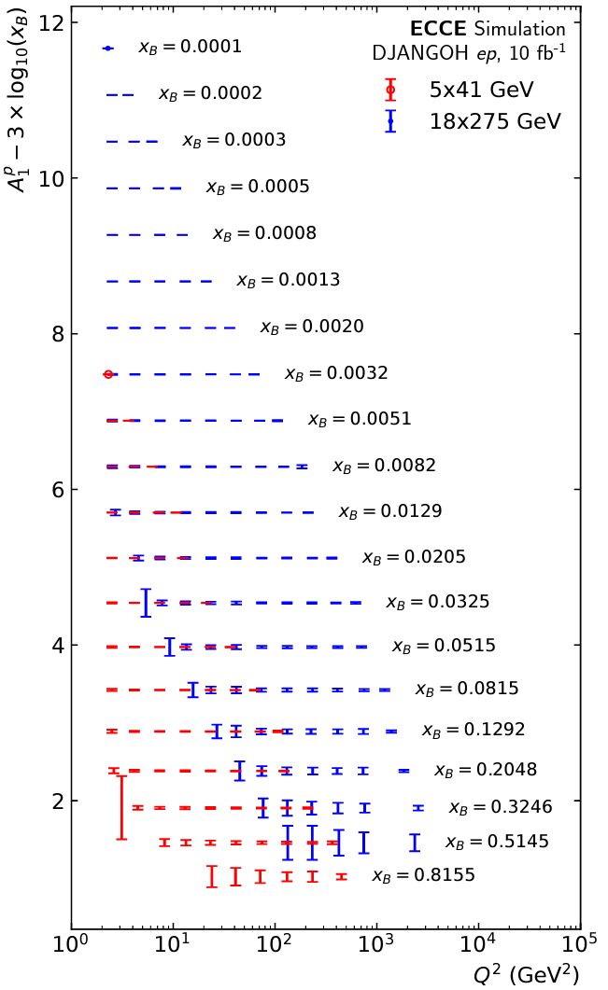
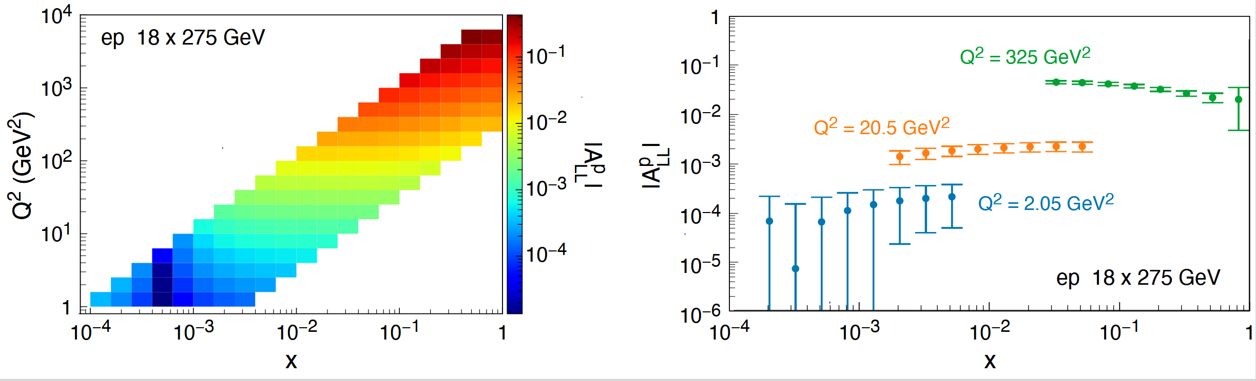

Proton’s helicity structure
Observable: Longitudinal double spin asymmetries ($A_{LL}$)
DIS scaling violations determine gluons at small x
Δg(x,Q²)=g (x,Q²)-g (x,Q²)
Key:
Acceptance
electron id
Inclusive double spin asymmetry A₁(x)
g₁ scaling violation
- Double spin asymm. in NC DIS
10 fb⁻¹
world data
till EIC

Slide 20
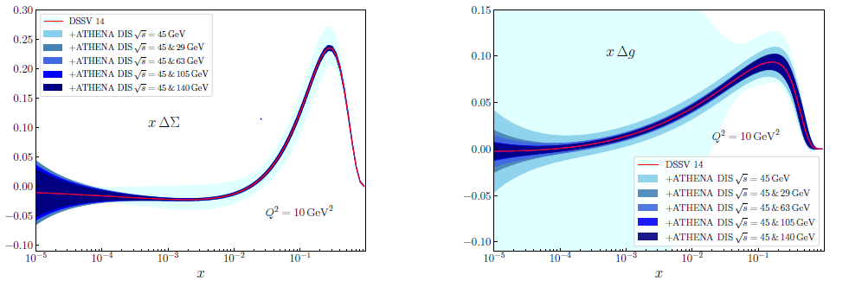

The spin sum rule
q spin
ΔΣ
g spin
Δg
New global fit by
JAM/DSSV collaboration
1/2 -
Quarks
-
Gluons
=
orb. angular momentum

Slide 21
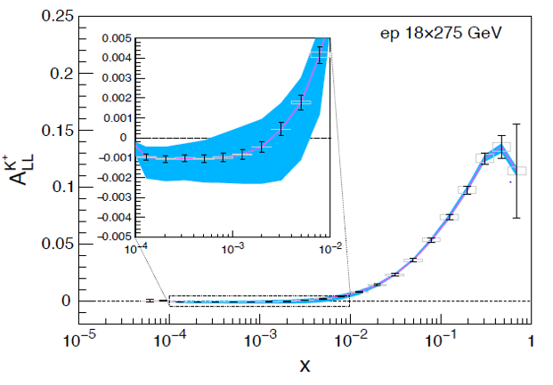
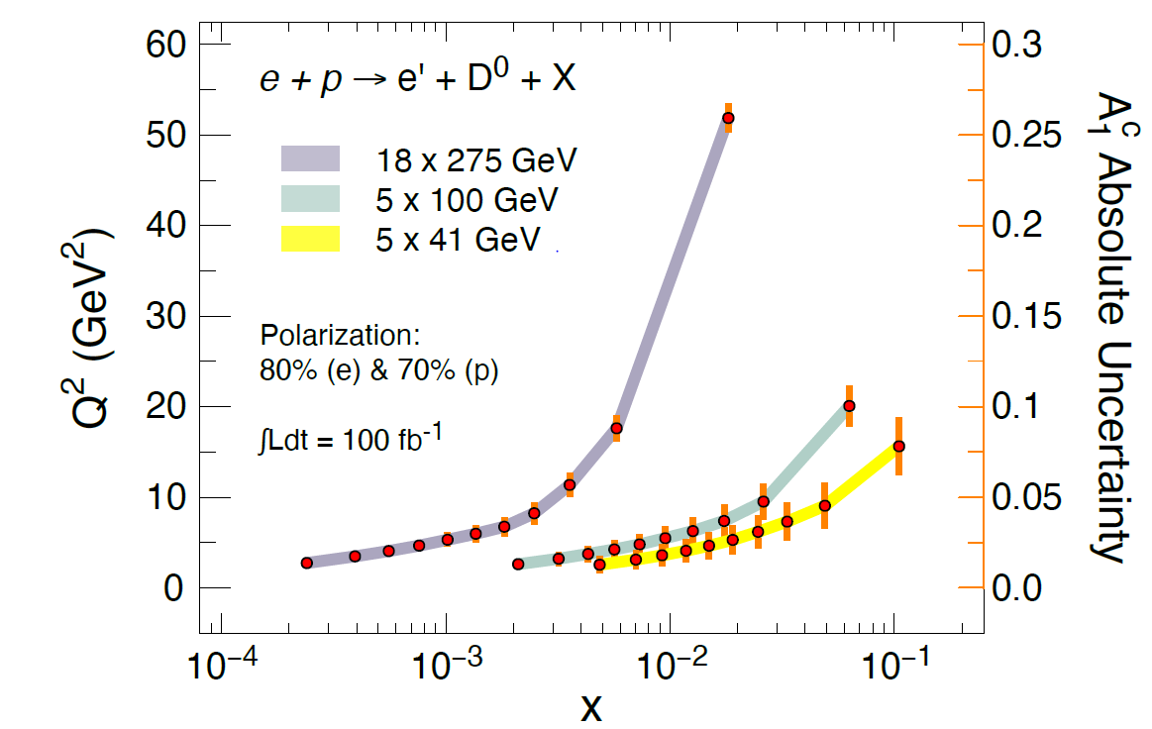
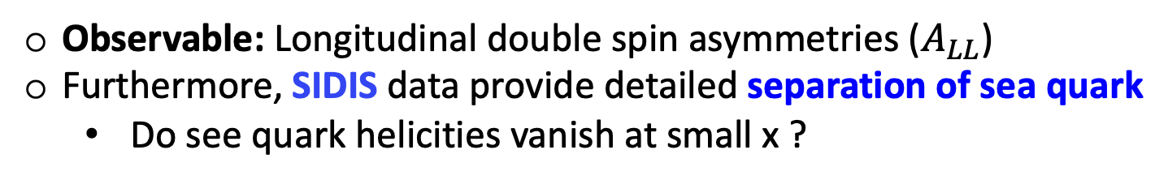
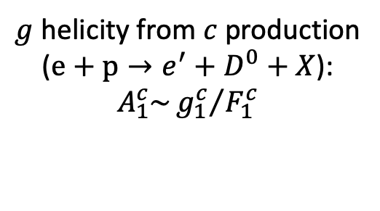
Proton’s helicity structure from SIDIS
Observable: Longitudinal double spin asymmetries ($A_{LL}$)
Furthermore, SIDIS data provide detailed separation of sea quark
  Do see quark helicities vanish at small x ?
Key:
PID (barrel, forward
Vertexing for charm tagging
Charged kaons
Charm production
$g$ helicity from $c$ production
($e+p→e^{′}+D^{0}+X$):
$$A_{1}^{c}\sim {g_{1}^{c}}/{F_{1}^{c}}$$
Theory bands from:
DSSV PDF & DSS FFs
15.5 fb⁻¹

Slide 22
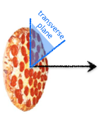
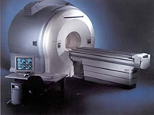
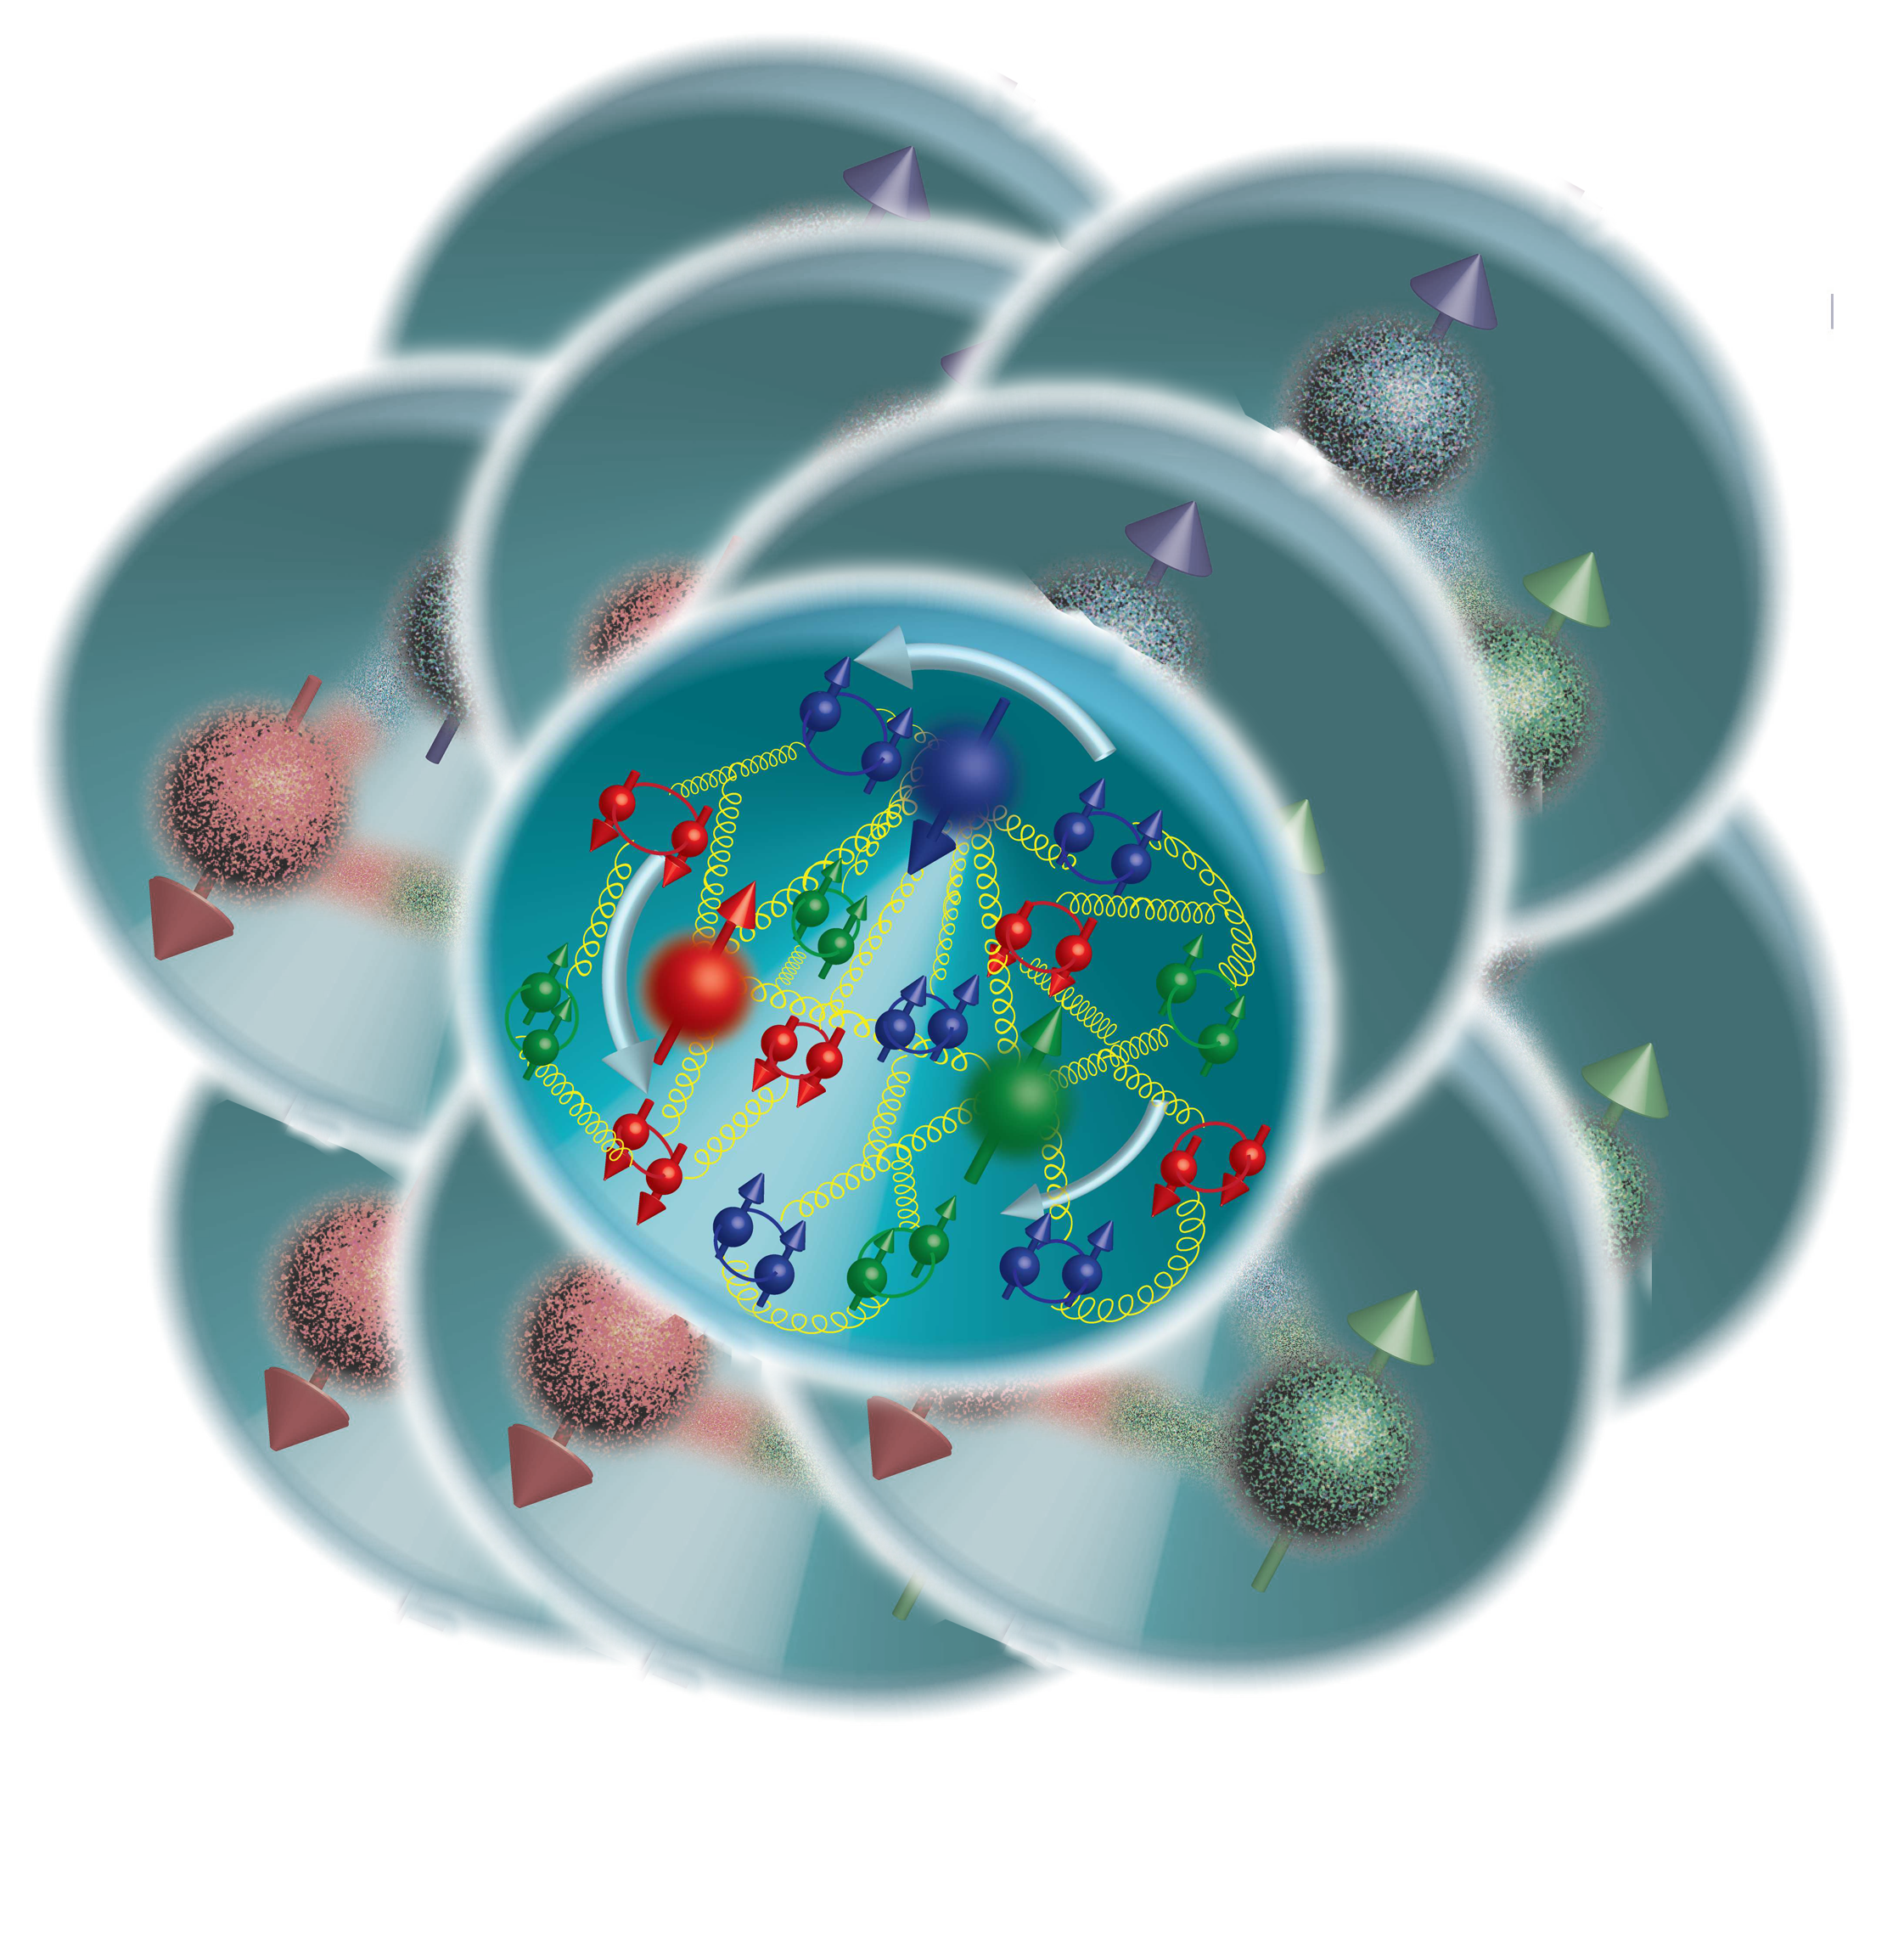
EIC: the Ultimate Multi-dimension Experience!
Proton Imaging
In a fast-moving nucleon the longitudinal size squeezes like a “pizza” but transverse size remains about 1 fm
what is the spatial and momentum distribution of quarks and gluons in nucleons/nuclei?
Can we produce tomographic images at a partonic scale?

Slide 23
Multidimensional imaging of quarks and gluons
Wigner functions
offer unprecedented insight into confinement and chiral symmetry breaking
W(x,b_{T},k_{T})
Momentum
space
∫d²b_{T}
∫ d²k_{T}
Coordinate
space
f(x,k_{T})
f(x,b_{T})
Spin-dependent 3D momentum space
images from semi-inclusive scattering
→ TMDs
Spin-dependent 2D coordinate space (transverse) + 1D (longitudinal momentum) images from exclusive scattering
→ GPDs

Slide 24
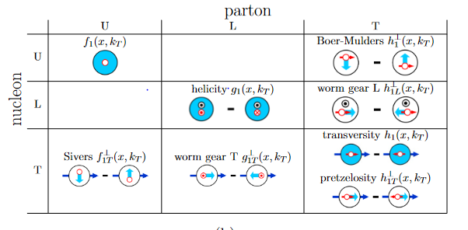

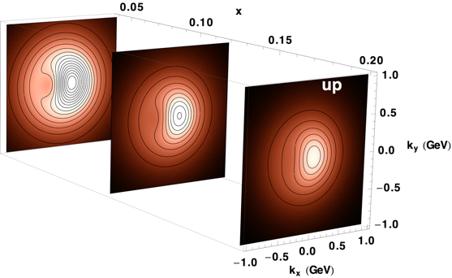
Momentum tomography
Transverse Momentum Dependent distributions (TMDs) are PDFs depending on transverse momentum
At low k_{T}, these functions cannot be perturbatively calculated → need precision measurement
What we want to measure:
6-fold differential cross sections in SIDIS
Azimuthal asymmetries and their modulations

Slide 25
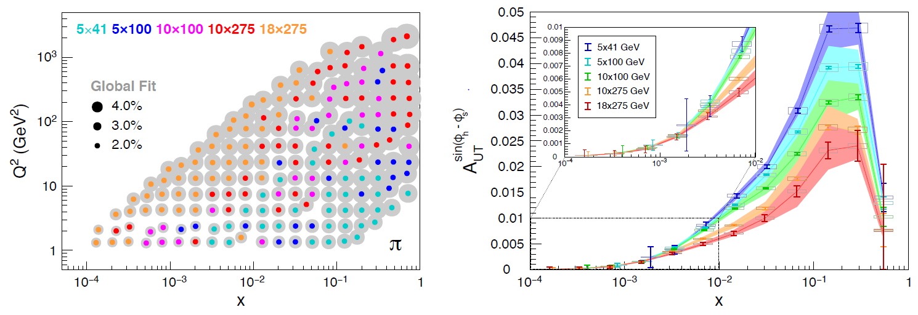
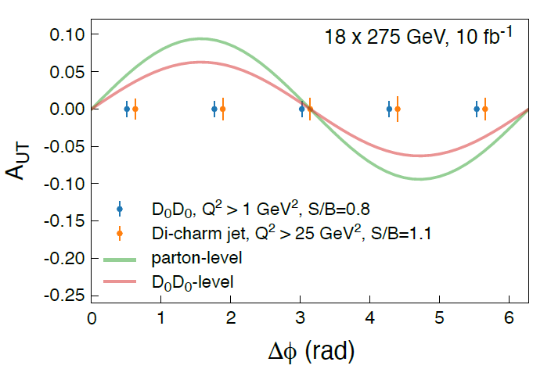
Momentum tomography – SIDIS, Heavy Flavor, Jets
Unpolarized cross section uncertainties
Projected Sievers asymmetries
Heavy flavor
Sensitivity for Sivers in di-charm
Key:
Azimuthal acceptance
PID
Acceptance
Vertexing (heavy flavor)
Quality of tracking
HCal (for jets)

Slide 26

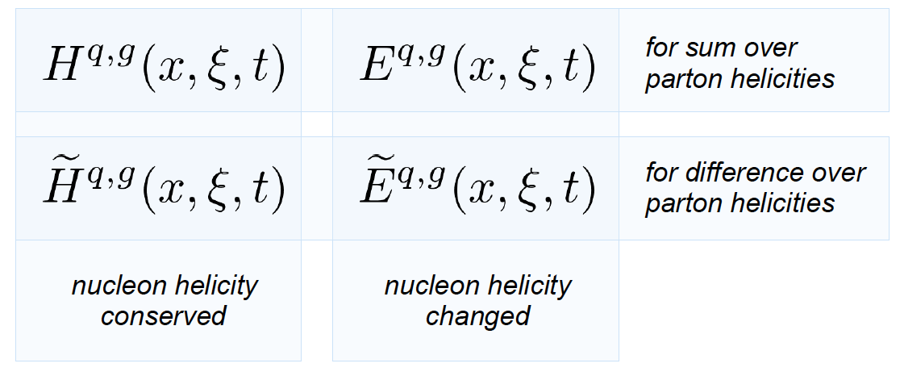
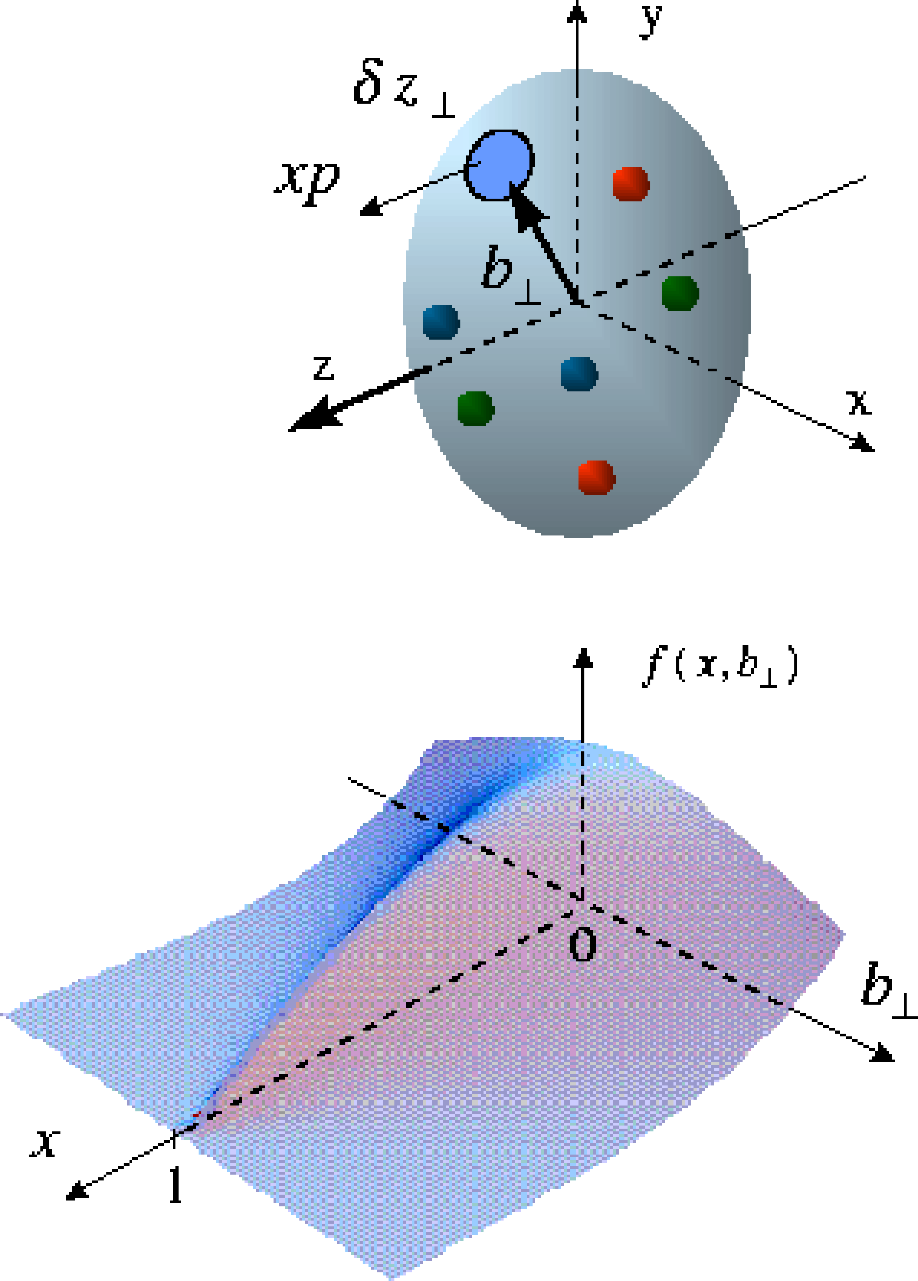
Accessing GPDs – the observables
The nucleon (spin-1/2) has four quark and gluon GPDs
Dominated by H
slightly dependent on E
sin(Φ_{Τ}−φ_{Ν})
governed by E and H
[Requires a polarized proton target]
Responsible for total orbital angular momentum through Ji sum rule: a window to the SPIN physics
[X.D. Ji, Phys. Rev. Lett. 78, 610 (1997)]
Done @ HERA
[Requires a positron beam]
Re(A) related to D-term, “last global unknown property” of a hadron, related to distribution of forces inside the nucleon [M. V. Polyakov and P. Schweitzer, Int. J. Mod. Phys. A 33, no. 26, 1830025 (2018)]

Slide 27






Accessing GPDs in exclusive processes
DVCS (γ)
VM (ρ, ω, φ, J/ψ, Υ)
^{γ*}
^{γ}
^{γ*}
V
4-momentum transfer
at the p vertex:
IP
$$p$$
$$p^{′}$$
$$p$$
$$p^{′}$$
$$t$$
Far Forward
spectrometers
t
Scale:
Q²
Q² + M²
DVCS:
Very clean experimental signature
No VM wave-function uncertainty
Hard scale provided by Q²
Sensitive to both quarks and gluons [via Q² dependence of xsec (scaling violation)
HEMP:
Uncertainty of wave function
J/Psi → direct access to gluons, c+bar-c pair produced via quark(gluon)-gluon fusion
Light VMs → quark-flavor separation
Psedoscalars → helicity-flip GPDs

Slide 28
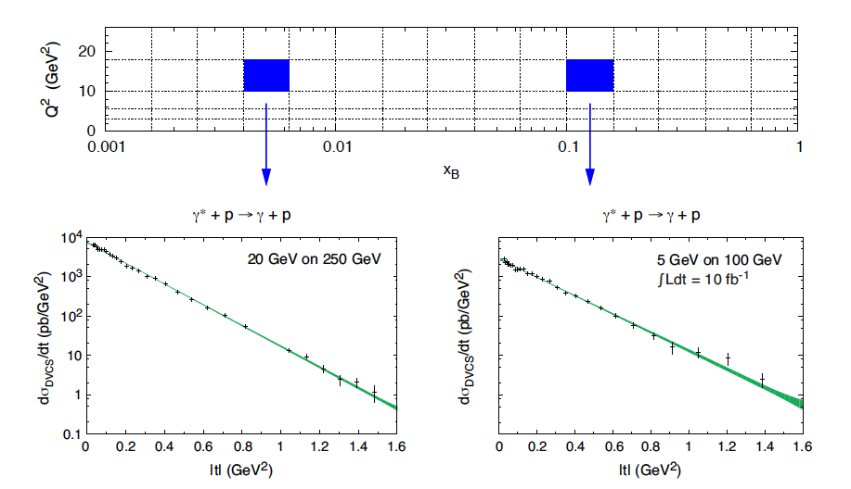
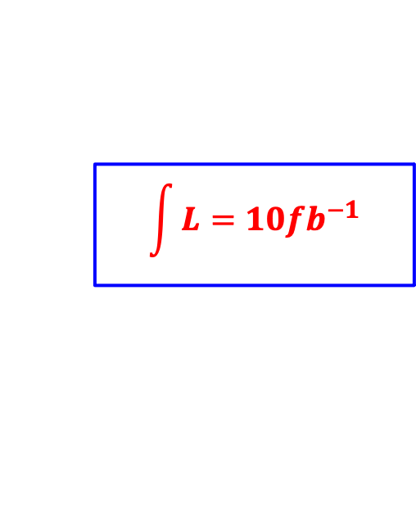
DVCS – differential cross section
$$\int{L=10{fb}^{−1}}$$
EIC White Paper
L = 10 fb⁻¹ per energy configuration
Measurement dominated by systematics
Fine binning in a wide range of x-Q² needed for GPDs
Assumed t-range: 0.03 < |t| (GeV²) < 1.6
Fourier transform of dσ/dt → partonic profiles
DVCS
Unpolarized
sea-quarks
Polarized
sea-quarks
gluons
Shift due to GPD E
E.C. Aschenauer, S. F., K. Kumerički, D. Müller [JHEP09(2013)093]

Slide 29







Detector Proposals- VMs
$$\vec{e}+\vec{p}→e+p+\vec{V}$$
Key:
$γ/{π^{0}}$ separation in ECAL for DVCS
Acceptance and low material for VM decay leptons
Resolution of lepton pair inv. mass
Muon id
Scattered electrons over full kinem.
$t$- lever arm in FF spectrometers
$$\int{L=100{fb}^{−1}}$$
$Y$ Photopoduction near threshold and electro-production (Q² < 1 GeV²)
-> origin of p-mass

Slide 30





Study of neutrons with light nuclei
Possibility to study neutron structure
DVCS on neutron compared to proton is important for flavor $u/d$ separation
𝛾
DVCS on incoherent D (D breaks up) but coherent on the neutron, the “double tagging” method
  Tag DIS on a neutron (by the ZDC)
  Measure the recoil proton momentum
  The recoil proton momentum cone is
    $α_{R}={\left(E_{R}+p_{R||}\right)}/{\left(E_{D}+p_{D||}\right)}$ and $p_{RT}$
  Gives you a free neutron structure, not affected by final state interactions
ATHENA – DVCS on e+D:
80-90% acceptance at low |t|,
|t|-acceptance loss at higher value mostly due to the loss in tagging the active neutron in ZDC.
Alternatively, |t| can be measured via scattered e and $γ$ → higher acceptance at large |t|.
Proton momentum is well reconstructed

Slide 31

And what about the nuclei?
How does the nuclear environment affect the distribution of quarks and gluons and their interaction in nuclei?
Incoming
Electron Beam
Where does the saturation of the gluon density set in?

Slide 32


Nuclear Structure Functions
Ratio:F₂(x,Q²)_{Pb}/F₂(x,Q²)_{p}
Inclusive DIS on e+A analog to e+p:
quark+anti-quark
gluons
(or tag on F₂-charm)
DGLAP evolution model:
predicts Q² but not A-dependence and x-dependence
Saturation models:
predict A-dependence and x-dependence but not Q²
→ Need: large Q² lever-arm for fixed x, A-scan
Aim at extending our knowledge on structure functions into the realm where gluon saturation effects emerge ⇒ different evolution
An EIC provides a factor 10 larger reach in Q² and low-x compared to available data

Slide 33


Nuclear Modifications to Patonic distributions
Inclusive DIS
Quark charm production
Charm production:
Novel probe!
Direct access to gluons at medium to high x by tagging photon-gluon fusion
  Higher $\sqrt{s}$ energy constrains gluons at mid- and low-x
  Fitting the charm pseudo-data has a dramatic effect at high-x
E.C. Aschenauer, S. F., M.A.C. Lamont, H. Paukkunen, P. Zurita
[arXiv:1708.05654]

Slide 34









Detec. Proposals - Collinear PDFs on protons and nuclei
nPDFs: Au/p
Impact after global fits
proton PDFs
gluon nPDFs
constrained at the ~10% level over large x-arm
$$g$$
$$g$$
$$u_{V}$$
proton PDFs
impact on HERA + LHC global fits
EIC/ATHENA constrains the high-x region
$$\overline{u}$$
xFitter framework
$$d_{V}$$
$$u_{V}$$
$$u_{V}$$
Key:
Fine resolution in y over a large phase space
Minimum x for p fit
Minimum x for A fit

Slide 35



A window into the Gluon Saturation regime
gluon
emission
gluon recombination
?=?
L ~ (2m_{N} x)⁻¹ > 2 R_{A} ~ A^{1/3}
Probe interacts coherently with all nucleons
Gold: 197 times smaller effective x !
EIC will map the transition between a non-saturated and a saturated regime with high precision, by making use of a large range of nuclei and spin
With its flexible ion source, we will be able to measure the A-dependence of the saturation scale Q_{s}(x)
→ a fundamental landmark of QCD
Ca
p

Slide 36


Saturation via Di-hadron correlations
side-view:
jet-1
beam-view:
p
π
A
Low gluon density (ep):
pQCD predicts 2→2 process
⇒ back-to-back di-jet
jet-2
High gluon density (eA):
2 → many process
⇒ expect broadening of away-side
Key:
Quality detection at mid rapidity
Reconstruction of dijets sensitive to saturation effects

Slide 37

Saturation via Diffraction
Diffraction
High sensitivity to gluon density in linear regime σ~[g(x,Q²)]²
Inclusive diffraction:
Transition in M_{x}
suppress
by detecting
break-up
neutrons

Slide 38


The EIC Users’ Group
EIC is an International enterprise!
EIC Users Group formally established in 2016
> 1331 di Ph.D. members
266 institutions from more than 36 countries
Continuously growing!
Visit EICUG.ORG
Institutions – Region of the World
25%
30%
39%

Slide 39
The EIC Project time schedule
E.C. Aschenauer – Det. 1 Meeting, Apr. 22, 2022
EIC
Operating* Funds
Project Engineering and Design (PED) Funds
Construction & PED
Funds
Operating Funds
Initiation
Definition
Execution
Closeout
Conceptual Design
Preliminary Design
Final Design
Construction
Critical
Decisions
CD-0
Approve Mission Need
CD-1
Approve Alternative Selection
and Cost
Range
CD-2
Approve Performance Baseline (PB)
CD-3
Approve Start of Construction or Execution
CD-4
Approve
Start of Operations or Project Completion
Gateway Reviews
CD-0, Mission Need
CD-1, Alternative Selection and Cost Range
CD-2, Performance Baseline
CD-3a, Long Lead Procurement
    EIC Critical Decision Plan at CD-1*
    CD-2/3a April 2023
    CD-3 July 2024
    CD-4a early finish July 2030
    CD-4a July 2031
    CD-4 early finish July 2031
    CD-4 July 2033
*revision ongoing based on FY22 actuals.

Slide 40
Summary
The EIC (with a state of art detector) will allow us to obtain the answers to the big questions discussed
  Solve the proton spin puzzle
  How visible matter emerges from quarks and gluons, confined in hadrons?
  3D imaging in momentum and coordinate space of nucleons and nuclei
    Investigate the origin of proton mass
  Map the region of the transition from non-saturated to saturated regime
  And much more I had no time to cover: e.g. Spectroscopy, Cold Nuclear matter, Wigner fnc., separation of Y states...
Excellent proposals have been presented for possible collider detector with high resolution, wide acceptance and good particle identification
  we are one single dedicated and enthusiastic community worldwide.

Slide 41


Slide 42

DVCS at the EIC
E.C. Aschenauer, S. F., K. Kumerički, D. Müller [JHEP09(2013)093]
DVCS signal
Bethe-Heitler QED bkgd.
Comprehensive EIC studies
Signal extraction “a la HERA”
xSec meas.: Specific requirements to suppress BH
keep BH/sample below 60% at high energies
Radiative Corrections evaluated
detector acceptance & smearing
t-slope: b=5.6 compatible with H1 data
|t|-binning is (3*resolution)
5% systematic uncertainties
Overlap with HERA:
Large impact on current fits at low x
Overlap with JLAB12:
Sanity check
Intermediate region:
Fine mapping of the GPDs evolution
HERA results limited by lack of statistics
EIC: the first machine to measure cross sections and asymmetries

Slide 43

J/ψ signal vs background
Yellow Report: Sylvester Joosten (ANL)
Comparisons of signal and di-lepton background (empty circles)
Basic analysis cuts applied
Electroproduction (Q²>1GeV²): Di-lepton background under control at all energies for heavy mesons [J/ψ; Y]
photoproduction (Q²~0): at lower energies, di-lepton higher that signal at backward rapidities: η<-2 (J/ψ) and η<-3 (Y)

Slide 44


Extracting F_{L} (e+Au)
Higher energy EIC: √s = 63, 78, 89 GeV
Simulation:
[√s = 63 GeV] –> L = 2 fb⁻¹/A
[√s = 78 GeV] –> L = 4 fb⁻¹/A
[√s = 89 GeV] –> L = 4 fb⁻¹/A
Errors still dominated by systematics
Total simulated event sample L = 10 fb⁻¹/A
total error = stat. + sys. in quadrature
assumed sys. = 3%

Slide 45
Charm production: a unique tool!
Direct access to gluons at medium to high x by tagging photon-gluon fusion
Helps determining heavy quarks mass scheme
Novel probe!
Selection of charm-production events:
We select kaons in the final state of the D meson decay, looking for:
a displaced vertex: 0.01 cm <|Vertex|< 3 cm
Momentum within the acceptance of an EIC model detector

Slide 46


The 2021 “marathon”
February 2021: EIC Conceptual Design Report: https://doi.org/10.2172/1765663
8 March 2021 Yellow Report released: https://arxiv.org/abs/2103.05419
March 2021: Call for detector proposals: https://www.bnl.gov/eic/CFC.php
March: First meetings of protocollaborations
28 June 2021: CD-1 passed "completion of the project Definition Phase and the conceptual design."
2-7 August 2021 EICUG meeting: https://indico.bnl.gov/event/11463/
10 August 2021 call EIC Detector R&D FY22: https://indico.bnl.gov/event/10974/contributions/53172/attachments/36485/59965/Detector_RD_Plan_Aug10.2021.pdf
1st December 2021: experiment proposals sent to DoE (ATHENA, ECCE, CORE)
13-15 December 2021: first meeting of Detector Proposal Advisory Panel vis à vis proto-collaborations

