Slide 1




Applications of Machine Learning to Lattice Quantum Field Theory
Biagio Lucini
(work in collaboration with G. Aarts and D. Bachtis)
Strong and Electro-Weak Matter 2022, Paris, France, June 2022

Slide 2
Overview
Augmenting physical knowledge with Machine Learning
Methods and models
Quantitative characterization of phase transitions with Machine Learning
Deriving new observables with Machine Learning
Inverting the renormalization group flow with Machine Learning
Summary and perspectives

Slide 3
Machine Learning for Phase Transitions
Recent and current problems investigated include
Can a Machine Learning algorithm detect a phase transition?
Which algorithms are “better”?
Can we find the order parameter?
Can we reconstruct the symmetry that drives the transition?
To which precision can we determine the transition temperature?
With which accuracy can we measure quantities such as critical exponents?
Can we see the features (e.g, topological excitations) that are relevant for the transition?
Can machine learning invert the Renormalisation Group flow?

Slide 4
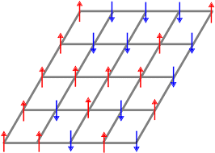
The Ising Model in D=2 dimensions

Slide 5
The Ising critical point

Slide 6
The self-interacting scalar field in D=2
Action
We fix and find a line of critical points, depending on the ratio
We consider the reference critical values
[D. Schaich, W. Loinaz, arXiv:0902.0045]

Slide 7
Convolutional Neural Networks

Slide 8
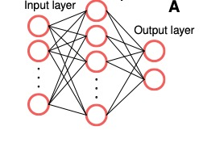
Exposing the phase structure
Neural Network trained on a square lattice
Critical temperature on the triangular lattice determined at the permille level (finite size shift?)
[Carrasquilla and Melko, Nature Physics volume 13, pages 431–434 (2017), arXiv:1605.1735]

Slide 9
Summary of other results
[C. Giannetti, B. Lucini and D. Vadacchino, Nucl.Phys.B 944 (2019) 114639, arXiv:1812.06726]
Critical exponents reproduced with very good accuracy
The machine learning method (SVM) finds the (square of the) magnetization as the decision function
The symmetry is encoded in the kernel transformation
Independence of the (sensibly chosen) training temperatures

Slide 10
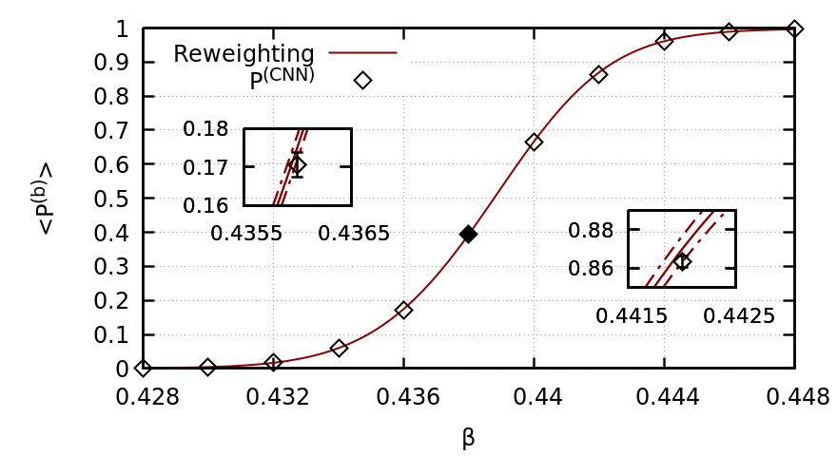
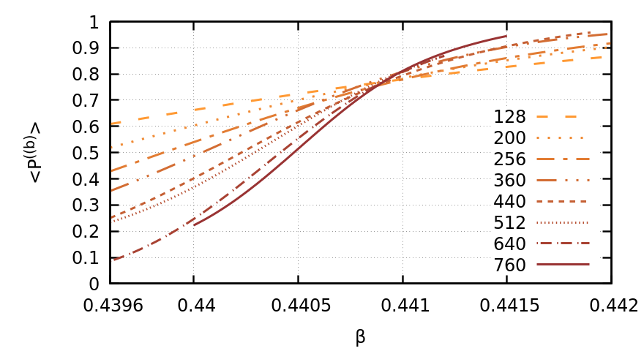
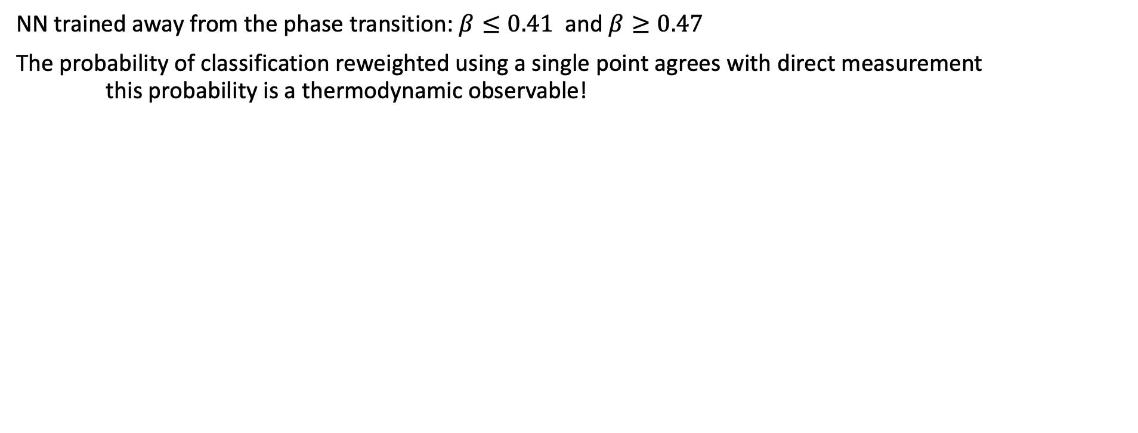
Probability of classification as an observable
NN trained away from the phase transition: $β≤0.41$ and $β≥0.47$
The probability of classification reweighted using a single point agrees with direct measurement this probability is a thermodynamic observable!
[D. Bachtis, G. Aarts and B. Lucini, Phys. Rev.E 102 (2020) 3, 033303, arXiv:2004.14341]

Slide 11
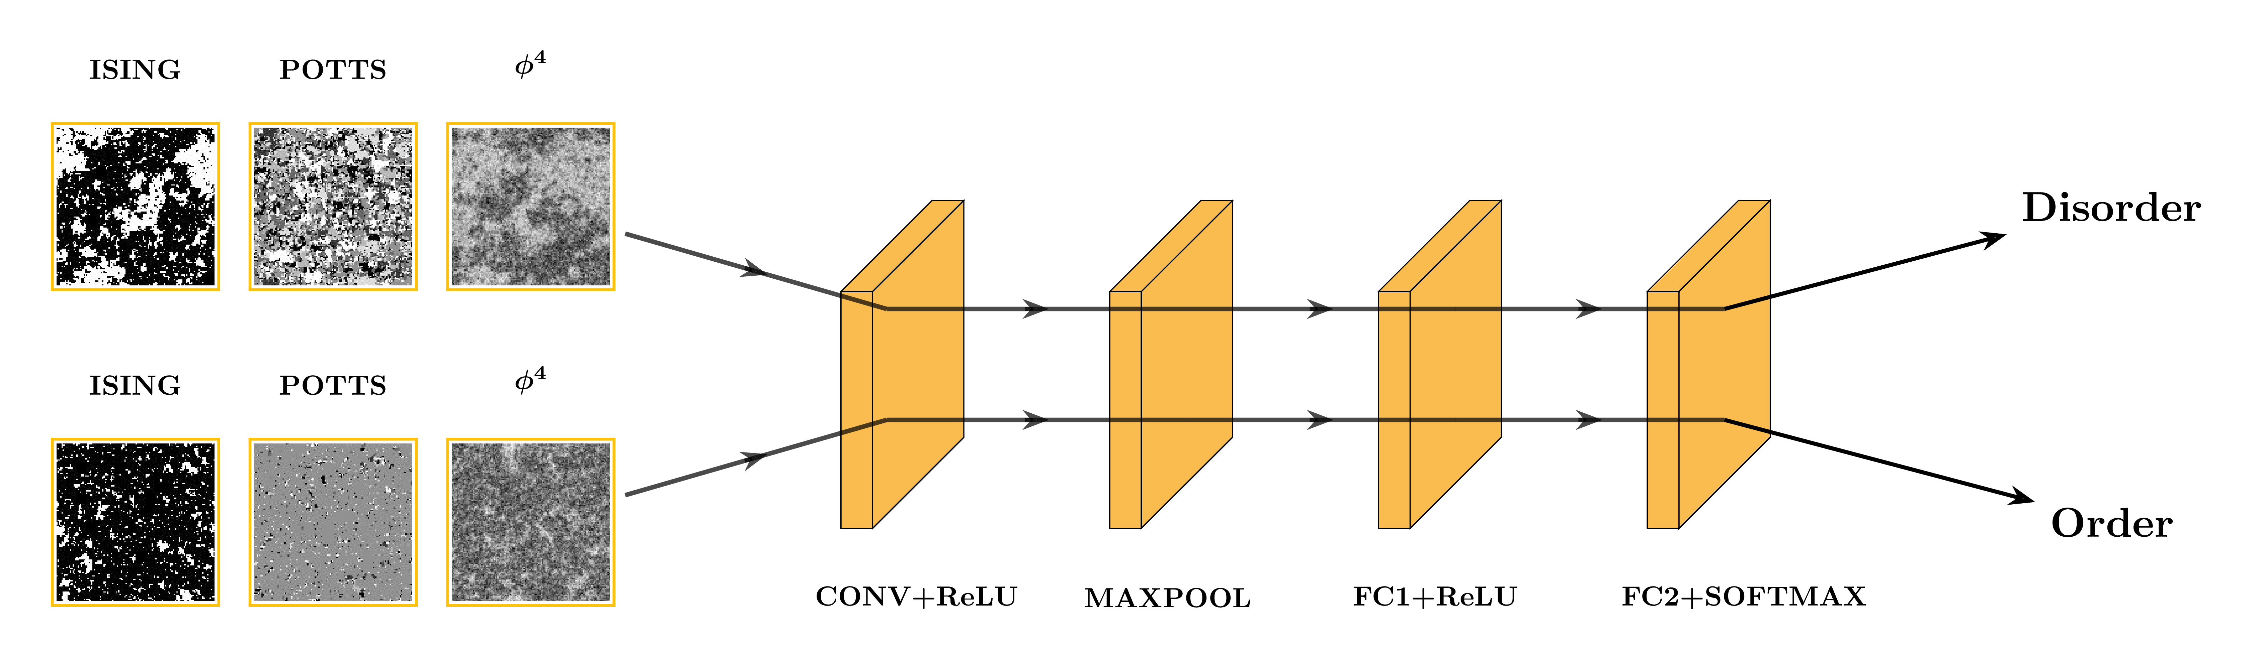
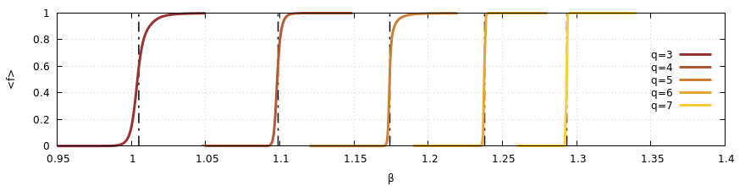
Transfer learning
[D. Bachtis, G. Aarts and B. Lucini, Phys.Rev.E 102 (2020) 5, 053306, arXiv:2007.00355]
A Convolutional Neural Network trained on Ising 2D can locate the order-disorder transition in other spin models

Slide 12
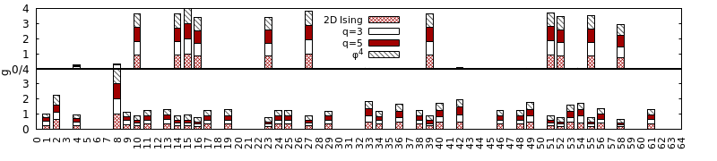
Towards interpretability: activation functions in NN
disordered
ordered
Universal features distinguish ordered and disordered phases, irrespective of e.g. order of transition

Slide 13
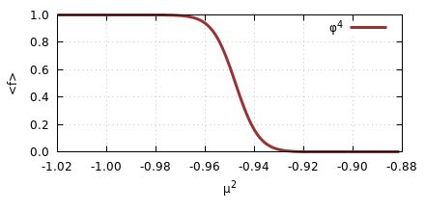
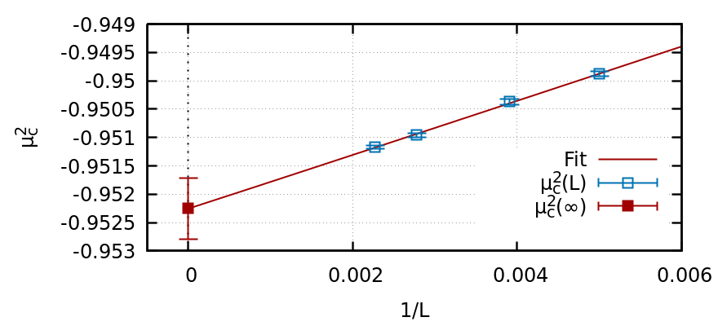
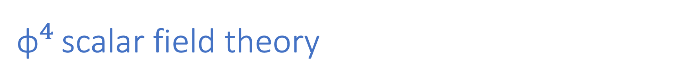

${\text{ɸ}}^{4 }$scalar field theory
symmetry-broken symmetric
reweight in mass parameter, $μ^{2}$
identify regions where phase is clear
retrain NN using $μ^{2}<−1.0$ and $μ^{2}>−0.9$
repeat finite-size scaling analysis as in 2d Ising model
same universality class as 2d Ising model
critical mass in agreement with results
obtained with standard methods
(Binder cumulant, susceptibility)

Slide 14
Coupling f to the Hamiltonian
Define an observable variable Y conjugated to f and write an extended Hamiltonian
Now f can be computed using path integral methods
Note that Y define a new direction for reweighting and that reweighting in this direction does not require the knowledge of E_{Y}

Slide 15
Induced phase transition
Critical exponents calculated with Renormalisation Group methods
f allows access to the magnetic critical exponent 𝜃

Slide 16
The Inverse Renormalisation Group
[D. Bachtis, G. Aarts, F. Di Renzo, and B. Lucini, Phys. Rev. Lett., 128:081603 (2022)]
Purpose: generating configurations on larger lattices starting from smaller ones near criticality with negligible computational cost
Not a new idea, e.g.
R.H. Swendsen, Phys. Rev. Lett., 42:859–861 (1979)
D. Ron, R.H. Swendsen, and A. Brandt, Phys. Rev. Lett., 89:275701 (2002)
S. Efthymiou, M.J.S. Beach, and R.G. Melko, Phys. Rev. B, 99:075113, (2019)
S.-H. Li and L. Wang, Phys. Rev. Lett., 121:260601 (2018)
K. Shiina, H. Mori, Y. Tomita, H.K. Lee, and Y. Okabe, Scientific Reports, 11(1):9617 (2021)
Our work presents the first IRG calculation for a Quantum Field Theory

Slide 17
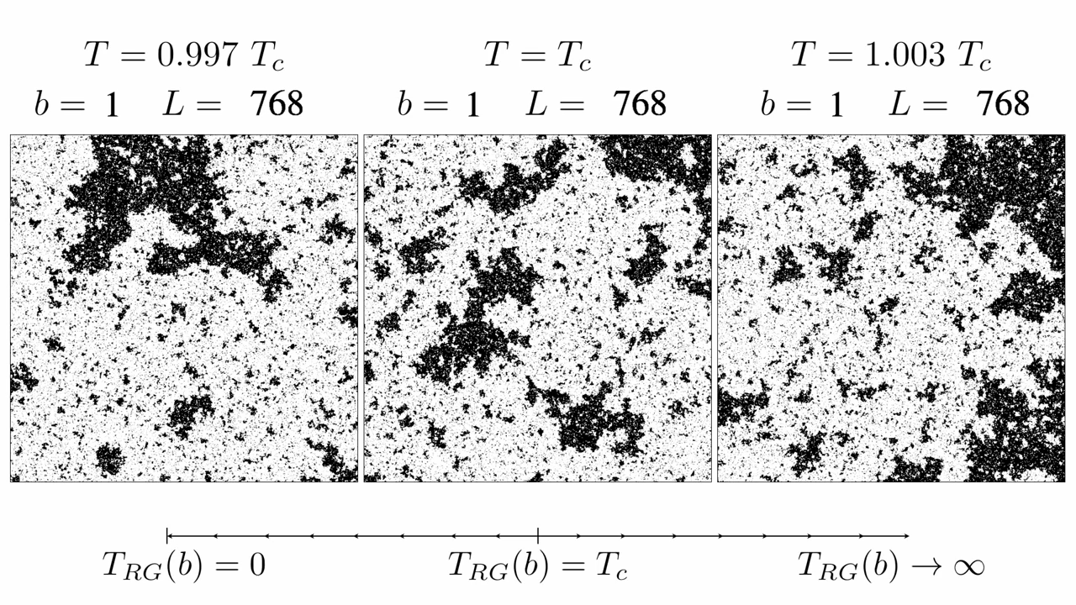
How the Renormalisation Group works
[Adapted from https://blog.dougashton.net/2012/04/the-renormalisation-group/ , video released under CC BY-SA 4.0]

Slide 18
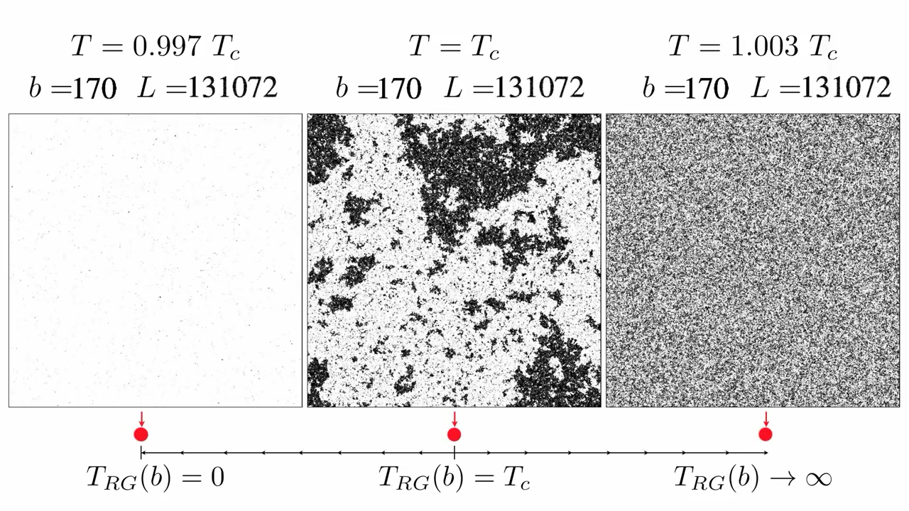
How we expect the IRG to work
[Adapted from https://blog.dougashton.net/2012/04/the-renormalisation-group/ , video released under CC BY-SA 4.0]

Slide 19
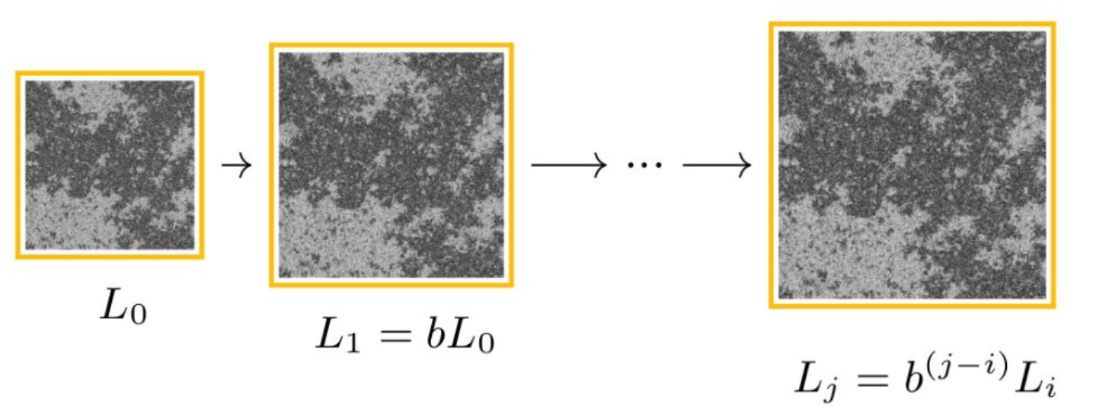
Benefits of the IRG
Overcome critical slowing down
More precise calculations of observables at criticality
Better insights on the infrared dynamics of the model
Can grow the lattice size indefinitely

Slide 20
Known problem: the RG is not invertible
To invert the RG, we would need to grow the number of degrees of freedom, but the process is not unique
E.g., for a blocked spin equal to +1 possibilities (majority rules) include
Even worse for the scalar field, e.g.
compatible with a blocked spin value 0.4

Slide 21
What we mean by inverting the RG then?
We start from a set of configuration generated via a Monte Carlo on a lattice of size L
Using a Machine Learning algorithm, from those we derive a set of configurations on a lattice L’ = b L (typically, b=2)
We assume that the ensemble at L’ as distributed according to the Boltzmann measure at L
This enables us to compute (and to reweight!) observables at L’
Using crossing of curves, we compute critical quantities
Advantage: numerical effort done on small lattices, hence relatively cheap
Critical to the process: blocking method, ML algorithm and assumption of Boltzmann distribution

Slide 22
The blocking method
Given a block B with generic point i, consider
and
Now, set
This is equivalent to the majority rule in the Ising model

Slide 23
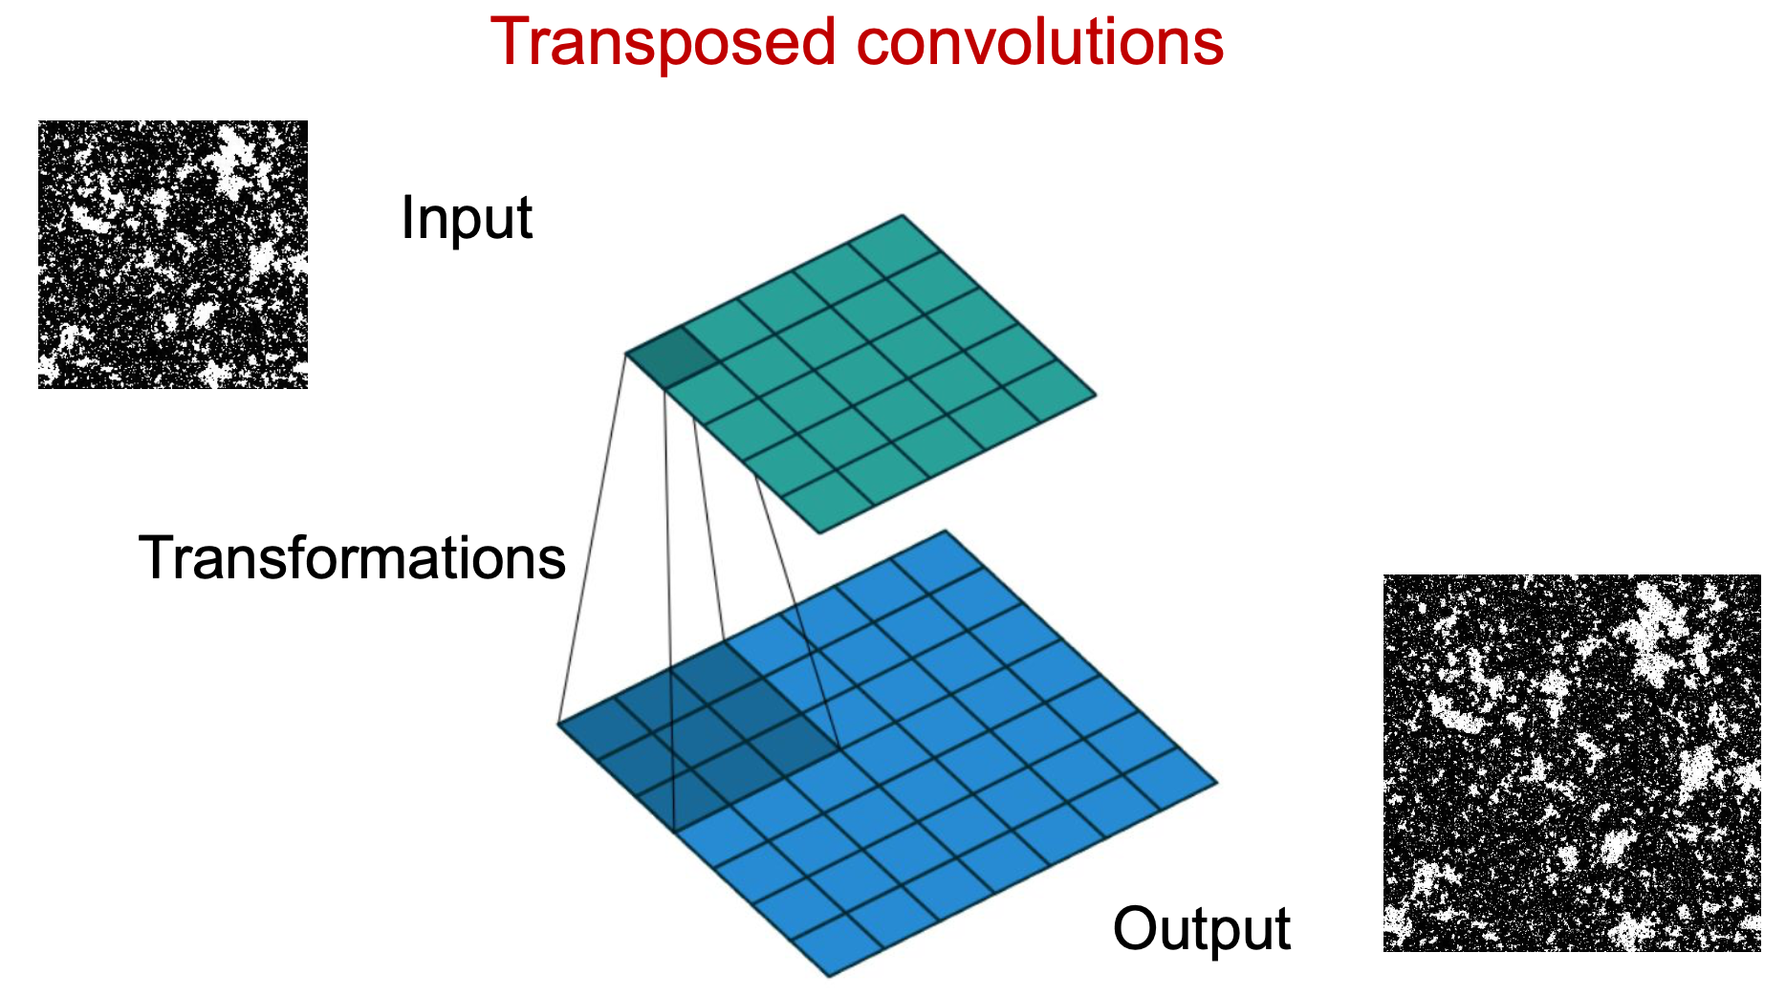
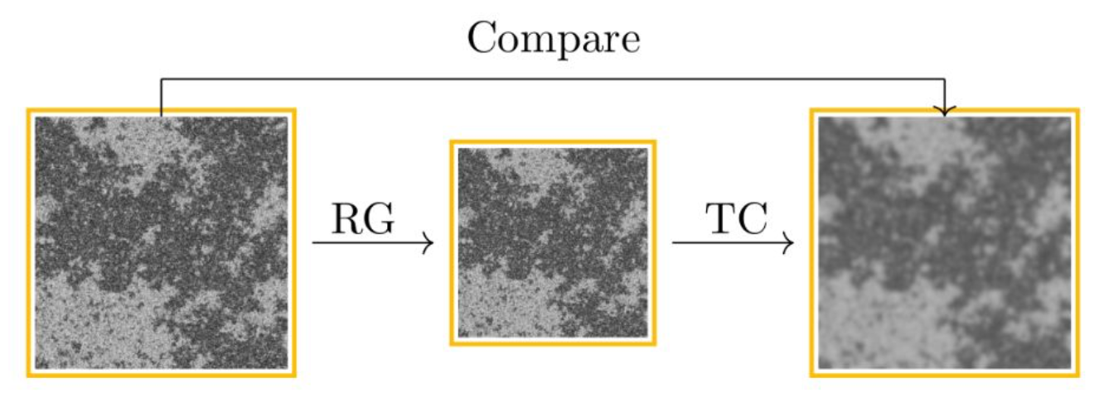
Lattice augmentation with Machine Learning
Central concept: transposed convolution

Slide 24
Determining the direction of the RG flow
Comparison with directly simulated lattices show that in the augmented system the coupling flows towards the critical point
Plotting two different lattice sizes (no need for direct simulation!) the crossing identifies an estimate for the critical coupling

Slide 25
Determining critical quantities
We can rewrite the scaling relationships for the magnetisation
in terms of the correlation length
to obtain the operational definition of the critical exponent ratio
Similarly, from we get

Slide 26
Critical exponents
Method: configurations obtained with a simulation for L=32 and IRG augmentation up to L=512
Ratios of critical exponents extracted for pairs of lattices
Expected asymptotic approach to Ising values clearly observed
All with no critical slowing down!

Slide 27
Conclusions and Outlook
Machine Learning offers a novel angle to look at phase transitions
It enables precise calculations of critical properties with no assumed knowledge on the underlying symmetry
Machine Learning exposes novel observables, whose behaviour can offer insights on the dynamics of the phase transition
A powerful demonstrator of the potential of Machine Learning is the Inverse Renormalisation Group
Future work focusing on interpretability
Related work ongoing to derive more efficient and interpretable Machine Learning methods from Quantum Field Theories
[e.g., D. Bachtis, G. Aarts and B. Lucini, Phys.Rev.D 103 (2021) 7, 074510, arXiv:2107.00466]

Slide 28
License notice
The video on the RG in slide 17 is adapted from https://blog.dougashton.net/2012/04/the-renormalisation-group/ removing the explanatory first part.
The video on the IRG in slide 18 is obtained playing backward the video in slide 17.
Both videos are released under the CC BY-SA 4.0.

