Slide 1


Time Synchronization Schemes for the Hyper-Kamiokande experiment
24/02/2021

Slide 2
Context
LPNHE, CEA and INFN have joint forces to design a full time distribution scheme that will be submitted to the international collaboration this spring. If approved the group will be in charge of the construction and commissioning. Together with the LLR digitizer it will give IN2P3 a central role in HK!
The proposal envisions to provide a system that fulfil the needs of both HK far and intermediate detector. Possible synergies can be found with the future T2K upgrades (when integrated in HK).
To conceive this proposal, an intense and fruitful R&D campaign is being carried out. Its results will be available for other IN2P3 experiments. This group believes that the time distribution system will be a strategic assets for future experiments due to the constant size increase of particle detectors.
This program has already created synergies across CNRS institutes thanks to a very fruitful collaboration with the SYRTE lab (Observatorie de Paris).

Slide 3
HK Clock Distribution Scheme
Cavern
/
/
2
Time data and UTC
DAQ
(PC)
Slow control
FE
GNSS
GNSS
Commands
2nd distribution stage
…
Time Ref/
fanout
PPS/10MHz
PPS/10MHz
1st distribution stage
FE
Clk and data
(redounded link)
PPS/10MHz
125MHz & data
Slow
control
…
Time/
Freq comp.
Atomic Clock
Sync commands
125MHz & data
FE
Calibration
/
10
2nd distribution stage
…
PPS/10MHz
FE
Clk and data
(redounded link)
PPS/10MHz
Time Ref/
fanout
1st distribution stage
GNSS
Atomic Clock
GNSS
PPS/10MHz
PPS/125MHz
Redundancy

Slide 4
HK Clock Distribution Scheme
Cavern
/
/
2
Time data and UTC
DAQ
(PC)
Slow control
FE
GNSS
GNSS
Commands
2nd distribution stage
…
Time Ref/
fanout
PPS/10MHz
PPS/10MHz
1st distribution stage
FE
Clk and data
(redounded link)
125MHz & data
LPNHE
INFN
LPNHE
PPS/10MHz
CEA
Slow
control
…
Time/
Freq comp.
Atomic Clock
Sync commands
125MHz & data
FE
Calibration
/
10
2nd distribution stage
…
PPS/10MHz
FE
Clk and data
(redounded link)
PPS/10MHz
Time Ref/
fanout
1st distribution stage
GNSS
Atomic Clock
GNSS
PPS/10MHz
PPS/125MHz
Redundancy

Slide 5
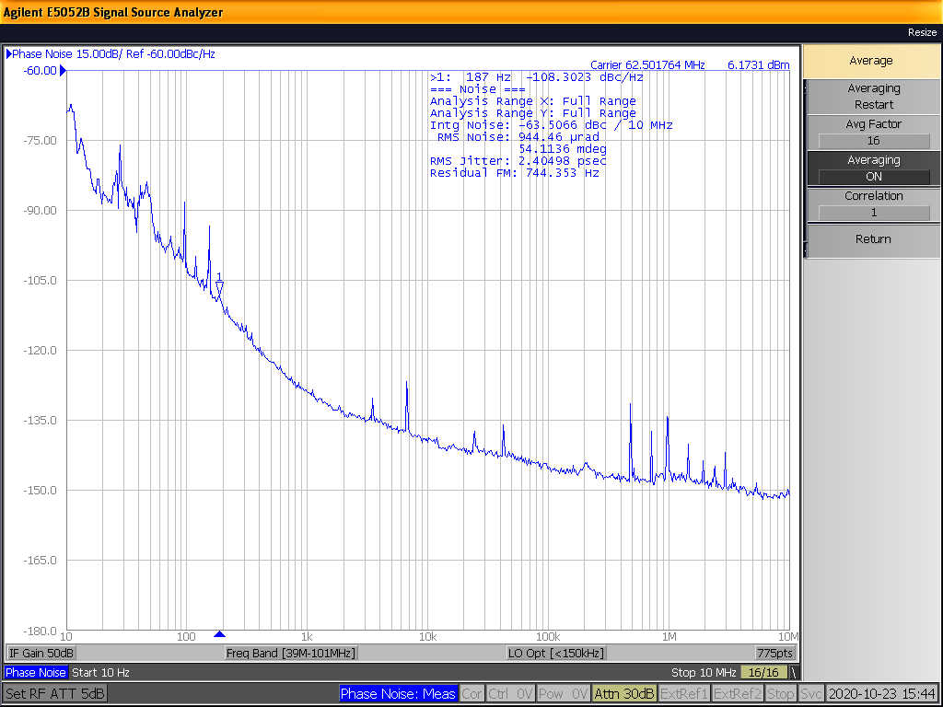
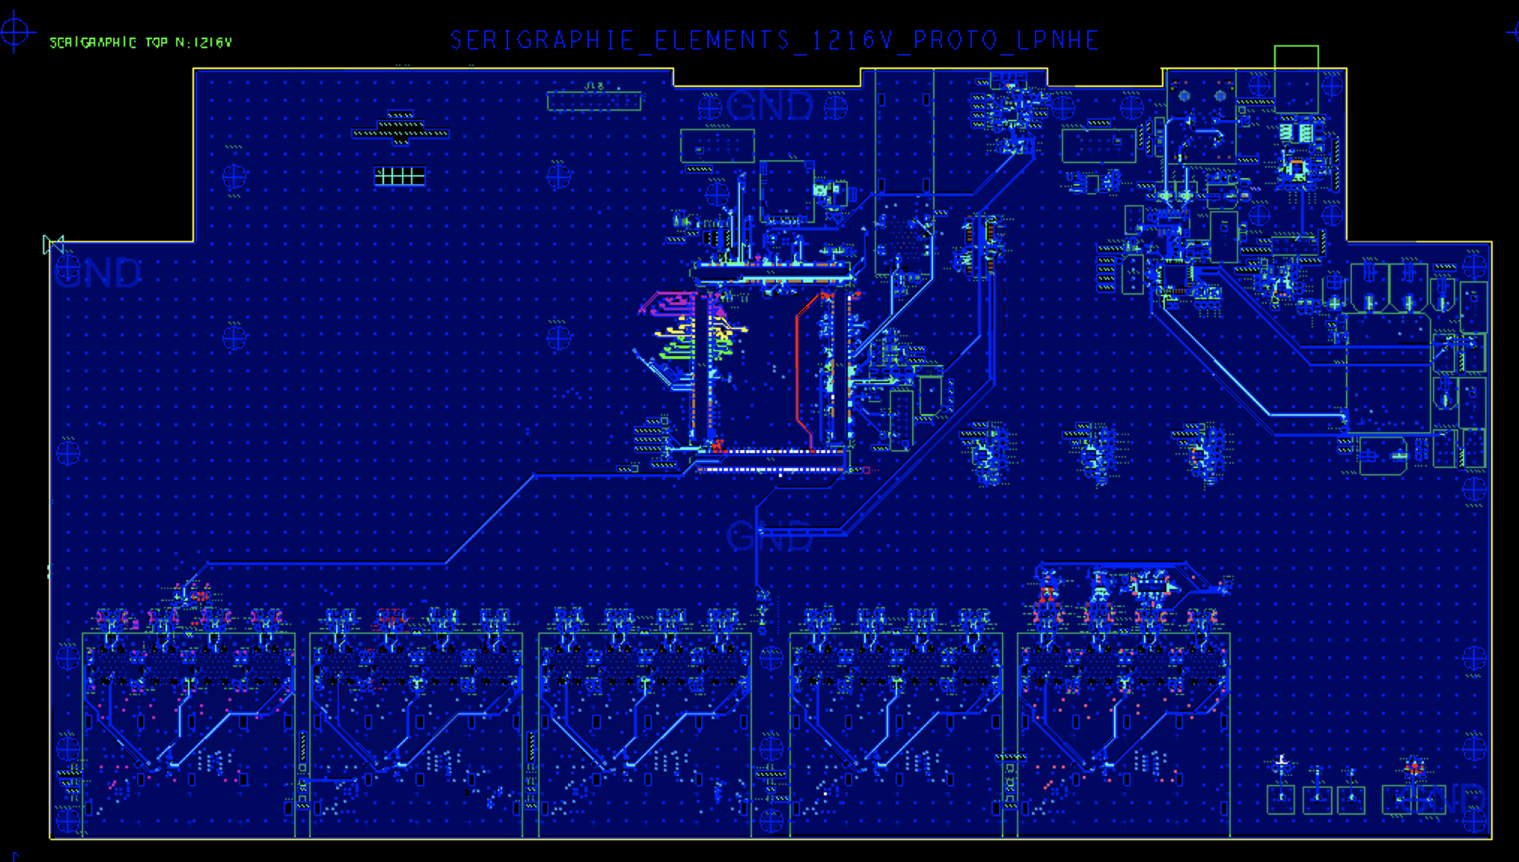
Status
The final conceptual scheme has been conceived.
Test and characterization campaigns have been carried out.
First prototypes have been designed (great synergy with CEA)
The technical note (include precise cost estimation) for the final review is being prepared
GNSS and atomic clock
characterization
Clock Jitter at endpoint (FE)
characterization
Second distribution stage
prototype board
We look forward to share our material with the IN2P3 management to prepare the financial proposal for the final commitment

