Slide 1
WP3 – ESCAPE Repository

Slide 2
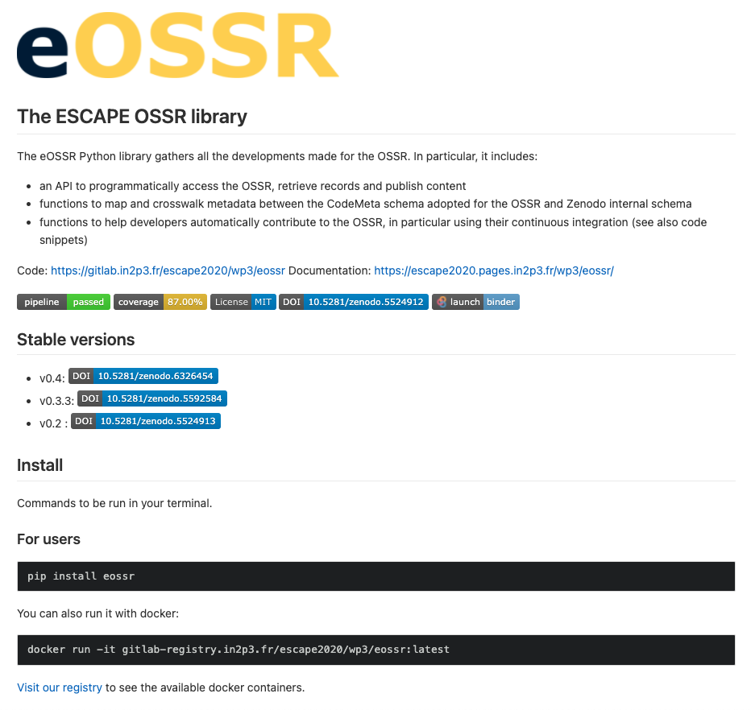
v0.4 released
That version introduces some API changes but mostly internal to the library that should not affect heavily users, while new features have been introduced.
Here are some of the major changes that should be noted:
updates in OSSR metadata requirements. Requirements and recommendation are now clearly identified in the eOSSR documentation.
an eOSSR metadata validator comes with these new requirements
add search functions for licenses, grants, funders, communities and records
the OSSR search is now limited to software and datasets
Full changelog: https://gitlab.in2p3.fr/escape2020/wp3/eossr/-/releases/v0.4

Slide 3
OSSR: https://zenodo.org/record/6326454
pypi : pip install eossr==0.4
docker run gitlab-registry.in2p3.fr/escape2020/wp3/eossr:v0.4
mybinder: https://mybinder.org/v2/git/https%3A%2F%2Fgitlab.in2p3.fr%2Fescape2020%2Fwp3%2Feossr/HEAD

