Slide 1




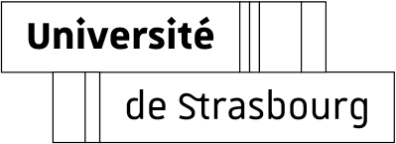
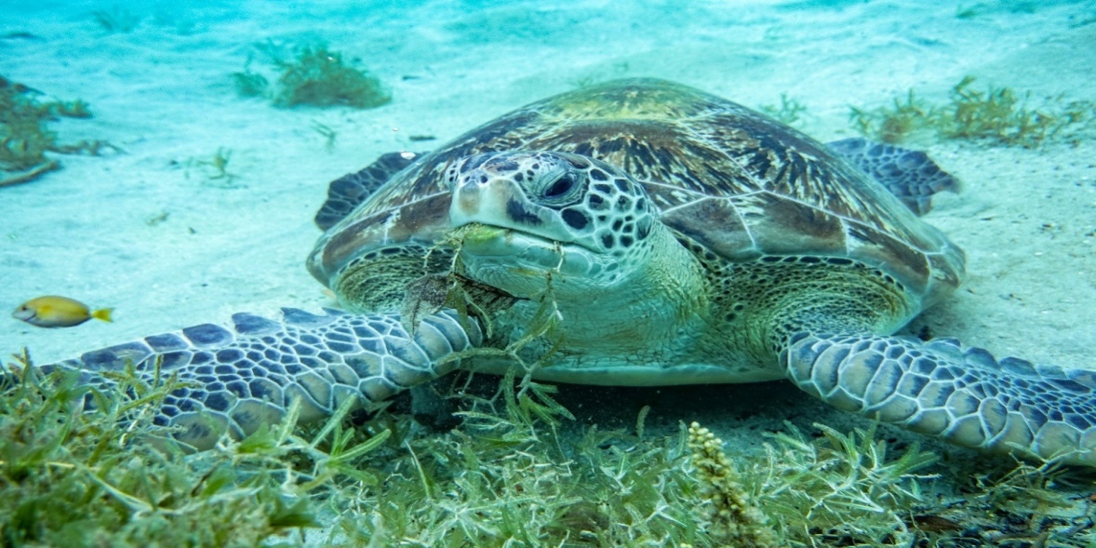
Food strategies and optimization of the diving behaviors of sea turtles in relation to oceanographic conditions
Lorène Jeantet
Supervisor :
Damien Chevallier

Slide 2
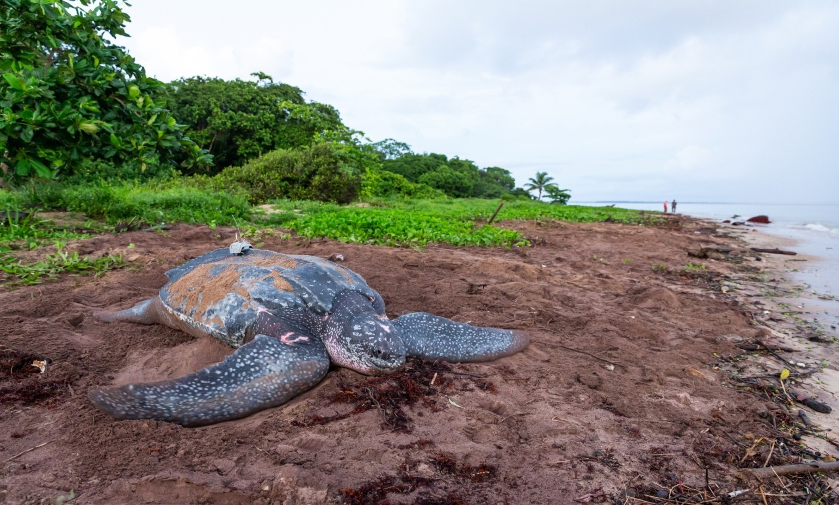
CONTEXTE
Decline of 68% of the global population of vertebrates
The number of leatherback turtle nests per season has dropped from 50 000 in the 1990s to less than 200 in 2019 in French Guiana
Decline in populations of olive ridley and green turtles as well
Crucial need to better know their underwater behaviors in order to identify and protect their resting/feeding areas.

Slide 3
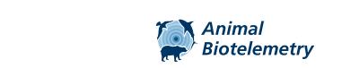
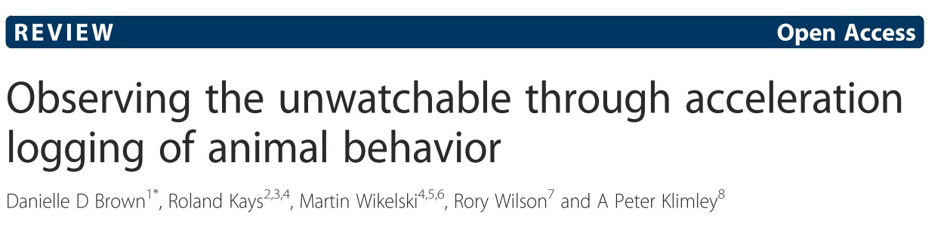
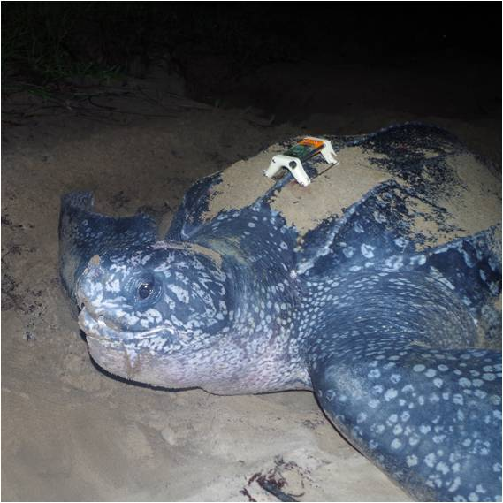
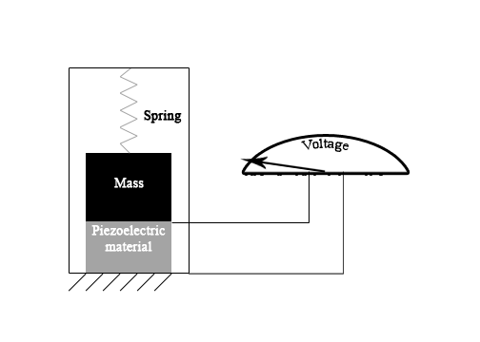
MATERIALS & METHODS
Ay
Az
Ax

Slide 4
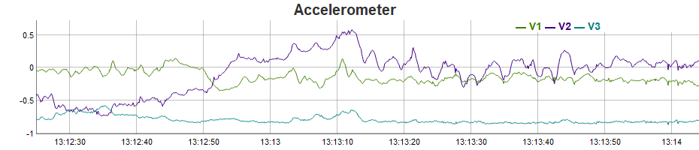
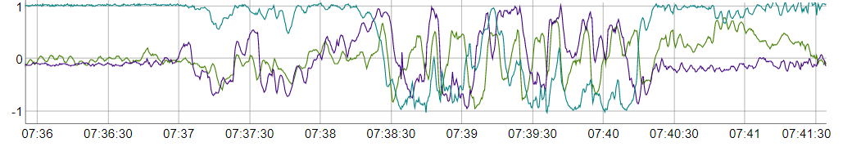
Accelerometer (g)
AccX
AccY
AccZ
AccX
AccY
AccZ

Slide 5
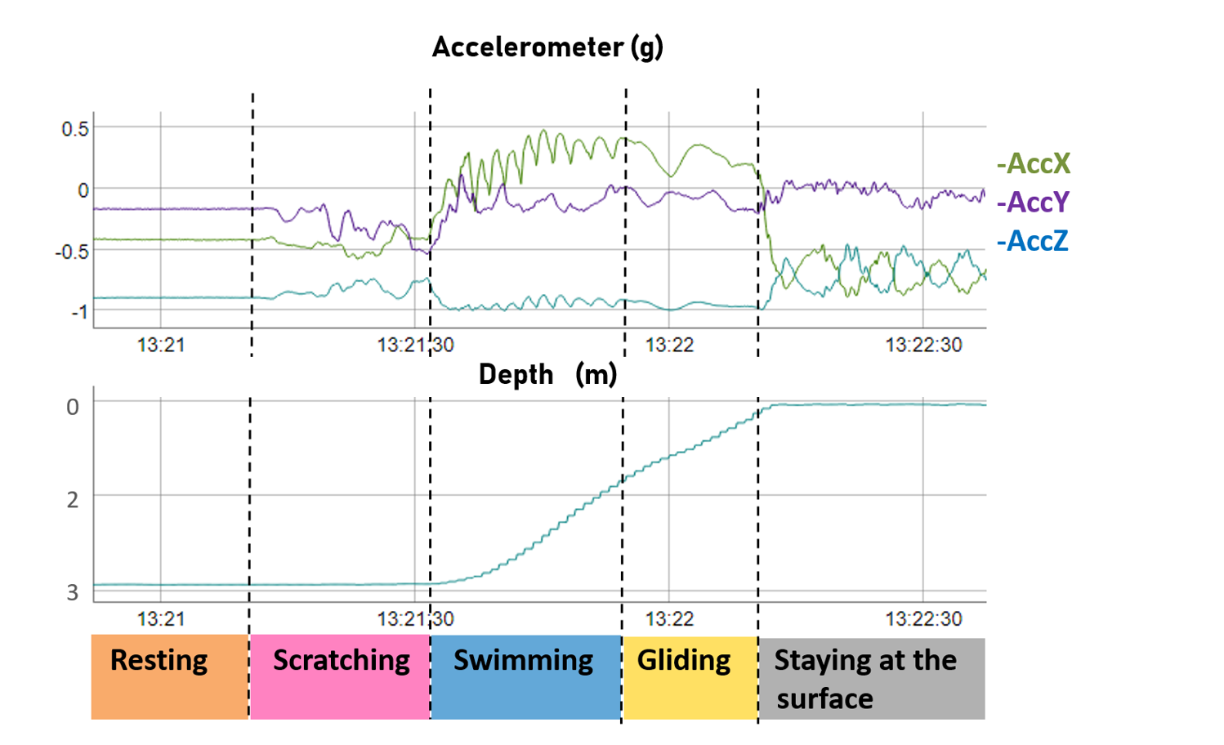
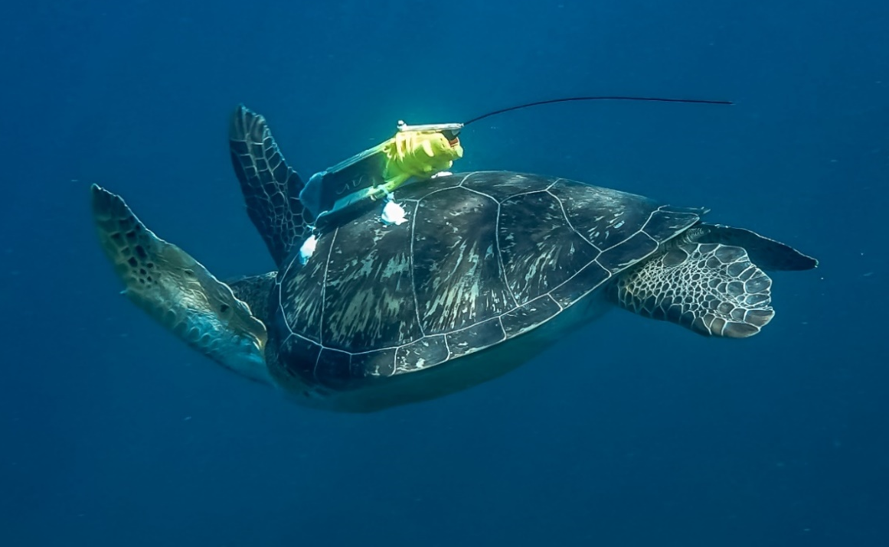
MATERIALS & METHODS
Validation of the acceleration signals in Martinique

Slide 6

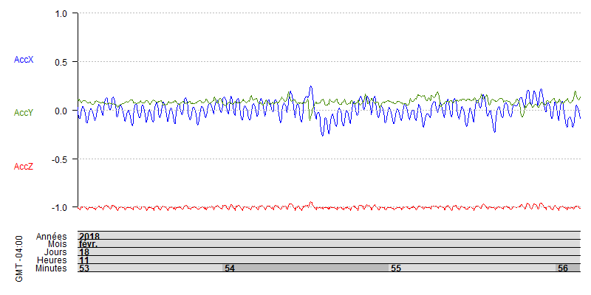
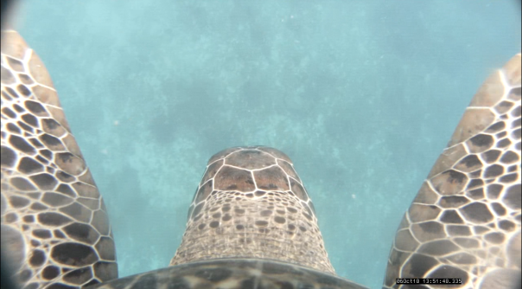
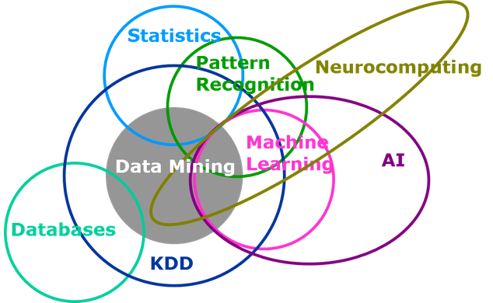
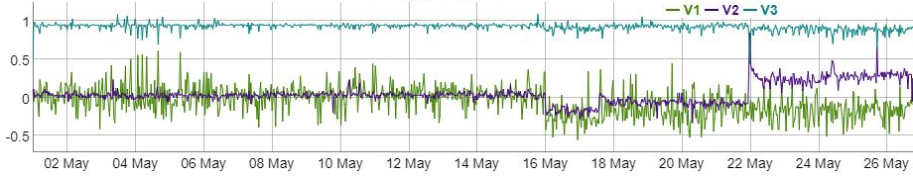
Accelerometer (g)

Slide 7


Fully Convolutional Neural Network:
a powerful tool to infer the behaviours of immature green turtle from multi-sensor data
Lorène Jeantet, Vincent Vigon, Sébastien Geiger, Damien Chevallier

Slide 8
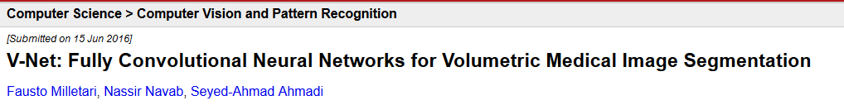
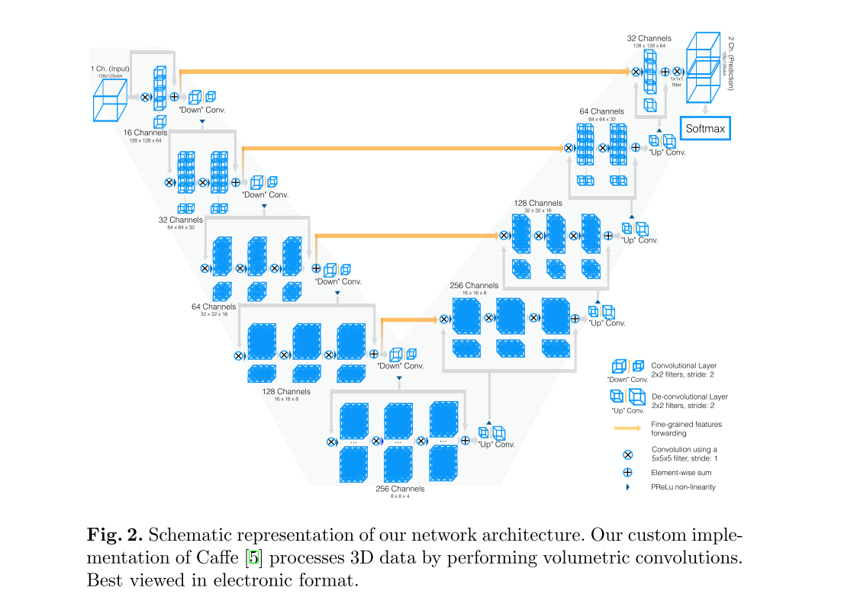
NEURAL NETWORK : V-NET

Slide 9
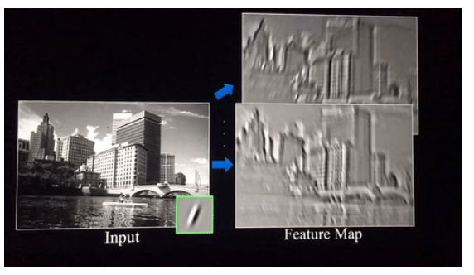
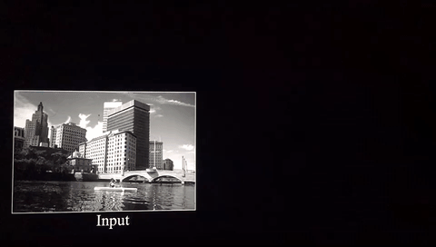

Slide 10
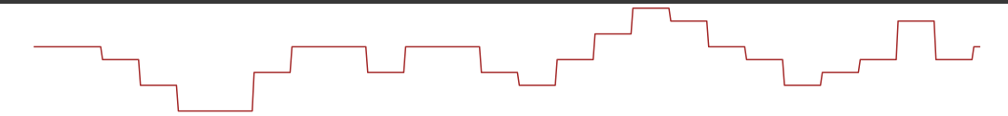
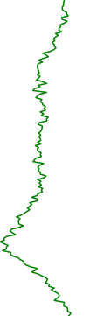
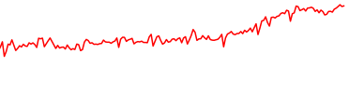
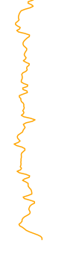

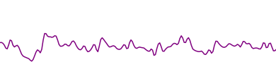
NEURAL NETWORK : V-NET
Window_size
Depth
AccY
AccX
AccZ
GyrZ
DBA
Time series 1D (20 Hz):
…
Accelerometer (3 axes)
Depth captor (1 axe)
Gyroscope (3 axes)
Calculated variables (DBA, AccX_High…)
Descriptors

Slide 11
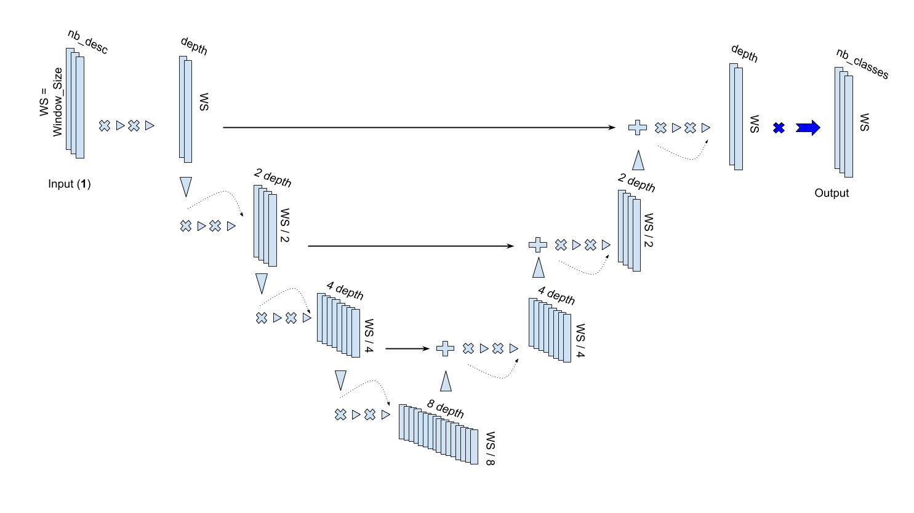
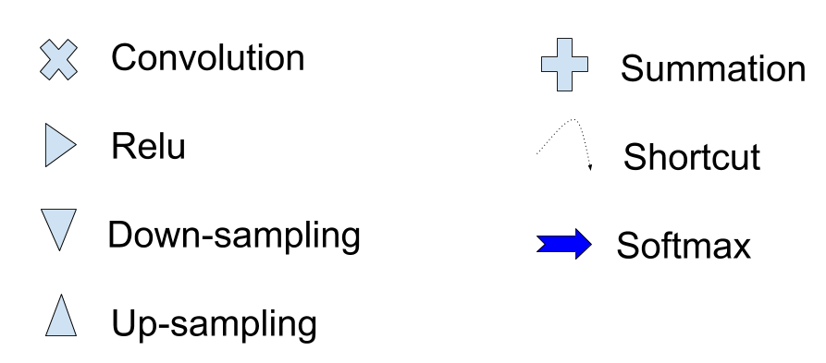
NEURAL NETWORK : V-NET

Slide 12
Strenghts of the V-net :
Deep learning
‘handcrafted’ variables
Prediction with centiseconde precision
Segmentation
Light model

Slide 13

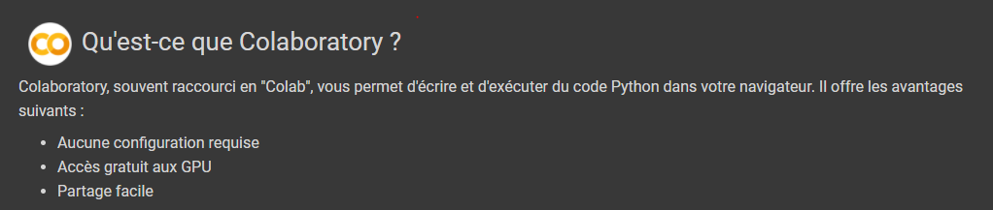
COMPUTER RESOURCES
Data size :
  13 free-ranging green turtles recorded
  66h of video recorder
Training process :
  100 epochs
  15 000 windows/epoch
  validation on 3 000 windows
30 minutes

Slide 14
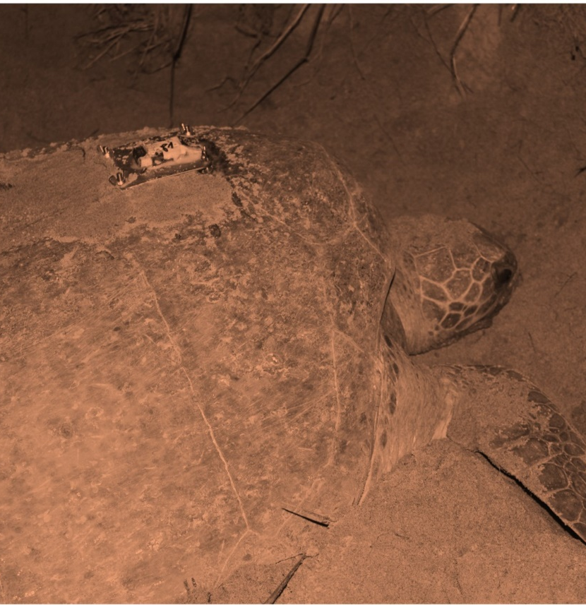
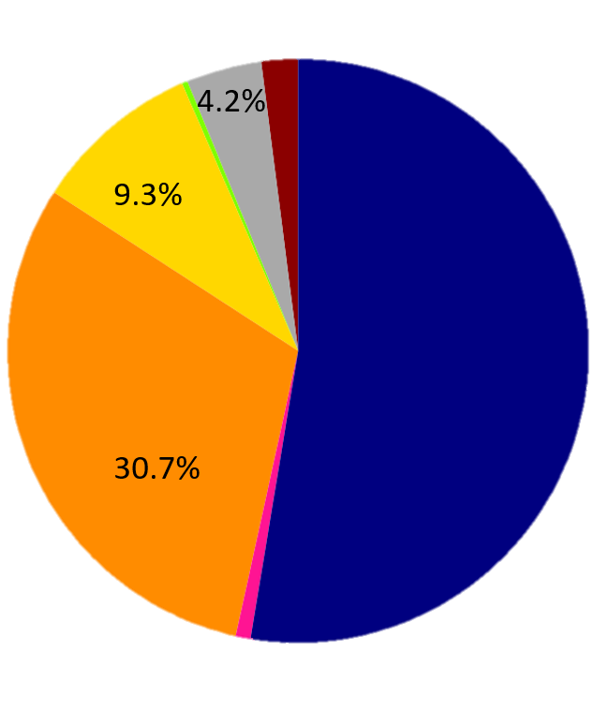
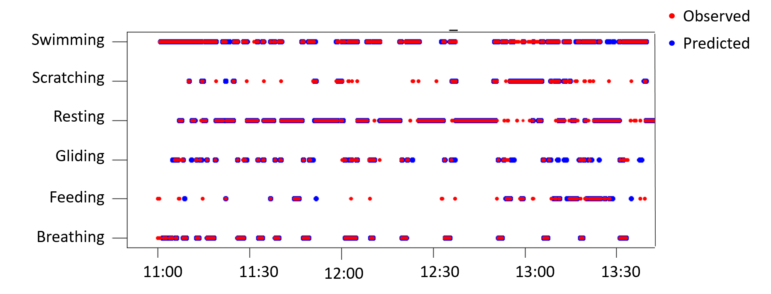
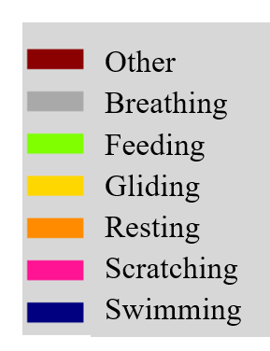
RESULTS
Global Precision : 97 %
2%
0.3%
Activity budget of green turtle :
52.6%
0.8%
Martinique
French Guiana
(13 days)

Slide 15
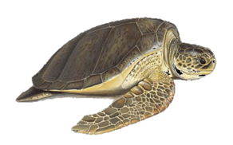
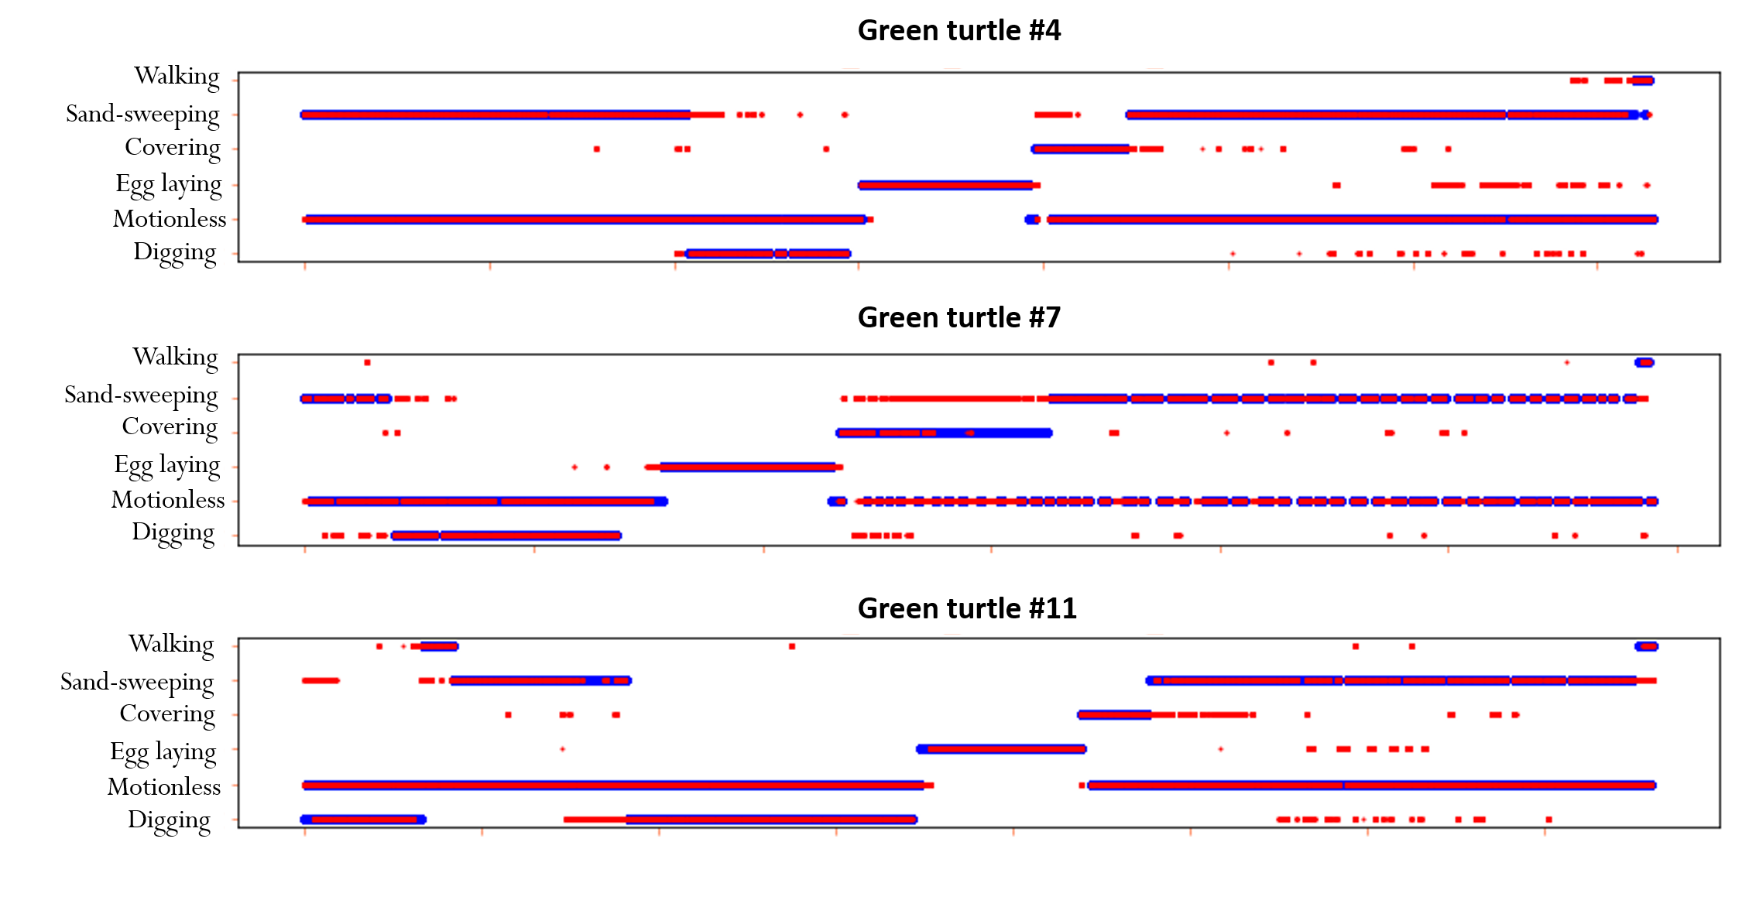
RESULTS
Nesting behaviors in French Guiana
Global precision :
95%

Slide 16
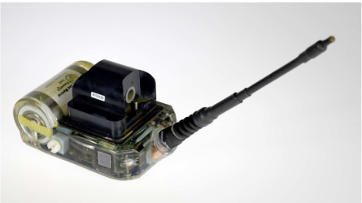
PERSPECTIVES
① -Implementation of V-net in Argos tag for signal processing at sea

Slide 17
PERSPECTIVES
① -Implementation of V-net in Argos tag for signal processing at sea
② - Development of an interface for processing accelerometric signals (ANTIDOT project)
Notes:
Création d’un logiciel gratuit à disposition de tous les acteurs impliqués dans le suivi de population de TM, permettant d’interprétation des signaux accelero

Slide 18
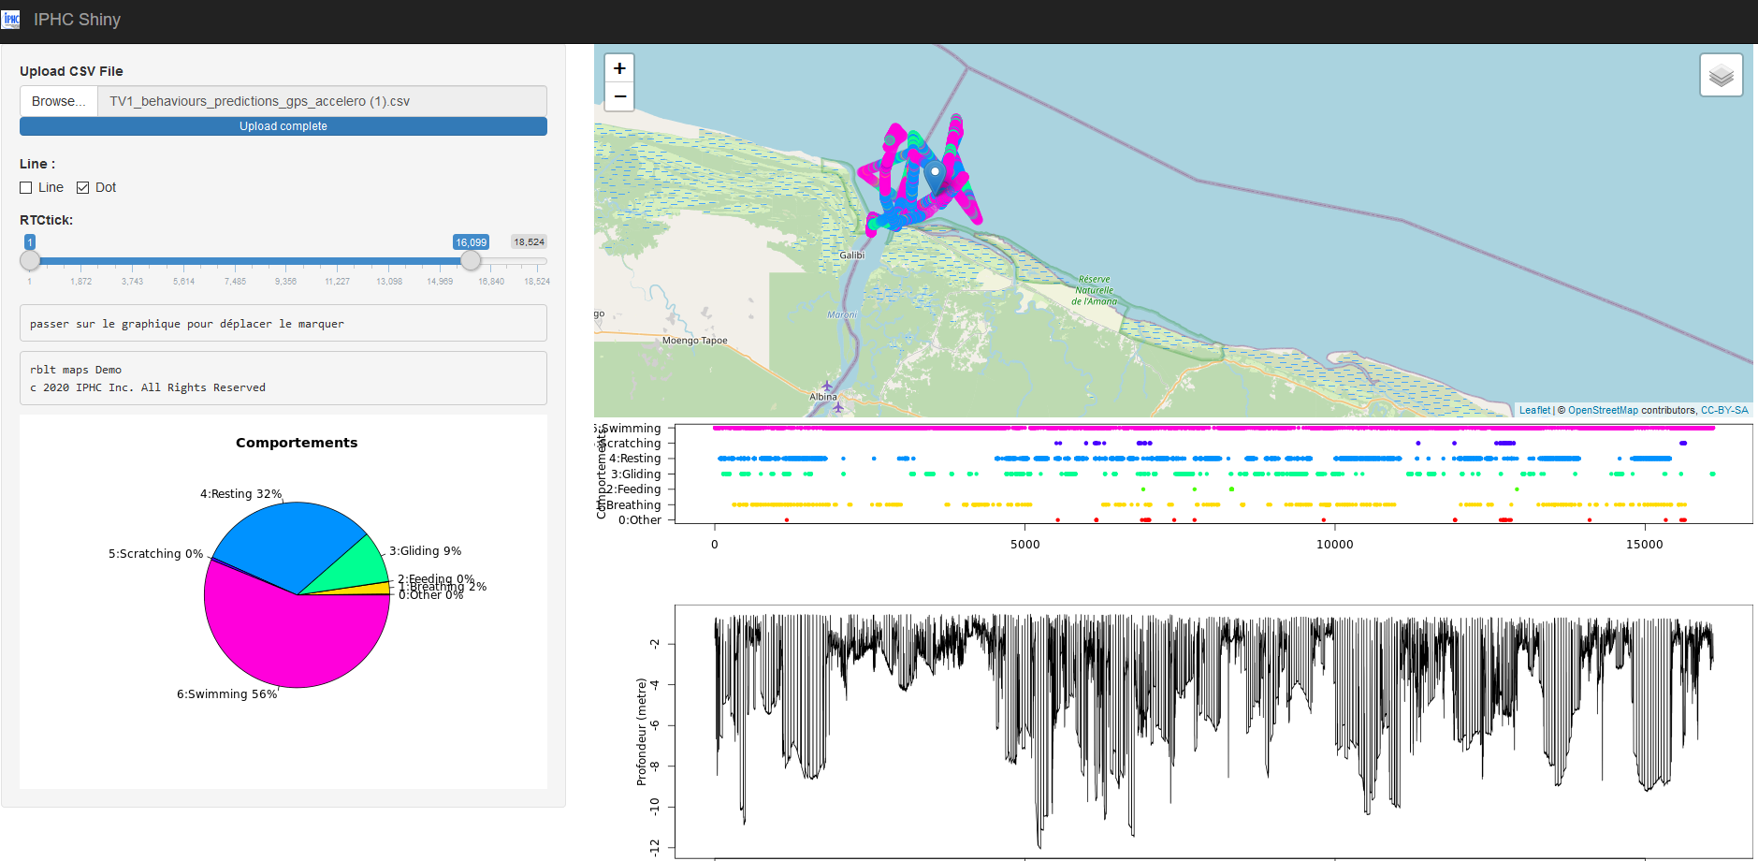
INTERFACE ANTIDOT
ANTIDOT INTERFACE
Development : Sébastien Geiger, IPHC

Slide 19
































Guyane française
Partenaires financiers
Partenaires techniques et scientifiques
Martinique
Partenaires financiers
Partenaires techniques et scientifiques
Notes:
Possible grâce à l’implication de tous nos partenaires

