Slide 1
Task 4.3 Summary and Status
Martino Romaniello on behalf of Task 4.3

Slide 2
WP4 Tasks
Task 4.1 Integration of astronomy VO data and services into the EOSC
Lead: Marco Molinaro (INAF)
Task 4.2 Implementation of FAIR principles for ESFRI data through the Virtual Observatory
Lead: François Bonnarel (CDS CNRS Université de Strasbourg)
Task 4.3 Adding value to trusted content in astronomy archives
Co-leads: Mark Allen (CNRS-ObAS) & Martino Romaniello (ESO)

Slide 3
Task 4.3 Adding value to trusted content in astronomy archives
Next generation functionalities for creation and publication of high-level, value-added data products from ESFRIs
Assessment and application of new techniques – machine learning analytics. (connection to WP3)
  Specific example applied to ESO archives data products: spectra, cubes, source catalogues
Identification of stewardship best practices
  Curation and publication of next-generation data products via ESFRI archives
  Technical and human aspects

Slide 4
Major milestones
D4.5 Release of prototype machine learning enabled archive services providing value-added content to archives (Demonstration) | Month 30 (+6) January 2022
D4.8 Final analysis report on use of IVOA standards for FAIR ESFRI and community data and best stewardship practices for value-added data (Report) (includes report of feedback on prototype services developed for D4.5) | Month 40 (+6) November 2022

Slide 5
News
Deliverable D4.5 delivered
The person hired at ESO to work on Task 4.3 has left the project
  Highlighted as possible risk in the Project Risk Register
  Not much mitigation possible
  The work on Deep Learning effectively concluded

Slide 6
Deep Learning & Data Archives
Scope: provide archive users with novel ways to identify data
  Beyond traditional approach of specifying query parameters
  Revolutionary extension of recent move from instrument to data keywords (e.g. exposure time to signa-to-noise)
Target: the different data types in the ESO Science Archives
  Spectra
  Cubes
  Source catalogues
Let the data speak … on a massive scale
  Huge data variety: impractical, and not desirable, to impose preconceived interpretations

Slide 7
Deep Learning on 1D spectra: HARPS
Scope: Deep Learning analysis of the entire HARPS archive
  High-resolution, high-stability spectrograph
  Main science case: discovery and characterization of exoplanets
  ~270,000 spectra, ~300,000 wavelengths channels each
  1D spectra, pipeline-reduced to high accuracy
Different approaches
  HITS: fully-connected autoencoder with 2 latent dimensions, down sampled spectral resolution
    Agile architecture for speed and interactivity
  ESO: combination of convolutional and fully-connected layers with between 4 to 8192 latent dimensions, full spectral resolution
    Find minimal representation which preserves all the relevant information

Slide 8
So now, how to turn this into user services?
These techniques have the potential of being a game-changer, BUT:
  The results have to be meaningful
  Interaction with the results has to be user-friendly
In practice:
  What makes spectra similar?
    What are the uses and limitations of a similarity service?
  Can spectra be tagged with some physical properties of the celestial object?
    If so, what are they?
    What are the uses and limitations?
  What is the best way to present and interact with the results?
  Services for the few or for the many?
    About half of the astronomical community uses the ESO Science Archives

Slide 9
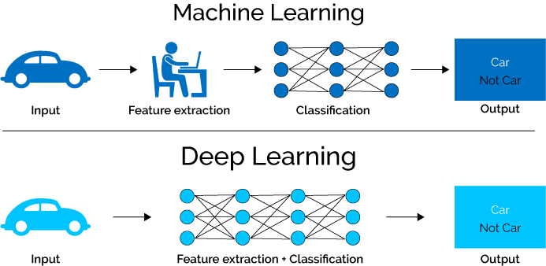
From Hand-Crafted Features to Representation Learning

Slide 10
Let the Data Speak for itself!
Define the problem and data carefully
Design your own network (with inspiration from existing ones)
Train it
Try to interpret how the network solved the problem
Let’s see how a network chooses to perceive big data
Push for disentangled representations
  Facilitates interpretation

Slide 11
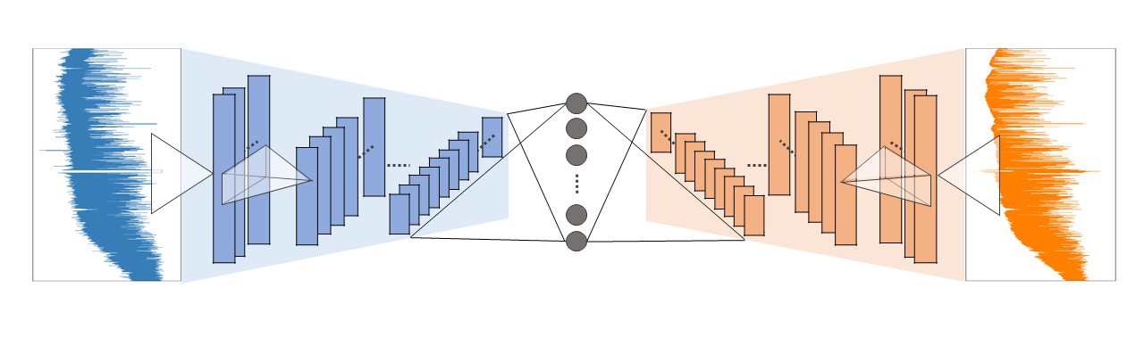
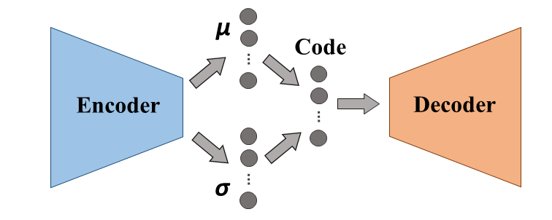
Network schematics
Loss function

Slide 12
How does the learning happen?

Slide 13
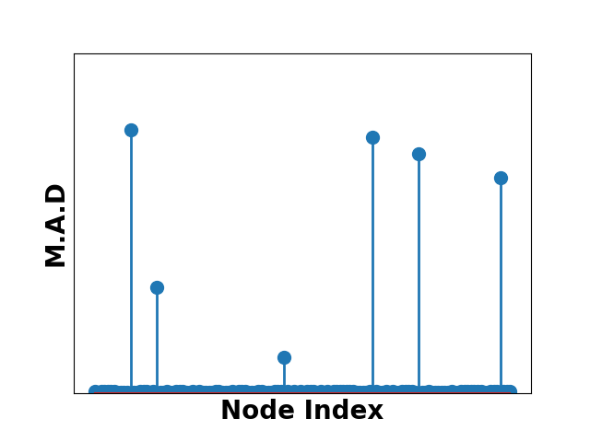

Not all dimensions are informative
Only 6 dimensions out of 128 carry information
So now, are they physically interpretable?

Slide 14
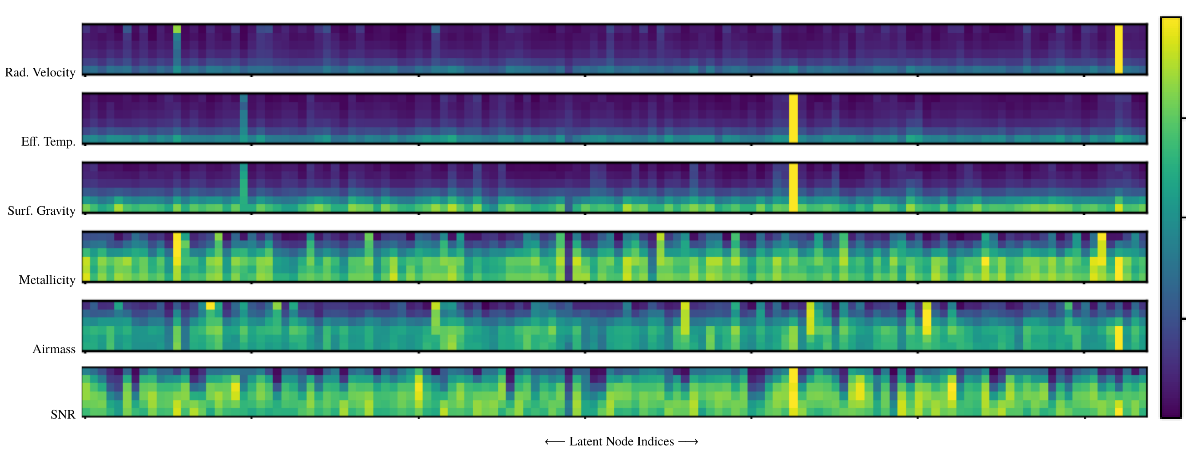
Mutual Information with Stellar Parameters
Sedaghat, MR, Carrick, Pineau 2021, MNRAS, 501, 6026
15-16 March 2022

Slide 15
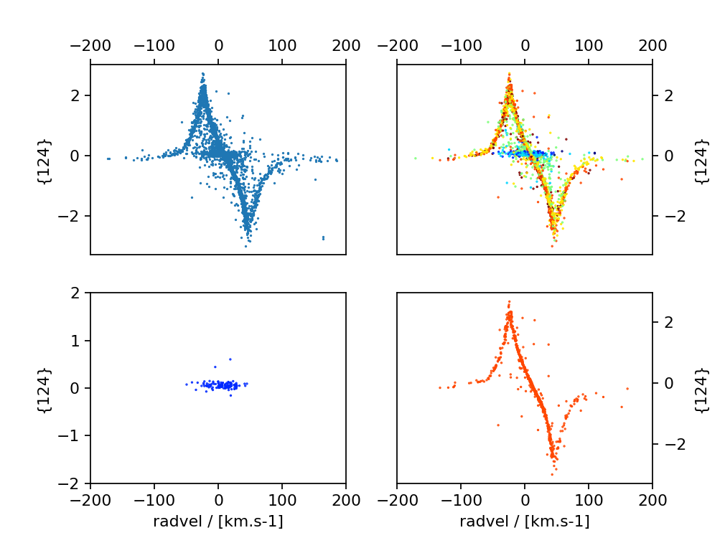
Mutual Information with Stellar Parameters
Sedaghat, MR, Carrick, Pineau 2021, MNRAS, 501, 6026
15-16 March 2022

Slide 16
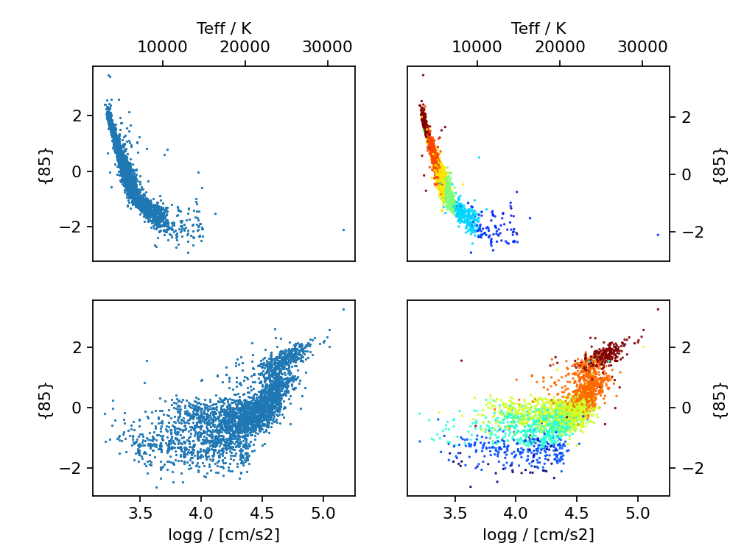
Mutual Information with Stellar Parameters
Sedaghat, MR, Carrick, Pineau 2021, MNRAS, 501, 6026
15-16 March 2022

Slide 17
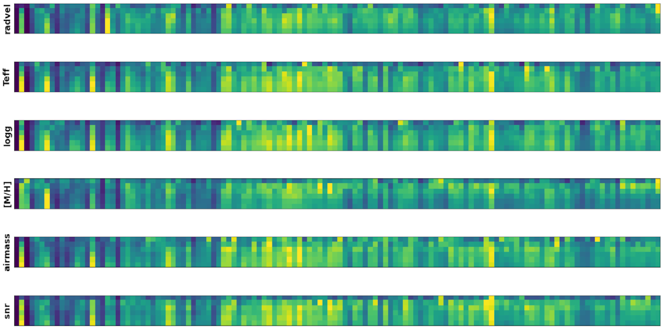
PCA: no one-to-one mapping with physical features
Sedaghat, MR, Carrick, Pineau 2021, MNRAS, 501, 6026

Slide 18
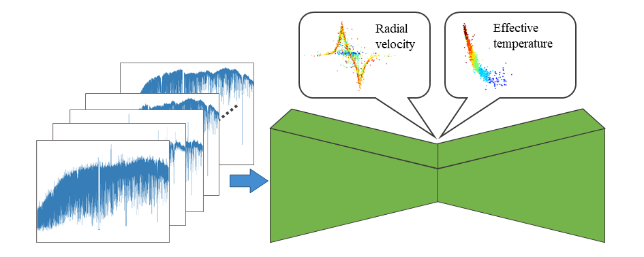
The first step is taken: the basic idea works
Next steps
What physical parameters are the other significant dimensions linked to?
  Why isn’t RV representation monotonic?
Extension to different spectral datasets
  Stellar: RAVE, GALAH (non-ESO)
  Non-stellar: UVES, X-Shooter
Extension to images/cubes: ALMA
Source separation
  Stellar vs telluric features
Sedaghat, MR, Carrick, Pineau 2021, MNRAS, 501, 6026

Slide 19
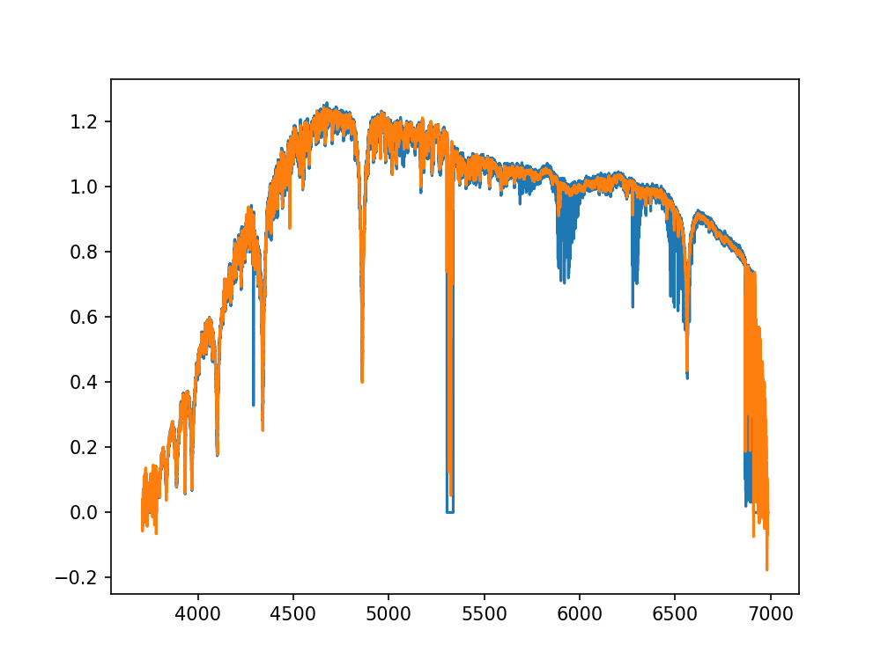
Source separation: stellar vs telluric features
Sedaghat, MR et al, in preparation
15-16 March 2022

Slide 20
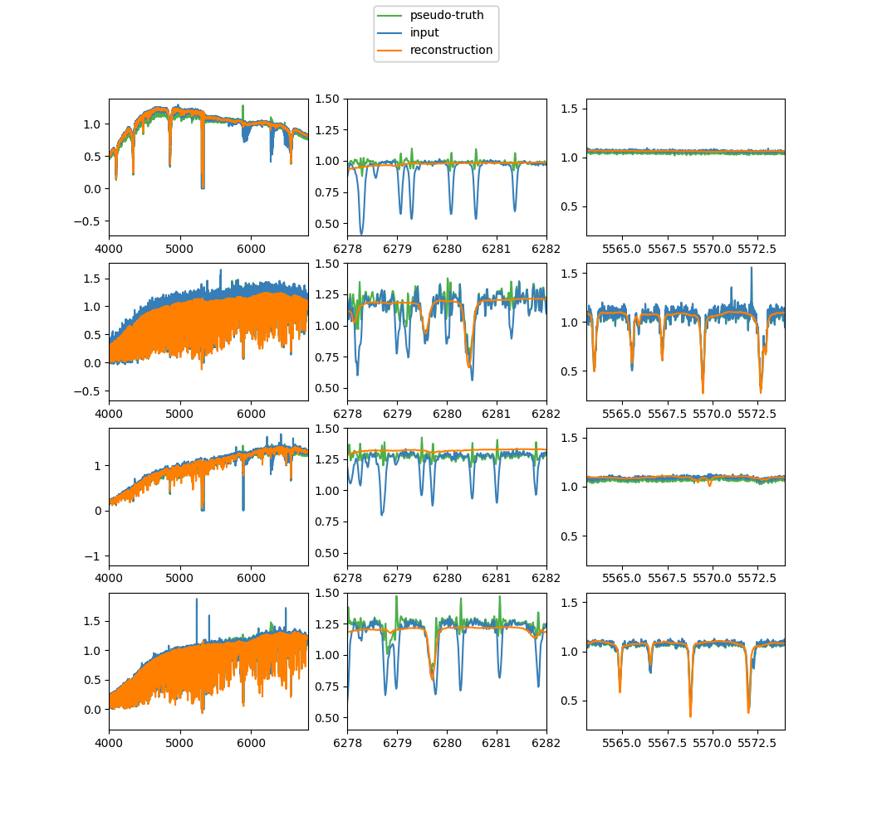
Source separation: stellar vs telluric features
Sedaghat, MR et al, in preparation
15-16 March 2022

Slide 21
WIP: ALMA cubes and images
ALMA generates 3D data cubes: 2 spatial + 1 spectral dimensions
The cubes themselves unfortunately are not homogeneous enough long the spectral dimension to be readily fed to the Deep Learning machinery
We started from 2D images with the spectral dimension compressed (“continuum images”), running them through the same machinery as the spectra
WIP …

Slide 22
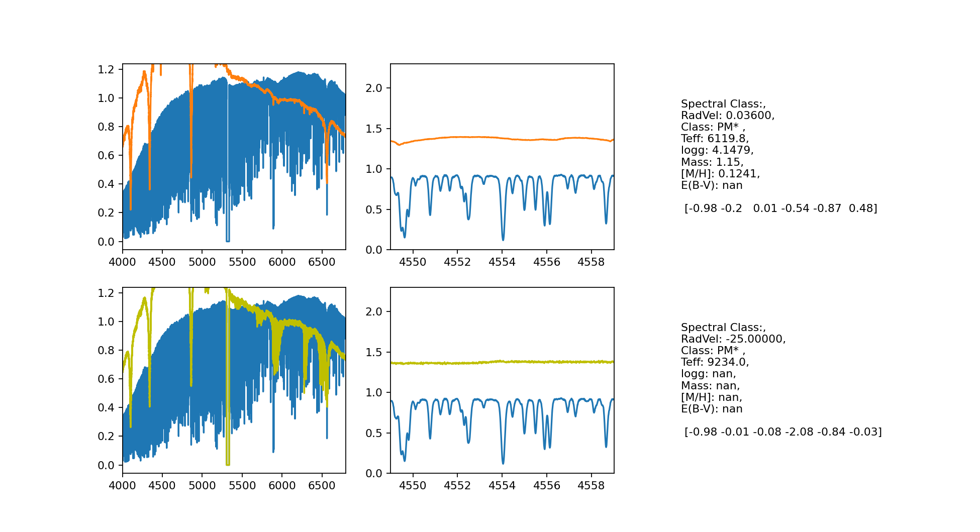
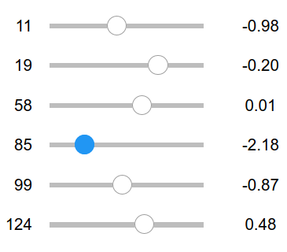
User tools: “Sliders” for exploration of the latent space
https://www.eso.org/~nsedagha/universe/#astromachines

Slide 23
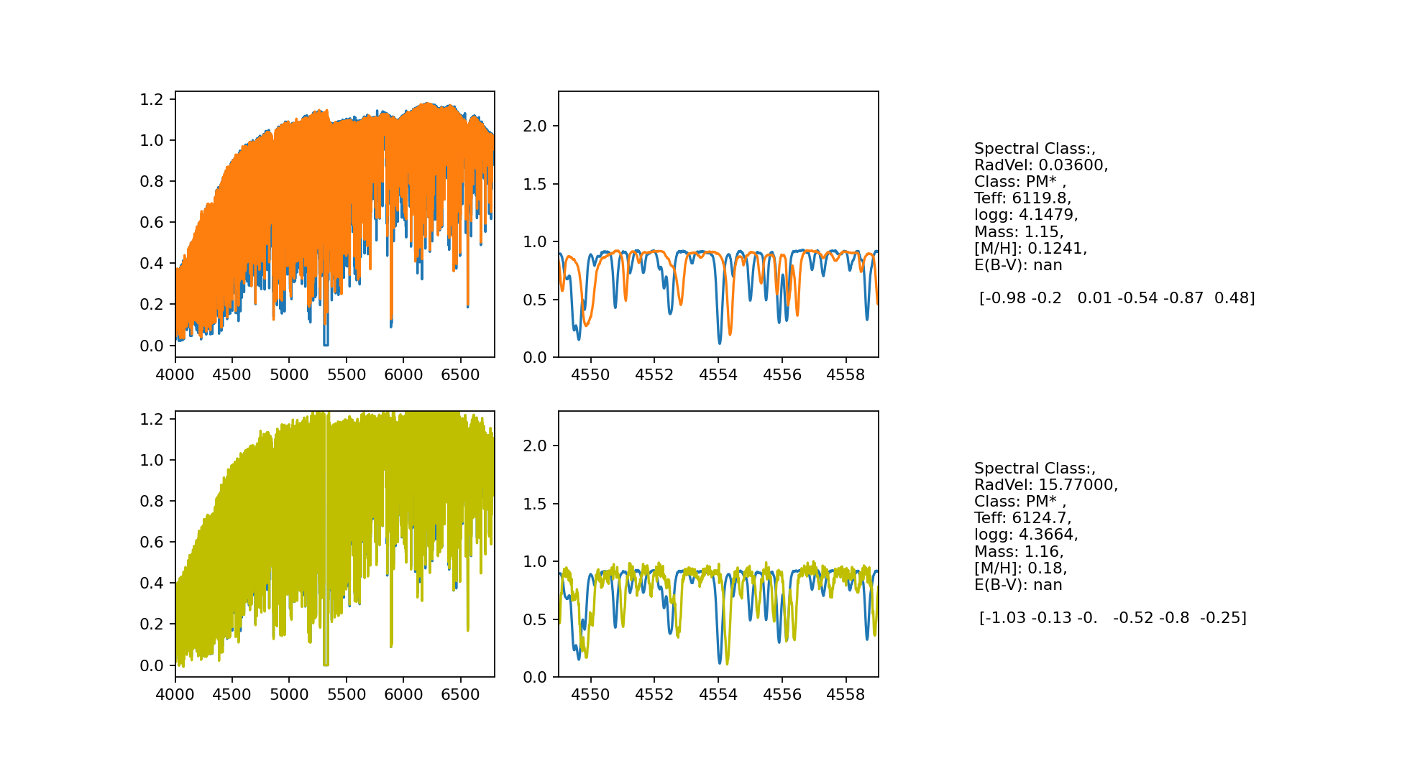
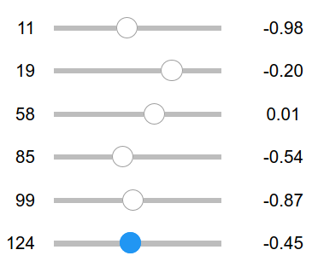
User tools: “Sliders” for exploration of the latent space
https://www.eso.org/~nsedagha/universe/#astromachines

Slide 24
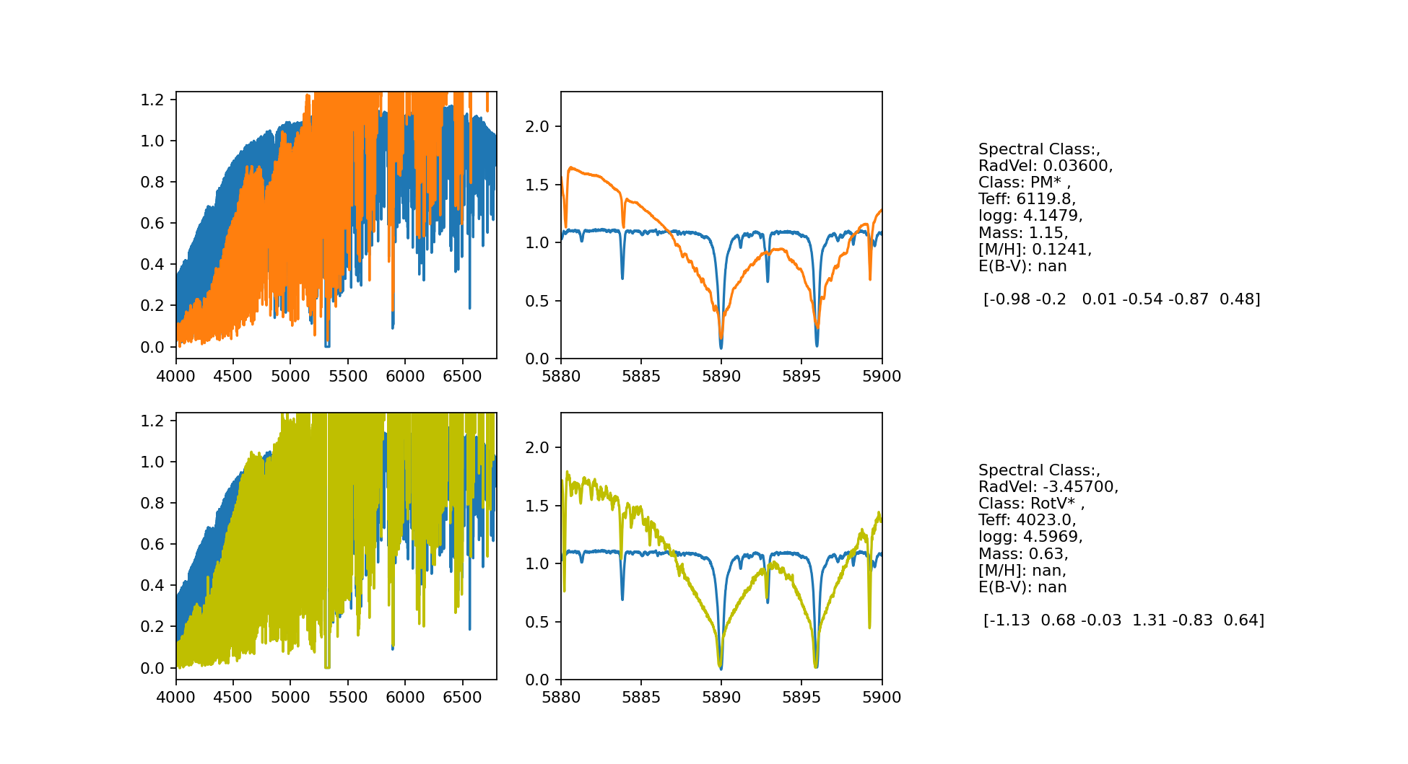
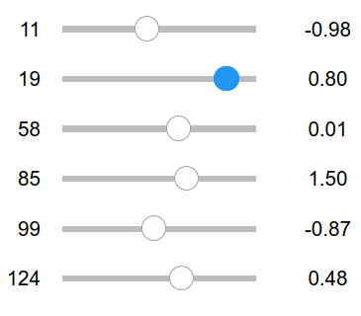
User tools: “Sliders” for exploration of the latent space
https://www.eso.org/~nsedagha/universe/#astromachines

Slide 25
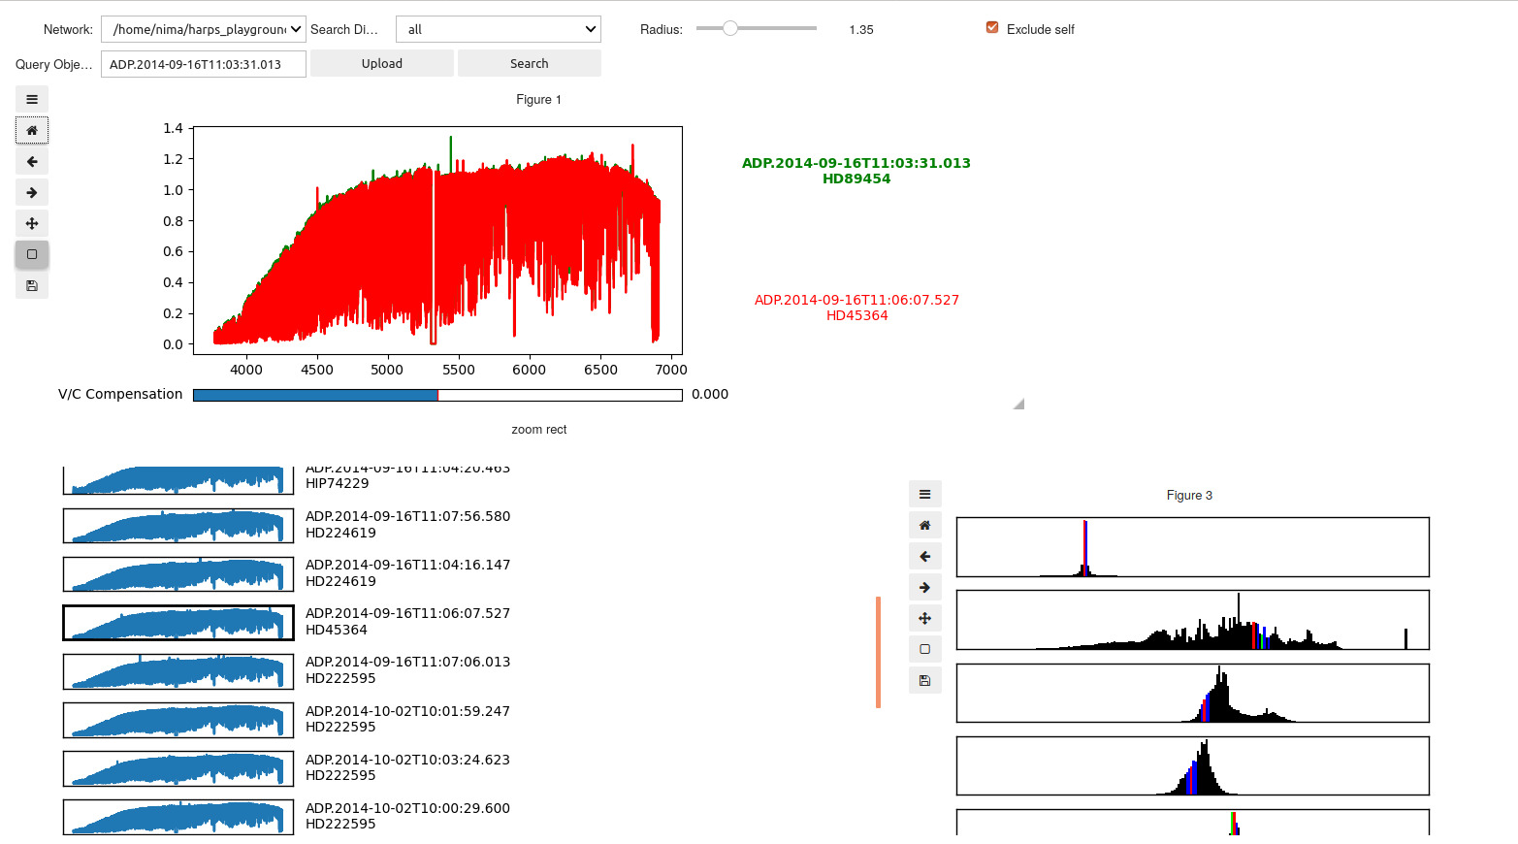
User tools: RETR-SPECT, a Retrieval engine for Spectra
https://www.eso.org/~nsedagha/universe/#retrspect

Slide 26
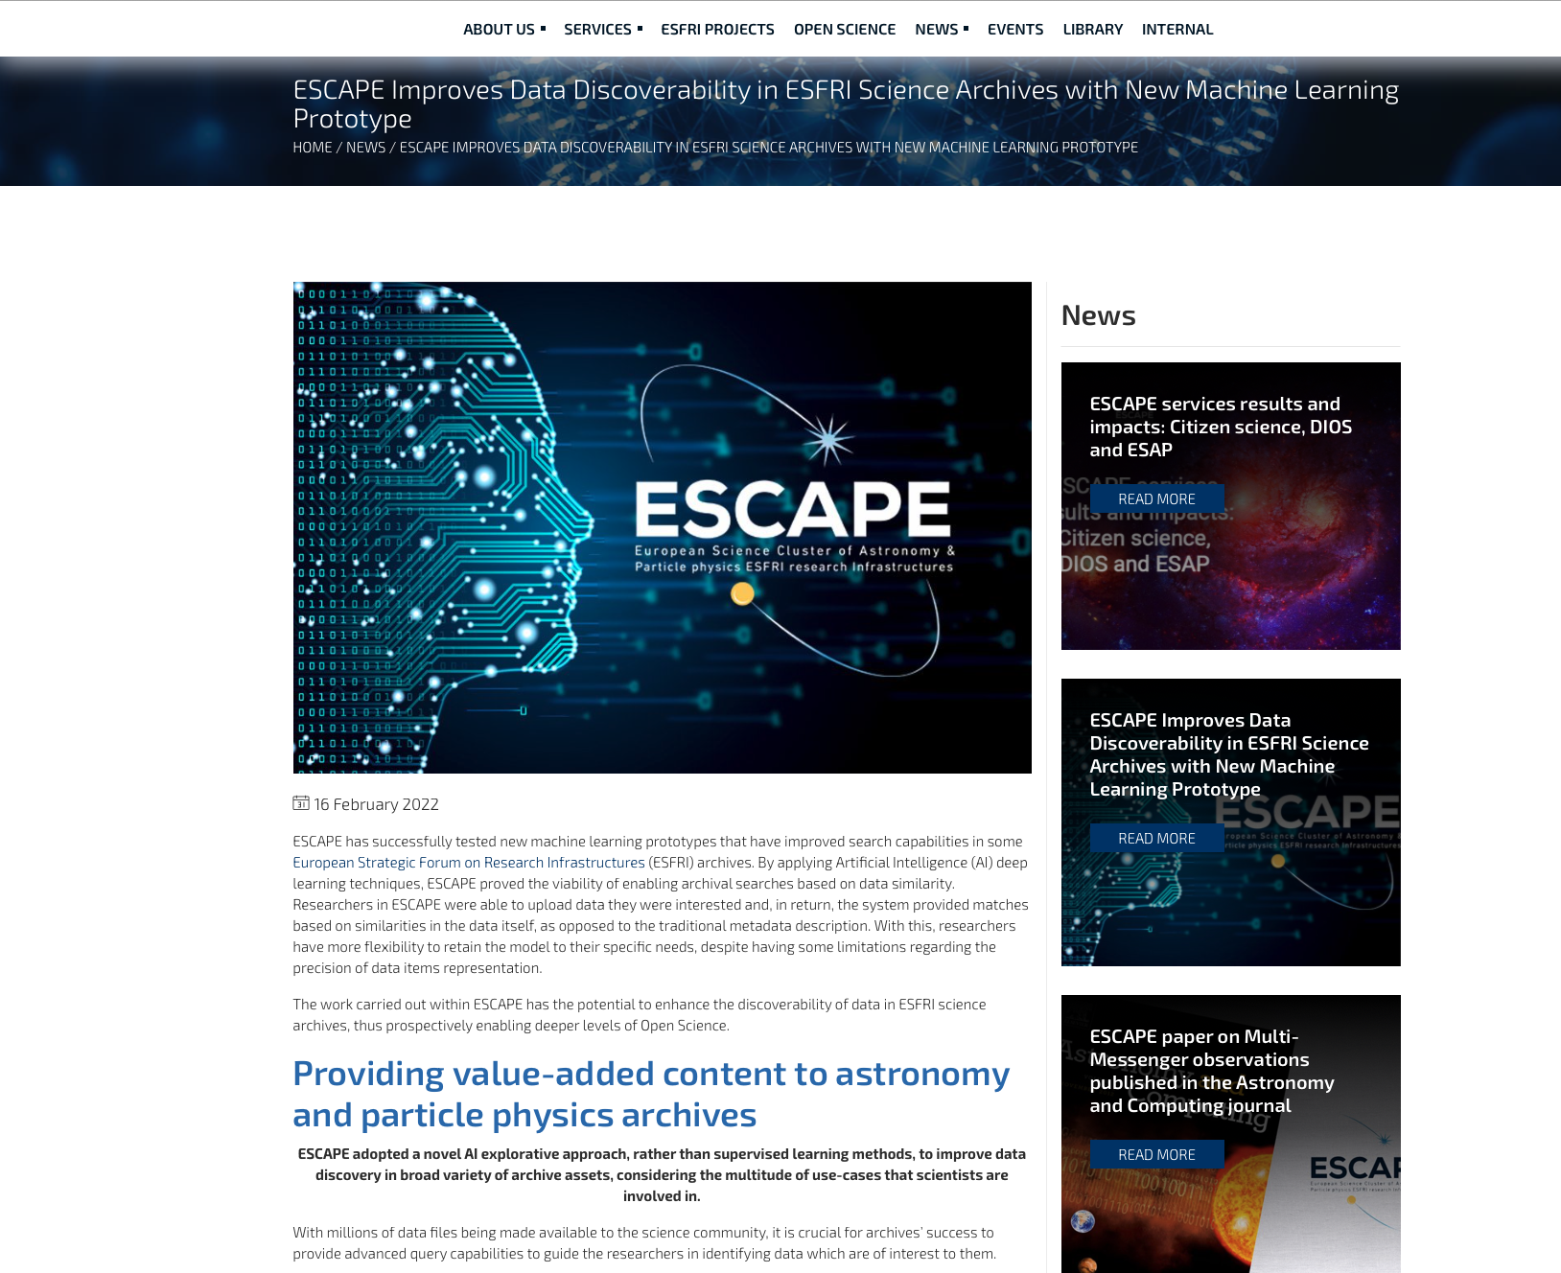
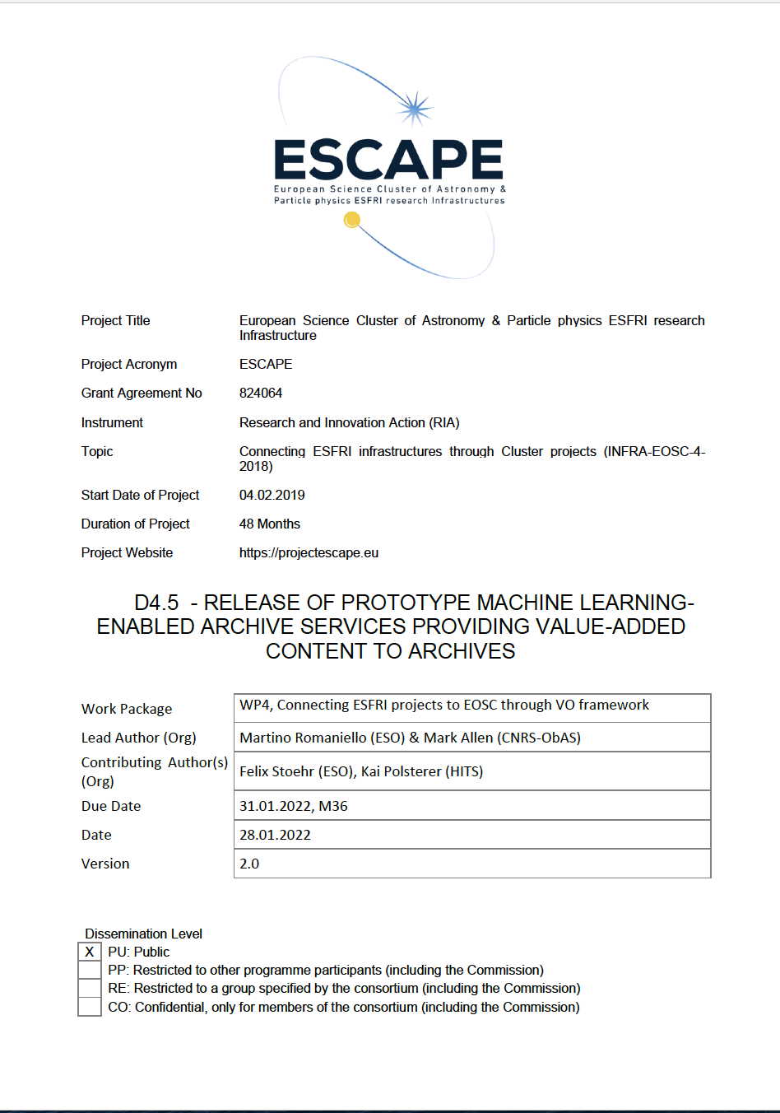
Deliverable D4.5 – January 2022

