Slide 2
LoTSS DR2
A technical overview
Yan Grange, Tim Shimwell
ASTRON, 2022
This work is licensed under a
Creative Commons Attribution-ShareAlike 2.0 Generic License.

Slide 3
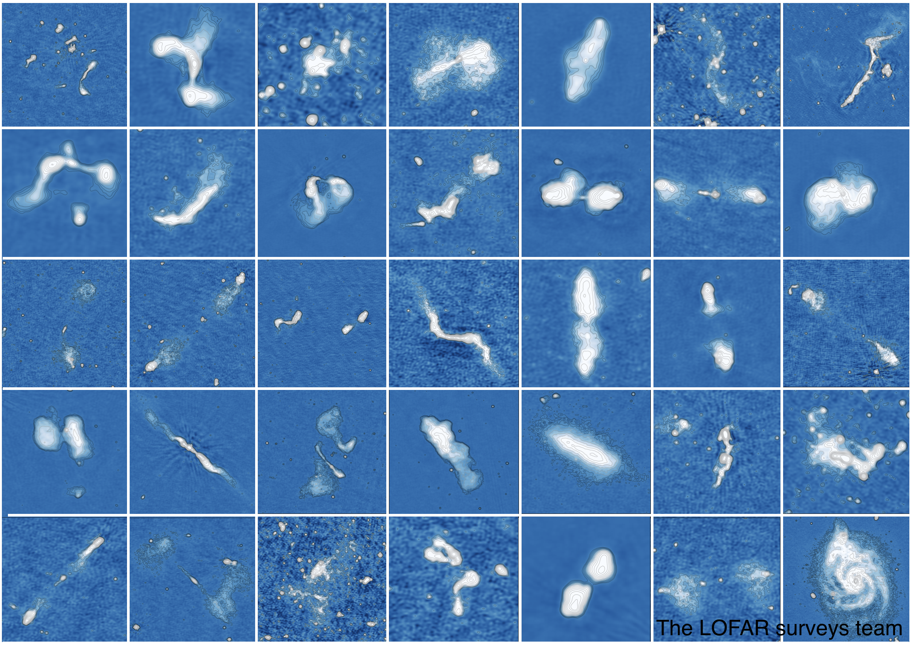
LoTSS
The LOFAR Two-metre* Sky Survey
aims to survey the whole northern sky
at the full resolution of Dutch LOFAR (6 arcseconds)
declination-dependent sensitivity which will typically be around 100 μJy/beam
Prefactor direction-independent and DDF direction-dependent calibration pipeline
Preliminary Data Release (PDR): 2017
First Data Release (DR1): 2019
Second Data Release: 2022!
* HBA = 1.8 - 2.4 m wavelength

Slide 4
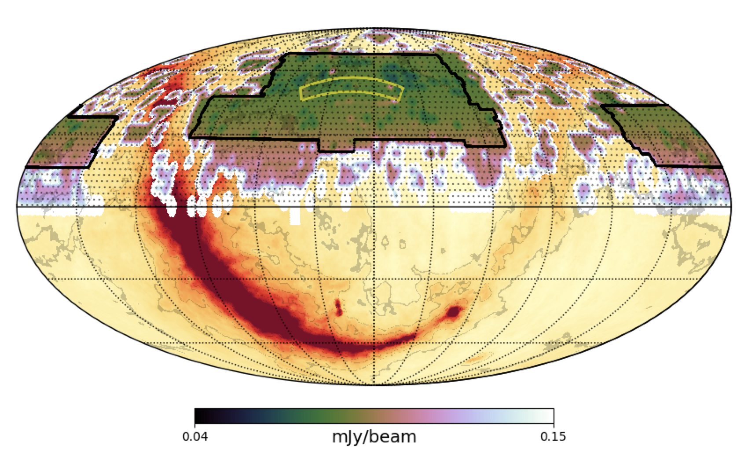
LoTSS – DR1
Feb 2017
424 deg²
2% of sky (N)
58 pointings
325 694 sources
Yellow: DR1 Black: DR2
T Shimwell

Slide 5
LoTSS – DR2
Feb 2022
5634 deg²
27% of sky (N)
841 pointings
4 395 448 sources
Yellow: DR1 Black: DR2
T Shimwell

Slide 6
LoTSS DR2 – the data
Type | Total size
Mosaiced astrometric corrected Stokes I 6’’ and 20’’ resolution images | 1.5 TB
Individual Stokes I 6’’ and 20’’ (with and without astrometric correction) resolution restored images with associated DDFacet model, residual and mask images | 7.5 TB
Catalogue of the 4,395,448 radio sources and the 5,120,353 Gaussian components that describe them | 2 GB
Stokes I 6’’ and 20’’ HIPS* files | 2 TB
Individual observation Stokes QU 20’ and 3’ resolution undeconvolved 480-plane image cubes | 34 TB
Individual observation Stokes V 20’’ resolution 120-168MHZ continuum dirty images | 400 GB
DI calibrated visibilities and DD calibration solution, facet layout and astrometric corrections | 100 TB
Raw data in the LTA | 12 PB

Slide 7
LoTSS DR2 – Data access
Type |  | Locality
Mosaicked astrometric corrected Stokes I 6’’ and 20’’ resolution images | 1.5 TB | Disk
Individual Stokes I 6’’ and 20’’ (with and without astrometric correction) resolution restored images with associated DDFacet model, residual and mask images | 7.5 TB | Disk
Individual observation Stokes QU 20’ and 3’ resolution undeconvolved 480-plane image cubes | 34 TB | Tape
Individual observation Stokes V 20’’ resolution 120-168MHZ continuum dirty images | 400 GB | Tape
DI calibrated visibilities and DD calibration solution, facet layout and astrometric corrections | 100 TB | Tape
Raw data in the LTA (only linked through the VO, unrelated to SDR) | 12 PB | LTA (ext)
HiPS are stored separately on a web server.

Slide 8
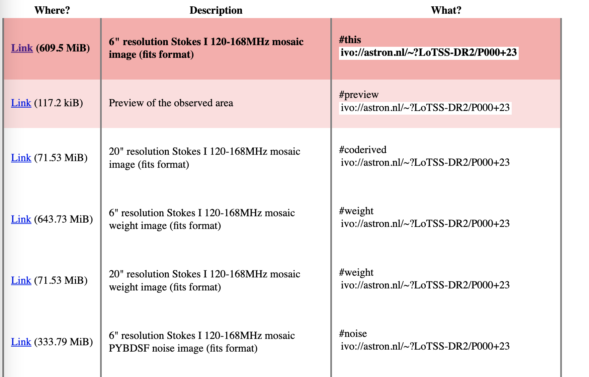
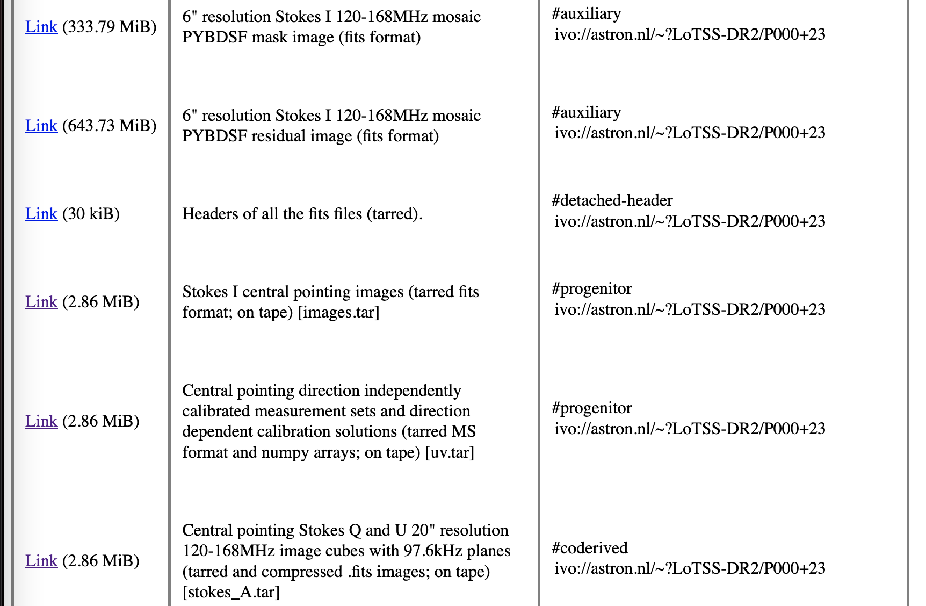
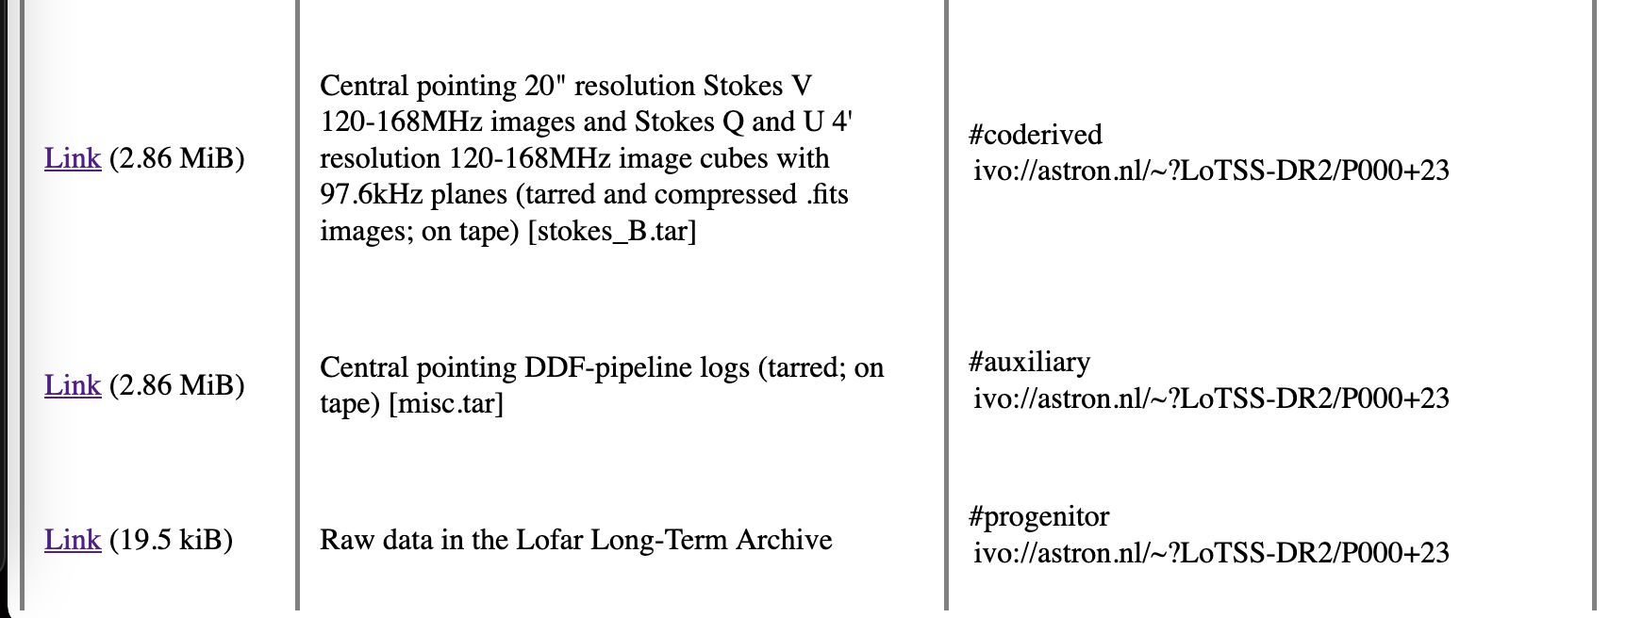
LoTSS DR2 – DataLinks
Datalink for each mosaic. Primary data product is 6” resolution image. All other products are linked through datalink.
Also each source in the source list links to a datalink

Slide 9
LoTSS DR2 – Total view
Stokes I central pointing images
Direction-independent calibrated visibilities with direction-dependent solns
Central pointing Stokes Q and U image cubes (20")
Central pointing 20" resolution Stokes V and Stokes Q and U 4’
Pipeline logs
DataLink
Stokes I mosaics (6”, 20”)
Mosaics weights image (6”, 20”)
Source finder Noise image (6”)
Source finder Mask image (6”)
Source finder resitual image (6”)
Tarred headers (of all fits)
Stokes I mosaics (6”)
Observed visibilities

Slide 10
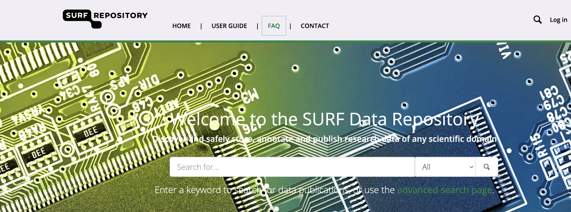
the SURF data repository
Publication platform for research data sets
Links directly to the SURF storage
Also makes data findable outside of astronomy
Makes access to data on tape easier (staging trough the platform)

Slide 11
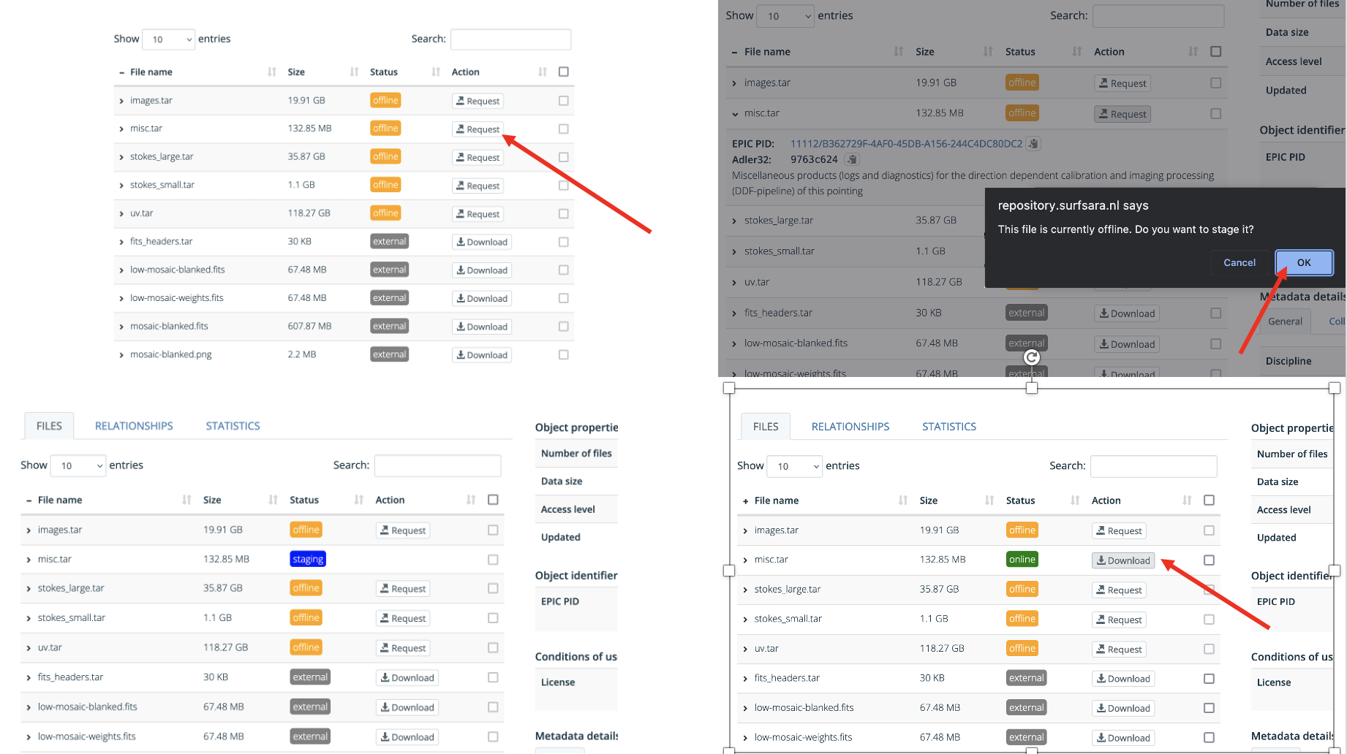
LoTSS DR2 – Staging

Slide 12
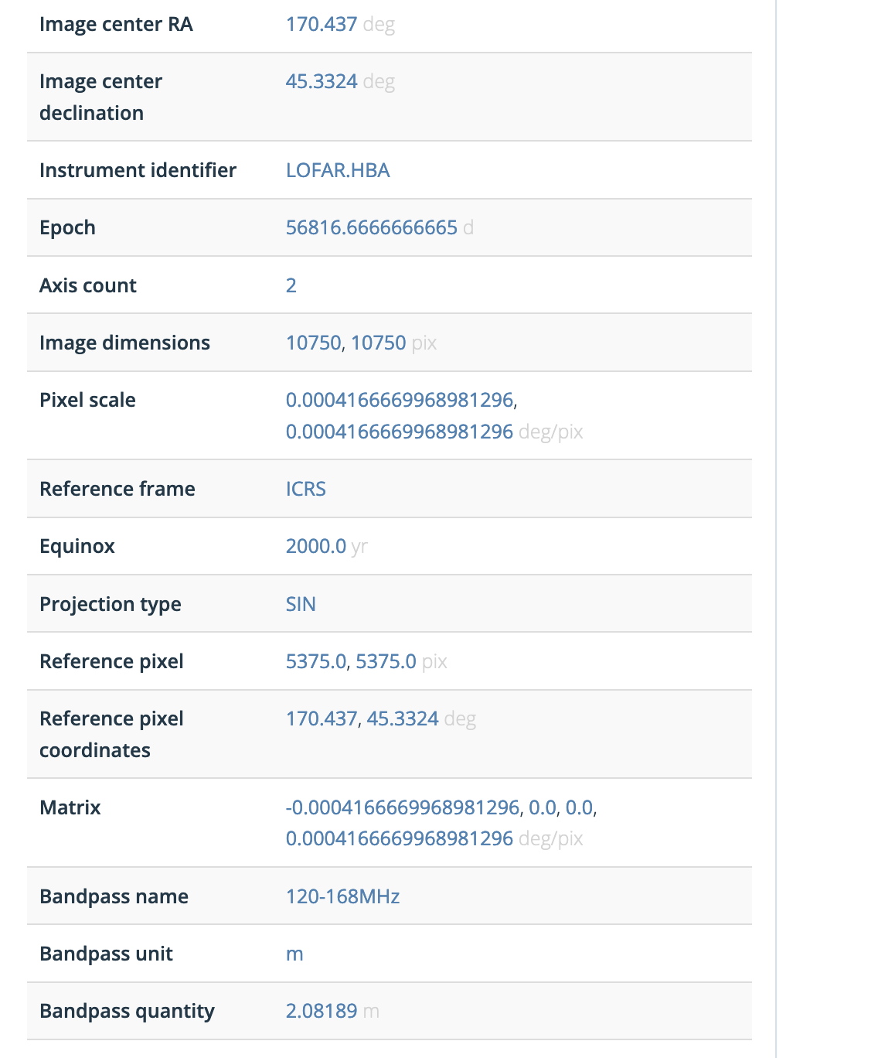
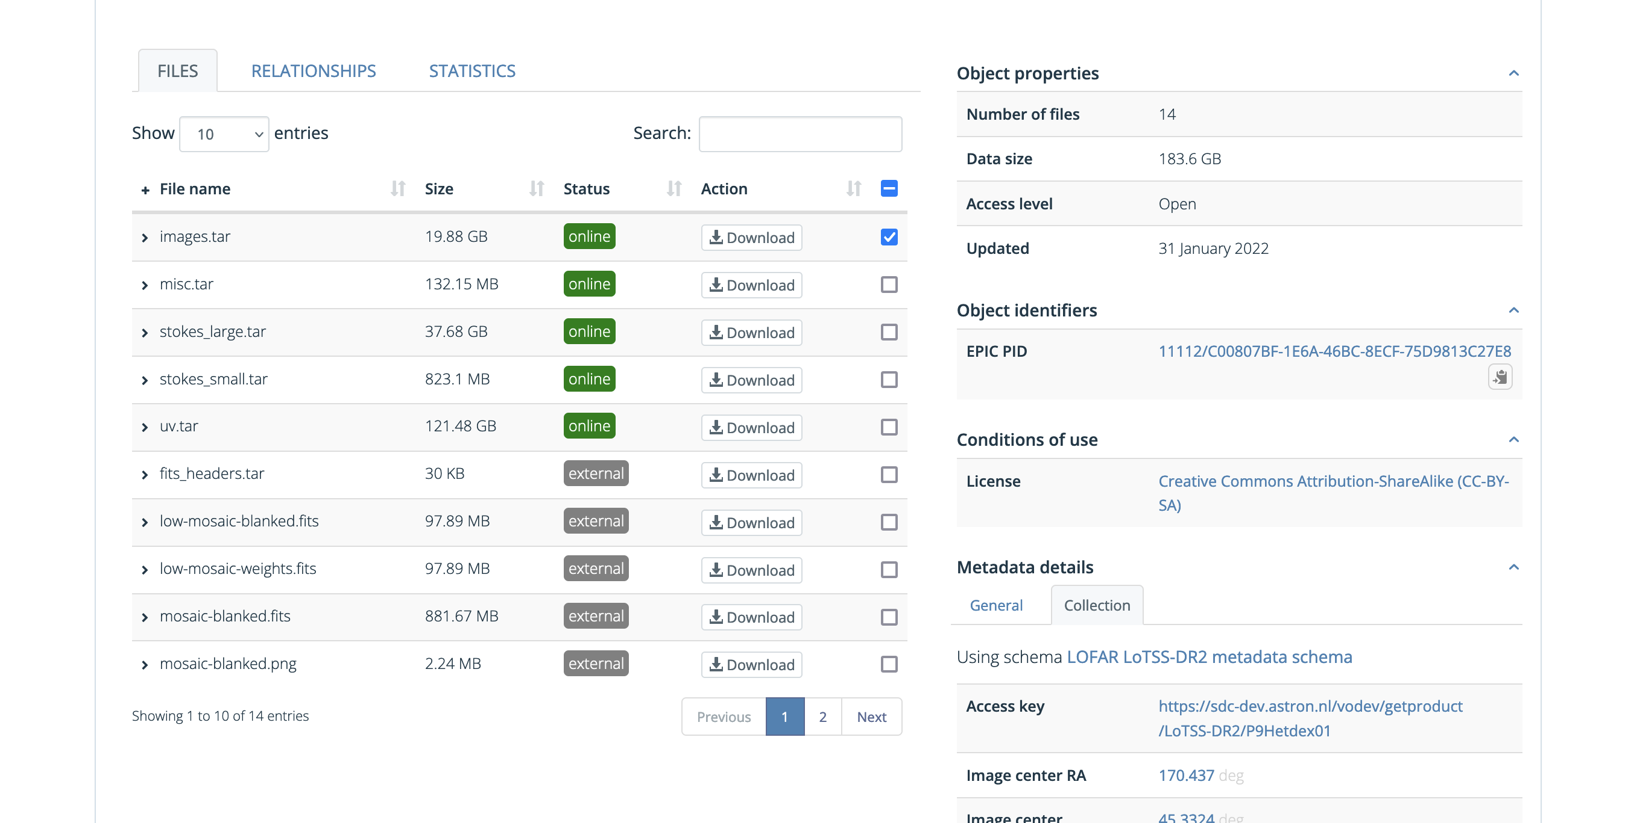
LoTSS DR2 – Data model
Main source of dat is the VO. Filled the SDR using ADQL output.
From SDR we add ePIC PIDs and adler32 checksums in the VOTable that is returned from query.

Slide 13
LoTSS DR2 – Making it (even) FAIRer
Licensing
Default license: CC-BY-SA for ASTRON-VO (as well as this talk)
PIDs
ePIC PIDs for each data product in the release,
for each pointing
ánd for the release itself (and one for the documentation)
Also a DOI for the release itself
All those PIDs point to the SURF repository.

Slide 14
LoTSS DR2 – As a driver for developments
Raw data is not really in the VO but Radio IG could lead to standards that make this possible.
Downloading more than ~100MB directly is considered bad practice, one should consider a cutout.
Have been playing with the HTTP range headers to only download coutout data (FITS is fantastically predictable). May think of creative ways.
Data staging could be wrapped in a UWS pattern making it directly accessibe for tools that support this pattern in stead of going to a web page to stage.

Slide 15
LoTSS DR2 – final remarks
The main PID for the release is:
21.12136/95f9f5a9-406e-4270-ad8b-45e36c809561
Corresponding paper: DOI 10.1051/0004-6361/202142484.
Surf Data Repository landing page DOI: 10.25606/SURF.lotss-dr2

