Slide 1
WP4 Technology Forum Introduction
(including slides from RP2 review)
Mark ALLEN
CDS, Observatoire Astronomique de Strasbourg (CNRS-ObAS)
For the CEVO Team

Slide 10
WP4 “CEVO” in the ESCAPE thematic cell
Connecting ESFRI projects to EOSC through the VO framework
    EOSC – European Open Science Cloud
    VO – Virtual astronomical Observatory

Slide 11
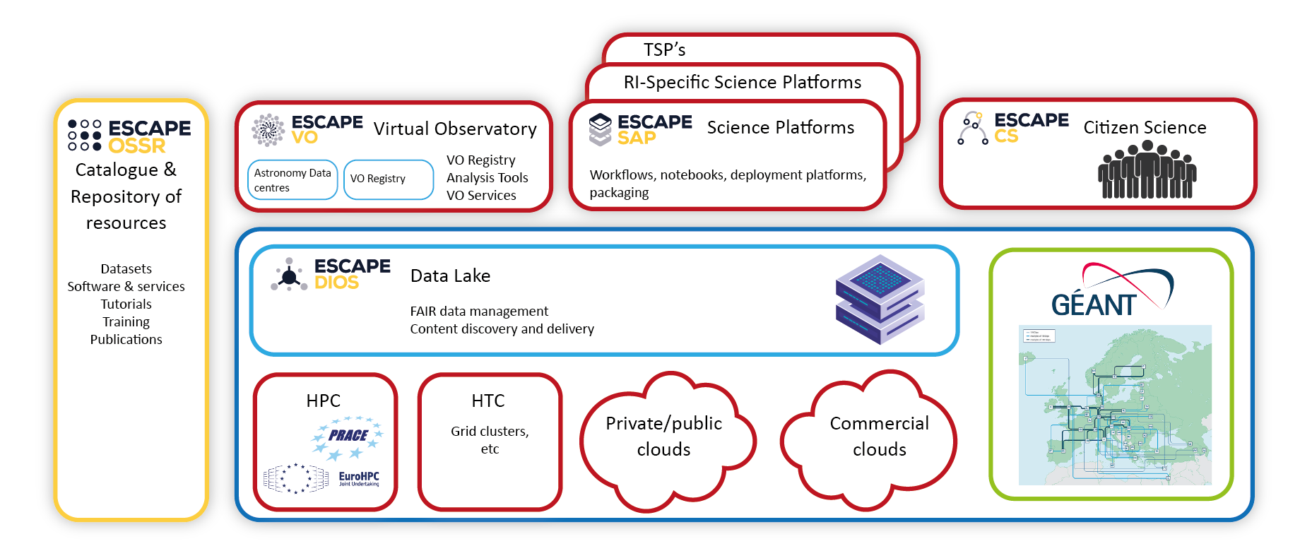
WP4 / CEVO in the ESCAPE ‘thematic cell’
Notes:
Data Lake:
Build a scalable, federated, data infrastructure as the basis of open science for the ESFRI projects within ESCAPE. Enable connection to compute and storage resources.
Software Repository:
Repository of "scientific software" as a major component of the “data” to be curated in EOSC. Implementation of a community-based approach for the continuous development of shared software and for training of researchers and data scientists.
Virtual Observatory:
Extend the VO FAIR standards, methods and to a broader scientific context; prepare the VO to interface the large data volumes of next facilities.
Science Platforms:
Flexible science platforms to enable the open data analysis tailored by and for each facility as well as a global one for transversal workflows.
Citizen Science:
Open gateway for citizen science on ESCAPE data archives and ESFRI community

Slide 12
Objectives of WP4 are to:
  Assess and implement the connection of ESFRI and other astronomy research infrastructures to the EOSC by the Virtual Observatory - demonstrating EOSC capacity to include existing frameworks.
  Refine and pursue implementation of FAIR principles for astronomy data via common interoperability standards - extending the VO to new communities.
  Establish data stewardship practices for adding value to trusted content in astronomy archives

Slide 13
Making data FAIR with the Virtual Observatory.
The Virtual Observatory is:
An operational framework for interoperable access to world-wide astronomical data and services.
A pioneer of FAIR data sharing - an existing global framework – populated by major data providers (space and ground based) that is heavily used by the community.
Built on International Virtual Observatory Alliance (IVOA) standards
  Recognised in the ESFRI roadmap (2021).
    ‘… a global implementation of a FAIR disciplinary framework and openly avail- able data, the so-called astronomical Virtual Observatory.’
  Quoted as an example in EOSC SRIA document (Feb 2021).
Supported in Europe by Euro-VO (VO Partners + EC projects since ~2001).
  Recognised in ASTRONET roadmap (2008, 2014, 2022).

Slide 14
Virtual Observatory – a part of ESCAPE and EOSC
Integration of an existing interoperability framework
  Domain specific thematic services supporting Open Science
  Integration in ESCAPE:
      VO services available in ESAP prototypes (WP5)
      VO software on-boarding to Open Source Software Repository (WP3)
      Assessment of Data Lake back-ends and interoperability (WP2)
      Making astronomy data available for citizen science (WP6)
Data stewardship practices of Astrophysics in EOSC context
  Common metadata standards
EOSC to enable next steps of VO
  Connection to computing, platform integration, scalability for big data
Developing the vision of next generation astro ESFRI archives

Slide 15
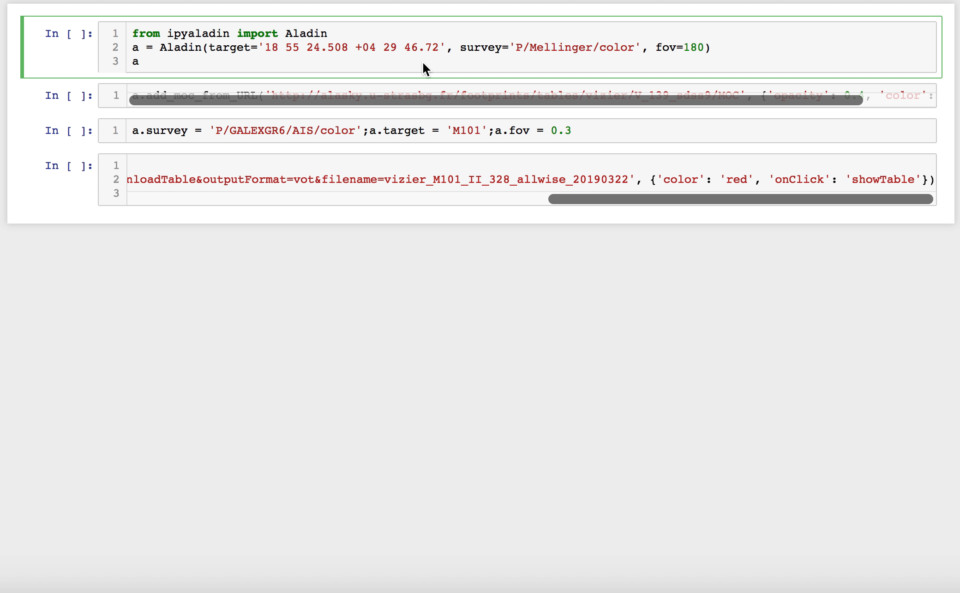
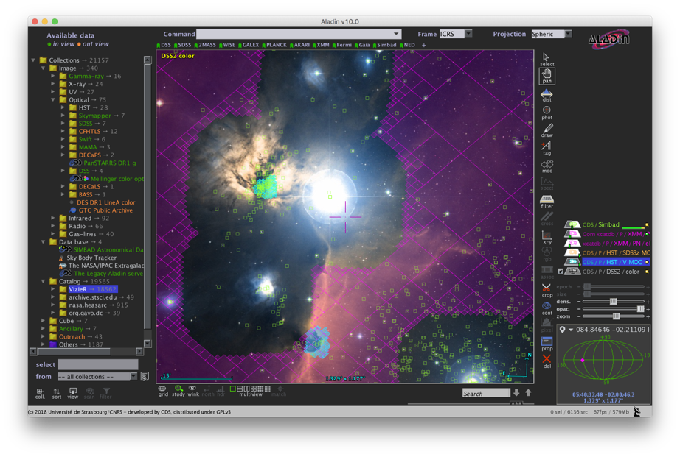


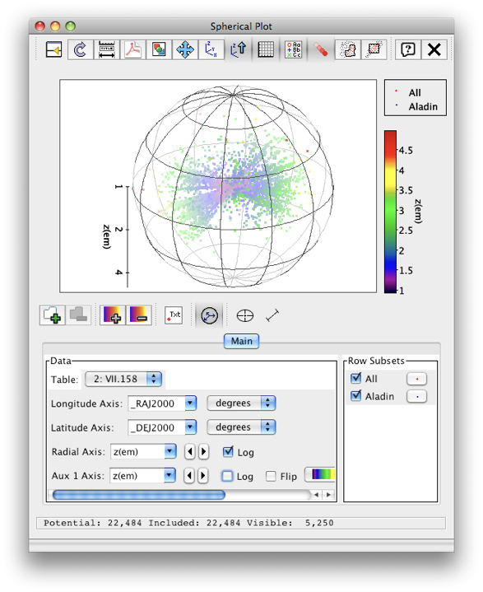
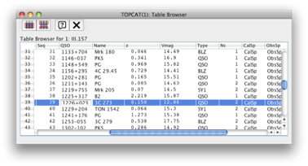
Enables a Virtual Research Environment of interoperable tools and services based on IVOA standards:
One view of the VO from an application/portal :
Built from VO Registry
1000s All-Sky data sets
Data from many observatories and missions
Complex ADQL queries
Largest catalogues: ESO surveys, Gaia etc.

Slide 16


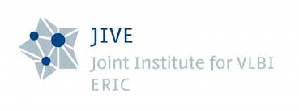












Engagement of ESFRI/RIs and ESCAPE partners
Astronomy ESFRIs, Research Infrastructures and associated partners
ESO
SKAO
NWO-I-ASTRON
JIVE
CTAO
KIS
ORB
EGO
HITS (WP3)
CNRS-OBAS
CNRS-CPPM
INAF
UEDIN
UHEI
INTA
Partners bringing experience from European Virtual Observatory

Slide 17
Progress in Reporting Period 2
Overview:
Task 4.1 Integration of astronomy VO data and services into the EOSC
Interaction with EOSC projects based on experience of onboarding via EUDAT
➔ Intermediate Analysis Report of VO data and service integration into EOSC (D4.4)
Task 4.2 Implementation of FAIR principles for ESFRI data through the Virtual Observatory
ESCAPE priorities at IVOA level : (MS23, MS25, MS26)
Community training events for scientists and data producers/providers:
➔ 1st Science with interoperable data school (D4.3)
➔ European data providers Forum - Hands-on workshop for data providers (MS25)
Task 4.3 Adding value to trusted content in astronomy archives
Results of deep learning applied to archive data sets (joint with WP3)
➔ Prototype demonstrator for value-added archive services (D4.5)

Slide 18
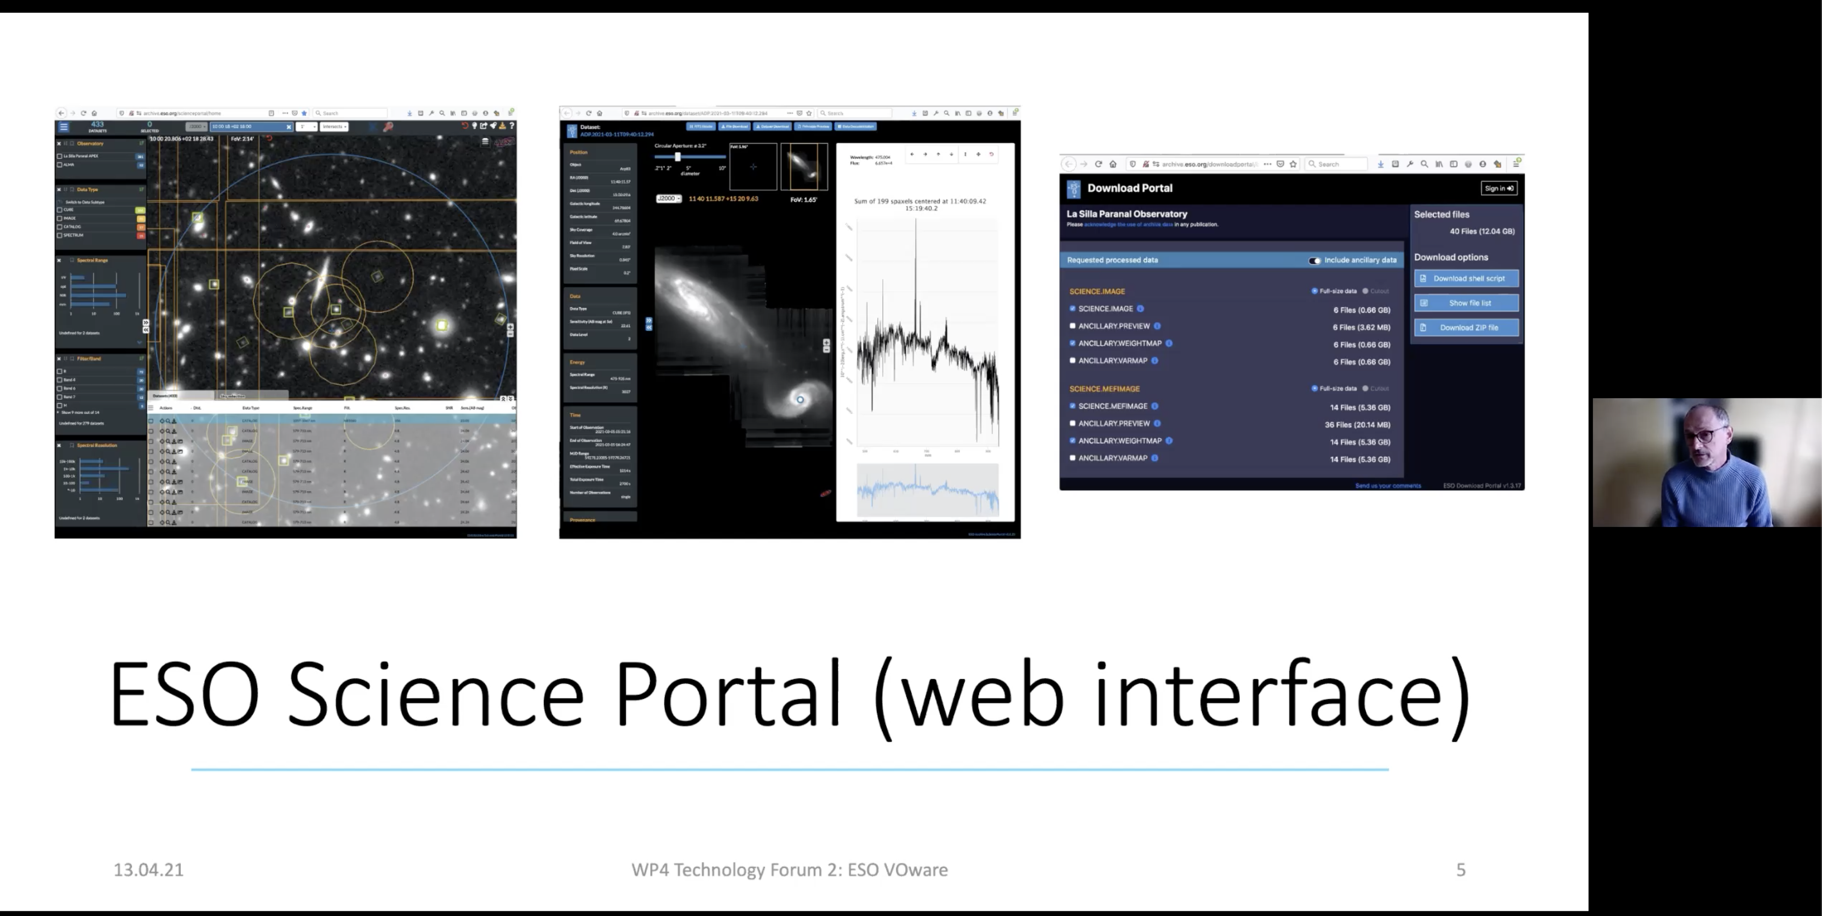
WP4 Technology Forum 2. (13-15 April 2021)
Work Package coordination and cross-WP activities
Progress presentations + Hack-a-thon working meeting sessions
  Major Work Package meeting (+ WP3, WP5 interaction)
Invited experts and collaborators
  EUROPLANET, TOPCAT-developer, ObsParis – Radio & Solar expertise
Detailed review: ESO Science Archive experience adopting of VO Technologies
  Used as example to help other RIs
Mapping VO expertise – ESFRI needs
Demos and coding
Results / publications / tools
Planning of the next steps

Slide 19

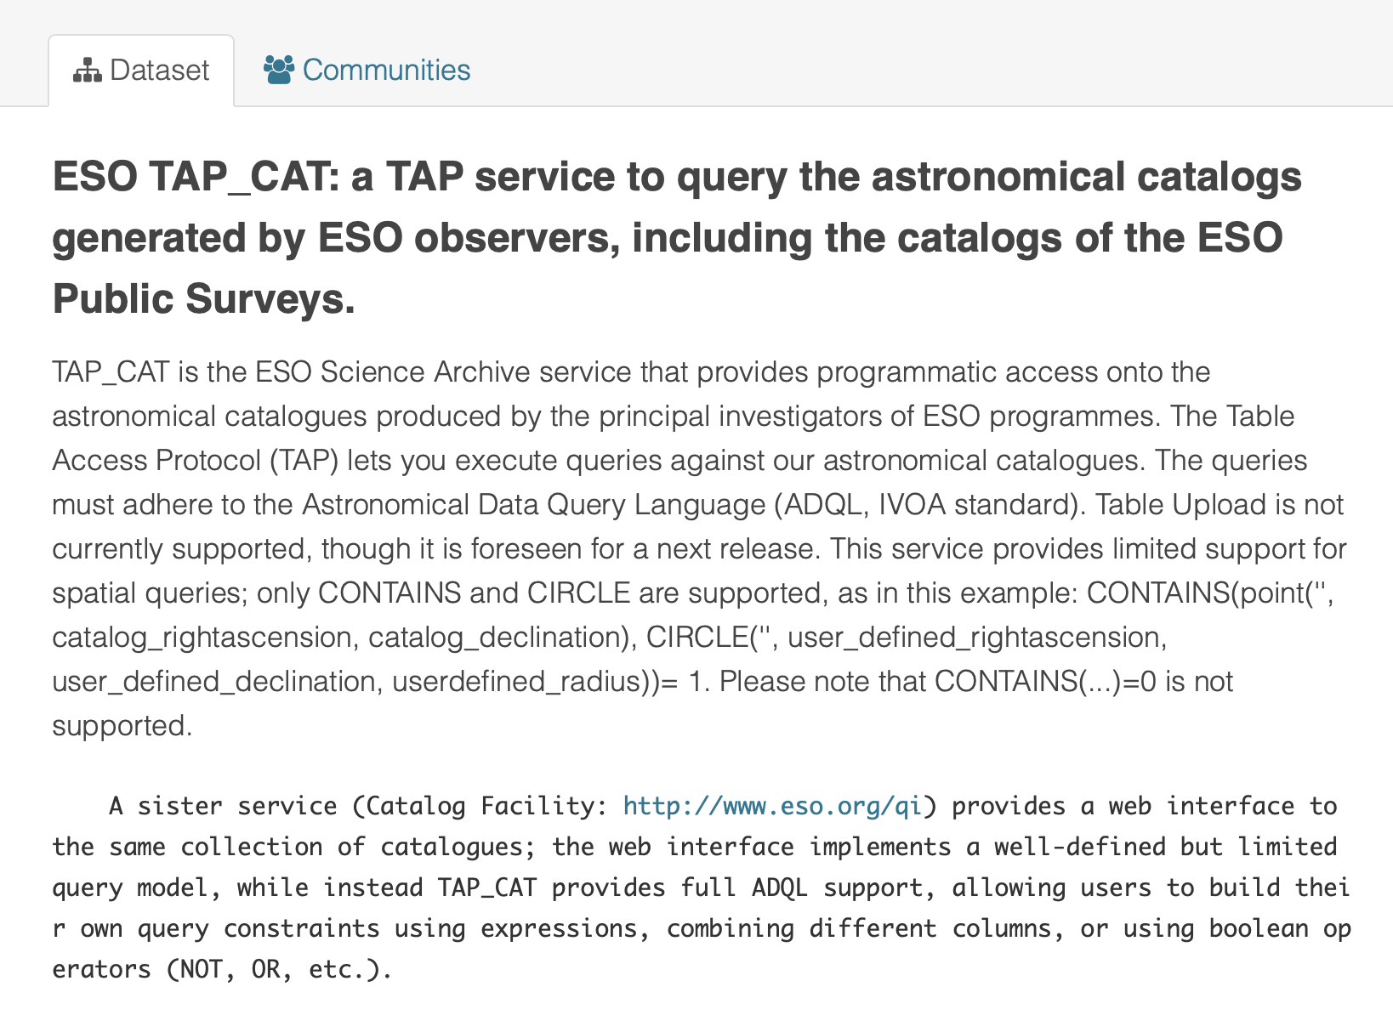
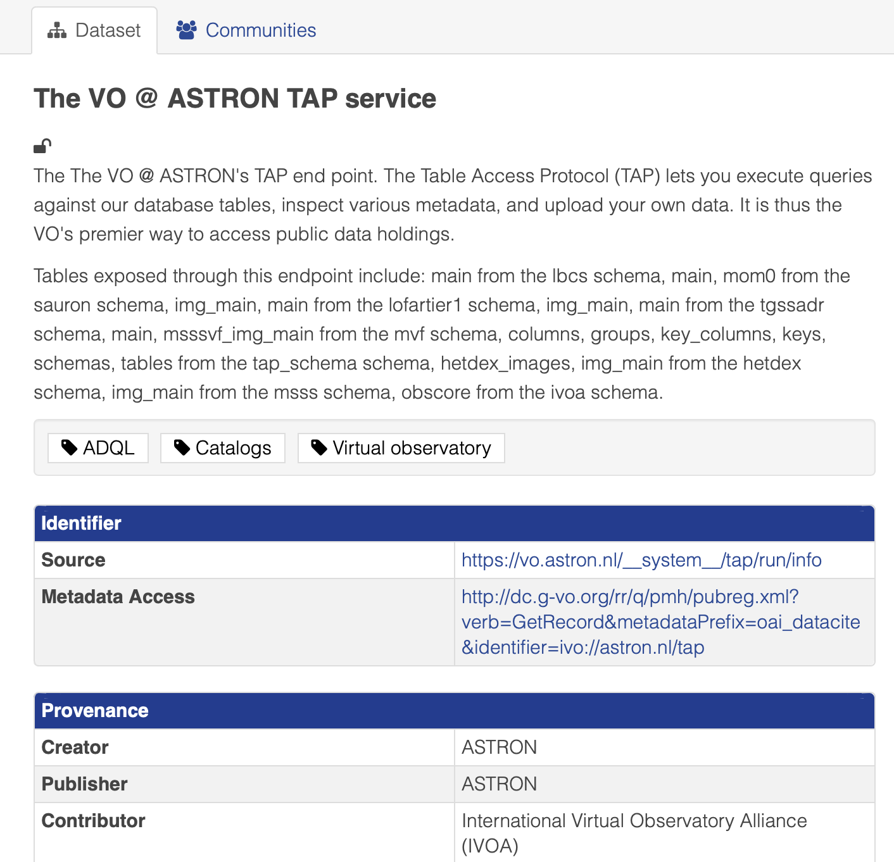
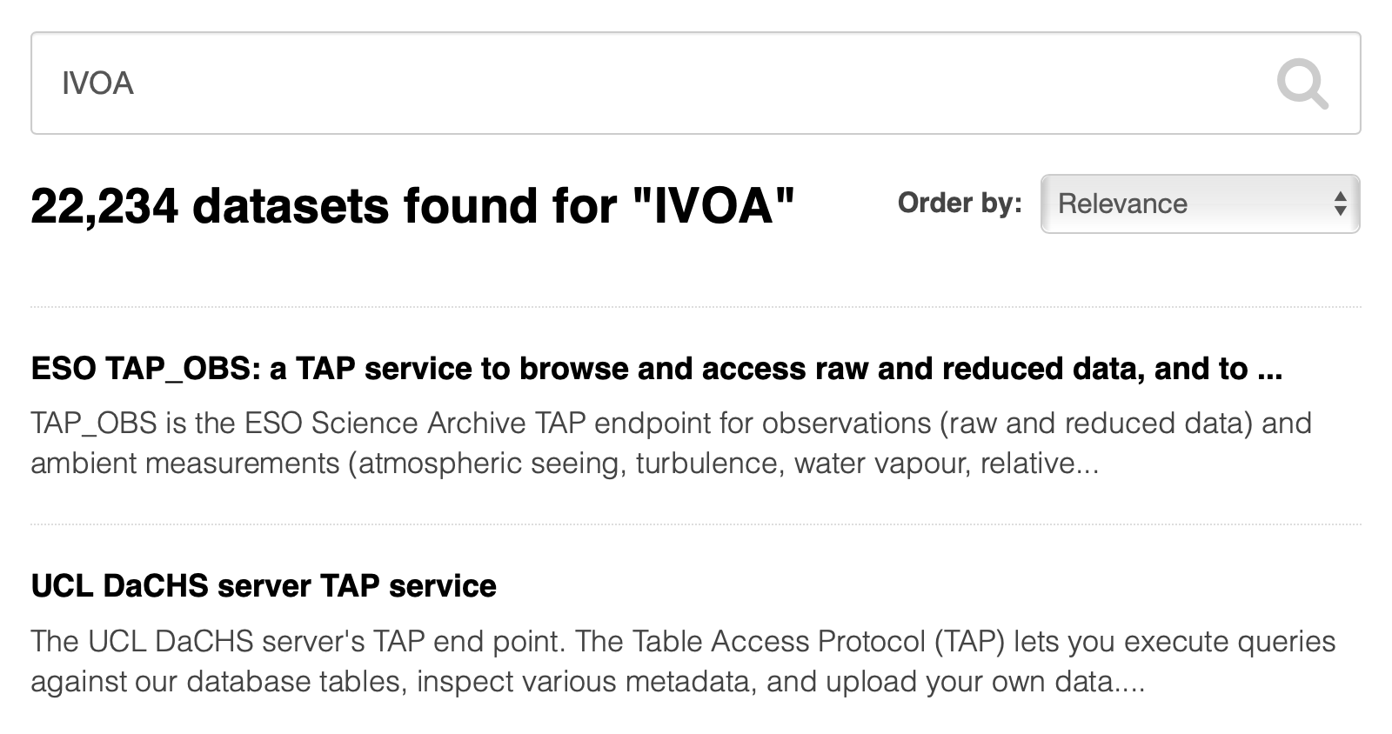
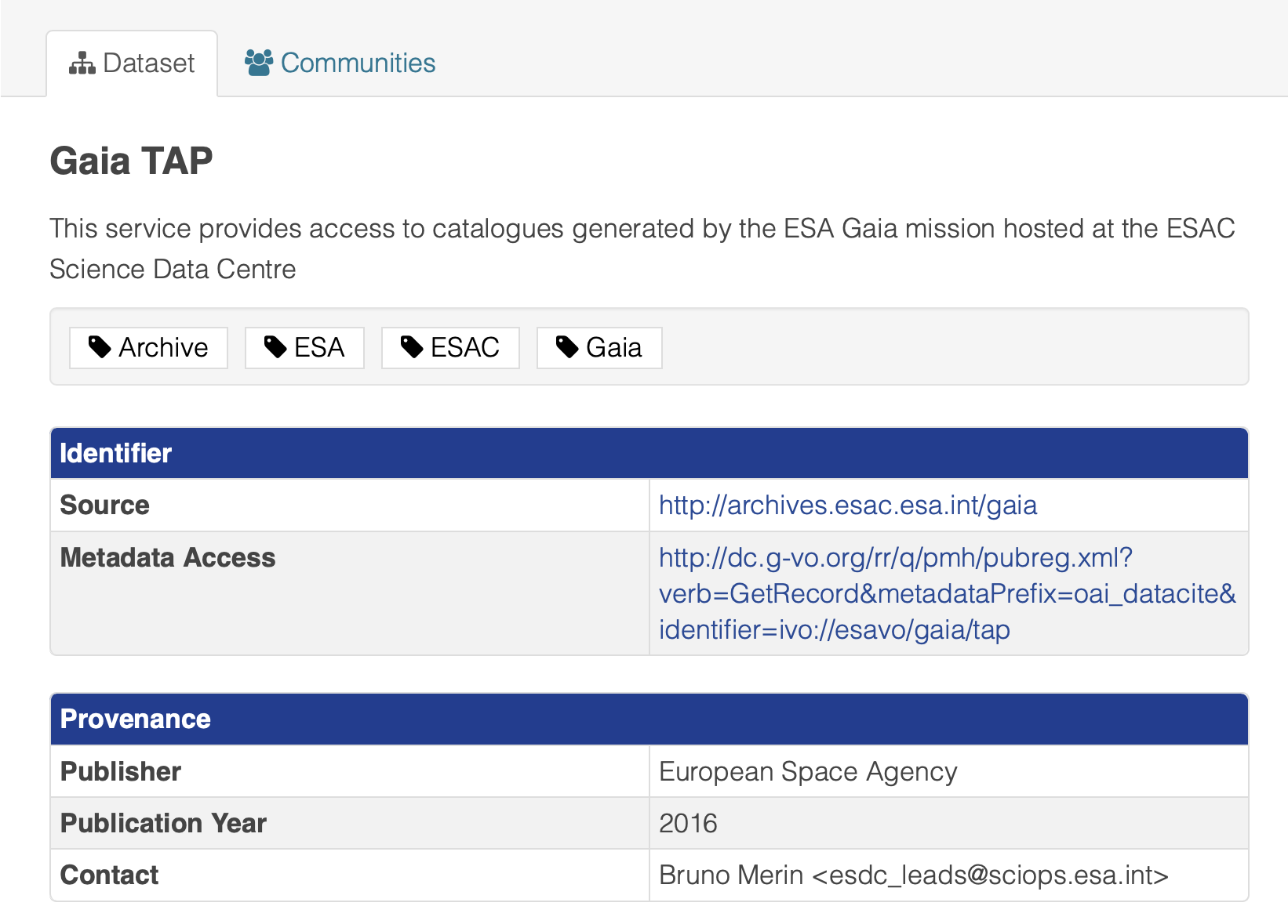
Task 4.1 highlight : VO in B2FIND
Demonstrates 1st level of metadata compatibility
  Links to the actual service
  - enables feedback to EOSC

Slide 20

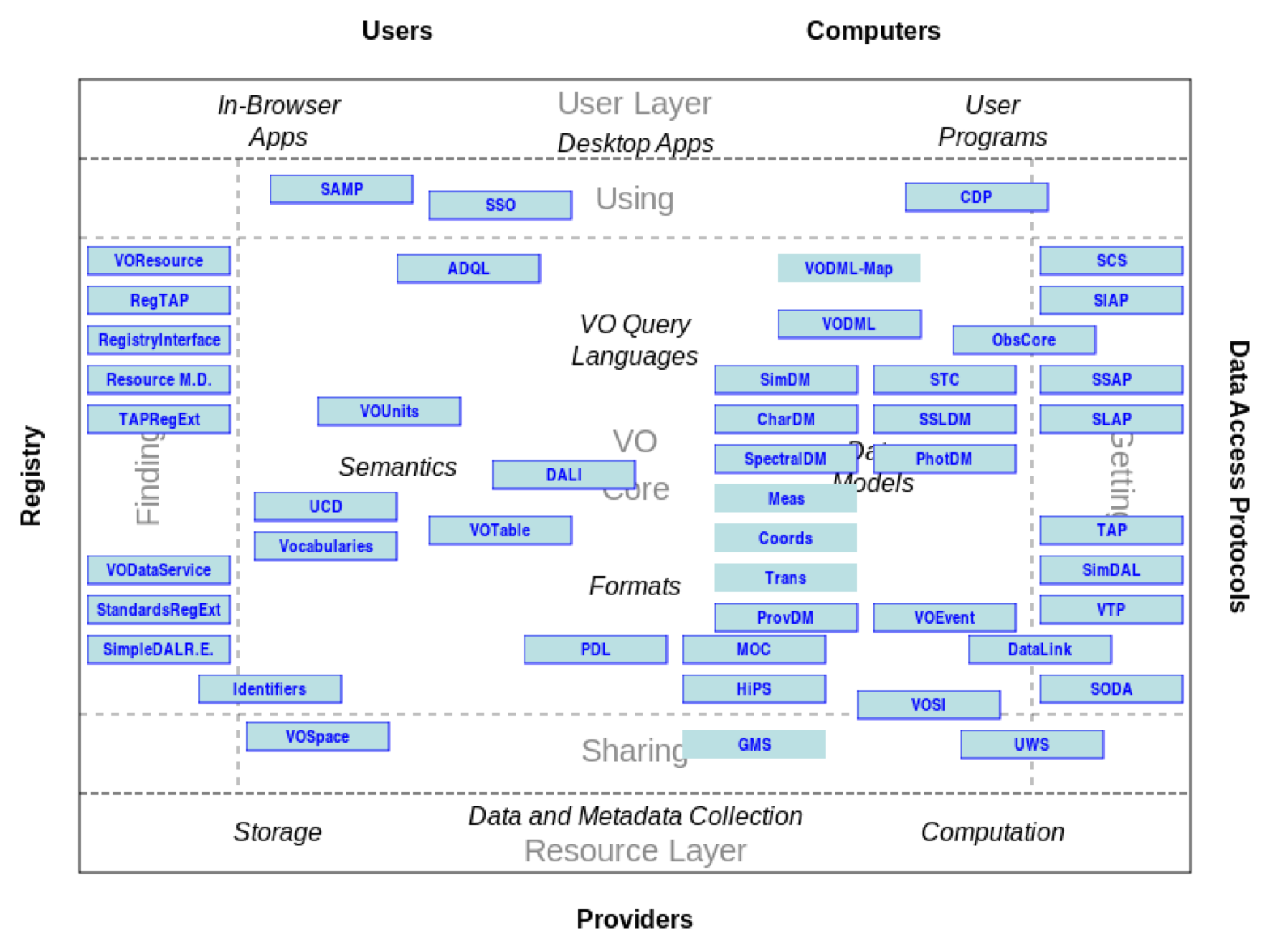
Highlight Task 4.2: Implementations of IVOA standards
Gravitational Waves (EGO-Virgo) – Space time indexing and use in applications for GW follow-up
Solar physics (EST) – Analysis of IVOA semantic UCD metadata for solar physics.
Radio Astronomy – interoperability and data volume aspects, new Radio Astronomy services registered in VO registry, standardized metadata for radio astronomy (JIVE, ASTRON, SKAO, ALMA)
ESO science archive services
Relevant standards used/assessed in ESCAPE @ IVOA ◉
◉
◉
◉
◉
◉
◉
◉
◉
◉
◉
◉
◉
◉
◉
◉
◉
◉
◉
◉
◉
Working Draft
IVOA Recommendation

Slide 21
3 Milestones: “Progress and priorities at IVOA”
Milestone 24 – On-line IVOA meeting (Nov 2020). ✓
  Radio (ESCAPE provided a VO tutorial, and Provenance BoF at ADASS)
  Enhancing description of Radio data in VO standards,
  15 contributions from ESCAPE partners
Milestone 25 – On-line IVOA meeting (May 2021). ✓
  ESCAPE partners provided the Introductory tutorial sessions
  Status of MOC – space-time indexing, EPN-TAP (for solar physics), VO and platforms
  29 contributions from ESCAPE partners
Milestone 26 – On-line IVOA meeting (Dec 2021). ✓
  ESCAPE partners provided the VO for newcomers sessions
  Registering IVOA software (in OSSR)
  Results of ESCAPE for Radio Astronomy (JIVE, ASTRON) and high-energy astrophysics (CTA)
  Results of ESCAPE for Provenance, time domain, data models, semantics
  29 contributions from ESCAPE partners

Slide 22
ESFRI / RIs | Results for ESCAPE work toward FAIR standards and tools
ESO-ELT | Data access and visualisation standards and tools Support of VO standards in ESO archive services – used as exemplary case to help others Relevant IVOA standards updated
EGO/VIRGO | Development of MOC2.0 and mocpy Tools / libraries integrated into GW community software Paper published in Astronomy & Computing
SKA, JIVE, ALMA (LOFAR) | Creation and support of the IVOA Radio Astronomy Interest Group Example TAP services, accessible in VO tools and in the ESCAPE platform
CTA & KM3NeT | Data Provenance standards approved by IVOA Many activities for adoption and implementation (Workshop held) Reference paper published on a: Management System for Provenance Information
EST | VO metadata developed for Solar Physics Prototype TAP services for solar data
ESO, CNRS-ObAS, INTA, INAF,UHEI UEDIN, HITS
EGO (INFN), CNRS-ObAS,
JIVE, ASTRON, SKAO, ESO/ALMA, UHEI, CNRS-ObAS
CTAO, Obs-Paris, CNRS (ObAS+CPPM)
UHEI
ORB, KIS, CNRS-ObAS, INTA, UHEI

Slide 23
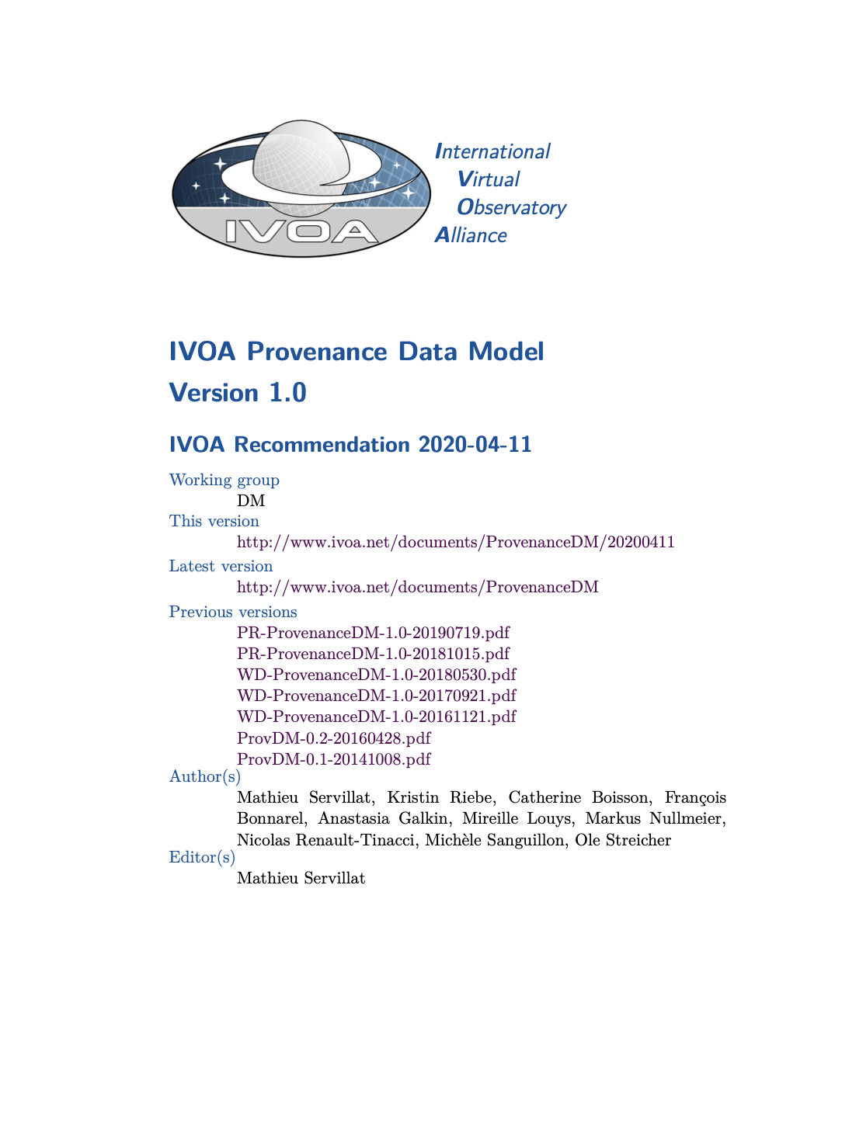
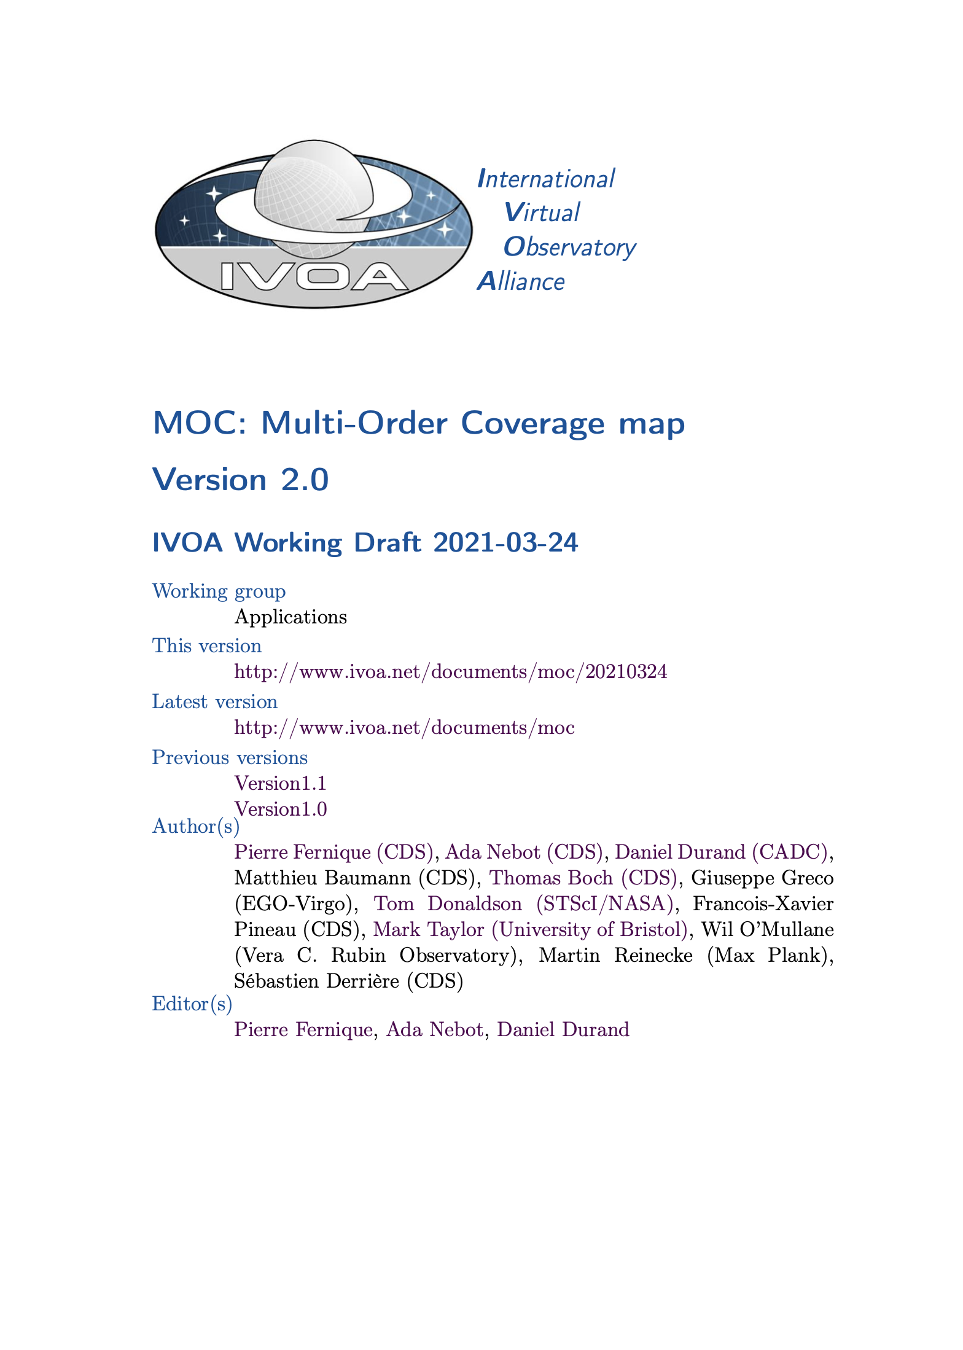
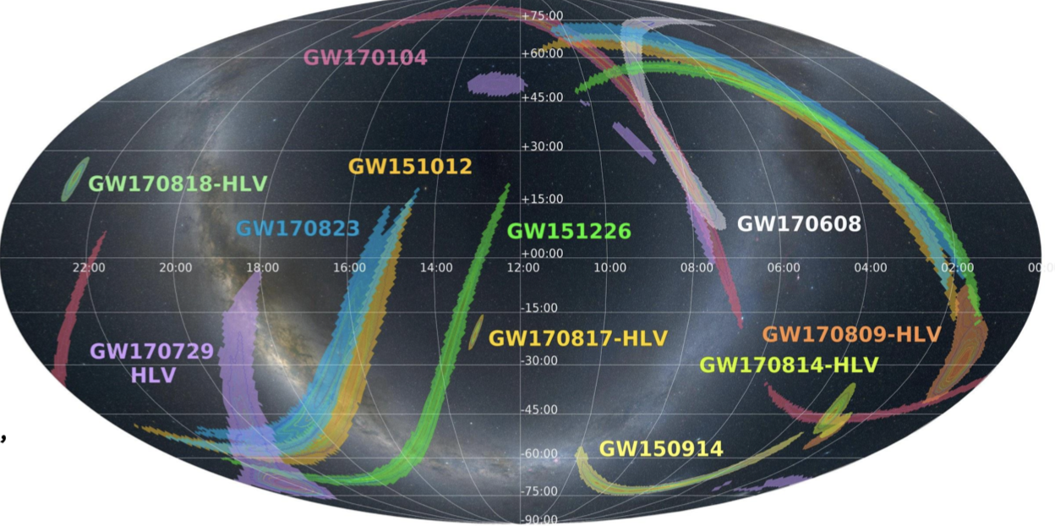
Example – 2 of the standards led/contributed to by ESCAPE partners
Provenance Data Model
Finalised and approved April 2020.
Brought to community via ESCAPE Provenance workshop September 2020.
- Published - Servillat et al. – SPIE
e.g. IVOA metadata for Sky Coverage maps of Gravitational Wave detections
Multi-Order Coverage 2.0
Space coverage extended with TIME coverage. Submitted for IVOA review. Expect approval in March 2022.
Driven by ESFRI/RI needs (EGO, ESO, Radio astronomy,+++ ).

Slide 24
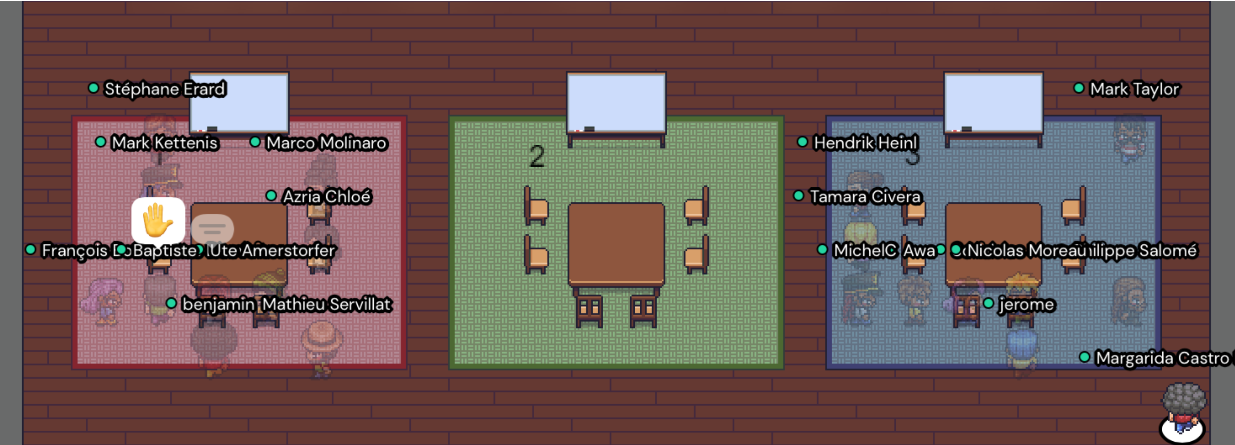
Hands-on workshop for Data Providers
European Data Provider Forum - Hands on Workshop for Data Providers
  On-line event held 23-25 November 2021
  59 participants: Researchers, Technicians, Data Stewards involved in publishing of data
  Promoted the exchange of information/experience among data providers at all scales. (ESFRIs, RIs, European Space Agency, projects, individuals)
    Also participation from Australia, India, South Africa, USA
Included 10 (~2hr) ‘Hands-on’ workshops

Slide 25
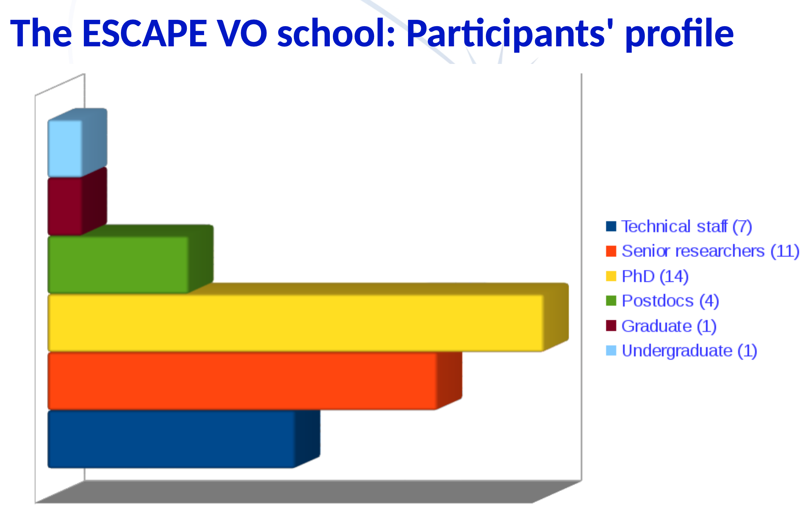
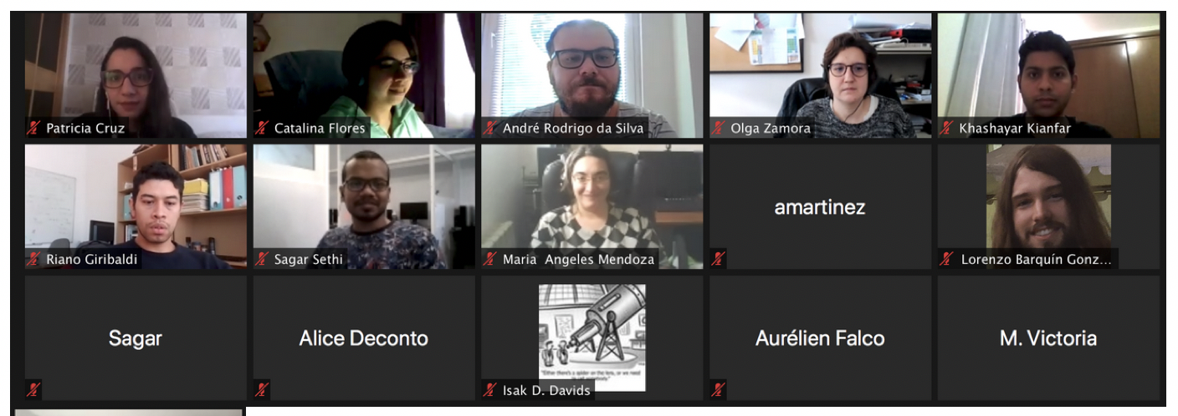
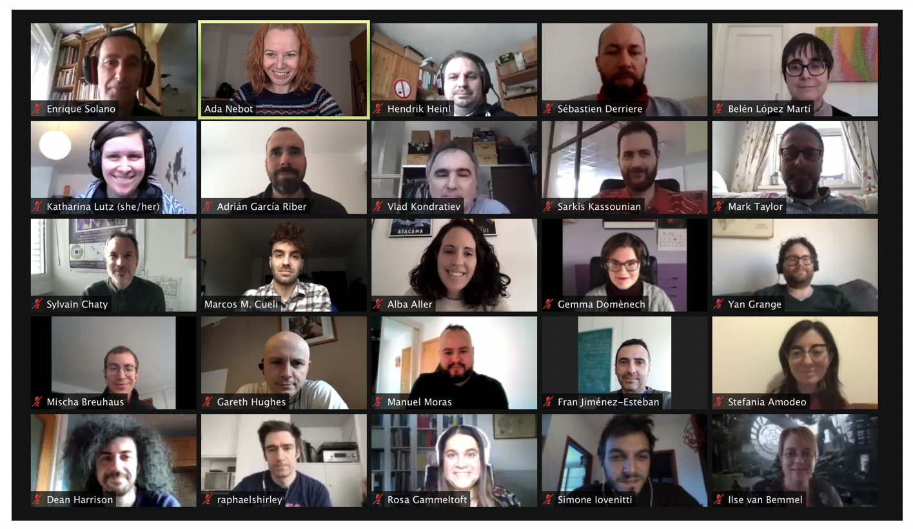
Highlight Task 4.2 : Science with Interoperable Data School
Virtual Observatory tools and services for Science – aimed at students and post-docs
Strong emphasis on hands-on use of tools and services, and highlighting new capabilities
Unique point – Support Participants’ projects before / during / after the school
Training materials re-usable ( already integrated into a number of eternal events for wider impact of ESCAPE – e.g. LOFAR Schools)
z

Slide 26
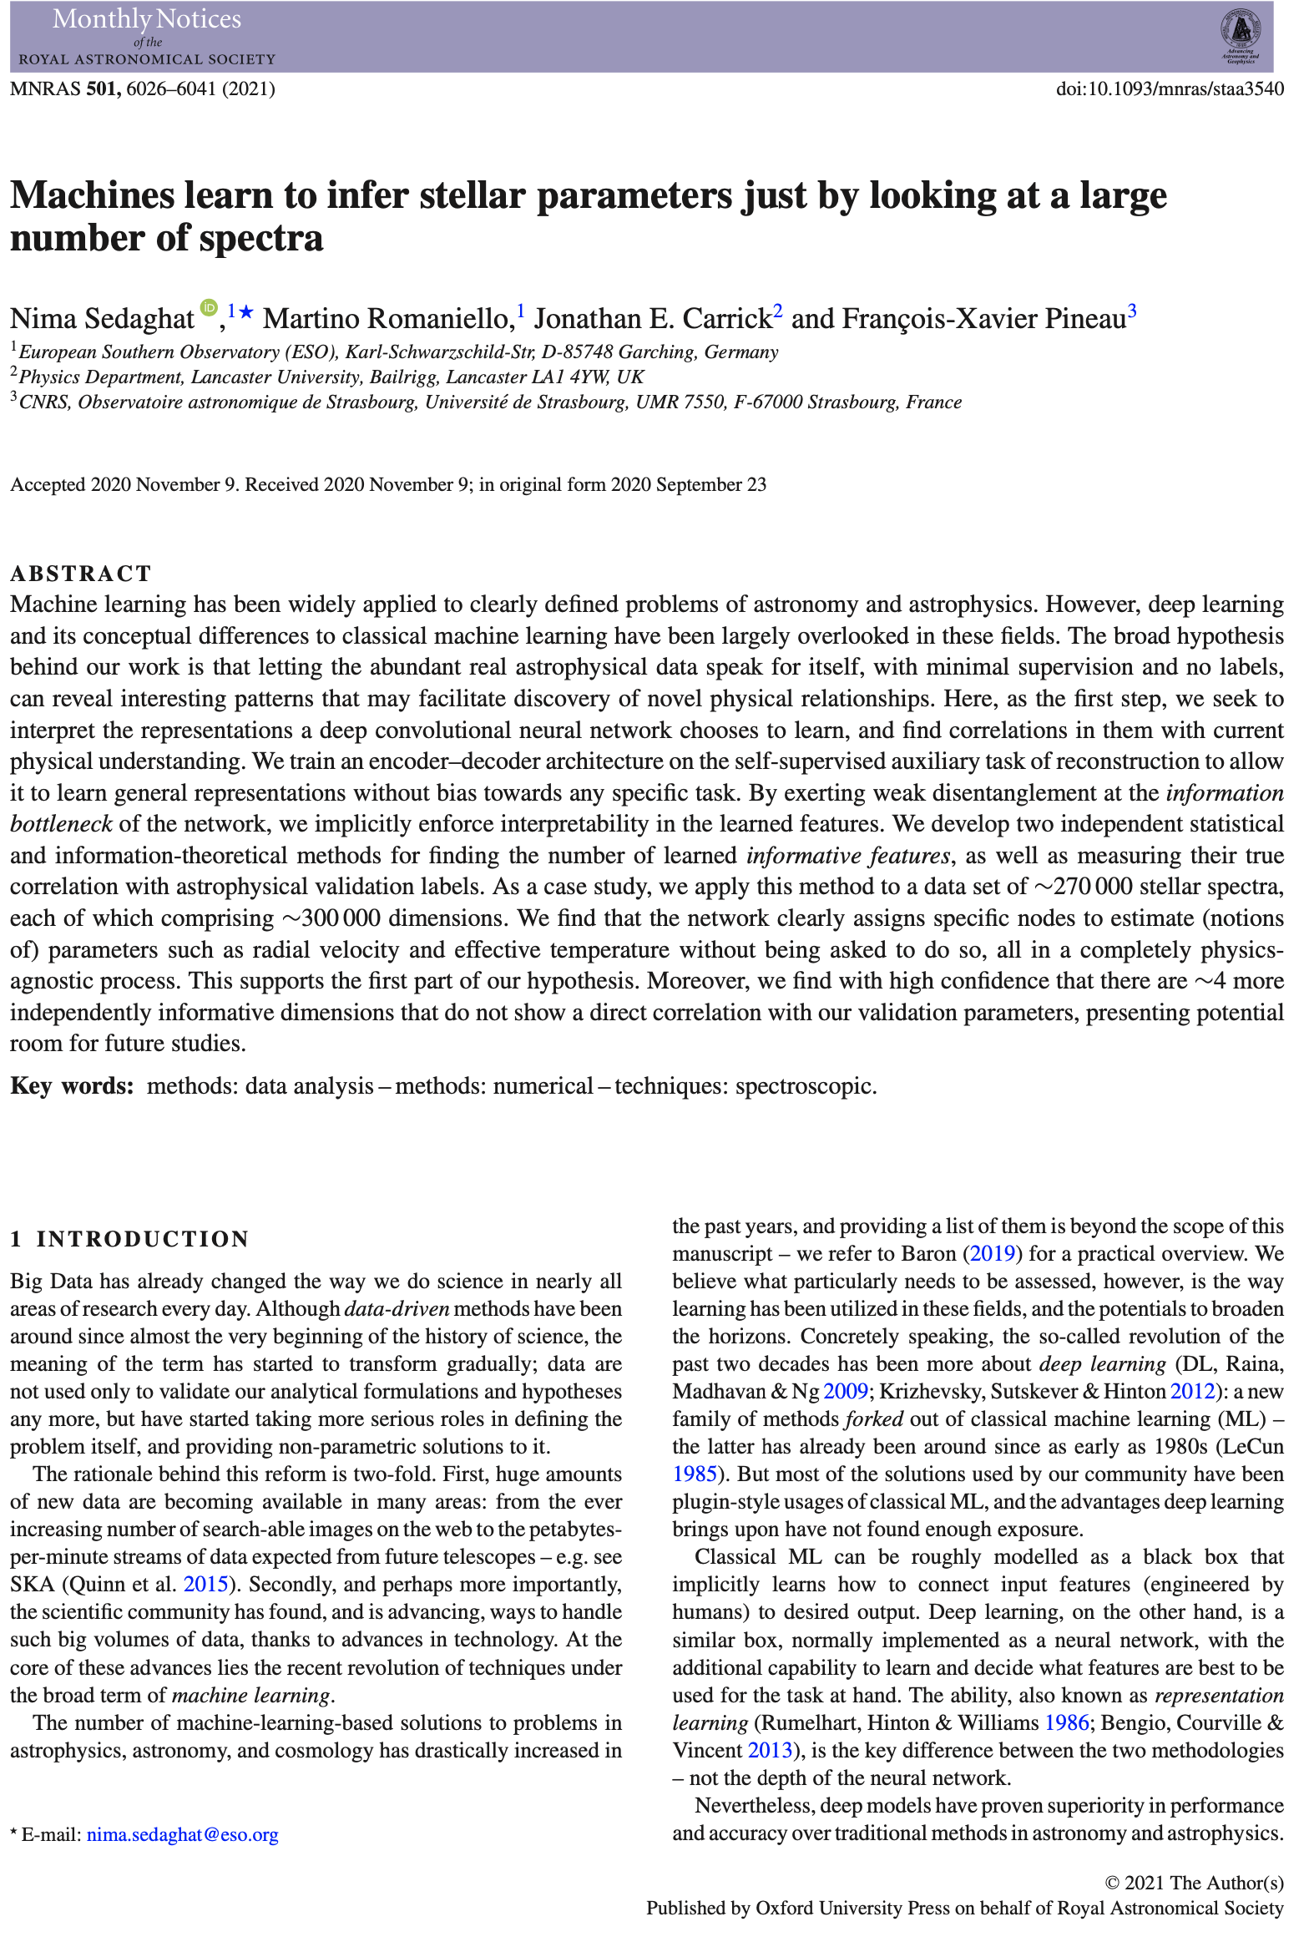
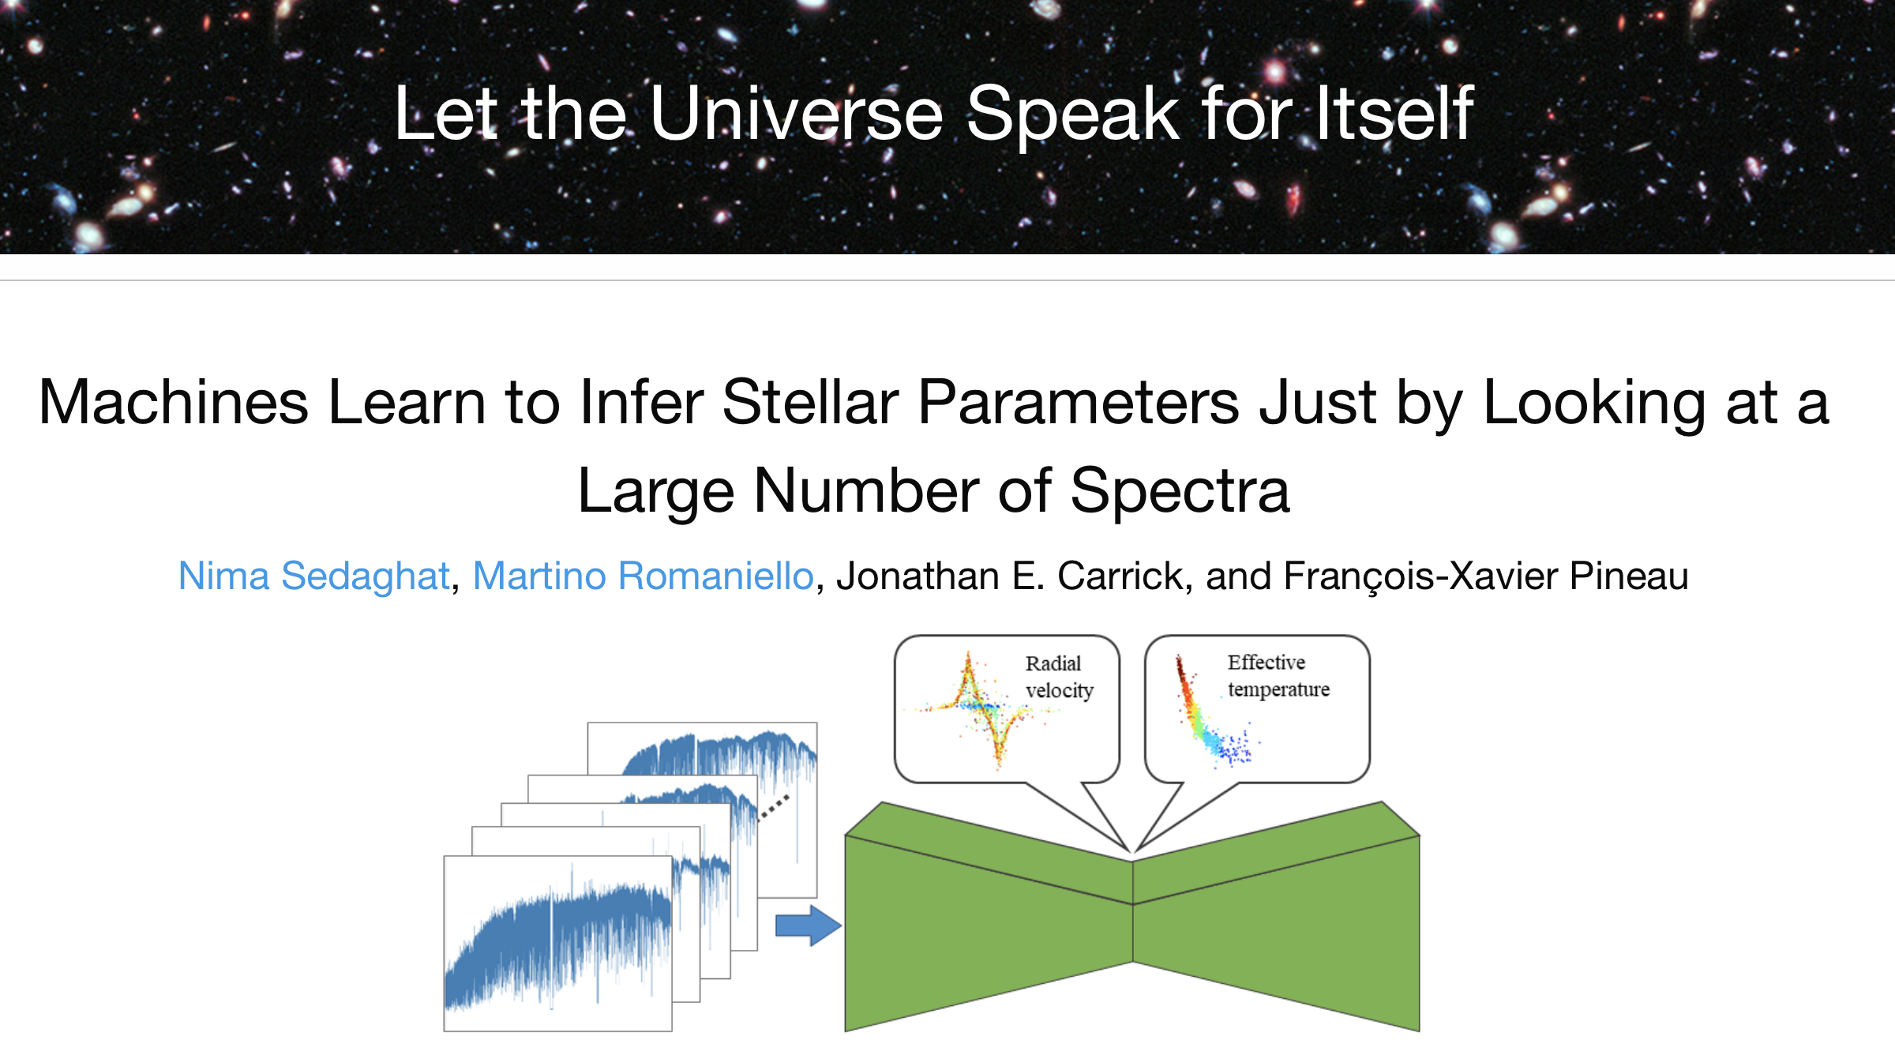
Highlight Task 4.3: Adding value to archives with Deep Learning
Demonstrations made at various community events including the ADASS conference
WP4 & WP3
➜ D4.5

Slide 27
Interfaces and cooperation with WPs
WP3:
Interaction with EOSC bodies on metadata and interfaces
Joint work on Deep Learning applied to the ESO archive
  Scope: provide archive users with novel ways to identify data
  Going beyond query parameters approach – Let the data speak!
  Applied to HARPS archive (~270k spectra) to enable Search for ‘similar spectra’
WP5:
Cooperation for VO data to be discoverable/usable in ESAP
  Cross-WP activities on use of IVOA protocols
WP2:
Interface on connection of VO to computing
  identified benefits of VOSpace package ontop of RUCIO

Slide 28
Visibility in the community:
Astronomy Interoperability Standards community
- Representation of ESCAPE priorities
- Development of standards for ESFRIs/RIs
Astronomy Data and Software Services community
Presentation of ESCAPE results
Invited talks, tutorials, focus demonstrations
Research Community
ESCAPE VO Schools
Community Meetings and conferences (EAS, SCIOPS, LISA)
Open Science Community
- EOSC events
Interactions with other clusters (EOSC-Assoc.)
Participation in EOSC-A Task Forces:
  User engagement
  Interoperability
- RDA plenaries
FAIRsFAIR
EUDAT
NEANIAS

Slide 29
Number | Title | Due | Completed
MS20 | Progress and Priorities at IVOA (1) | M5 (June 2019) | M5 (June 2019)
MS21 | Progress and Priorities at IVOA (2) | M10 (Nov 2019) | M10 (Nov 2019)
MS22 | Progress and Priorities at IVOA (3) | M17 (June 2020) | M17 (June 2020)
MS23 | Progress and Priorities at IVOA (4) | M23 (Dec 2020) | M23 (Dec 2020)
MS24 | Hands-on Workshop for Data Providers | M28 (May 2021) ➜ M35 (Dec 2021) | M35 (Dec 2021)
MS25 | Progress and Priorities at IVOA (5) | M29 (June 2021) | M29 (June 2021)
MS26 | Progress and Priorities at IVOA (6) | M34 (Nov 2021) | M34 (Nov 2021)
RP1, RP2
✓
✓
✓
✓
✓
✓
✓

Slide 30
Number | Title | Due | Completed / status
D4.1 | Detailed Project Plan for WP4 | M6 (July 2019) | M6 (July 2019)
D4.2 | Intermediate Analysis Report on Use of IVOA Standards for FAIR ESFRI and Community Data | M14 (March 2020) | M14 (March 2020)
D4.3 | 1st Science with interoperable data school | M16 (May 2020) ➜ M27 (April 2021) | M27 (April 2021)
D4.4 | Intermediate analysis report of VO data and service integration into EOSC | M18 (July 2020) ➜ M22 (Nov 2020) | M22 (Nov 2020)
D4.5 | Prototype demonstrator for value-added archive services | M30 (July 2021) ➜ M36 (Jan 2022) | M36 (Jan 2022)
D4.6 | 2nd Science with interoperable data school | M35 (Dec 2021) ➜ M41 (June 2022) | Event held 24-28 Feb 2022. Report expected M39 (April 2022)
D4.7 | Final analysis report on integration of VO data and services into EOSC | M38 (March 2022) ➜ M42 (July 2022)
D4.8 | Final analysis report on IVOA standards and stewardship best practices | M40 (May 2022) ➜ M44 (Sept 2022)
RP1, RP2
✓
✓
✓
✓
✓

Slide 31
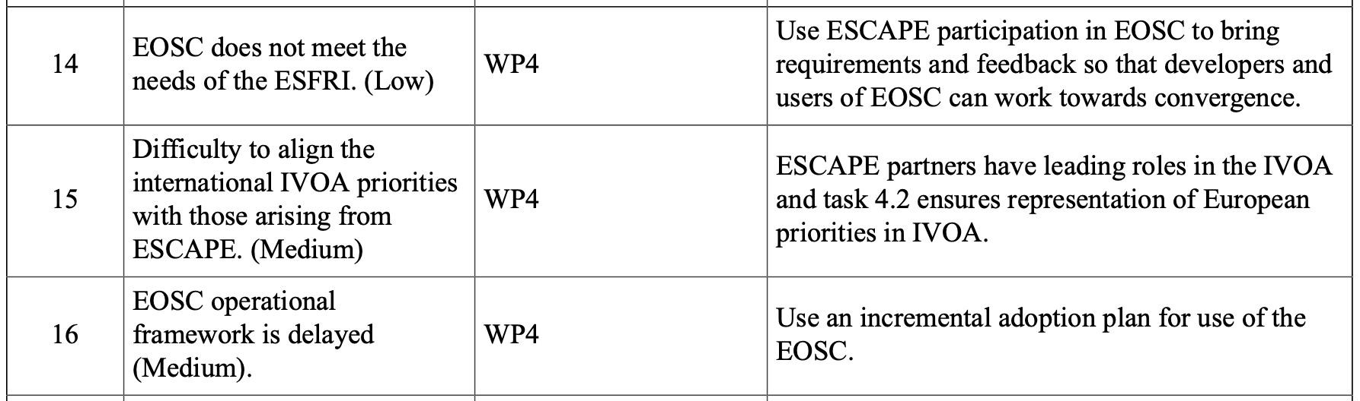
2.4 Risk mitigations
Active participation in EOSC events, input to SRIA and cluster statements have expressed ESFRI needs
Continue strong representation of ESCAPE in IVOA as done in RP1
All steps so far are incremental
Other risks identified:
Risk – Premature departure of contract personnel. – Realized with 2 contractors departing (CDS, ESO)
Mitigation – Partners manage contractors, and ensure intermediate results are documented. – D4.5 delivered
Risk – On-going pandemic prevents in-person training events.
Mitigation – Significant efforts are being made to adapt training activities to on-line events.

Slide 32
Addressing issues of RP1 review
  User engagement significantly increased!
    Schools, Forums were missing in RP1 due to COVID. These have now happened!
    User-facing events involved direct use of services for science
      The various portals and interfaces have been presented to users
      Science cases of PhD students and ECR supported in the schools
    User-participation events for publication of data – a wide range of users in ESFRI/RIs and beyond
    Engagement of ESFRI/Ris in their participation in standardization process at IVOA
  Integration and coordination with other WPs
    Increased coordination with cross-WP activities for integration of VO services in ESAP
    Cross-link of WP4 VO school with the WP3 summer school information (notebooks)
    D4.5 is the result of a joint WP3/WP4 activity

Slide 33
  Using the help of the External Advisory Board
  Continuing close discussions with ESFRI/RIs for their needs of VO standards.
    A success of the project is that ESFRI/RIs are now actors in the definition of standards via their participation in IVOA. ESCAPE has supported the building of capacity of VO expertise in ESFRIs.
  Integration of VO and Data Lake technologies
    The integration of VO-Space (Astronomy distributed storage system) and the Data Lake system has been the subject of WP5 – WP2 – WP4 joint discussion. (findings to be included in D4.8)
    The application of rich metadata schema (as developed in VO) to DIOS is to be assessed.
  Identification of standards required for Test Science Cases
    To be followed as the TSPs develop

Slide 34
WP4 Next Steps
2nd School – Strasbourg, 22-24 February + 4 March 2022. (D4.6)
  Link the school with TSPs so that VO capabilities are well understood by TSP teams, plus precious feedback on the developments / tools / services
Integration with other Work Packages
  Virtual Observatory part of convergence of WPs for ESCAPE thematic cell
Support of Test Science Cases
Final Deliverable Reports to be developed in 2022
  Final analysis report on integration of VO data and services into EOSC (D4.7)
  Final analysis report on IVOA standards and stewardship best practices (D4.8)
2022 – Make the results visible in Astronomy and EOSC communities
  Plan for next steps of VO in ESCAPE thematic cell and in EOSC

