Slide 1


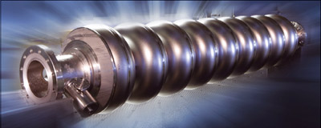
ATF2 studies and ILC preparation – AR10
3
KEK, High Energy Accelerator Research Organization, Tsukuba, Japan
LAL, Laboratoire de l'Accélérateur Linéaire, Orsay, France
LAPP-IN2P3-CNRS, Université de Savoie Mont Blanc, Annecy, France

Slide 2

ATF2 the ILC FFS testbench
Notes:
ATF2 is a scale down version of the Final Focus to test local chromaticity correction and to demonstrate the nano-beam technologies for LCs: ILC and CLIC.
There has been a continuous work from many labs, in ATF first and ATF2 after to get nanobeam size and its stabilization, last times centered in ultra-low beams for CLIC and intensity dependence studies.
ATF2 is an international project to build and operate a test facility for the final focus system that is envisaged at ILC. The primary project goal is to establish the hardware and beam handling technologies pertaining to transverse focussing of the electron beams to nearly 40nm.
The emphasis of the effort will be on repeatable, stable operation of this beam manipulation to the level which can be readily applied to physics runs of ILC.
ATF2 is built on KEK Tsukuba campus as an extension of the existing ATF. The ATF, which has a world record of the normalized emittance (the smaller, the better) of 3 x 10^-8 m, will provide the beam with ATF2.

Slide 3
ATF2 goals and achievements
Goal 2: 2 nm beam stabilization at ATF2 IP, (much harder than nm stabilization in collision at ILC).
FB latency 133 nsec achieved (target < 366 nsec)
Position jitter at ATF2 IP: 41 nm (2018) (direct stabilization limited by IPBPMs resolution 20 nm). Upstream FB shows capability for 2nm stabilization. Demonstrated ILC IPFB system.
Nanometer beam sizes at IP
Distribution of bunch positions measured at IPB, with two-BPM FB oﬀ (green) and on (purple)
Small beam sizes were obtained with beam intensities of 0.5-1.5 10⁹ e⁻/bunch (10¹⁰ design value) and reduced aberration optics (10β_{x}* x β_{y}*)
Predicted vertical position jitter with FB on-off
Notes:
But nevertheless we have obtained “outstanding” and “unique” results:
I remind the two main goals of ATF2:
-Achievement of 37 nm spot size
-Control of beam position at nm level.
What we have obtained:
-Nano-beams: 41 nm
-FB (feed back) latency of 133 ns and a direct stabilization of position IP jitter of 41 nm (limited by IPBPMs resolution)
Right figures:
Distribution of bunch positions measured at IPB, with two-BPM feedback oﬀ (green) and feedback on (purple).
The Position Jitters of the Bunches with Feedback Oﬀ and On, for Two-BPM Feedback:
------------------------------------------------------------------------------------------------------------------------
Feedback Position jitter (nm) Correlation (%)
Bunch1 Bunch 2
Off 106 +- 11 96 +- 10 91.6
On 106 +- 11 41 +- 4 41.3
------------------------------------------------------------------------------------------------------------------
Predicted vertical position jitter (calculated from the position at P2 and P3) in the region of the focal point with feedback off (solid) and feedback on (dashed).
In ILC and CLIC we profit from the level arms for the BPM location that are at a certain distance.
During these last years we have studied: Intensity dependence, Ultra-low beta*, Feedback stabilization and R&D for instrumentation.

Slide 4
ILC FFS - ATF3 objective and collaboration:
Based on the achievements of the ATF2 no showstopper for ILC has been found, ATF3 plan is to pursue the necessary R&D to maximize the luminosity potential of ILC. In particular the assessment of the ILC FFS system design from the point of view of the beam dynamics aspects and the technological/hardware choices and the long-term stability operation issues.
Long Term stability
High-order aberrations
Instrumentation R&D
Collimator
Incoherent Diffraction Cherenkov Radiation Monitor
Ultra-low β* studies
Intensity dependence studies
Energy bandwidth
Waveguide BPM
Notes:
Based on this achievements and with the support of the KEK DG we have started to plan the next operation years of ATF2 and the future ATF3.
The main objective of the ATF3 is to deep in the understanding of the luminosity optimization of the ILC.
In particular the system design and harware and the long term stability operation issues.
The tentative plan is summarized in the following slides.

Slide 5
ILC FFS Technical Preparation Plan: Tasks
ILC-FFS Tasks : Maximize Luminosity potential of ILC
T1: ILC-FFS system design | T1.1: Hardware optimization
 | T1.2: Realistic beam line driven / IP design
T2: ILC-FFS beam tests | T2.1: Long-Term stability
 | T2.2: High-order aberrations
 | T2.3: R&D complementary studies
Long Term stability
High-order aberrations
Instrumentation R&D
Collimator
Incoherent Diffraction Cherenkov Radiation Monitor
Ultra-low β* studies
Intensity dependence studies
Energy bandwidth
Waveguide BPM
Notes:
The main objective of the ATF3 is to maximize the luminosity potential of ILC.
Two task has been identified:
- The system design of beam optics and hardware for the ILC FFS based on established technologies
- The necessary beam experiments to solve the long term stability operation issues, the deep understanding of the high-order aberration's and the R&D on complementary studies as beam instrumentation or other as collimation, kicker technologies....

Slide 6
T2.1 ILC FFS beam tests: Long-Term stability
Nominal (10β_{x}* x β_{y}*) optics operation routine assessment
  Automated steering procedures and basic tuning algorithms (like envisaged for ILC)
  2nd order correction knobs assessment (sextupoles and skew, octupoles)
              Energy bandwidth measurements
Wakefield evaluation and mitigation
Upstream beam line (relatively low- β_{y})
Movable set-up mitigation techniques
Vibrations long-term monitoring system
Jitter sources assessment
Measurements (entrance/IP)
CBPMs calibration process upgrade
Duration of calibration optimization
Lifetime - degradation of calibration over time
New time and phase invariant digital processing software to be developed, algorithm could first be tested on simulated data.
FONT FB system performance optimization
Long-term beam trajectory control
Routine use of y-y’ FB to reduce jitter
AR10
Two bunch operation
ATF2 vibrations long-term monitoring
Notes:
Vibrations long-term monitoring system – ATF2 upgrade – 2021/22
• To have data of all shifts even if no vibrations studies are planned
• To increase the possibility to use this monitoring with dynamics beam studies by all the collaborators
• New setup has to be discussed
• Installation before end of 2021 could be possible if various factors are going in the right way…
FONT FB
Beam size as a function of beam charge (left) and distribution of IP vertical angle jitter (right) for two bunch operation with feedback on (unﬁlled points, dashed line) and feedback o˙ (ﬁlled points, solid line). Each point represents a single beam size measurement. The lines are ﬁts of intensity parameter equation.
The figure show how the Wakefield effects on beam size are reduced by the FONT upstream FB. This motivates the importance of long-term beam control.
Cavity BPMs recap
• C-band (6426 MHz) copper cavity BPM system, tuners for X-coupling minimisation, capacitive adapters, 2a = 20 mm, cavities produced by PAL
• Beam pipe continues into respective magnet, rigid mounting, calibrations using magnet movers or “dogleg” bumps
• PCB electronics by SLAC, most units have 20 dB attenuation at the front (direct contribution into NF)
• Oﬀ-the-shelf Struck 14 bit, 125 MS/s digitisers
• Digital processing, calibration, scripting etc by RHUL
• The system has been working with very little maintenance since ~2010, 24/7, any problems usually arise from start/stop
• Best resolution ~20-30 nm (no att), typical ~200-300 nm (with att), degradation to ~1-3 um when reaching 1 mm oﬀset (with att) — designed for 100 nm resolution, +/- 100 um range
• ~1/3 of cavities have been removed to reduce wakeﬁelds
• Larger ~40 mm aperture S-band cavities in the IP region
abandoned due to mechanical errors
2020/2021 were blank years

Slide 7
Vibrations influence on the SuperKEKB beam
G. Balik³, L. Brunetti³, E. Montbarbon³, F. Poirier³, P. Bambade², S. Wallon², M. Masuzawa¹, H. Yamaoka¹
1: KEK, High Energy Accelerator Research Organization, Tsukuba, Japan
2: LAL, Laboratoire de l'Accélérateur Linéaire, Orsay, France
3: LAPP-IN2P3-CNRS, Université de Savoie Mont Blanc, Annecy, France
TYL/FKPPL workshop, 16th of May 2022
Application-A-RD-14-2020-LB
Contact: L. BRUNETTI – brunetti@lapp.in2p3.fr

Slide 8
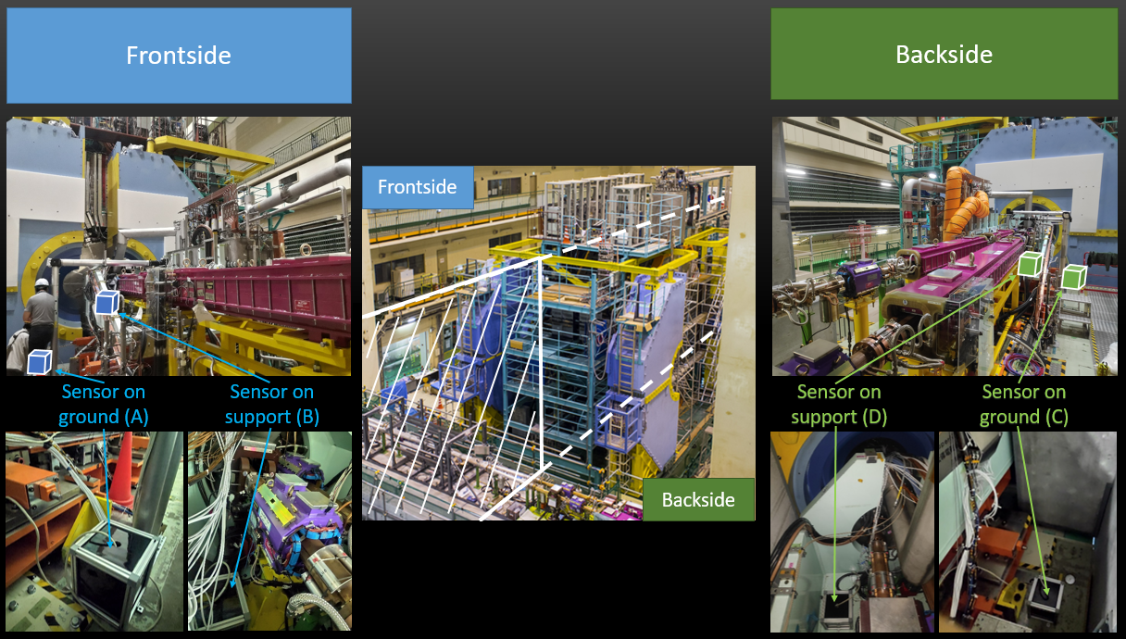
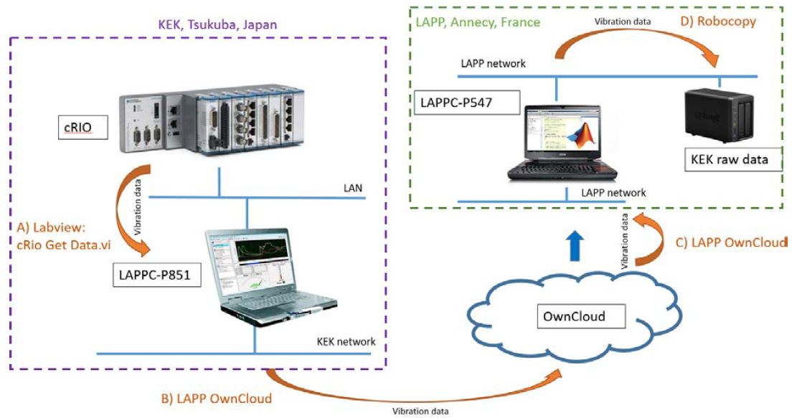
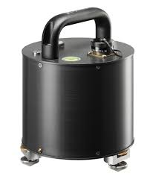
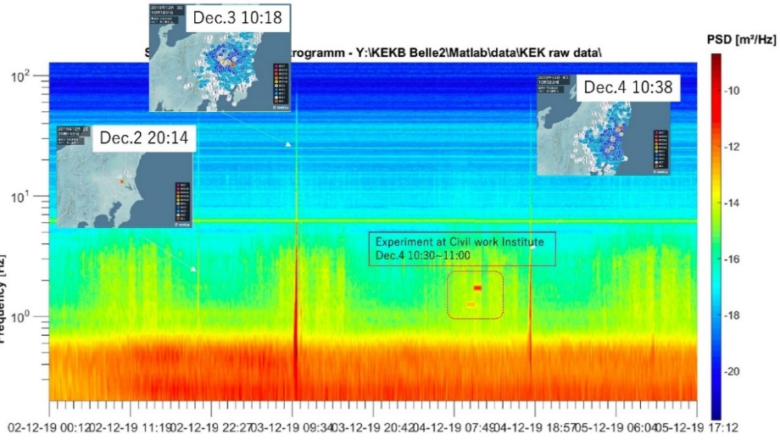
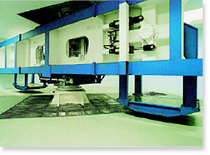
SuperKEKB – setup & initial target
Long-term monitoring with continuous available data for the collaboration:
4 seismic sensors - 2 at each side of the BELLE II detector
Monitoring 10’/hour to limit the data
Guralp 6T
Acquisition architecture
Weekly reports are available at : https://lappweb.in2p3.fr/SuperKEKB/
Objective 1: Identification of disturbances or specific events:
5
Permanent disturbance
Comparison day – night
Seismic events
External disturbances
Drift in time…
Day
Night
Experiment of accelerate centrifugal force close to KEK
Seismic
activity
Vibration analysis: earthquake and external perturbations

Slide 9
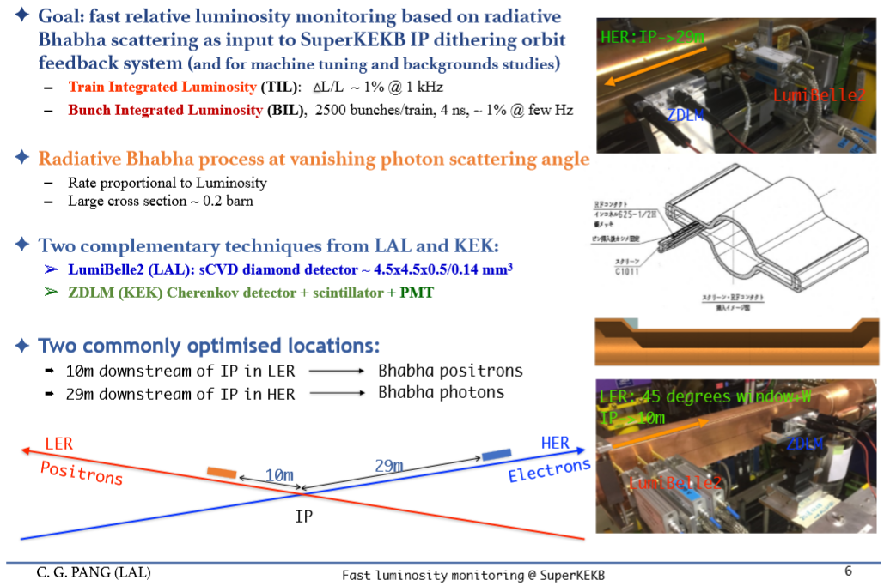
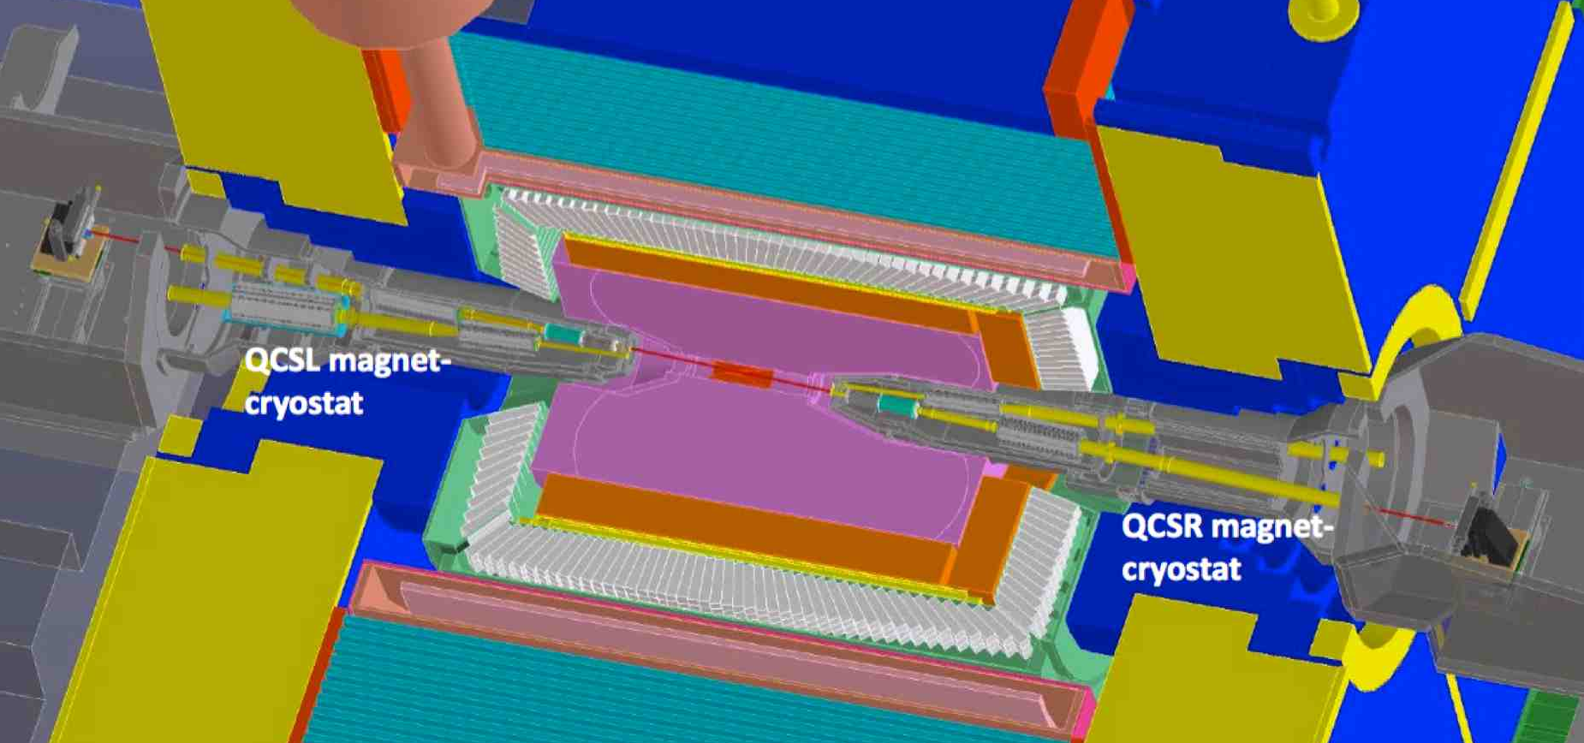
SuperKEKB: luminosity measurements
Setup:
4 luminosity measurements (IJClab) 2 on the HER(e+) beam, 2 on the LER(e-) beam at 1 KHz
About the same measurements (ZDLM) are done by KEK

Slide 10
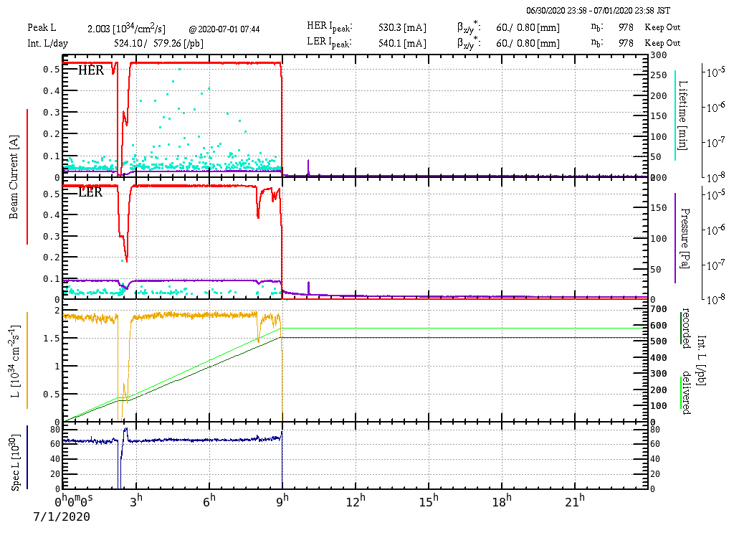
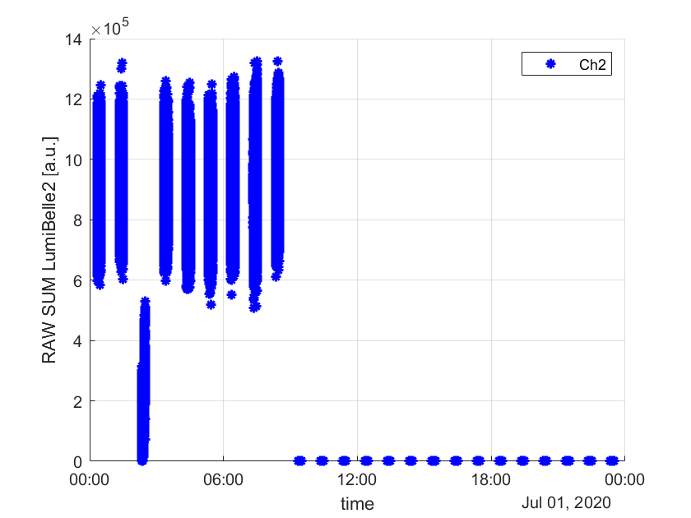
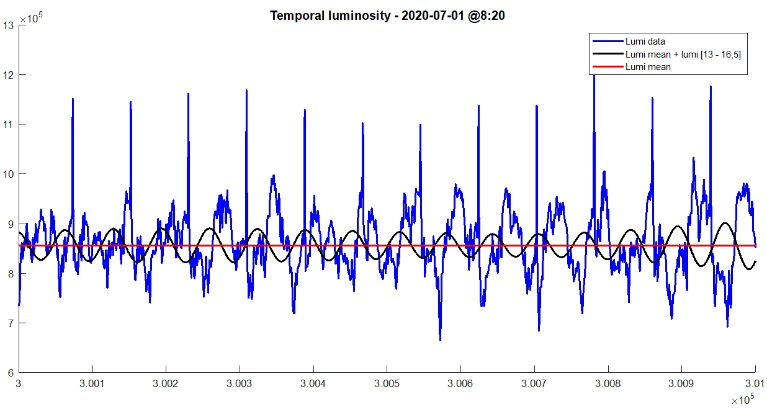
SuperKEKB: comparison vibrations – luminosity
Comparison vibrations vs Luminosity monitoring via Bhabha scattering (IJCLab & KEK)
HER intensity
LER intensity
Injection @12,5Hz
Injection @25Hz
1st mechanical mode
Lumi machine
- PSD of the Luminosity
- Max(PSD of the 4 seismic sensors) x offset
Lumi
Temporal measurement
Except the peaks at 12,5 Hz & 25 Hz dues to the injection, all the luminosity peaks are mainly dues to vibrations amplified by asymmetrical mechanical structures
Publication: M. Serluca, G. Balik, L. Brunetti, B. Aimard, A. Dominjon, P. Bambade, S. Wallon, S. Di Carlo, M. Masukawa, S. Uehara, Vibration and luminosity frequency analysis of the SuperKEKB collider, NIMA (2021).
Zoom 1s
This study highlights the effects of the dynamic of the cryostat on the beam
Presentation of these results at the MDI SuperKEKB (2020 May 19)
PSD : Power Spectrum Densities

Slide 11
SuperKEKB: current studies
Evaluation (SAD optics simulation) of the observed effects on the beam parameters due to the cryostat vibrations
Master 2 internship in progress (collaboration LAPP & IJClab)
Comparison luminosity – vibrations of coherent disturbances at low frequency
External disturbance
PSD of the vertical displacement
PSD of the luminosity measurement (CH1)
And various studies as the performances of the IP BPM control, the drift of the cryostat behavior in time…

Slide 12
SuperKEKB: Schedule & budget
Collaboration:
IJClab, KEK and LAPP
Past milestones
Cabling of the sensors : beginning of the autumn 2018 by a supplier
Connections and first measurements (coherence, dynamics) : November 2018
First installation with two sensors (Guralp 6T): February 2019
Last installation with four sensors and an upgrade of the electronics : Autumn 2019
Next mission on site
Target:
- Analysis of the correlation between the beam position (KEK - BPMs), the vibrations level (LAPP - seismic sensors) and the luminosity (KEK&LAL - in the transverse and in the vertical directions), with and without the IP feedback
Requirements:
- Calibration of the sensors after 3 years of operation
- Measurement of the ground coherence around the interaction region to improve the analysis
LAPP request:
Total 6 Keuros
Missions on site (2 persons)

Slide 13


ARD_16 : Magnetic field monitoring and management for Superconducting RF cavities
CEA – Saclay, France
KEK, Tsukuba, Japan
Juliette Plouin
Enrico Cenni
Marchand Claude
Thomas Proslier
Mika Masuzawa
Kensei Umemori
Kiyosumi Tsuchiya
Ryuichi Ueki
Takafumi Okada

Slide 14

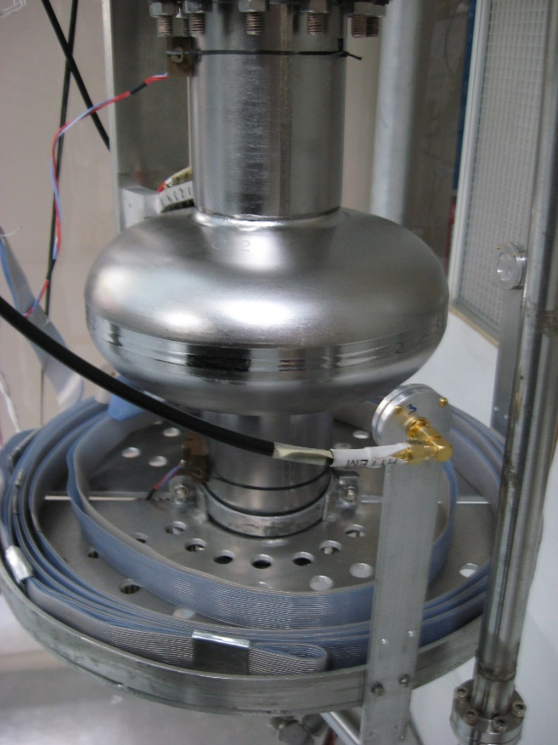
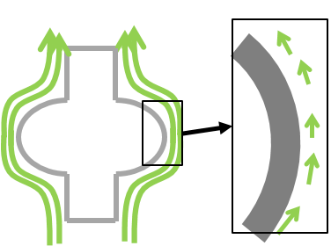
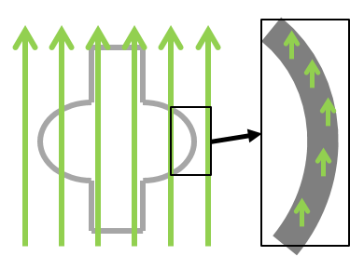
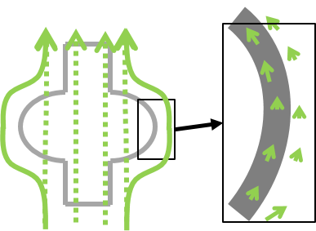
Motivation
Various studies progress around the world for achieving the high-Q operation of superconducting radio frequency (SRF) cavity.
⇨ Necessity of reducing the surface resistance.
T> Tc
T< Tc
Total expulsion
Perfect Meissner effect
When a cavity is cooled down to a superconducting state, some part of the ambient magnetic field (few µT) is trapped into the cavity.
Partial expulsion
Imperfect Meissner effect
Monocell superconducting cavity
MAIN R&D AXIS OF THIS COLLABORATION
Understand the mechanism of flux trapping
Develop a magnetic field mapping system to monitor the magnetic flux trapping and expulsion around the cavity during its cool down and warm up process

Slide 15

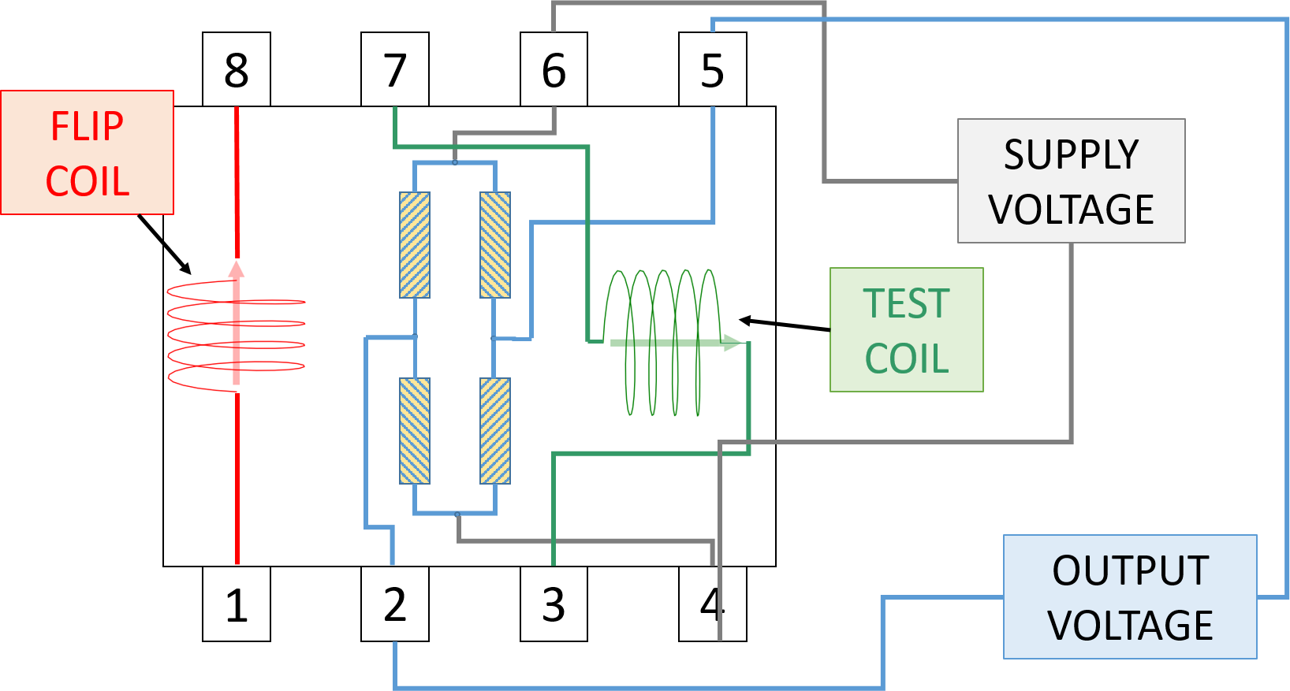
AMR (Anisotropic Magneto Resistance) sensors
Ferromagnetic material

Slide 16
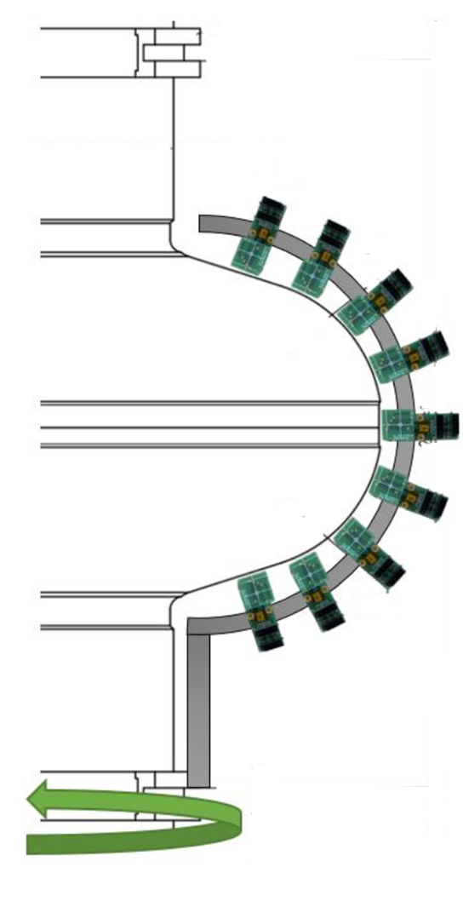
AMR mapping
Initial configuration
z
CAVITY
z
r
θ
r
θ
New configuration
New configuration
Rotating device
(in development)

Slide 17
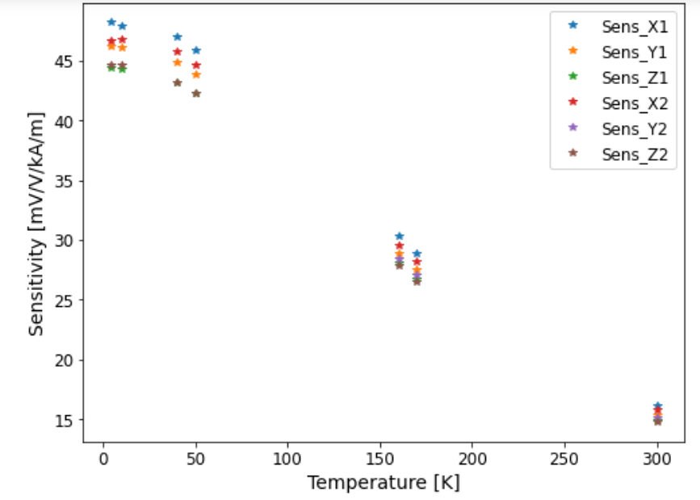
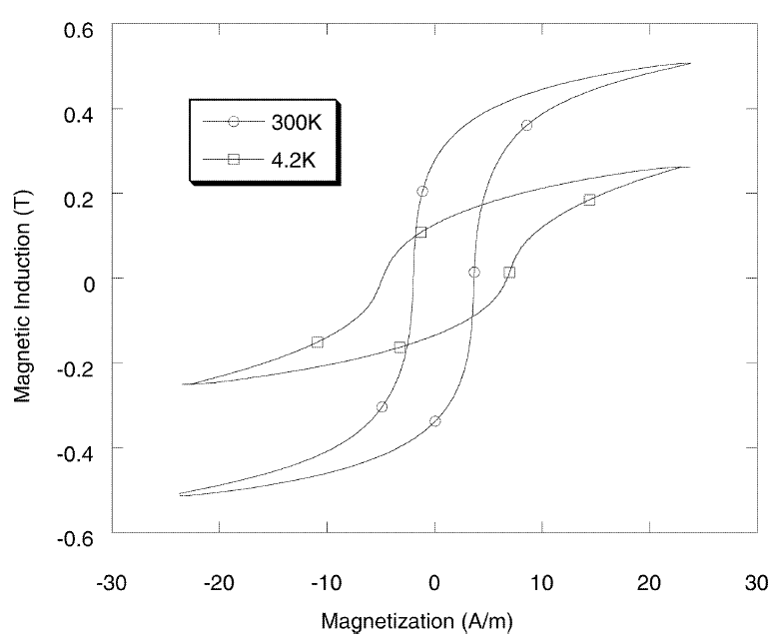
AMR sensors sensitivity vs temperature
Measurements at CEA for 6 sensors
Hysterisis curve of the ferromagnetic material
when temperature 
Remnant magnetisation 
Sensitivity 
Coercive field 
Necessary flip current  and calibration is more difficult

Slide 18
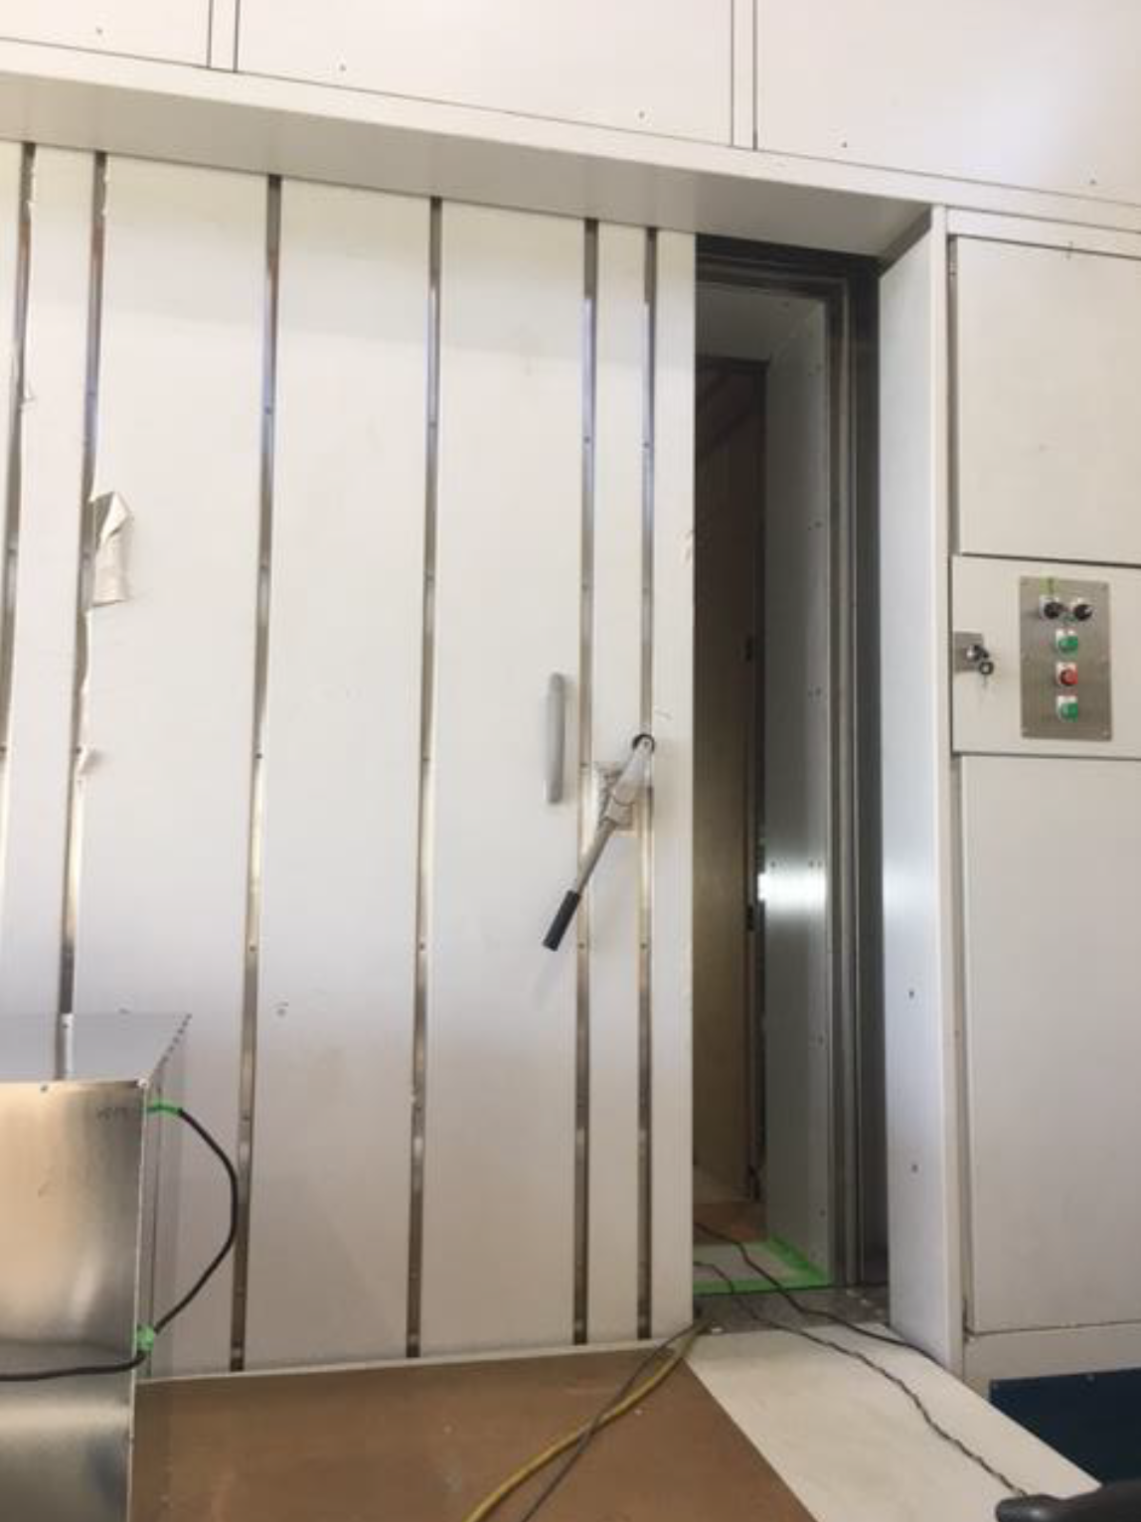
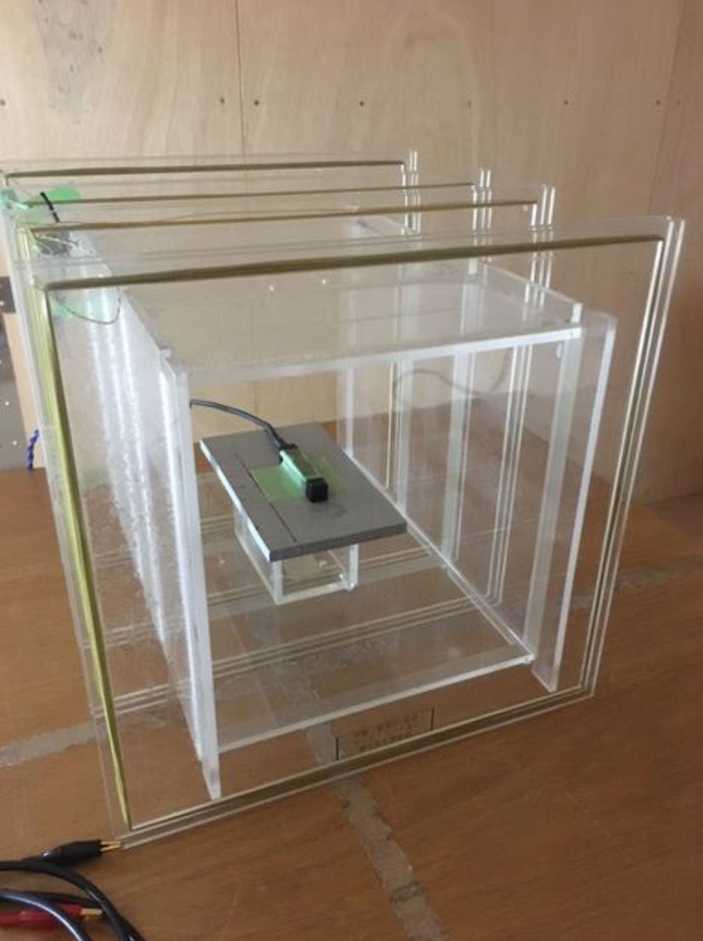
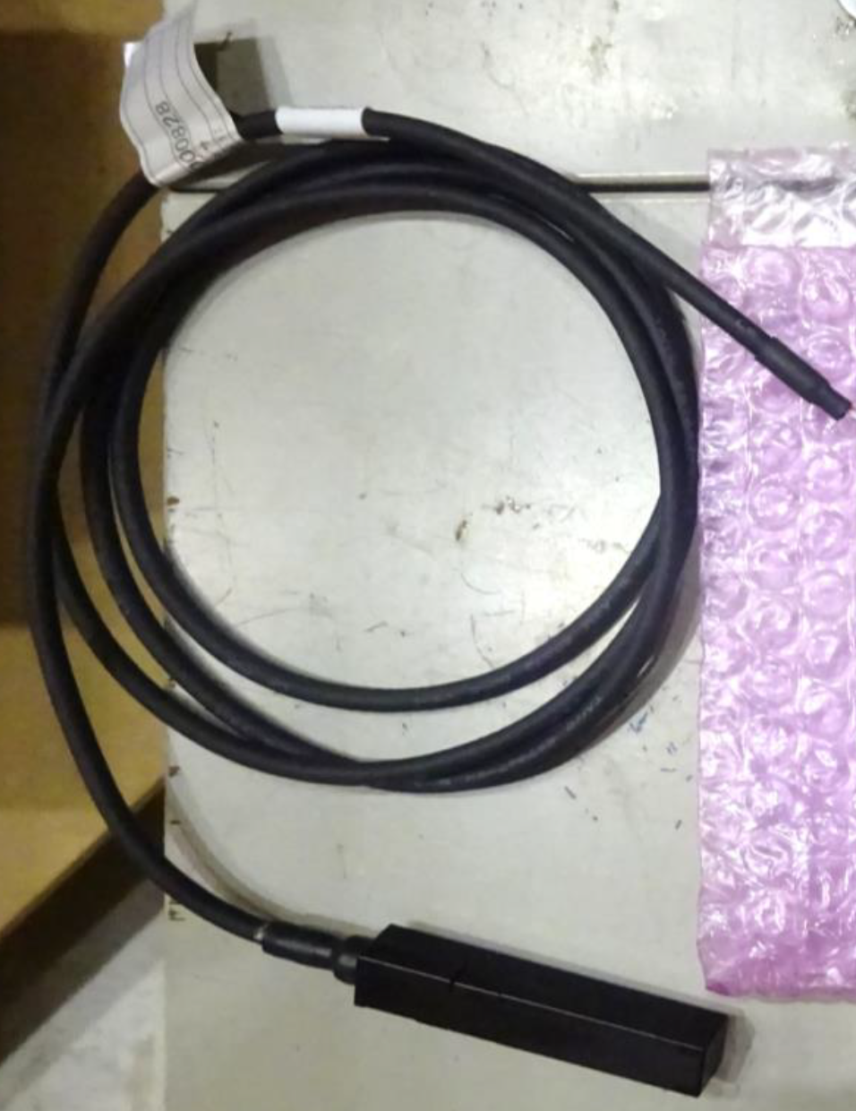
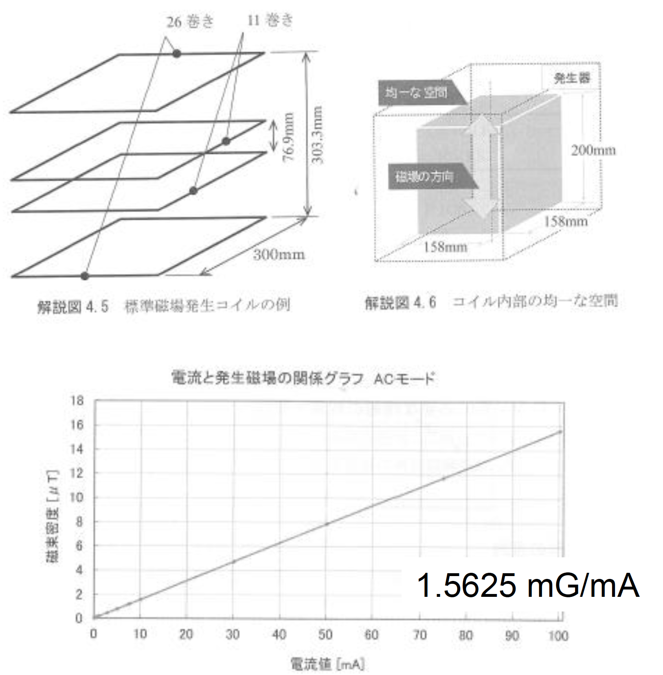
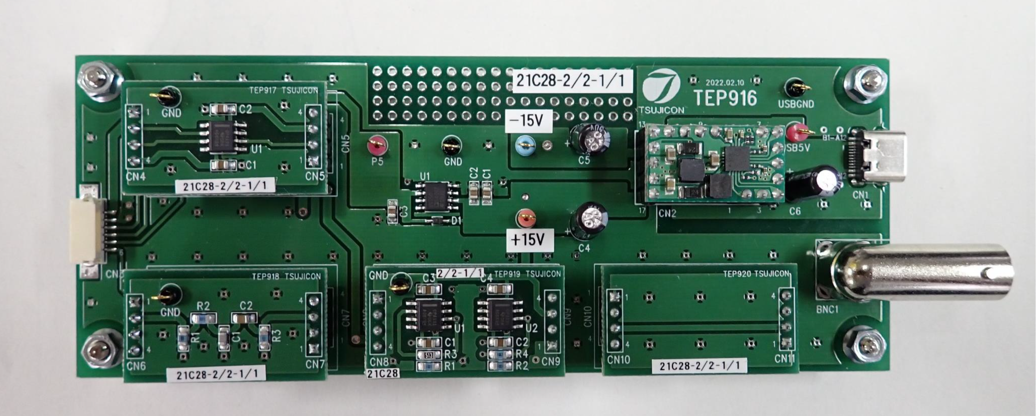

Test and evaluation of a MR (Magneto Resistive) sensor
Specification
Range $pT\sim μT$
S/N $\frac{3pT}{\sqrt{Hz}}$
Sensor head
12 mm×12mm ×74 mm
Read out circuit
Sensor test and evaluation
Using
magnetic shield room
calibrated Helmholtz coil

Slide 19
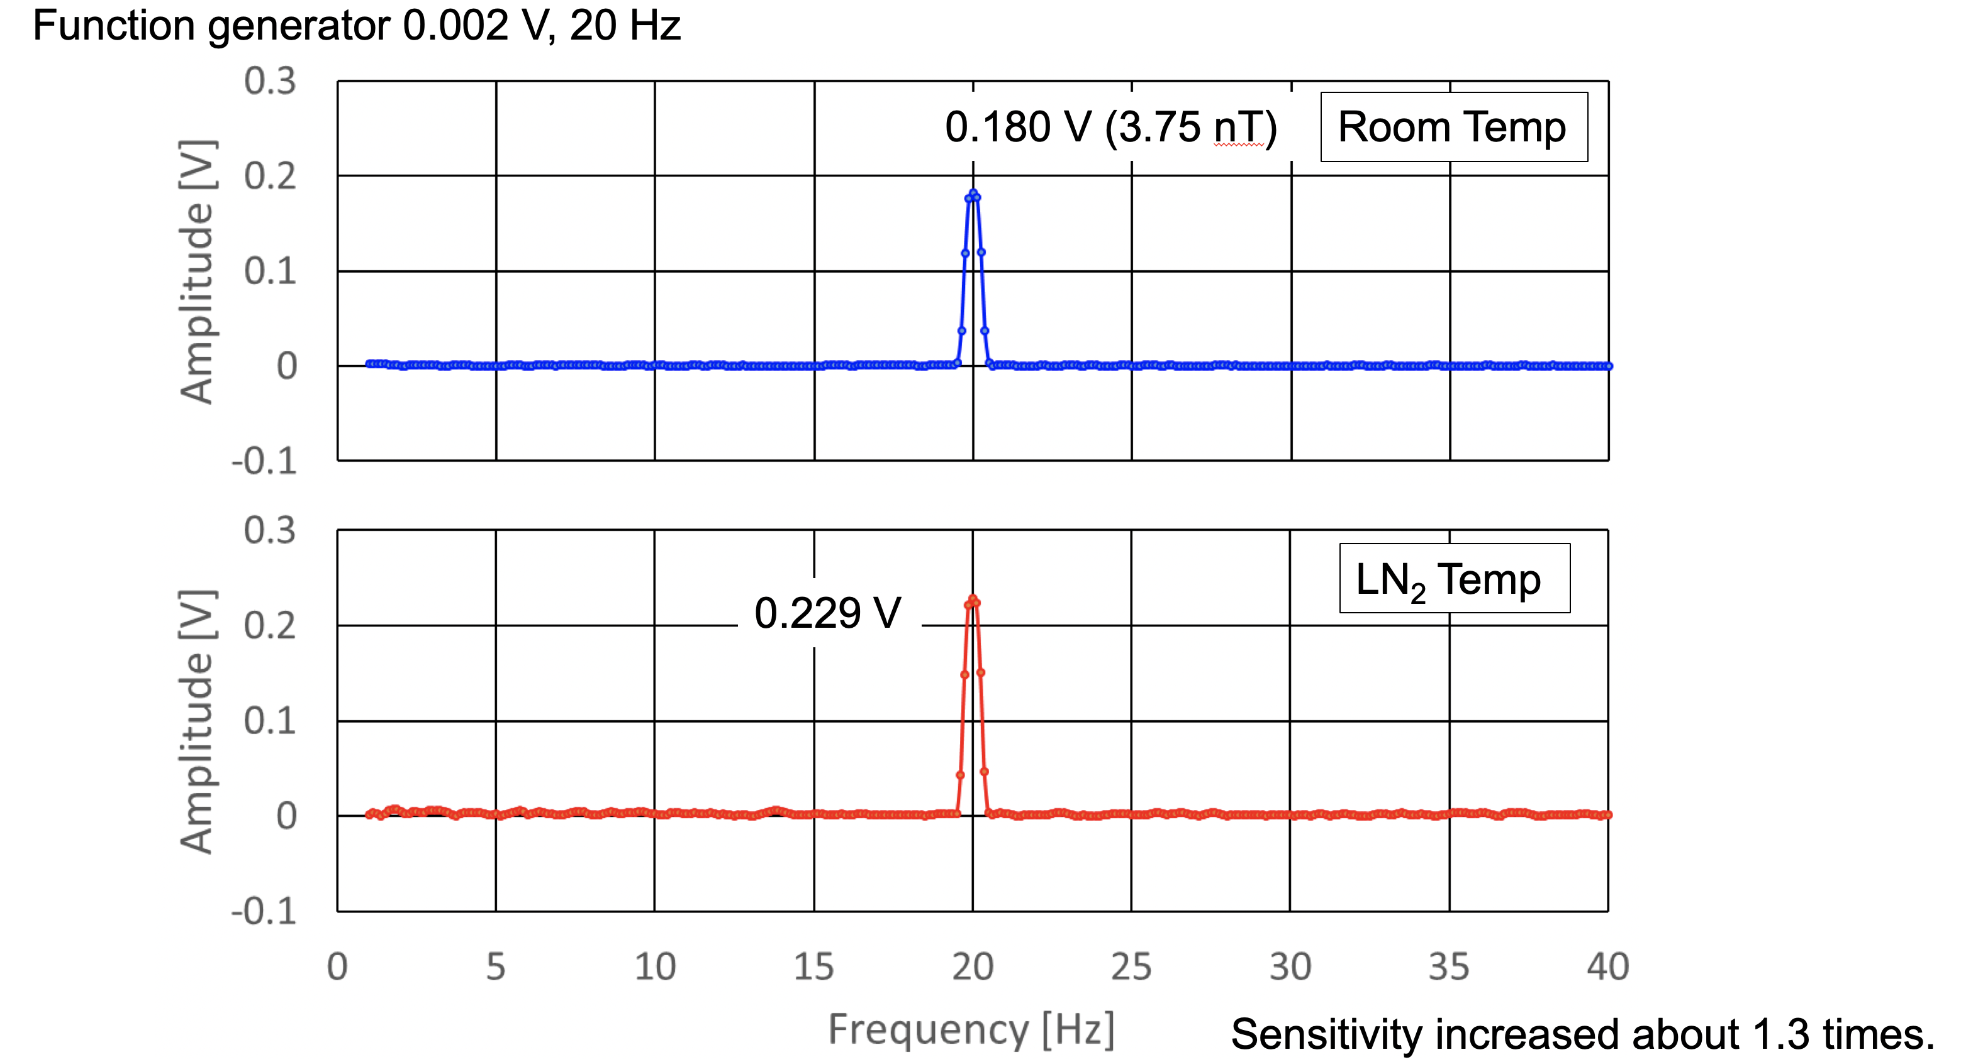
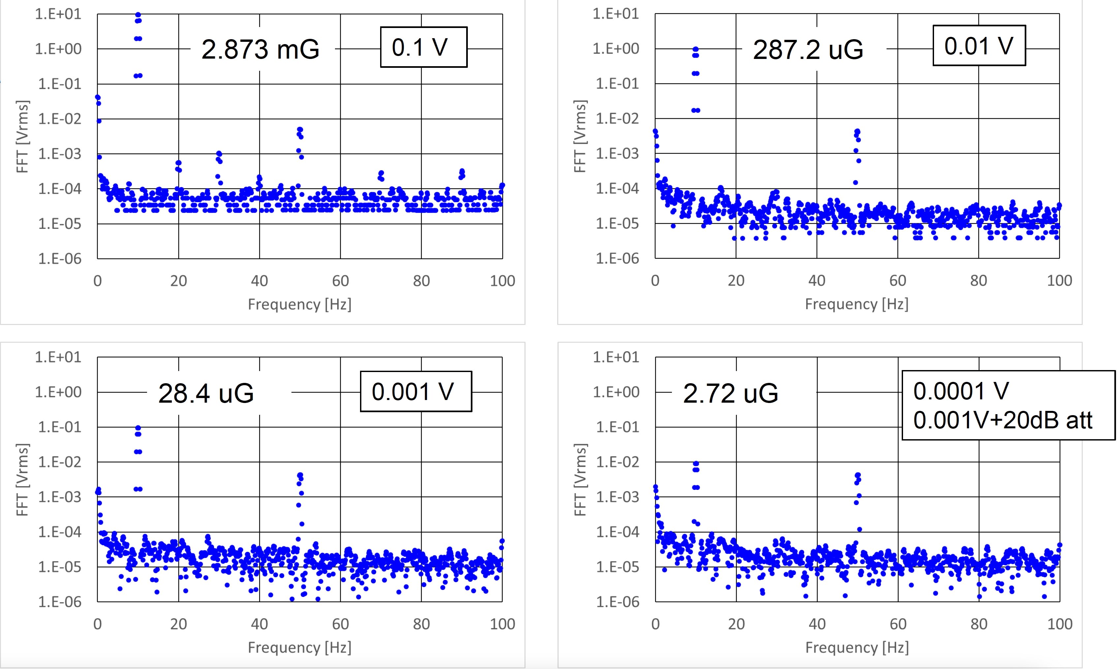
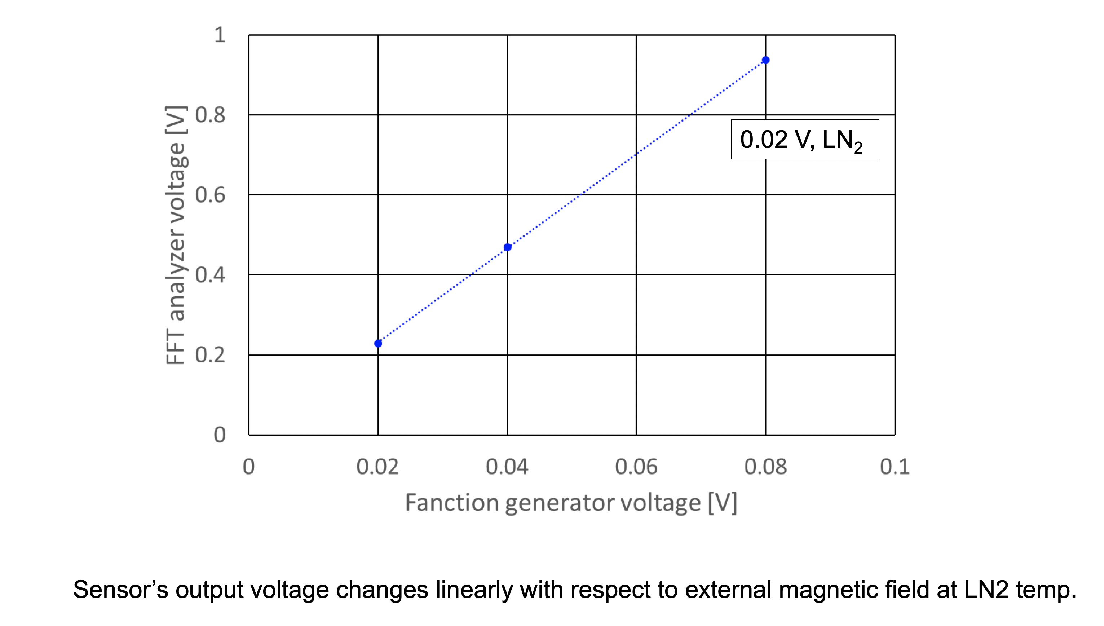
Test and evaluation of a MR (Magneto Resistive) sensor
Sensor output dependence on temperature
Sensor test at room temperature
1µG = 0,1 nT
External magnetic field was changed @ 10 Hz
The magnetic field strength was changed by the Helmholtz coil
➜magnetic field of ~micro Gauss @10Hz was observed successfully.

Slide 20

Conclusion
We continued to look more into the sensors suitable for measuring low ambient magnetic field.
We tested other type of MR (Magneto-Resistive) sensors in the magnetic shield room.
A very good S/N and frequency responses were obtained.
We observed a sensitivity enhancement at liquid nitrogen temperature, which is similar to ARM sensors that we tested before.
Good and inexpensive sensors will be useful for understanding the behavior of the ambient magnetic field around the cavities during the cool down/warm up processes and quenches.
This will eventually lead us to realize high-Q SRF cavities.
Our aim is to use these sensors for magnetic field mapping and we plan to implement a new rotating frame with temperature, X-rays and magnetic sensors.
This rotating frame will be dedicated to elliptical cavities.
The mechanical study of this frame has started, and will be continued.
The electronic card for driving the 30 magnetic sensors is ready.
AMR Sensors Studies and Development for Cavities Tests Magnetometry at CEA, 2021 International Conference on RF Superconductivity
Expected outcomes from the collaboration
Share experience on magnetic sensors
Participation flux expulsion operation
Data analysis
“Observation of Quenching-Induced Magnetic Flux Trapping using a Magnetic Field and Temperature Mapping System”, Takafumi Okada et al., to be published in Physical Review Accelerators and Beams

