Slide 1
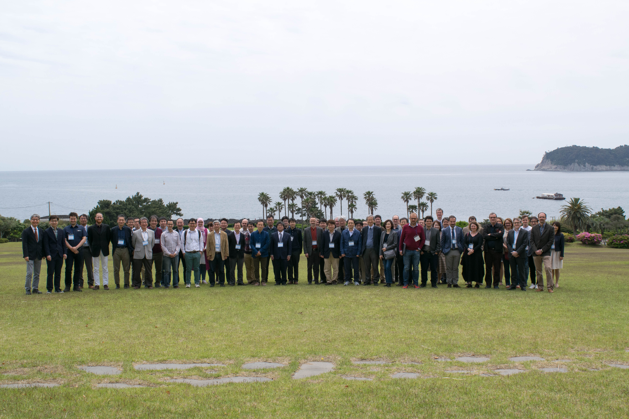
France-Korea Particle Physics and e-science Laboratory
Joint TYL-FKPPL workshop , Jeju Island, May 8-10 2019
M. Besançon, V. Breton, K. Cho, D. Sarramia
May 16-18, 2022

Slide 2
FKPPL scientific perimeter in 2020-2021
16 projects (2020-2021)
14 korean institutes
12 french laboratories
6 disciplinary fields
Detector R&D
Hadronic and nuclear Physics
High Energy Physics
Multidisciplinary and Computing
Neutrino Physics
Theory
Several projects are really trilateral projects with Japanese teams involved (TYL)

Slide 3
FKPPL in 2021
12 projects submitted to the 2021 call
Very constrained travel rules between France & Korea
CNRS FKPPL budget not distributed to the French teams
Nevertheless the scientific activity continued…
Scientific production
Virtual meetings
But considerable slow down…

Slide 4
FKPPL in 2021 (continued)
3 out of the 4 new 2021 projects could not start
FAZIA collaboration @GANIL successfully started (See slides from Professor Byungsik Hong talk yesterday)
Several projects did report continuing activities despite the sanitary crisis
R&D for CALICE calorimeter (see slides from Roman Pöschl talk on monday)
Theoretical activities on dark matter (see slides from Yann Mambrini talk earlier this morning)
And more…
Notes:
Visit of korean scientists to GANIL in April and May

Slide 5
2022 call: all 12 FKPPL projects resubmitted
Hadronic-nuclear physics (2 IN2P3/CEA)
GPD (Generalized Parton Distributions)
S. Choi, C. Munoz
FAZIA (Nuclear Equation of State)
B. Hong, N. Le Neindre
R&D (3)
CMS RPC (iRPC)
J.J. Goh, M. Gouzevitch,
ILCCALICE (PCB)
M. Ghergherehchi, R. Poeschl
HPRPC
I. Laktineh, D-W Kim
Interdisciplinary & computing (2)
Beam / Geant4
M. Verderi, K. Cho
EXTREME
D. Kim, V. Breton
HEP: experiments (2 IN2P3)
ALICE HF (b-jet in p-Pb)
M. J. Kweon, R. Guernane
CMS IL (quarkonium probes of QGP)
Y. Kim, M. Nguyen
HEP: theory (2 IN2P3 + 1 INP)
FNEPS
H. M. Lee, Y. Mambrini
CCC-DM (dark matter)
B. Fuks, P. Ko
Neutrino physics (1)
NeutrinoBSM
S. H. Seo, A. Cabrera

Slide 6
Young investigator award 2022
Jae Beom Park
(Korea Univ.)
See Jae Beom slides on https://indico.in2p3.fr/event/26306

Slide 7
2022: resuming scientific exchanges
Visit of korean scientists to GANIL in April and May
Visit to FKPPL Korean partners in July (Vincent)
The FKPPL project leaders will be very quickly informed of their travel budget
No restrictions for travels between France and Korea if vaccinated
https://kr.ambafrance.org/Informations-Coronavirus-Covid-19

Slide 8
FKPPL 2022: a constant budget
2022: same budget from CNRS as in 2021 (20+15 = 35 KEuros)

Slide 9
A message to project leaders
The French Embassy strongly supports scientific exchanges
PHC STAR: scientific and technological exchanges
Funded by Korean NRF and French Science Ministry
Next call: january 2023
France Excellence grants for korean students to study in France
Funded by the French Science ministry
2021: Ms CHOI Jieun, joint PhD @IP2I Lyon
Contact: Denis Fourmeau

Slide 10
FKPPL communication
FKPPL has a new logo
Selected by 75% of the voters
FKPPL new web site under development
WordPress

Slide 11
Conclusion: let us go !
COVID-19 pandemic has considerably impacted scientific activities within FKPPL in 2020 and 2021
But many projects have continued
The motivation is still the same: 12 projects are ready to resume exchanges in 2022
The support from CNRS-IN2P3 has not decreased despite the pandemic crisis

