Slide 1
ESCAPE WP3 – OSSR
18/03/2022

Slide 2
General news
eOSSR v0.5 released
See changelog: https://gitlab.in2p3.fr/escape2020/wp3/eossr/-/releases/v0.5
The main change concerns the simplification of the upload of a repository with a change of API for users.
EDASS 2022 (ESCAPE Data Science School) date set: June 20-24 2022
In Annecy
Started the organisation locally and to contact some teachers (the programme is still under construction)

Slide 3
CITATION.cff
https://citation-file-format.github.io/
CITATION.cff files are plain text files with human- and machine-readable citation information for software (and datasets). Code developers can include them in their repositories to let others know how to correctly cite their software.
cff-version: 1.2.0 message: "If you use this software, please cite it as below." authors: - family-names: Druskat given-names: Stephan orcid: https://orcid.org/0000-0003-4925-7248 title: "My Research Software" version: 2.0.4 doi: 10.5281/zenodo.1234 date-released: 2021-08-11

Slide 4
Yet another format?
One of the two formats recommended on https://fair-software.eu/recommendations/citation
(the other one being CodeMeta)
Gained a lot of support in the last year(s)
Supported by GitHub
Supported by Zenodo !
When using the GitHub-Zenodo integration, Zenodo takes `CITATION.cff` as source of metadata
`.zenodo.json` comes first if there is one
Supported by Zotero
Many tools to work with this format

Slide 5
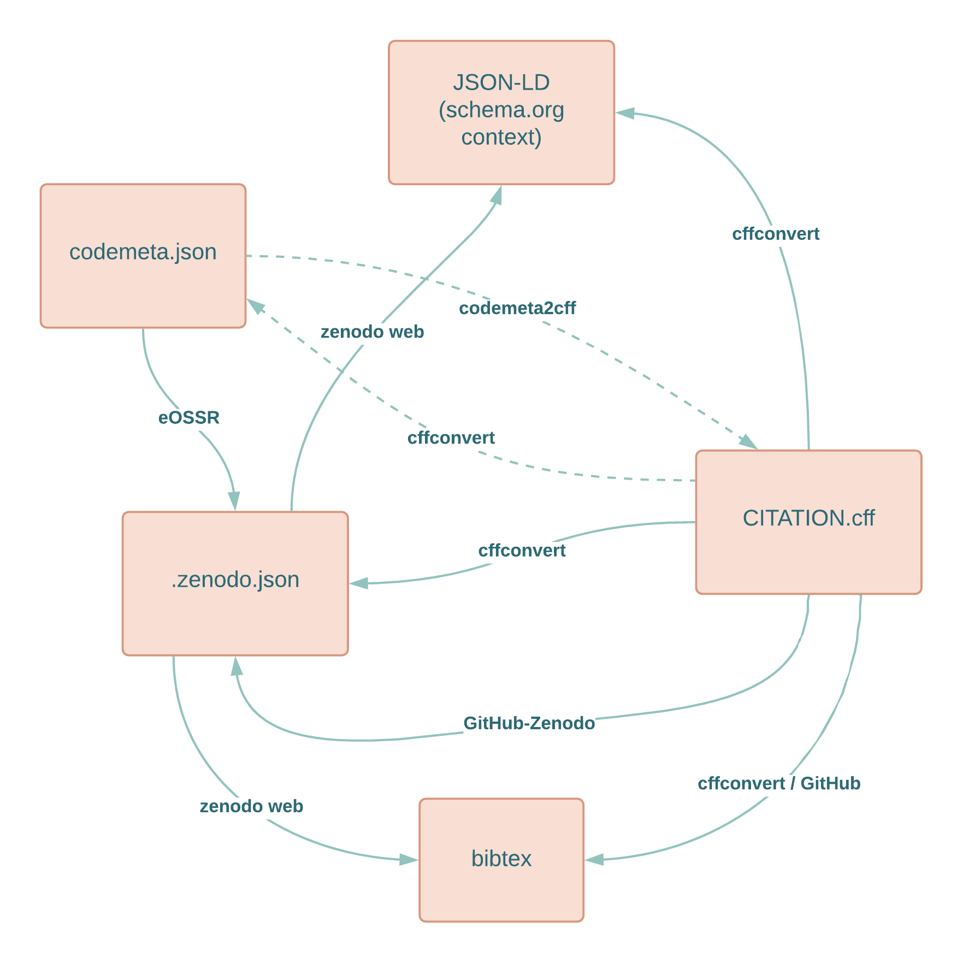
Some tests
https://github.com/vuillaut/ossr-metadata-tests
It appears there is a lot of confusion between CodeMeta and schema.org schemas – most tools* « supporting » codemeta actually support schema.org context
OR CodeMeta itself does not work the way it’s supposed to.
Issues opened:
https://github.com/citation-file-format/cff-converter-python/issues/272
https://github.com/codemeta/codemeta/issues/273
*cffconvert, codemeta2cff, Zenodo

Slide 6
OSSR accepted metadata formats
Current status: we recently moved from recommending CodeMeta to requiring it
Should we accept CITATION.cff?
Should we support CITATION.cff?
Our first goal is to provide FAIR software
CITATION.cff answers this requirement
gammapy currently uses CITATION.cff
Requiring codemeta.json makes them convert CITATION.cff to codemeta.json to then convert to .zenodo.json (they could convert directly from CITATION.cff to .zenodo.json but that might lead to more mistakes?)
What would be the implications?

Slide 7
Back to CodeMeta issues
4. Funding and funder
Goal: cite grants
Issues:
https://gitlab.in2p3.fr/escape2020/wp3/eossr/-/issues/38
5. Licenses
Issues:
https://gitlab.in2p3.fr/escape2020/wp3/eossr/-/issues/32
6. Associated data (format) with a software
Goal: ESAP can suggest software to analysis the pre-selected data
Issues:
https://gitlab.in2p3.fr/escape2020/wp3/eossr/-/issues/33

