Slide 1
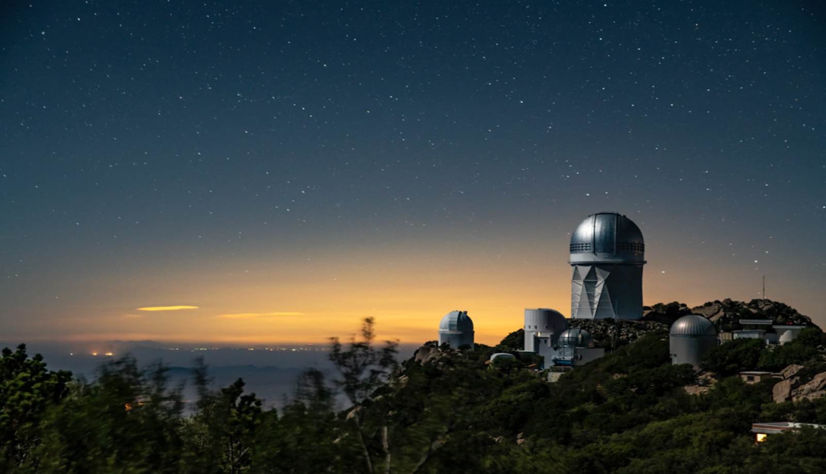
HOD for Emission Line Galaxies in DESI
Antoine Rocher - PhD student
Supervisors : Vanina Ruhlmann-Kleider, Etienne Burtin
IRFU, CEA, Université Paris-Saclay, F-91191 Gif-sur- Yvette, France
antoine.rocher@cea.fr

Slide 2
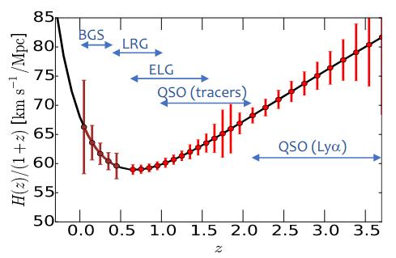
Dark Energy Spectroscopic Instument (DESI)
(Emission Line Galaxies)
(Luminous Red Galaxies)
z
=> DESI over 5 years :
Footprint ~14 000 deg²
40M redshifts (already > 10M)
Probe the large scale structure of the universe (BAO, RSD, FNL)
4 main tracers (BGS, LRG, ELG, QSO+Lyα) ​
ELGs ~17M spectra in z range 0.6-1.6
=> Main DESI tracer
DESI ELGs : Star forming selected with [OII] flux

Slide 3
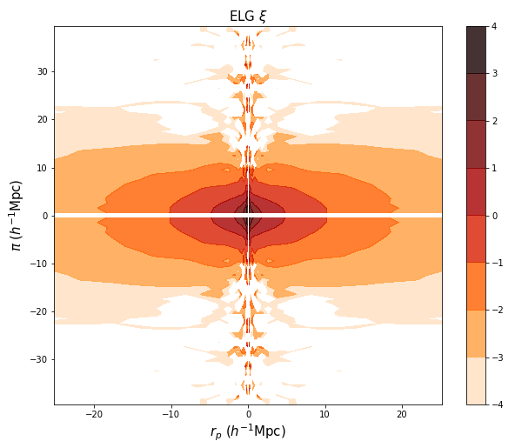
DESI Emission Line Galaxy early data
Preliminary
Result on early data
Describing the galaxy-halo connection of early ELG DESI data :​
Provide feedback to better understand the underlying physics of the connection
Create simulated galaxy catalogs (mocks) to prepare Y1 cosmological analyses.
Evaluate the impact of galaxy-halo connection on cosmological constraints
ξ
We use Halo occupation distribution (HOD) :
Empirical relation to link DM halos in N-body simulations to tracers, based on halo masses
ELG HOD models ≠ standard HOD model (designed for LRGs)
ELG expected to live in lower halo masses than LRGs
ELG sample incomplete in halo mass
DESI ELGs :
Star forming galaxies selected with [OII] flux
DESI early data: 224k ELGs (z 0.8 - 1.5)
(eBOSS DR16: 173k ELGs)
High data quality !
Lot of information at small scales !

Slide 4
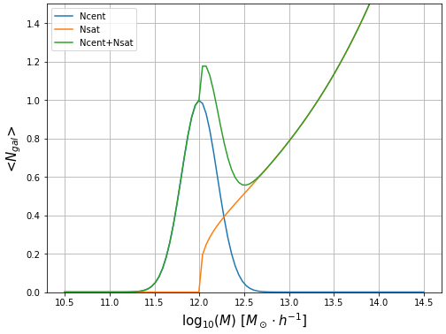
Halo Occupation Distribution (HOD) for ELGs
Gaussian HOD model GHOD (eBOSS studies, Avila et al. 2020) :
- Central galaxy assignment from Bernoulli distribution (0/1) with halo properties
- Satellite galaxy assignment from Poisson distribution :
Position in a NFW profile
Velocity drawn from random normal distribution around V_{halo}
Can live without central galaxies in the halo
+ scaling factor f_{v} for satellite velocity dispersion
Other HOD models for ELGs (N_{cent} asymmetric Gaussian):
High mass quenched (HMQ) (Alam et al. 2019)
Star forming HOD (SFHOD) (Avila et al. 2020)
V_{sat,x} = rd.normal(V_{halo,x}, σ_{v}.f_{v}) ​
We use this model to fit early ELG DESI data

Slide 5
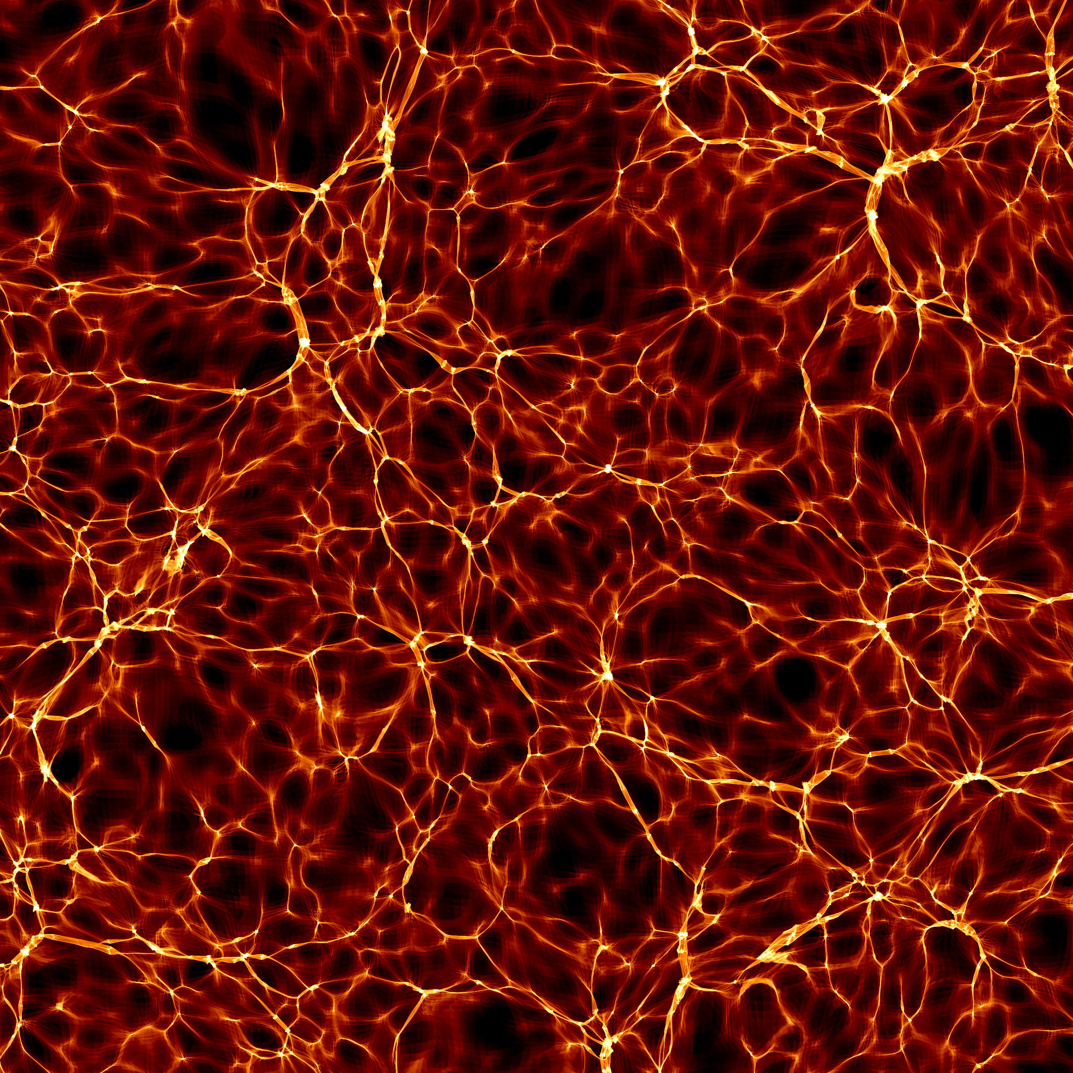
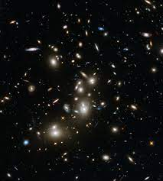
HOD fitting method (I)
Traditional schematic view of ​HOD fitting process
- HOD models are stochastic
- MCMC fits ~100000 points
=> Highly CPU expensive
Halo catalog from
Nbody simulation box
Galaxy mock catalog
Clustering statistics (2PCF)
HOD model
~ 10⁸ halos
~10⁶ galaxies
~few sec
~few sec
~few sec
~few sec
We developed an alternative procedure of HOD fitting using Gaussian processes

Slide 6
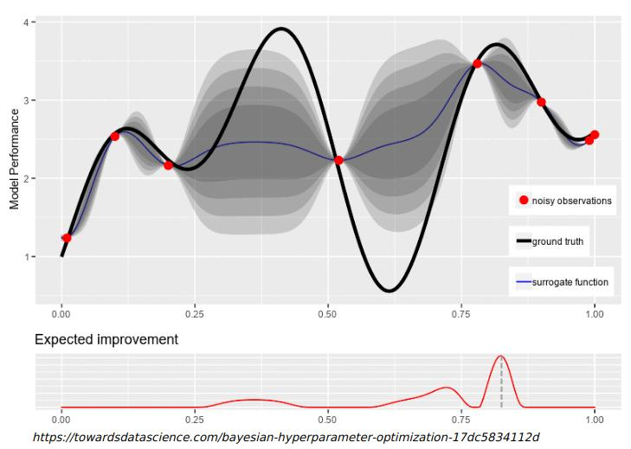
HOD fitting method (II)
Fitting procedure with Gaussian Processes (GP) :
- Iterative procedure
- Start: initial training sample
- GP creates a surrogate model of the likelihood function (LH)
- New point added to improve model
- Stochasticity of LH estimation
=> 20 χ² computations to get uncertainty
https://towardsdatascience.com/bayesian-hyperparameter-optimization-17dc5834112d
~1000 points in total to reach convergence

Slide 7
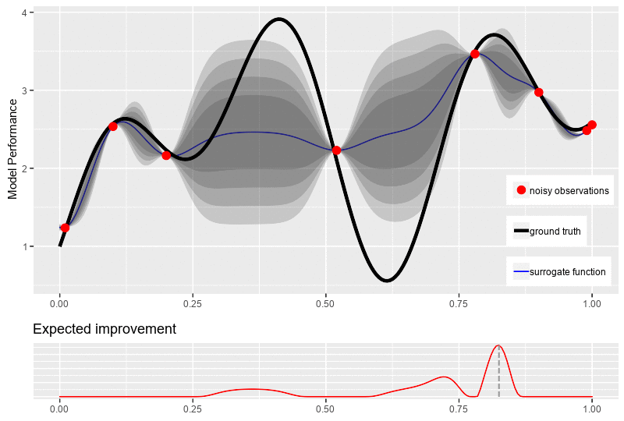
HOD fitting method (II)
Fitting procedure with Gaussian Processes (GP) :
- Iterative procedure
- Start: initial training sample
- GP creates a surrogate model of the likelihood function (LH)
- New point added to improve model
- Stochasticity of LH estimation
=> 20 χ² computations to get uncertainty
https://towardsdatascience.com/bayesian-hyperparameter-optimization-17dc5834112d
~1000 points in total to reach convergence

Slide 8
HOD fitting method (III)
Accuracy test :
- 25 fiducial data sets from different N-body simulation boxes 1 [Gpc/h]³ at fixed cosmology
- Fixed HOD model : GHOD
- Fit with 3 free parameters:
As
α
logM_{c}
=> input parameters recovered within 1σ (cosmic variance + stochasticity)
Rocher et al. in prep

Slide 9
HOD results on data: fitting conditions
- Simulation box : ​
AbacusSummit N-body ​simulation (designed for DESI) (Maksimova et al. 2021)
Cubic box 1 [Gpc/h]³​ with 6300³ particles at z = 1.175
Mass resolution 2 10⁹ [M☉/h]​
CompaSO halo catalog M_{halo} > 10.86 [log(M☉/h)] (Hadzhiyska et al. 2021)
- Fitting conditions:​
Projected clustering w_{p}(r_{p}) + multipoles ξ₀(s), ξ₂(s)
r_{p} : 0.03 - 30 Mpc/h with 25 log bins
s : 0.8 - 30 Mpc/h with 25 log bins
Fixed density 10⁻³ gal/[Mpc/h]³
GHOD model + scaling factor f_{v} for satellite velocity dispersion
(impacts multipoles at small scales <10 [Mpc/h])
Landy-Szalay 2PCF estimator :
75 bins in total
Projected along los:
velocity independent at small scales

Slide 10
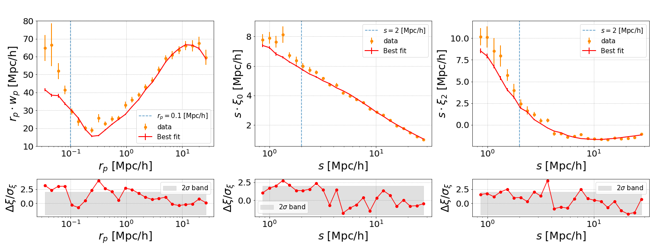
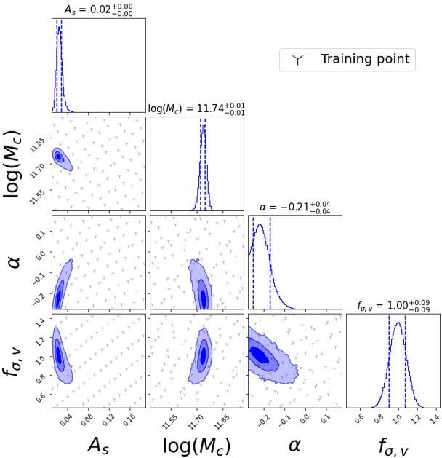
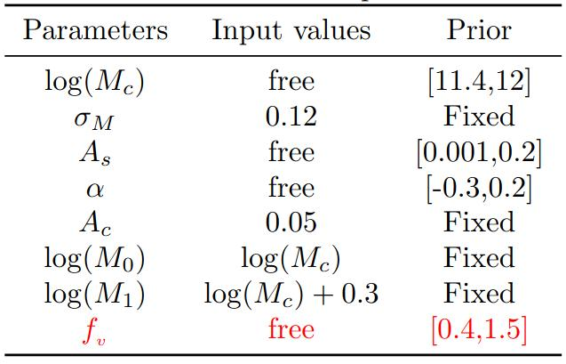
HOD results on data: 4 parameter fit
Preliminary
Result on early data
- Tight constraints on HOD parameters
- Good agreement with data r_{p} > 0.1 Mpc/h, s > 1Mpc/h
- Scales r_{p} < 0.1 Mpc/h, s < 2Mpc/h (blue vertical line) :
Strong upturn in w_{p} i.e. close ELG pairs
not fully reproduced
- α best fit tends to be negative => satellites in low mass halos favored
χ²=160.30 +/-1.64 (71 DoF)
Physically motivated model :
(Avila at al. 2020 & Gonzalez-Perez et al. 2018)

Slide 11
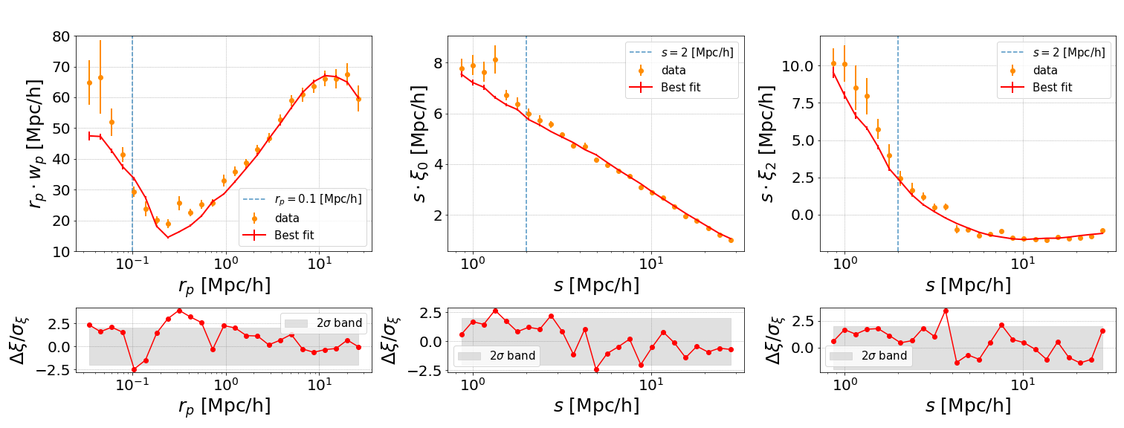
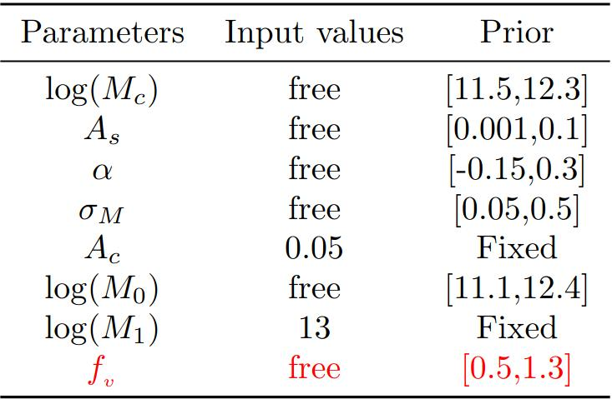
HOD results on data: 6 parameter fit
Preliminary
Result on early data
χ²=154.31+/-1.60 (69 DoF)
M₀ free, M₁ fixed, both independent from M_{c} :
- Same conclusion as in previous fit, with lower M₀ values
M₀ : 11.74 => 11.49 log(Msol/h)
- α ~ 0 => HOD for satellites is uniform in halo mass above M₀
=> Both fits strongly suggests low mass halos for satellites

Slide 12
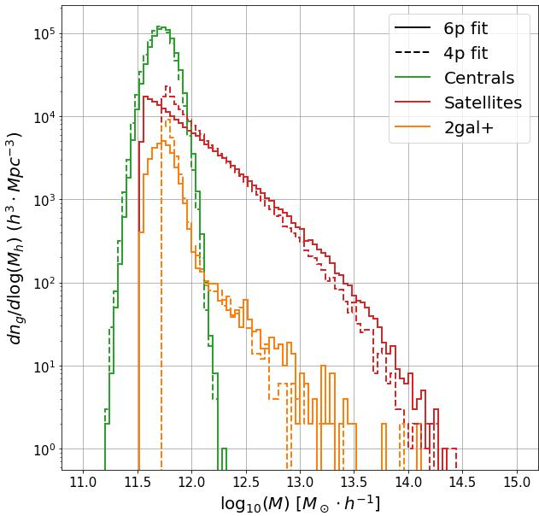
HOD results on data: populated halo mass function
4p fit :
f_{sat} = 0.17
f_{1h} = 0.03
<M_{h}> = 10^{11.84} M☉/h
M_{h,med}= 10^{11.74} M☉/h
Density = 1.10⁻³ gal/(Mpc/h)³
6p fit :
f_{sat} = 0.20
f_{1h} = 0.03
<M_{h}> = 110^{11.86} M☉/h
M_{h,med}= 10^{11.74} M☉/h
Density = 1.10⁻³ gal/(Mpc/h)³
- Both fits recover similar halo properties :
- <M_{h}> agrees with physical expectations for ELGs
(~10¹² M☉/h)
BUT :
- ELG Satellites in low mass halos < 10^{12.5} M☉/h) favored
- 1 halo term (1h = halos hosting ≥ 2 galaxies):
=> mainly from halos with mass < 10¹² M☉/h)
Galaxy pairs in low mass halos: not expected from ELG physics

Slide 13
Conclusions
Early ELG data : lot of information from small scales & good quality sample !
Strong upturn of the projected clustering at very small scales (r_{p}< 0.1 Mpc/h)
=> requires galaxy pairs at very small separations (i.e. in low mass halos)
GHOD model : good agreement with data at s > 1 Mpc/h, r_{p}> 0.1 Mpc/h
Scales s < 1 Mpc/h, r_{p} < 0.1 Mpc/h, hard to reproduce
=> Consider other HOD models and ways to treat satellite positions and velocities ?
=> Is a satellite HOD meaningful for ELGs ?
A way out : compare to hydrodynamical simulation results ?
Caveat : HOD modeling at very small scales (s < 1 Mpc/h, r_{p} < 0.1 Mpc/h) strongly depends on N-body simulation resolution/code

Slide 14
Thank you !
Any questions?
Rocher Antoine - Action Dark Energy 2022

Slide 15
Backup slides

Slide 16
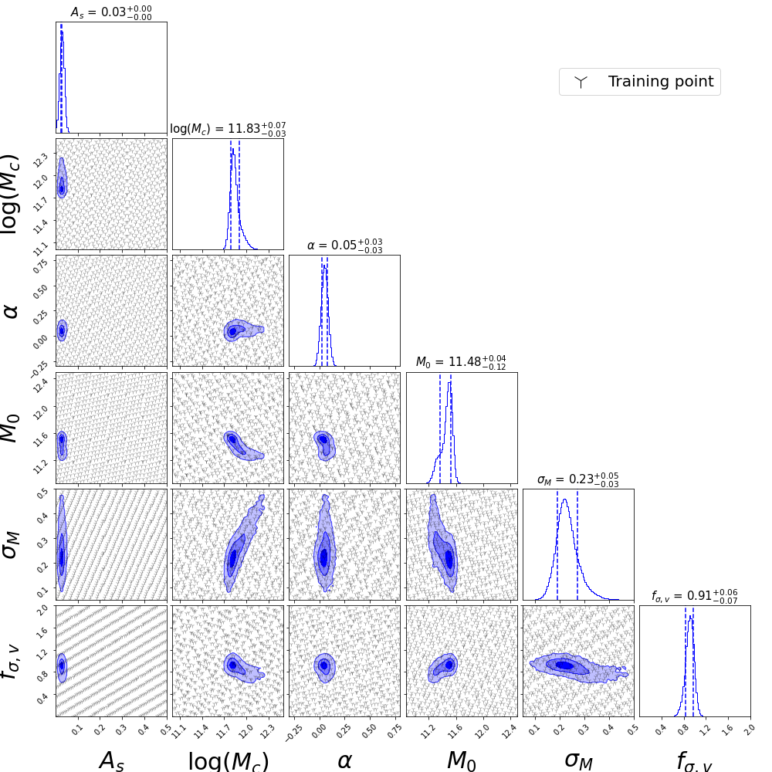
6p GHOD (initial prior)

Slide 17
Nbody sim Halos Simulation box
Start Likelihood evaluation procedure
Iterative process
Stop
Halo finder
Fit converged
Likelihood evaluation
Fit not converged
Evaluate accuracy of the prediction
Select a new interresting point
Populated halos according HOD models
Repeat 20 times for each point to variance estimate
Predict
Likelihood estimation
X 20
Add to the trainning sample
+1
Compute
correlation functions
(w_{p}, multipoles...)
Likelihood estimation + error
Training sample
Train
Gaussian Process
Gaussian Process Regression (GPR)
Start iterative procedure

Slide 18
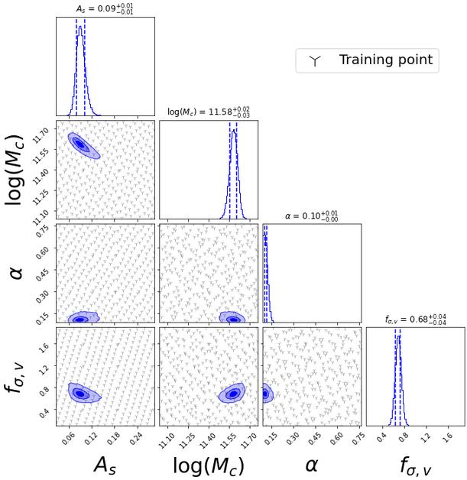
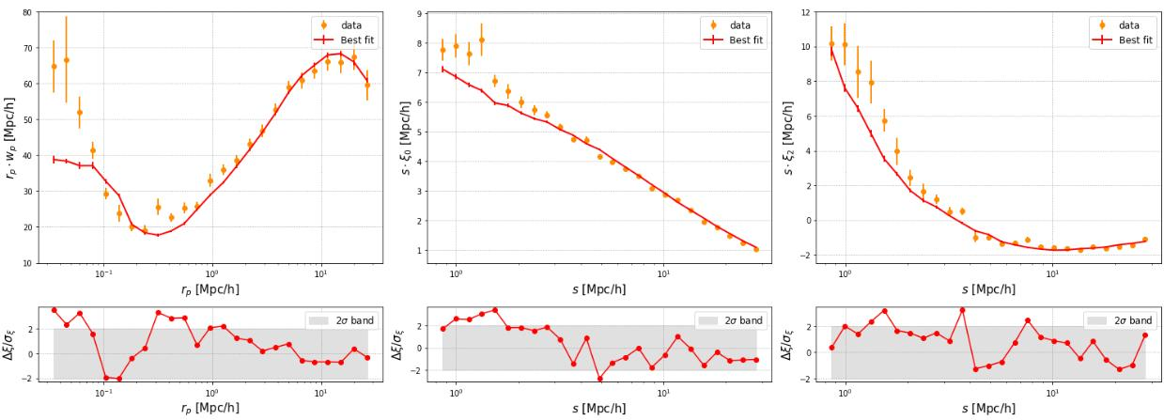
4p (initial prior)
r_{p}.w_{p}(r_{p})
s.ξ₀(s)
s.ξ₂(s)​
Preliminary
χ²=186.81+/-1.93 (75-4 DoF)

Slide 19
Each point will define a collection of random variables that we be used to determine a collection of multivariate gaussian distributions
The GP give a distribution of the probable values of the point that we want to evaluate
It use a correlation kernel to smooth out the variations of the function over the parameter space within a specific smoothing length l
https://distill.pub/2019/visual-exploration-gaussian-processes/

Slide 20
Technic to interpolate the LH
We want to evaluate the conditional probability p(LH(y)|Lh(X), y)
Each point will define a collection of random variables that we be used to determine a collection of multivariate gaussian distributions
The GP give a distribution of the probable values of the point that we want to evaluate
d(x_{i}, x_{j}) Euclidian distance between a couple of parameter sets x_{i} and x_{j}
length scale l : determines the reach of influence on neighbours
Covariance kernel

Slide 21
Gaussian HOD model GHOD (eBOSS studies, Avila et al. 2020) :
- Central galaxy assignment from Bernoulli distribution (0/1) with halo properties
- Satellite galaxy assignment from Poisson distribution :
Position in a NFW profile
Velocity drawn from random normal distribution around V_{halo}
Can live without central galaxies in the halo
+ scaling factor f_{v} for satellite velocity dispersion
V_{sat,x} = rd.normal(V_{halo,x}, σ_{v}.f_{v}) ​

