Slide 1
Processing of observational data with AbAO-T70
S. Berazde^{1,2}; N. Kochiashvili¹; R. Inasaridze^{1,2};
R. Natsvlishvili¹; M.Vardosanidze^{1,2}; V. Aivazyan^{1,2};
D. Datashvili^{1,2}; G. Kapanadze^{1,2}.
¹ E. Kharadze Georgian National Astrophysical Observatory.
² Samtskhe-Javakheti State University.
May 30 - June 3, 2022
Observatoire de la côte d'Azur, Nice

Slide 2
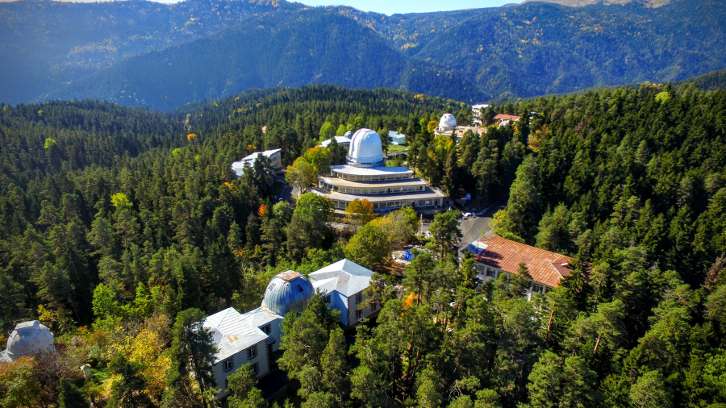
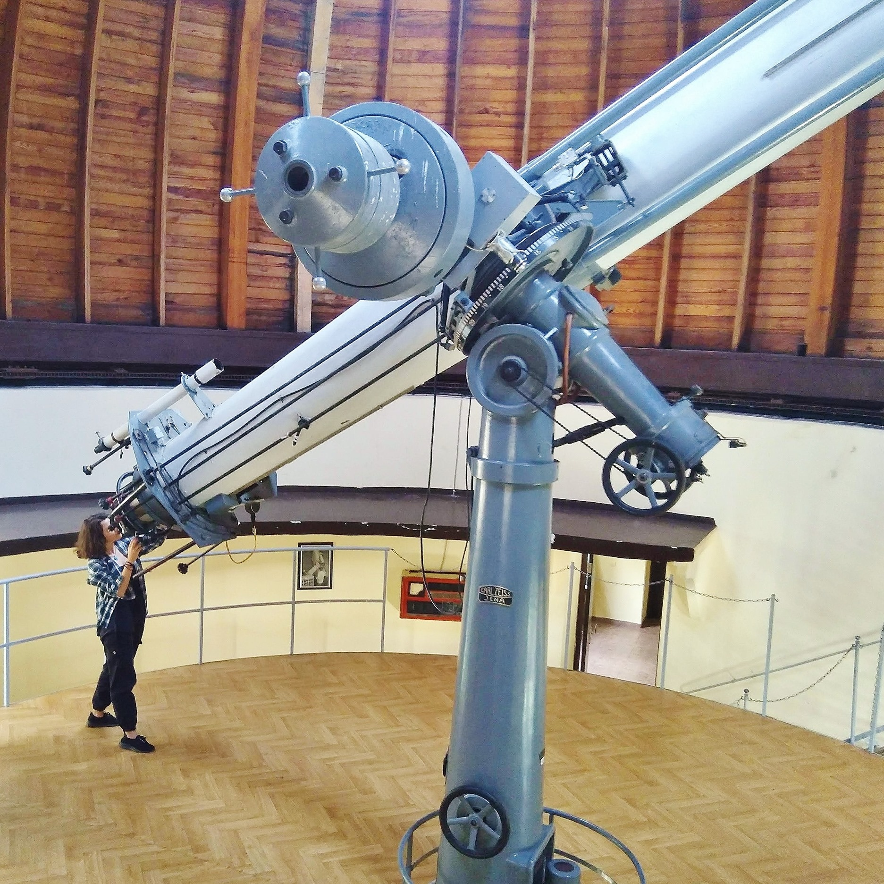
Cassegrain telescope has diameter of 480 mm, equivalent focal length of 7715 mm and is equipped with a CCD Apogee Alta KAF-16801E, with U,B,V,R,I filters
May 30 - June 3, 2022
Observatoire de la côte d'Azur, Nice

Slide 3
Cassegrain telescope has diameter of 480 mm, equivalent focal length of 7715 mm and is equipped with a CCD Apogee Alta KAF-16801E, with U,B,V,R,I filters

Slide 4
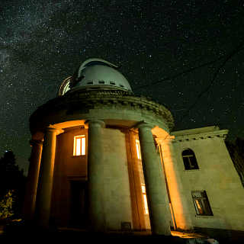
70 cm Meniscus telescope
May 30 - June 3, 2022
Observatoire de la côte d'Azur, Nice

Slide 5
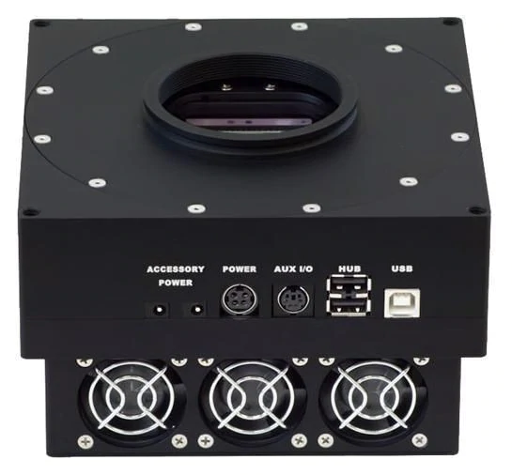
pl4240-ccd-camera-back-illum-63-5mm-shutter-gra

Slide 6
R Filter
….
B

Slide 7
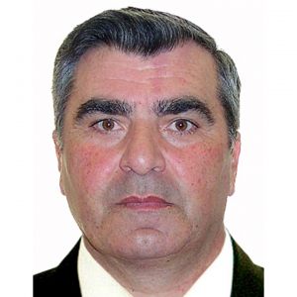
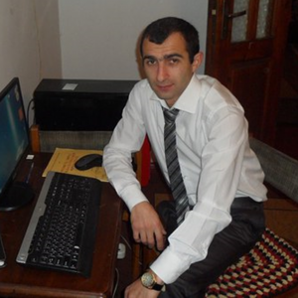
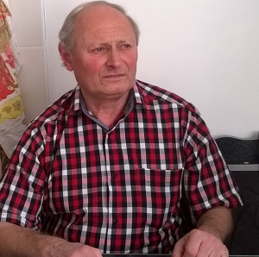
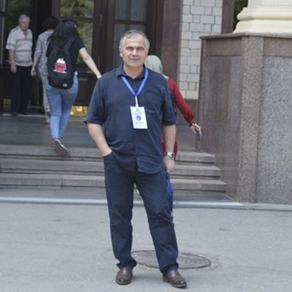
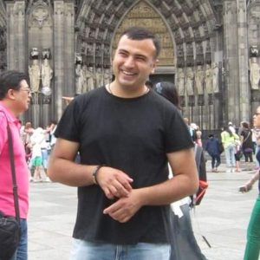
Abastumani Team

Slide 8
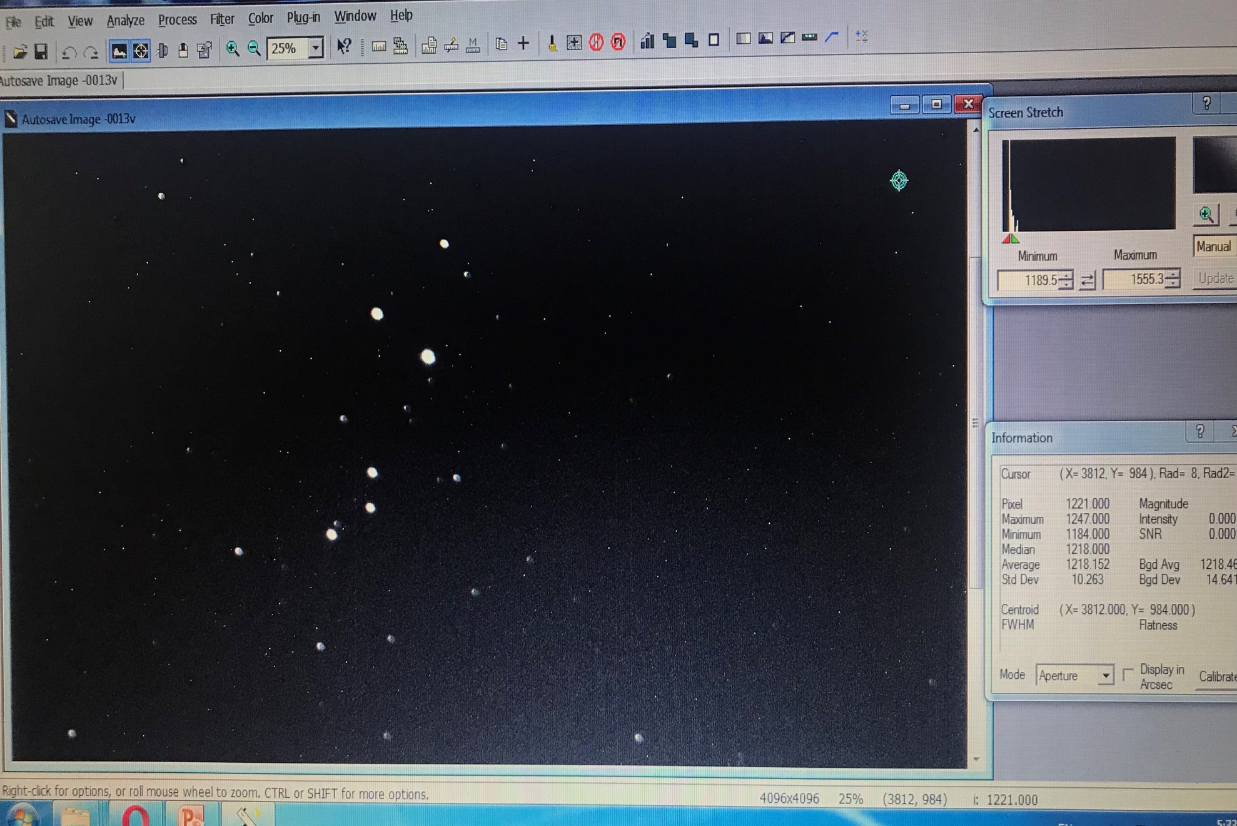
MaxIm DL 5

Slide 9
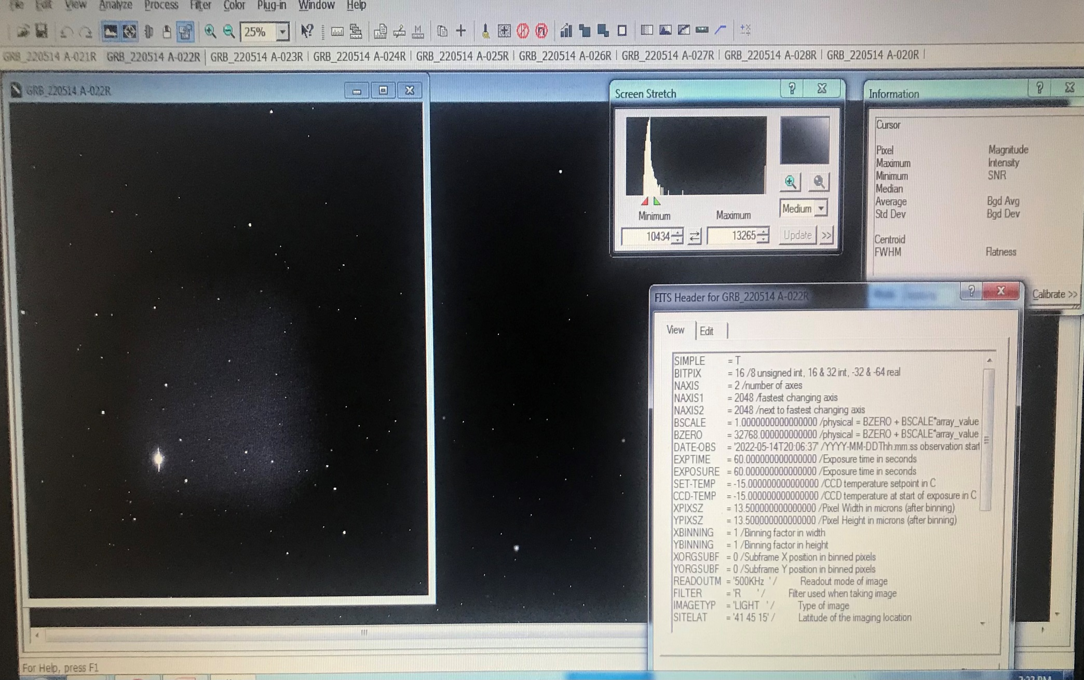

Slide 10
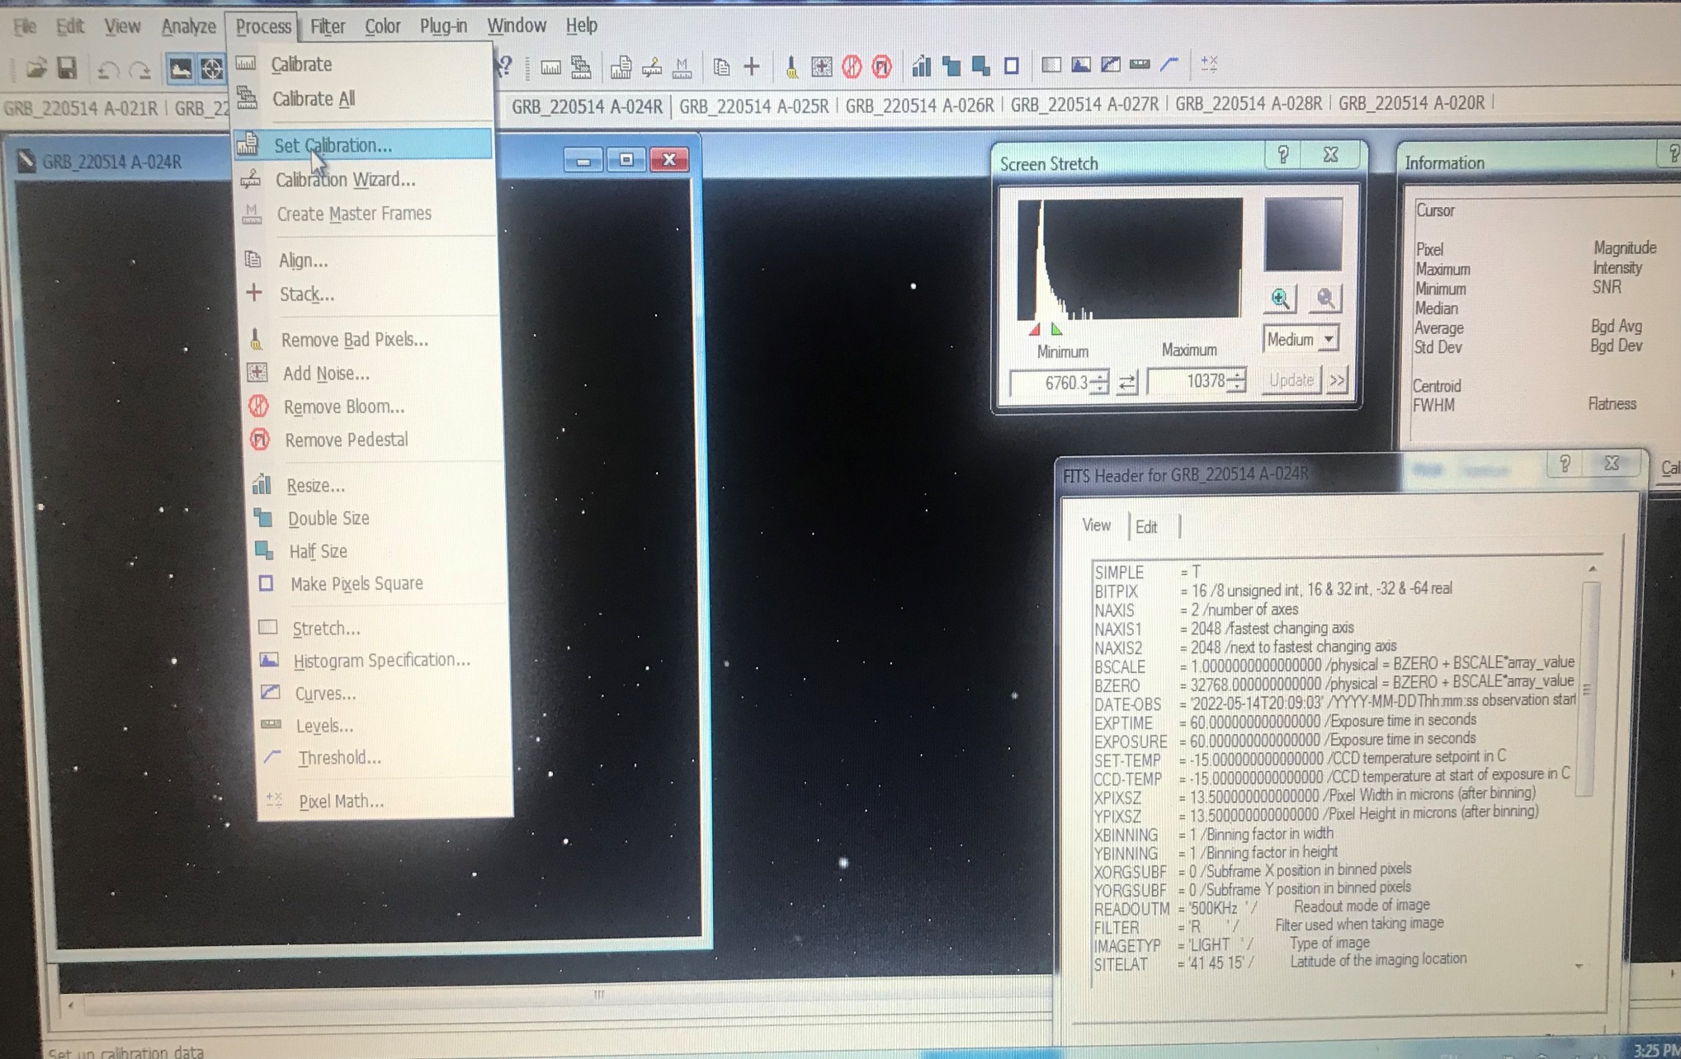

Slide 11
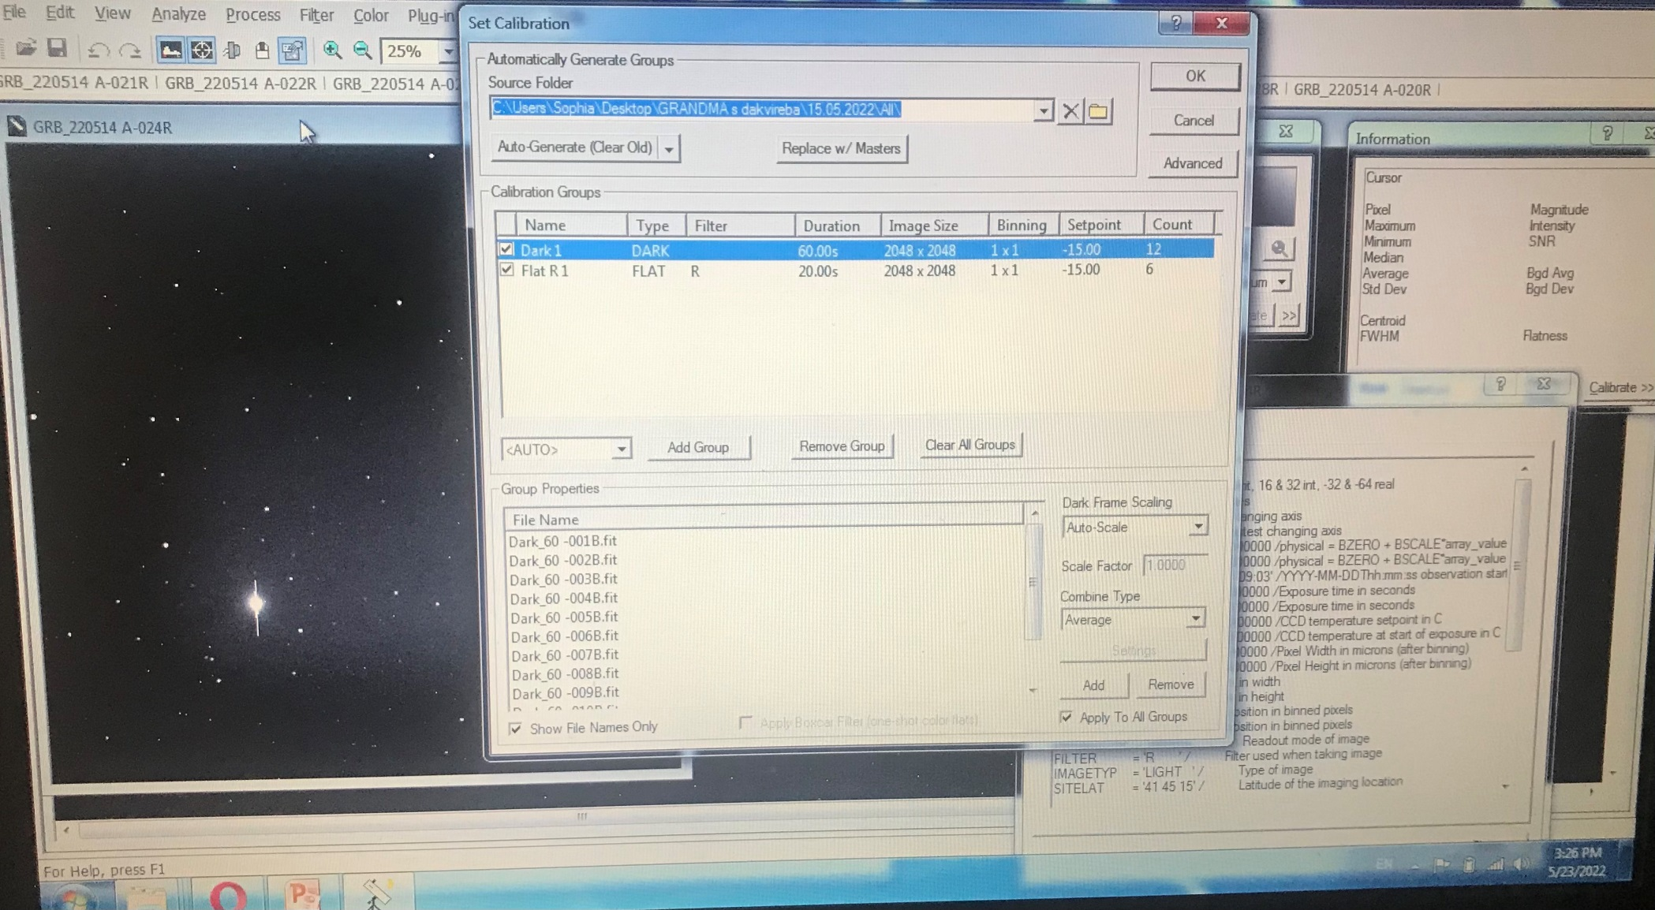

Slide 12
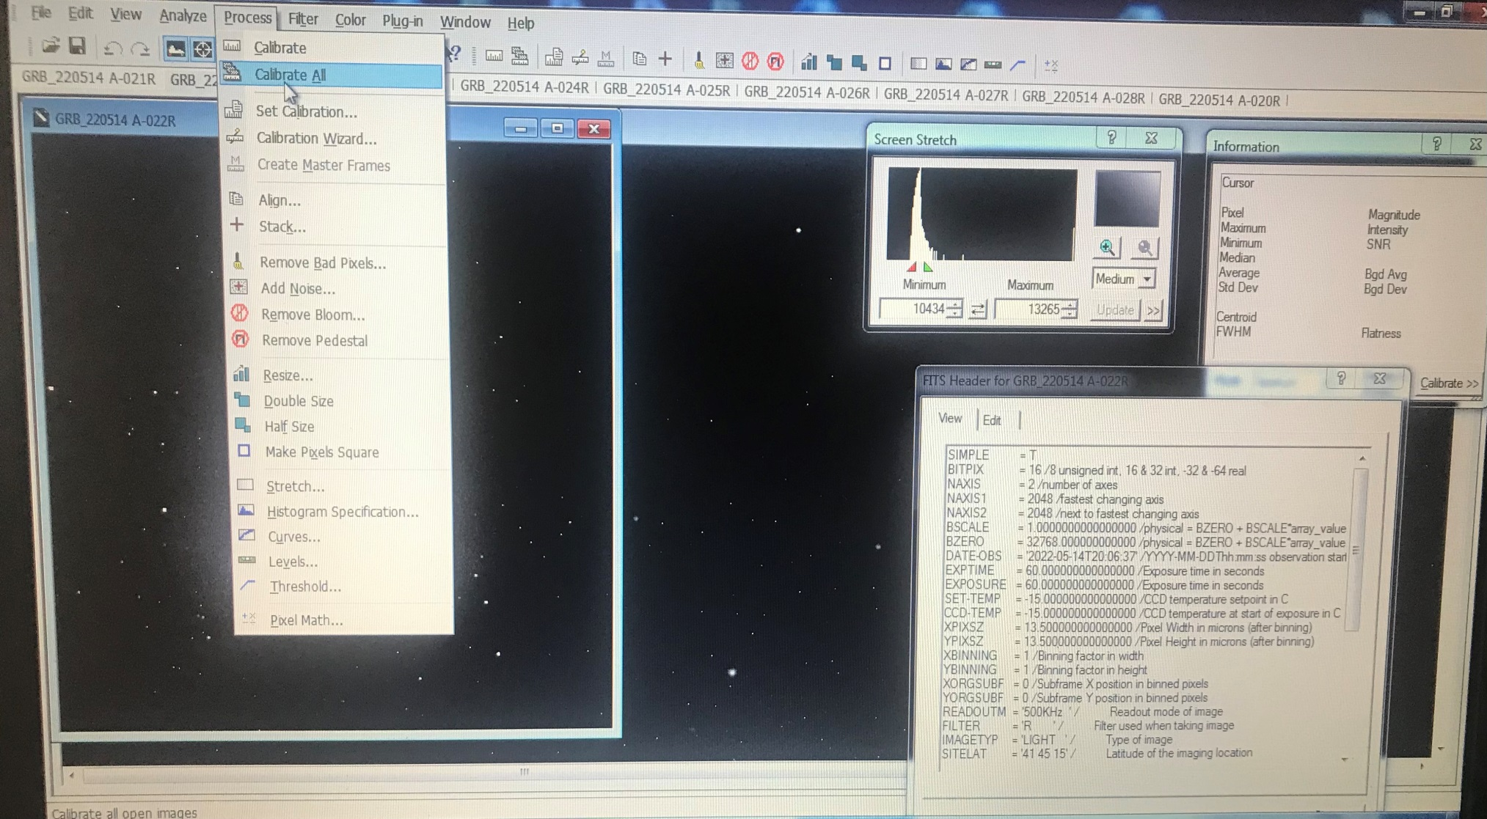

Slide 13
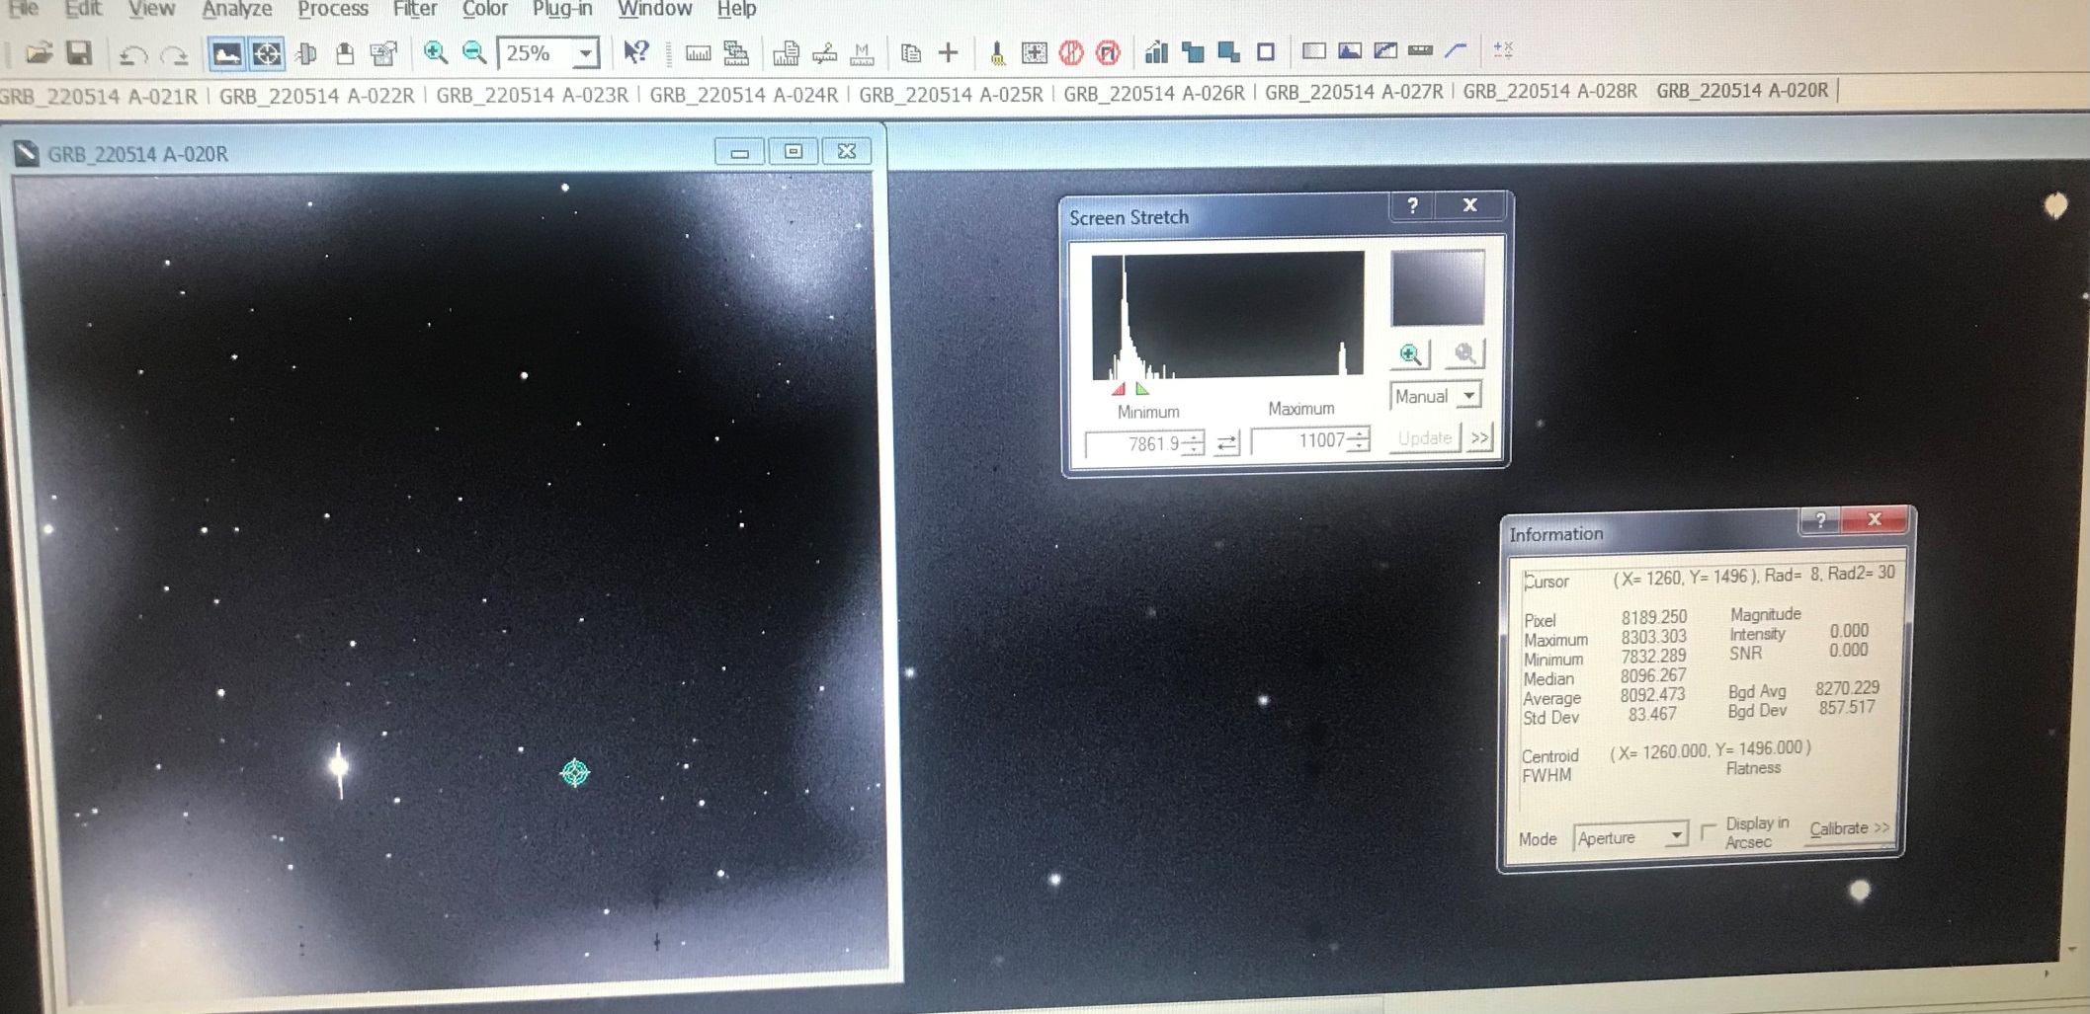

Slide 14
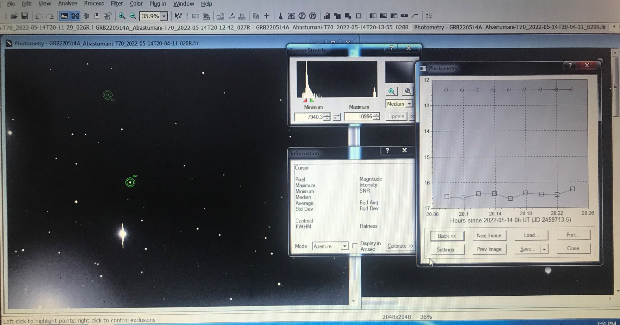

Slide 15
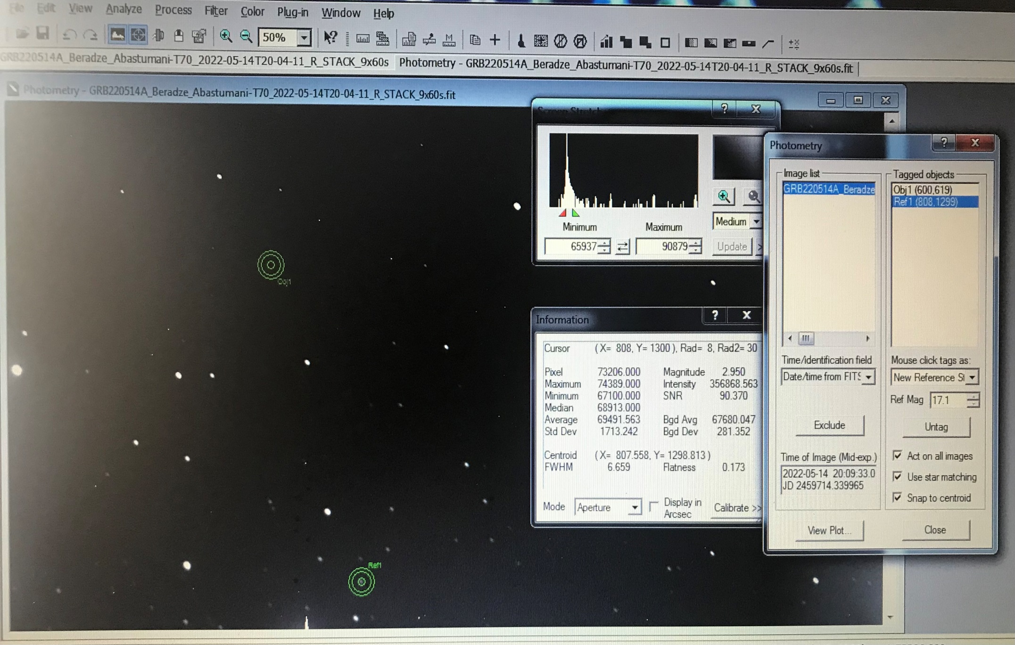
2MASS J09505108+1307287 – Star
R=17.1

Slide 16
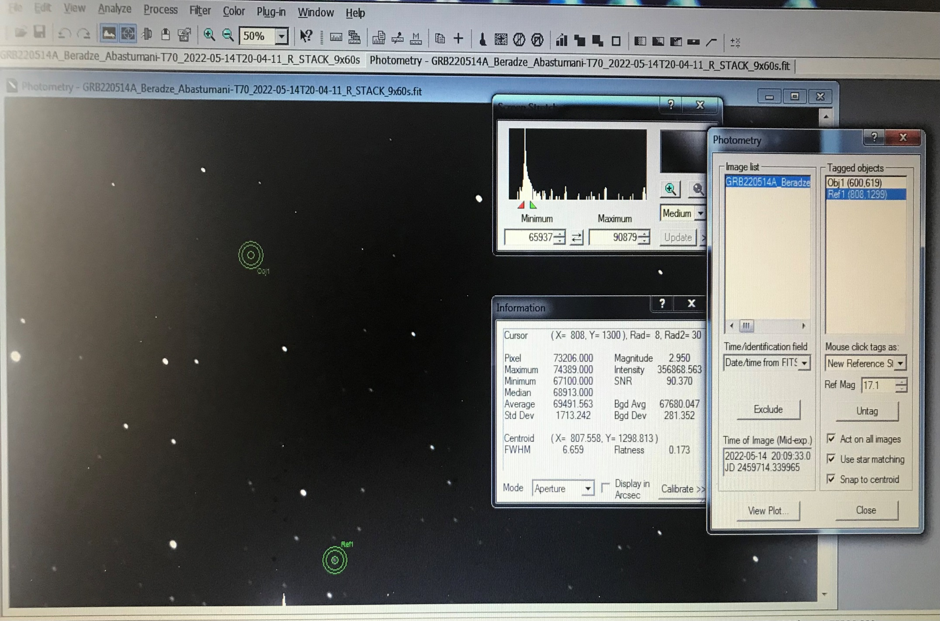
Lim Mag = 18.3
2MASS J09505108+1307287 – Star
R=17.1

Slide 17
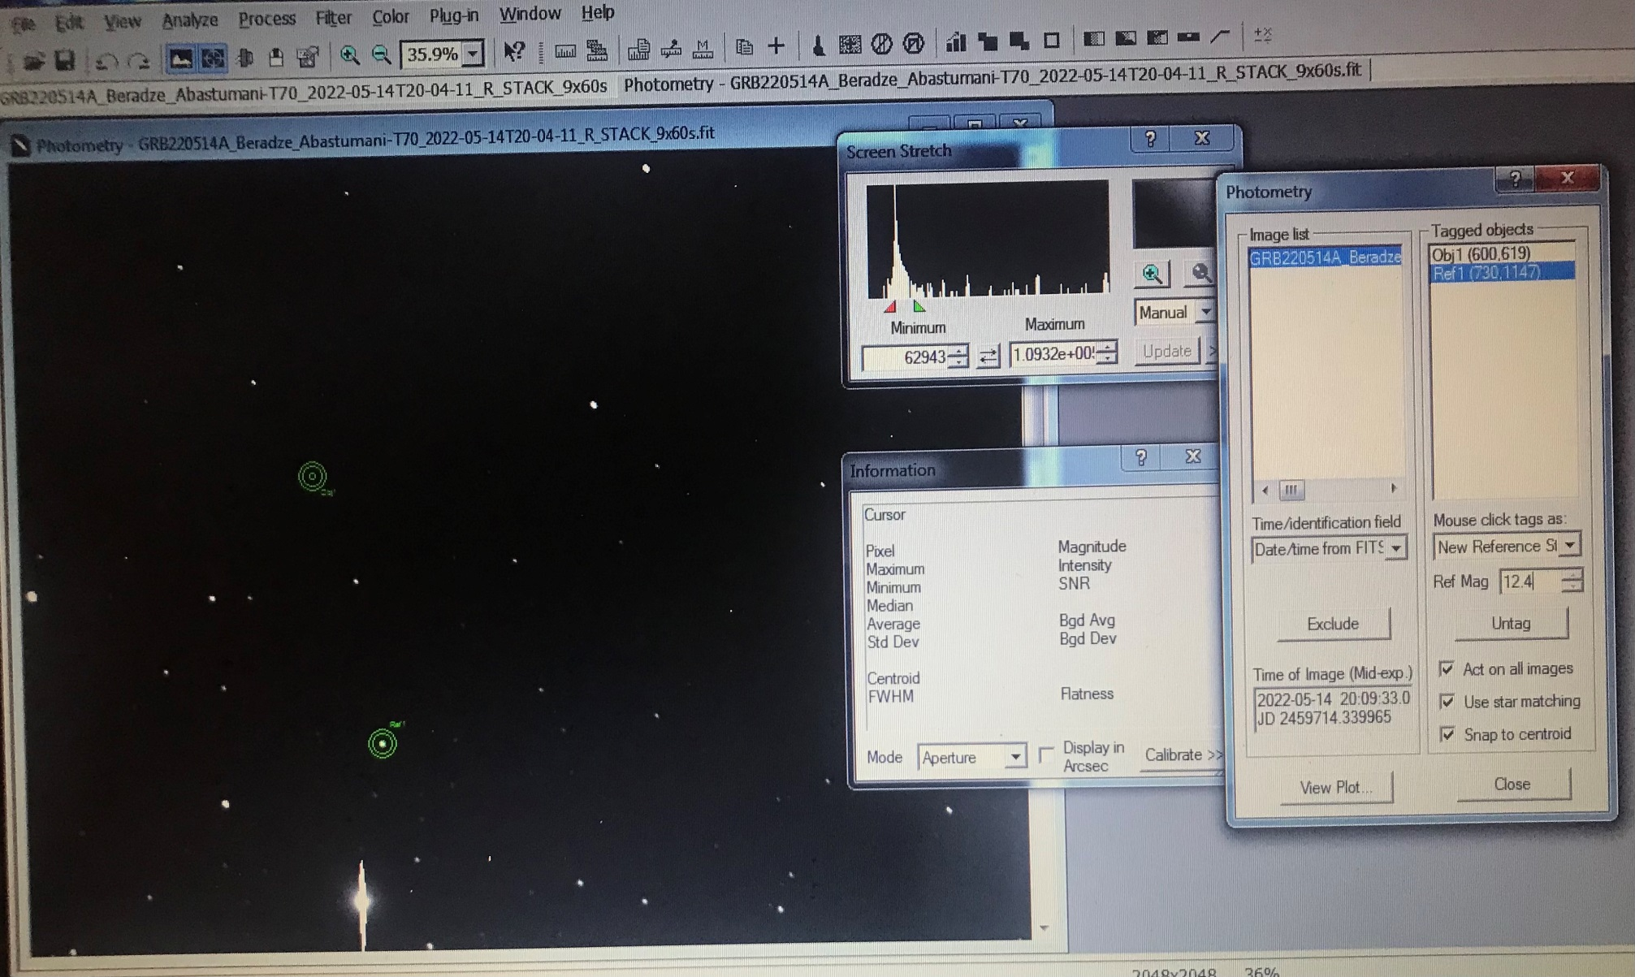

Slide 18
TYC 834-310-1 – Star
R=12.4

Slide 19
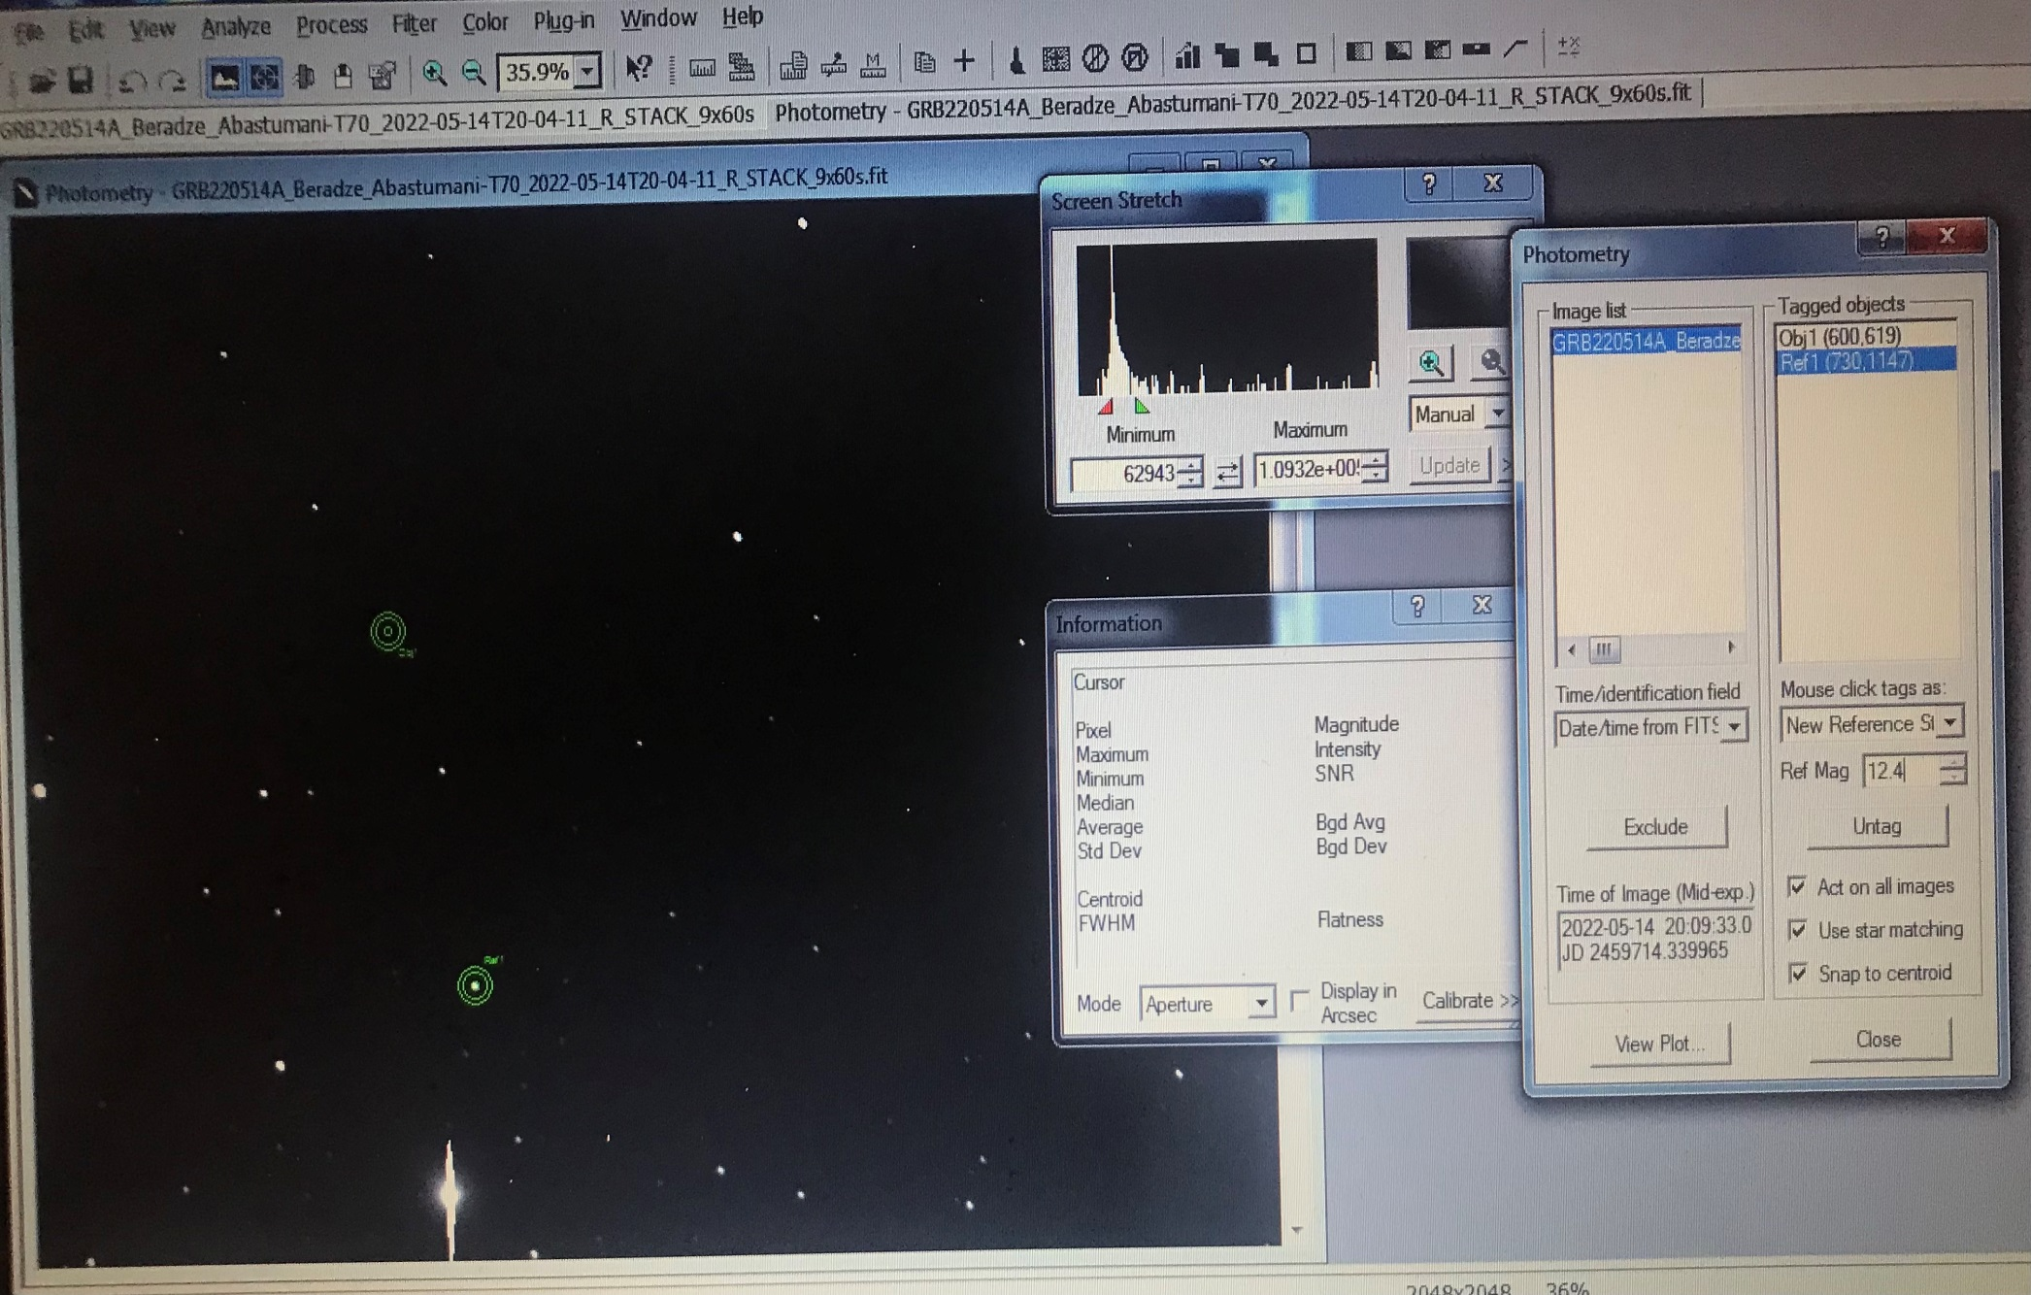
Lim Mag = 16.5
TYC 834-310-1 – Star
R=12.4

Slide 20
Thank you for your attention !!!

