Slide 1
Optimization Simulations for Kilonova Detections in Optical and Near Infrared
Mouza Almualla¹, Raiyah Alserkal¹, Adib Ghiasi¹, Vishwesh Kumar¹,
Michael W. Coughlin², Nidhal Guessoum¹
¹American University of Sharjah, UAE
⁵University of Minnesota, Minneapolis, USA

Slide 2
General Overview
Important to strategize detection of kilonovae:
  through follow-up of GW events
  serendipitously (during regular surveys)
We used Gwemopt (GW-EM optimization), a code that creates observing plans and evaluates their efficiency for ZTF detections.
We used LSST packages and metrics to simulate surveys in 6 photometric filters.
We have considered several observing factors and schemes: past failed observations, dynamic vs. fixed exposures, optical vs. near-infrared, etc.

Slide 3
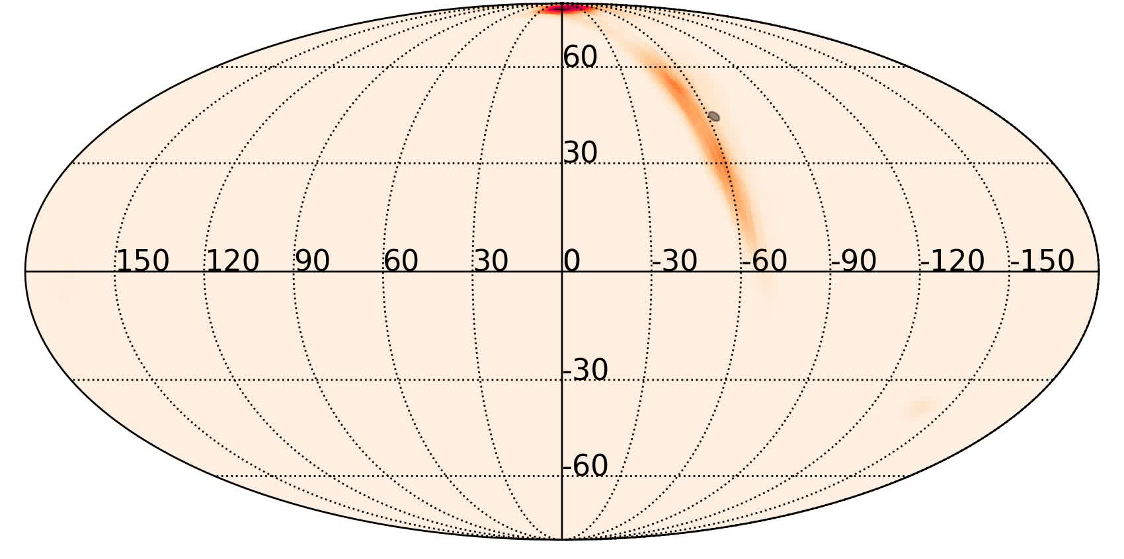
SuperScheduler algorithm
SuperScheduler can take into account past observations and dynamically schedule new ones.
Some fields are not observed due to weather issues.
Three rounds of scheduling with three telescopes.
Unobserved tiles after each round are shown in white.

Slide 4
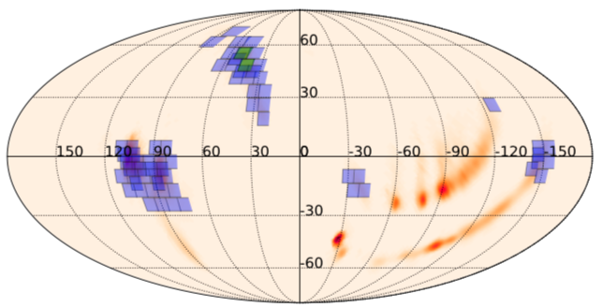
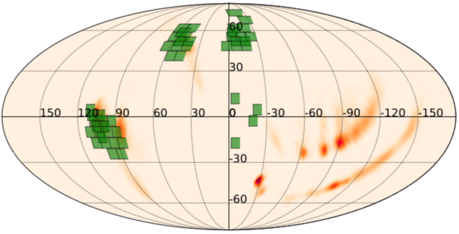
Filter Balancing
Difficulties in scheduling multi-epoch observations for large maps with multiple “lobes”.
Implemented a way to schedule each of these lobes by splitting them up in right ascension.
Before and after the new implementations. Fields in green have had all requested obs. scheduled, while those in violet have not.

Slide 5
Dynamic Exposures
Set Exposure (standard) technique:
  short exposures → increase in skymap coverage, useful for skymaps with large localization regions.
  long exposures → reaches greater depth (limiting magnitude), useful for candidates with high luminosity distances.
For maximum efficiency, we need the right balance between coverage and depth/distance.
Exposure time of each field is calculated using the skymap’s 3D probability distribution, i.e., using the distance distributions of each pixel within the field.

Slide 6
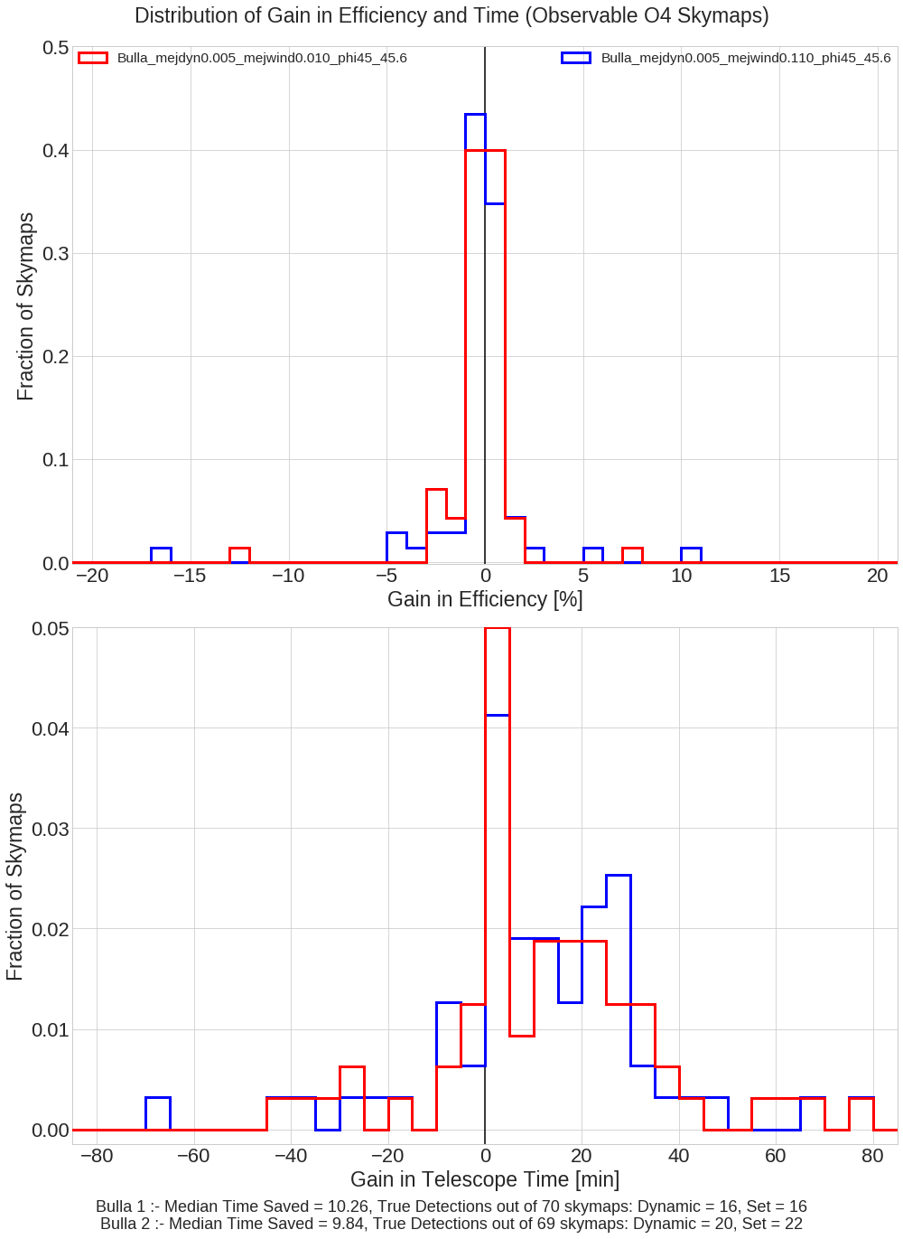
Dynamic Exposures (cont’d)
We find that by using Dynamic Exposures over Set Exposures, we save 20 (median) minutes of telescope time (6-8 % of observing time, roughly) without compromising efficiency.
Fraction of Skymaps
Fraction of Skymaps
Gain/Loss in Efficiency (%)
Gain in Telescope Time (min)

Slide 7
Optical vs. Near-Infrared Observations
KNe are expected to last longer in NIR compared to the 72-hour follow-up strategies for Optical.
We ran simulations using ZTF configurations in Optical (g- and r- bands) and NIR (J- and K-) with GW190425 skymaps and light curve models from the literature.
We used exposures of 30 to 600 seconds for observations up to 120 hours.

Slide 8
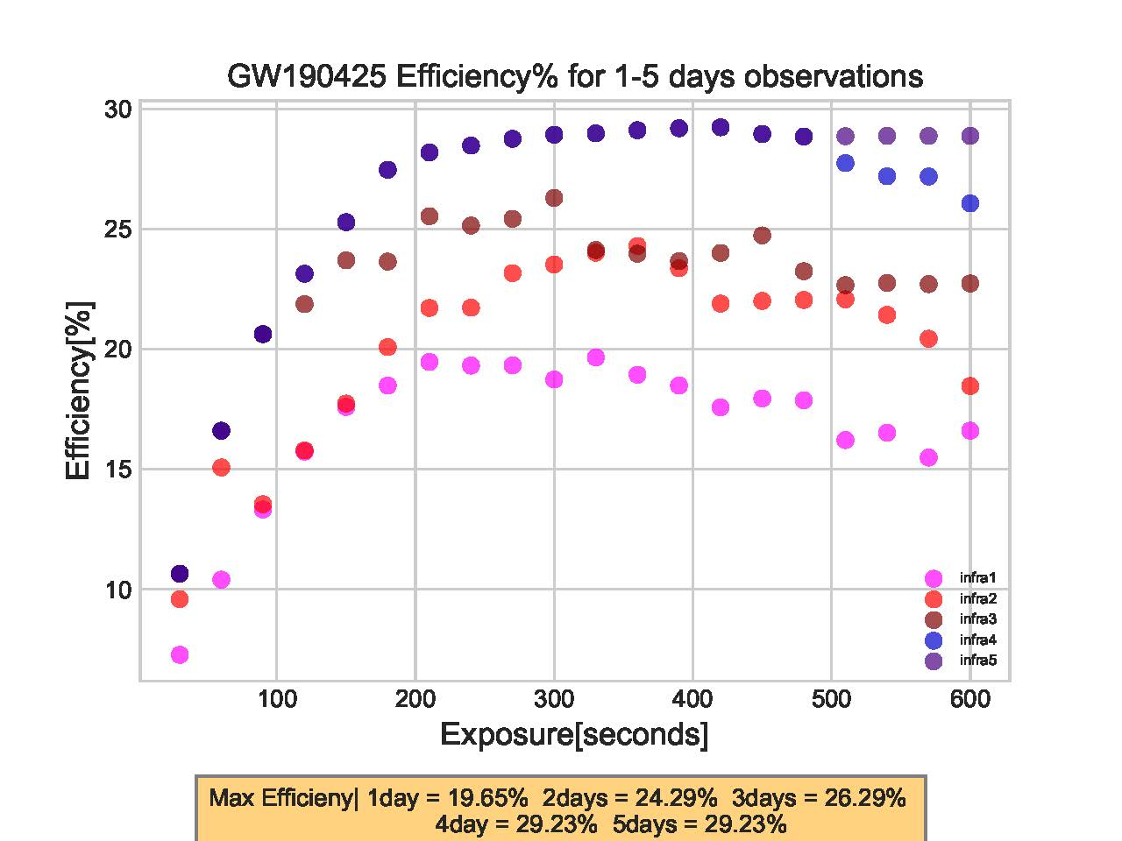
In Optical, maximum efficiencies are obtained with exposures of less than 100s.
In NIR, best exposures are 200 to 400s for each tiling, reaching 25% after 48 h, decreasing for very long exposures.

Slide 9
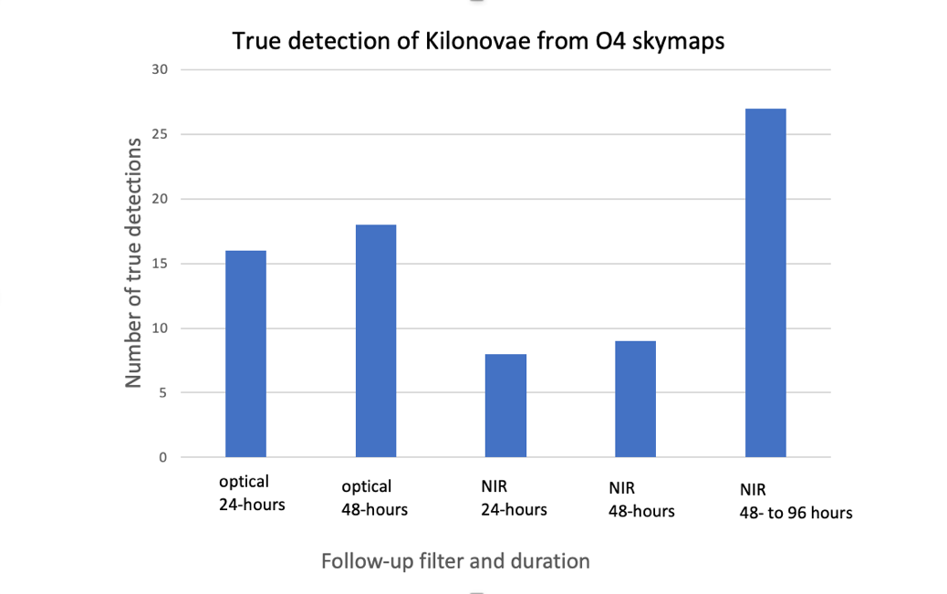
Also, number of detections for O4 skymap follow-ups in Optical and NIR for different time periods (post GW signal):

Slide 10
VRO/LSST Filter Selections
We used LSST packages and metrics to simulate surveys in 6 photometric filters.
Filter | u | g | r | i | z | y
λ (nm) | 305.3 – 408.6 | 386.3 – 567.0 | 536.9 – 706.0 | 675.9 -833.0 | 802.9 – 938.60 | 908.0 – 1100.0
GW170817 kilonova light curves were injected into the simulations.
Kilonova model parameters:
M_{dyn} = 0.005M⊙
M_{wind} = 0.050M⊙
Viewing angle (θ) = 25.8°
Half lanthanide-rich composition opening angle (Φ) = 30°
Mag
Time (days)

Slide 11
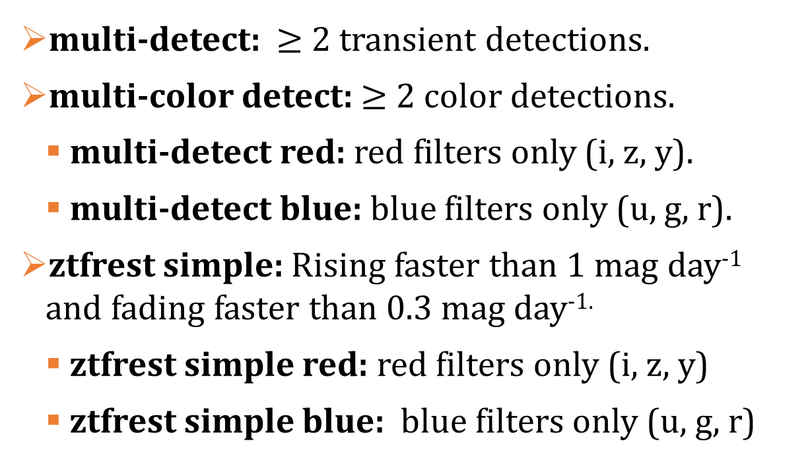
A metric gives the detection criteria for each event injected in our simulations:
multi-detect: $≥$2 transient detections.
multi-color detect: $≥$2 color detections.
  multi-detect red: red filters only (i, z, y).
  multi-detect blue: blue filters only (u, g, r).
ztfrest simple: Rising faster than 1 mag day⁻¹ and fading faster than 0.3 mag day^{-1.}
  ztfrest simple red: red filters only (i, z, y)
  ztfrest simple blue: blue filters only (u, g, r)

Slide 12
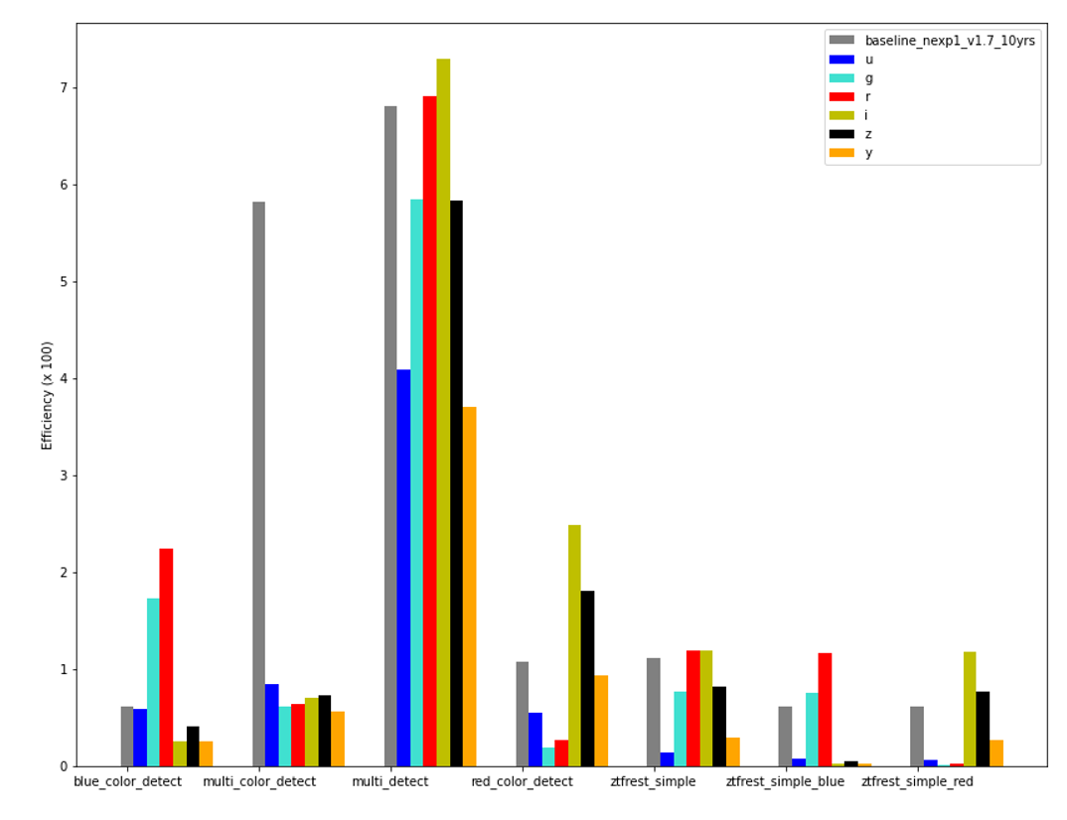
Results: Detections and Recovery Efficiencies
(500,000 events injected into the simulations)
Baseline
u
g
r
i
z
y
7-
6-
5-
4-
3-
2-
1-
0-
Efficiency (x100)
blue_color_detect
multi_color_detect
multi_detect
red_color_detect
ztfrest_simple
ztfrest_
simple_blue
ztfrest_
simple_red

Slide 13
Results: Detections and Recovery Efficiencies
(500,000 events injected into the simulations)
ztfrest_simple rates are much lower than the multi_detect because of the KN discovery criteria.
Efficiency rates show that i- and r-band filters proved to be the best optimal filters for kilonova and transient detection alike.
While kilonovae appear red and fade slower in redder/near-infrared bands, the y- and z-bands performed worse than expected due to VRO’s lower sensitivity in NIR.

Slide 14
Conclusions
Using gwemopt, we have simulated observational scenarios (cadences, exposure lengths, Optical and NIR filters, etc.) for O4 skymaps on ZTF in the aim of optimizing KN detections.
Using LSST survey strategies, we have simulated and investigated filter selections (in particular).
We have published our main results, some of which may be surprising.
Along with the GRANDMA observational campaigns that prepare for the upcoming O4 events, we believe such theoretical/modeling efforts are extremely useful.

