Slide 1
Readiness of Maidanak observatory to the observations of optical transients during the O4 run
Yusuf Tillayev
Ulugh Beg Astronomical Institute (UBAI)
May 14, 2021

Slide 2
Outline
Introduction
UBAI
Maidanak observatory
4m telescope named after Ulugh Beg
Maidanak site characteristics for optical astronomy
New cameras
New telescope and camera
Conclusion

Slide 3
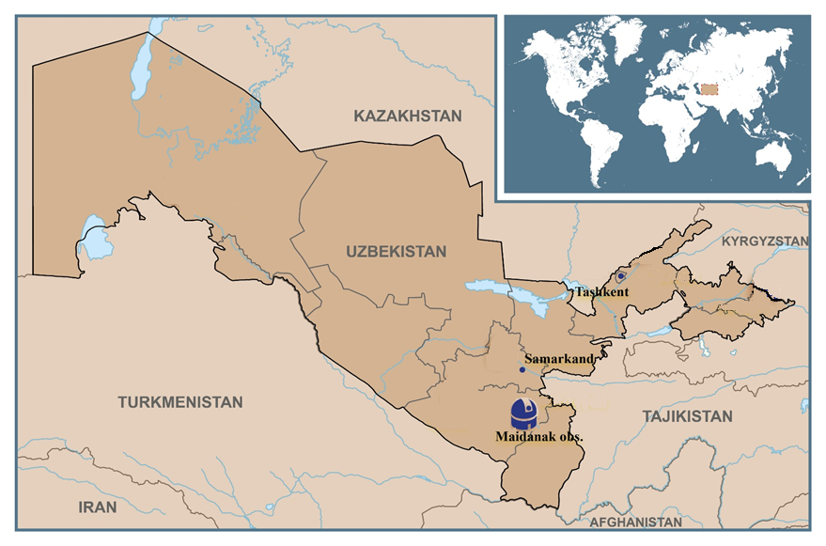
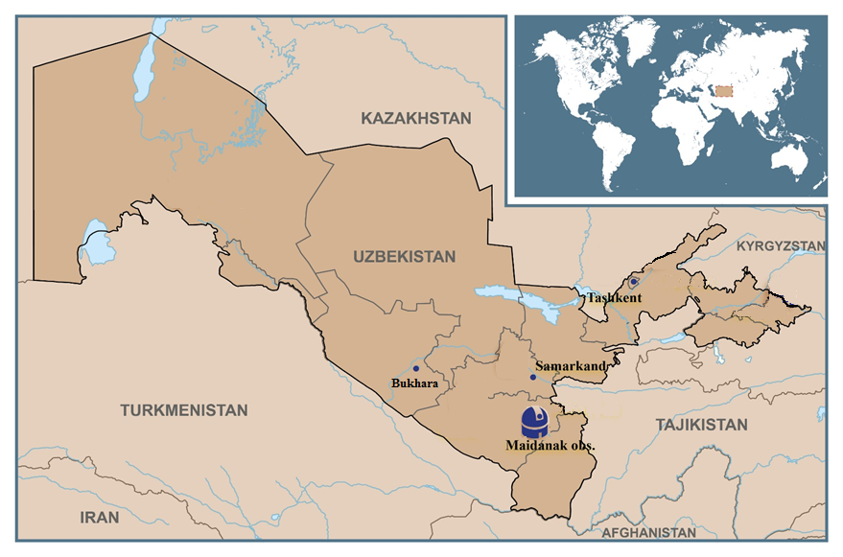
Uzbekistan

Slide 4
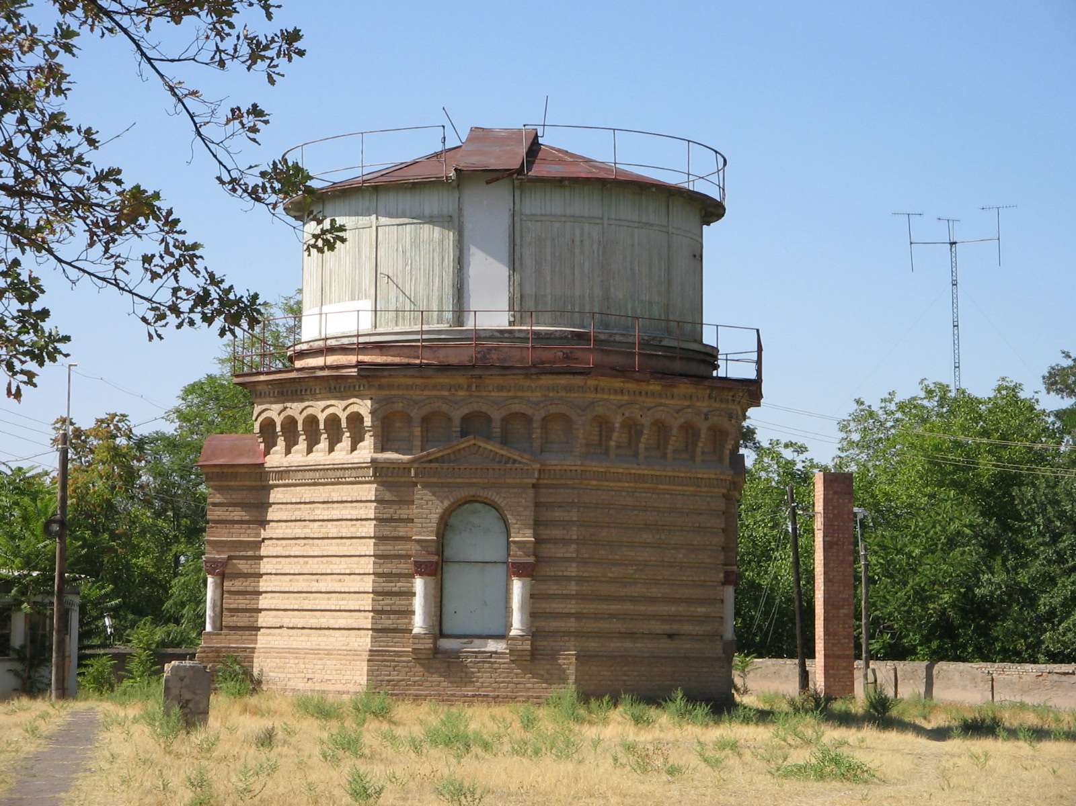
Ulugh Beg Astronomical Institute (UBAI)
UBAI is one of the oldest institutions of Uzbekistan

Slide 5
Ulugh Beg Astronomical Institute (UBAI)
Scientific staff 51 of 140
Main observational facility is Maidanak

Slide 6
Main fields of research
Minor planets
Galactic Astronomy
Physical variable stars, exoplanets and close binary systems
Extragalactic objects (AGN, GLS)
Space geodynamics
Astroclimate (site testing)
Theoretical astrophysics of compact objects, GR and gravitation effects

Slide 7
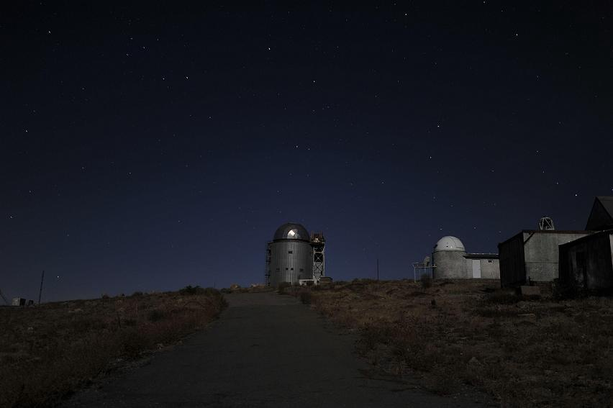
Maidanak Observatory 66°56”E, 38°41”N 2700 m asl

Slide 8
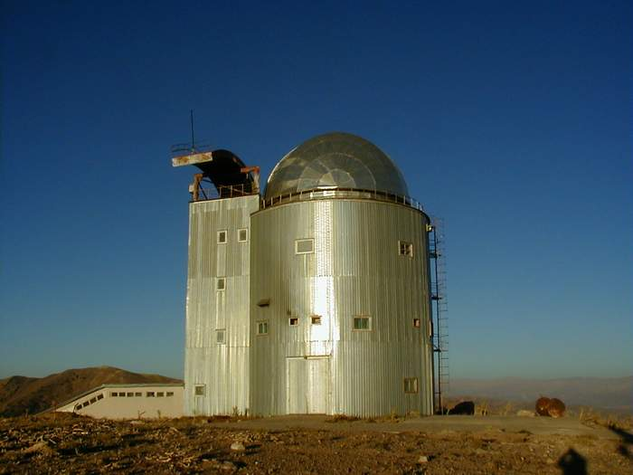

Slide 11
1m ZEISS-1000 telescope

Slide 12
Telescopes of MAO
Focal instrumentation | Programs | Partners
1.5 meter AZT-22 telescope (D = 1500 мм, F = 11500 мм (+long focus is f/11.5))
SI 600 Series 4096x4096 CCD (Seoul National university) FOV 18’ x 18’ | Near by galaxy Gravitational lenses Asteroids Blazars Seyfert galaxies GRB objects | Korea Russia Ukraine Japan Italy
1 meter Zeiss-1000 telescope (D=1.0m, f=13300 mm)
Apogee Alta-U 9000 CCD 3056x3056 | SAGE project - 70% of time UBAI - 30% available | NAOC
Zeiss-600 0.6m telescope “North” (D = 600 мм, F = 7200 мм)
FLI ML0580911 1024×1024 | Asteroids Exoplanets | Japan
Zeiss-600 0.6m telescope “South” (D = 600 мм, F = 7200 мм)
FLI IMG ProLine 1024x1024 CCD | Blazars Variable stars | Italy
Zeiss-600 0.6m telescope “East” (D = 600 мм, F = 7200 мм)
AMT-1 0.5m telescope (D=51 cm, Corrected Ritchey–Chretien f/8)
Apogee Alta-U16M CCD | Exoplanets (Under discuss)

Slide 13
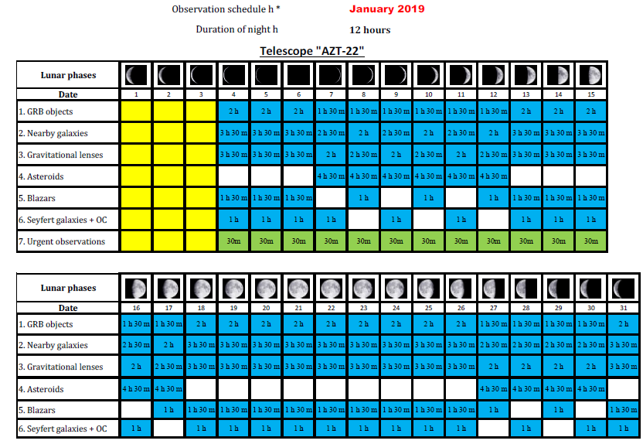

Slide 14
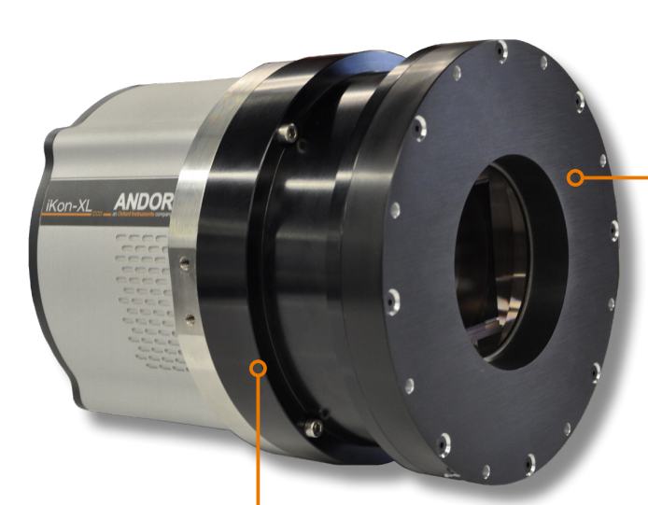
New set of Andor cameras
Three Andor cameras purchased for ~400kEUR
iKon-XL (XL-EA07-DS)
iKon-L (DZ 936N-BEX2-DD)
Apogee Aspen CG 230-1-G09-S58

Slide 15
4 m telescope initiative
New telescope project

Slide 16
Atmospheric conditions at the Maidanak observatory
Site testing (astroclimate)
The parameters of the atmosphere above the observatory relevant to optical astronomy

Slide 17
New studies of astroclimate
The project of 4-meter telescope acted as a new motivation to re-initialize site testing measurements
The next slides show new data about atmospheric conditions of Maidanak observatory

Slide 18
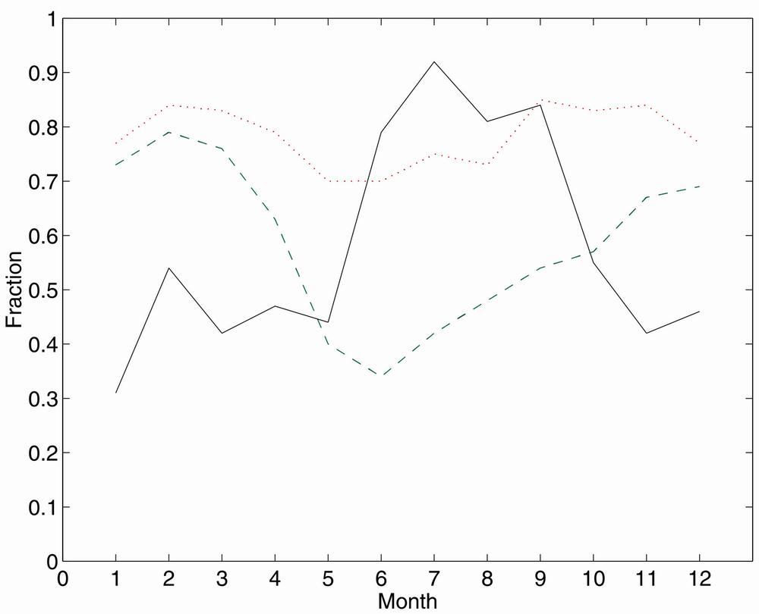
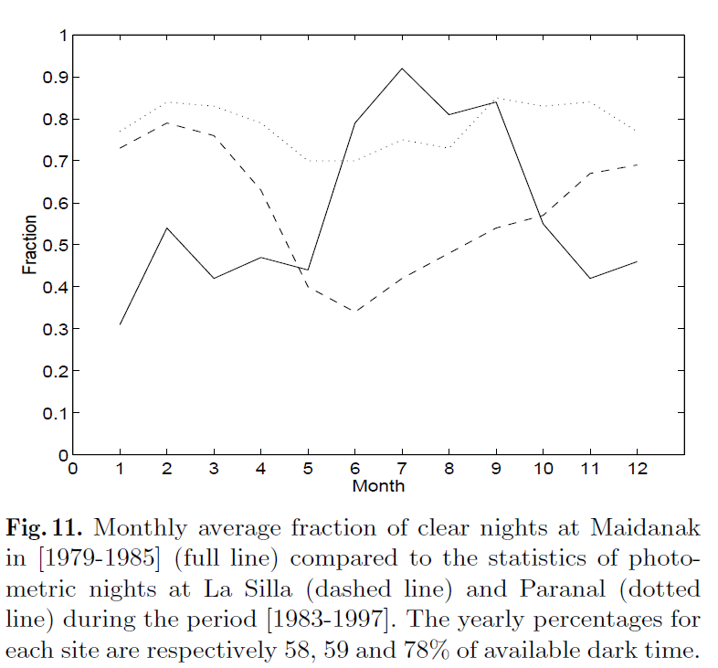
Monthly fraction of clear nights
Ehgamberdiev et al, 2000 Astron.Astrophys.Suppl.Ser., v. 145. p.293.

Slide 19
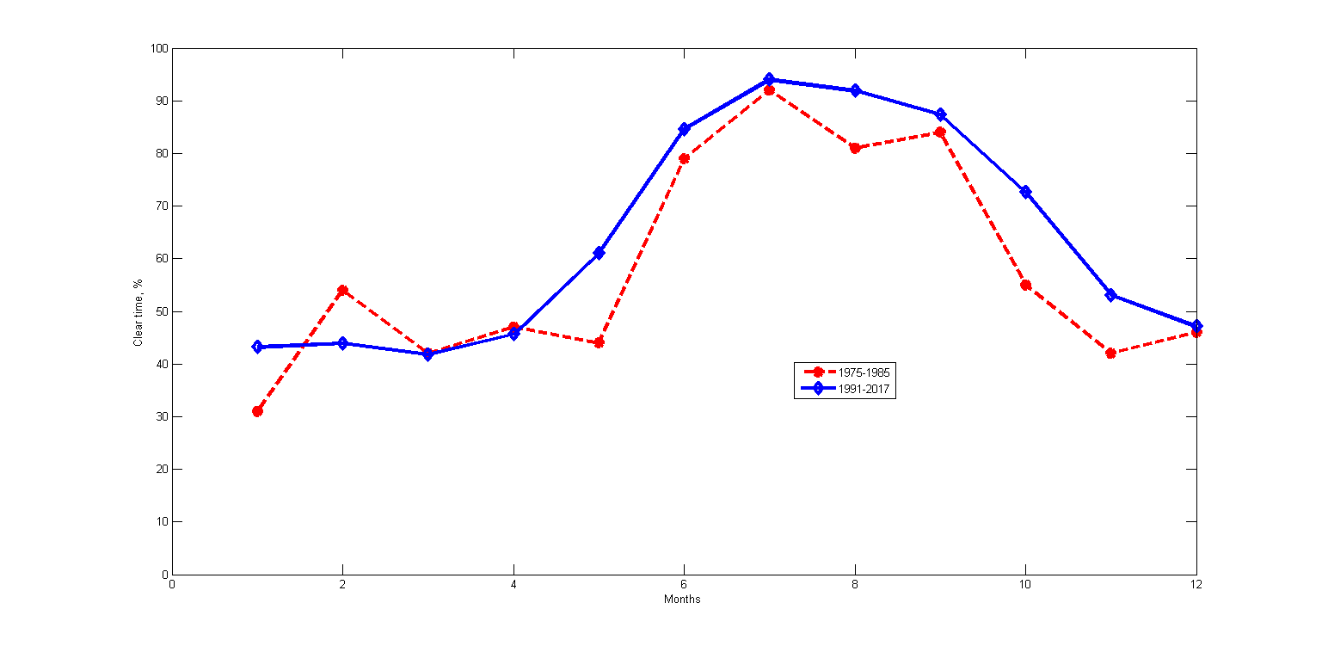
Data of 1991-2017
The Annales Of The Geographical Society Of Uzbekistan, 2020, v57, pages 218-225

Slide 20
Differential image motion monitor (DIMM)

Slide 21
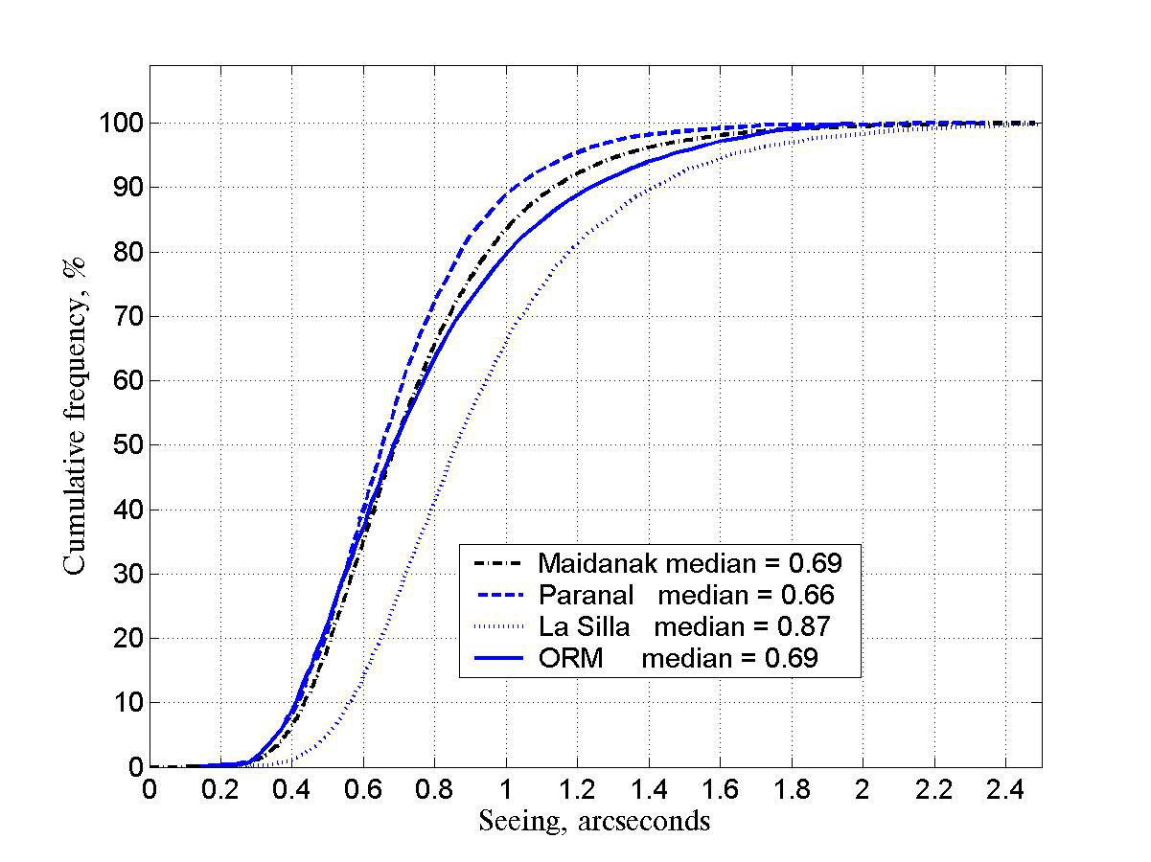
Seeing conditions at Mt. Maidanak
Ehgamberdiev et al, 2000 Astron.Astrophys.Suppl.Ser., v. 145. p.293.

Slide 22
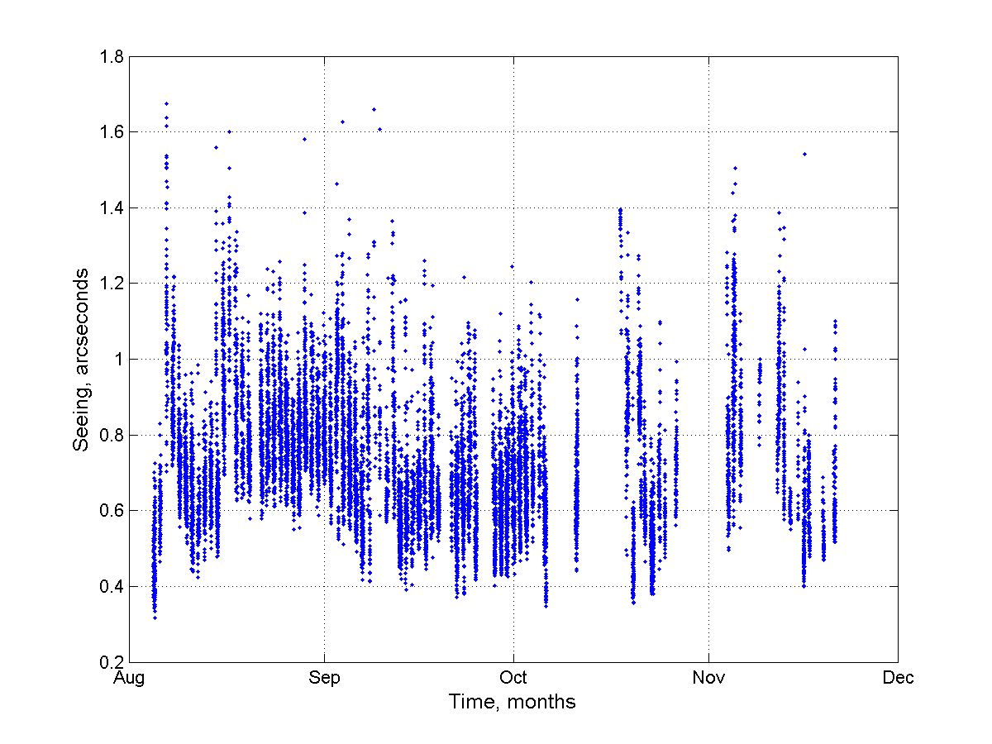
Seeing data of 2018
Tillayev et al, 2021 submitted to MDPI Galaxy

Slide 23
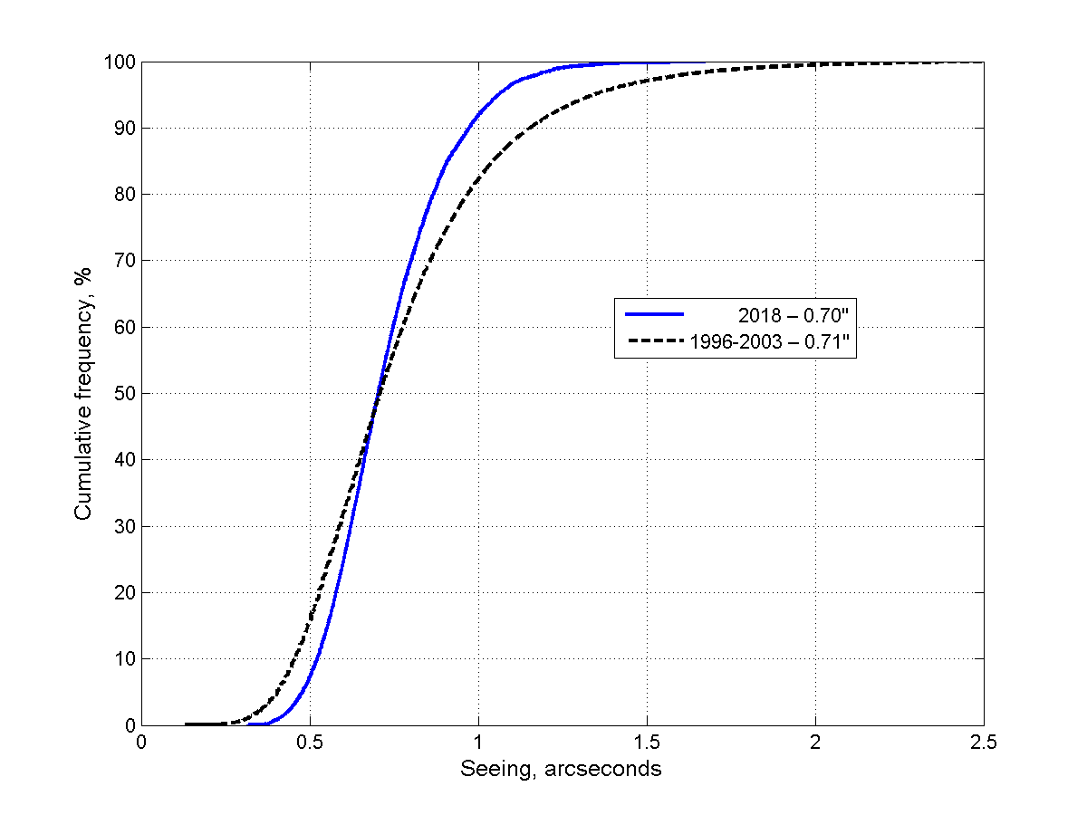
Seeing – data of 2018

Slide 24
Seeing-data of 2018

Slide 25
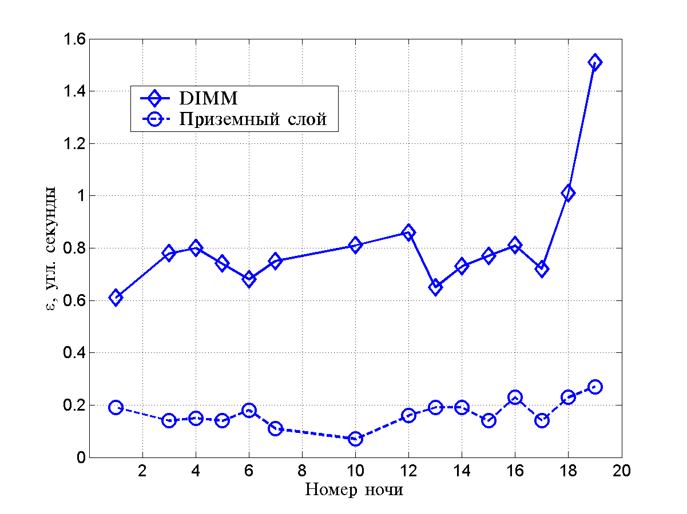
Contribution of the surface layer

Slide 26
UBAI participation in GRANDMA
Since 2019
Yusuf Tillayev
Otabek Burkhonov
Tatyana Sadibekova
Yodgor Rajabov (pre-PhD student)

Slide 27
Uzbekistan team telescopes
Responsible person for observations Yodgor Rajabov
For observations we are going to use:
0.6 meter “North” telescope – NT-60
0.6 meter “South” telescope – ST-60
Probably we will be able to use the 1.5 meter telescope (under discussion) if:
It is possible to interrupt the telescope program
The object is fainter
All of the telescopes have CCD and UBVRI filters.

Slide 28
UBAI ST-60 and NT-60 photometry
Photometry contact person – Otabek Burkhonov
Photometry routine ○ Real-time astrometry on the telescope MaxIm DL (UCAC 4 catalogue) ○ custom aperture photometry via MaxIm DL ○ full field source checking by SExtrator software ○ Final photometry using custom STDPipe-based pipeline, run manually ○ Alternative independent processing based on IRAF by using our own scripts

Slide 29
New telescope
GRB and GW optical counterparts
Target of opportunity objects (ToO) become more and more important
Since the 4-m telescope is a long term project, a small but powerful telescope required.

Slide 30
80-cm telescope
In collaboration with GRANDMA
With financial support of the ministry of Innovative development

Slide 31
Budget

Slide 32
EQ800PF f2,26

Slide 34
Conclusion
A project of the 4 m telescope has been initiated
New measurements of the atmospheric parameters have been carried out
New studies confirm high quality conditions for optical astronomy
Installation of 80 cm telescope is in progress for GW, GRB counterparts observations

Slide 35
Thanks for your attention!

Slide 36
Network of educational observatories

