Slide 1
WP3 ESCAPE Data Science School 2022 & OSSR
T. Vuillaume, 24-01-2022

Slide 2
Hybride mode
Format and program similar to last year:
accross two weeks
general data science lectures + specific tools to the community
add lectures specific to ESCAPE services (data lake, OSSR, ESAP, VO… )?
@LAPP: limited to 60 participants + 20 tutors / LOC
Online registrations: limited?

Slide 3
First steps
Pick a date !
Aiming for this summer (rather June-July)
limitation for ESCAPE?
Other conferences / meetings ?
https://conference-service.com/conferences/gravitation-and-cosmology.html
Jean XXIII
https://calendar.google.com/calendar/u/0?cid=aDZoanJjNjJmdDBsNG1mdG12Ym02OWk2YmtAZ3JvdXAuY2FsZW5kYXIuZ29vZ2xlLmNvbQ
ESCAPE General assembly (July?)
Feedback before next week please

Slide 4
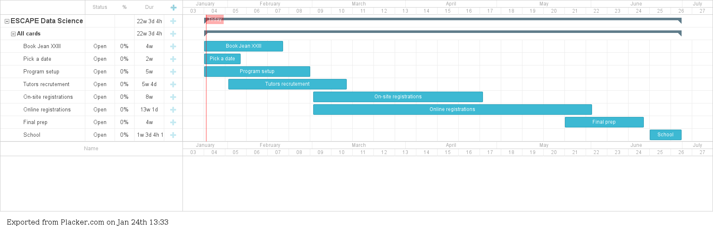
Rough agenda

Slide 5
LOC
Julie Chaudan
(Mathilde Hubert) → Maud
Enrique Garcia
Frederic Gillardo
Nicolas Hantz
Corinne Feullar
Marie Paturel
Thomas Vuillaume
... ?
If you wish to participate to the LOC, please let me know !

Slide 6
SOC
Kay Graf (TBC)
Thomas Vuillaume
... ?
If you wish to participate to the SOC, please let me know !

Slide 7
OSSR & EOSC
Technical coordination needed to onboard ESCAPE services in the EOSC
Not limited to OSSR
Coordinated task
We need someone to takeover in Ian’s absence
Or wait ☺

