Slide 1
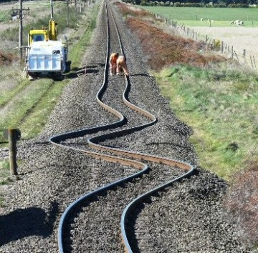
Two physicist @ SNCF
From quantum field theory
to maintenance supply chain
Héloïse Nonne

Slide 2
SNCF: 5 millions voyages / day in France

Slide 3
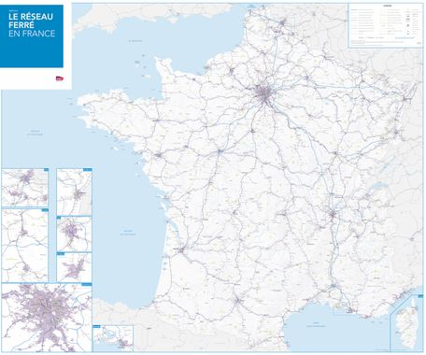
SNCF: 5 millions voyages / day in France
Operations
15 000 trains / day
100 000 000 train tickets sold / year (oui.sncf)

Slide 4
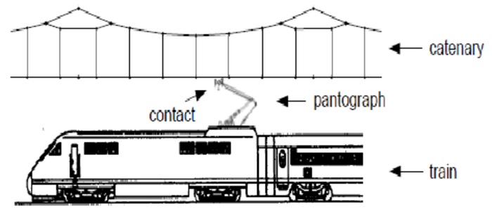
SNCF: 5 millions voyages / day in France
Operations
Energy
15 000 trains / day
100 000 000 train tickets sold / year (oui.sncf)
14 TWh / year
(8 TWh for traction)

Slide 5
SNCF: 5 millions voyages / day in France
Operations
Energy
Infrastructure
15 000 trains / day
100 000 000 train tickets sold / year (oui.sncf)
14 TWh / year
(8 TWh for traction)
30 000 km railways
(2 700 km high speed)
3 000 train stations

Slide 6
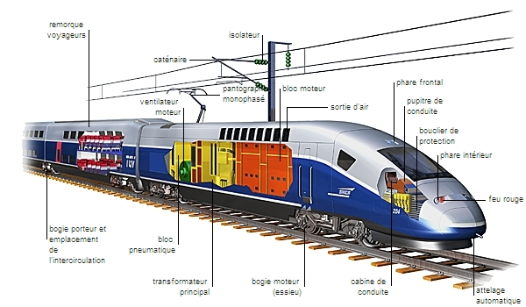
SNCF: 5 millions voyages / day in France
Operations
Energy
Infrastructure
Rolling stock
15 000 trains / day
100 000 000 train tickets sold / year (oui.sncf)
14 TWh / year
(8 TWh for traction)
30 000 km railways
(2 700 km high speed)
3 000 train stations
3 500 locomotives / trains

Slide 7
Examples of data projects

Slide 8
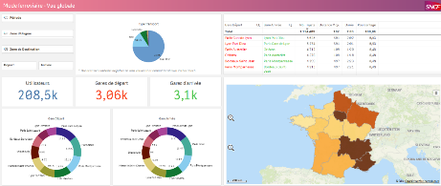
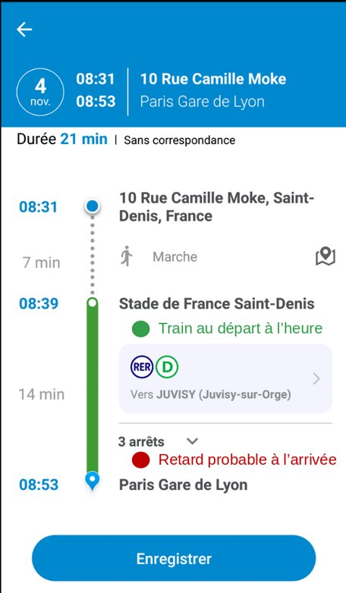
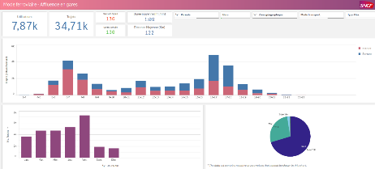
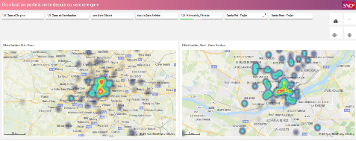
Mobility Knowledge
SNCF mobile app: 600 000 users

Slide 9
Delay predictions
Predict delays higher than 2 min 30 s
in the next 7 days
at each train stop
900 000 predictions everyday

Slide 10
Delay predictions
Filling = what really happened
Frame = predictions
1
Pré modification RER D
Predict delays higher than 2 min 30 s
in the next 7 days
at each train stop
900 000 predictions everyday
2
Post modification RER D

Slide 11
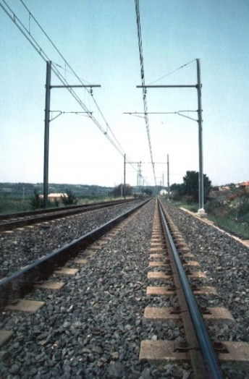
Predict energy consumption
SNCF energy subsidiary:
Predict on a yearly procurement volume of about 500 millions euros
Short, medium, long term consumption

Slide 12
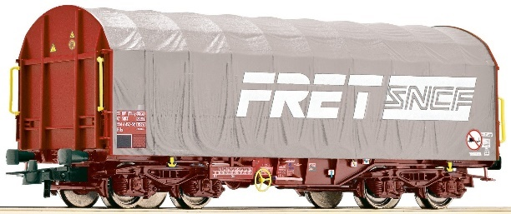
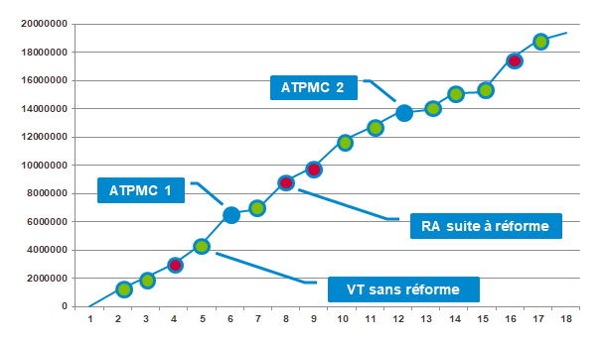
Predict freight wagons breakdowns
Predict a risk of breakdown in the next 4 months on 12 000 wagons
A wagon’s life

Slide 13
supply chain

Slide 14
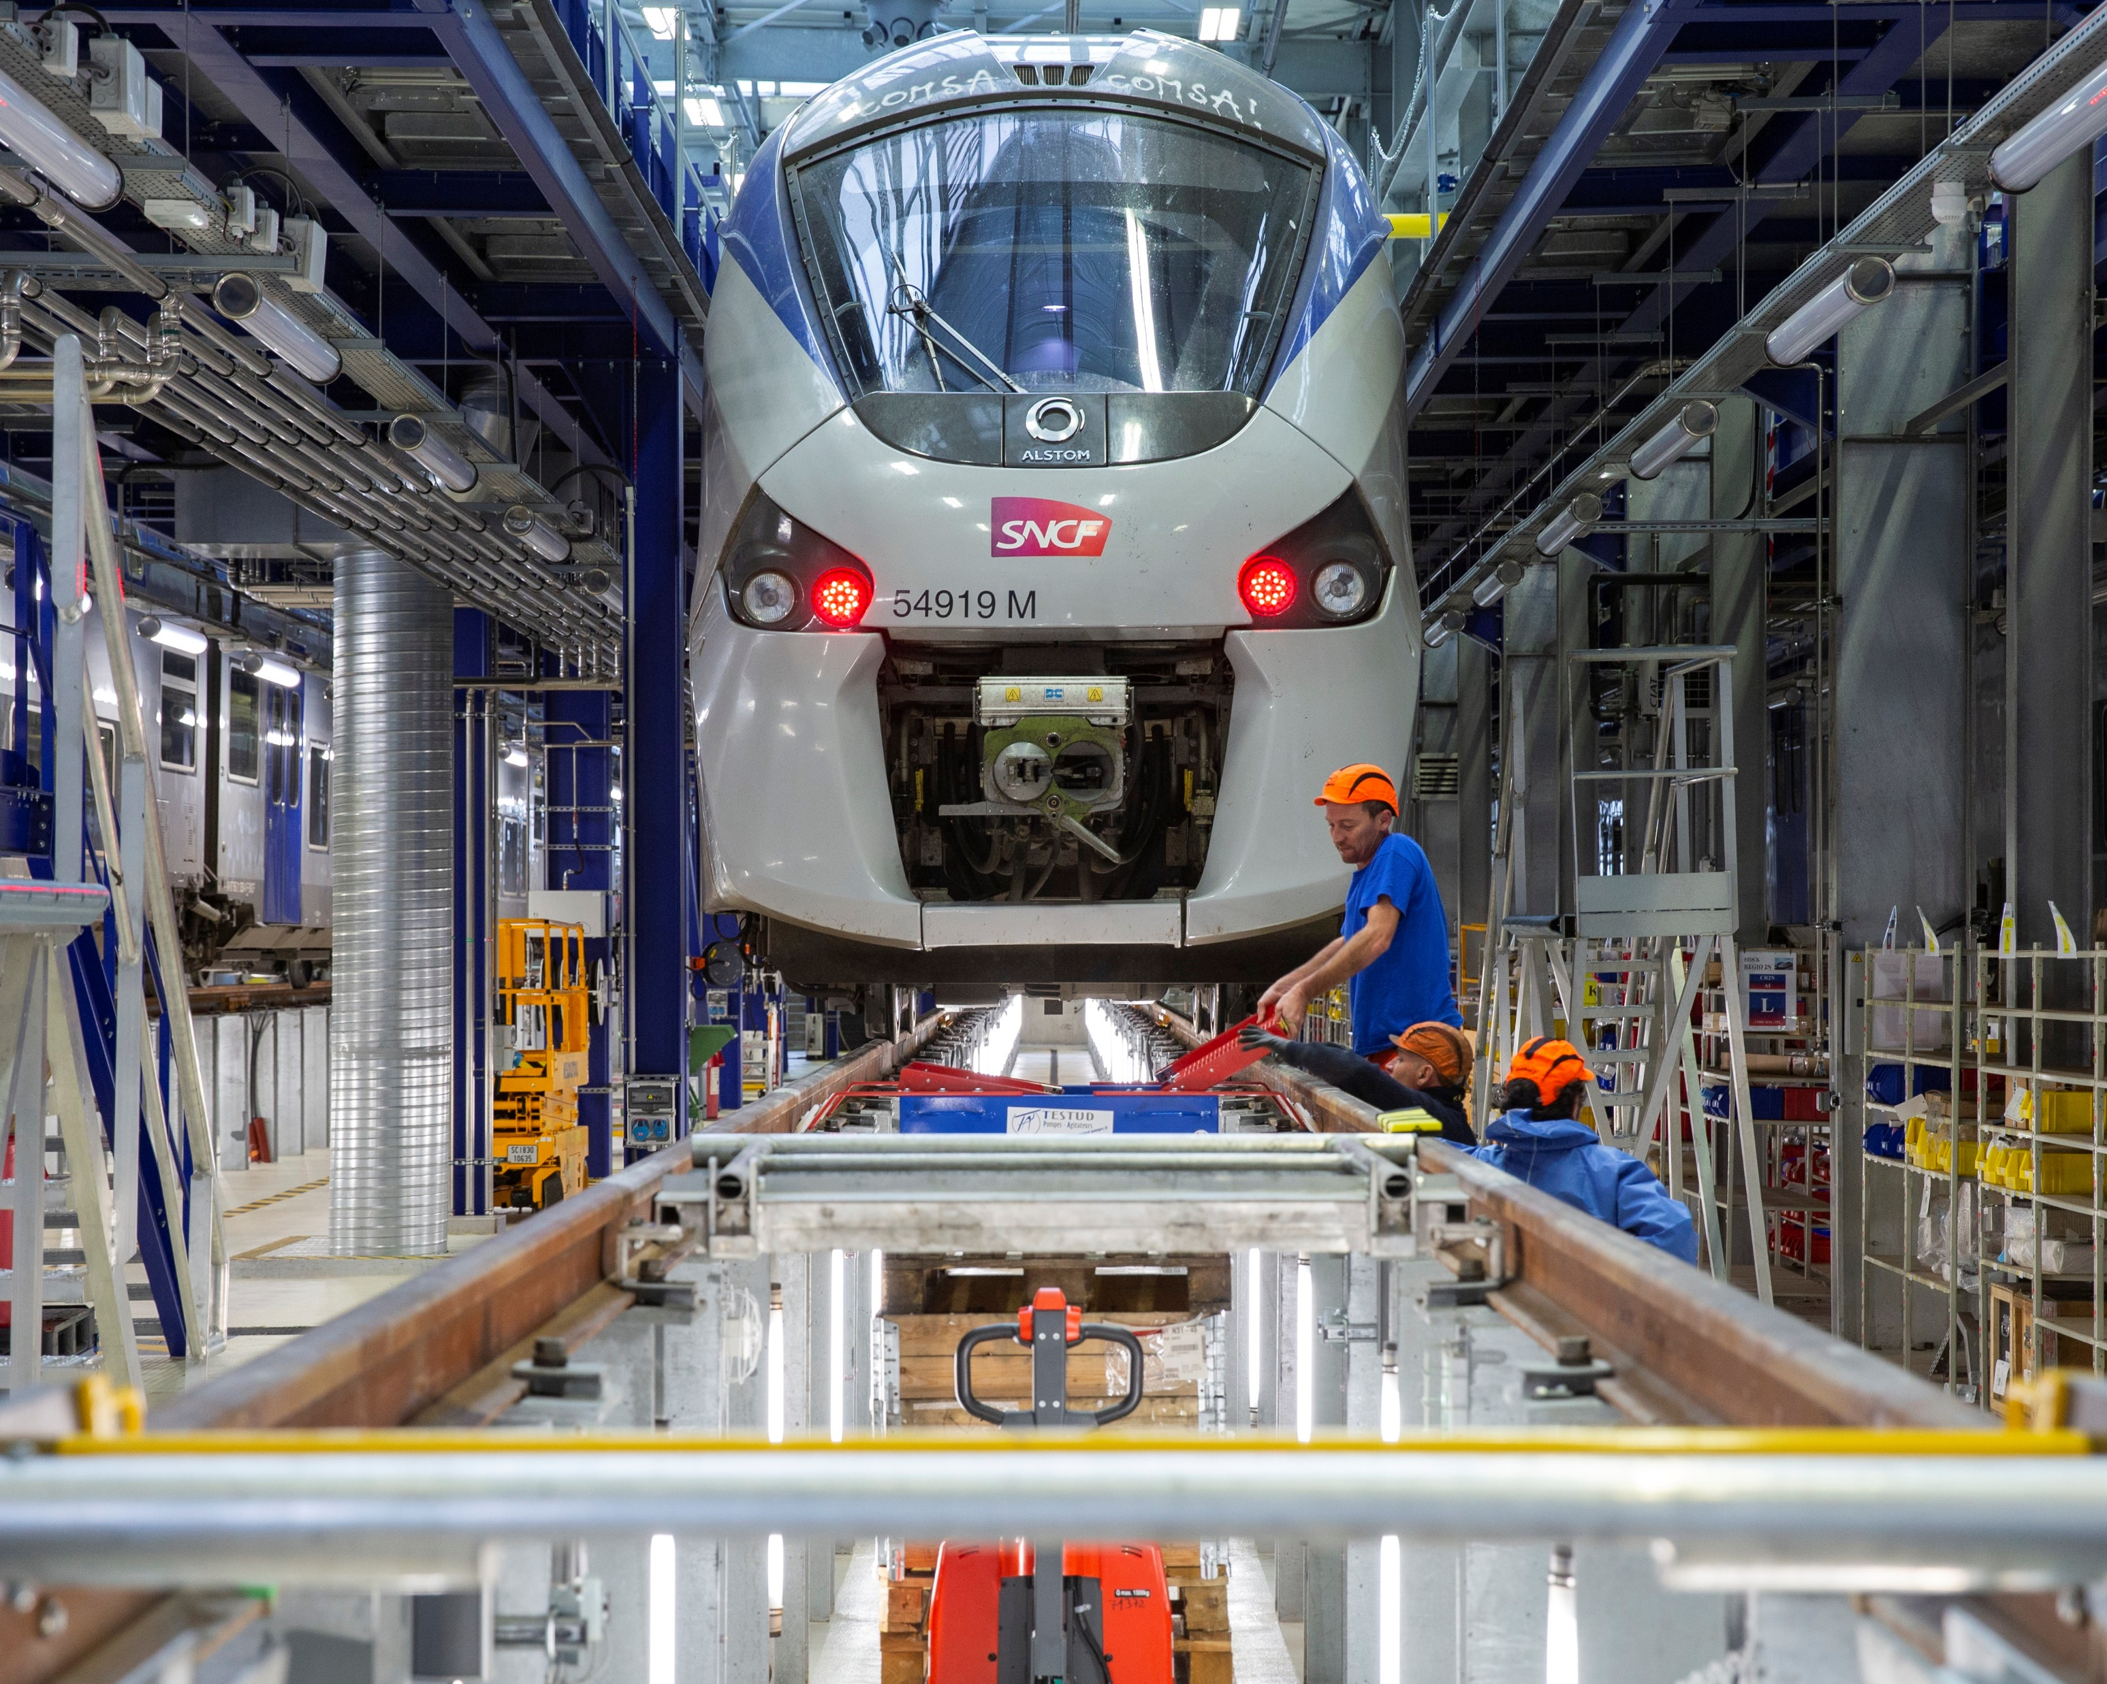
Maintenance

Slide 15
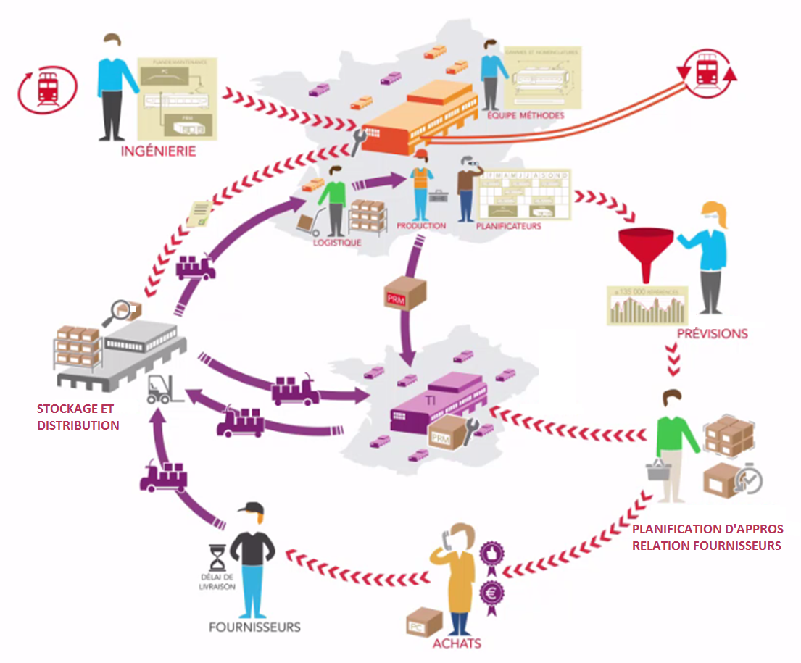
Supply chain stocks
Stocks > Needs
100s of millions €
150 000 references
60 000 workshop deliveries at « day + 1 » every month

Slide 16
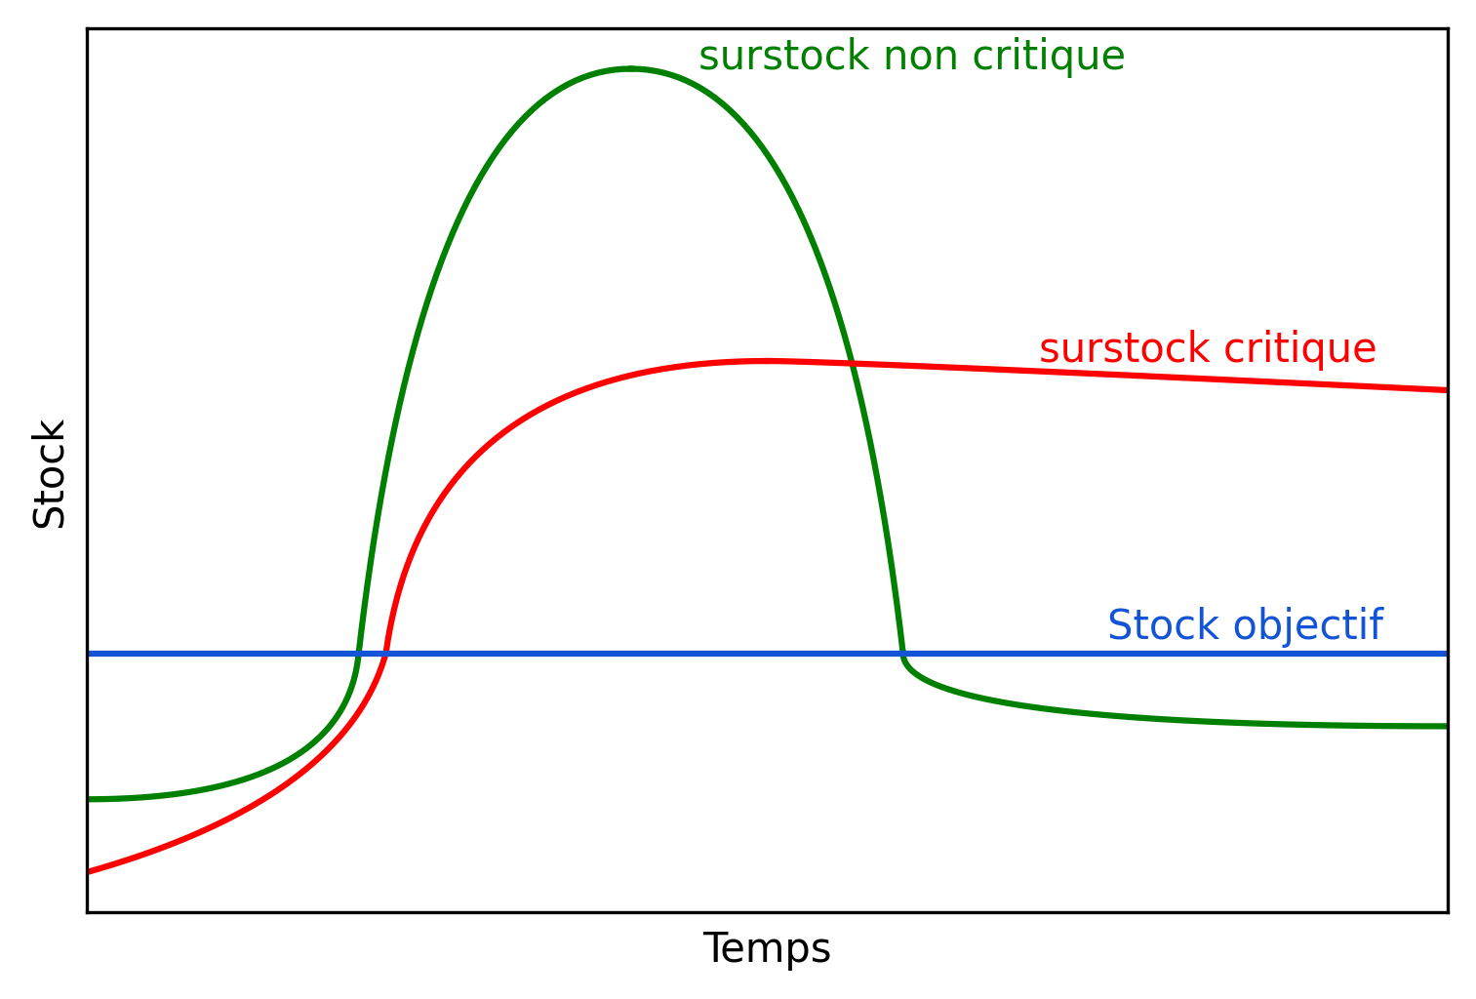
Define overstock
Target overstock:
overstock / consumption rate

Slide 17
Inputs
Many possible inductors
References: - item references - Entities - Nomenclatures - Rolling stock series
History of procurement: - Stock history - Procurement orders - Workshop orders - Demand - Shortage / client alerts
Maintenance
- Replacement rate

Slide 18
MACHINE LEARNING
Predict overstock risks
Define performance criteria
Explain predictions
Prediction algorithm
Stick to the current decision process :
3 levels
Tune algorithme sensitivity
Too sensitive: too many alerts
Not enough: overlook problems
Explain the reasons for a prediction
For decision making:
Allow critical look
Give hints for investigations
Low risk
Moderate
Critical

Slide 19
Dependence analysis
Item families
Replacement rate

Slide 20
Machine learning algorithm
Labelled procurement orders
Training set
CDA 1
Caract 1 | x
Caract 2 | x
Caract 3 | x
… | …
Cible
CDA 2
Caract 1 | x
Caract 2 | x
Caract 3 | x
… | …
Cible
CDA 3
Caract 1 | x
Caract 2 | x
Caract 3 | x
… | …
Cible
Supervised algorithm
CDA 4
Caract 1 | x
Caract 2 | x
Caract 3 | x
… | …
Cible
CDA 5
Caract 1 | x
Caract 2 | x
Caract 3 | x
… | …
Cible
…
Trained algorithm
Test set
CDA 80 001
Caract 1 | x
Caract 2 | x
Caract 3 | x
… | …
Cible
CDA 80 002
Caract 1 | x
Caract 2 | x
Caract 3 | x
… | …
Cible
Performance metrics
CDA 80 003
Caract 1 | x
Caract 2 | x
Caract 3 | x
… | …
Cible
…

Slide 21
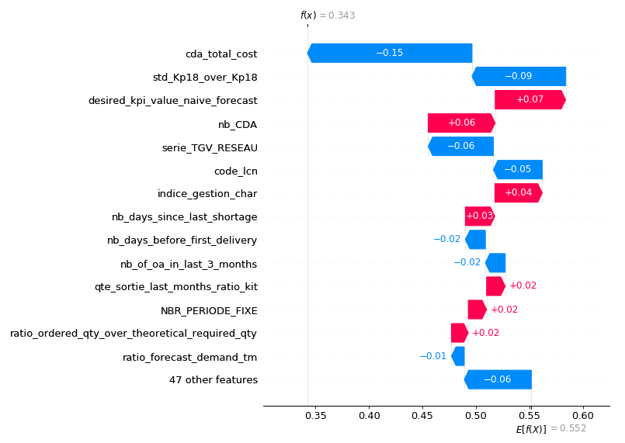
Final application
PAST
Order history
Data preparation
Learning
Trained algorithm
Data
Data preparation
Prediction and explanation
0.2
0.7
New orders
0.1
FUTURE

Slide 22
Explain predictions
Quantify relative influence of each characteristics on the risk level prediction
Blue: lower the risk
Red: increase the risk

Slide 23
Performance

Slide 24
Why physicists?

Slide 25
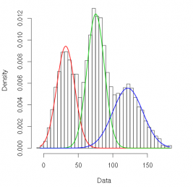
Be Good at math

Slide 26
scientific Modelling
Nb of defects / km
Traffic

Slide 27
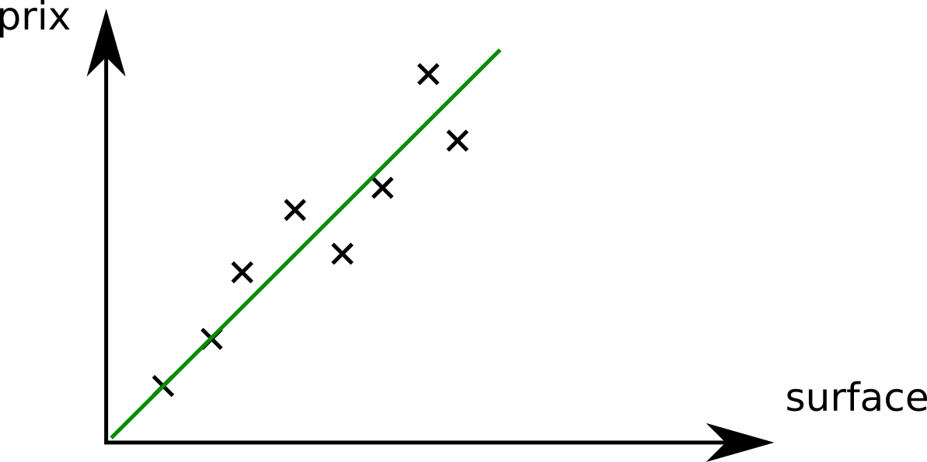
scientific Modelling
Nb of defects / km
Traffic
$$y=a_{0}+a_{1}x$$

Slide 28
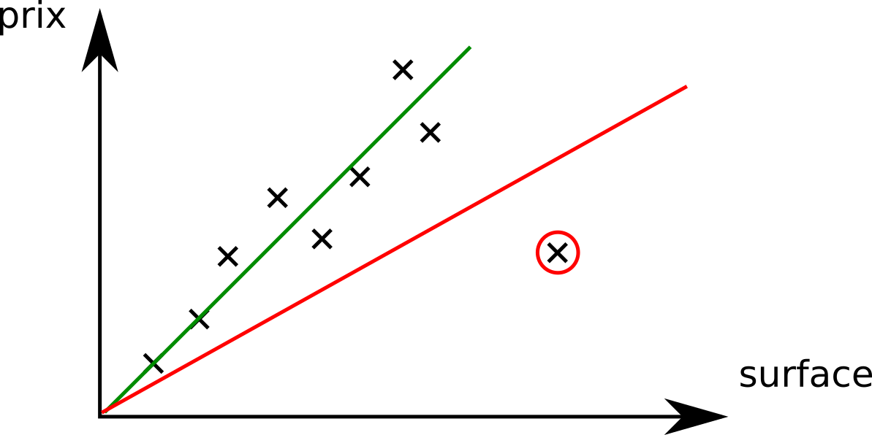
Being analytic and taking a critical look
Nb of defects / km
Traffic
$$y=a_{0}+a_{1}x$$

Slide 29
Think of everything
Nb of defects / km
Traffic
$$y=a_{0}+a_{1}x$$

Slide 30
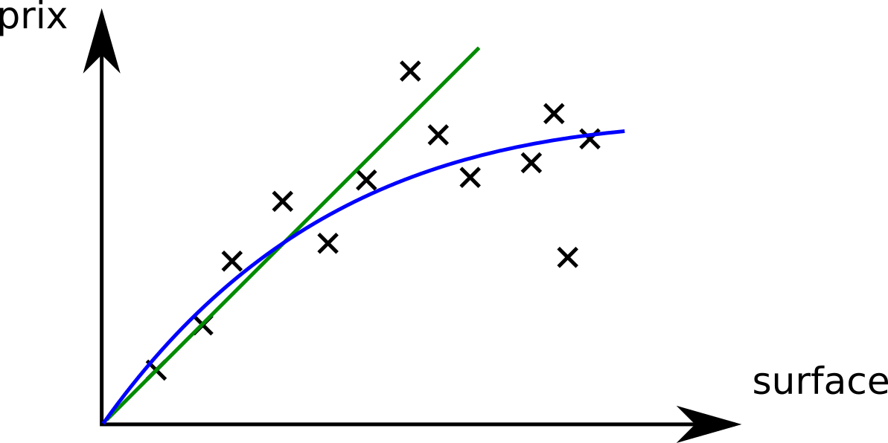
Think of everything
Nb of defects / km
Traffic
$$y=a_{0}+a_{1}x+a_{2}x^{2}+ …$$

Slide 31
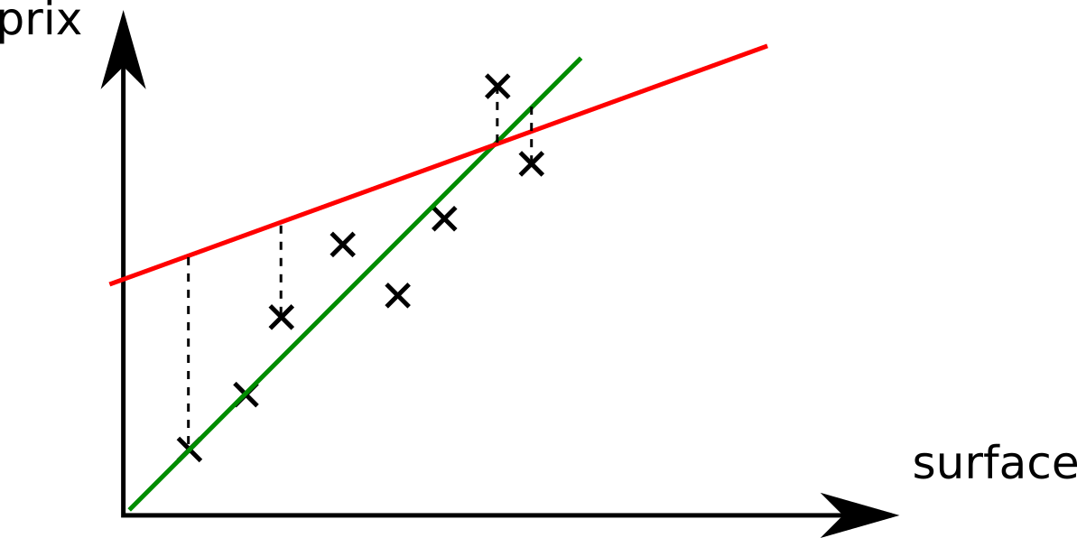
Optimizing
Nb of defects / km
$$E=\sum_{i}{δ_{i}}$$
Traffic
Minimize error

Slide 32
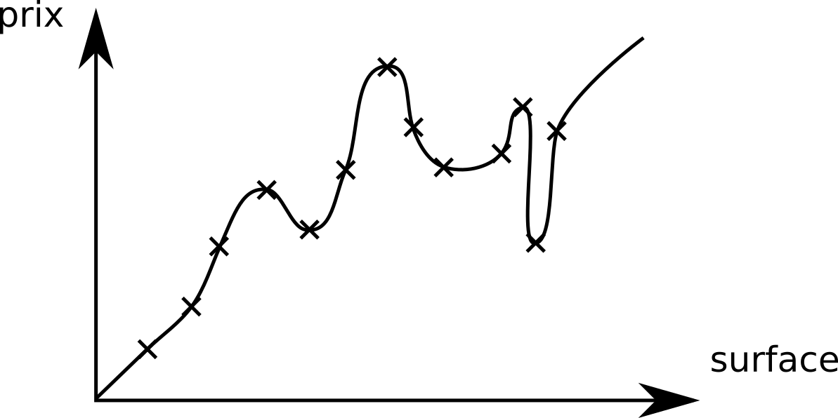
Not to much
Nb of defects / km
Traffic
$$y=a_{0}+a_{1}x+a_{2}x^{2}+ …$$

Slide 33
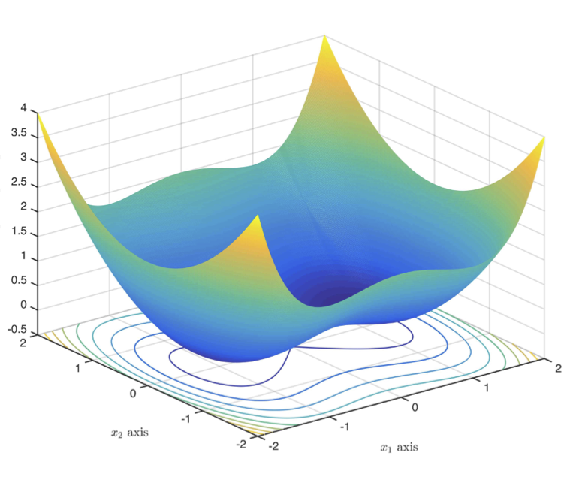
… lots of optimization
$$E\left(a_{0},a_{1}\right)=\sum_{i}{δ_{i}}$$
$$a_{0}$$
$$a_{1}$$

Slide 34
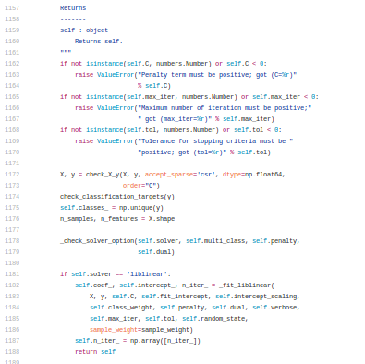
… and code

Slide 35
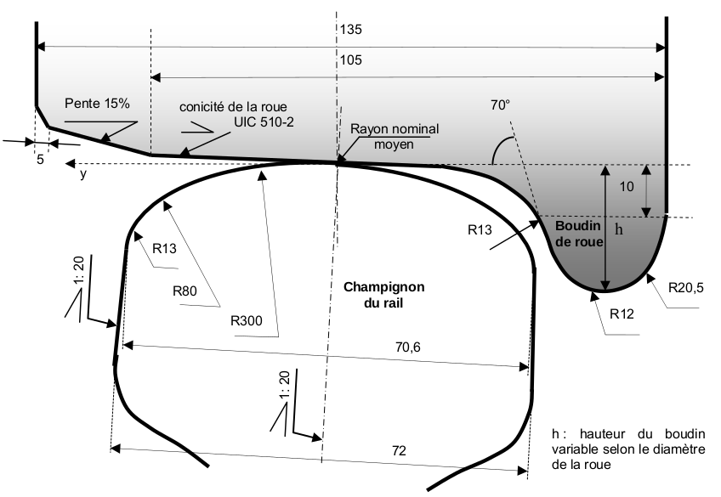
Know how to learn and understand
Pressure at a surface point

Slide 36
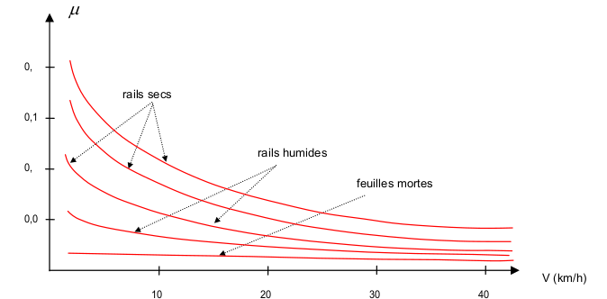
Develop intuitions
ADHESION (GRIP) COEFFICIENT AS A FUNCTION OF RAIL STATE AND TRAIN SPEED

Slide 37
Know what is important and what to neglect

Slide 38
Be good at explaining and convincing

Slide 39
Thank you

