Slide 1
WP3 – OSSR
OSSR and EOSC
T. Vuillaume, 10-01-2022

Slide 2
EOSC onboarding process
https://zenodo.org/record/5746503#.YdgTRxPMLDQ
the process that an EOSC Provider must follow to register the Provider and its Resources in the EOSC Portal Reg
EOSC portal profiles
https://zenodo.org/record/5726890#.YdgTRxPMLDQ
specifications that define common data models for EOSC entities (Providers, Resources, etc.) and related Code Lists, Taxonomies and Classifications

Slide 3
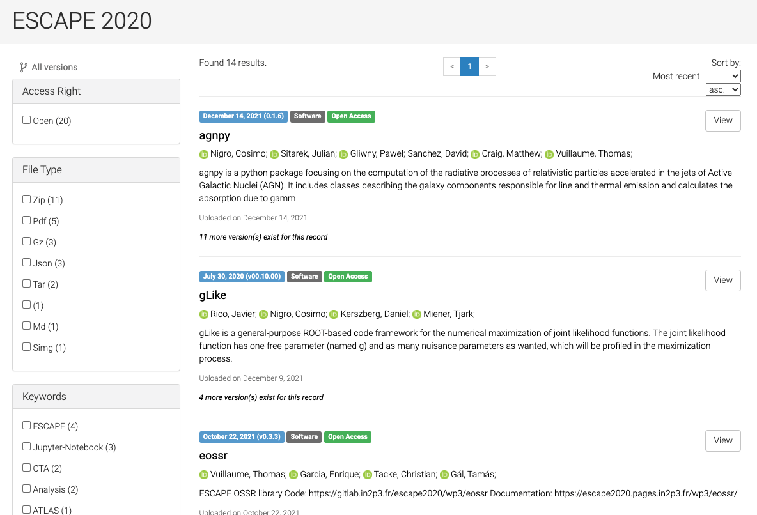
EOSC onboarding process
Single providers or multi-providers (aggregators) = MPRTP
OSSR = MPRTP
ESCAPE
OSSR
EOSC

Slide 4
The 5 Phases (19 stages) of the MPRTP EPOP v4.00 are:
Phase 1: An Authorised Representative of MPRTP registers into the EOSC Portal.
Phase 2: The Authorised and Authenticated Representative of an MPRTP (AARM) onboards the Providers registered at the MPRTP.
Phase 3: The AARM onboards the Resources registered at the MPRTP.
Phase 4: The AARM onboards the Options/Offerings of Resources offered by the providers registered at the MPRTP.
Phase 5: The AARM and the EPOT maintain the quality of the Profiles.

Slide 5
EOSC onboarding process – the 19 stages of the MPRTP EPOP v4
Stage 1: The Representative of the MPRTP (RM) visits the EOSC Portal.
Stage 2: The RM registers with the EOSC Portal using an existing identity from a supported Social or Academic AAI mechanism.
Stage 3: The Authenticated Representative of the MPRTP (ARM) logs into the EOSC portal.
Stage 4: The ARM asserts he/she is an Authorized Representative of an MPRTP.
Stage 5: The Authenticated and Authorized Representative of an MPRTP (AARM) apply to onboard the MPRTP.
Stage 6: The EOSC Portal Onboarding Team (EPOT) reviews the newly onboarded MPRTP.
Stage 7: The AARM gets access to the Portal Dashboard.
Stage 8: The AARM logs into the API Token Portal.
Stage 9: The AARM selects to Get the Value of the Access Token.
Stage 10: The AARM selects to Create a Refresh Token.
Stage 11: The AARM selects to Manage all Access/Refresh Tokens.
Stage 12: The AARM onboards the MPRTP Providers into the EOSC Portal using the token acquired.
Stage 13: The AARM onboards the Resources of the MPRTP Providers on the EOSC. Portal with the token acquired.
Stage 14: The EPOT reviews the onboarded MPRTP Providers and Resources.
Stage 15: The AARM or the MPRTP Provider Managers may onboard. Options/Offerings of the Resources of the MPRTP Providers.
Stage 16: The EOSC Portal Onboarding or Ordering Team reviews the Resource. Options/Offerings of the MPRTP Providers’ Resources.
Stage 17: The EPOT creates a Review and Feedback Report.
Stage 18: Upon Request of MPRTPs the EPOT can provide best practices, feedback, and consultation to MPRTPs.
Stage 19: Profiles on the EOSC Portal are updated by MPRTPs and periodically audited by the EPOT.

Slide 6
p.24
The onboarding of an MPRTP should have as a prerequisite to sign an agreement with the EOSC Portal to abide by the EOSC Rules of Participation, EOSC Portal Onboarding Process and\or any other assumptions to allow for representing and managing the resources of its providers in the EOSC portal. This is handed over to EOSC Future.
Τhe Onboarding Process v4.00 for the MPRTP is very similar to the Onboarding Process of the Single Provider and includes 5 Phases and 19 distinct Stages.
EPOT = EOSC Portal Onboarding Team
https://aai.eosc-portal.eu/providers-api/
>> log in and get (temporary) TOKEN to onboard resources through the API
https://providers.eosc-portal.eu/openapi
https://sandbox.providers.eosc-portal.eu/openapi

Slide 7
Steps
Done on EOSC sandbox (test purposes)
✅
Register ESCAPE as a provider
Who?
Information to provide:
Contacts
Admins
Metadata crosswalk between Zenodo and EOSC
Connect through the EOSC API
Develop functions in eOSSR library to automatise the job
Register existing resources in OSSR
Use CI to keep resources updated in EOSC

Slide 8
Mandatory resources metadata currently missing in the OSSR metadata
Provider: name, email
Public contact: email
Helpdesk email
Security Contact email
Technology Readiness Level
Terms of Use (license?)
Privacy Policy

Slide 9
Questions
Is the ressources content uploaded to EOSC?
How to allow metadata update by the providers?
Metadata crosswalk with CodeMeta?

Slide 10
Technical discussion in WP3 this Wednesday:
https://indico.in2p3.fr/event/25927/

