Slide 1


DETECTION IN HIGH POWER LASER ENVIRONMENT
Emmanuel Atukpor
Excitations Nucléaires par Laser: ENL

Slide 2
CONTENT SUMMARY
Context: High power Lasers for ion acceleration
  Solid targets to Gas Jet targets
Main work:
  Online proton detection
    From Imaging Plates to CMOS detector
  Gamma Spectroscopy in Laser environment
    Scintillators
    Semiconductors
Conclusions and Perspectives

Slide 3
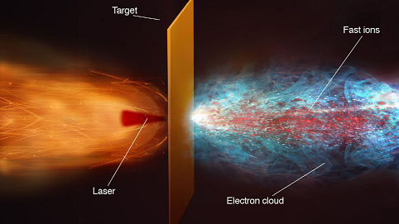
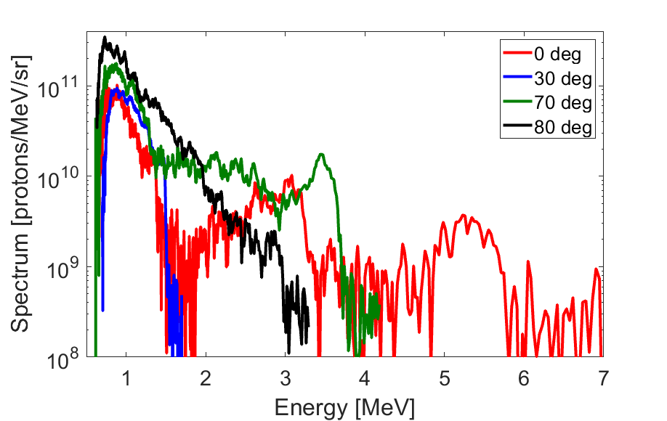
LASER ION ACCELERATION
1 shot per 1 hour
~1Hz
SOLID TARGET: TNSA
New kind of target for high repetition rate
GAS TARGET: CSA
H⁺
ROTH, Met al. Ion Acceleration—Target Normal Sheath Acceleration. CERN Yellow Reports, [S.l.], v. 1, p. 231, feb. 2016.
Puyuelo-Valdes, Proc. SPIE 11037, Laser Acceleration of Electrons, Protons, and Ions V, 110370B (2019)
Puyuelo-Valdes et al., Phys Plasma, 26, 123109 (2019)

Slide 4
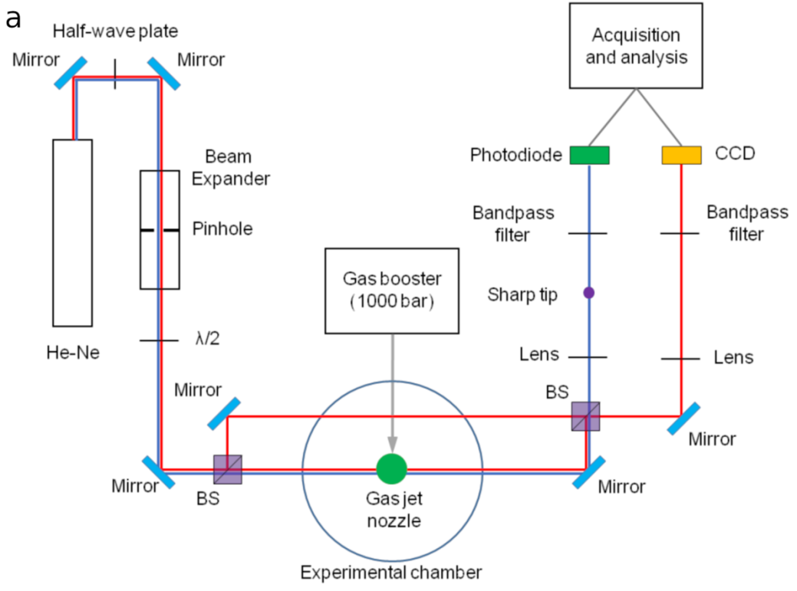
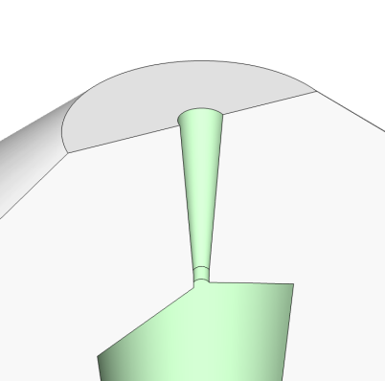
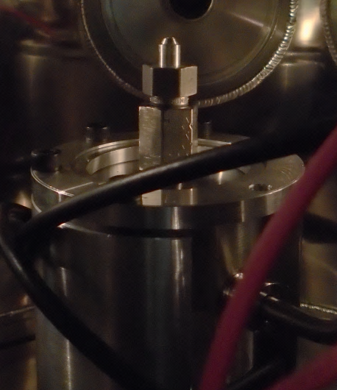
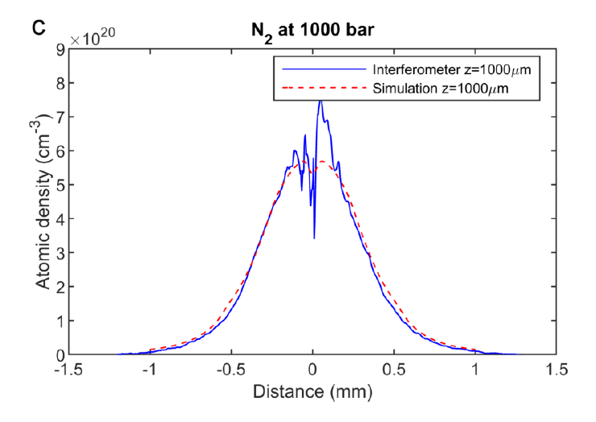
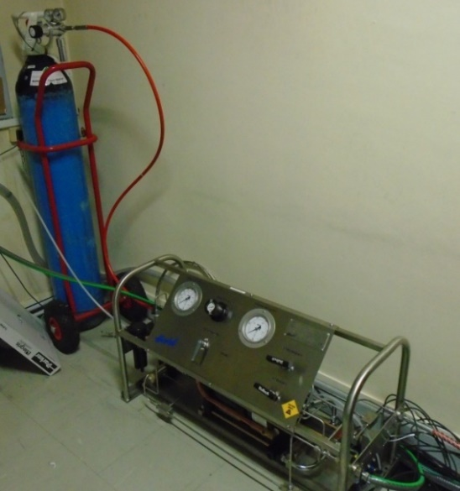

LASER DRIVEN ION SOURCE ACCELERATION
With gas jet targets
Interféromètre Mach-Zehnder
Service instrumentation
J.L. Henares, et al. Rev. Sci. Instrum. 90, 063302 (2019)
J L Henares, J. Phys. : Conf. Ser. 1079 012004 (2018)
Solenoid valve + nozzle
4

Slide 5
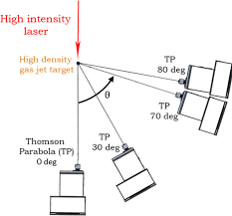
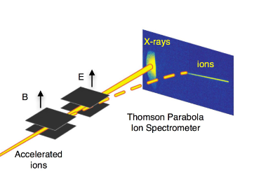
  ONLINE PROTON DETECTION
Imaging plates are a common tool for detection of laser accelerated protons
High repetition rate implies online detection
Thomson Parabola + Imaging Plates IP
IP
Imaging plates are limited with high repetition rate Lasers
Not suitable for online detection
CMOS detector
Thomson Parabola + CMOS detector

Slide 6
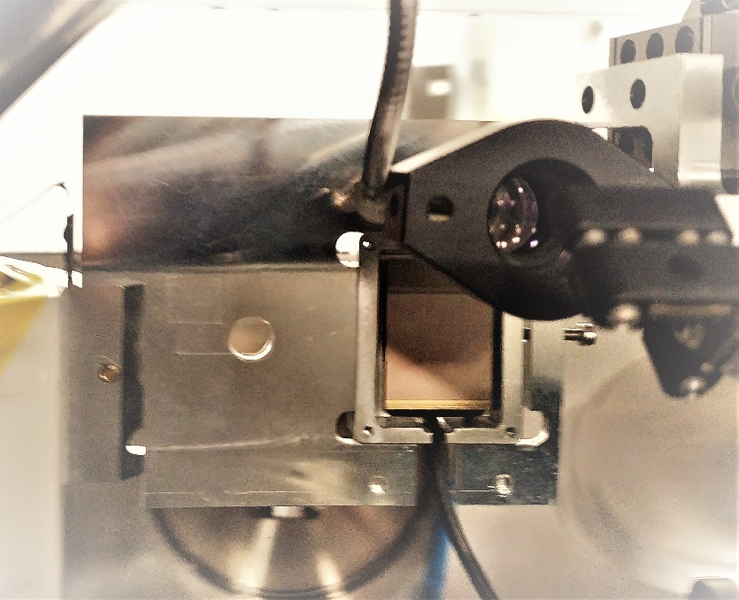
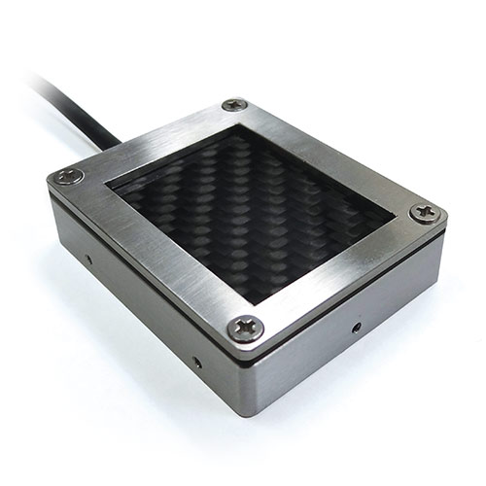
  ONLINE PROTON DETECTION
CMOS from IPHC Strasbourg
CMOS RadEye detector calibration done at AIFIRA
Quartz
Collaboration
First test was in April 2021, LULI PICO 2000
EMP challenges
CMOS detector sensitive area
Front
Pixel dimension: 20µm
http://www.iphc.cnrs.fr/PLUME.html
Energy: 3MeV
Beam diameter: 1µm
Mean current ~1pA
Nano beamline to fully control the sweep through different pixels of the detector

Slide 7
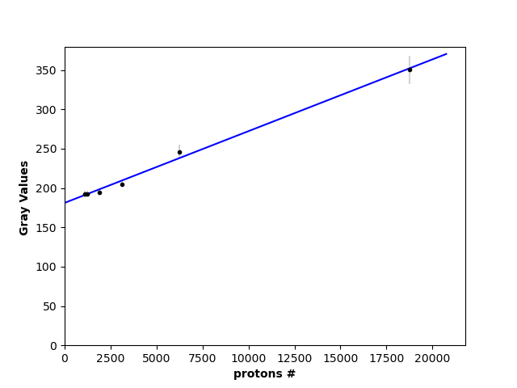
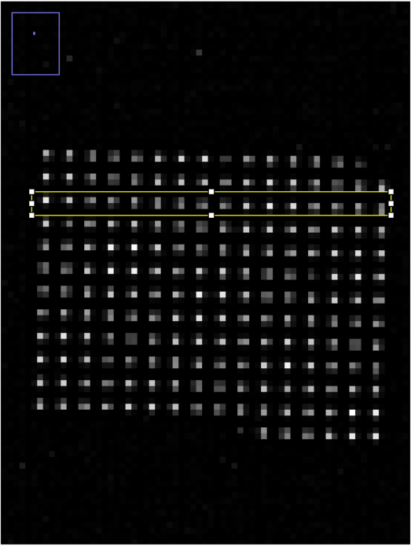
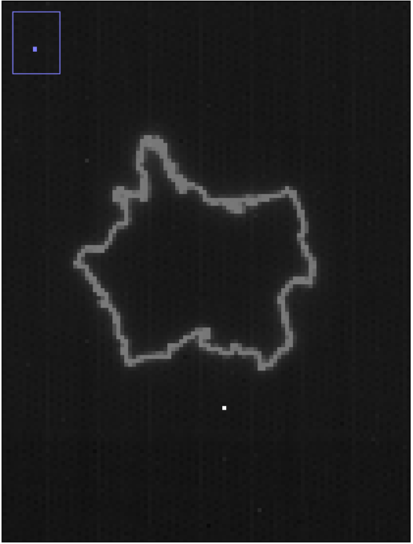
  ONLINE PROTON DETECTION
Obtained Calibration
y=0.009x+ 181
La France

Slide 8
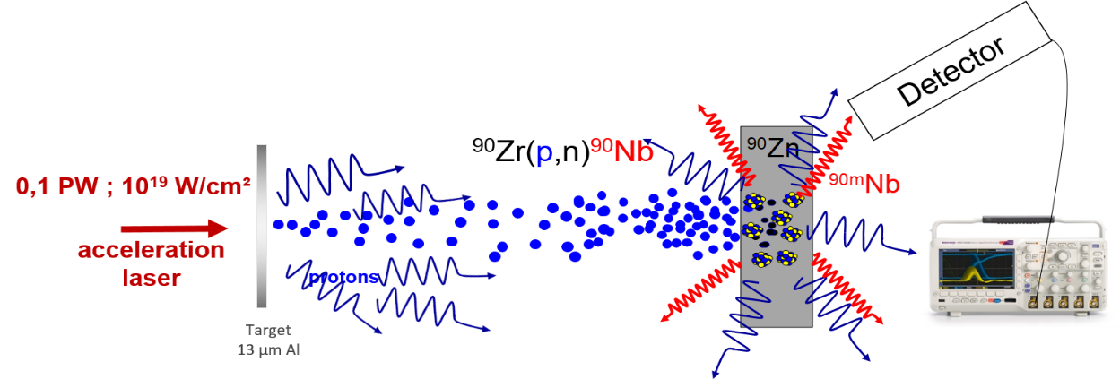
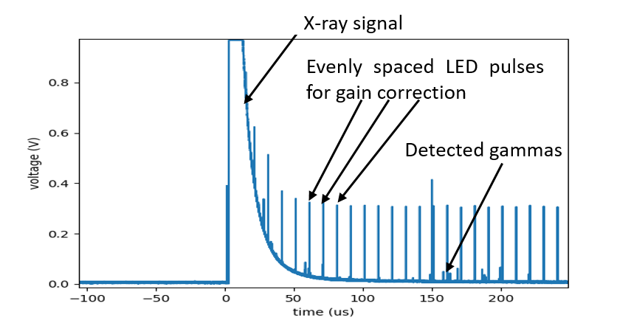
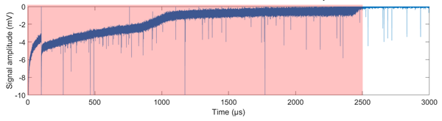
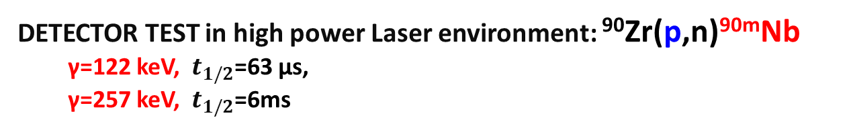
NUCLEAR PHYSICS IN PLASMA: EXPERIMENTAL STUDY
DETECTOR TEST in high power Laser environment: ⁹⁰Zr(p,n)^{90m}Nb
  γ=122 keV, $t_{1/2}$=63 µs,
  γ=257 keV, $t_{1/2}$=6ms
Lanthinum Bromide+ PMT
Lanthinum Bromide+ Hybride Photodiode
Scintillator Detector
Inject LED in HPD
LaBr3
LaBr3
PMT
HPD
Lots of X-rays
Few µs
Full oscillogram is necessary
Some µs
It is necessary to perform offline treatment and analysis
~3ms
F. Negoita et al., AIP Conference Proceedings vol. 1645, p. 228, 2015
M.Tarisien, et al., IEEE Transactions on Nuclear Science, Vol 65, issue 8, p.2216-2219 (2018)
Detector recovery time

Slide 9
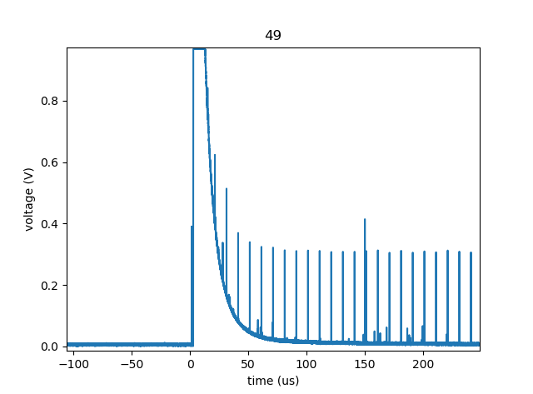
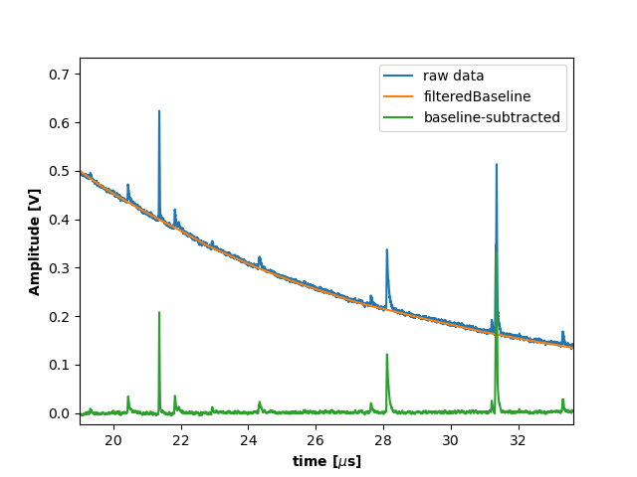
NUCLEAR PHYSICS IN PLASMA: EXPERIMENTAL STUDY
OFFLINE ANALYSIS 1/2
Oscillogram
X-ray signal baseline subtraction
1
2
Subsequently:
Noise treatment
Gain correction
Peak detection
Histogramming

Slide 10
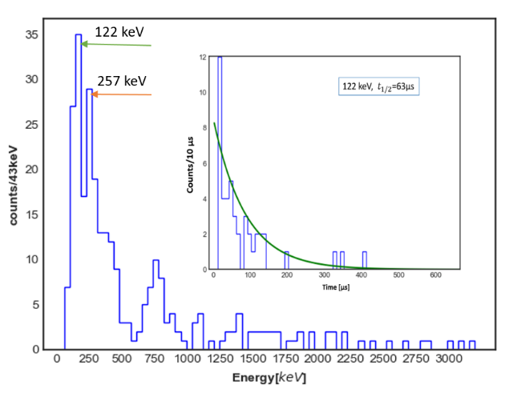
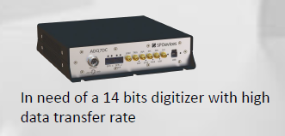
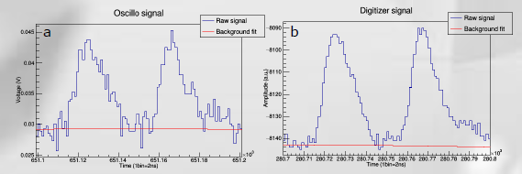
NUCLEAR PHYSICS IN PLASMA: EXPERIMENTAL STUDY
OFFLINE ANALYSIS 2/2
122 keV detected
More statistics are needed
New generation of lasers >1Hz
optimised detection: Digitizer, …
Service electronique et aquisition
=> Pileup

Slide 11
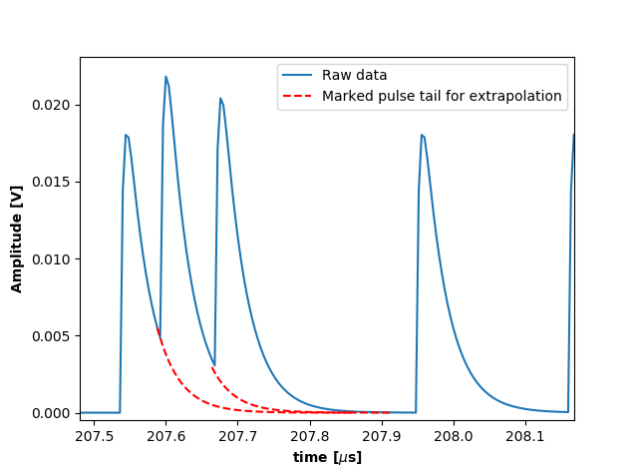
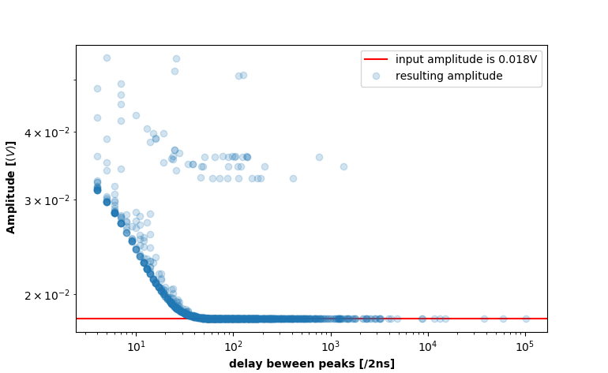
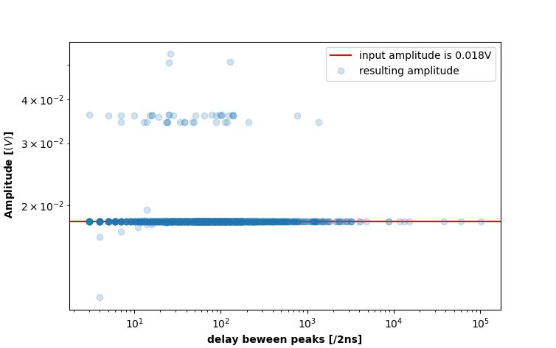
MANAGE PILEUP OCCURRENCES OFFLINE
PILEUP SIMULATION: From LaBr₃ Scintillator Captured By An Oscilloscope
1
2
Delay, dt
LaBr₃ properties
Rise time: 2ns
Decay time: 16ns
Pileup below 60ns
3
analysis after detection is ready!
Currently at some µs with scintillators
Result is improved for beyond 4ns
Correction via template pulse
Semiconductors could help improve the time of detection?

Slide 12
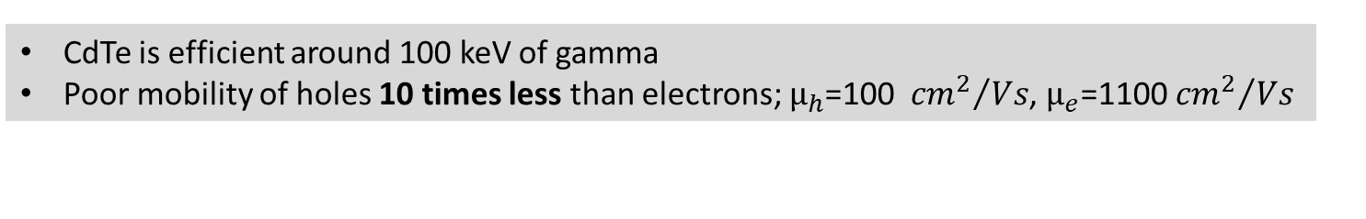
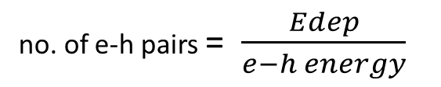
EXPLORING SEMICONDUCTOR: Cadmium telluride (CdTe)
How it works: Drift current
CdTe is efficient around 100 keV of gamma
Poor mobility of holes 10 times less than electrons; $µ_{h}$=100 ${{cm}^{2}}/{Vs}$, $µ_{e}$=1100 ${{cm}^{2}}/{Vs}$
no. of e-h pairs = $\frac{Edep}{e−h energy}$
Radiation
-
+
To Preamplifier
e-h pairs are created when particle interact in detectors
Under an Electric field, they drift to their respective electrodes
Current is induced in the process =>Ramo-shockley: I α v(e,h)
e Drift
Cathode
electrons
Anode
holes
h Drift
+70 V

Slide 13
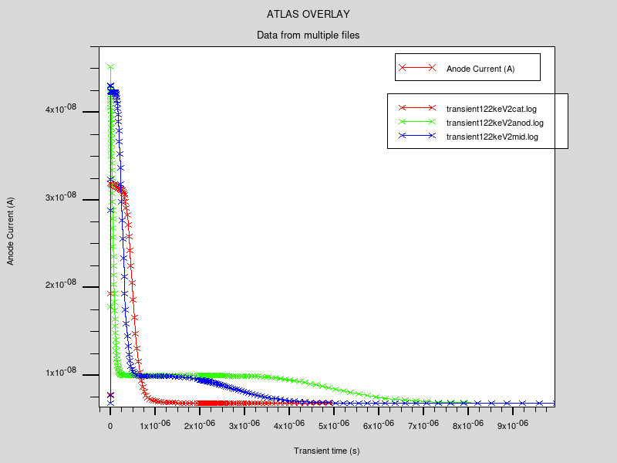
EXPLORING SEMICONDUCTOR: Cadmium telluride (CdTe)
With ATLAS SILVACO: CdTe+ γ (different positions in Crystal)
2mm
-
+
Holes travel longer distance=>longer time
3 points of γ interaction
Gamma 122 keV
4.83mm
Anode current (A)
cathode
Anode
5µs
3µs
Near the anode
1µs
In the middle
Near the cathode
Exposing the Cathode electrode will help reduce signal duration
Transient time (s)
PILEUP CONCERNS!!!

Slide 14
EXPLORING SEMICONDUCTOR: Cadmium telluride (CdTe)
Ideal case: CdTe+X-flash+γ
t+Δt
t≈0
2mm
2mm
X-flash signal (100MeV of deposited x-ray energy)
X-flash
100MeV
-
+
Gamma signal 122 keV
4.83mm
4.83mm
Gamma 122 keV
Anode
Current A
cathode
Anode
cathode
Time s
Homogeneous distribution of charges from X-ray flash
When can the 122 keV signal be found on the flash signal if it arrives after the flash?

Slide 15
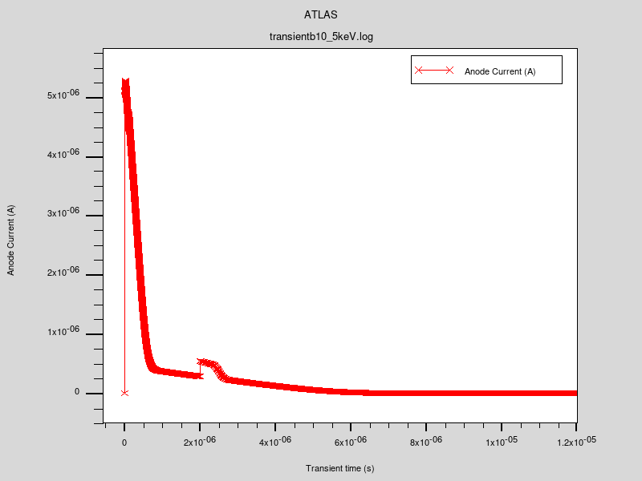
EXPLORING SEMICONDUCTOR: Cadmium telluride (CdTe)
Real case: CdTe+X-flash+γ
X-flash(t=0)+γ(10ns)+γ(100ns)+γ(3µs)
undetected 122 keV
@10ns and 100ns
X-ray flash signal tail
Long duration=>Hole drift and electron diffusion current
Within some µs for detection (for 100MeV)
Anode current (A)
detected 122 keV@3µs
T=0
Transient time (s)

Slide 16
CONCLUSIONS AND PERSPECTIVES
Online particle detection is necessary for high repetition rate lasers
CMOS (IPHC+RadEye) detector calibration is mandatory for online proton detection
Large Quantities of Xrays =>A major limitation of 𝜸 spectroscopy in Laser Plasma
With scintillators => Deadtime: 10s of µs
CdTe considered:
    detection possible within few µs
    Pileup concerns
Back to scintillators=> Filter emission light from Scintillator
Use 14 bits ; 2Gs/s ; 1GB memory digitizer
Try silicon=> with more thickness (good hole and electron mobility)
Further test experiments next year: CELIA/LULI/CLPU
Suggestions are welcomed

Slide 17
MERCI
Service electronique et aquisition
Service instrumentation
Service Mecanique/BE
Service Administration (Nadine )
THANK YOU FOR LISTENING

Slide 18
Backup slides

Slide 19
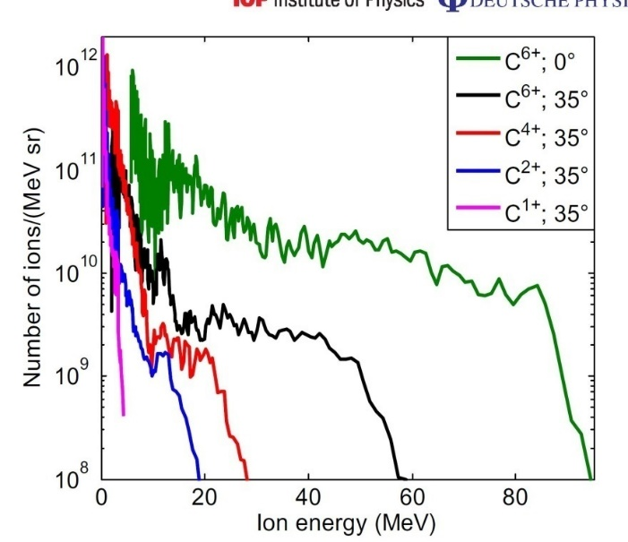
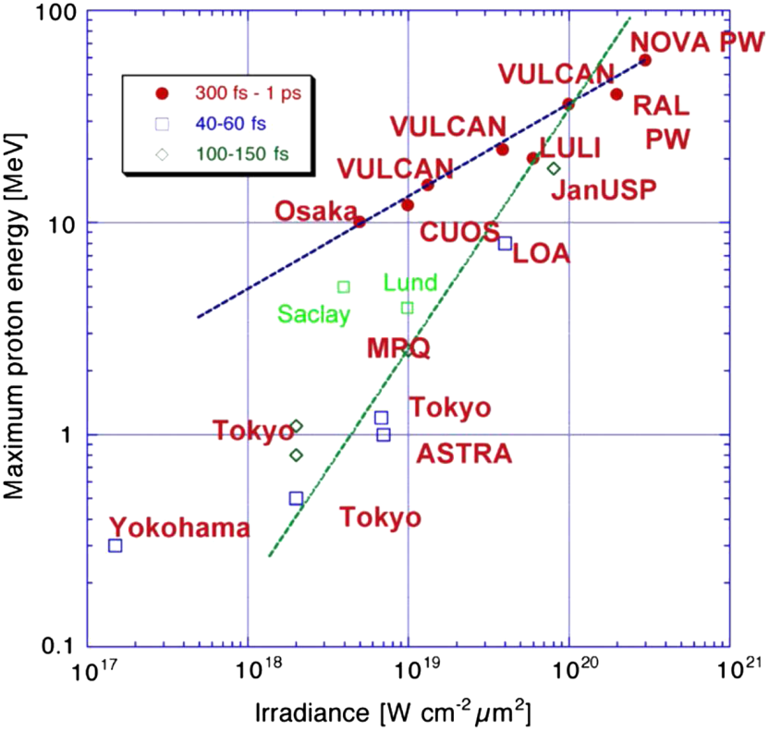
Energies reached for C and H ions
Macchi et al. Rev. Mod. Phys, 85, 751 (2013)
Carroll, D. C et al.,New Journal of Physics 12 (2010) 045020 (15pp)

Slide 20
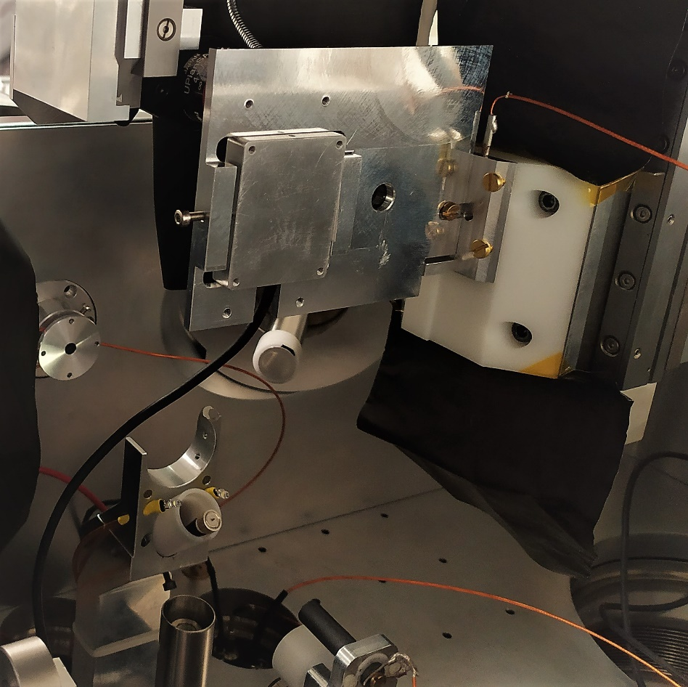
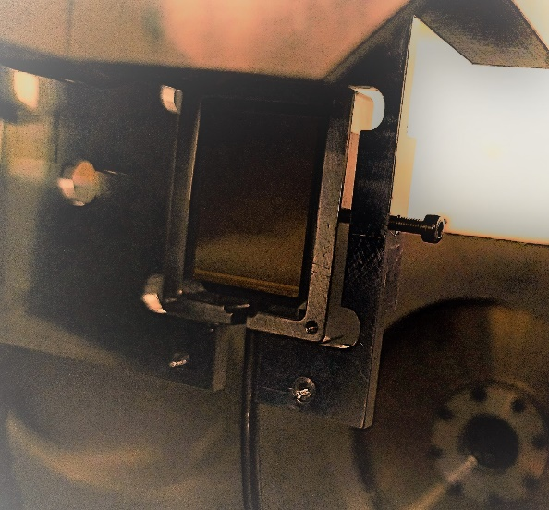
  ONLINE PROTON DETECTION
CMOS detector calibration done at AIFIRA
Picture of cmos
Some irradiation
Calibration

Slide 21
OFFLINE ANALYSIS
HPD has a wider range compared to PMT
PMT
HPD

Slide 22
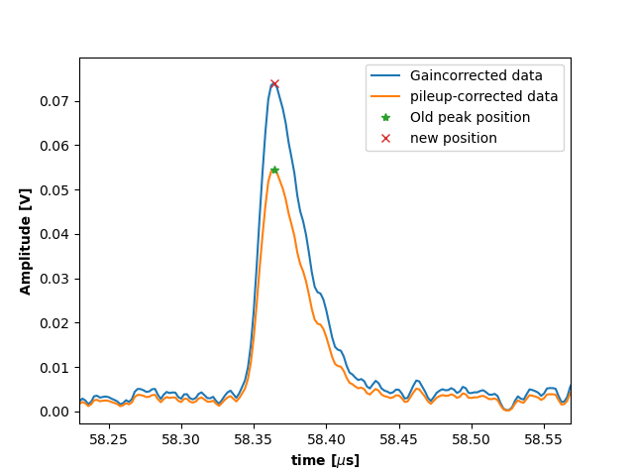
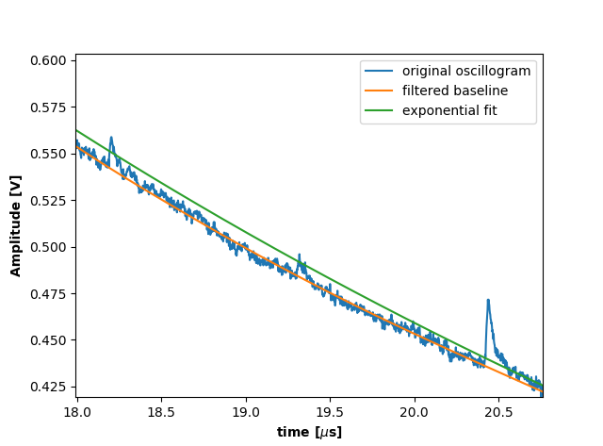
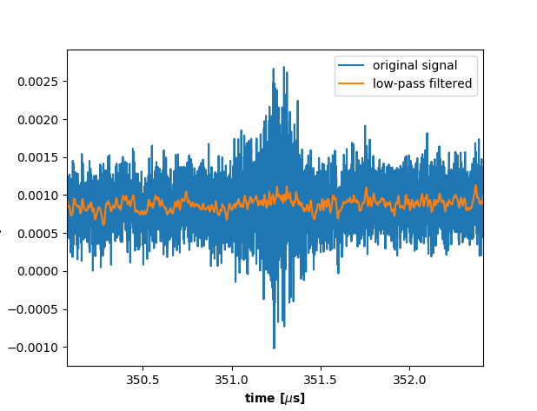
OFFLINE ANALYSIS
Gain correction
Combining successive LEDs we can restore each gamma pulse to their original amplitudes
X-ray signal baseline subtraction
Noise and EMP perturbation treatment

Slide 23
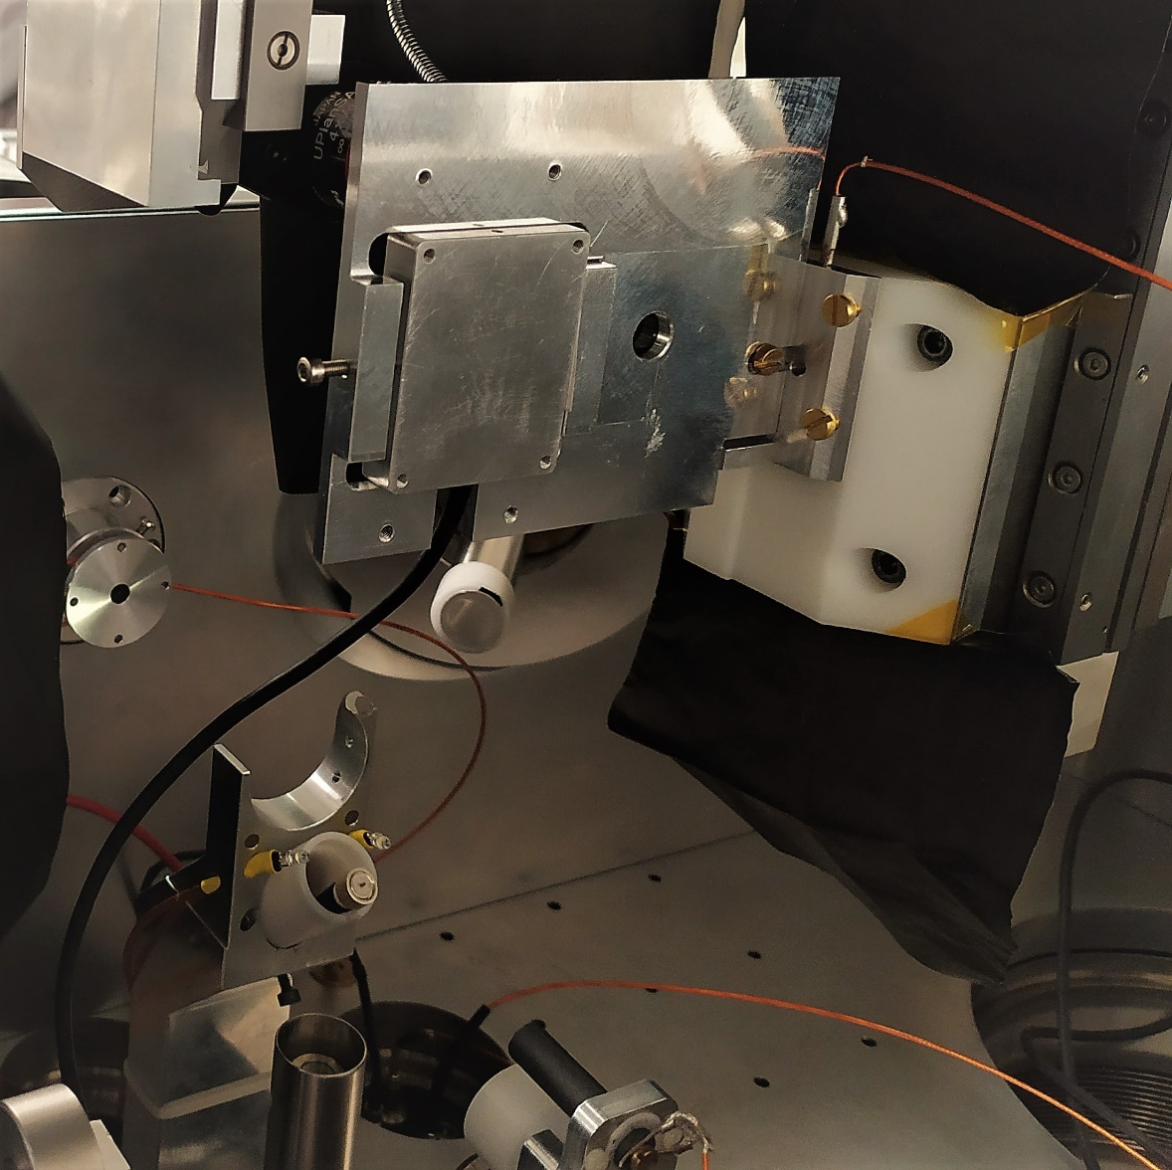
  ONLINE PROTON DETECTION
CMOS detector calibration done at AIFIRA
In the experimental Chamber
Quartz
back
CMOS detector
CMOS detector sensitive area
Front
Pixel dimension: 20µm
Proton beam
Detector Holder
Motor to move detector vertically
Energy: 3MeV
Beam diameter: 1µm
Mean current ~1pA
Nano beamline to fully control the sweep through different pixels of the detector

Slide 24
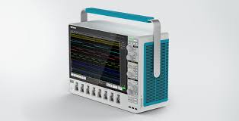
NUCLEAR PHYSICS IN PLASMA: EXPERIMENTAL STUDY
DETECTOR TEST in high power Laser environment: ⁹⁰Zr(p,n)^{90m}Nb
  γ=122 keV, $t_{1/2}$=63 µs,
  γ=257 keV, $t_{1/2}$=6ms
Lanthinum Bromide+ PMT
Lanthinum Bromide+ Hybride Photodiode
Scintillator Detector
Inject LED in HPD
⁹⁰Zr
Ps/fs Laser 1
10-90J
C ions
LaBr3
LaBr3
PMT
HPD
^{84m}Rb
Detector
µm target
Few µs
Full oscillogram is necessary
Some µs
Lots of X-rays
~3ms
It is necessary to perform offline treatment and analysis
F. Negoita et al., AIP Conference Proceedings vol. 1645, p. 228, 2015
M.Tarisien, et al., IEEE Transactions on Nuclear Science, Vol 65, issue 8, p.2216-2219 (2018)
Detector recovery time

Slide 25
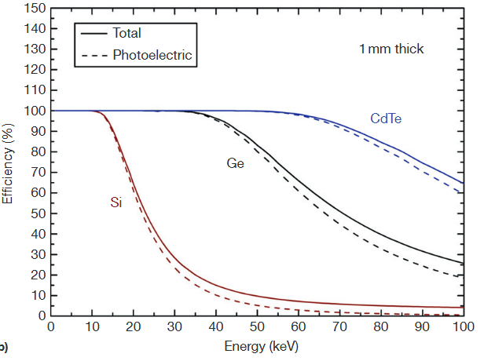
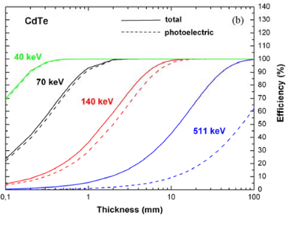


WITH SEMICONDUCTOR HOW CLOSE CAN WE GET FOR 122 keV?
Exploring Cadmium telluride (CdTe) : ⁹⁰Zr(p,n)⁹⁰Nb
$>{10}^{9}$Ωcm
50Ωcm
${10}^{4}$Ωcm

Slide 26

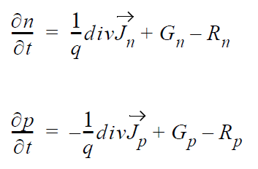
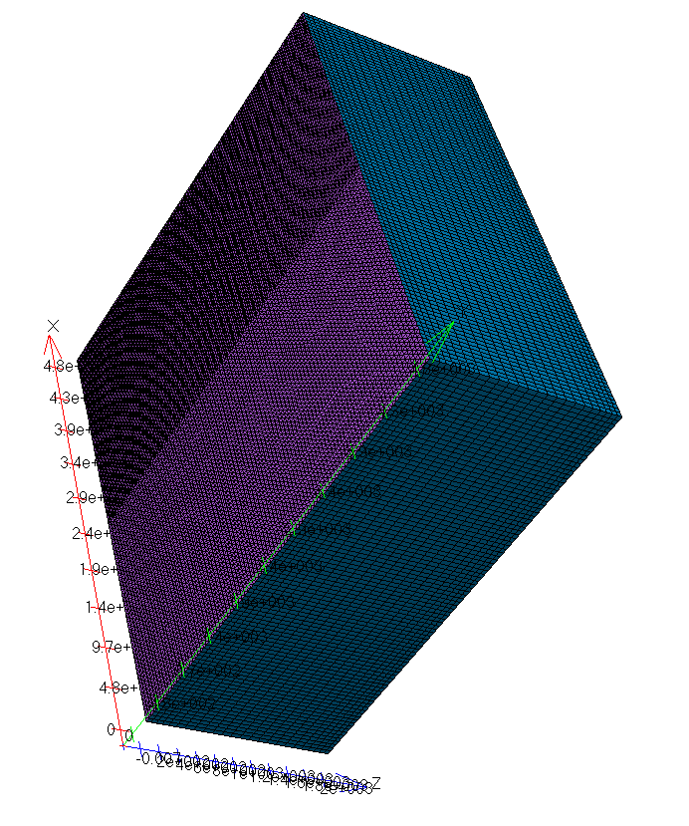
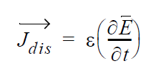
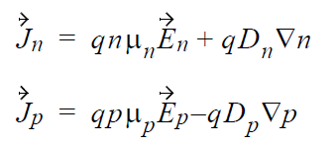
SILVACO SOLVES THE FOLLOWING EQUATIONS
Modelling CdTe detector with SILVACO
Radiation pass through the anode Electrode
Electron current
Hole curent
Displacement current
Bulk crystal in blue
cathode

Slide 27
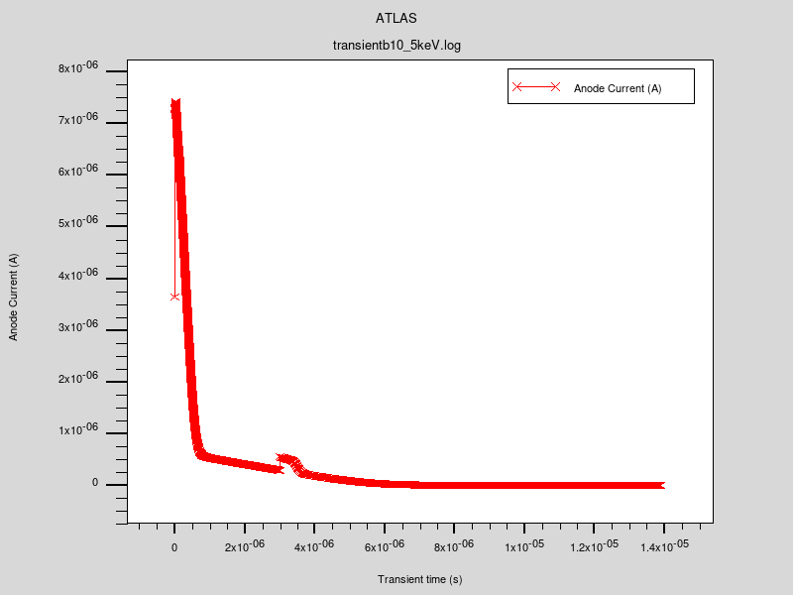
EXPLORING SEMICONDUCTOR: Cadmium telluride (CdTe)
Real case: CdTe+X-flash+γ
X-flash(t=0)+γ(10ns)+γ(100ns)+γ(3µs)
undetected 122 keV
@10ns and 100ns
X-ray flash contribution
e drift + h drift
No detector saturation
Long duration=>Hole drift and electron diffusion current
Anode current (A)
detected 122 keV@3µs
Hole drift + e diffusion current
T=0
Transient time (s)

Slide 28
EXPLORING SEMICONDUCTOR: Cadmium telluride (CdTe)
Real case: CdTe+X-flash+γ
X-flash(t=0)+γ(10ns)+γ(100ns)+γ(3µs)
undetected 122 keV
@10ns and 100ns
X-ray flash contribution
Long duration=>Hole drift and electron diffusion current
Within some µs for detection (for 100MeV)
Anode current (A)
detected 122 keV@3µs
T=0
Transient time (s)

Slide 29


NUCLEAR PHYSICS IN PLASMA: EXPERIMENTAL STUDY
Modification of nuclei apparent lifetime in plasma: ⁷⁶Ge(¹²C,p+3n)^{84m}Rb
We need carbon ions for this reaction
High power lasers can also accelerate ions and produces Plasma
⁷⁶Ge
Ps/fs Laser 1
10-90J
C ions
^{84m}Rb
HAPPY!!!
Detector
µm target
ns Laser 2
30kJ
Lots of X-rays
Huge quantities of X-rays!!!
Our detectors will be blind

