Slide 1
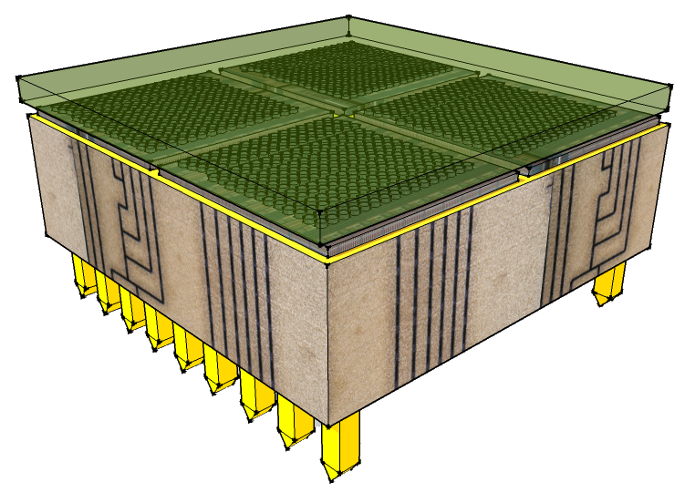

Elbereth conference 2022
Development of high pixel density hard X-ray spectroscopic imagers for the direct imaging of astrophysical sources and solar flares beyond 30 keV
Hugo Allaire, CEA/IRFU/DAP/LSIS & ED127
2022-03-24
Notes:
Saisir les champs « Titre », « P. Nom » et « Date.
Laisser ou retirer le bandeau.

Slide 2
Science case: thermonuclear supernovae
Low mass star end-of-life
  Red giant phase (H decrease)
SOHO picture of the Sun in extreme UV
Notes:
Death of stars: supernovae emitting in X-rays
Chandra observation of Tycho supernova: Type 1a, from white dwarf
Crab nebula observation: Type II, core collapse of large star

Slide 3
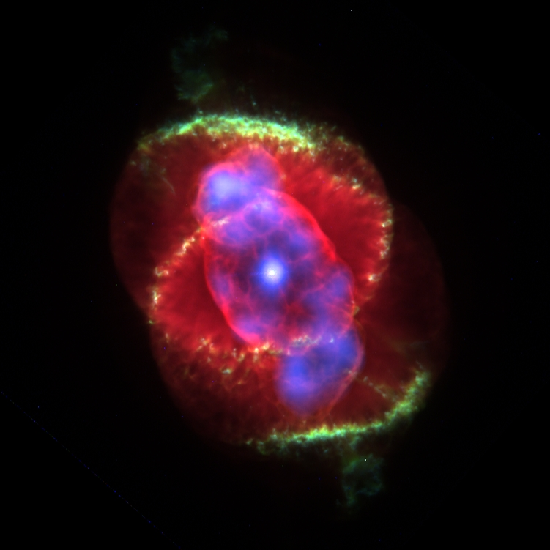
Science case: thermonuclear supernovae
Low mass star end-of-life
  Red giant phase (H decrease)
  Planetary nebulae (external layers ejected in ISM)
  White dwarf (T° decrease)
Cat’s Eye planetary nebula optical/X-ray composite
Notes:
Death of stars: supernovae emitting in X-rays
Chandra observation of Tycho supernova: Type 1a, from white dwarf
Crab nebula observation: Type II, core collapse of large star

Slide 4
Science case: thermonuclear supernovae
Low mass star end-of-life
  Red giant phase (H decrease)
  Planetary nebulae (external layers ejected in ISM)
  White dwarf (T° decrease)
Binary system
  Captures companion star material
  Reaches Chandrasehkar limit
  Thermonuclear conflagration
Binary system artistic view
Notes:
Death of stars: supernovae emitting in X-rays
Chandra observation of Tycho supernova: Type 1a, from white dwarf
Crab nebula observation: Type II, core collapse of large star

Slide 5
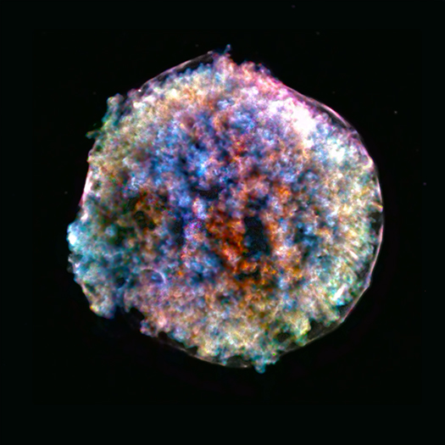
Science case: thermonuclear supernovae
Low mass star end-of-life
  Red giant phase (H decrease)
  Planetary nebulae (external layers ejected in ISM)
  White dwarf (T° decrease)
Binary system
  Captures companion star material
  Reaches Chandrasehkar limit
  Thermonuclear conflagration
Type Ia supernova
  Disperse material
  Ni to Co to Fe decay
  Lines
    Co57 @ 122 keV
    Fe fluorescence @ 6.4 keV)
  Standard candle
Chandra observation of Tycho supernova
Notes:
Death of stars: supernovae emitting in X-rays
Chandra observation of Tycho supernova: Type 1a, from white dwarf
Crab nebula observation: Type II, core collapse of large star

Slide 6
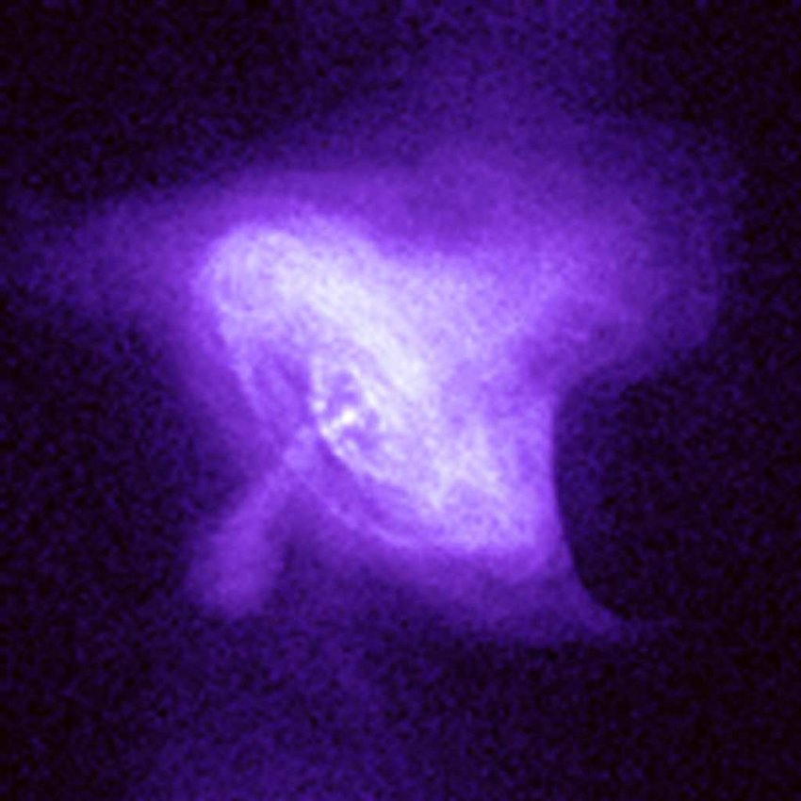
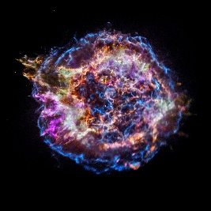
Hard X-ray astronomy sources
Most violent phenomena of the Universe
  Type Ia and type II supernovae
Ti-44 lines at 67.9 and 78.4 keV in Cas A observed with INTEGRAL/ISGRI
Crab nebula X-ray emissions
Notes:
Type II: core collapse supernova, heating and blows matter in the ISM
Left with a compact object in the center (BH or NS)

Slide 7
Hard X-ray astronomy sources
Most violent phenomena of the Universe
  Type Ia and type II supernovae
  Pulsars
Pulsar emission principle
Notes:
Neutron star avec type II supernova
Rapidly rotating (10-100 rev/s)
Highly magnetized (10^15 G)
Jets radiation production, crossing observers FoV periodically -> from radio to high energy gamma
With companion star, hot spot from falling matters emit in X-ray -> X-ray pulsars
Also: Synchrotron radiation from electron interaction with rotating field (IR to hard X-rays)

Slide 8
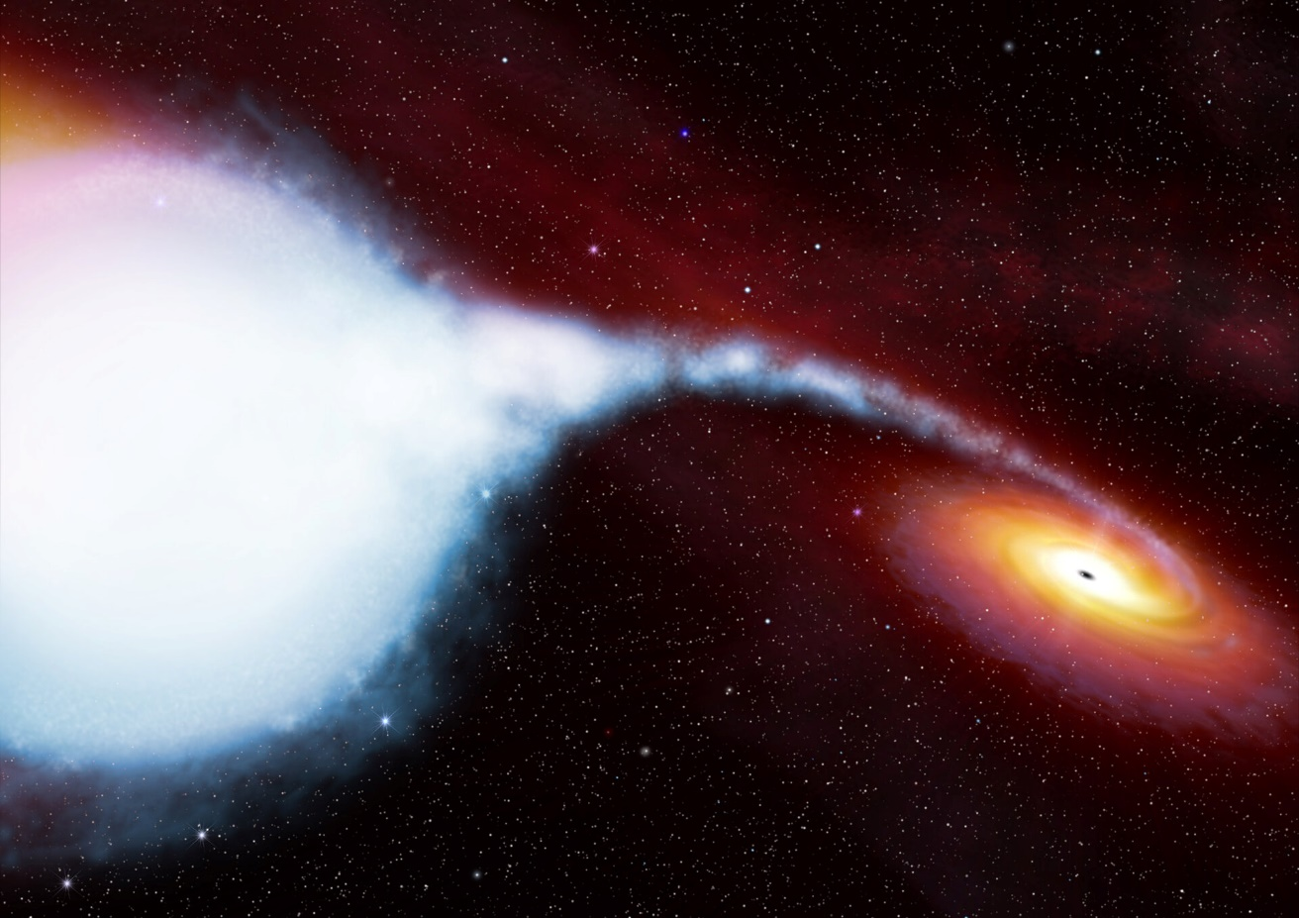
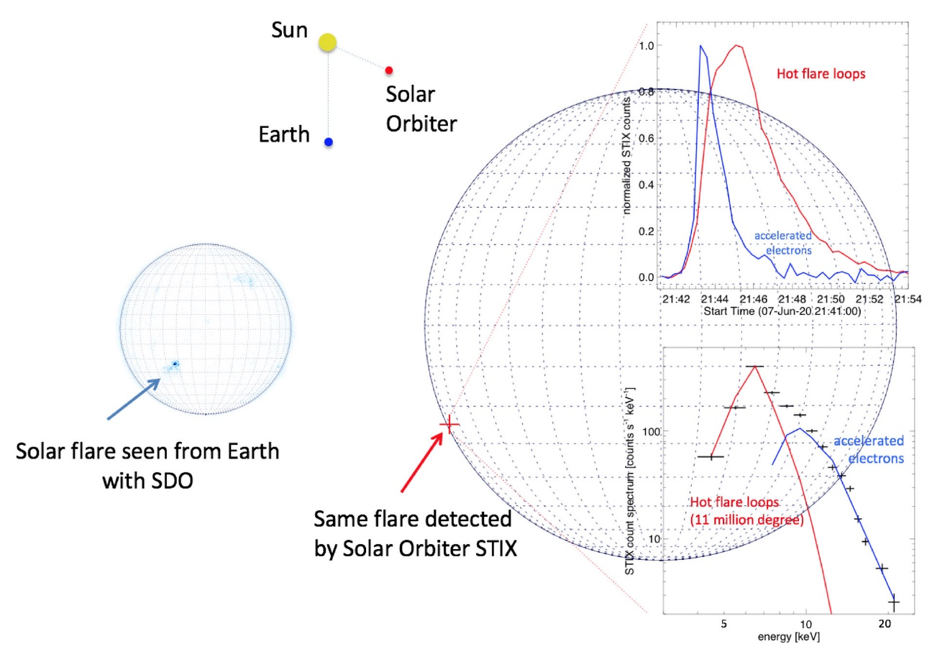
Hard X-ray astronomy sources
Most violent phenomena of the Universe
  Type Ia and type II supernovae
  Pulsars
  Accretion around compact object
  Solar flares
Artistic view of a black hole accreting from companion
Solar Orbiter/STIX instrument X-ray location, light curve and spectrum from flare event
Notes:
Accretion around object from companion: temperatures oe 10^7 can be reached close to the compact object, heating emits X-rays up to gfew keV
Hard component (1-10 meV) ca^n be seen on top of soft emissions: Compton inverse on very energetic electrons ?
Solar flares: intense X-ray and gamma-ray emissions from magnetic fields energy release in ISM during eruptions (both dissipating in radiation and particle flow)

Slide 9
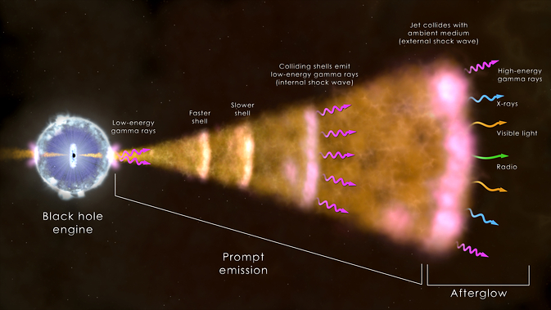
Hard X-ray astronomy sources
Most violent phenomena of the Universe
  Type Ia and type II supernovae
  Pulsars
  Accretion around compact object
  Solar flares
  Active galactic nuclei (AGN)
  Gamma-ray burst (GRB)
AGN high energy emission from the Milky Way
GRB: illustration of the « Fireball » model
Notes:
AGN: super massive black hole accretion disk in the center of galaxy
Emits through entire spectrum, with heating of disk and ejection of matter
GRB: explosion from either two mergers (short burst) or hypernova collapse (20 times solar mass, long burst); BH resulting abosrb immediate matter and eject if through jet, shocking with ISM and emitting in hard X-ray/low gamma ray in prompt emission, before candling in the afterglow in all wavelenghts

Slide 10
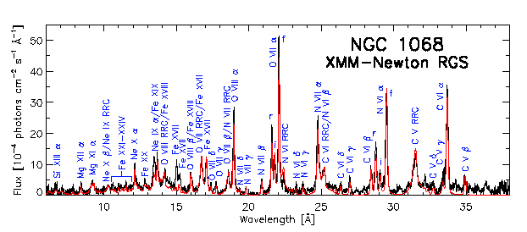
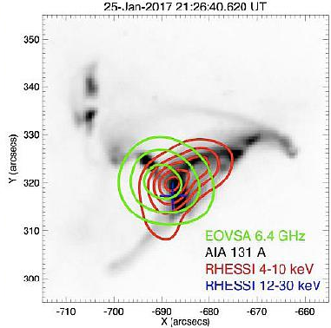
Hard X-ray astronomy sources
Most violent phenomena of the Universe
  Type Ia and type II supernovae
  Pulsars
  Accretion around compact object
  Solar flares
  Active galactic nuclei (AGN)
  Gamma-ray burst (GRB)
Signatures of emission processes
  Spectrum: particle acceleration and energy transfer
  Imaging: structures of close sources (solar flares), location of distant ones
  Polarimetry: magnetic field geometry and emission region
XMM-Newton spectrum from the active Seyfert 2 galaxy NGC 1068
Observations of flare by RHESSI and EOVSA
Notes:
For solar physicists, photon spectrum gives access to the primary electron spectrum revealing particle acceleration and
energy transfer processes; imaging solar flares is also a way to understand the structures of electrical and magnetic fields at the surface of the Sun
Polarimetry should give precious information about the geometries of magnetic field and emission regions in compact objects and binary systems

Slide 11
Hard X-ray astronomy sources
Most violent phenomena of the Universe
  Type Ia and type II supernovae
  Pulsars
  Accretion around compact object
  Solar flares
  Active galactic nuclei (AGN)
  Gamma-ray burst (GRB)
Signatures of emission processes
  Spectrum: particle acceleration and energy transfer
  Imaging: structures of close sources (solar flares), location of distant ones
  Polarimetry: magnetic field geometry and emission region
XMM-Newton spectrum from the active Seyfert 2 galaxy NGC 1068
Hard X-ray wavelengths blocked by atmosphere
→ Go to space !
Observations of flare by RHESSI and EOVSA
Notes:
For solar physicists, photon spectrum gives access to the primary electron spectrum revealing particle acceleration and
energy transfer processes; imaging solar flares is also a way to understand the structures of electrical and magnetic fields at the surface of the Sun
Polarimetry should give precious information about the geometries of magnetic field and emission regions in compact objects and binary systems

Slide 12
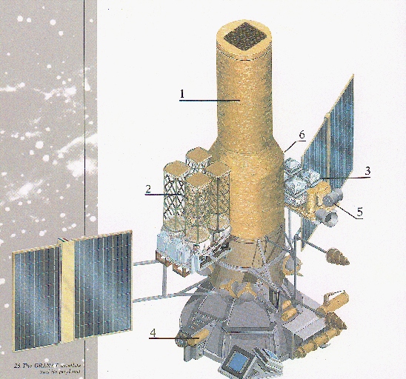
Hard X-ray astronomy missions
Started in 1960’s, major breakthrough in the 1990’s
  Sigma Telescope (onboard Granat)
  35 keV – 1.3 MeV
  15 arcmin
  8% ΔE @ 511 keV
Imaging capability
  Coded mask
Single photon detection
  Scintillators detectors
Drawing of the Granat satellite
Notes:
From the 1950’s, gamma-ray sources were
predicted, based on particle and nuclear physics theories and first discoveries in
radioastronomy; but the difficulty to embed sufficiently large detection areas in balloons and
sounding rockets used to limit observations. Experimental X-ray and gamma-ray astronomy
really started at the end of 1960’s, with the American SAS (Small Astronomy Satellite) and
OSO (Orbiting Solar Observatory) series satellites. X-ray emissions from Scorpius X-1 and
Centaurus X-3 were interpreted as neutrons stars accreting matter from an orbiting star: the
concept of X-ray binaries was born.
Major breakthrough for
gamma-ray astrophysics came later, at the beginning of the 1990’s, with the Compton Gammaray
Observatory (CGRO) and the Sigma telescope onboard the Granat satellite. Various stellar
objects at the end of their evolution (neutron stars, black holes, supernovae) were detected and
observed; Batse onboard CGRO provided the very first catalog of gamma-ray bursts. Active
galactic nuclei whose gamma-ray emission comes from the gravitational energy produced
during matter accretion around a supermassive black hole were identified in few percents of
the galaxies.
High-energy detectors are based on single photon detection, by measuring the charges
created by the ionization or the temperature elevation (micro calorimeter). We can classify the
Photodetectors in 4 categories:
• Gaseous ionization detectors: used in few space experiments like Integral/JEM-X, they
require a large volume for good efficiency and they are sensitive to voltage breakdown by
cosmic proton interaction. They could be of interest for X-ray polarimetry [4].
• Scintillation detectors: first detectors used in space, coupled with photomultipliers (NaI
onboard OSO-7 in 1972). Inorganic scintillation crystals stay efficient solutions for energy
measurement in gamma-ray experiments above 10 MeV because they can be implemented
in large quantities and volumes (e.g. recently in AGILE [5] and FERMI [6]). Plastic
scintillators are also widely used as active shielding in high-energy experiments for
background particle detection and rejection.
Semiconductor detectors: Si, Ge, CdTe, CdZnTe detectors have progressively replaced
scintillators in space experiments because of their better intrinsic spectral performance;
they show now high technological maturity to propose compact solutions for both high
resolution imaging and spectroscopy from the visible range to the soft gamma-ray range,
with versatile readout, dimensions and granularity.
• X-ray calorimeter: shorty operated in space (helium failure after calibration onboard
Suzaku in 2005), they would provide ultimate energy resolution, ~50 times better than
solid-state detectors to resolve features of the iron line fluorescence features at 6 keV in
compact objects. R&D programs are on-going based on superconducting transition-edgesensors
or metal insulator semiconductor coupled with high-Z absorbers [7]. They require
cryogenic temperatures (<100 mK), which makes the realization and the readout of
matrices extremely challenging.

Slide 13

Hard X-ray astronomy missions
INTEGRAL/ISGRI
  15 keV to 1.5 MeV
  13 arcmin angular resolution
  8% ΔE @ 60 keV
  Cas A Ti-44 lines
Imaging capability
  Coded mask
Single photon detection
  Scintillators detectors
  Semiconductor detectors (CdTe)
Illustration of the INTEGRAL spacecraft
Notes:
From the 1950’s, gamma-ray sources were
predicted, based on particle and nuclear physics theories and first discoveries in
radioastronomy; but the difficulty to embed sufficiently large detection areas in balloons and
sounding rockets used to limit observations. Experimental X-ray and gamma-ray astronomy
really started at the end of 1960’s, with the American SAS (Small Astronomy Satellite) and
OSO (Orbiting Solar Observatory) series satellites. X-ray emissions from Scorpius X-1 and
Centaurus X-3 were interpreted as neutrons stars accreting matter from an orbiting star: the
concept of X-ray binaries was born.
Major breakthrough for
gamma-ray astrophysics came later, at the beginning of the 1990’s, with the Compton Gammaray
Observatory (CGRO) and the Sigma telescope onboard the Granat satellite. Various stellar
objects at the end of their evolution (neutron stars, black holes, supernovae) were detected and
observed; Batse onboard CGRO provided the very first catalog of gamma-ray bursts. Active
galactic nuclei whose gamma-ray emission comes from the gravitational energy produced
during matter accretion around a supermassive black hole were identified in few percents of
the galaxies.
High-energy detectors are based on single photon detection, by measuring the charges
created by the ionization or the temperature elevation (micro calorimeter). We can classify the
Photodetectors in 4 categories:
• Gaseous ionization detectors: used in few space experiments like Integral/JEM-X, they
require a large volume for good efficiency and they are sensitive to voltage breakdown by
cosmic proton interaction. They could be of interest for X-ray polarimetry [4].
• Scintillation detectors: first detectors used in space, coupled with photomultipliers (NaI
onboard OSO-7 in 1972). Inorganic scintillation crystals stay efficient solutions for energy
measurement in gamma-ray experiments above 10 MeV because they can be implemented
in large quantities and volumes (e.g. recently in AGILE [5] and FERMI [6]). Plastic
scintillators are also widely used as active shielding in high-energy experiments for
background particle detection and rejection.
Semiconductor detectors: Si, Ge, CdTe, CdZnTe detectors have progressively replaced
scintillators in space experiments because of their better intrinsic spectral performance;
they show now high technological maturity to propose compact solutions for both high
resolution imaging and spectroscopy from the visible range to the soft gamma-ray range,
with versatile readout, dimensions and granularity.
• X-ray calorimeter: shorty operated in space (helium failure after calibration onboard
Suzaku in 2005), they would provide ultimate energy resolution, ~50 times better than
solid-state detectors to resolve features of the iron line fluorescence features at 6 keV in
compact objects. R&D programs are on-going based on superconducting transition-edgesensors
or metal insulator semiconductor coupled with high-Z absorbers [7]. They require
cryogenic temperatures (<100 mK), which makes the realization and the readout of
matrices extremely challenging.

Slide 14
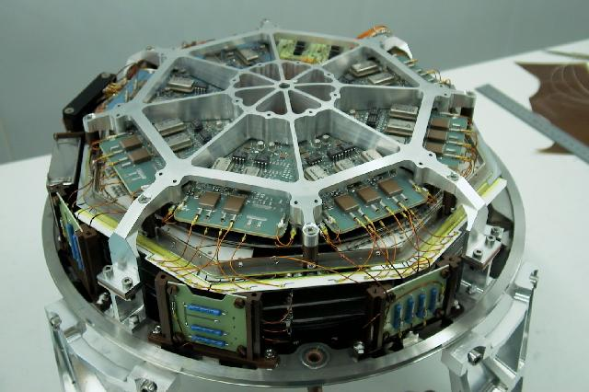
Hard X-ray astronomy missions
INTEGRAL/JEM-X
  3 to 35 keV
  3 arcmin angular resolution
  Complements main instrument
Imaging capability
  Coded mask
Single photon detection
  Scintillators detectors
  Semiconductor detectors
  Gaseous detector
JEM-X instrument gaseous chamber
Notes:
From the 1950’s, gamma-ray sources were
predicted, based on particle and nuclear physics theories and first discoveries in
radioastronomy; but the difficulty to embed sufficiently large detection areas in balloons and
sounding rockets used to limit observations. Experimental X-ray and gamma-ray astronomy
really started at the end of 1960’s, with the American SAS (Small Astronomy Satellite) and
OSO (Orbiting Solar Observatory) series satellites. X-ray emissions from Scorpius X-1 and
Centaurus X-3 were interpreted as neutrons stars accreting matter from an orbiting star: the
concept of X-ray binaries was born.
Major breakthrough for
gamma-ray astrophysics came later, at the beginning of the 1990’s, with the Compton Gammaray
Observatory (CGRO) and the Sigma telescope onboard the Granat satellite. Various stellar
objects at the end of their evolution (neutron stars, black holes, supernovae) were detected and
observed; Batse onboard CGRO provided the very first catalog of gamma-ray bursts. Active
galactic nuclei whose gamma-ray emission comes from the gravitational energy produced
during matter accretion around a supermassive black hole were identified in few percents of
the galaxies.
High-energy detectors are based on single photon detection, by measuring the charges
created by the ionization or the temperature elevation (micro calorimeter). We can classify the
Photodetectors in 4 categories:
• Gaseous ionization detectors: used in few space experiments like Integral/JEM-X, they
require a large volume for good efficiency and they are sensitive to voltage breakdown by
cosmic proton interaction. They could be of interest for X-ray polarimetry [4].
• Scintillation detectors: first detectors used in space, coupled with photomultipliers (NaI
onboard OSO-7 in 1972). Inorganic scintillation crystals stay efficient solutions for energy
measurement in gamma-ray experiments above 10 MeV because they can be implemented
in large quantities and volumes (e.g. recently in AGILE [5] and FERMI [6]). Plastic
scintillators are also widely used as active shielding in high-energy experiments for
background particle detection and rejection.
Semiconductor detectors: Si, Ge, CdTe, CdZnTe detectors have progressively replaced
scintillators in space experiments because of their better intrinsic spectral performance;
they show now high technological maturity to propose compact solutions for both high
resolution imaging and spectroscopy from the visible range to the soft gamma-ray range,
with versatile readout, dimensions and granularity.
• X-ray calorimeter: shorty operated in space (helium failure after calibration onboard
Suzaku in 2005), they would provide ultimate energy resolution, ~50 times better than
solid-state detectors to resolve features of the iron line fluorescence features at 6 keV in
compact objects. R&D programs are on-going based on superconducting transition-edgesensors
or metal insulator semiconductor coupled with high-Z absorbers [7]. They require
cryogenic temperatures (<100 mK), which makes the realization and the readout of
matrices extremely challenging.

Slide 15
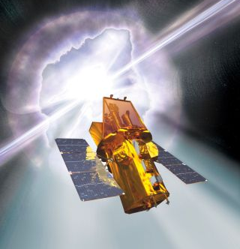
Hard X-ray astronomy missions
Swift/Bat
  15 keV to 150 keV
  17 arcmin angular resolution
  5% ΔE @ 60 keV
  Gamma ray bursts
Imaging capability
  Coded mask
Single photon detection
  Scintillators detectors
  Gaseous detector
  Semiconductor detectors (CZT)
Swift artistic view
Notes:
From the 1950’s, gamma-ray sources were
predicted, based on particle and nuclear physics theories and first discoveries in
radioastronomy; but the difficulty to embed sufficiently large detection areas in balloons and
sounding rockets used to limit observations. Experimental X-ray and gamma-ray astronomy
really started at the end of 1960’s, with the American SAS (Small Astronomy Satellite) and
OSO (Orbiting Solar Observatory) series satellites. X-ray emissions from Scorpius X-1 and
Centaurus X-3 were interpreted as neutrons stars accreting matter from an orbiting star: the
concept of X-ray binaries was born.
Major breakthrough for
gamma-ray astrophysics came later, at the beginning of the 1990’s, with the Compton Gammaray
Observatory (CGRO) and the Sigma telescope onboard the Granat satellite. Various stellar
objects at the end of their evolution (neutron stars, black holes, supernovae) were detected and
observed; Batse onboard CGRO provided the very first catalog of gamma-ray bursts. Active
galactic nuclei whose gamma-ray emission comes from the gravitational energy produced
during matter accretion around a supermassive black hole were identified in few percents of
the galaxies.
High-energy detectors are based on single photon detection, by measuring the charges
created by the ionization or the temperature elevation (micro calorimeter). We can classify the
Photodetectors in 4 categories:
• Gaseous ionization detectors: used in few space experiments like Integral/JEM-X, they
require a large volume for good efficiency and they are sensitive to voltage breakdown by
cosmic proton interaction. They could be of interest for X-ray polarimetry [4].
• Scintillation detectors: first detectors used in space, coupled with photomultipliers (NaI
onboard OSO-7 in 1972). Inorganic scintillation crystals stay efficient solutions for energy
measurement in gamma-ray experiments above 10 MeV because they can be implemented
in large quantities and volumes (e.g. recently in AGILE [5] and FERMI [6]). Plastic
scintillators are also widely used as active shielding in high-energy experiments for
background particle detection and rejection.
Semiconductor detectors: Si, Ge, CdTe, CdZnTe detectors have progressively replaced
scintillators in space experiments because of their better intrinsic spectral performance;
they show now high technological maturity to propose compact solutions for both high
resolution imaging and spectroscopy from the visible range to the soft gamma-ray range,
with versatile readout, dimensions and granularity.
• X-ray calorimeter: shorty operated in space (helium failure after calibration onboard
Suzaku in 2005), they would provide ultimate energy resolution, ~50 times better than
solid-state detectors to resolve features of the iron line fluorescence features at 6 keV in
compact objects. R&D programs are on-going based on superconducting transition-edgesensors
or metal insulator semiconductor coupled with high-Z absorbers [7]. They require
cryogenic temperatures (<100 mK), which makes the realization and the readout of
matrices extremely challenging.

Slide 16
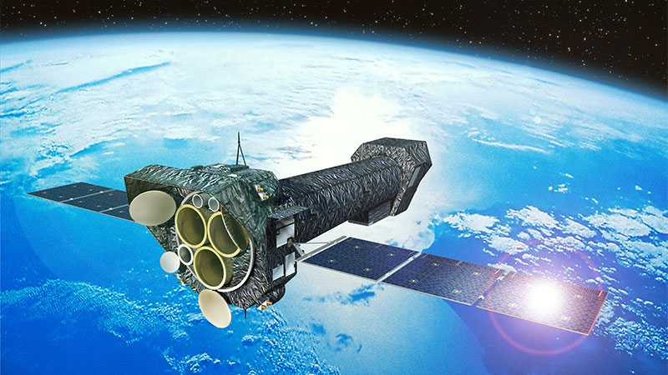
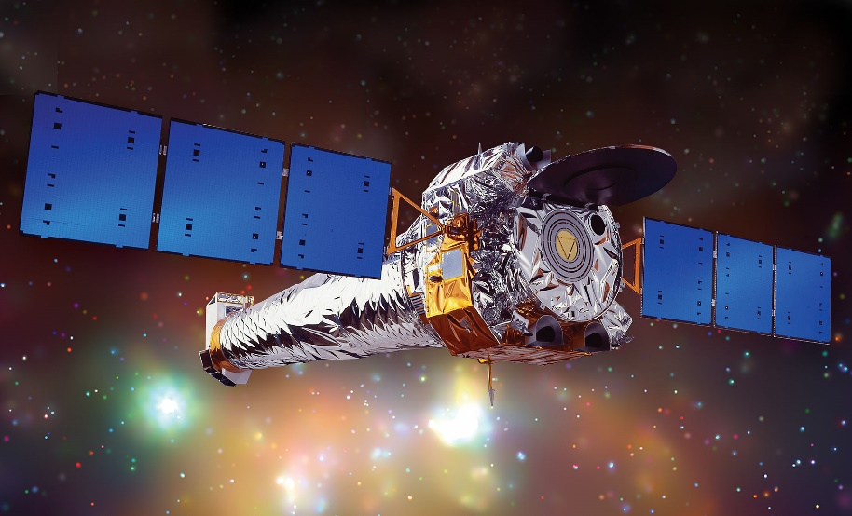
Hard X-ray astronomy missions
XMM-Newton and Chandra
  Up to 10 keV
  Few to 15 arcsec resolution
  5% ΔE & 1% @ 1 keV
  Very hot region of Universe
Imaging capability
  Coded mask
  Grazing mirrors
Single photon detection
  Scintillators detectors
  Gaseous detector
  Semiconductor detectors (CCD)
XMM-Newton artistic representation
Chandra artistic representation
Notes:
From the 1950’s, gamma-ray sources were
predicted, based on particle and nuclear physics theories and first discoveries in
radioastronomy; but the difficulty to embed sufficiently large detection areas in balloons and
sounding rockets used to limit observations. Experimental X-ray and gamma-ray astronomy
really started at the end of 1960’s, with the American SAS (Small Astronomy Satellite) and
OSO (Orbiting Solar Observatory) series satellites. X-ray emissions from Scorpius X-1 and
Centaurus X-3 were interpreted as neutrons stars accreting matter from an orbiting star: the
concept of X-ray binaries was born.
Major breakthrough for
gamma-ray astrophysics came later, at the beginning of the 1990’s, with the Compton Gammaray
Observatory (CGRO) and the Sigma telescope onboard the Granat satellite. Various stellar
objects at the end of their evolution (neutron stars, black holes, supernovae) were detected and
observed; Batse onboard CGRO provided the very first catalog of gamma-ray bursts. Active
galactic nuclei whose gamma-ray emission comes from the gravitational energy produced
during matter accretion around a supermassive black hole were identified in few percents of
the galaxies.
High-energy detectors are based on single photon detection, by measuring the charges
created by the ionization or the temperature elevation (micro calorimeter). We can classify the
Photodetectors in 4 categories:
• Gaseous ionization detectors: used in few space experiments like Integral/JEM-X, they
require a large volume for good efficiency and they are sensitive to voltage breakdown by
cosmic proton interaction. They could be of interest for X-ray polarimetry [4].
• Scintillation detectors: first detectors used in space, coupled with photomultipliers (NaI
onboard OSO-7 in 1972). Inorganic scintillation crystals stay efficient solutions for energy
measurement in gamma-ray experiments above 10 MeV because they can be implemented
in large quantities and volumes (e.g. recently in AGILE [5] and FERMI [6]). Plastic
scintillators are also widely used as active shielding in high-energy experiments for
background particle detection and rejection.
Semiconductor detectors: Si, Ge, CdTe, CdZnTe detectors have progressively replaced
scintillators in space experiments because of their better intrinsic spectral performance;
they show now high technological maturity to propose compact solutions for both high
resolution imaging and spectroscopy from the visible range to the soft gamma-ray range,
with versatile readout, dimensions and granularity.
• X-ray calorimeter: shorty operated in space (helium failure after calibration onboard
Suzaku in 2005), they would provide ultimate energy resolution, ~50 times better than
solid-state detectors to resolve features of the iron line fluorescence features at 6 keV in
compact objects. R&D programs are on-going based on superconducting transition-edgesensors
or metal insulator semiconductor coupled with high-Z absorbers [7]. They require
cryogenic temperatures (<100 mK), which makes the realization and the readout of
matrices extremely challenging.

Slide 17
Hard X-ray astronomy missions
Goal: improve sensitivity
  Detector efficiency
  Energy resolution
  Observational time
  Collection area
Imaging capability
  Coded mask
  Grazing mirrors
Single photon detection
  Gaseous ionization detectors
  Scintillators detectors
  Semiconductor detectors
Observations of flare by RHESSI and EOVSA
Notes:
From the 1950’s, gamma-ray sources were
predicted, based on particle and nuclear physics theories and first discoveries in
radioastronomy; but the difficulty to embed sufficiently large detection areas in balloons and
sounding rockets used to limit observations. Experimental X-ray and gamma-ray astronomy
really started at the end of 1960’s, with the American SAS (Small Astronomy Satellite) and
OSO (Orbiting Solar Observatory) series satellites. X-ray emissions from Scorpius X-1 and
Centaurus X-3 were interpreted as neutrons stars accreting matter from an orbiting star: the
concept of X-ray binaries was born.
Major breakthrough for
gamma-ray astrophysics came later, at the beginning of the 1990’s, with the Compton Gammaray
Observatory (CGRO) and the Sigma telescope onboard the Granat satellite. Various stellar
objects at the end of their evolution (neutron stars, black holes, supernovae) were detected and
observed; Batse onboard CGRO provided the very first catalog of gamma-ray bursts. Active
galactic nuclei whose gamma-ray emission comes from the gravitational energy produced
during matter accretion around a supermassive black hole were identified in few percents of
the galaxies.
High-energy detectors are based on single photon detection, by measuring the charges
created by the ionization or the temperature elevation (micro calorimeter). We can classify the
Photodetectors in 4 categories:
• Gaseous ionization detectors: used in few space experiments like Integral/JEM-X, they
require a large volume for good efficiency and they are sensitive to voltage breakdown by
cosmic proton interaction. They could be of interest for X-ray polarimetry [4].
• Scintillation detectors: first detectors used in space, coupled with photomultipliers (NaI
onboard OSO-7 in 1972). Inorganic scintillation crystals stay efficient solutions for energy
measurement in gamma-ray experiments above 10 MeV because they can be implemented
in large quantities and volumes (e.g. recently in AGILE [5] and FERMI [6]). Plastic
scintillators are also widely used as active shielding in high-energy experiments for
background particle detection and rejection.
Semiconductor detectors: Si, Ge, CdTe, CdZnTe detectors have progressively replaced
scintillators in space experiments because of their better intrinsic spectral performance;
they show now high technological maturity to propose compact solutions for both high
resolution imaging and spectroscopy from the visible range to the soft gamma-ray range,
with versatile readout, dimensions and granularity.
• X-ray calorimeter: shorty operated in space (helium failure after calibration onboard
Suzaku in 2005), they would provide ultimate energy resolution, ~50 times better than
solid-state detectors to resolve features of the iron line fluorescence features at 6 keV in
compact objects. R&D programs are on-going based on superconducting transition-edgesensors
or metal insulator semiconductor coupled with high-Z absorbers [7]. They require
cryogenic temperatures (<100 mK), which makes the realization and the readout of
matrices extremely challenging.

Slide 18
Hard X-ray astronomy missions
Goal: improve sensitivity
  Detector efficiency
  Energy resolution
  Observational time
  Collection area
Imaging capability
  Coded mask
  Grazing mirrors
Single photon detection
  Gaseous ionization detectors
  Scintillators detectors
  Semiconductor detectors
Longer focal length → better angular resolution for 1 – 150 keV
Notes:
From the 1950’s, gamma-ray sources were
predicted, based on particle and nuclear physics theories and first discoveries in
radioastronomy; but the difficulty to embed sufficiently large detection areas in balloons and
sounding rockets used to limit observations. Experimental X-ray and gamma-ray astronomy
really started at the end of 1960’s, with the American SAS (Small Astronomy Satellite) and
OSO (Orbiting Solar Observatory) series satellites. X-ray emissions from Scorpius X-1 and
Centaurus X-3 were interpreted as neutrons stars accreting matter from an orbiting star: the
concept of X-ray binaries was born.
Major breakthrough for
gamma-ray astrophysics came later, at the beginning of the 1990’s, with the Compton Gammaray
Observatory (CGRO) and the Sigma telescope onboard the Granat satellite. Various stellar
objects at the end of their evolution (neutron stars, black holes, supernovae) were detected and
observed; Batse onboard CGRO provided the very first catalog of gamma-ray bursts. Active
galactic nuclei whose gamma-ray emission comes from the gravitational energy produced
during matter accretion around a supermassive black hole were identified in few percents of
the galaxies.
High-energy detectors are based on single photon detection, by measuring the charges
created by the ionization or the temperature elevation (micro calorimeter). We can classify the
Photodetectors in 4 categories:
• Gaseous ionization detectors: used in few space experiments like Integral/JEM-X, they
require a large volume for good efficiency and they are sensitive to voltage breakdown by
cosmic proton interaction. They could be of interest for X-ray polarimetry [4].
• Scintillation detectors: first detectors used in space, coupled with photomultipliers (NaI
onboard OSO-7 in 1972). Inorganic scintillation crystals stay efficient solutions for energy
measurement in gamma-ray experiments above 10 MeV because they can be implemented
in large quantities and volumes (e.g. recently in AGILE [5] and FERMI [6]). Plastic
scintillators are also widely used as active shielding in high-energy experiments for
background particle detection and rejection.
Semiconductor detectors: Si, Ge, CdTe, CdZnTe detectors have progressively replaced
scintillators in space experiments because of their better intrinsic spectral performance;
they show now high technological maturity to propose compact solutions for both high
resolution imaging and spectroscopy from the visible range to the soft gamma-ray range,
with versatile readout, dimensions and granularity.
• X-ray calorimeter: shorty operated in space (helium failure after calibration onboard
Suzaku in 2005), they would provide ultimate energy resolution, ~50 times better than
solid-state detectors to resolve features of the iron line fluorescence features at 6 keV in
compact objects. R&D programs are on-going based on superconducting transition-edgesensors
or metal insulator semiconductor coupled with high-Z absorbers [7]. They require
cryogenic temperatures (<100 mK), which makes the realization and the readout of
matrices extremely challenging.

Slide 19
Hard X-ray astronomy missions
Goal: improve sensitivity
  Detector efficiency
  Energy resolution
  Observational time
  Collection area
Imaging capability
  Coded mask
  Grazing mirrors
Single photon detection
  Gaseous ionization detectors
  Scintillators detectors
  Semiconductor detectors
Longer focal length → better angular resolution for 1 – 150 keV
Spatial resolution
Energy resolution
Large field of view
Notes:
From the 1950’s, gamma-ray sources were
predicted, based on particle and nuclear physics theories and first discoveries in
radioastronomy; but the difficulty to embed sufficiently large detection areas in balloons and
sounding rockets used to limit observations. Experimental X-ray and gamma-ray astronomy
really started at the end of 1960’s, with the American SAS (Small Astronomy Satellite) and
OSO (Orbiting Solar Observatory) series satellites. X-ray emissions from Scorpius X-1 and
Centaurus X-3 were interpreted as neutrons stars accreting matter from an orbiting star: the
concept of X-ray binaries was born.
Major breakthrough for
gamma-ray astrophysics came later, at the beginning of the 1990’s, with the Compton Gammaray
Observatory (CGRO) and the Sigma telescope onboard the Granat satellite. Various stellar
objects at the end of their evolution (neutron stars, black holes, supernovae) were detected and
observed; Batse onboard CGRO provided the very first catalog of gamma-ray bursts. Active
galactic nuclei whose gamma-ray emission comes from the gravitational energy produced
during matter accretion around a supermassive black hole were identified in few percents of
the galaxies.
High-energy detectors are based on single photon detection, by measuring the charges
created by the ionization or the temperature elevation (micro calorimeter). We can classify the
Photodetectors in 4 categories:
• Gaseous ionization detectors: used in few space experiments like Integral/JEM-X, they
require a large volume for good efficiency and they are sensitive to voltage breakdown by
cosmic proton interaction. They could be of interest for X-ray polarimetry [4].
• Scintillation detectors: first detectors used in space, coupled with photomultipliers (NaI
onboard OSO-7 in 1972). Inorganic scintillation crystals stay efficient solutions for energy
measurement in gamma-ray experiments above 10 MeV because they can be implemented
in large quantities and volumes (e.g. recently in AGILE [5] and FERMI [6]). Plastic
scintillators are also widely used as active shielding in high-energy experiments for
background particle detection and rejection.
Semiconductor detectors: Si, Ge, CdTe, CdZnTe detectors have progressively replaced
scintillators in space experiments because of their better intrinsic spectral performance;
they show now high technological maturity to propose compact solutions for both high
resolution imaging and spectroscopy from the visible range to the soft gamma-ray range,
with versatile readout, dimensions and granularity.
• X-ray calorimeter: shorty operated in space (helium failure after calibration onboard
Suzaku in 2005), they would provide ultimate energy resolution, ~50 times better than
solid-state detectors to resolve features of the iron line fluorescence features at 6 keV in
compact objects. R&D programs are on-going based on superconducting transition-edgesensors
or metal insulator semiconductor coupled with high-Z absorbers [7]. They require
cryogenic temperatures (<100 mK), which makes the realization and the readout of
matrices extremely challenging.

Slide 20
Semiconductor detectors and CdTe
Semiconductor detectors
  High density (low volume for same efficiency)
  High quantum efficiency
  Better spectral performances
Notes:
Below ~10 keV, astrophysics missions such as XMM–Newton and Chandra use X–ray mirrors based on grazing
incidence reection properties. This allows extremely good angular resolution, down to 0.5arcsec for Chandra, and
a good signal to noise ratio thanks to the focusing of the X–rays onto a small detector surface. This technique has
been so far limited to energies below ~10 keV because of the maximum focal length that can t in a single rocket
fairing. Hard X–ray and gamma–ray imaging instruments thus use a different imaging technique, for example that of
coded masks, as those onboard the INTEGRAL or SWIFT missions. This non-focusing technique has intrinsically a
much lower sensitivity than focusing telescopes and does not allow reaching angular resolutions better than a few arc
minutes. In addition to the difference in angular resolution, there is also roughly two orders of magnitude of difference
in point source sensitivity between X–ray and gamma–ray telescopes.
This transition of techniques unfortunately happens roughly at the energy above which the identication of a
non-thermal component is unambiguous with respect to thermal emission. Considered from the low energy side,
that obviously strongly limits the interpretation of the high quality X–ray measurements in this range, and particularly
those related to the acceleration of particles. Considered from the high-energy side, that prevents the mapping of the
gamma–ray emission of extended sources to the required scales to understand the emission mechanisms by comparison
with lower energy data. The hard X–ray range is the energy domain where fundamental problems of astrophysics
have their essential signatures, either via non thermal emissions characterizing populations of particles accelerated to
extreme energies, or via thermal emissions revealing the presence of very hot comptonizing plasmas as those believed
to exist close to compact objects. In addition, whereas low energy X–rays are stopped by a relatively small amount
of matter, hard X–rays are extremely penetrating and can reveal sources that are otherwise left hidden. This has been
shown in particular by the measurements made by the IBIS/ISGRI instrument, a CdTe based soft gamma-ray imager,
onboard INTEGRAL, which has led to the discovery of a number of highly absorbed sources, mainly pulsars in supergiant
binary systems but also of obscured AGNs, which are fundamental to understand the Cosmic X-ray Background.
A clear requirement for future high-energy astrophysics missions is thus to bridge this gap of sensitivity, by offering
instrumentation in the hard X–ray range with a sensitivity and angular resolution similar to those of the current X–ray
telescopes. In order to take up this challenge, a hard X–ray-focusing optics is mandatory. Such optics can readily be
implemented by a simple extension of the current X–ray mirror technology to long focal lengths.
The straight consequence of using focusing optics to drastically improve the hard X-ray telescopes sensitivity is to
create the corresponding detector planes. The sensors in question must be able to cover a large led of view thus
being in the range of 100 cm2, to sample the point spread function of the mirror system with highest achievable spatial
resolution (500 μm pitch typical) and to get outstanding energy resolution (~1% at 60 keV) without bringing too
many constraints at system level, such as power and mass. Top-level requirements will be rediscussed in 3.3.

Slide 21
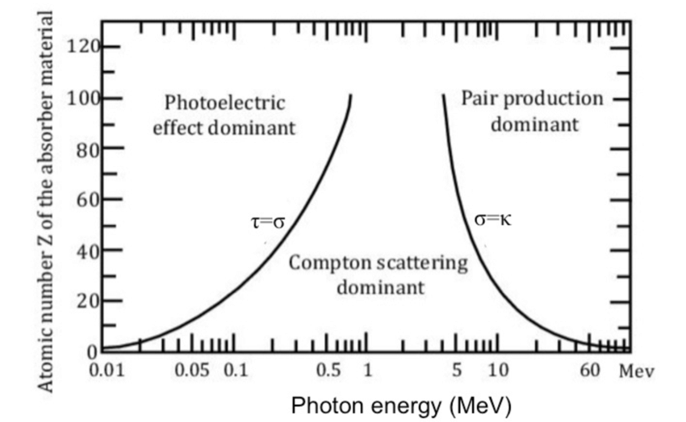
Semiconductor detectors and CdTe
Semiconductor detectors
  High density (low volume for same efficiency)
  High quantum efficiency
  Better spectral performances
Processes of photon-matter interaction
  Photoelectric absorption
  Compton scattering
  Pair production
* At 77K
** @ 100 keV, 5mm thickness
Notes:
Below ~10 keV, astrophysics missions such as XMM–Newton and Chandra use X–ray mirrors based on grazing
incidence reection properties. This allows extremely good angular resolution, down to 0.5arcsec for Chandra, and
a good signal to noise ratio thanks to the focusing of the X–rays onto a small detector surface. This technique has
been so far limited to energies below ~10 keV because of the maximum focal length that can t in a single rocket
fairing. Hard X–ray and gamma–ray imaging instruments thus use a different imaging technique, for example that of
coded masks, as those onboard the INTEGRAL or SWIFT missions. This non-focusing technique has intrinsically a
much lower sensitivity than focusing telescopes and does not allow reaching angular resolutions better than a few arc
minutes. In addition to the difference in angular resolution, there is also roughly two orders of magnitude of difference
in point source sensitivity between X–ray and gamma–ray telescopes.
This transition of techniques unfortunately happens roughly at the energy above which the identication of a
non-thermal component is unambiguous with respect to thermal emission. Considered from the low energy side,
that obviously strongly limits the interpretation of the high quality X–ray measurements in this range, and particularly
those related to the acceleration of particles. Considered from the high-energy side, that prevents the mapping of the
gamma–ray emission of extended sources to the required scales to understand the emission mechanisms by comparison
with lower energy data. The hard X–ray range is the energy domain where fundamental problems of astrophysics
have their essential signatures, either via non thermal emissions characterizing populations of particles accelerated to
extreme energies, or via thermal emissions revealing the presence of very hot comptonizing plasmas as those believed
to exist close to compact objects. In addition, whereas low energy X–rays are stopped by a relatively small amount
of matter, hard X–rays are extremely penetrating and can reveal sources that are otherwise left hidden. This has been
shown in particular by the measurements made by the IBIS/ISGRI instrument, a CdTe based soft gamma-ray imager,
onboard INTEGRAL, which has led to the discovery of a number of highly absorbed sources, mainly pulsars in supergiant
binary systems but also of obscured AGNs, which are fundamental to understand the Cosmic X-ray Background.
A clear requirement for future high-energy astrophysics missions is thus to bridge this gap of sensitivity, by offering
instrumentation in the hard X–ray range with a sensitivity and angular resolution similar to those of the current X–ray
telescopes. In order to take up this challenge, a hard X–ray-focusing optics is mandatory. Such optics can readily be
implemented by a simple extension of the current X–ray mirror technology to long focal lengths.
The straight consequence of using focusing optics to drastically improve the hard X-ray telescopes sensitivity is to
create the corresponding detector planes. The sensors in question must be able to cover a large led of view thus
being in the range of 100 cm2, to sample the point spread function of the mirror system with highest achievable spatial
resolution (500 μm pitch typical) and to get outstanding energy resolution (~1% at 60 keV) without bringing too
many constraints at system level, such as power and mass. Top-level requirements will be rediscussed in 3.3.

Slide 22
Semiconductor detectors and CdTe
Semiconductor detectors
  High density (low volume for same efficiency)
  High quantum efficiency
  Better spectral performances
Processes of photon-matter interaction
  Photoelectric absorption
  Compton scattering
  Pair production
Choice of semiconductor
  Si: 10-15 keV detection
  Ge: cryogenic cooling
  CdTe: low leakage current, high Z (more likely to have photoelectric absorption) and high density (compact)
We are here !
 | Si | Ge | CdTe
Z | 14 | 32 | 48, 52
EPair (eV) | 3,62 | 2,96* | 4,42
Density | 2,33 | 5,33 | 5,85
Qe** | 19% | 77% | 99%
Exemple | XMM | SPI | ISGRI
* At 77K
** @ 100 keV, 5mm thickness
Notes:
Below ~10 keV, astrophysics missions such as XMM–Newton and Chandra use X–ray mirrors based on grazing
incidence reection properties. This allows extremely good angular resolution, down to 0.5arcsec for Chandra, and
a good signal to noise ratio thanks to the focusing of the X–rays onto a small detector surface. This technique has
been so far limited to energies below ~10 keV because of the maximum focal length that can t in a single rocket
fairing. Hard X–ray and gamma–ray imaging instruments thus use a different imaging technique, for example that of
coded masks, as those onboard the INTEGRAL or SWIFT missions. This non-focusing technique has intrinsically a
much lower sensitivity than focusing telescopes and does not allow reaching angular resolutions better than a few arc
minutes. In addition to the difference in angular resolution, there is also roughly two orders of magnitude of difference
in point source sensitivity between X–ray and gamma–ray telescopes.
This transition of techniques unfortunately happens roughly at the energy above which the identication of a
non-thermal component is unambiguous with respect to thermal emission. Considered from the low energy side,
that obviously strongly limits the interpretation of the high quality X–ray measurements in this range, and particularly
those related to the acceleration of particles. Considered from the high-energy side, that prevents the mapping of the
gamma–ray emission of extended sources to the required scales to understand the emission mechanisms by comparison
with lower energy data. The hard X–ray range is the energy domain where fundamental problems of astrophysics
have their essential signatures, either via non thermal emissions characterizing populations of particles accelerated to
extreme energies, or via thermal emissions revealing the presence of very hot comptonizing plasmas as those believed
to exist close to compact objects. In addition, whereas low energy X–rays are stopped by a relatively small amount
of matter, hard X–rays are extremely penetrating and can reveal sources that are otherwise left hidden. This has been
shown in particular by the measurements made by the IBIS/ISGRI instrument, a CdTe based soft gamma-ray imager,
onboard INTEGRAL, which has led to the discovery of a number of highly absorbed sources, mainly pulsars in supergiant
binary systems but also of obscured AGNs, which are fundamental to understand the Cosmic X-ray Background.
A clear requirement for future high-energy astrophysics missions is thus to bridge this gap of sensitivity, by offering
instrumentation in the hard X–ray range with a sensitivity and angular resolution similar to those of the current X–ray
telescopes. In order to take up this challenge, a hard X–ray-focusing optics is mandatory. Such optics can readily be
implemented by a simple extension of the current X–ray mirror technology to long focal lengths.
The straight consequence of using focusing optics to drastically improve the hard X-ray telescopes sensitivity is to
create the corresponding detector planes. The sensors in question must be able to cover a large led of view thus
being in the range of 100 cm2, to sample the point spread function of the mirror system with highest achievable spatial
resolution (500 μm pitch typical) and to get outstanding energy resolution (~1% at 60 keV) without bringing too
many constraints at system level, such as power and mass. Top-level requirements will be rediscussed in 3.3.

Slide 23
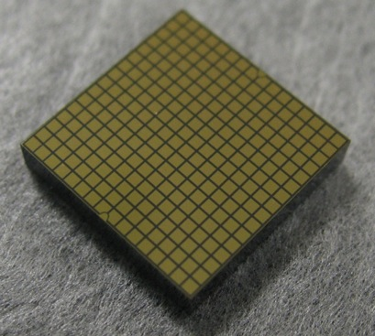
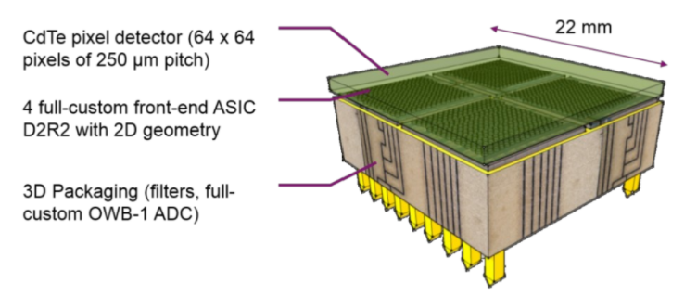
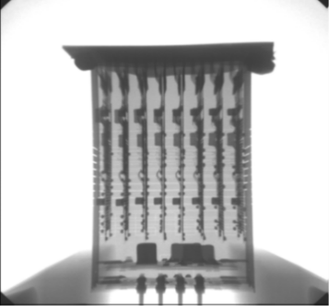
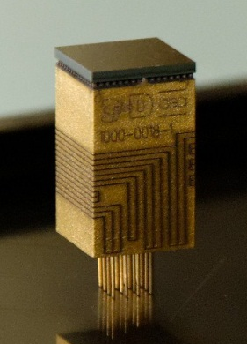
MC²: Mini-Cdte on Chip
What are the ultimate hard X-ray performances for imaging spectroscopy one can achieve ?
Caliste-HD
MC2-4K
Spectral resolution: 670 eV @ 60 keV
Spatiale resolution: 625µm
Pixels: 256 (16x16)
Detection area: 1 cm²
FWHM: 0.5 keV @ 60 keV
Pixels: 64x64 de 0.25x0.25mm²

Slide 24
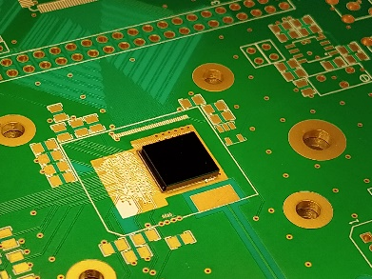
MC²: Mini-Cdte on Chip
What are the ultimate hard X-ray performances for imaging spectroscopy one can achieve ?
Caliste-HD
MC2-1K
Spectral resolution: 670 eV @ 60 keV
Spatiale resolution: 625µm
Pixels: 256 (16x16)
Detection area: 1 cm²
FWHM: 0.5 keV @ 60 keV
Pixels: 32x32 de 0.25x0.25mm²
Abutable for a 64x64 pixels version

Slide 25
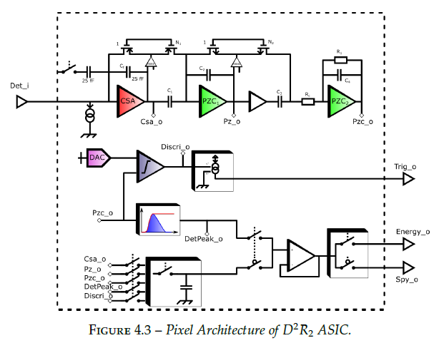
Detector signal acquisition
IdeF-X D2R2:
  32 x 32 matrix Application Specific Integrated Circuit (ASIC)
  Read low leakage current semiconductors
  250 x 250 µm² pixels
x 1024

Slide 26
Detector signal acquisition
IdeF-X D2R2:
  32 x 32 matrix Application Specific Integrated Circuit (ASIC)
  Read low leakage current semiconductors
  250 x 250 µm² pixels
Full spectroscopic chain
x 1024
Current (A)
Charge
Temps (µs)

Slide 27
Detector signal acquisition
IdeF-X D2R2:
  32 x 32 matrix Application Specific Integrated Circuit (ASIC)
  Read low leakage current semiconductors
  250 x 250 µm² pixels
Full spectroscopic chain
  Charge Sensitive Amplifier
x 1024
Tension (V)
Integrate
+ continous reset
Temps (µs)

Slide 28
Detector signal acquisition
IdeF-X D2R2:
  32 x 32 matrix Application Specific Integrated Circuit (ASIC)
  Read low leakage current semiconductors
  250 x 250 µm² pixels
Full spectroscopic chain
  Charge Sensitive Amplifier
  Pole Zero Cancelation
x 1024
Tension (V)
Band pass filter
Temps (µs)

Slide 29
Detector signal acquisition
IdeF-X D2R2:
  32 x 32 matrix Application Specific Integrated Circuit (ASIC)
  Read low leakage current semiconductors
  250 x 250 µm² pixels
Full spectroscopic chain
  Charge Sensitive Amplifier
  Pole Zero Cancelation
  Peak Detector
x 1024
Tension (V)
Keeps Vmax
Temps (µs)

Slide 30
Detector signal acquisition
IdeF-X D2R2:
  32 x 32 matrix Application Specific Integrated Circuit (ASIC)
  Read low leakage current semiconductors
  250 x 250 µm² pixels
Full spectroscopic chain
  Charge Sensitive Amplifier
  Pole Zero Cancelation
  Peak Detector
x 1024
Tension (V)
Keeps Vmax
Ephoton ∝ (Vmax – VBL)
Temps (µs)

Slide 31
Detector signal acquisition
IdeF-X D2R2:
  32 x 32 matrix Application Specific Integrated Circuit (ASIC)
  Read low leakage current semiconductors
  250 x 250 µm² pixels
Full spectroscopic chain
  Charge Sensitive Amplifier
  Pole Zero Cancelation
  Peak Detector
  Discriminator
x 1024
Tension (V)
Triggers
Threshold
Trigger
Temps (µs)

Slide 32
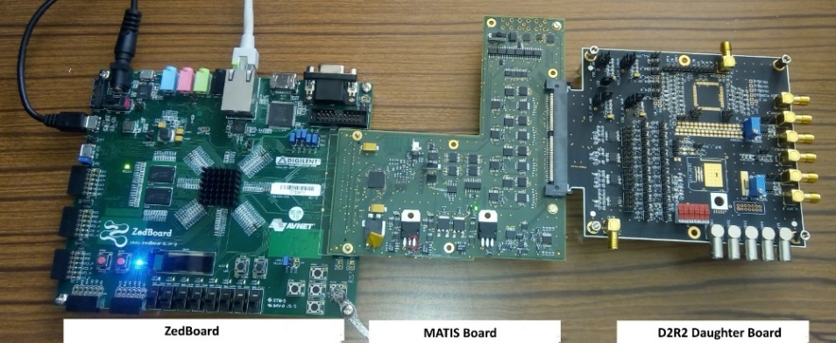
Detector signal acquisition
IdeF-X D2R2:
  32 x 32 matrix Application Specific Integrated Circuit (ASIC)
  Read low leakage current semiconductors
  250 x 250 µm² pixels
Full spectroscopic chain
  Charge Sensitive Amplifier
  Pole Zero Cancelation
  Peak Detector
  Discriminator
Test bench setup
  ZedBoard FPGA
  Generic test board
  Daughter board
  Spy analysis via external ADC
x 1024

Slide 33
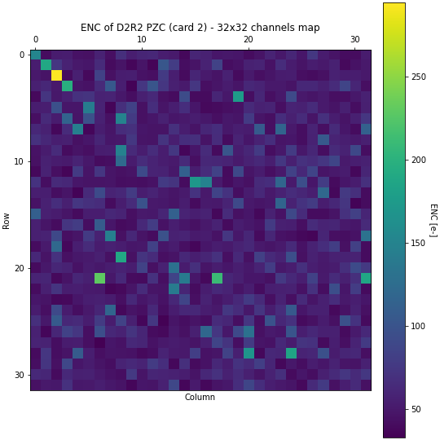
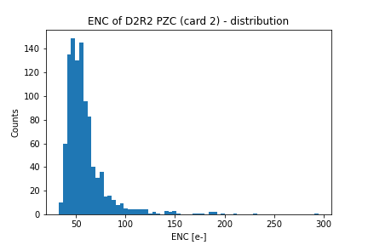


D2R2 performances
ENC computation at the filter output and associated map
 | ASIC 1 | ASIC 2
Gain [µV/e-] | 15.7 +- 0.2 | 15.3 +- 0.1
ENC median [e- R.M.S] | 54 (CdTe: 654 eV @ 31 keV)

Slide 34
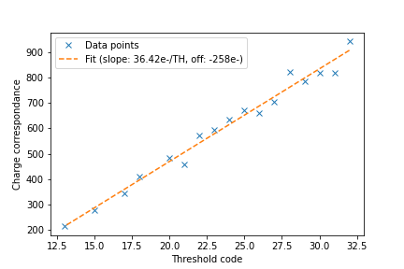
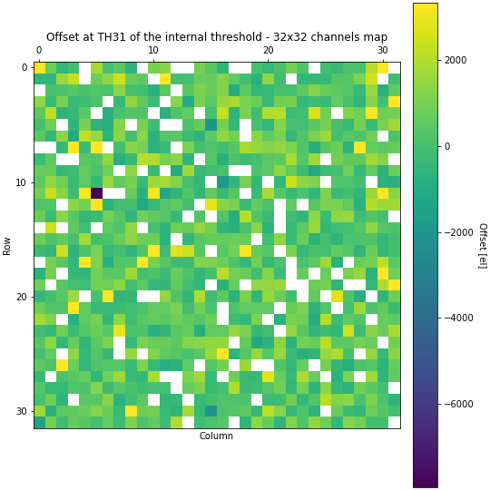
D2R2 performances
ENC computation at the filter output and associated map
Pixel’s internal low energy threshold calibration
 | ASIC 1 | ASIC 2
Gain [µV/e-] | 15.7 +- 0.2 | 15.3 +- 0.1
ENC median [e- R.M.S] | 54 (CdTe: 654 eV @ 31 keV)
Functionnal pix discriminators [%] | 85.6 | 86.3

Slide 35
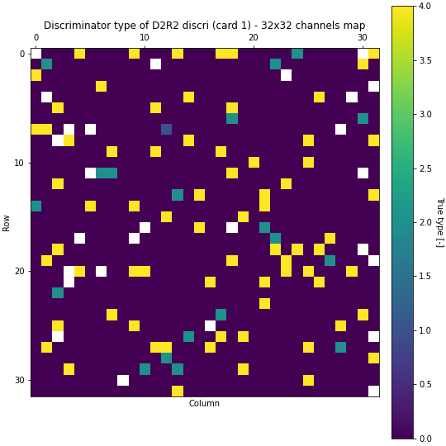
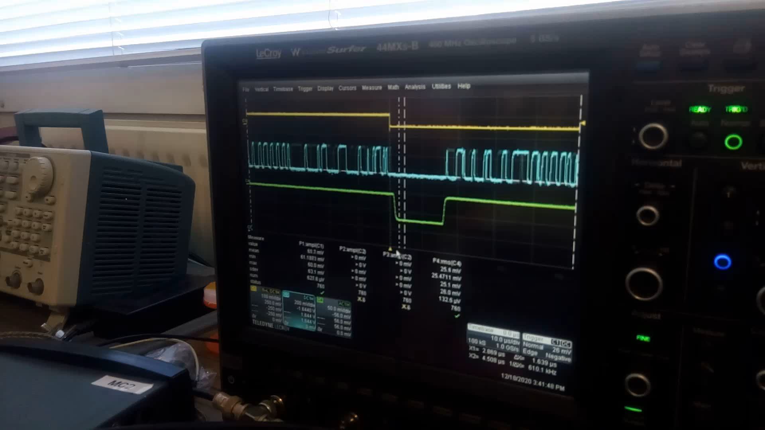
D2R2 performances
ENC computation at the filter output and associated map
Pixel’s internal low energy threshold calibration
No injection: 9.2% pixels triggers
 | ASIC 1 | ASIC 2
Gain [µV/e-] | 15.7 +- 0.2 | 15.3 +- 0.1
ENC median [e- R.M.S] | 54 (CdTe: 654 eV @ 31 keV)
Functionnal pix discriminators [%] | 85.6 | 86.3
Consequences: unstable global trigger signal output → « frame » acquisition mode

Slide 36
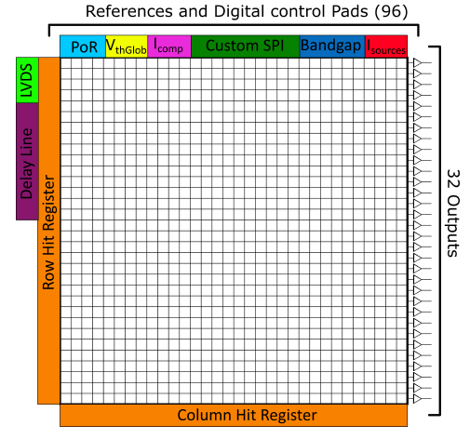
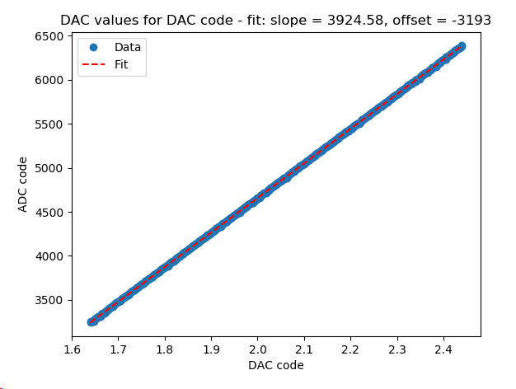
Detector signal acquisition & conversion
OWB-1 ADC:
  32 channels Analog-to-Digital converted
  13 bits resolution
  0.84V to 2.84V (adjustable)
13 bits value
Pixel voltage

Slide 37
Detector signal acquisition & conversion
OWB-1 ADC:
  32 channels Analog-to-Digital converted
  13 bits resolution
  0.84V to 2.84V (adjustable)
Full system « frame » acquisition
  Rolling shutter mode
  Column by column mux
  Select specific areas
x 32

Slide 38
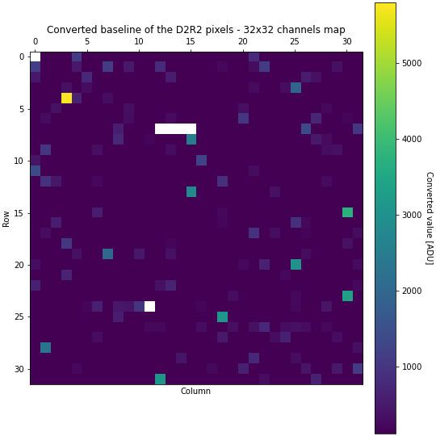
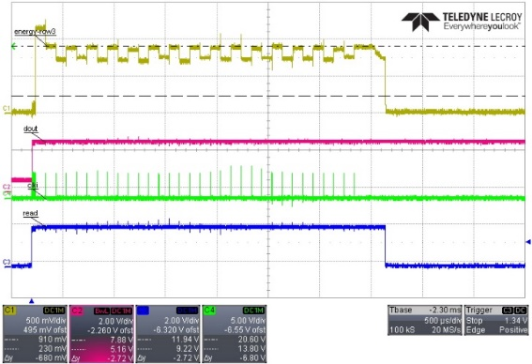
Detector signal acquisition & conversion
OWB-1 ADC:
  32 channels Analog-to-Digital converted
  13 bits resolution
  0.84V to 2.84V (adjustable)
Full system « frame » acquisition
  Rolling shutter mode
  Column by column mux
  Select specific areas
First experiments
  Calibration of channels
  D2R2 baselines acquisition
  Injection over given pixels
Noisy pixel !

Slide 39
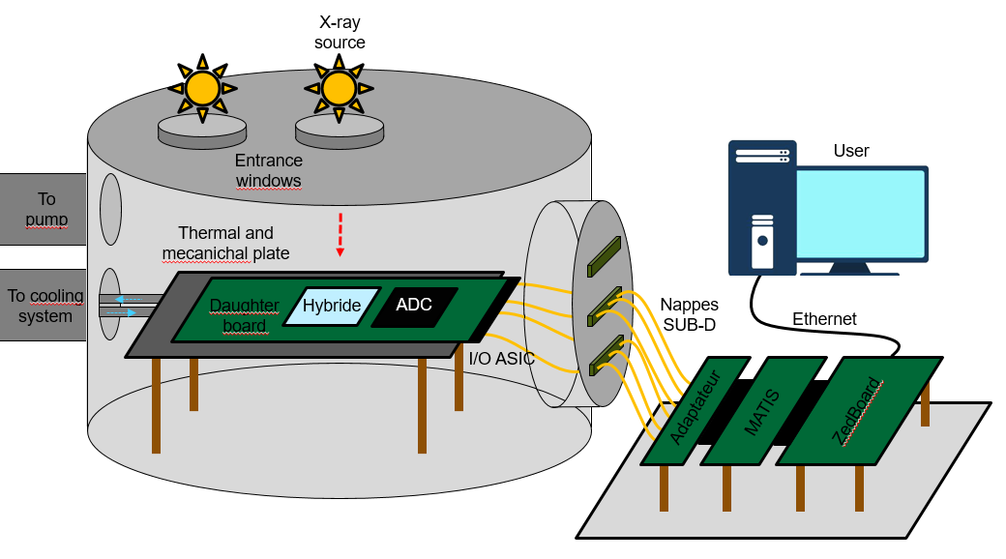
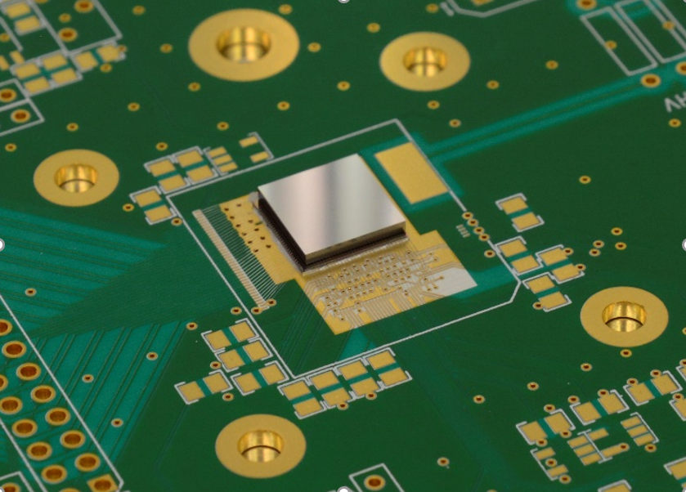
System characterization setup

Slide 40
what’s next ?
First tests and characterization of MC2-1K in the complete acquisition setup
Imaging spectroscopy capability demonstration of the hybrid detector
Temperature and polarisation voltage effects on spectrales performances and stability
Simulation of subpixels measurements capability and comparison to experimental data

Slide 41

Thank you for your attention !

