Slide 1


Meeting FCC-ee
Vacuum
Suheyla BILGEN – Bruno MERCIER – Gaël SATTONNAY
MAVERICS team at IJCLab / IN2P3
November 16, 2021
Réunion R. Kersevan 16/11/2021

Slide 2
Plan
Contexte équipe MAVERICS-IJCLAB/IN2P3
Présentation plateforme Vide&Surfaces
Exemple : NEG
Collaboration CERN 2018-2020 : mesures VPS+désorption ionique
Simulation Vide dynamique DYVACS
Propositions
Réunion R. Kersevan 16/11/2021

Slide 3
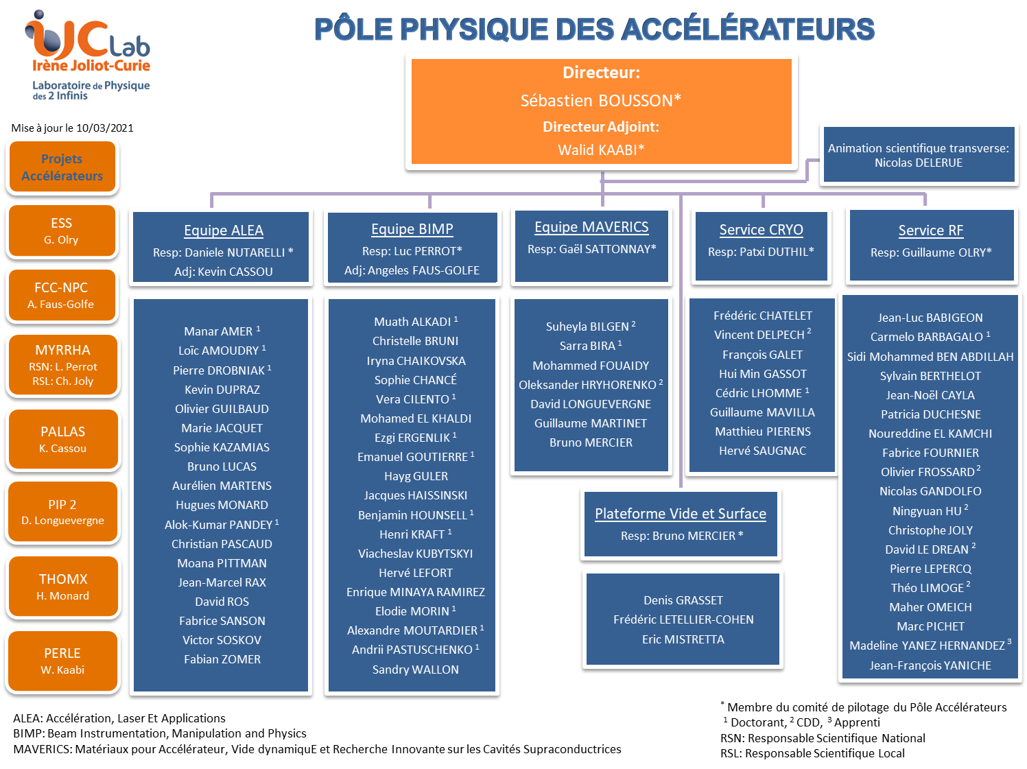
Réunion R. Kersevan 16/11/2021

Slide 4

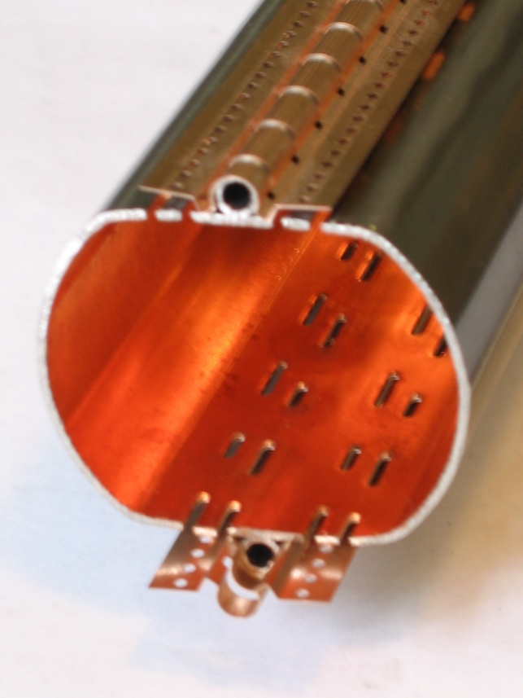
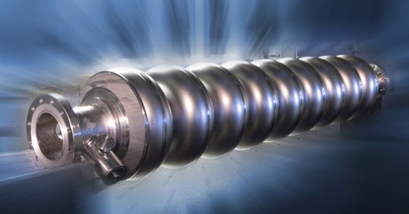
MAVERICS : Thématiques de recherche
Propriétés supraconductrices des surfaces (résistance de surface et blindage magnétique des cavités SRF)
Vide Dynamique
  désorption stimulée
  phénomènes collectifs (nuages d’électrons dans le LHC)
Modifications par irradiation (électrons, photons, ions) des propriétés de surface des matériaux (émission électronique secondaire, désorption moléculaire, chimie de surface)
But : Améliorer les performances des accélérateurs de particules de haute énergie
 | Cavités SRF |  | Lignes faisceaux / chambres à vide
 | Augmenter les gradients accélérateur Réduire les pertes RF | Limiter le multipacting |  | Limiter les augmentations de pression
Traitements de surface | Niobium massif : thermique, dopage/ infusion N, polissage (Projets HELOISE et PACCAS du MP SRF) | Traitements thermiques Conditionnement des surfaces Nettoyage plasma, UV |  |  | Traitements de surface
Couches minces | Matériaux alternatifs : multicouches supraconductrices S-I-S (Projet AXE SRF du MP SRF) | TiN, Carbone amorphe, NEG (Projet MULTIPAC du MP SRF + CNRS 80PRIME) |  |  | Couches minces
→ Analyses de surface des matériaux → Plateforme Vide et Surfaces
-Participation à des projets de conception / construction d'accélérateurs du Pôle (ESS, MYRRHA, PIP2)
-Participation au Groupe Transverse FATI (fabrication additive métallique) / Projet FABBAC
Réunion R. Kersevan 16/11/2021

Slide 5
Plan
Contexte équipe MAVERICS-IJCLAB/IN2P3
Présentation plateforme Vide&Surfaces
Exemple : NEG
Collaboration CERN 2018-2020 : mesures VPS+désorption ionique
Simulation Vide dynamique DYVACS
Propositions
Réunion R. Kersevan 16/11/2021

Slide 6
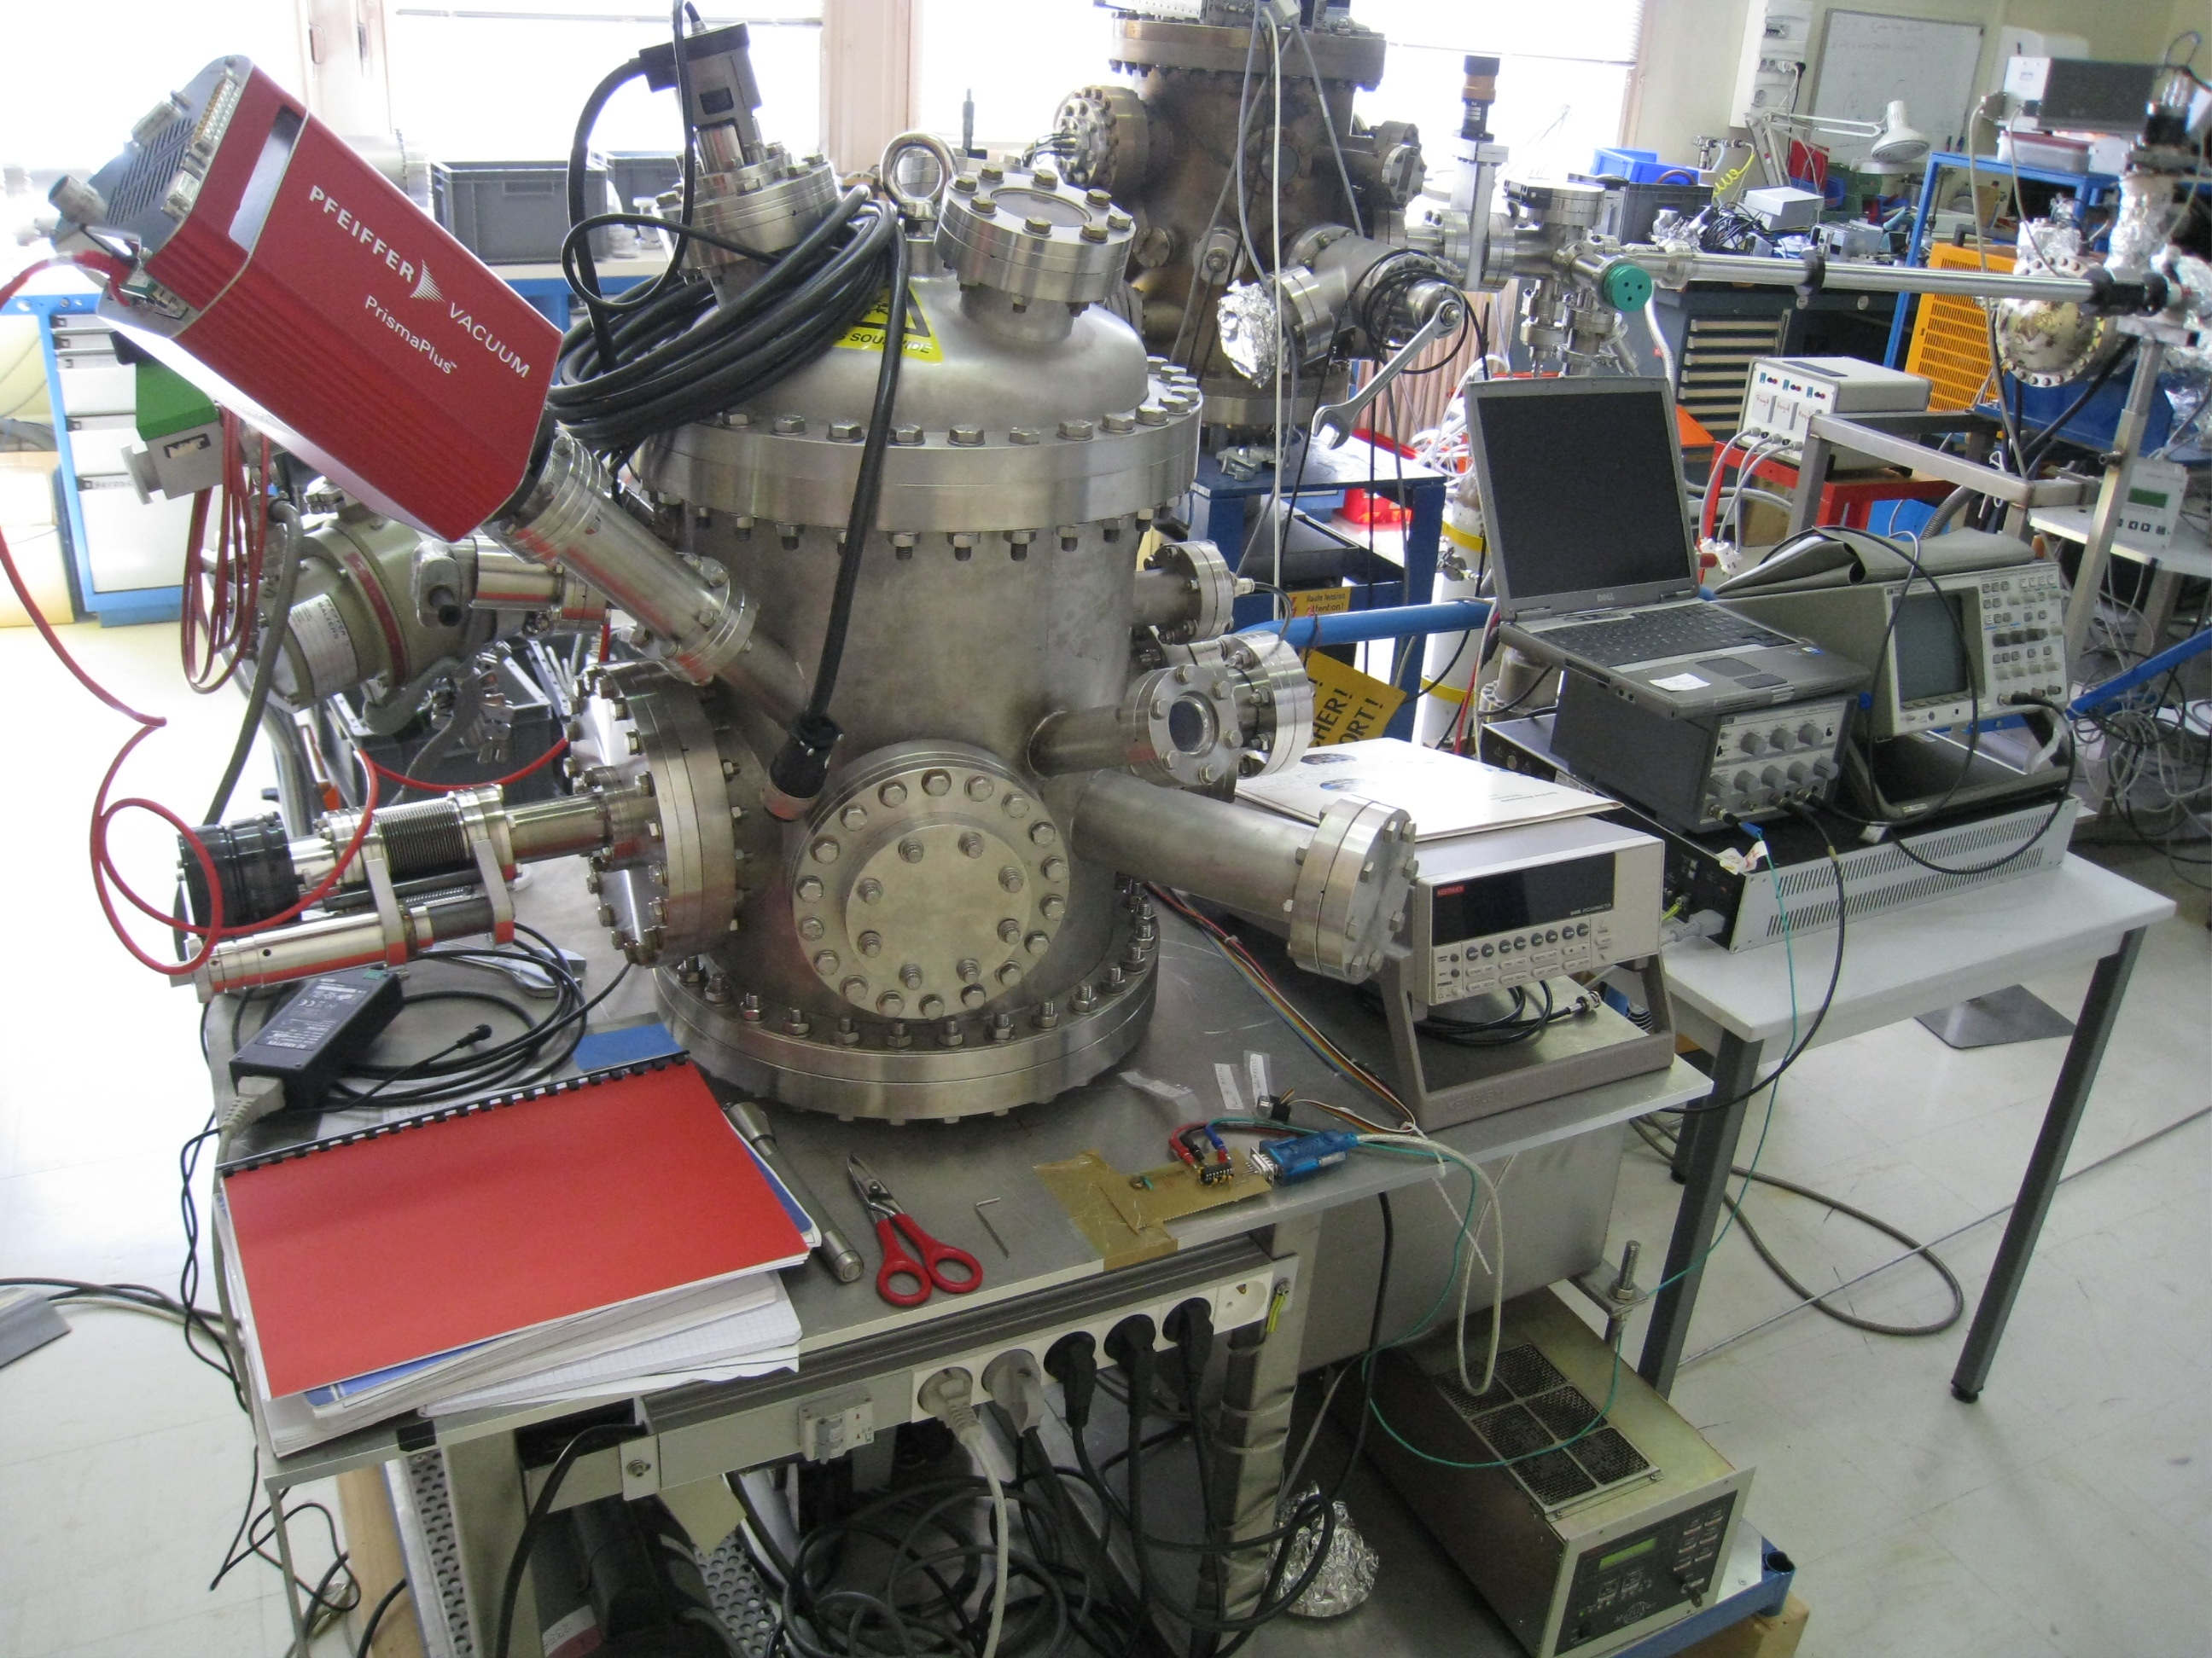
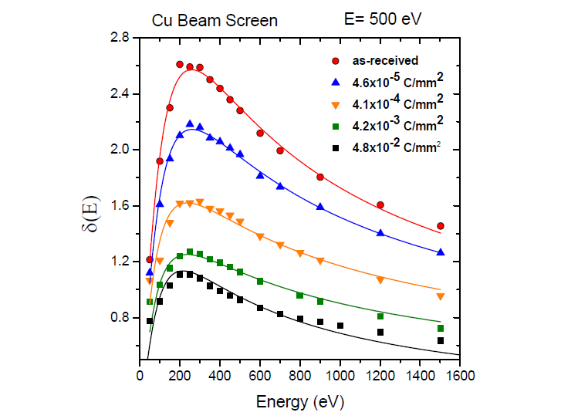
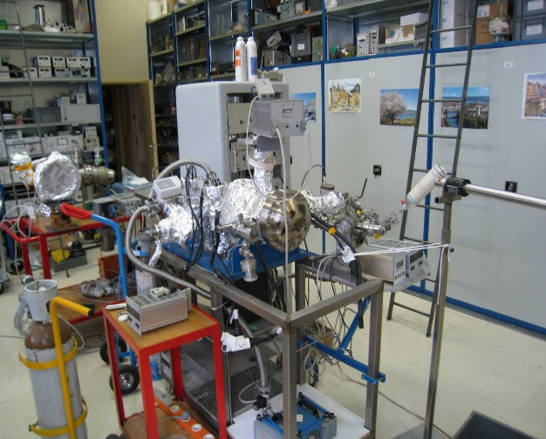
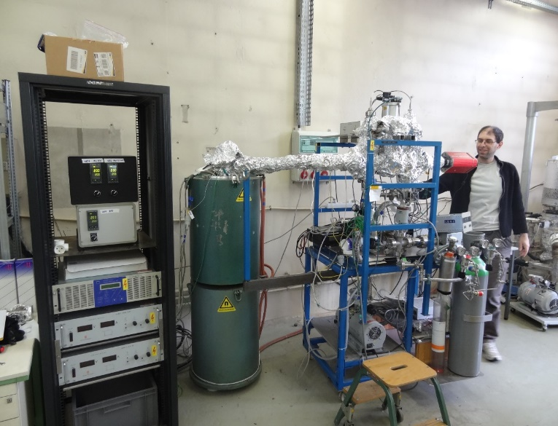
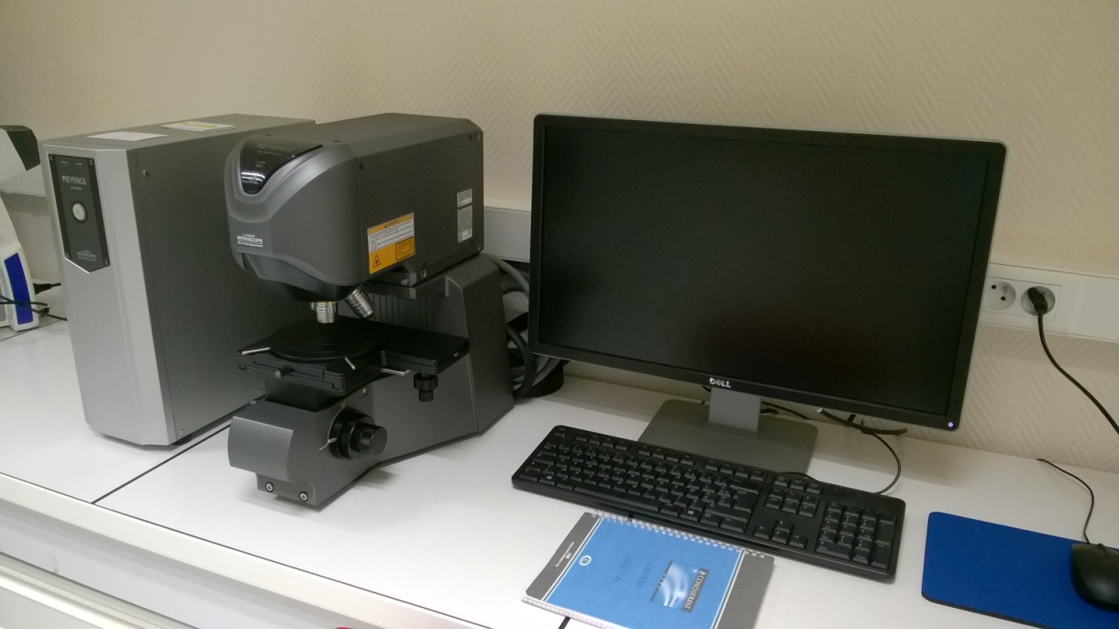
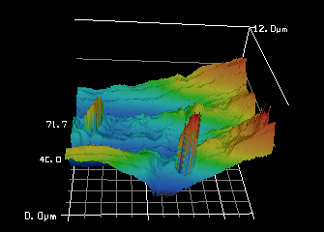
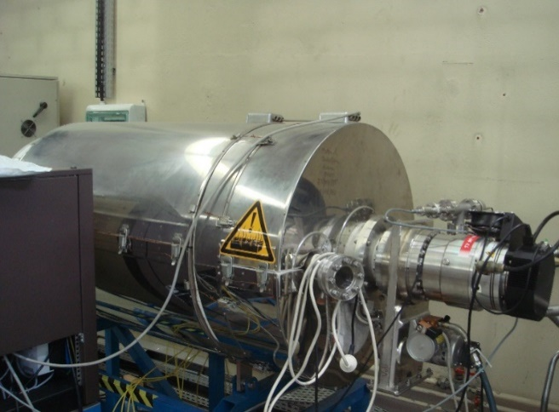
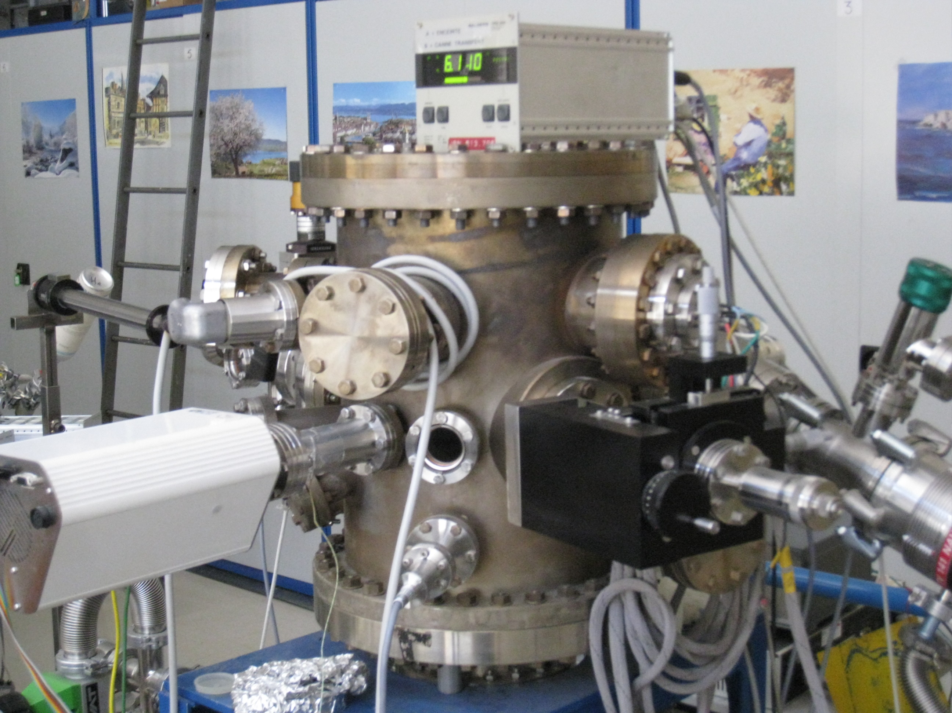
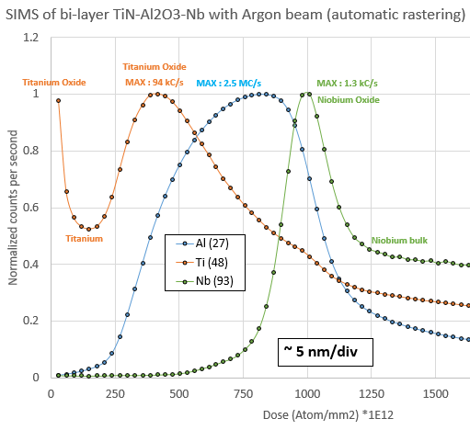
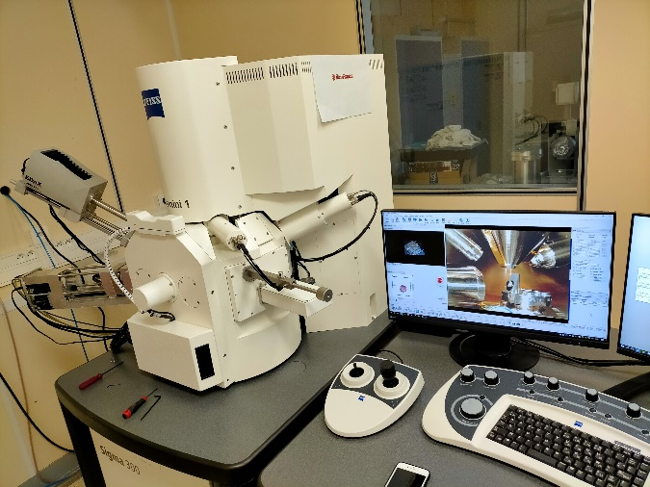
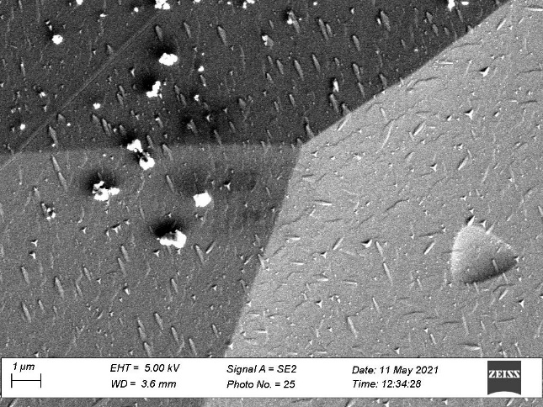
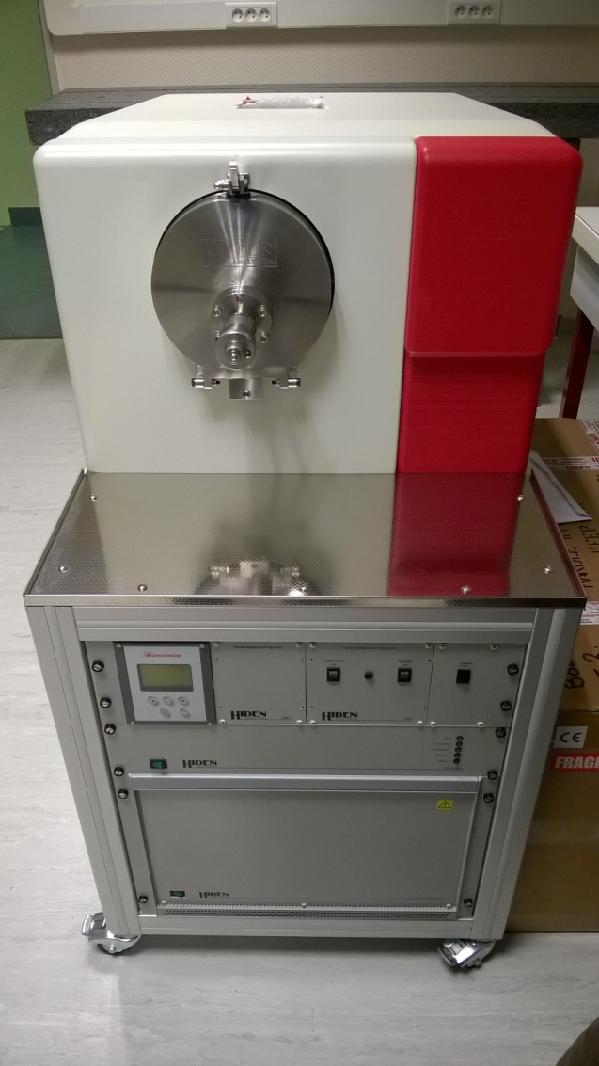
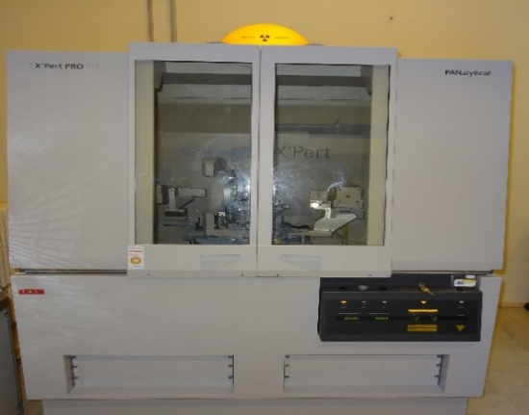
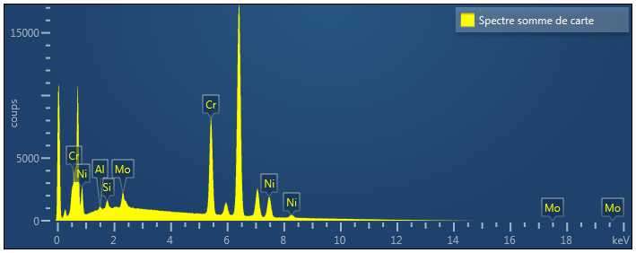
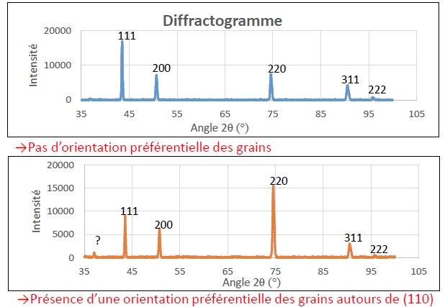
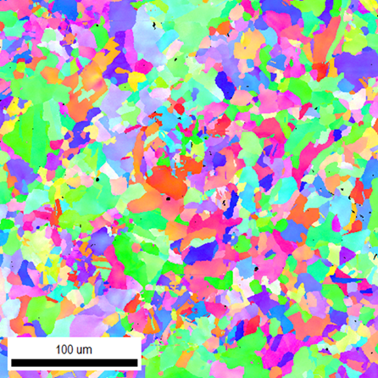
Accelerator Department
Equipment of the V&S Platform (some Examples)
Pôle accélérateurs
dedicated to characterization and surface analysis of materials used in accelerator technology
Secondary Electron Yield (SEY)
outgassing rate
NEG coating chamber (Ti,Zr,V)
Confocal Microscope
surface roughness
Thèse S. Bilgen
VKX200 de Keyence
Heat treatment (H2)
molecular desorption energy
scanning electron microscope
Secondary Ion Mass Spectrometry (SIMS)
X-ray difractometer
Surface Structure and Texture
Composition (EDS)
Structural (EBSD)
    Compact SIMS Hiden Analytical
Profile of bi-layer TiN/Al2O3/Nb
Thèse S. Birra
Réunion R. Kersevan 16/11/2021

Slide 7
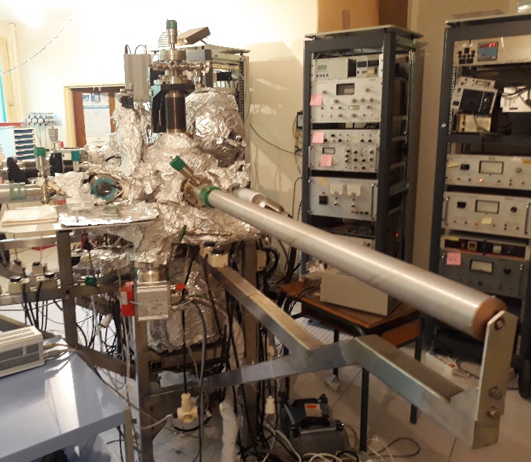
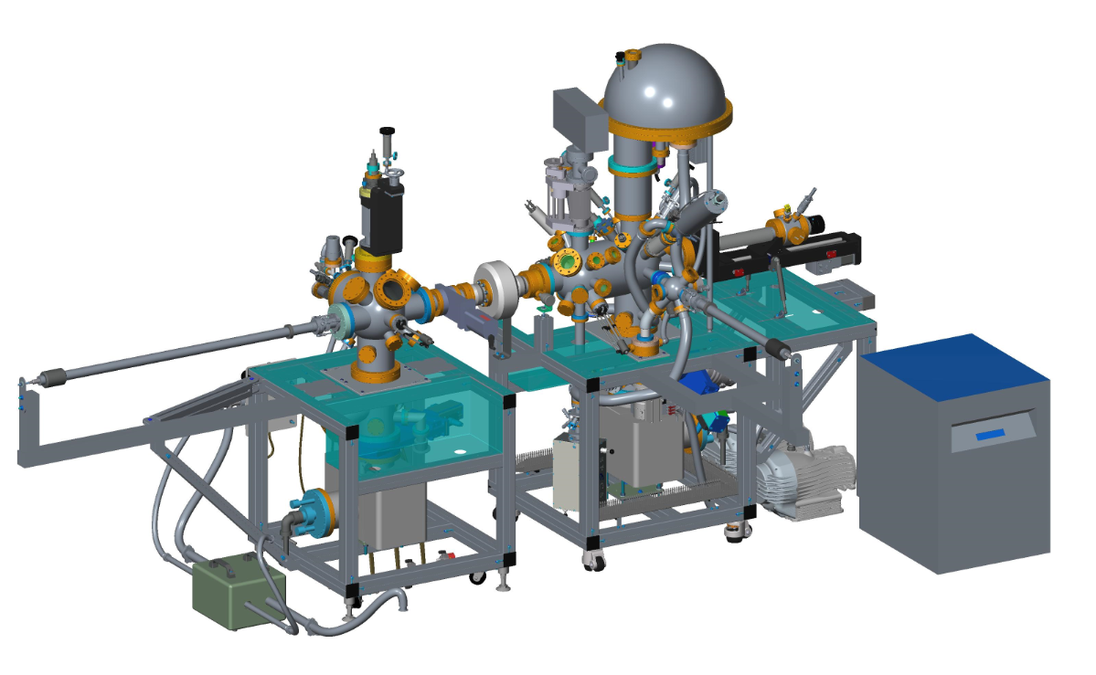
Emission électronique secondaire / Analyses de surfaces
Bâti mesure SEY
ISIS (ICMMO)
SEY
+Analyse de surfaces/XPS
+ mesures haute T
+Conditionnement NEG in situ
e
Bâti multitechnique
SEY
+Analyse de surfaces (XPS)
+mesures basse T (10K)
Analyse de surfaces
XPS de routine
2022/2023
EQUIPEX PACIFICS
Réunion R. Kersevan 16/11/2021

Slide 8

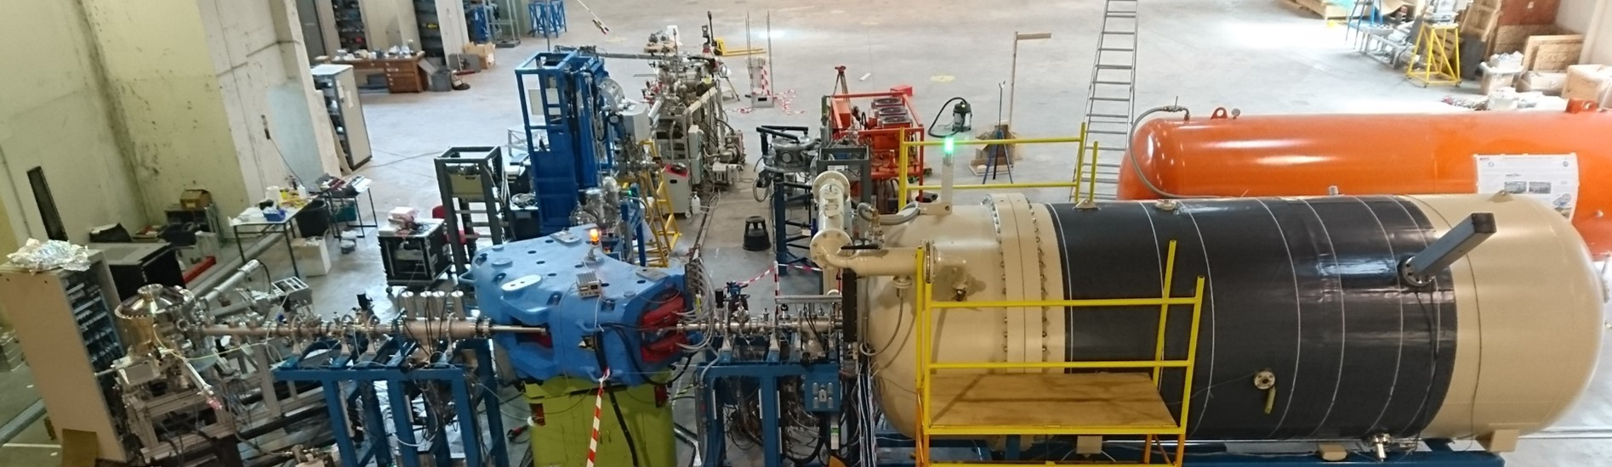
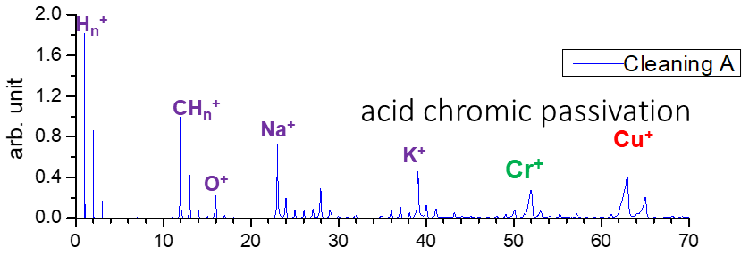
Plateforme ANDROMEDE IJCLab : TOF-SIMS
Analysis of contaminants
3 MV
SuperACO
Sample
12MeV – Au₄₀₀⁴⁺ nanoparticle beam
Carbon on the surface of a fully conditioned Cu
Graphene reference sample
TOF-SIMS : a graphitic (graphene) carbon layer is formed on the surface of the fully conditioned sample (with a large amount of H).
Réunion R. Kersevan 16/11/2021

Slide 9
Plan
Contexte équipe MAVERICS-IJCLAB/IN2P3
Présentation plateforme Vide&Surfaces
Exemple : NEG
Collaboration CERN 2018-2020 : mesures VPS+désorption ionique
Simulation Vide dynamique DYVACS
Propositions
Réunion R. Kersevan 16/11/2021

Slide 10
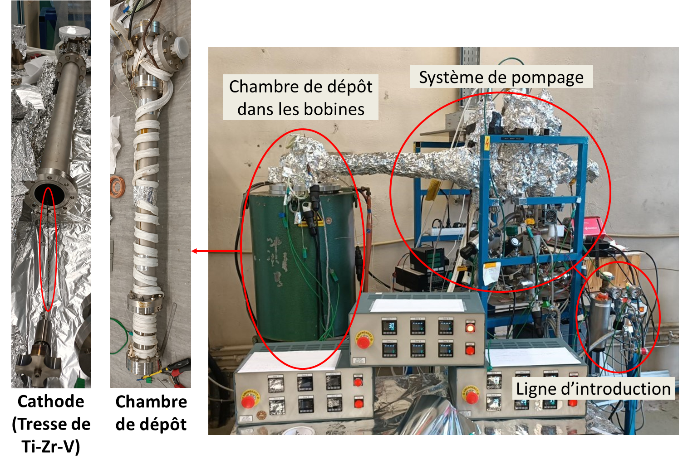
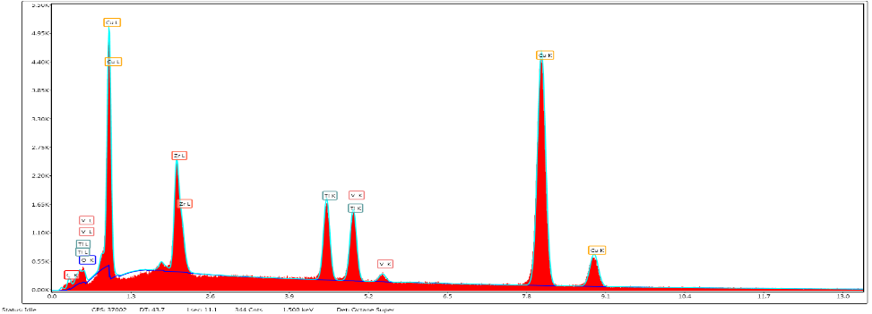
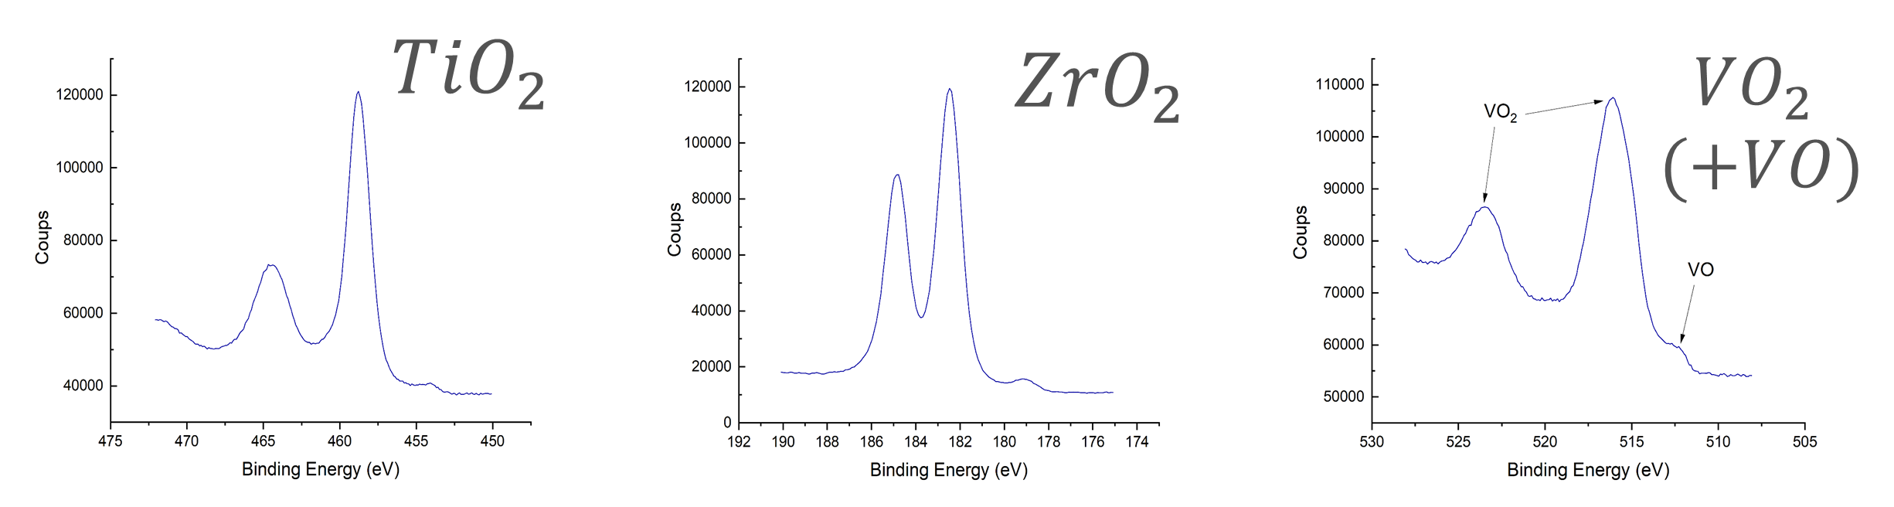
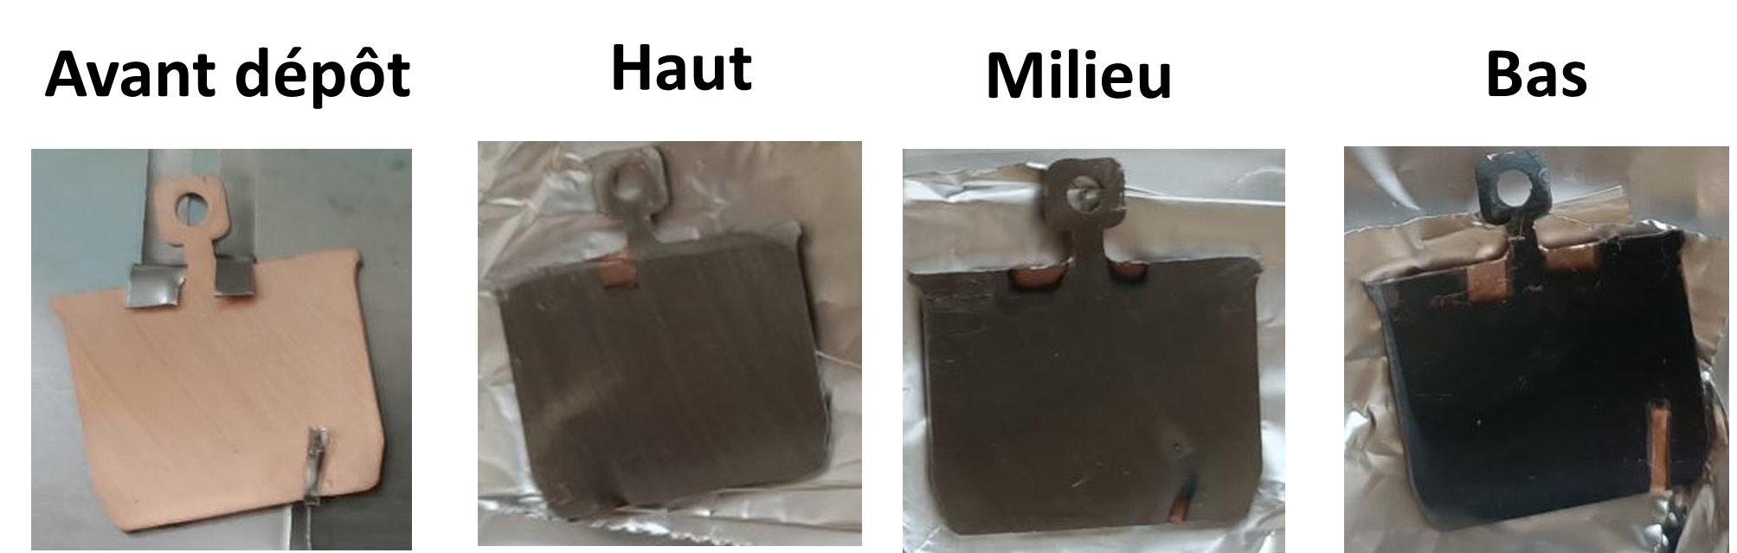
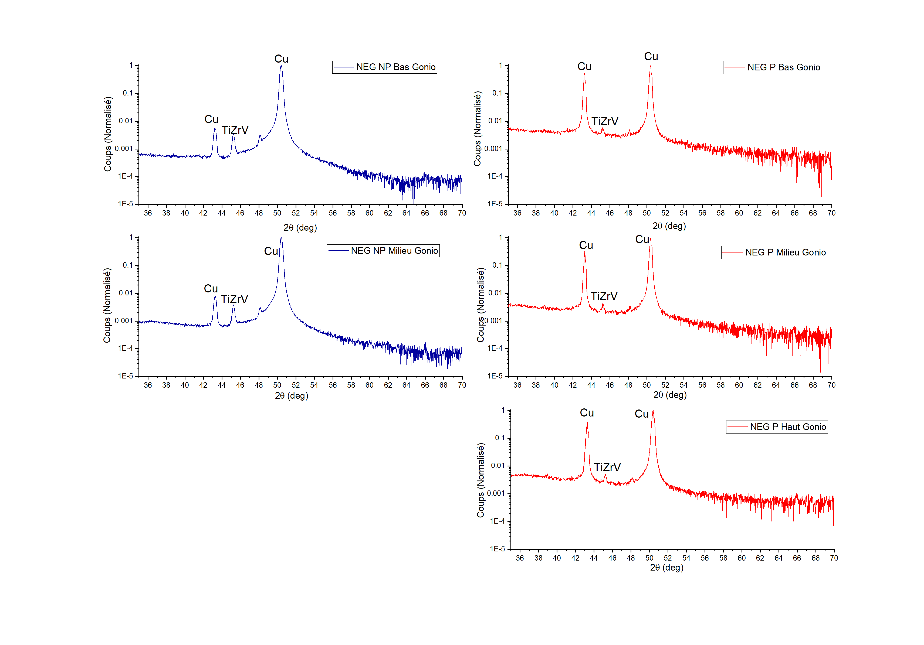
NEG coating – preliminary results
SEM
270 nm
25,4at% Zr
39,5at% Ti
35,1at% V
XPS
XRD
Réunion R. Kersevan 16/11/2021

Slide 11
Plan
Contexte équipe MAVERICS-IJCLAB/IN2P3
Présentation plateforme Vide&Surfaces
Exemple : NEG
Collaboration CERN 2018-2020 : mesures VPS+désorption ionique
Simulation Vide dynamique DYVACS
Propositions
Réunion R. Kersevan 16/11/2021

Slide 12
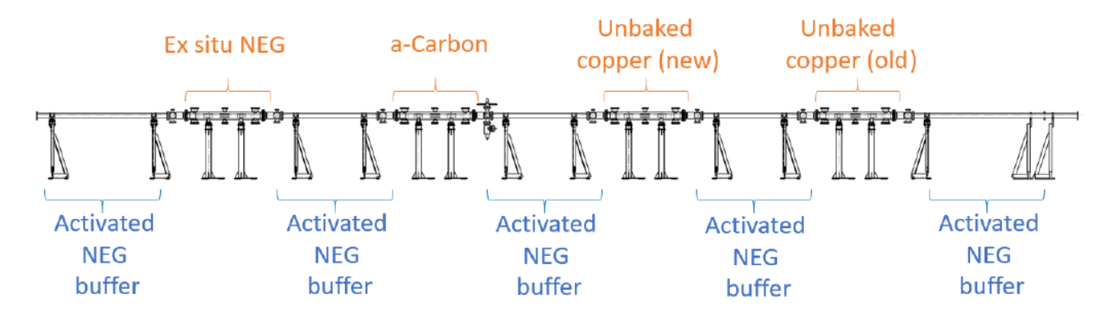
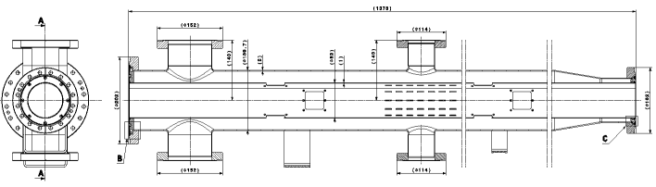
Collab CERN – V. Baglin – Thèse S. Bilgen
Vacuum Pilot Sector
Instruments
Vacuum port
Vacuum
enveloppe
Liner
Vacuum port
Réunion R. Kersevan 16/11/2021

Slide 13
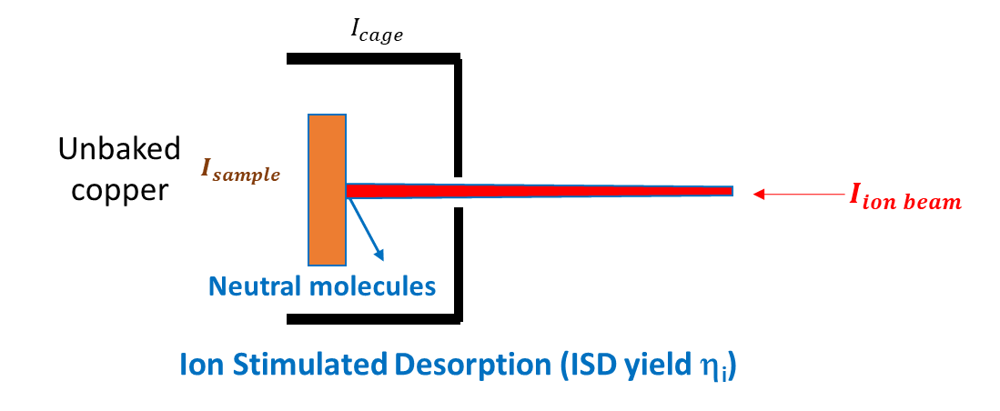
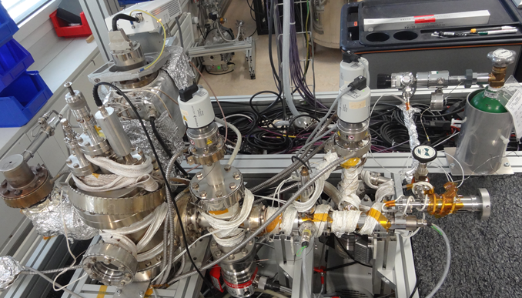
Collab CERN – V. Baglin – Thèse S. Bilgen
Set up : Ion stimulated desorption
base pressure: 5x10⁻¹⁰ mbar
Gases used: Ar, H2, CO
Continuous beam
Beam current: pA up to 300 nA
Beam energy: 200 eV to 5keV
Réunion R. Kersevan 16/11/2021

Slide 14
Plan
Contexte équipe MAVERICS-IJCLAB/IN2P3
Présentation plateforme Vide&Surfaces
Exemple : NEG
Collaboration CERN 2018-2020 : mesures VPS+désorption ionique
Simulation Vide dynamique DYVACS
Propositions
Réunion R. Kersevan 16/11/2021

Slide 15





DYVACS - Gas density profiles in presence of e-cloud
Analytical model of the dynamic pressure – DYVACS – DYnamic VACuum Simulation code
$C_{j}\frac{∂^{2}n_{j}}{{∂x}^{2}}+{\text{D}}_{ion−j}\text{ + }{\text{D}}_{e−j}+{\text{D}}_{ph−j}+D_{th−j}−S∙n_{j}=0$
DYVACS is based on the gas balance differential equation (VASCO)
It is used to compute the gas density n_{j}
for j= H₂, CH₄, CO, CO₂
Boundary conditions: continuity of flux and pressure between each segment
For the LHC
Synchrotron
Radiation
e- accelerated
multipacting
Photo e⁻
e _
p⁺
p⁺
p⁺
Secondary e-
e⁻
Electron cloud
ions
e⁻
Evolution of the e-cloud is explicitly taken into account
Réunion R. Kersevan 16/11/2021
15

Slide 16
DYVACS - Gas density profiles
Analytical model of the dynamic pressure – DYVACS – Dynamic VACuum Simulation code
$C_{j}\frac{∂^{2}n_{j}}{{∂x}^{2}}+{\text{D}}_{ion−j}\text{ + }{\text{D}}_{e−j}+{\text{D}}_{ph−j}+D_{th−j}−S∙n_{j}=0$
Residual gas ionization
by the p beam
by the EC
for i= H₂, CH₄, CO, CO₂
Synchrotron
Radiation
e- accelerated
e _
p⁺
p⁺
p⁺
Secondary e-
e⁻
Electron cloud
ions
Inputs: C_{j},,${\text{h}}_{i,j}$, ${\text{h}}_{e,j}$, ${\text{h}}_{ph,j}$,${\text{G}}_{i}, {\text{G}}_{e}$, ${\text{G}}_{ph}$, $q_{th,j}$, S_{j} , σ_{p→i,} σ_{e→i} , I_{beam} , ${\text{ρ}}_{e}$, $v_{e}$,
Réunion R. Kersevan 16/11/2021
16

Slide 17

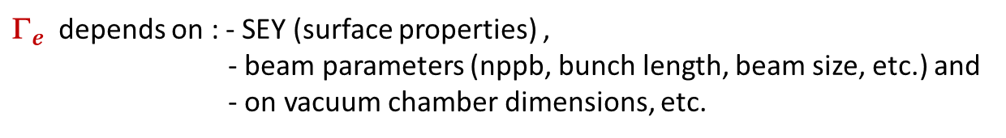
DYVACS - Gas density profiles
Analytical model of the dynamic pressure – DYVACS – Dynamic VACuum Simulation code
$C_{j}\frac{∂^{2}n_{j}}{{∂x}^{2}}+{\text{D}}_{ion−j}\text{ + }{\text{D}}_{e−j}+{\text{D}}_{ph−j}+D_{th−j}−S∙n_{j}=0$
${\text{D}}_{e,j} =$ ${\text{h}}_{e,j}{\text{G}}_{e}$
* ${\text{G}}_{e} EC$density computed with « the map model »
T. Demma et al. Model
${\text{G}}_{e}$ depends on : - SEY (surface properties) ,
- beam parameters (nppb, bunch length, beam size, etc.) and
- on vacuum chamber dimensions, etc.
Synchrotron
Radiation
e- accelerated
e _
p⁺
p⁺
p⁺
Secondary e-
e⁻
Electron cloud
ions
e⁻
Inputs: C_{j},,${\text{h}}_{i,j}$, ${\text{h}}_{e,j}$, ${\text{h}}_{ph,j}$,${\text{G}}_{i}, {\text{G}}_{e}$, ${\text{G}}_{ph}$, $q_{th,j}$, S_{j} , σ_{p→i,} σ_{e→i} , I_{beam} , ${\text{ρ}}_{e}$, $v_{e}$, a, b, c, size of the segment, radius BP, E_{beam}, time of one turn, etc.
Réunion R. Kersevan 16/11/2021
17

Slide 18


DYVACS - Gas density profiles in presence of e-cloud
Analytical model of the dynamic pressure – DYVACS – DYnamic VACuum Simulation code
$C_{j}\frac{∂^{2}n_{j}}{{∂x}^{2}}+{\text{D}}_{ion−j}\text{ + }{\text{D}}_{e−j}+{\text{D}}_{ph−j}+D_{th−j}−S∙n_{j}=0$
Many inputs are necessary → measurements in laboratory are needed!
It is possible to play with all phenomena independently!
Synchrotron
Radiation
e- accelerated
e _
p⁺
p⁺
p⁺
Secondary e-
e⁻
Electron cloud
ions
e⁻
Inputs: C_{j},,${\text{h}}_{i,j}$, ${\text{h}}_{e,j}$, ${\text{h}}_{ph,j}$,${\text{G}}_{i}, {\text{G}}_{e}$, ${\text{G}}_{ph}$, $q_{th,j}$, S_{j} , σ_{p→i,} σ_{e→i} , I_{beam} , ${\text{ρ}}_{e}$, $v_{e}$, a, b, c, size of the segment, radius BP, E_{beam}, time of one turn, etc.
Réunion R. Kersevan 16/11/2021
18

Slide 19
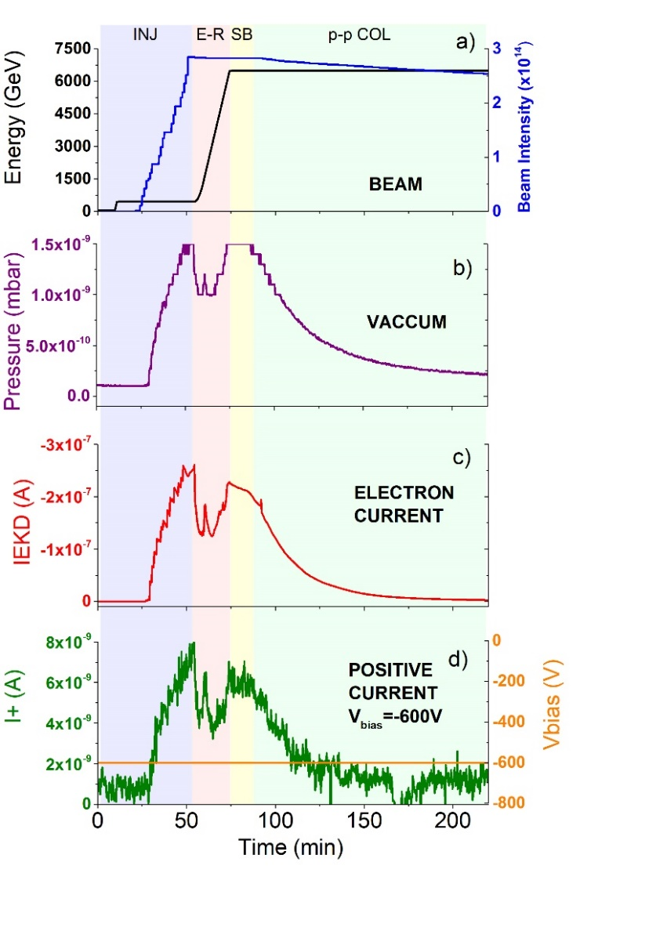
DYVACS - Gas density profiles
Comparison between in situ measurements in the LHC and the DYVACS simulation
In situ beam intensity and energy evolution
In situ pressure measurement (VPS Station N°4)
Réunion R. Kersevan 16/11/2021

Slide 20
DYVACS - Gas density profiles
Comparison between in situ measurements in the LHC and the DYVACS simulation
For a=1,4 (SEY=1,6); b=[0; -5] variation of the b factor by DYVACS; c=0
Experimental pressure (pink line)
computed pressure using DYVACS with EC (blue line)
and without EC (green line)
A good agreement was observed in a short computation time, between the in situ pressure measurements and DYVACS simulation
Réunion R. Kersevan 16/11/2021

Slide 21
DYVACS - Gas density profiles
Pressure time evolution measurements vs DYVACS simulations
inputs:
Same ESD,PSD and ISD used.
a fixed for a constant SEY
b is computed as a function of nppb.
All calculations reproduce with a good agreement the in situ pressure evolution measured in station 4 (unbaked copper) of VPS in the LHC.
Réunion R. Kersevan 16/11/2021

Slide 22
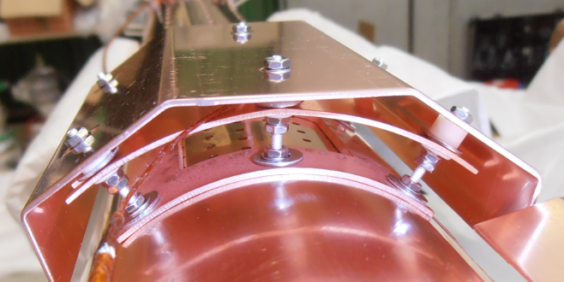
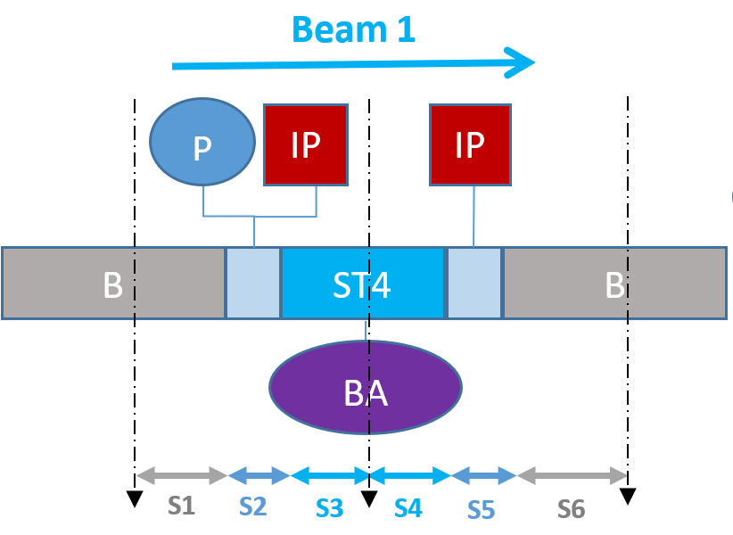
DYVACS - Gas density profiles
V. BAGLIN, meeting, CERN, 5th Dec. 2017
Distribution of partial pressures along the pipe
Distribution of partial pressures for H₂, CO₂, CO and CH₄ along the Cu station 4
Instruments
Vacuum port
Vacuum
enveloppe
Liner
Vacuum port
DYVACS reproduces the evolution of the partial pressures for H₂, CO₂, CO and CH₄ during beam operation
H₂ has the highest partial pressure
Réunion R. Kersevan 16/11/2021

Slide 23
DYVACS - Gas density profiles
Distribution of partial pressures for H₂, CO₂, CO and CH₄ along the Cu station 4
DYVACS reproduces the evolution of the partial pressures for H₂, CO₂, CO and CH₄ during beam operation
Réunion R. Kersevan 16/11/2021

Slide 24
Propositions
Four main axes:
measurement of the Secondary Emission Yield (SEY) a fundamental parameter for multipacting + influence of the surface chemistry+ conditioning
    Characterization of materials in the Vide&Surfaces platform + ANDROMEDE
    Thin films of NEG (influence of thickness)
(ii) the Ion Stimulated Desorption (ISD) focused in FCCee (ion cloud for e- beam)
    qualification/validation of the set up : ISD measurements on copper / C-coating
    Set up improvement : implementation of a protocol to perform measurements on activated NEG (activation in situ in the set up)
(iii) New measurements in the VPS during the next LHC RUN : NEG behaviour in the VPS (study of the e-cloud for the FCC e+ ring)
(iv) the dynamic pressure simulation code development (DYVACS)+comparison with measurements
    Consolidate the DYVACS model by comparing it with new measurements in the VPS during the next RUN
Réunion R. Kersevan 16/11/2021

