Slide 1
FCC-ee Arc Vacuum System and Synchrotron Radiation
Adapted from presentation
FCC Week 2021 (28 June 2021 - 2 July 2021) · Indico (cern.ch)
R. Kersevan*
* Reporting for the Vacuum Surfaces and Coatings group, TE Dept., CERN

Slide 2
Outline
Relevant machine and vacuum parameters
Vacuum chamber cross section
Synchrotron radiation spectrum, flux, power
SR absorbers: yes or no?
Pumping solutions
Pressure profiles
Future work: prototyping, experiments, …

Slide 3
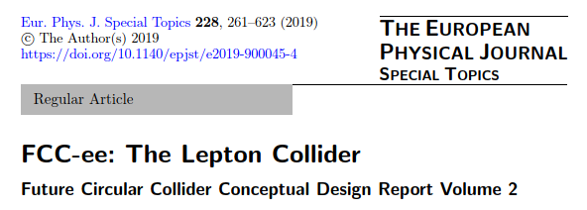
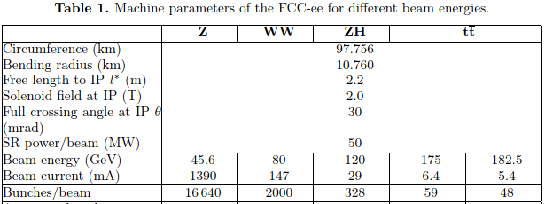
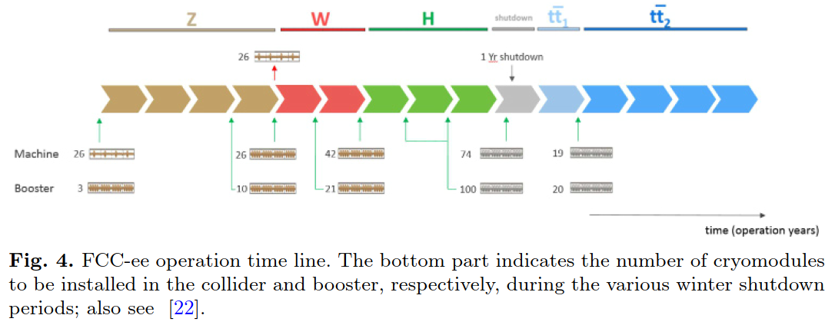
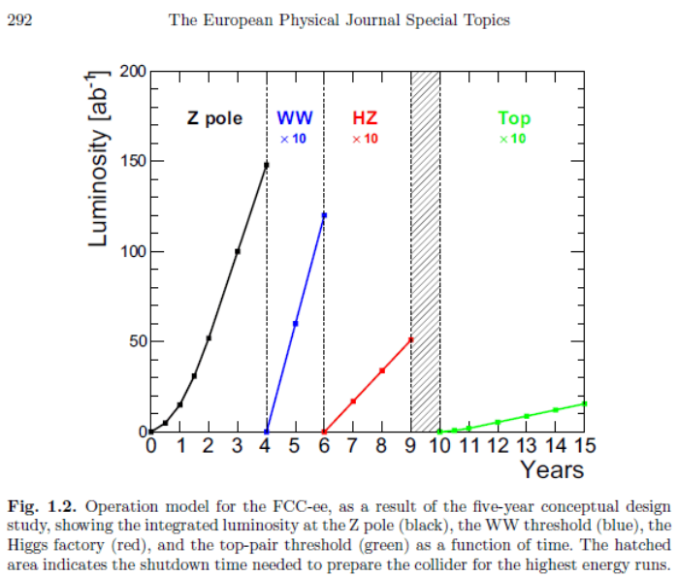
Relevant machine and vacuum parameters
Big variation of nominal current vs beam energy, since all machine versions are limited to 50 MW of synchrotron radiation per beam
P (W) = 88.46 · E⁴(GeV) · I(mA) / ρ(m)
F (ph/s) = 8.08·10¹⁷ · E(GeV) · I(mA)
We aim at an average pressure giving a beam-gas scattering lifetime large enough not to be detrimental to the integrated luminosity, say in the low 10-9 mbar range, or better, with a gas composition of 80~90% hydrogen, and no molecular masses above 44 (CO₂).
Typically, 80~90% H₂, 10~20% CO+CO₂, traces of CH₄

Slide 4
Vacuum chamber cross section
The choice of the vacuum chamber cross section is dictated by many different effects and requirements:
Minimize time to condition (to speed-up integrated luminosity at Z, most difficult case, vacuum wise)
Minimize beam-gas scattering effects, i.e. minimize pressures and improve pumping efficiency
Deal with large flux of Compton-scattered secondaries (at WZ, H, ttbar)
Keep fabrication complexity to a minimum (2x 98 km rings!(*));
Satisfy impedance requirements (geometric and resistive-wall as well)
(*) recent resizing/repositioning of the rings’ footpath, in order to avoid “forbidden” areas in CH and FR, and allow vertical access at depth not too deep. New circumference ~ 91.5 km

Slide 5
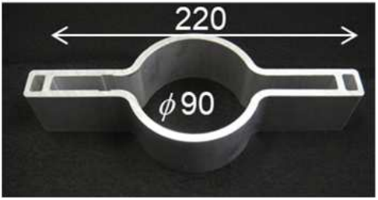
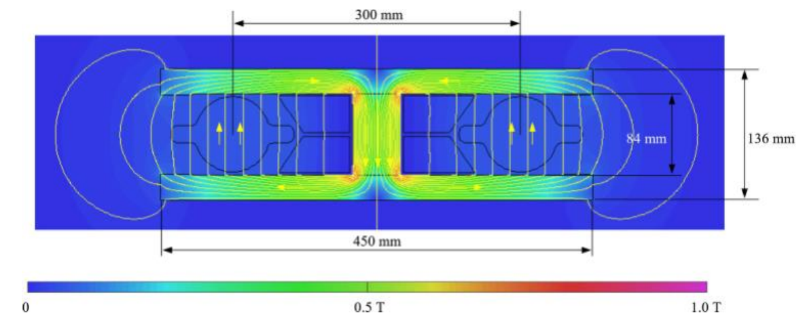
Vacuum chamber cross section
For this reasons we have proposed, in the CDR, to adopt a modification of the SuperKEKB vacuum chamber cross section (*), i.e. a circular chamber with two small symmetric “winglets” in the plane of the orbit
The diameter of the circular part is 70 mm (ID), vs 90 for SuperKEKB; vertical gap in our dipoles is 84 mm, same as the inscribed circle in the quadrupoles
The winglets we can accommodate taking into account the 300 mm horizontal beam-beam separation and the structure of the common-yoke dipoles and quadrupoles (**) are smaller than those of SuperKEKB. In our case the horizontal width is only 120 mm
(*) Y. Suetsugu, this conference
(**) J. Bauche, this conference

Slide 6
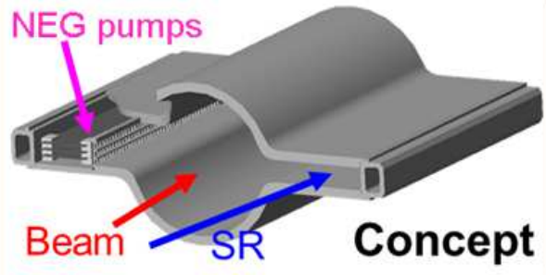
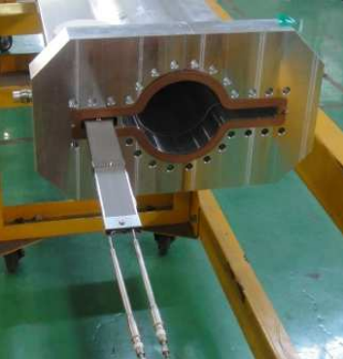
Vacuum chamber cross section
If we adopt the SuperKEKB vacuum chamber cross-section then it comes natural to try and adapt also the SuperKEKB concept for the MO-type flanges, bellows, and gate valves (*). This will probably help reduce the geometric impedance budget:
Unfortunately we can not adopt the distributed NEG pumping solution, since our winglets are not wide enough, only ~ 25 mm
(*) Y. Suetsugu, this conference
(**) J. Bauche, this conference

Slide 7
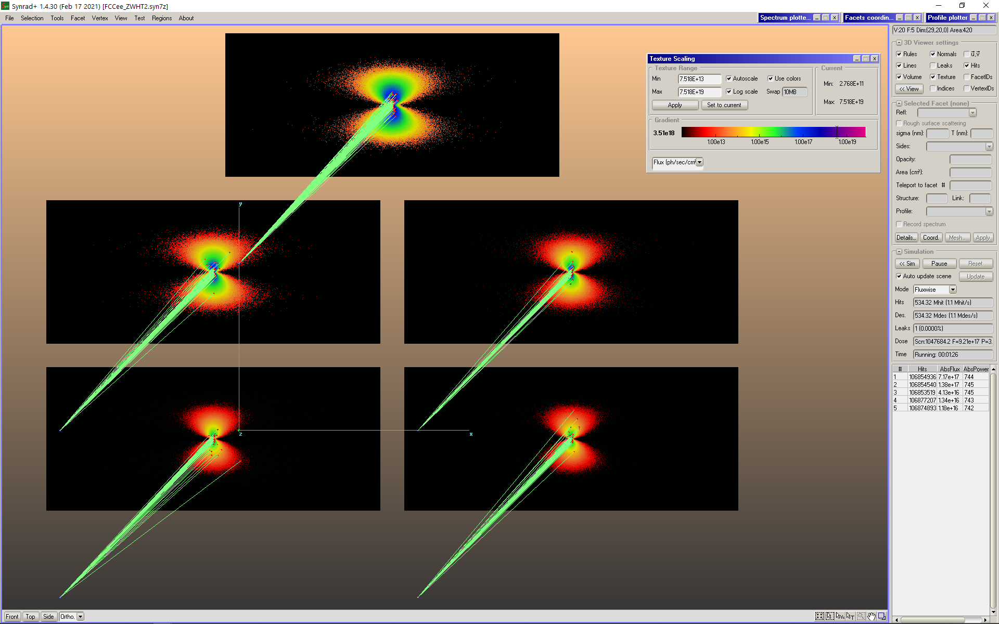
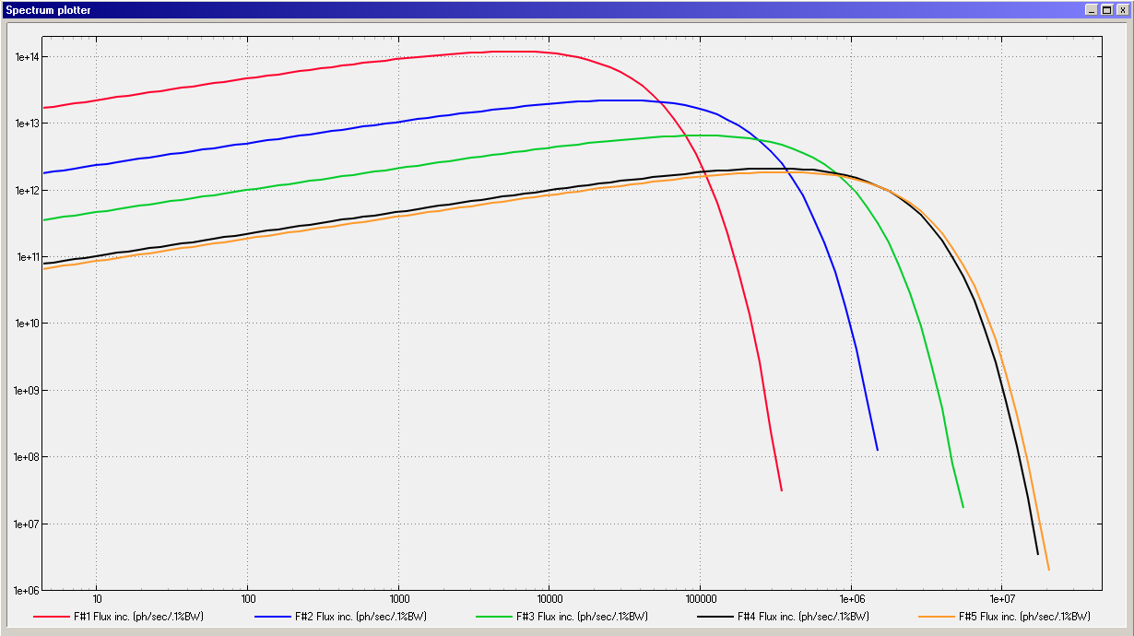
Synchrotron radiation spectrum, flux, power
SR Spectra computed with SYNRAD+
- Radiation projected onto
five 14x6 cm² screens;
- 1 cm-long dipole arc trajectories;
- Flux distribution shown here,
- Logarithmic scale for textures,
6 orders of magnitude displayed;
ε_{crit} = 2218 · E(GeV)]³ / ρ(m)
45.6 GeV
80 GeV
120 GeV
175 GeV
182.5 GeV
50 m
Beam Energy E(GeV) | Beam Current I(mA) | Critical Energy (keV) | Photon Flux F’(ph/s/m) | PSD Outgassing Load (mbar l/s/m) @ 1·10⁻⁶(mol/ph)
45.6 | 1390 | 19.5 | 7.17·10¹⁷ | 2.90·10⁻⁸
80 | 147 | 105.5 | 1.38·10¹⁷ | 5.58·10⁻⁹
120 | 29 | 356.2 | 4.13·10¹⁶ | 1.67·10⁻⁹
182.5 | 5.4 | 1253.1 | 1.18·10¹⁶ | 4.78·10⁻¹⁰
Units: Vertical: [photons/s/(0.1% bandwidth)/m]; Range [10⁶ - 2·10¹⁴]
Horizontal: [eV]; Range [4 - 5·10⁶ eV]

Slide 8
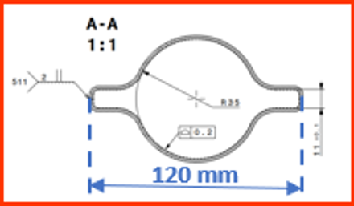
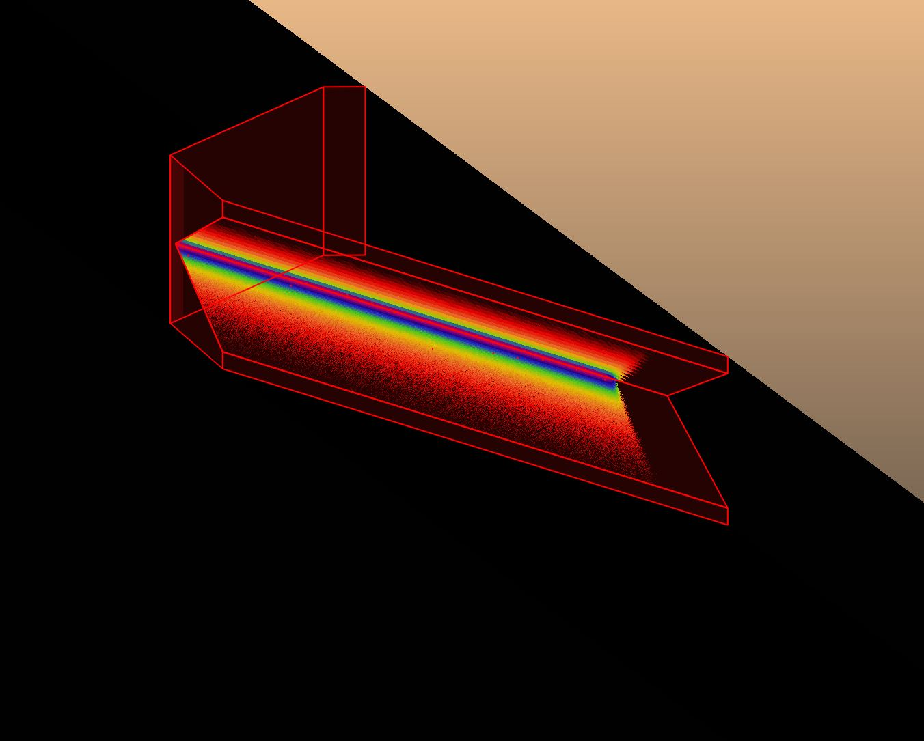
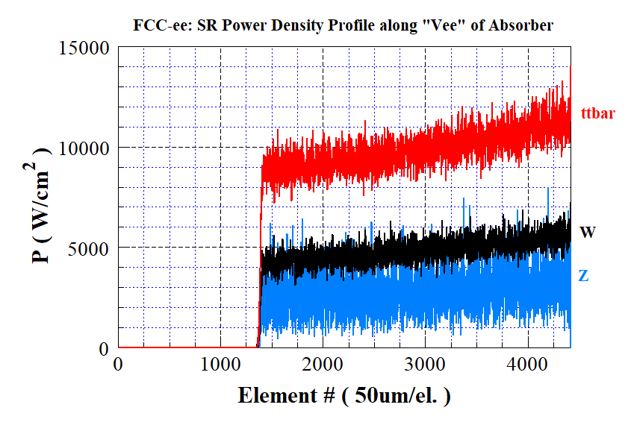
SR absorbers: yes or no?
The high beam energy generates an extremely narrow fan of SR, swiping a strip along the external wall of the vacuum chambers
If the SR is let impinge onto the vertical wall at the end of the winglet on the external side (60 mm from the beam axis), then the average photon travels ~38 m before hitting the wall
If SR absorbers like in the figure are used, 1 every ~5.6 m, then the average distance is ~34.6 m
Beam Energy E(GeV) | Natural SR Vertical Angle, 1/γ (μrad) | Vertical Fan Height at 35 m, (mm) | Beam Current I(mA) | Linear Photon Power Density (*) P’(W/m) | Peak Surface Photon Power Density (*) P’’(W/mm²) | Peak Surface Photon Power Density (**) P’’(W/mm²)
45.6 | 11.2 | 0.40 | 1390 | ~ 620 | ~ 1.4 | ~ 32
80 | 6.4 | 0.22 | 147 | “ | ~ 2.2 | ~ 56
120 | 4.3 | 0.15 | 29 | “ | ~ 3.0 | ~ 85
182.5 | 2.8 | 0.10 | 5.4 | “ | ~ 4.0 | ~115
B
18 mm
300 mm
A
**On absorber
*On external wall
175 mm
A
B

Slide 9
Pumping solutions
The 120 mm horizontal width of the chamber with winglets does not let us install a linear NEG pump like SuperKEKB has done
This leaves us with only two choices: use many lumped pumps, or use NEG-coating
The specific conductance of the 70 mm ID chamber with winglets is ~47 l·m/s (ref. LEP ~ 100 l · m/s): This means that the system is conductance limited, and we would need to install un unreasonable number of pumps in order to obtain a sufficient effective pumping speed
We plan to use NEG-coating (as thin as 150 nm, to minimize the resistive-wall impedance contribution) in order to profit from its low photon-stimulated molecular desorption (PSD) and also a rather low photoelectron yield (PEY) and secondary electron yield (SEY) as well
Low PEY and SEY are mandatory for the e+ ring, in order to avoid/minimize the electron cloud effect (ECE)
Even a small residual sticking coefficient s for the NEG-coating gives a large distributed pumping speed, 11.8·s (l/s/cm², CO gas), with the coated wall surface of ~ 3120 (cm²/m) or 36700·s (l/s/m)

Slide 10
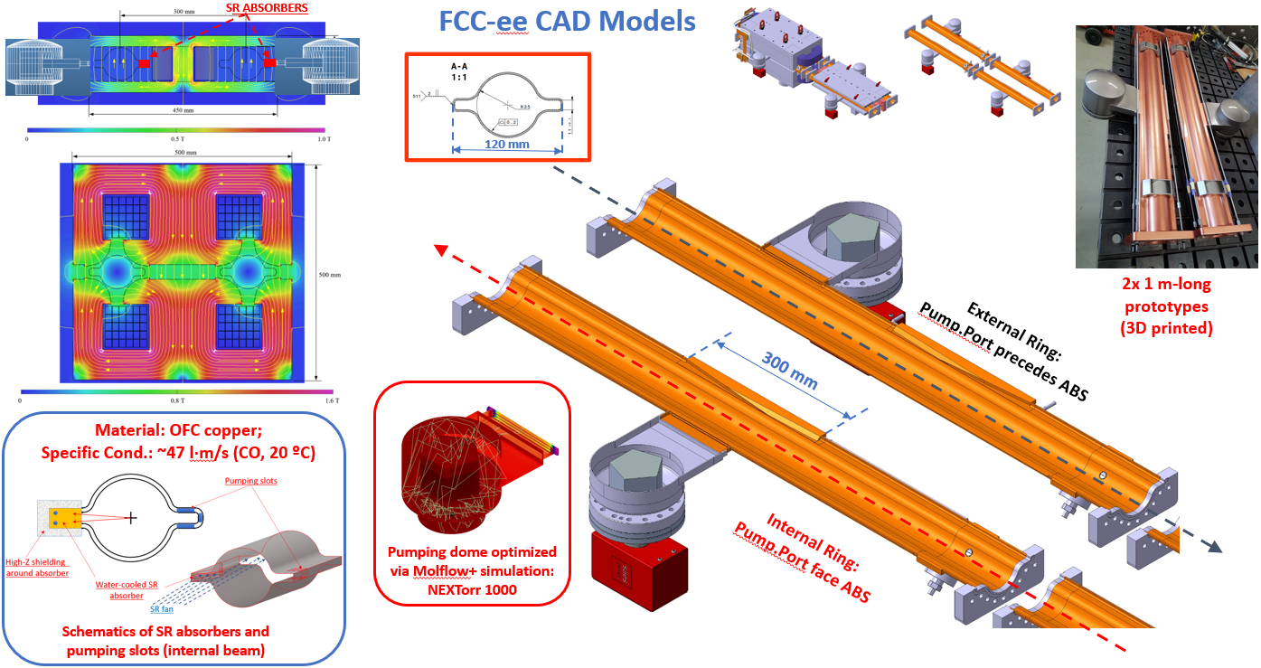
Pumping solutions

Slide 11
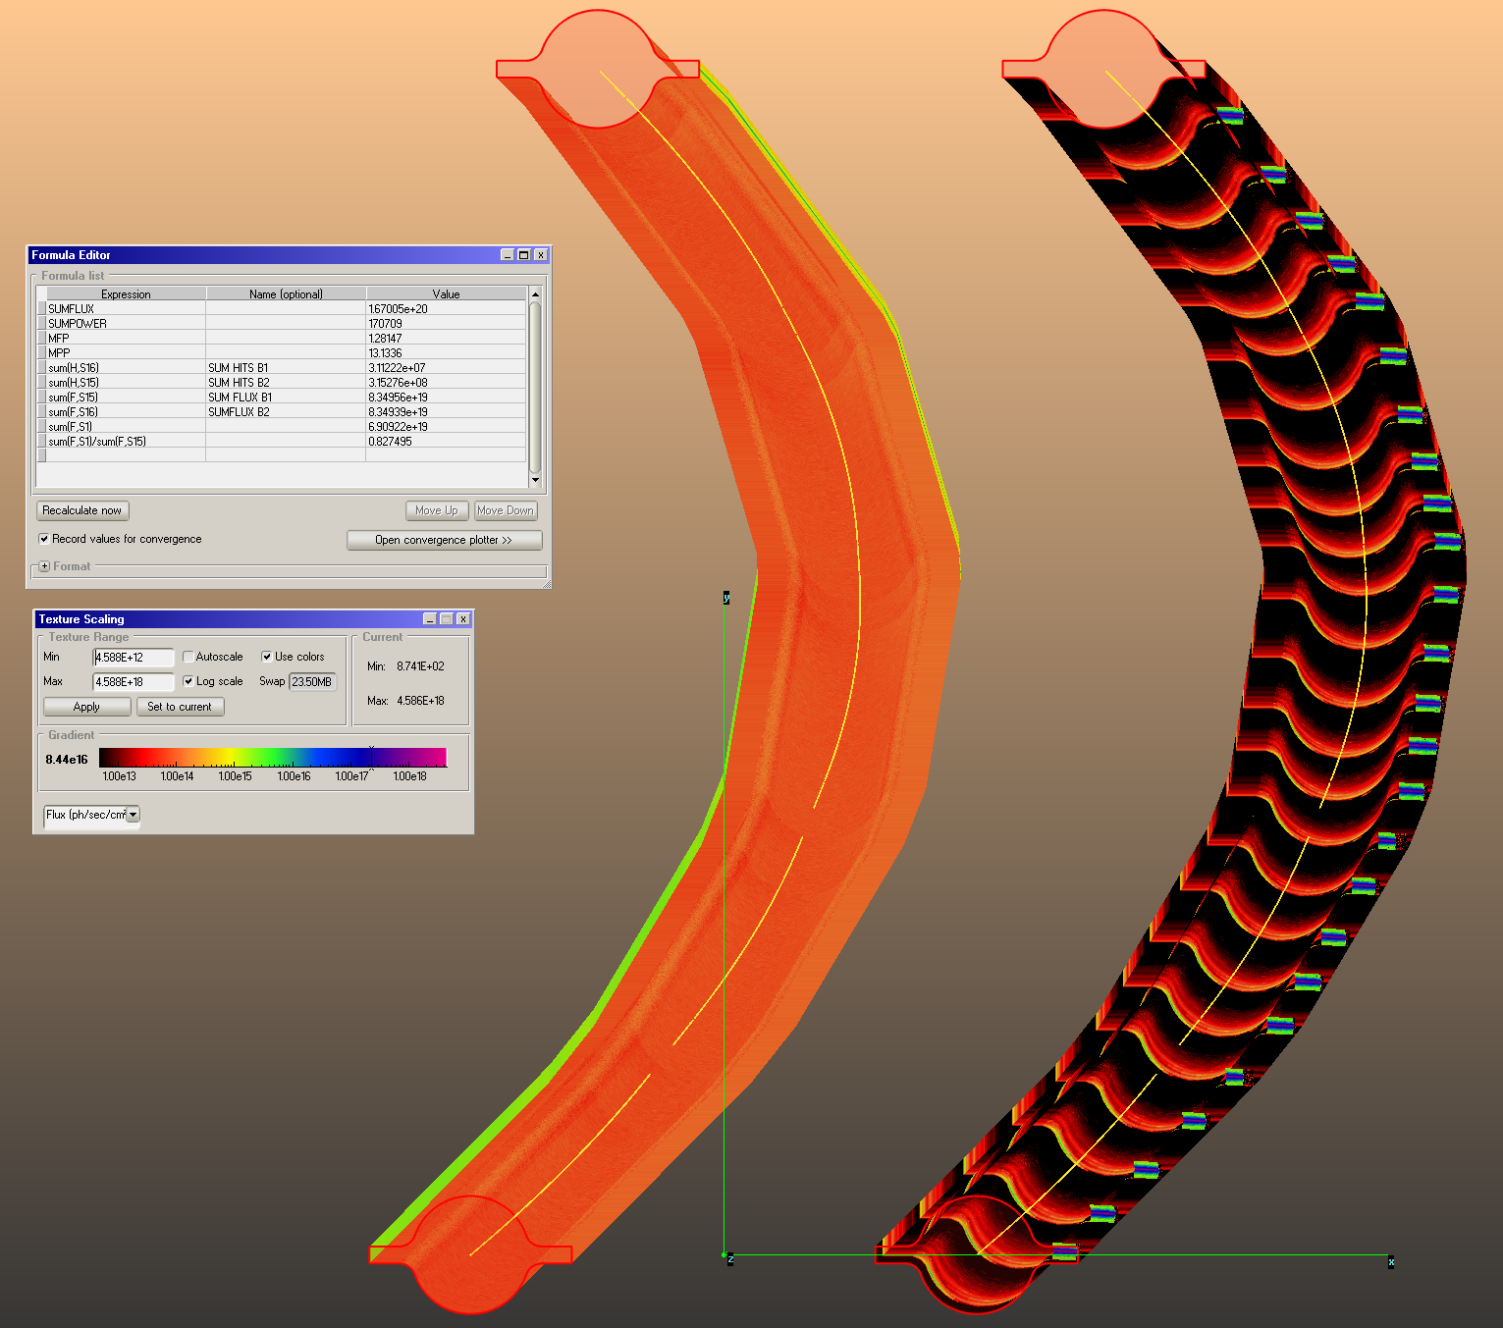
Pressure profiles
B2
We have used Molflow+ to calculate the PSD pressure rise at different beam doses, using the photon irradiation maps calculated by SYNRAD+
A sample 140.7 m-long section of an arc has been considered, with the two beams side by side
The orbits along 5 dipoles interleaved with 5 quadrupoles are simulated, importing the lattice files from MADX into SYNRAD+
The 3D model for B1 has 25 absorbers placed at ~ 5.6 m average spacing (avoiding quadrupoles and sextupoles which have tight coils), while B2 has no absorbers, and the SR fan is let impinge onto the bottom of the external winglet (see also B. Humann, this conf.)
B1

Slide 12
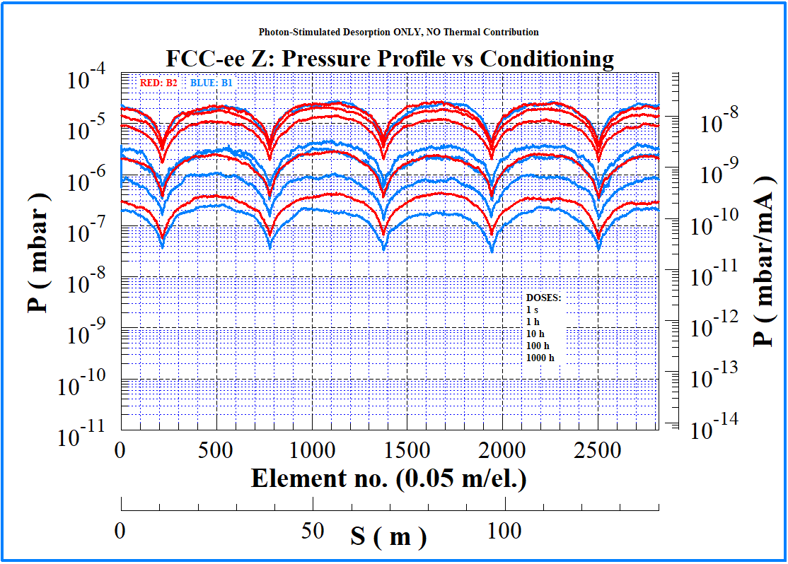
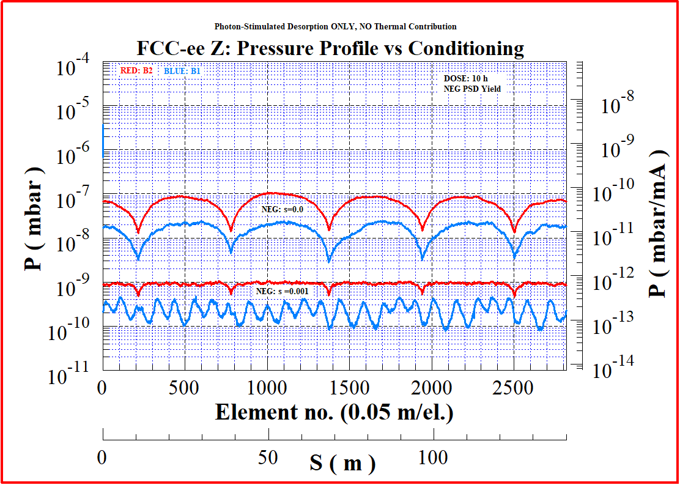
Pressure profiles
We have calculated the PSD pressure profiles for 5 different beam doses, corresponding to times of 1 s, 1 h, 10 h, 100 h, 1000 h. Simulated gas: CO
On the left the case with 5x 100 (l/s) lumped pumps/beam, and no NEG-coating
On the right, the case with NEG-coating, saturated (i.e s=0) and with some residual sticking (s=0.001)

Slide 13
Vacuum and energy deposition (taken from B. Humann, same conference)

Slide 14
Vacuum and energy deposition

Slide 15
Vacuum and energy deposition

Slide 16
Vacuum and energy deposition

Slide 17
Vacuum and energy deposition

Slide 18
Vacuum and energy deposition

Slide 19
Vacuum and energy deposition

Slide 20
Machine Detector Interface

Slide 21
Machine Detector Interface

Slide 22
Machine Detector Interface

Slide 23
Tunnel Integration Working Group (meetings organized by Fani Valchkova-Georgieva, EN-ACS-COS), @Sept 2021
Full energy booster synchrotron

Slide 24
Photodesorption Test Bench BESTEX, at KARA light source, KIT
2.5 GeV operation, ~150 mA e- current, no top-up

Slide 25
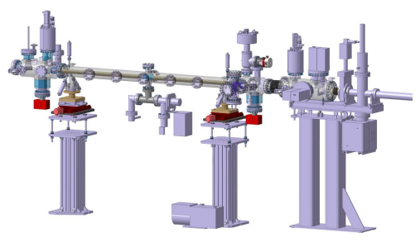
Photodesorption Test Bench BESTEX, at KARA light source, KIT
Activities have slowed down A LOT due to covid

Slide 26
Photodesorption Test Bench BESTEX, at KARA light source, KIT
Beam Energy E(GeV) | Beam Current I(mA) | Critical Energy (keV) | Photon Flux F’(ph/s/m) | PSD Outgassing Load (mbar l/s/m) @ 1·10⁻⁶(mol/ph)
45.6 | 1390 | 19.5 | 7.17·10¹⁷ | 2.90·10⁻⁸
80 | 147 | 105.5 | 1.38·10¹⁷ | 5.58·10⁻⁹
120 | 29 | 356.2 | 4.13·10¹⁶ | 1.67·10⁻⁹
182.5 | 5.4 | 1253.1 | 1.18·10¹⁶ | 4.78·10⁻¹⁰
FCC-ee, see slide 7
Hiring fellow/postdoc right now, starting early 2022

Slide 27
Future work: prototyping, experiments, …
Design prototype vacuum chambers with and without SR absorber (~ 2 m-long) and test them at light source (KARA/KIT?) (underway, 1 mech. engin. on it, part-time)
Test behavior of thin NEG-coating at light source (we did already tests at Photon Factory, KEK, on different cross section)
Define deposition technique for dipolar ~ 12 m-long vacuum chambers (horizontal sputtering with mole?, other techniques?) (YES: horizontal deposition over 12 m seems feasible, P. Costa Pinto, VSC)
In-situ measurement of photoelectron yield at light source (Have collaboration contract with INFN Frascati, they have 4 circular tubes to test, various surface treatments see next item; Pilot Test Sector at LHC? )
Test other thin-films with potential application to FCC-ee: amorphous carbon (a-C), hydrophobic silicon films (to reduce pump down time without bakeout); test surface texturing techniques (e.g. LASE)
Determine material and fabrication technology of SR absorbers and bonding technique to the vacuum chamber (surface power density above 100 W/mm² at the ttbar energy) (underway, 1 mech. engin. on it, part-time)
Design, fabricate, and test bellows with RF fingers, under elongation and misalignment conditions similar to those expected for FCC-ee (underway, 1 mech. engin. on it, part-time)
Continue collaboration with FLUKA team (see B. Humann, this conference), magnet group, tunnel integration working group, and machine optics group (plus MDI)
The next 4~5 years are going to be fun… ☺

Slide 28
Thank you for your attention! Questions?
28

