Slide 1


Plasma cleaning for SRF needs
at IJCLab
O. Hryhorenko (post-doc), E. Mistretta, B. Mercier, D. Longuevergne
Equipe MAVERICS – Plateforme Vide et Surfaces
Pôle Physique des Accélérateurs - IJCLAB
FCCee SRF IN2P3 collaboration meeting – 9th November

Slide 2
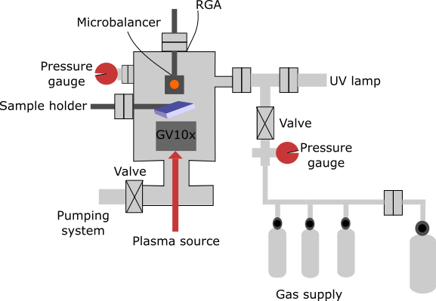
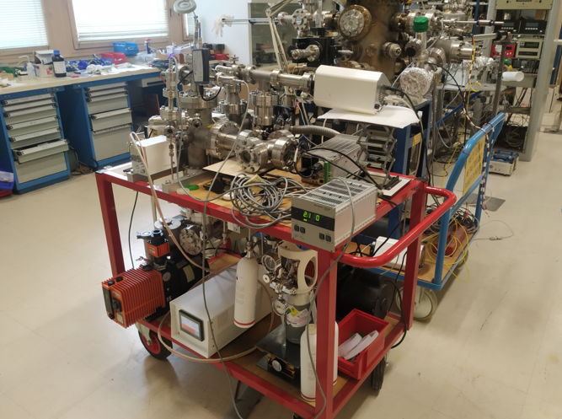
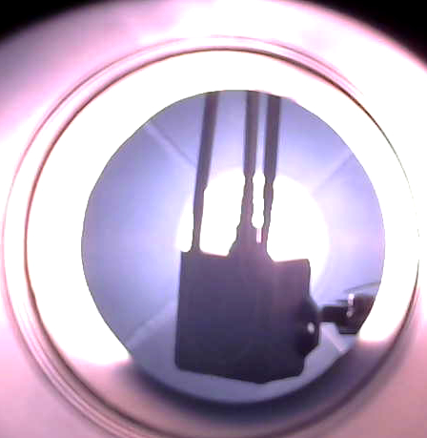
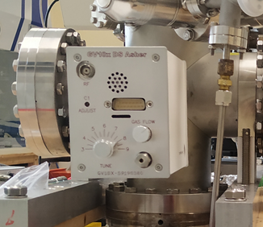
Test bench
Window
f = 13.56 MHz
P = 100 W
Way of gas injection

Slide 3
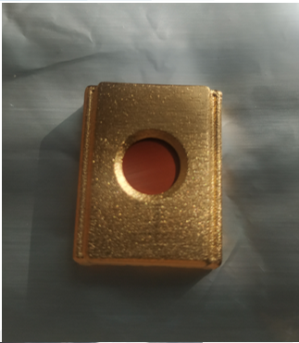
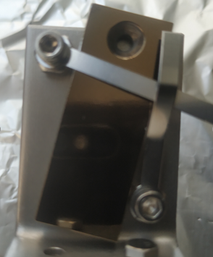
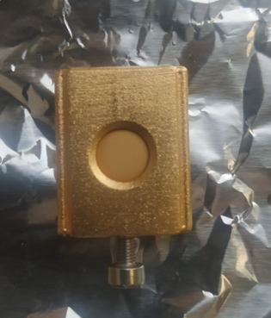
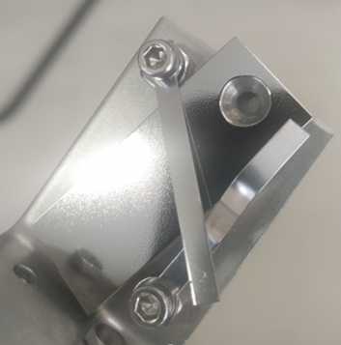

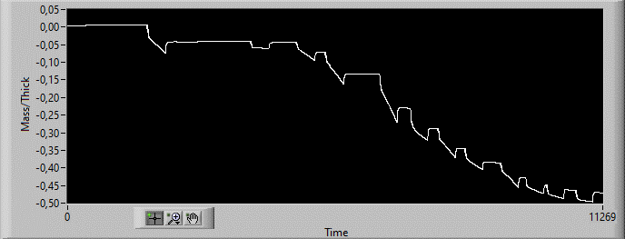
Before/after plasma cleaning
Before cleaning:
deposition of the C layer
(40-50 nm)
After cleaning:
No C-layer

Slide 4
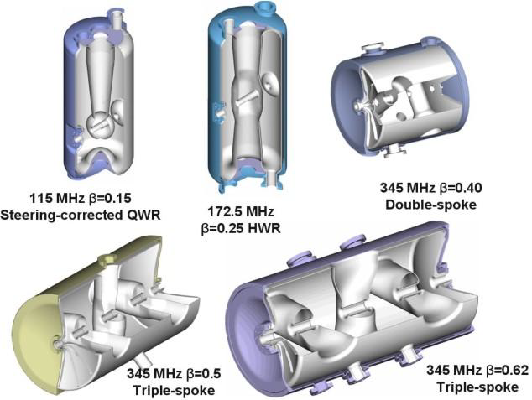
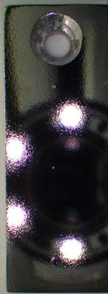
Plan and collaboration
Starting collaboration :
GANIL : apply in-situ plasma cleaning in Spiral2 cryomodules
LPP : experts in plasma diagnostics
INSP : expertise in surface oxide and decontamination by plasma
Apply to low beta cavities (Spiral2 QWR)
4

