Slide 1
Multipactor Simulation at IJCLab Ningyuan HU, Service RF/IJCLab/IN2P3/CNRS
In IJCLab, we use three multipactor simulation codes : SPARK3D, MUSICC3D and CST PIC.
N. HU et al, “ Multipactor Simulations for MYRRHA Spoke Cavity: Comparison Between SPARK3D, MUSICC3D, CST PIC and Measurement ”, IPAC2021.

Slide 2
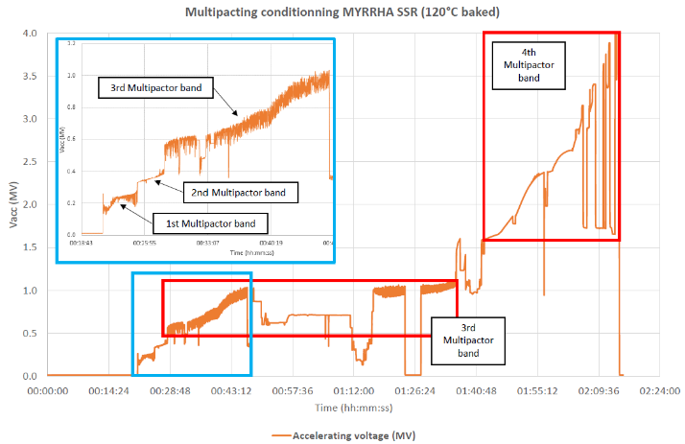
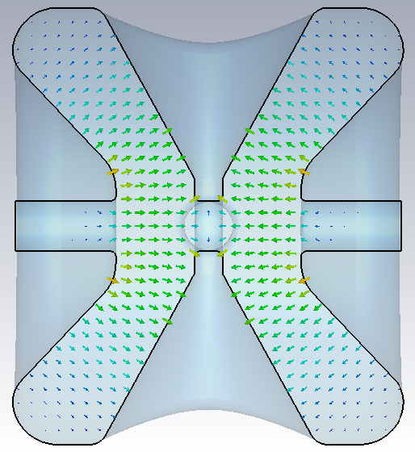
Superconducting Spoke Cavity of MYRRHA
Coupler for regulation
E
B
Beam tube
Resonator of Niobium content
Particle beam
Power coupler for the injection of RF power
Parameter | Unit | Value
$f$ (TM_{010-π}) | MHz | 352.2
$$β_{opt}$$ |  | 0.370
$V_{acc}$ @ 1J energy | MV | 0.691
$$V_{acc}$$
2

Slide 3
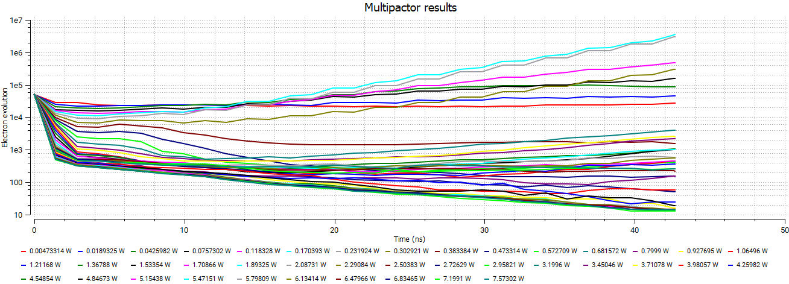
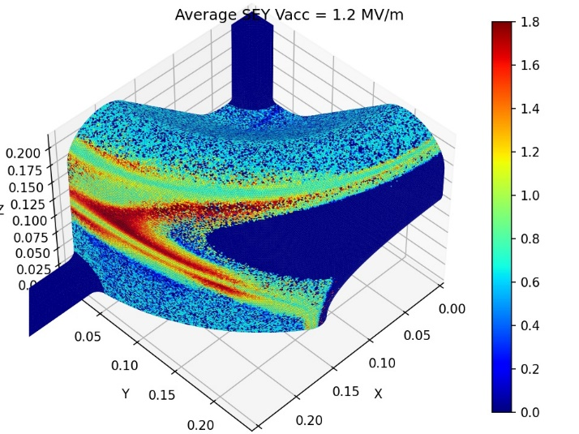
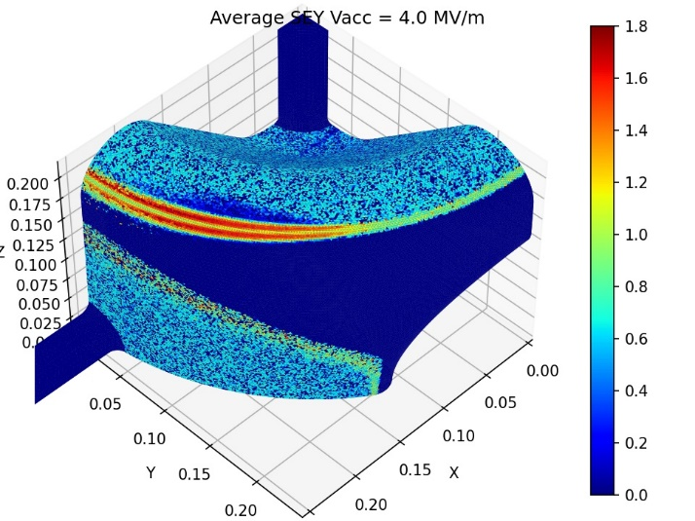
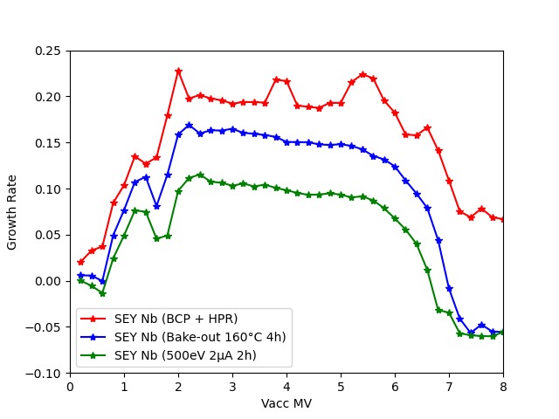
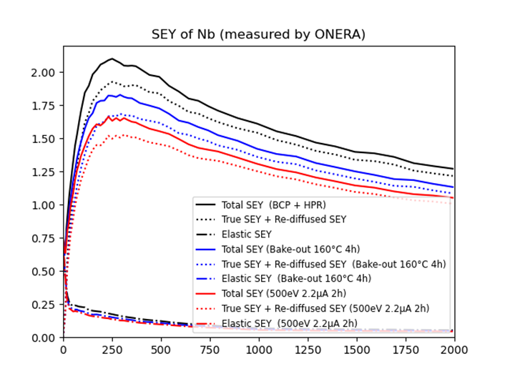
SPARK3D Simulation Results of MYRRHA Spoke Cavity
There are two peaks of multipactor barrier.
The first peak (0.6 MV≤V_acc≤1.6 MV) is a mixture of one-side multipactor of different orders which occupies very broad area.
The second peak (2 MV≤V_acc≤6 MV) is a two-side multipactor that migrates along corner.
Growth Rate $α$: $N\left(t\right)=N_{0}e^{αt}$
Evolution of average SEY

