Slide 1
FCCee R&D program Meeting with IN2P3
Franck Peauger
9th of Nov. 2021

Slide 2
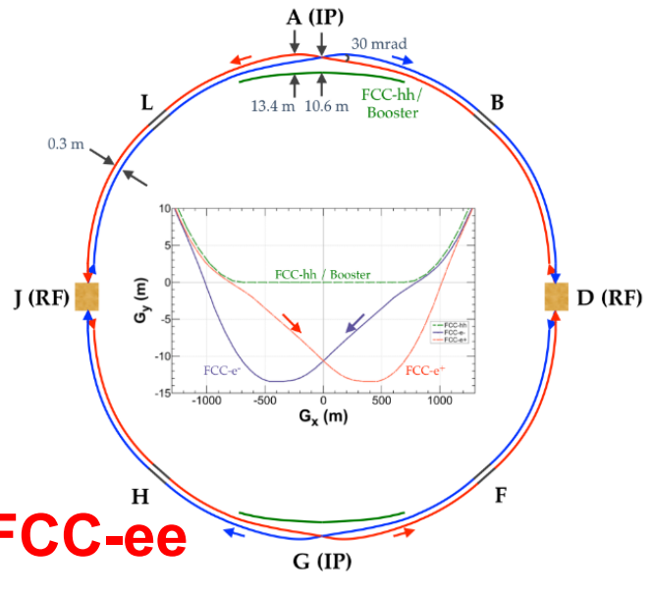
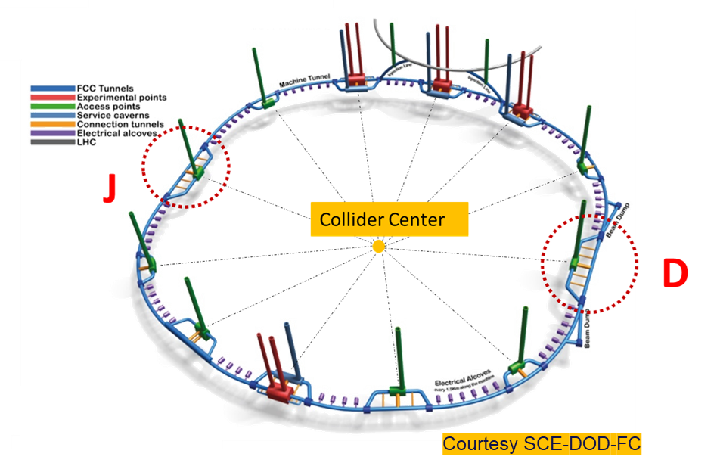
FCC
FCC is inspired by the LEP – LHC approach
Stage 1: FCC-ee (Z, W, H, tt) as Higgs factory, electroweak & and top factory at very high luminosities
Stage 2: FCC-hh (~100 TeV) as natural continuation at energy frontier, with ion and eh options
RF system is the most challenging for FCC-ee
Compensates for synchrotron radiation power of 50MW per beam
SRF cavities and RF sources are located in point J and point D which are straight sections of 2.2 km
FCC-ee layout
See also «CDR FCC-ee: The Lepton Collider, 2019»

Slide 3
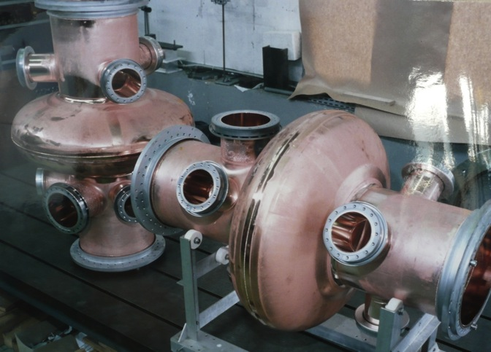
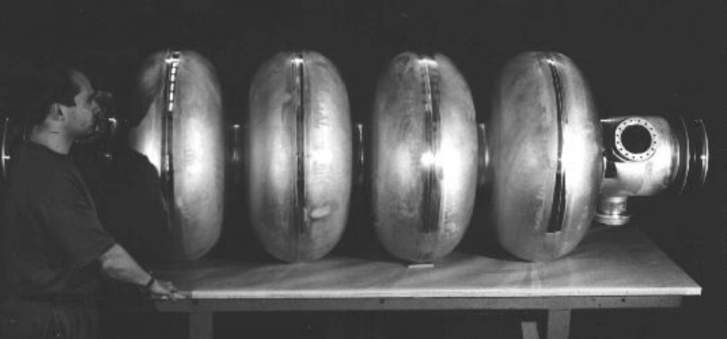
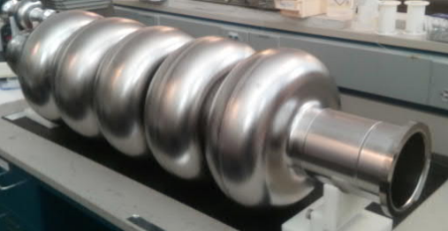
3 different types of cavities as a reliable baseline for FCC-ee
Cryomodules are installed / removed during shutdowns
400 MHz 1-cell cavities
Nb/Cu
400 MHz 4-cell cavities
Nb/Cu
800 MHz 5-cell cavities
Bulk Nb

Slide 4
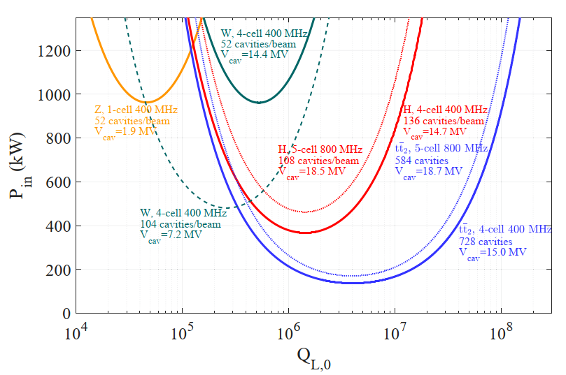
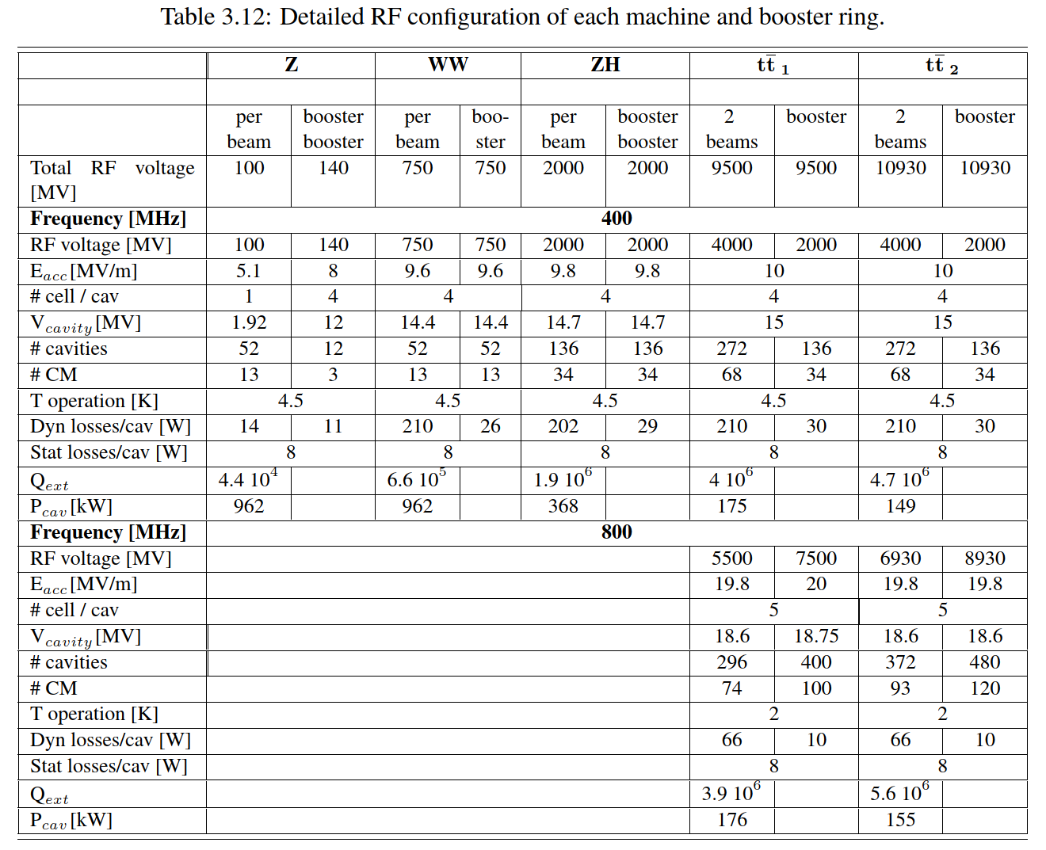
FCC-ee RF system baseline
Required RF power per cavity as a function of loaded quality factor QL with optimal detuning for beam loading compensation
CDR FCC-ee: The Lepton Collider, 2019

Slide 5
The FCC SRF programme at CERN (2020 – 2025)

Slide 6
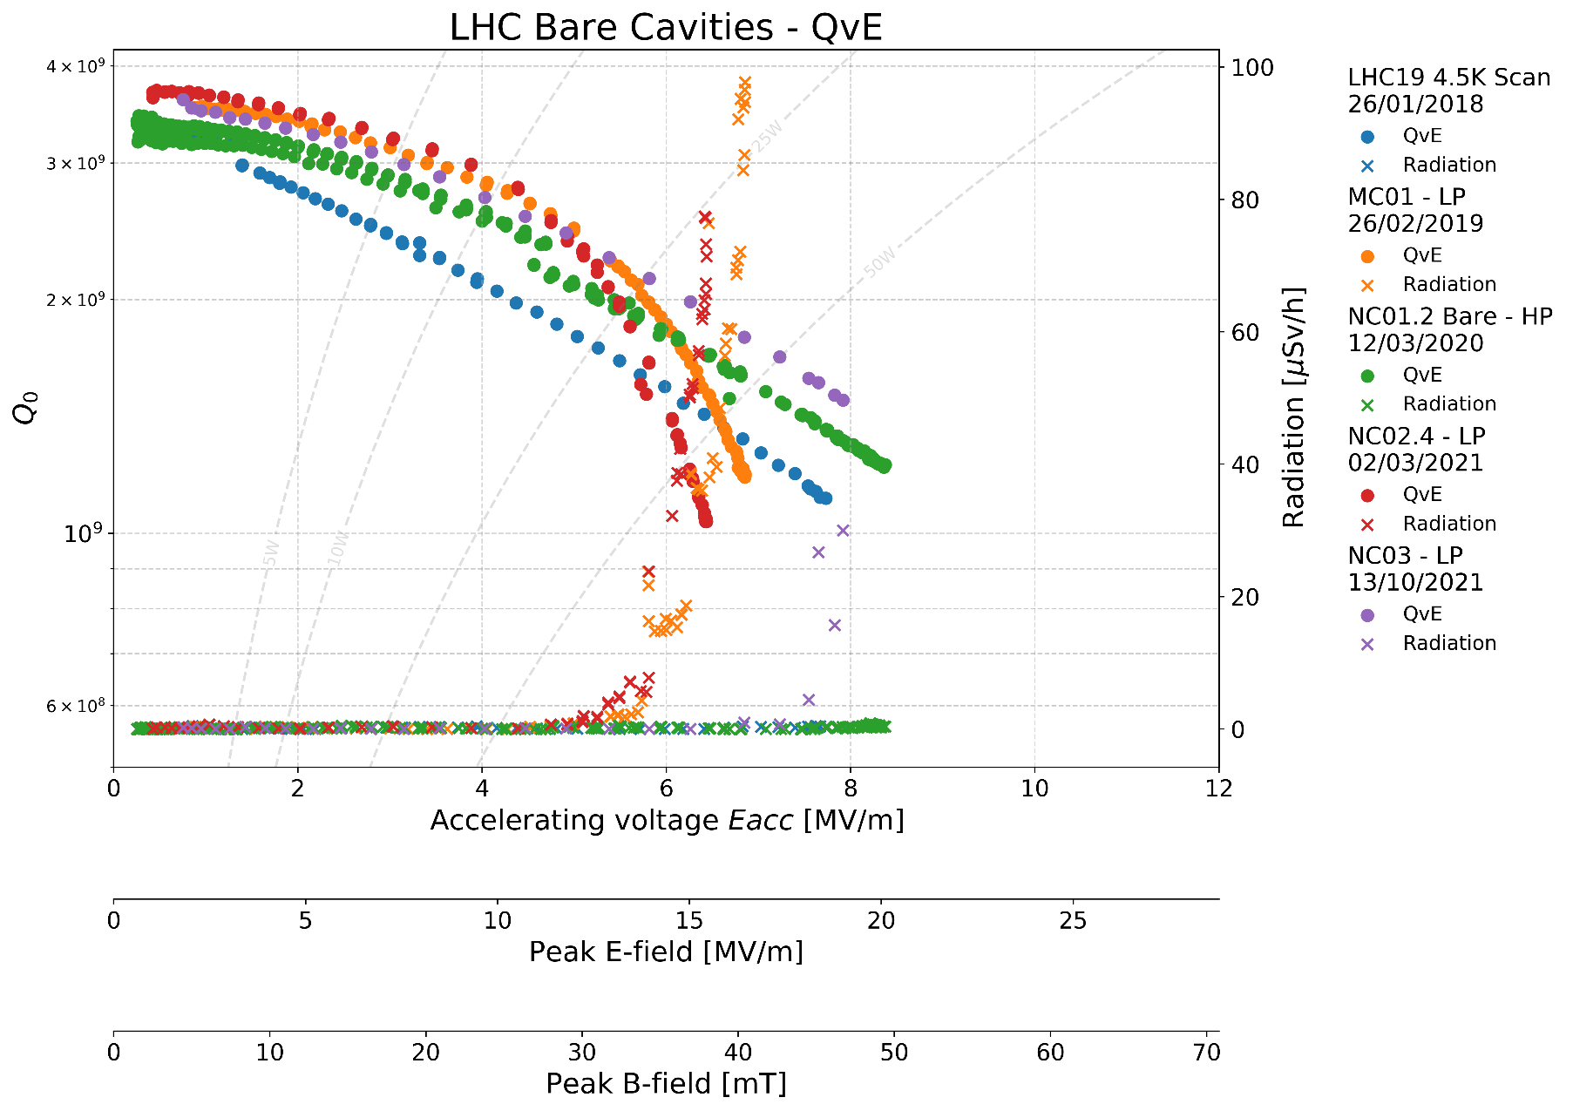
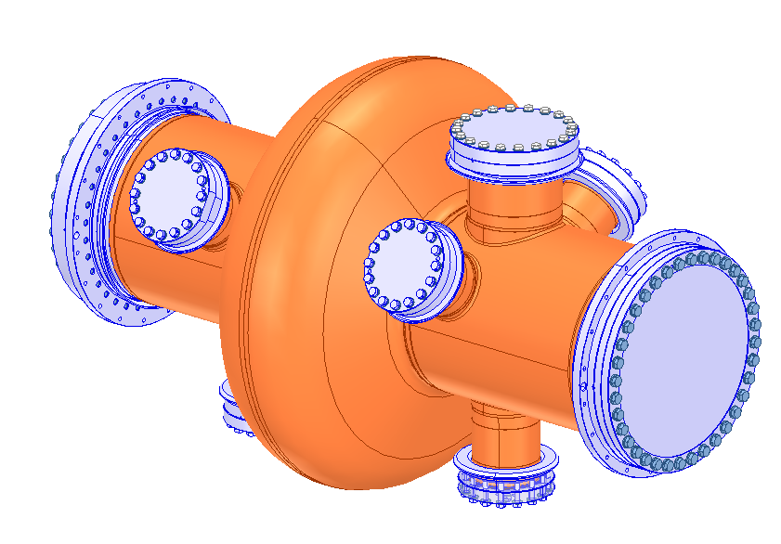
LHC cavities: recent vertical test results on new spares
Objectives for FCC:
Reach Eacc = 10 MV/m @ 4.5 K with 4 cells
Optimize the fabrication of large substrates (LHC 400 MHz single cell)
internal beam welding, electro-hydroforming, spinning, …
perspective = large production + multi-cell
FCC spec. (4 cells)
Jordan Walker, David Smekens, Guillaume Rosaz

Slide 7
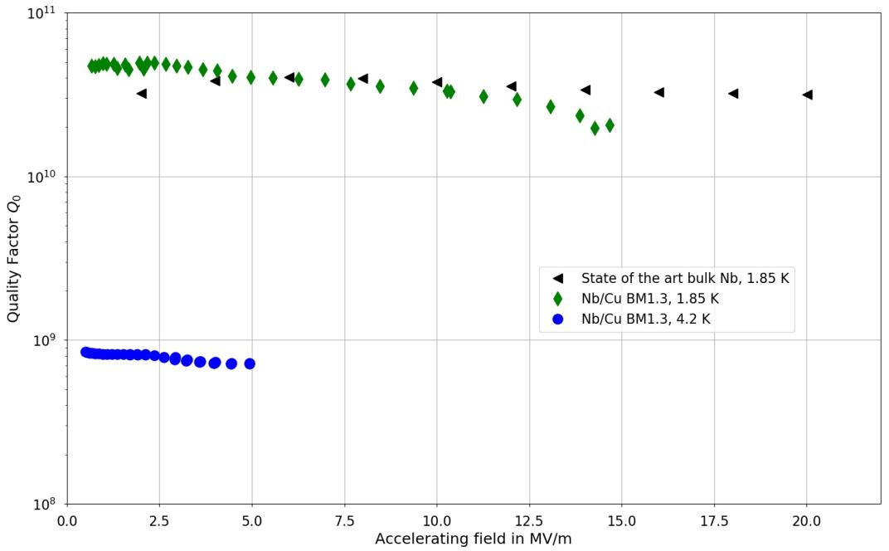
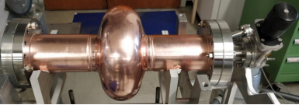
Pushing the performance of Nb/Cu
Vigorous R&D program at CERN motivated by the outstanding results of the HIE Isolde seamless QWR:
Development of seamless bulk 1.3 GHz cavities
Electro-polishing of copper
High quality (HIPIMS) coatings
Q slope mitigated, comparable with bulk Nb up to 15 MV/m -> more tests to come
M. Garlasche, S. Atieh, G. Rosaz, JF. Croteaux, P.Vidal-Garcia, L. Vega Cid, F. Manke, L. Ferreira, W. Venturini

Slide 8
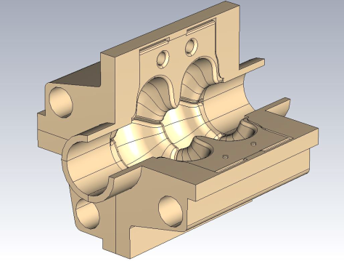
SWELL cavity as a beautifull alternative option for FCCee
A great candidate to have a single cavity type for all the FCCee beam energies
Can operate at high current and high gradient at the same time
2-cell elliptical cavity equipped with radial slots to efficiently damp higher order transverse modes.
The cavity is made of four quadrants in copper
Seamless by its nature
Very precise machining with low surface roughness
Easily accessible for Nb coating and surface treatments
I. Syratchev
Slotted waveguide (x4)
HOM extractors (x8)
 | Z | W | H | ttbar2
Frequency [MHz] | 600
r/Q [Ω] (circuit definition) | 96.7
Transit Time Factor | 0.579
G [Ω] | 272.2
Lacc [m] | 0.5
Epk/Eacc | 2.45
Bpk/Eacc [mT/(MV/m)] | 5.2
Accelerating voltage [MV] | 1.2 | 3 | 8 | 10
Accelerating gradient Eacc [MV/m] | 2.4 | 6 | 16 | 20
Max. surface electric field Epk [MV/m] | 5.93 | 14.7 | 39.3 | 49.2
Max. surface magnetic field Bpk [mT] | 12.5 | 31 | 82.8 | 103
Stored energy [J] | 2 | 12.3 | 87.8 | 137.2
Cooling circuits

Slide 9
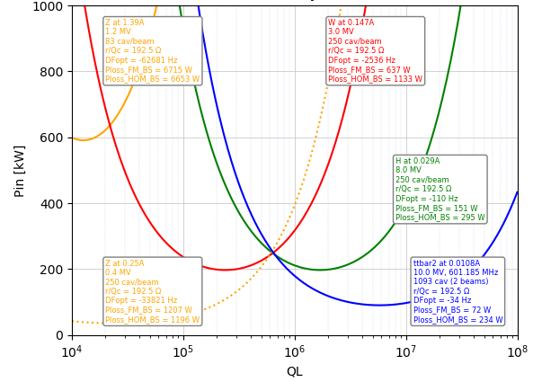
RF power requirement with SWELL
1
2
3

Slide 10
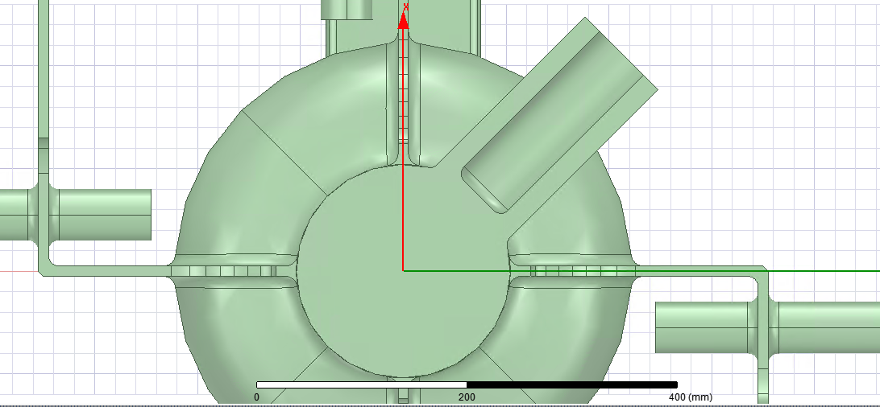
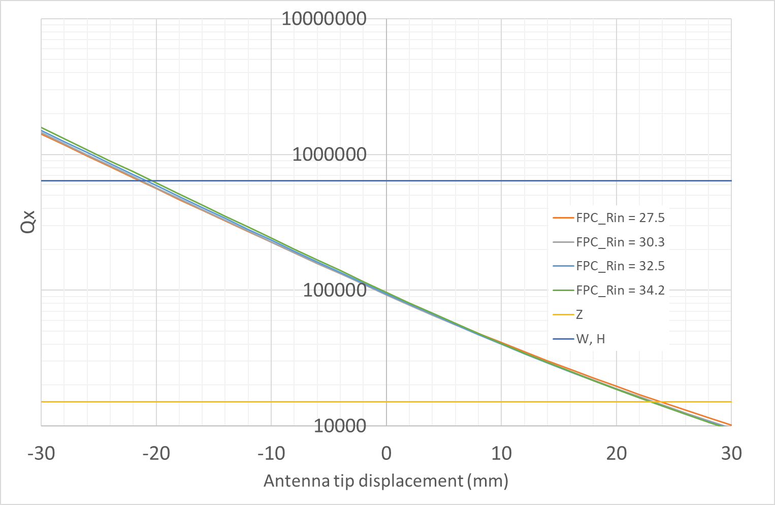
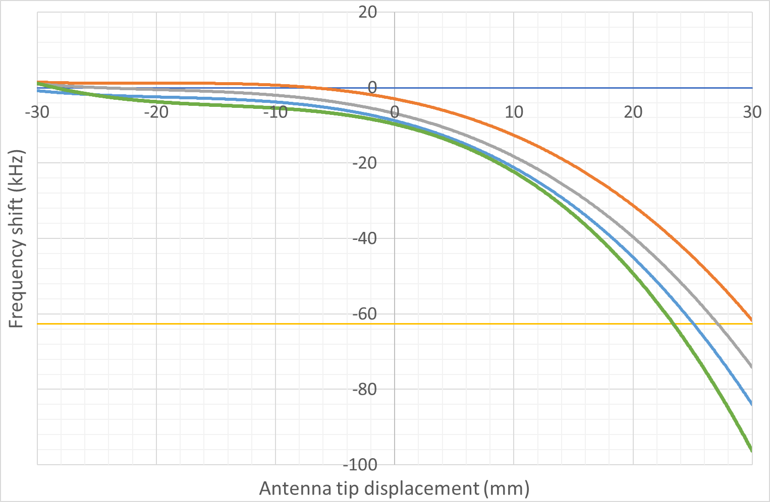
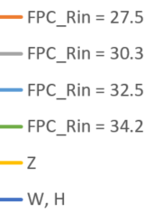
FPC antenna design
External diameter limited by the presence of the slots
Coax antenna with large diameter : impedance of 22.8 Ω with antenna radius of 34.2 mm
Variable coupler with antenna displacement of 44.5 mm (+ 23.5 mm for Z and - 21 mm for W and H from the central position)
frequency shift matched with optimal detuning for beam loading compensation at Z current
Peak fields ~ same as LHC coupler antenna
FPC_Rin
100 mm diameter

Slide 11
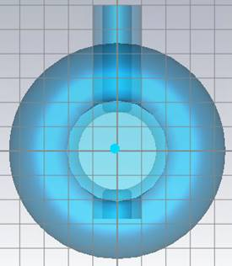
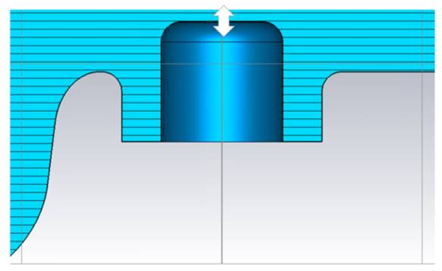
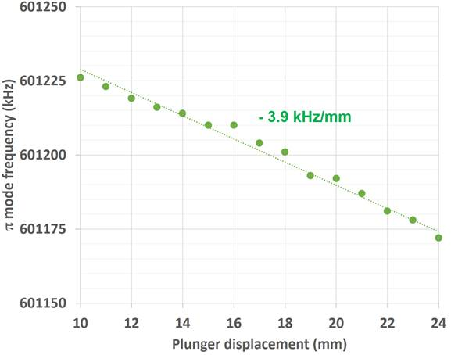
Frequency tuner
Frequency tuning by axial deformation of the cells is made impossible by the presence of the slots (stiffeners)
Tuning post can be placed in the beam tube on the opposite side of the FPC
Tuning range of 50 kHz can be achieved by changing the length of the post by ~ 15 mm
Tuning range required by fabrication tolerances and by operation (LLRF) to be studied
Other types of tuners could be envisaged (FE-FRT, …)
Tuning post
50 kHz

Slide 12
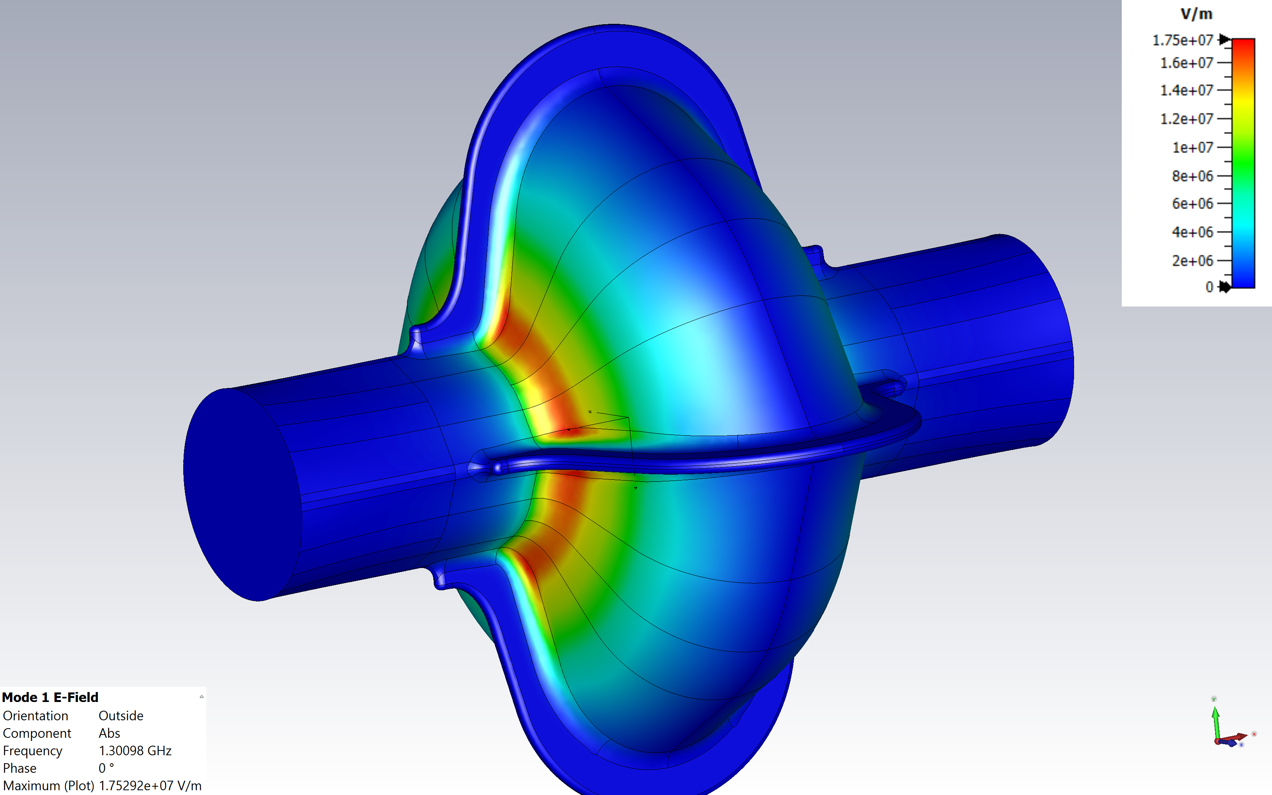
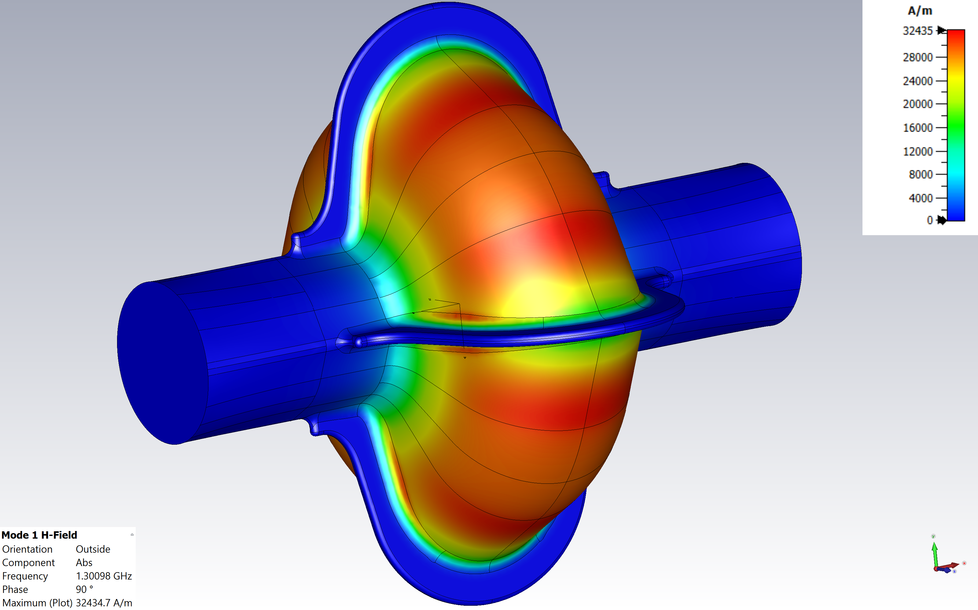
1.3 GHz SWELL as a first demonstrator
Parameters | Values
F (GHz) | 1.301
R/Q linac (Ω) | 122.9
Lacc (mm) | 115.3
Epk/Eacc | 2.01
Bpk/Eacc | 4.61
G (Ω) | 265.56
a SWELL version of the “standard” 1.3 GHz single cell SRF cavity specially designed, derived from well known TESLA shape cavity
The geometry is simplified (closed slots) to evaluate the maximum accelerating gradient achievable in vertical cold test

Slide 13
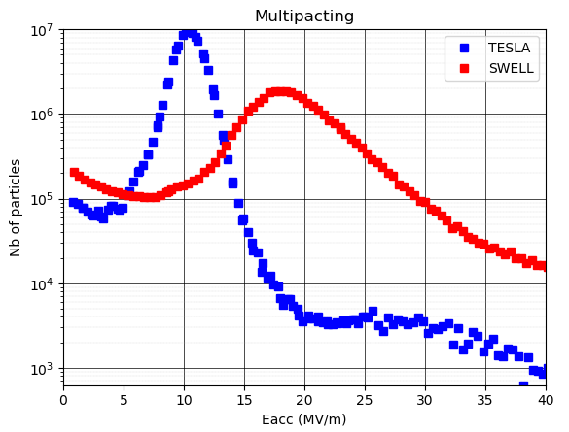
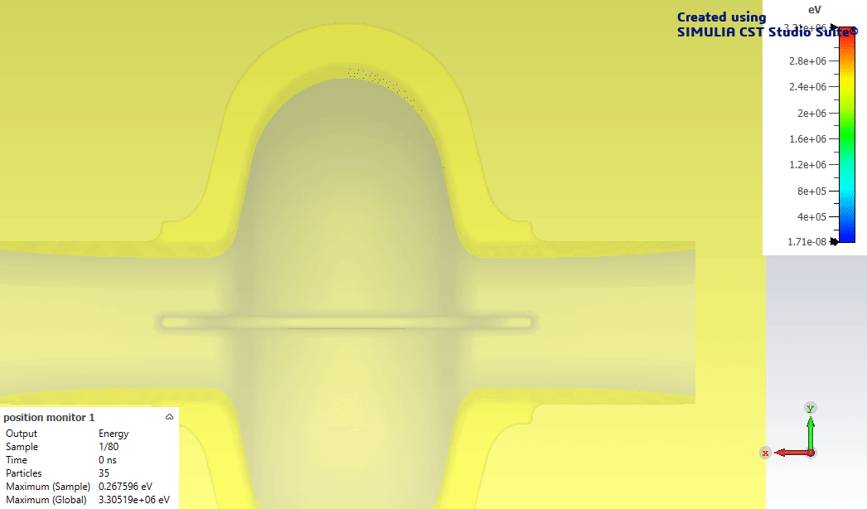
1.3 GHz SWELL - multipacting
Multipacting is weaker on SWELL than on a TESLA cavity and appears at higher voltage
Slots acts as a reservoir of electrons

Slide 14
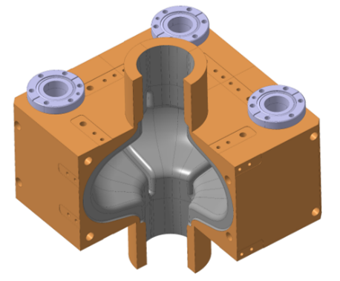
1.3 GHz SWELL – mechanical design
Cooling channels
The cavity is made of 4 copper quadrants machined, niobium coated and assembled in clean room
Thermal and mechanical design of the cavity are in progress
RF Test at 4.5 K and 2 K are foreseen in SM18 at CERN
M. Timmins, O. Capatina, S. Atieh, G. Rosaz, M. Therasse, V. Parma
Nb coating

Slide 15
Spare slides

Slide 16
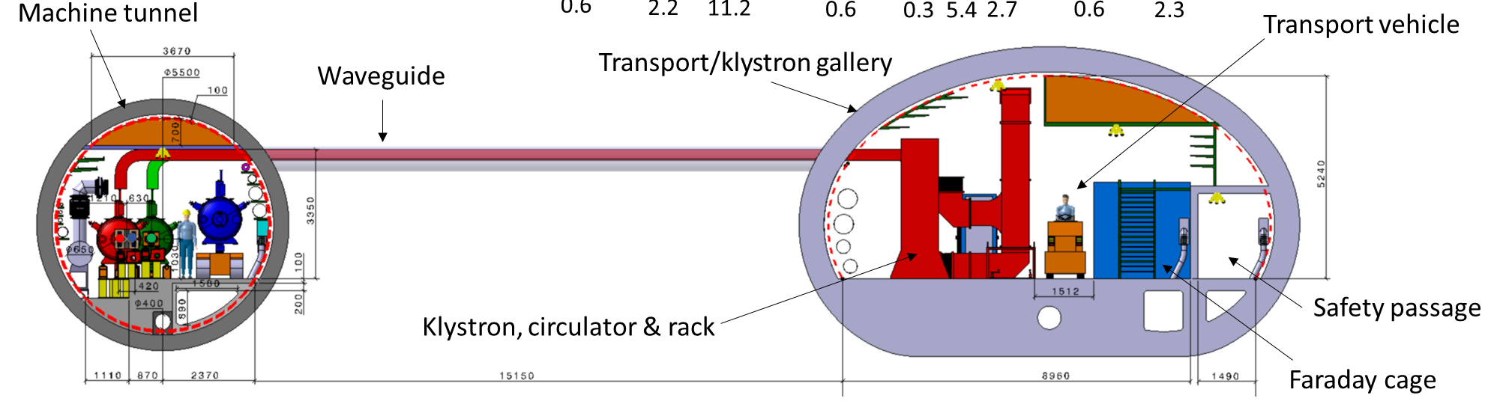
RF system integration in the tunnel
J-P. Corso / F. Valchkova-Georgieva

Slide 17
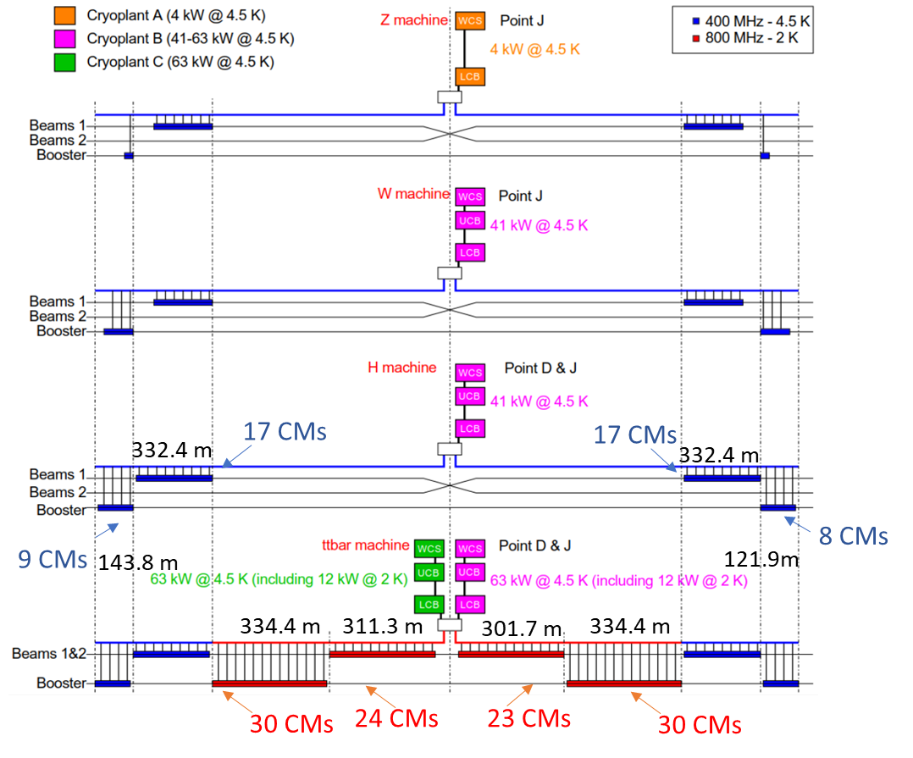
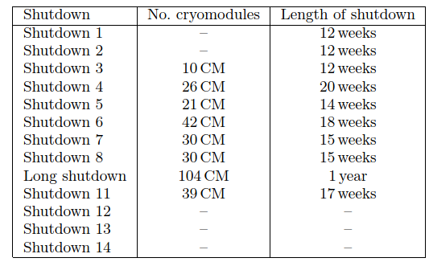
SRF cavities and cryogenic system installation
Upgrade of cryogenic infrastructure phased with cryomodule installation
O. Brunner, L. Tavian

Slide 18
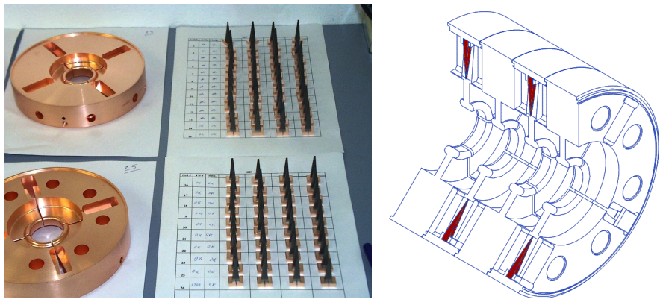
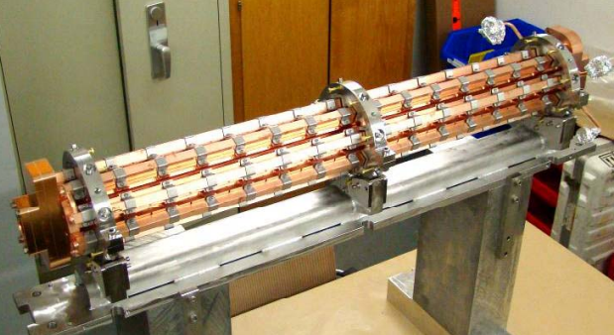
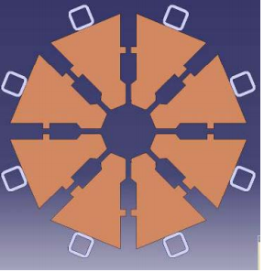
Highly damped / high gradient RF structures: experience from CLIC
Slotted Irises Constant Aperture (SICA) 3GHz accelerating structure used in CTF3
CLIC 12 GHz Power Extraction and Transport Structure (PETS) Built of 8 octants
beam current = 30/100 A
beam current = 3.5 A
E. Jensen, ‘CTF3 drive beam accelerating structures’, Proceedings of LINAC2002, Gyeongju, Korea.
I. Syratchev et al., “High RF Power Production for CLIC”, Proceedings of the 2007 Particle Accelerator Conference, Albuquerque, pp. 2194-2196

Slide 19
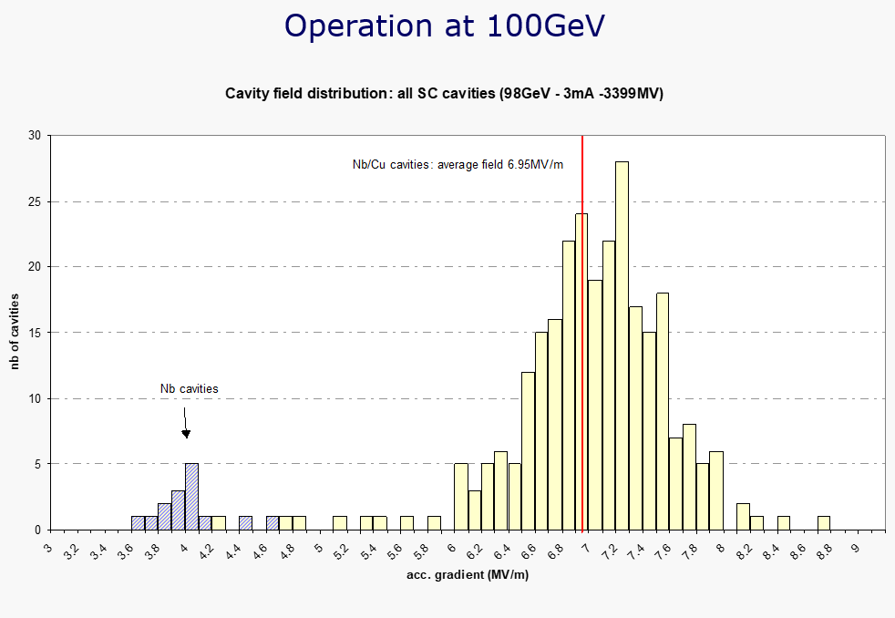
Performances of LEP cavities
O. Brunner

