Slide 1
Update on OSSR developments
Enrique GARCIA & Thomas VUILLAUME
FG2 call – 15/11/2021

Slide 2
Development updates
eOSSR new release
Container image guidelines
eOSSR registry
Open discussions

Slide 3
eOSSR library
ESCAPE OSSR library.
Code: https://gitlab.in2p3.fr/escape2020/wp3/eossr
Documentation: https://escape2020.pages.in2p3.fr/wp3/eossr/
CI documentation, examples and code snippets
Centralises all the developments, packages and tools developed within the WP3.
It also put together all the issues and open discussion that were generated in (already archived projects !)
ESCAPE metadata template
Codemeta2zenodo
ZenodoCI

Slide 4
eOSSR library
Last stable release v0.3.3 https://zenodo.org/record/5592584
What’s new: A major update of the eOSSR library.
Simplifies upload to the OSSR with a unique script
Introduces eOSSR logo
Record representation based on record ID only, improves its print_info
Handle lists in OSSR search kwargs
Solve lowercase issue in OSSR search kwargs
Introduces global HTTP errors handling
Improve documentation (notebooks are run live, clearer docstrings)
Include OSSR statistics in documentation
Update README with install and cite instructions
Bugfix of versions 0.3, 0.3.1 and 0.3.2 (typos, zipping of subdirectories)
Lightee Docker container

Slide 5
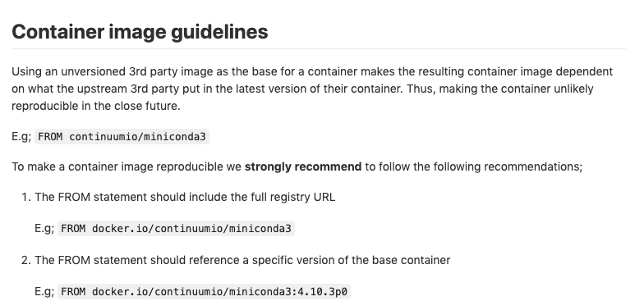
OSSR container image’s policy and guidelines
First proposal. Add it to the ossr-pages. Iterate and build from it;

Slide 6
OSSR registry
Idea: Registry of base containers to be used by users and ESAP
Where: gitlab escape2020/wp3/ossr-registry subgroup
First demonstrator with project ossr-autobuild-registry:
auto-build a docker container for each record in the OSSR
using repo2docker
Steps:
list records in the OSSR
list images already in the registry. Built images are identified by the unique record id.
build missing images and add them to the registry
build doc page listing and linking OSSR records and registry images
Nightly build to stay up to date

Slide 7
OSSR registry
Ideas to go further:
Build muti-project containers: e.g. dark-matter container
Allow user to build their own containers
start a project in the ossr-registry group
build your image using gitlab CI or push directly to the registry using tokens
add a README with description that can be read to centralise things

Slide 8
Open discussions
Container guidelines
OSSR registry

