Slide 1
GAMMORA A free, open-source, and validated GATE-based model for Monte-Carlo simulations of the Varian TrueBeam
Luc SIMON, Medical Physicist, PhD, HDR
IUCT-Oncopole, Toulouse, France
CRCT (INSERM U1037), Toulouse, France

Slide 2
What is GAMMORA? Gate Monte-Carlo MOdel for RAdiotherapy
In a nutshell: a GATE macro maker for radiotherapy!
A free and open-source project (Licence GNU GPL v3)

Slide 3
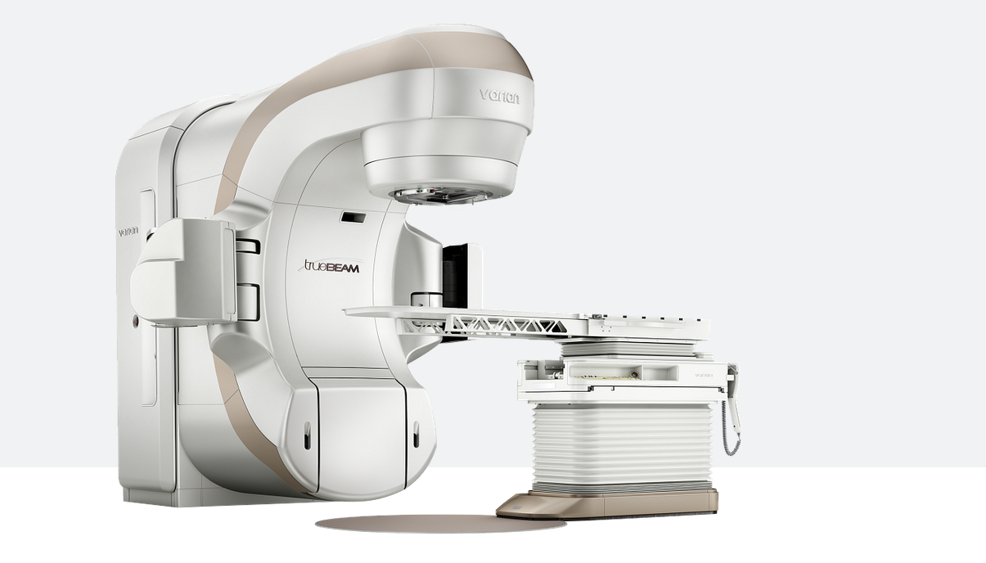
What is GAMMORA? Gate Monte-Carlo MOdel for RAdiotherapy
It can create simple or complex GATE macros for Varian TrueBeam STx
Photons energy modes: 6FF, 10FF, 6FFF and 10FFF (.IAEAphsp or gaga)
Electrons (only .IAEAphsp)
GATE phantom or patient CT (since GATE 8.2)
Splitting jobs (SLURM)

Slide 4
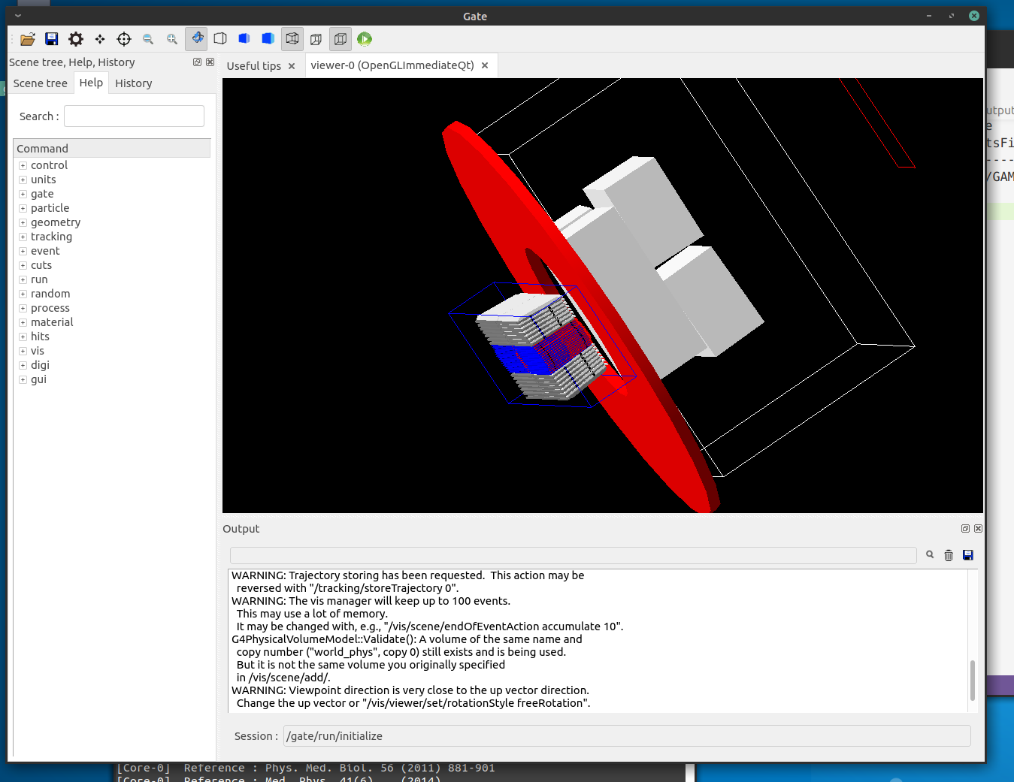
Who is GAMMORA?
GAMORA was implemented by:
Sara Beilla
Tony Younes
Jeremy Leste
Luc Simon

Slide 5
Why GAMMORA
An “easy-to-use” tool to perform GATE simulations for Radiotherapy
Powered by GATE/Geant4, GAMMORA provides a reference computation in the cases where classic algorithms reach their limits
Open-source: possibility to control, edit and modify any features of the computation
Why? We already have Varian Eclipse and it works fine

Slide 6
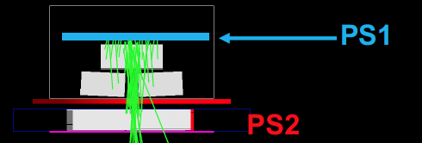
Inside GAMMORA
On myvarian.com, VARIAN provides for its customers
A brief description of the TrueBeam STx geometry
Phase space files (IAEAphsp) of the TrueBeamStx sources (photons, electrons) at the entrance of the linac head
First part of the linac, modelled with Geant4 (Constantin et al. )
Contains 2380.10⁶ particles (21 bytes/particles) with constant “y”
Constantin et al.

Slide 7
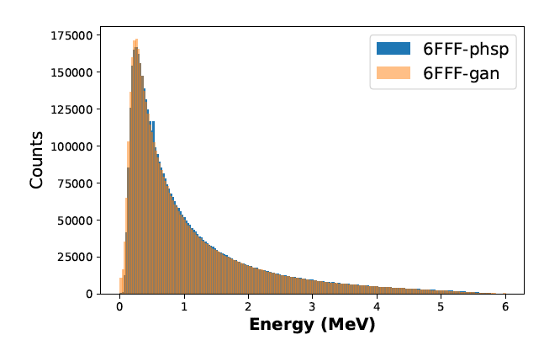
Inside GAMMORA
GAGA:
Sarrut D, Krah N, Letang JM.
Phys Med Biol. 2019
https://github.com/dsarrut/gaga-phsp
Thank you David Sarrut and CREATIS!
Leste et al. PM 2021
See PhD Thesis on HAL
GAN
Generative Adversarial Network
gaga phsp
Free (Gammora repo)
Trained GAN = particle gun
< 2 Mb for each energy
Unlimited number of particles
.IAEAphsp
Property of VARIAN
50 Gb for each energy
Limited number of particles

Slide 8
Inside GAMMORA
Origin of the “world” = isocenter
Y jaws
X Jaws
MLC 120 HD

Slide 9
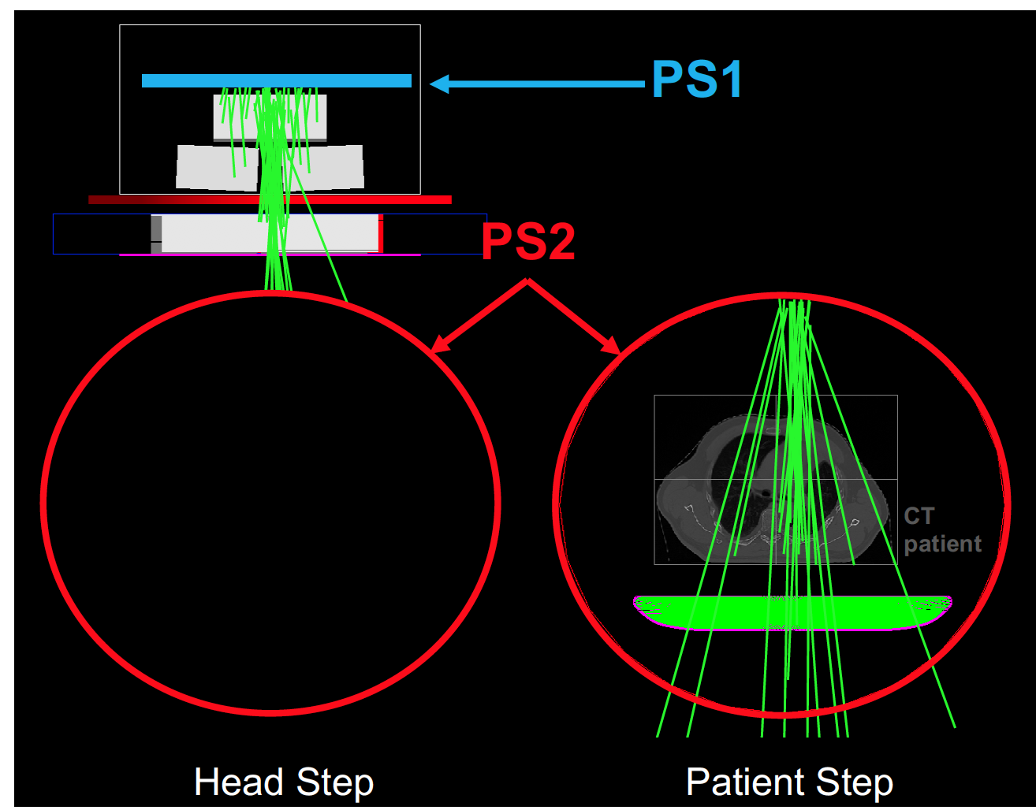
Inside GAMMORA A two-step simulation

Slide 10
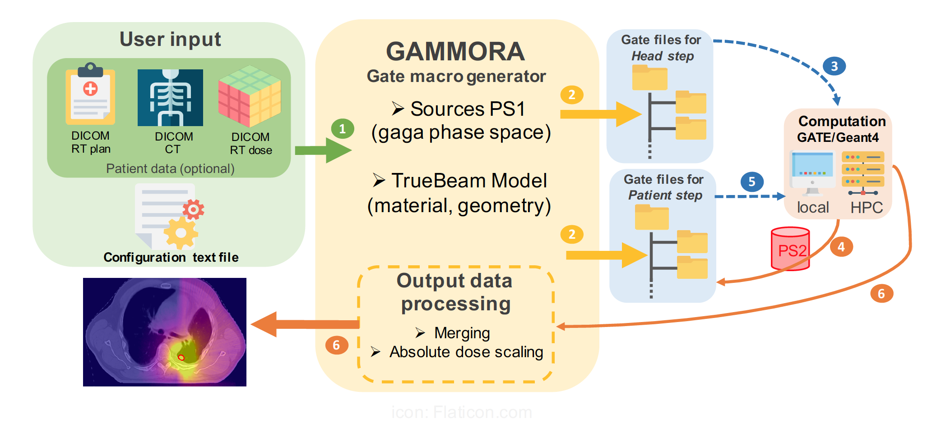
Inside GAMMORA

Slide 11
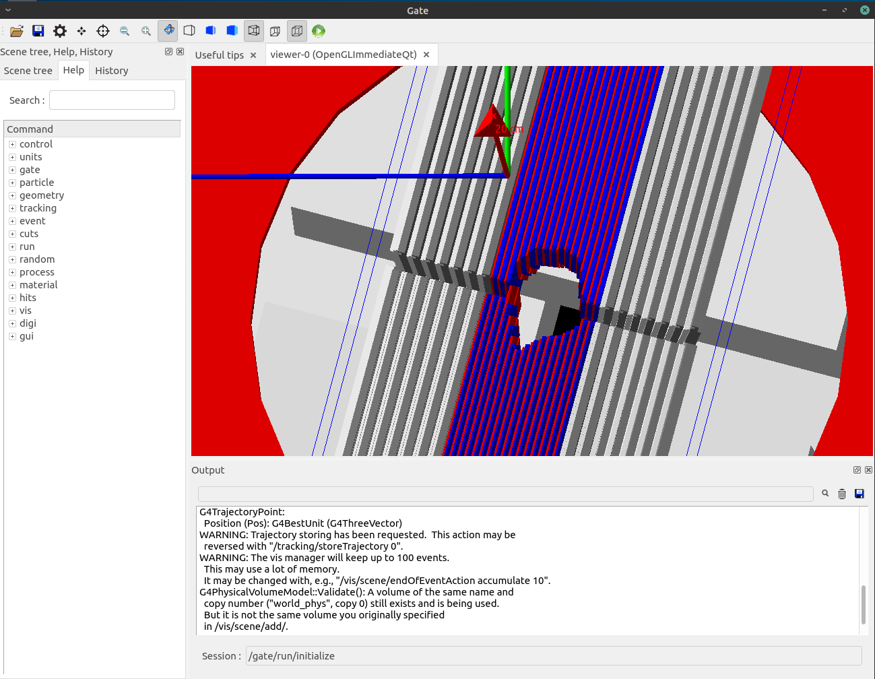
GAMMORA can produce splitted GATE macros and SLURM script
CALMIP (1,365Pflops/s)
13 464 cores, 48 GP-CPU cards, 76 To memory.
Each node: Intel® Skylake 6140 @ 2.3 Ghz 18 cores

Slide 12
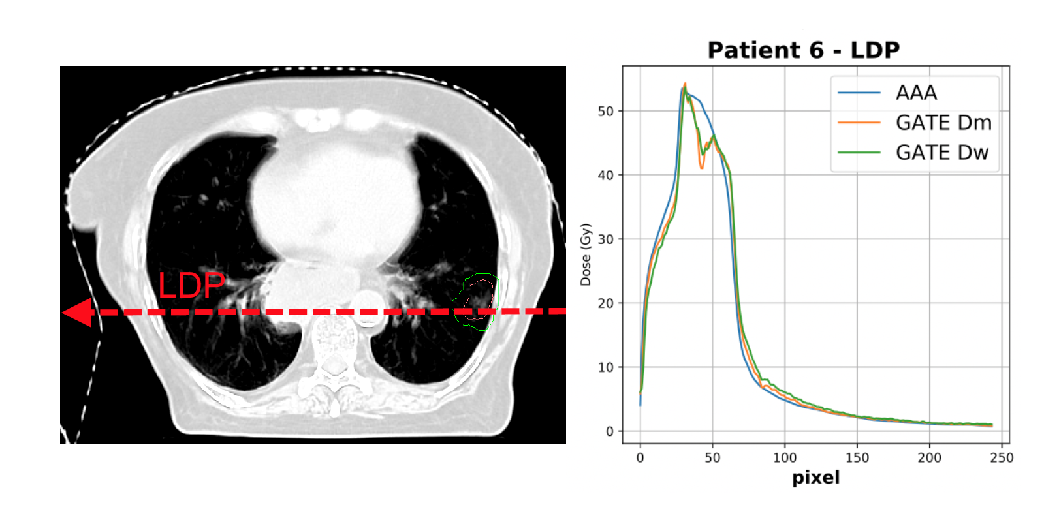
Applications of GAMMORA

Slide 13
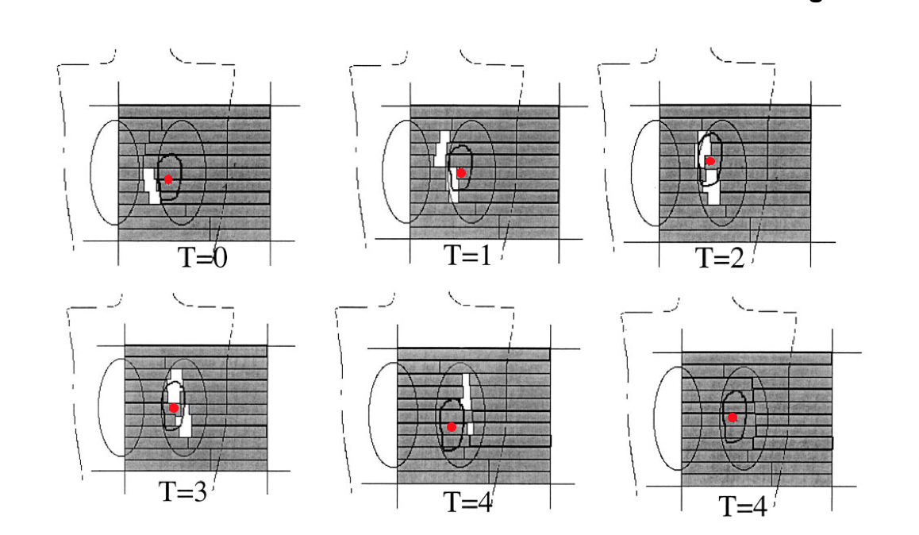
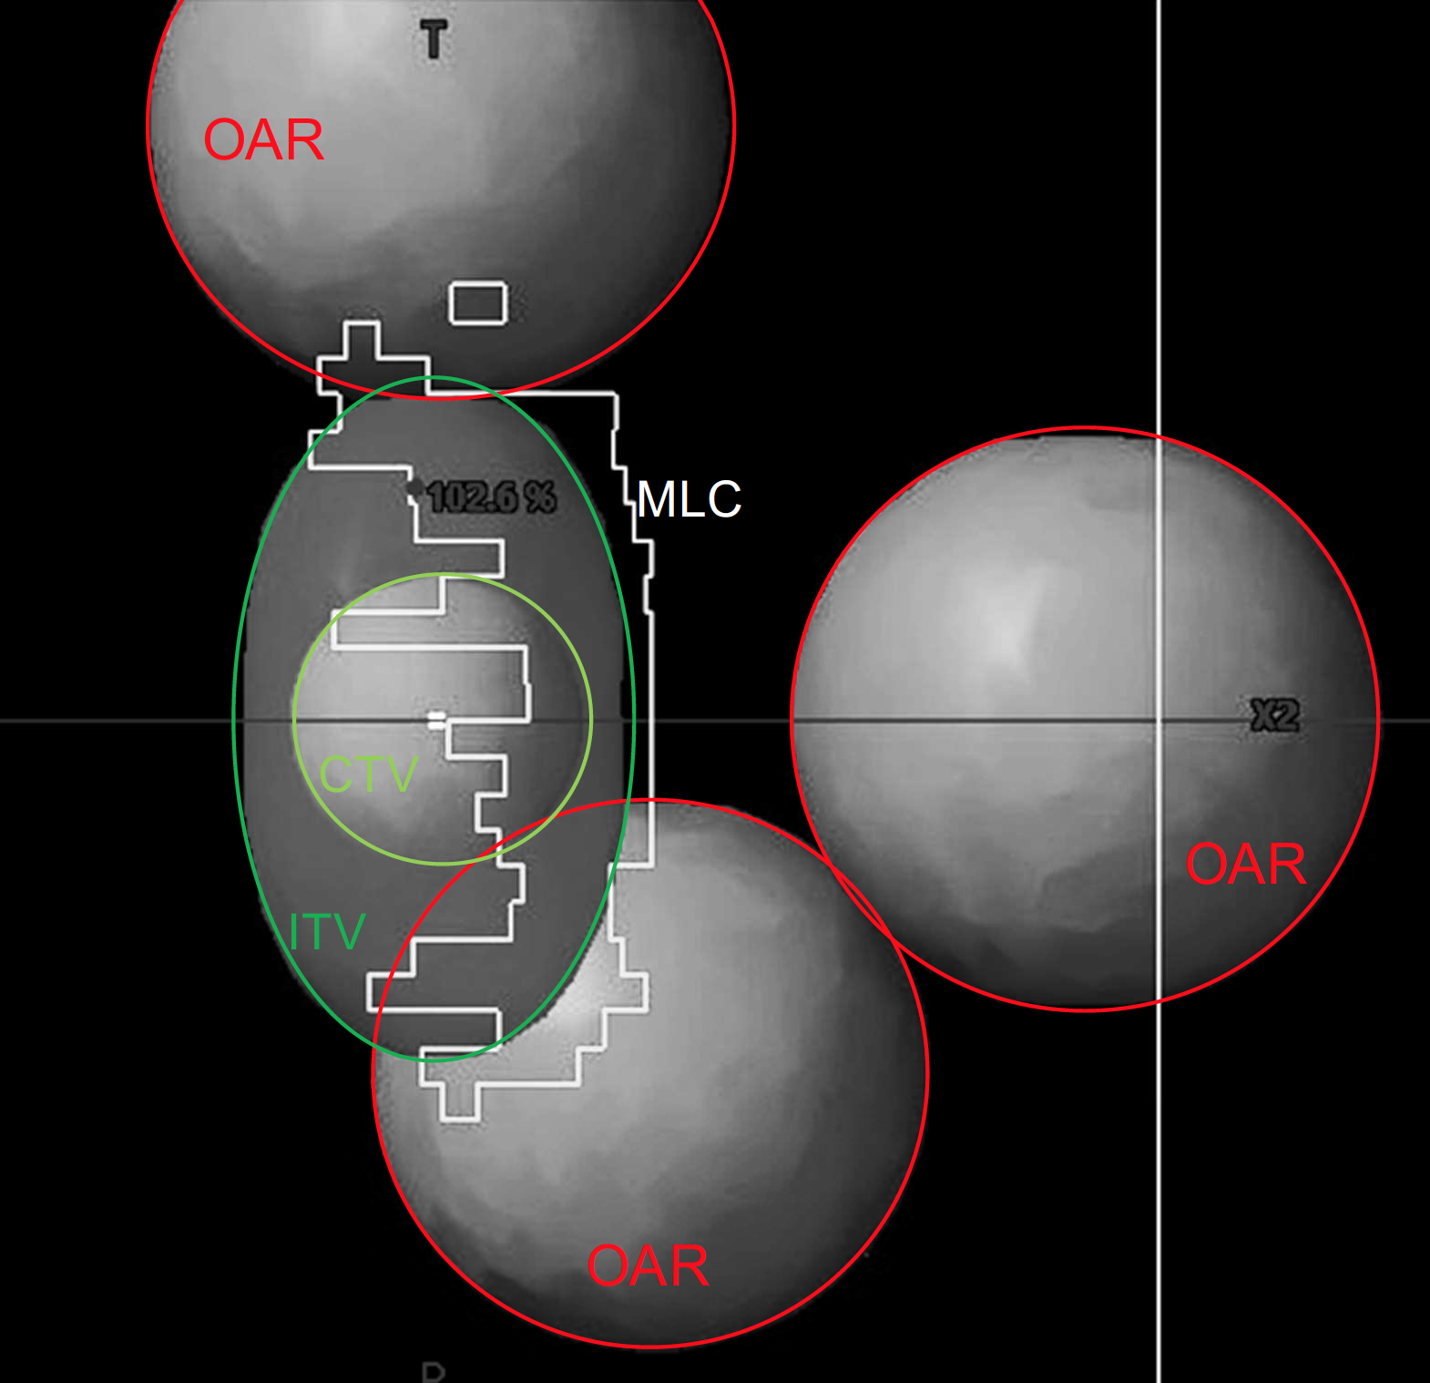
Applications of GAMMORA The interplay effect in lung modulated SBRT
Can we treat lung during free breathing with modulation ?

Slide 14
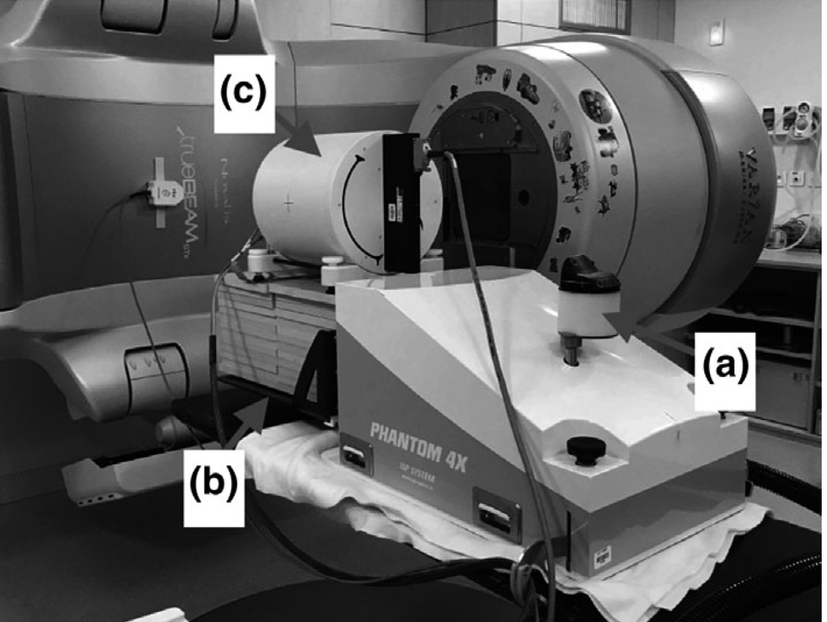
Applications of GAMMORA The interplay effect in lung modulated SBRT

Slide 15
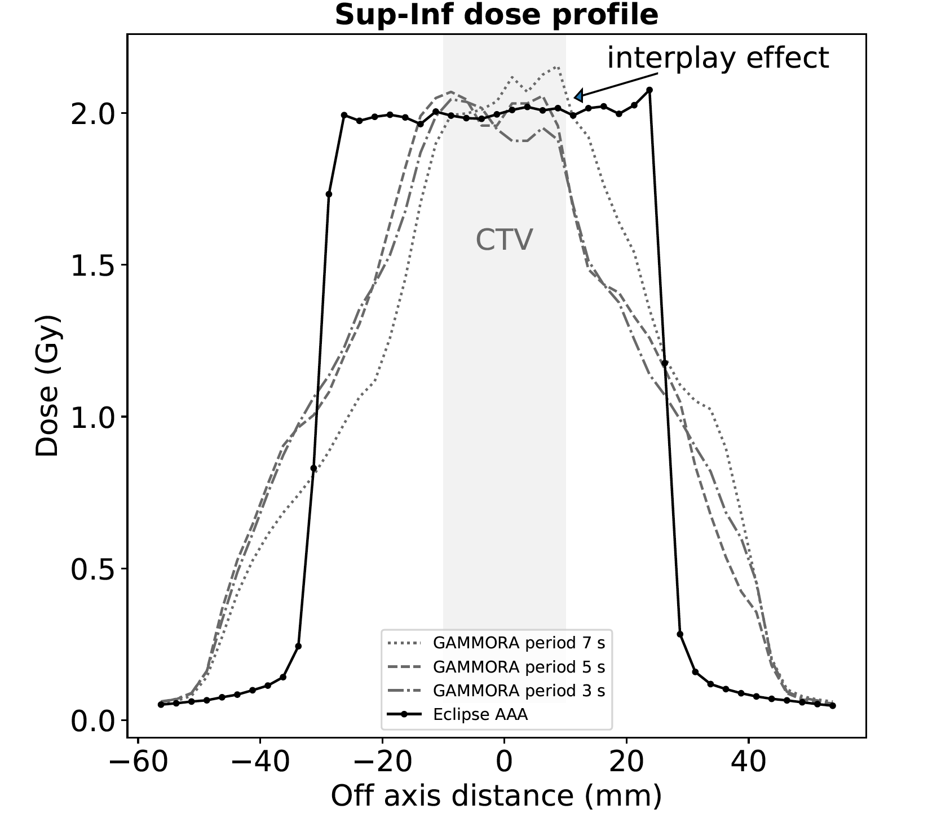
Applications of GAMMORA The interplay effect in lung modulated SBRT

Slide 16
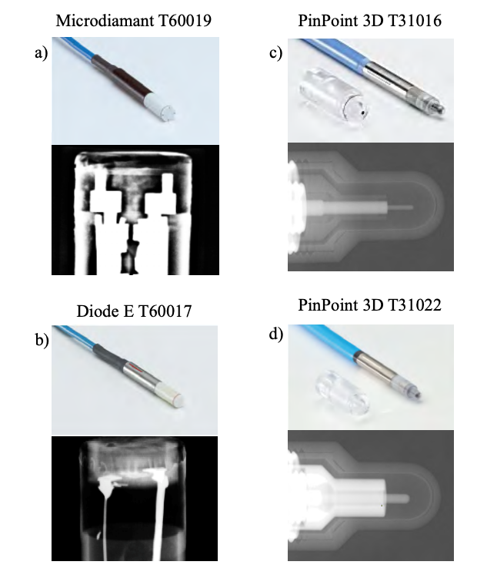
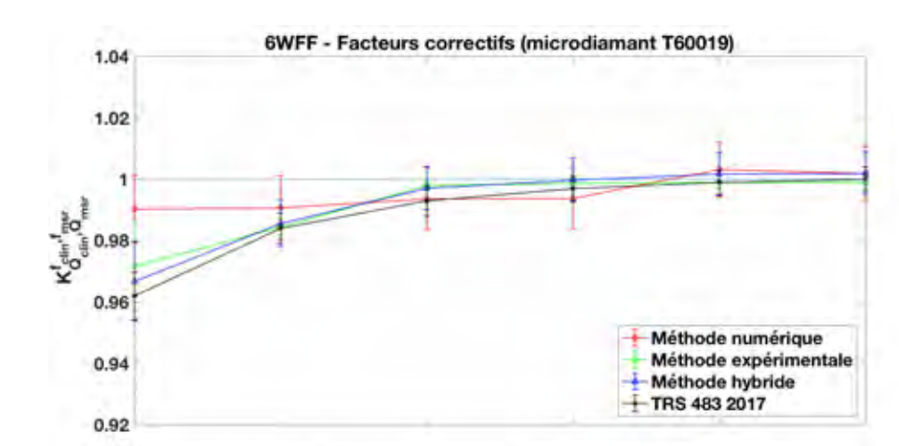
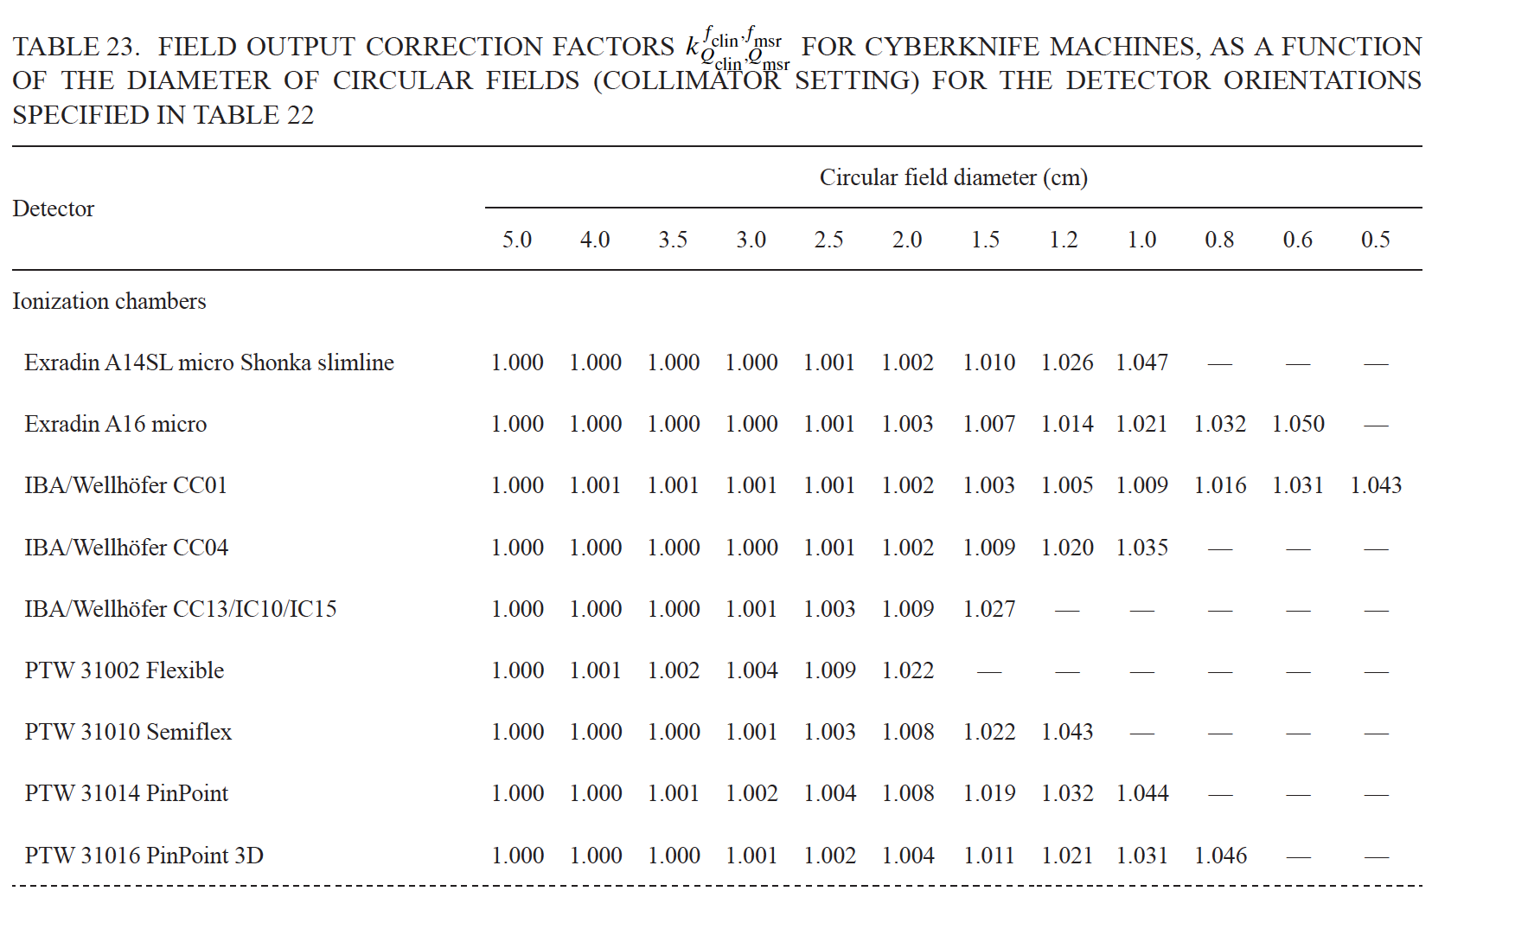
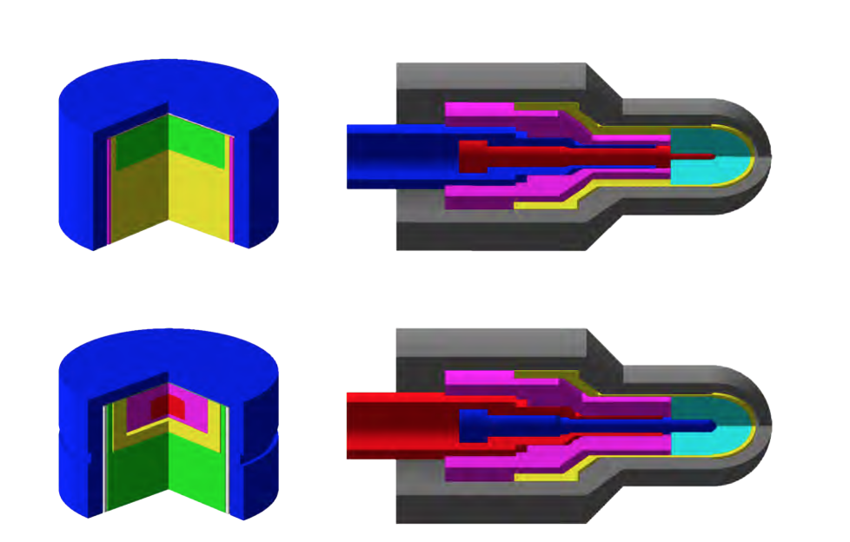
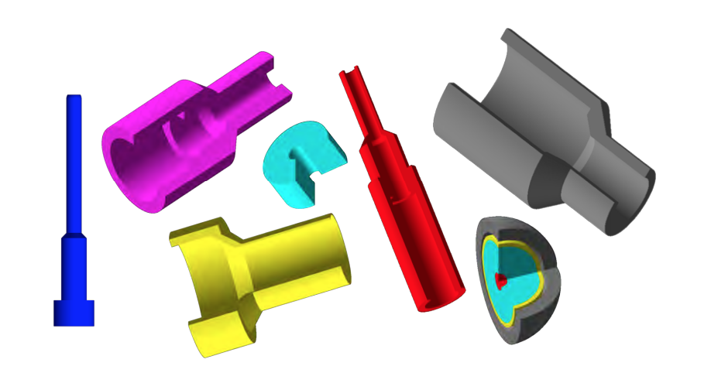
Applications of GAMMORA The output correction factors
IAEA TRS 483:
For very small field dosimetry, output factor must be corrected
Tony Younes, PhD Thesis
J. Labour, MSc

Slide 17
Applications of GAMMORA other applications
Assessment of a new formalism of measurement dose-to-media
Determination of fluence
Assessment of dose in strong heterogeneities (lung DIBH, bones, metal)

Slide 18
Conclusion Where do we go?
A PhD is in second year (A. Delbaere)
A PhD starts (S. Blas)
Difficulties to maintain GAMMORA (GATE 9.2)
A frozen version of GATE? (like GATE RT-ION)
Model of new units → Halcyon, Tomotherapy

Slide 19
Thank you
https://github.com/uhqd/GAMMORA

