Slide 1
Celebrating 150 years of advancing medical research, education, and patient care to help people live longer, healthier lives
Ashok Tiwari & John Sunderland
Department of Radiology & Physics
Simulations of therapeutic α-emitting radionuclides in various tissues
GATE Scientific Meeting 2021
Nov 18, 2021

Slide 2
Outline of presentation
Background
Methods
Results
Discussions
ashok-tiwari@uiowa.edu

Slide 3
Background
In radiopharmaceutical therapy there is a need to optimize the therapy
How to personalize it?
Internal emitter dosimetry is of great interest to calculate the patient specific absorbed doses (SNMMI Dosimetry Challenge ¹⁷⁷Lu absorbed dose calculations on patient data)
Dose point kernels (DPKs) are of interest because of its accuracy and lower calculation time compared to full MC calculations
For β- and γ-emitters such as ¹⁷⁷Lu, ⁹⁰Y - convolution of DPKs and image-based activity map → absorbed dose distribution
For α-emitters → local energy deposition, large voxel sizes
ashok-tiwari@uiowa.edu

Slide 4
Methods
We try to understand the dose profiles of α-emitting radionuclides (²²⁷Th, ²²⁵Ac, ²²⁴Ra, ²²³Ra, ²¹²Pb, ²¹¹At, ²¹³Bi, ²¹²Bi) in several tissues
Simulations were performed to observe the Bragg peaks of therapeutic α-emitters and monoenergetic alphas (3-9) MeV
Dose point kernels were generated
Impact of tissue types on DPKs were studied
Dosimetric comparison were performed by comparing the absorbed dose per decay for simulated radionuclides
All simulations were performed in GATE v9.0
ashok-tiwari@uiowa.edu

Slide 5
How did we perform simulations?
Spherical homogeneous phantom of radius up to 400 µm were used
Ion source was placed at the center of the phantom
Tissues: Compact Bone, Blood, Red Marrow, Water, Adipose, Lung
All decay modes are activated: dose depositions were by α-, β-, γ’s, and Auger electrons
Physics lists: EmStandard_opt4, RadioactiveDecay, FTFP_BERT_EMZ, atomic de-excitation, fluorescence x-rays, Auger cascade emissions, and PIXE
50 million decays were simulated
A total of 90 simulations were performed in GATE (v 9.0)
ashok-tiwari@uiowa.edu

Slide 6
Simulation of monoenergetic alphas
Simulation of monoenergetic α-particles (3-9) MeV
Simple decay schemes compared to radionuclide decay characteristics
DPKs were generated and Bragg peaks were plotted
DPKs were scaled using the radius of spherical phantom where maximum value of Bragg peak was observed
$J\left(\frac{r}{R_{α}}\right)=4π×r^{2} ×ρ ×D\left(r\right)×\left(\frac{R_{α}}{E}\right)$
where,
r is radius of the phantom
ρ is density of tissues
D(r) is absorbed dose
R_{α} is range of alphas
E is energy of alpha particle
ashok-tiwari@uiowa.edu

Slide 7
Simulation of α-emitting radionuclides
Clinically relevant α-emitting radionuclides
Complex decay scheme compared to monoenergetic α-decay
DPKs were generated and Bragg peaks were plotted
DPKs were scaled using the maximum range of α’s in tissues as the radionuclide decay have multiple α-emissions
$J\left(\frac{r}{R_{α}}\right)=4π×r^{2} ×ρ ×D\left(r\right)×\left(\frac{R_{α}}{E_{ave}}\right)$
ashok-tiwari@uiowa.edu

Slide 8
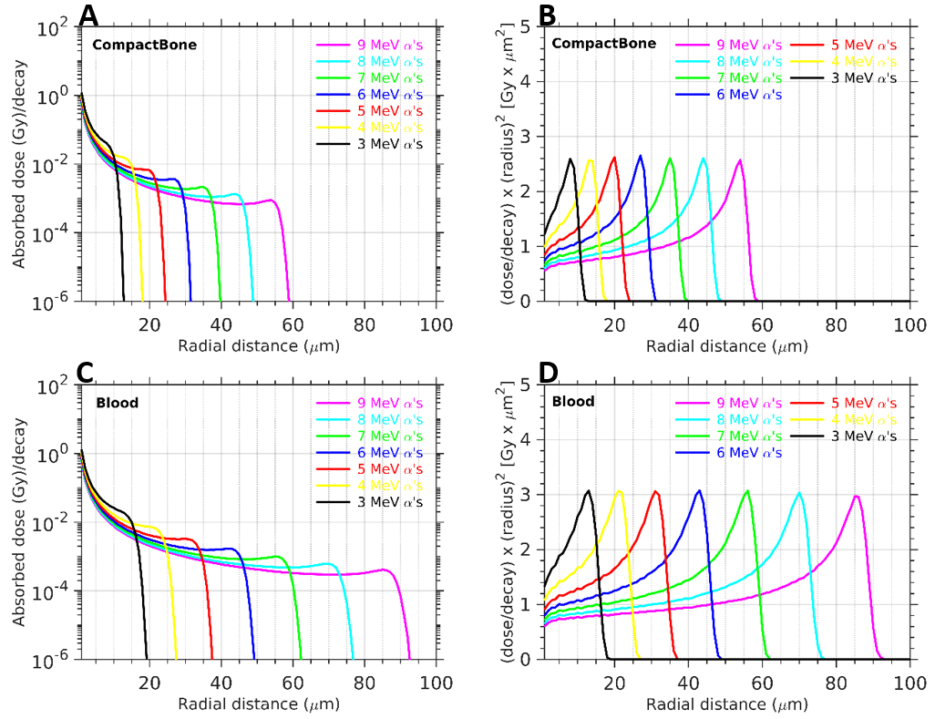
Results:
(Monoenergy α’s)
As the particle approaches the end of its track a peak is observed as expected
Regardless of the energy, height of the Bragg peak is same for all alpha energies in the same tissue.
ashok-tiwari@uiowa.edu

Slide 9
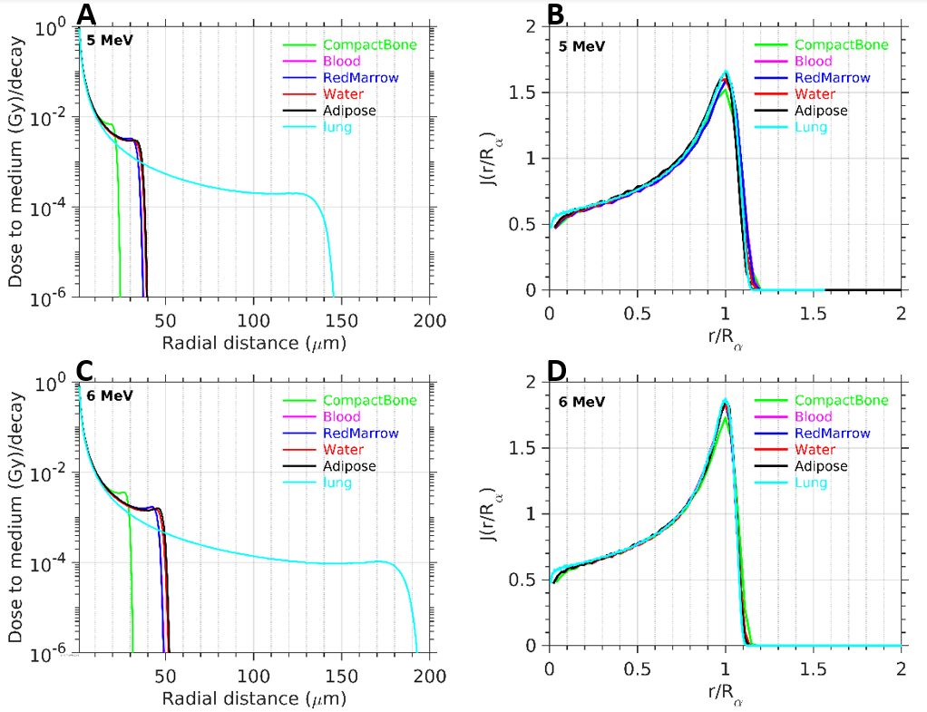
DPKs –
(Monoenergy α’s)
Before the Bragg peak, average differences of ~5%
Differences up to ~10% at the Bragg peak and dose fall-off regions
Fig: Dose point kernels of monoenergetic α-particles in several tissues
ashok-tiwari@uiowa.edu

Slide 10
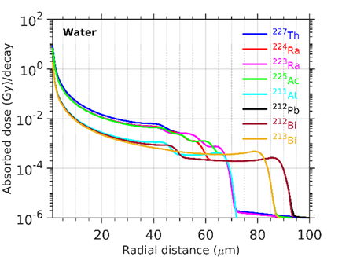
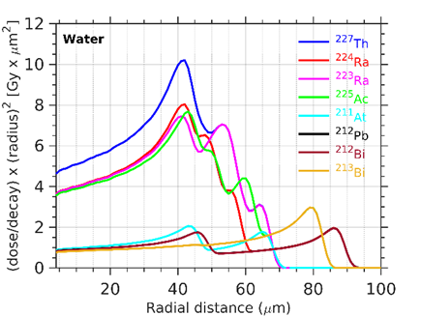
Radionuclide α-emitters
Multiple Bragg peaks (1 - 4) are observed.
Comparison: At 42 µm, the absorbed dose deposition from ²²⁷Th decay is the greatest, which is ~(1.3-1.4)x larger than decay due to ²²⁴Ra, ²²³Ra, ²²⁵Ac, and ~(5-9)x larger compared to decay of ²¹²Pb, ²¹²Bi, and ²¹³Bi.
ashok-tiwari@uiowa.edu

Slide 11
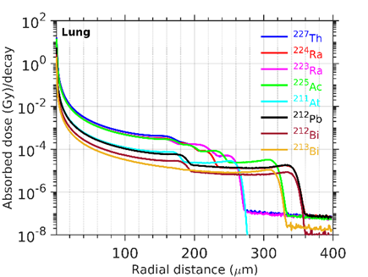
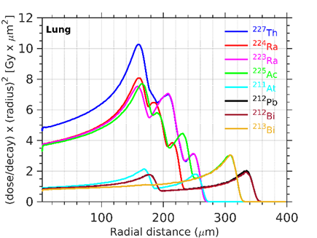
Radionuclide α-emitters
Similar comparison was observed in different tissue types.
ashok-tiwari@uiowa.edu

Slide 12
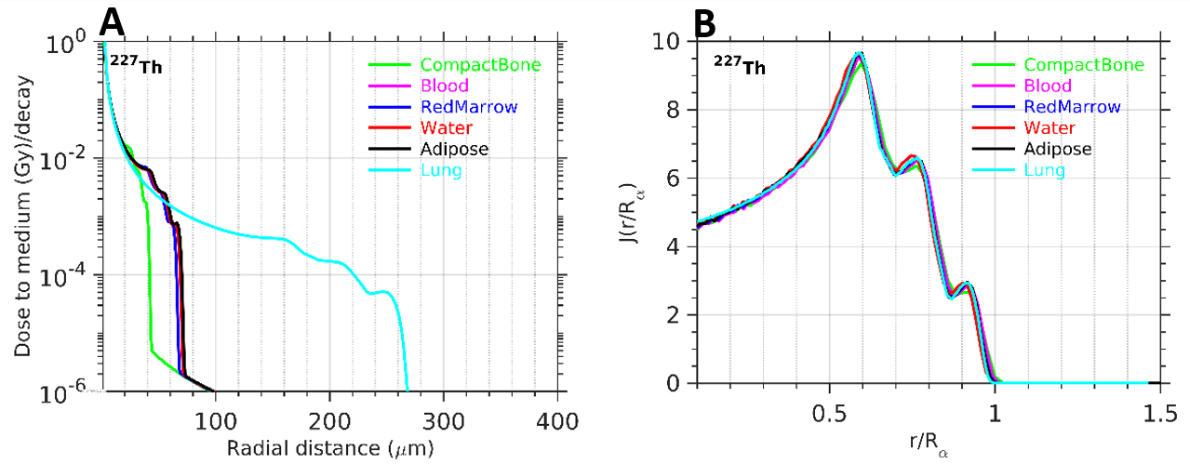
Dose point kernels - comparison
Differences up to ~23% were observed in the Bragg peak and dose fall-off region after the last peak. Up to the first Bragg peak ~5% difference was observed for ²²⁷Th decay.

Slide 13
Discussion
Eight clinically relevant α-emitters were studied and mono-energy α-particles (3-9) MeV.
Multiple Bragg peaks were observed (up to 4 peaks).
Comparison of water kernels with other tissue specific kernels demonstrated a difference of ~5%, except at the higher dose gradient region (Brag peak fall–off regions), where difference up to ~23% were observed.
Higher discrepancies were observed for lung and compact bone tissues compared to water.
Blood, red marrow, adipose tissues are in close agreement with water dose point kernels.
Dosimetric comparison of radionuclides were performed.
ashok-tiwari@uiowa.edu

Slide 14
Thank you for listening!
Questions? ashok-tiwari@uiowa.edu
https://ashok-tiwari.github.io
ashok-tiwari@uiowa.edu

