Slide 1
GATE status and future perspectives
David Sarrut, on behalf of the collaboration

Slide 2
Current release is 9.1 – April 2021
Mostly consolidation of 9.0
With Geant4 10.7.x
Gate is only evaluated with this Geant4 version
May work with previous, but no guarantee (and not maintained)
New :
Features: range Actor, options in PhaseSpaceActor, improvements in CCMod, in LET/EnergySpectrum actors, …
Bug fixes
More than 70 contributors (since 2012 only)
Automated compilation check on Linux + OSX
https://github.com/OpenGATE/Gate

Slide 3
Docker and Virtual Machine
Docker versions are available
https://hub.docker.com/r/opengatecollaboration/gate
Virtual Machine
On google drive
See doc: https://opengate.readthedocs.io

Slide 4
Benchmarks
17 benchmarks: dose, LET, PET, DPK, e+ range, EM field, etc
(… and more to come)
A benchmark is
A GATE simulation, macro with associated data (not too long comp. time)
A python script to compare results according to ref or previous version
A (arbitrary) threshold fail/pass
Can be run by any user on her/his computer
Is automatically run on code change
https://github.com/OpenGATE/GateBenchmarks

Slide 5
GATE galaxy ...
Gate itself
Gate documentation
Gate benchmarks
Gate RT-Ion
Gate contrib
Gate tools
Open-source and collaborative
https://github.com/OpenGATE

Slide 6
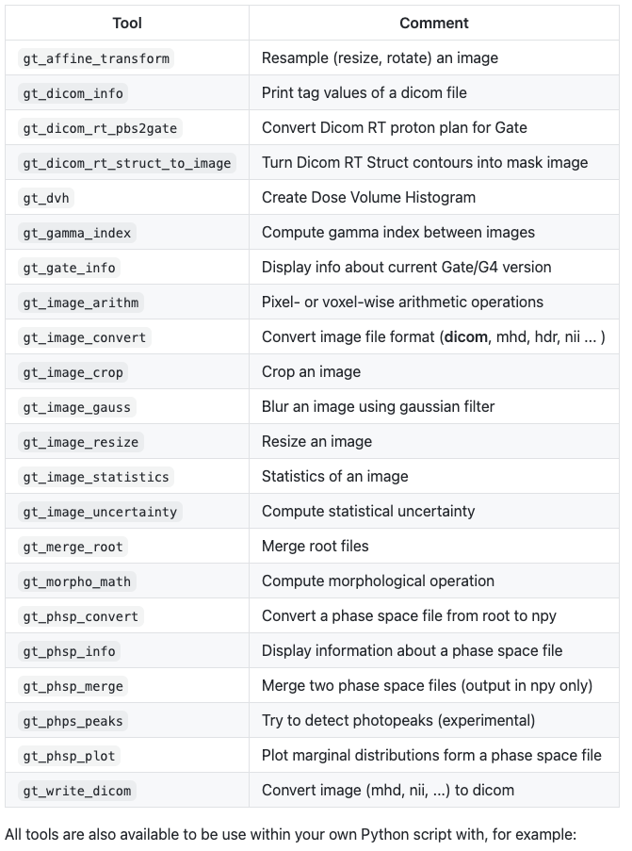
List of GateTools
https://github.com/OpenGATE/GateTools

Slide 7
Please, contribute !
https://github.com/OpenGATE/Gate
Report issues on github, reply to the mailing list
Correct, clarify documentation (via github)
Use, test and upgrade python gatetools
Provide Pull Request for bug correction or new feature

Slide 8
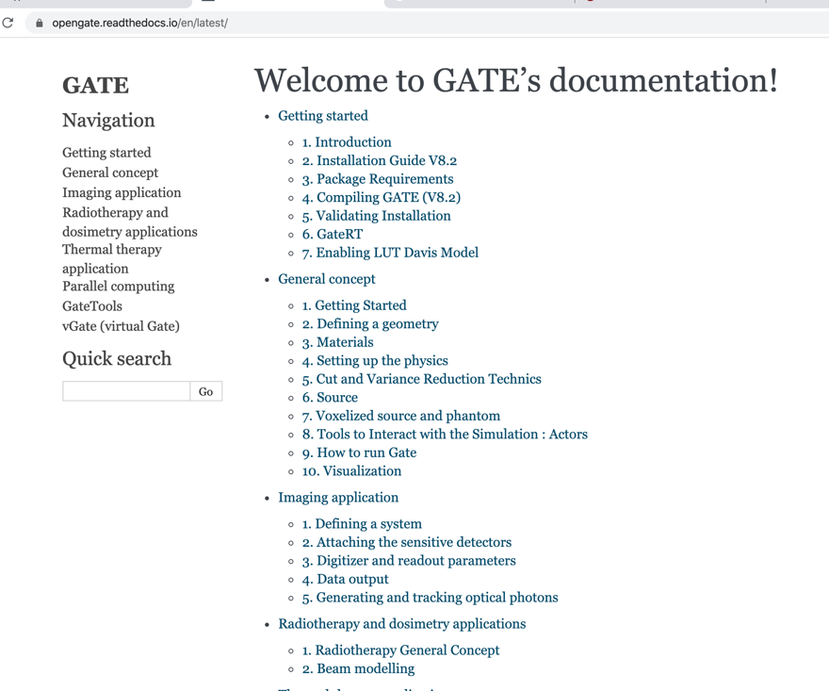
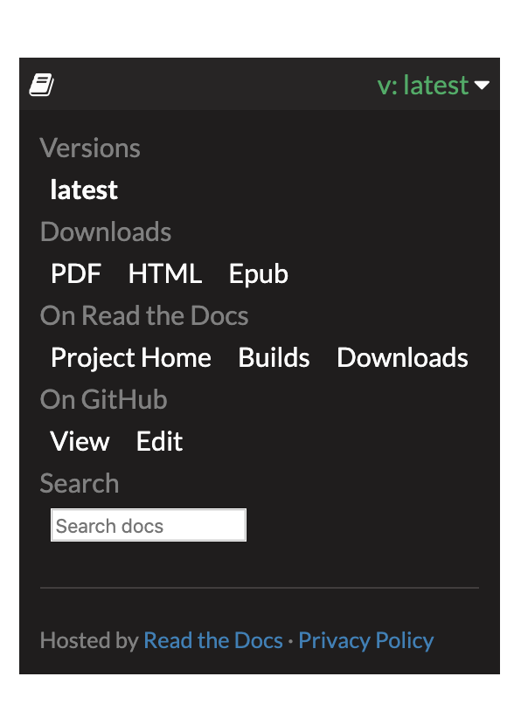
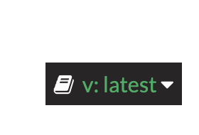
Documentation system
https://opengate.readthedocs.io

Slide 9
Technical board
Once a month, thursday morning 9am CET (1 hour max)
Next: 25th November
We discuss about Issues and Pull-Request on GitHub, future features, benchmarks, etc.
Everyone is welcome, just ask to be part of:
gate-devel@lists.opengatecollaboration.org

Slide 10
Fun: Gate history on youtube
https://youtu.be/XE6CB2Eh0IM

Slide 11
Future developments

Slide 12
Next release: early 2022
Will be compatible with G4 version 11
Probably version 9.2
Bug fixes and improvements:
optical photon fixes (cerenkov)
Scoring option with stopping power (EnergySpectrumActor)
No really new features since May 2021

Slide 13
Proposals?
[Carlotta]: improve optical photon output ; check with G4 to integrate changes needed for optical simulation
[Julien]: improve sources management
[Mariele]: analyse past messages in mailing list to detect most frequent question
[Christian]: GDML support, improve readout/digitizer, plugin system?
[Karl]: improve readout/digitizer
[DavidB]: make an user wish list ?
[Wojciech]: improve readout/digitizer, better Castor-Gate interface, actors attached to several volumes
[DavidS]: discussion pending in steering committee for future directions

Slide 14
Rationale 1/2
GATE is useful in medical physics
As shown in publications, collaboration with industrials, also in education …
[Jan et al. 2004] [Jan et al. 2011] [Sarrut et al. 2014] [Sarrut et al. 2021]
Still evolving science: large FOV axial PET, CZT, Compton Camera, Cerenkov, optical, TOF, DOI,EM field, proton/carbon/molecular therapies, VEE, flash, nano etc … GATE-like simulation platform remains useful

Slide 15
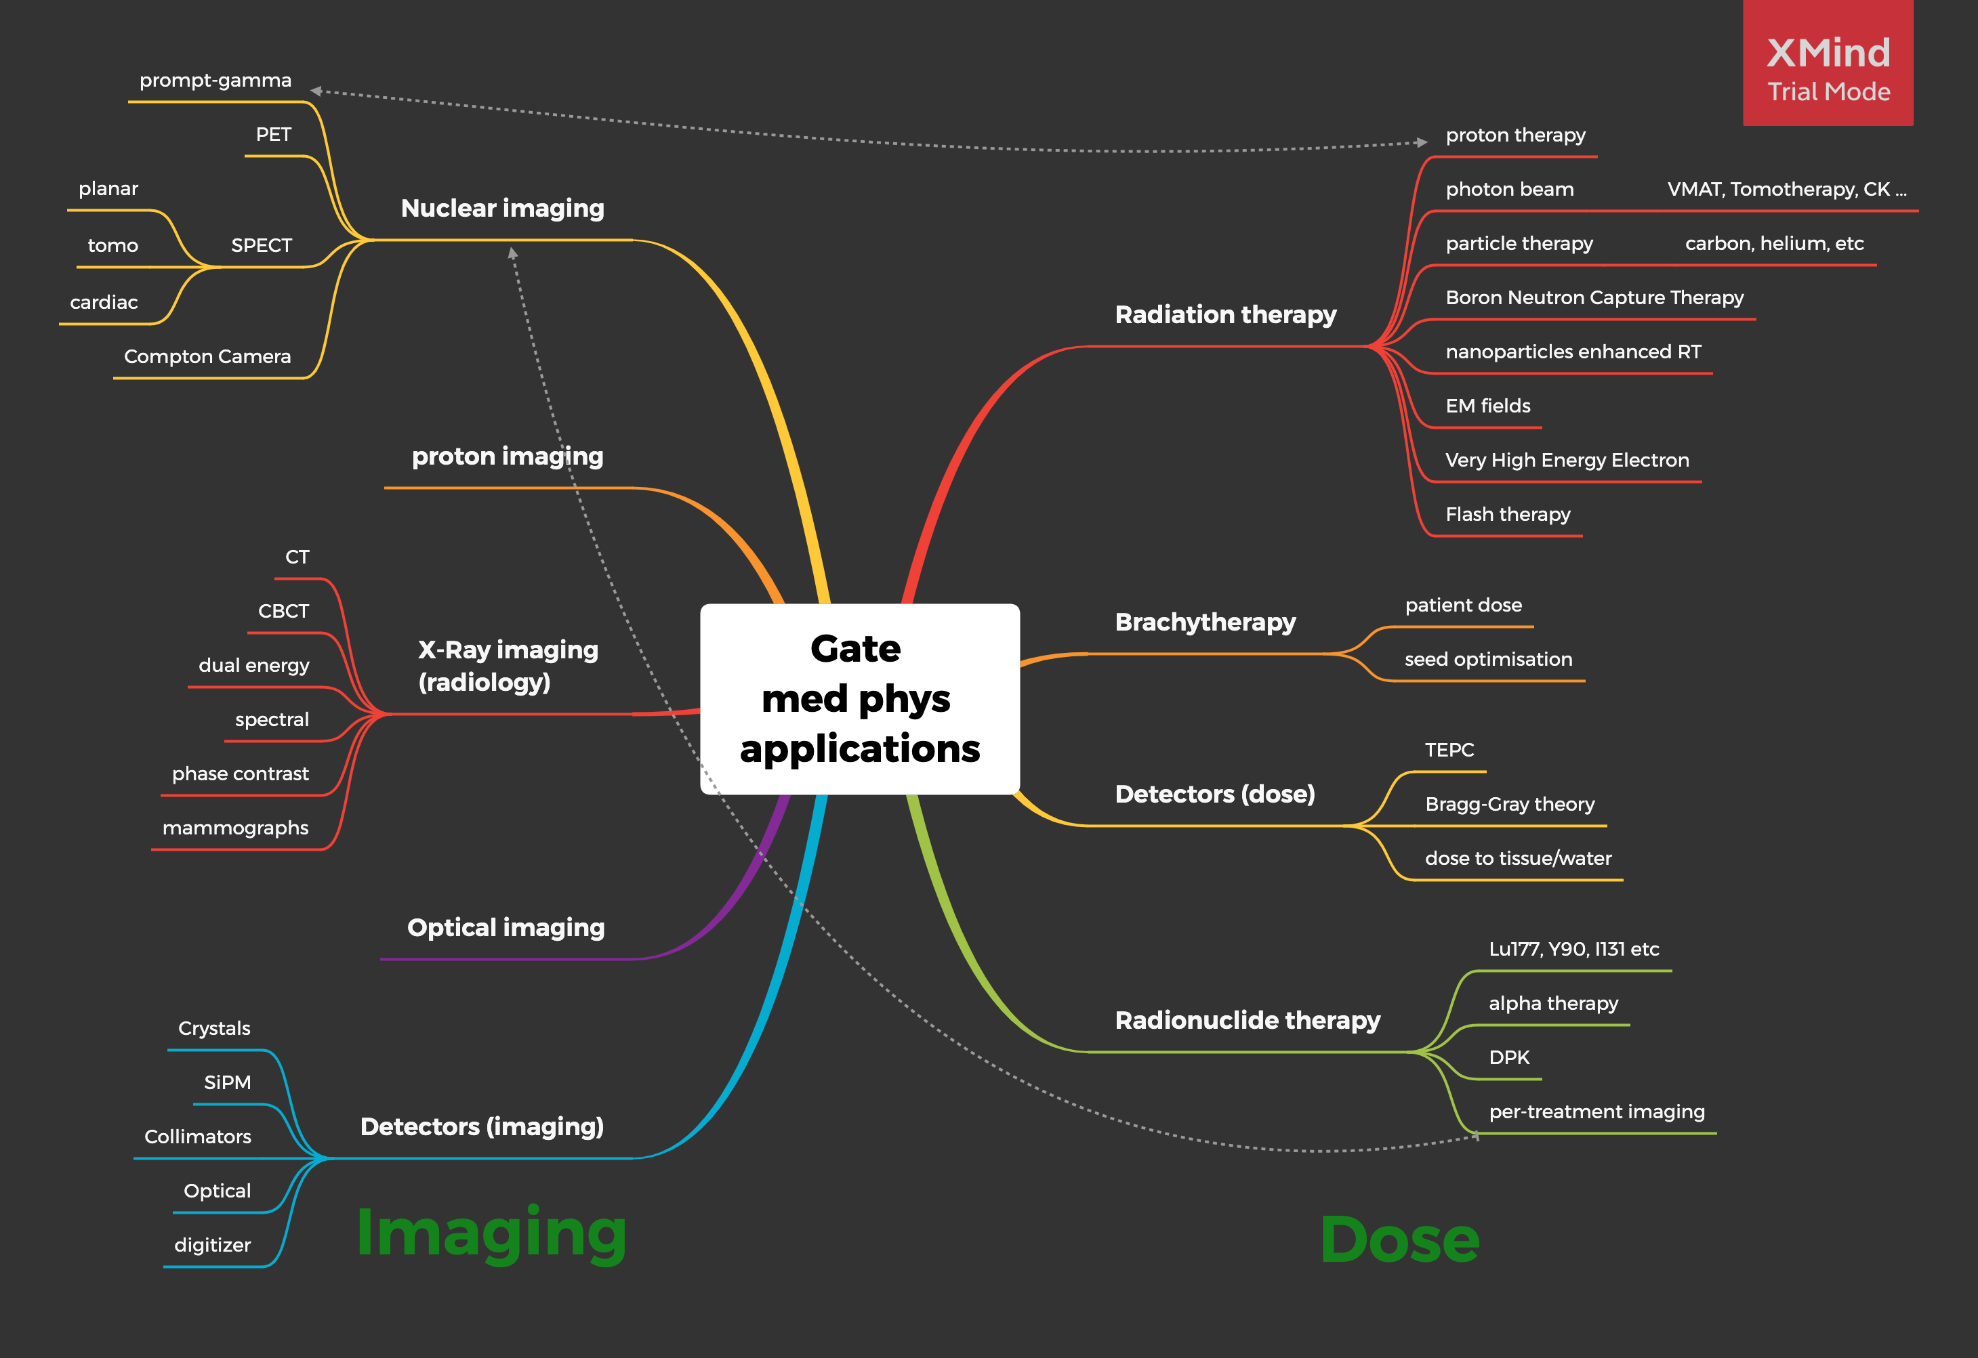

Slide 16
Rationale 2/2
But GATE code is old ~ 20 years
C++ code has becomes a mess, hard to maintain, hard to debug
There are bugs, hidden/unused/obsolete functions
Geant4 evolved, C++ evolved
Geant4 “confirmed” for next 10 years at CERN
Third party software: itk, root, castor, rtk, stir, SpekPy, etc …
Python is rising for data analysis
IA is rising for … everything ;)
Time for a new GATE ?

Slide 17
Start an *experimental* new version ?
Keep
OpenGate community
Open-source
Collaborative work
Changes
1) Digitizer refactoring
2) Replace macro by python scripts
3) AI integration (Mocamed project, experimental)

Slide 18
Expected gains
G4 multithreading
Single line installation (both GATE and all dependencies, including G4)
Easier and enhanced user development (python instead of macros)
New digitizer chain: easier to prototype/extend. Used both online & offline
Better timing management (phantom, sources)
Integrated VRT and analytical methods (FFD, TLE) based on third party ray tracing lib
Integrated image management (with third party image lib such as ITK)
Integrated IA: continue the link with pytorch (or other libs)
Better integration with reconstruction software (castor, rtk, stir, etc)
Better output analysis (root tree with uproot)
Add benchmarks/tests right from the start
Linux, OSX … but also maybe Windows ?

Slide 19
Feasibility & difficulties
Geant4 python warping: with pybind11
Already discussed with Geant4 collaboration ; ready to collaborate
Python is slow ? Not here !
GATE remains in C++ (same computation time than G4)
Python only instead of “macros” to create the simulation
Warning:
source code may be more complex (Python and C++ mixed)
current GATE code-base is huge
Some parts should be adapted
Will take time

Slide 20
Current prototype
Install as user: pip install gam-gate
comes with Geant4 + ITK + … (all deps)… + GATE: all in once
Install as developer: more complex …
https://github.com/dsarrut/gam-gate
Everything still under discussion and can evolve
Already show it is feasible

Slide 21
DEMO …

Slide 22
demo
Terminal
Pip install -> explain G4, etc
Example with visu (ex4)
show code in pc
MT
Visu

Slide 23
Conclusion
Current GATE version is still the official one, maintained and improved
Experimental project is starting
If interested, please contact us !

