Slide 1
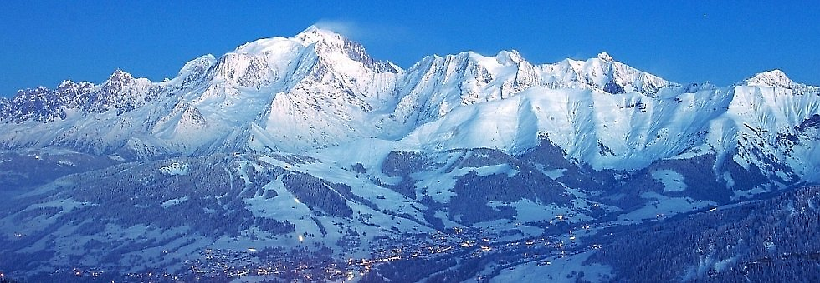
SVOM BA workshop
The goal of the workshop is to present ant to test the tools that will be available to the Burst Advocates, the future on-call scientists who will be responsible for the scientific organization of the multi-wavelength observations of the gamma-ray bursts detected by SVOM.
January 2017
B. Cordier SVOM Science Meeting

Slide 2
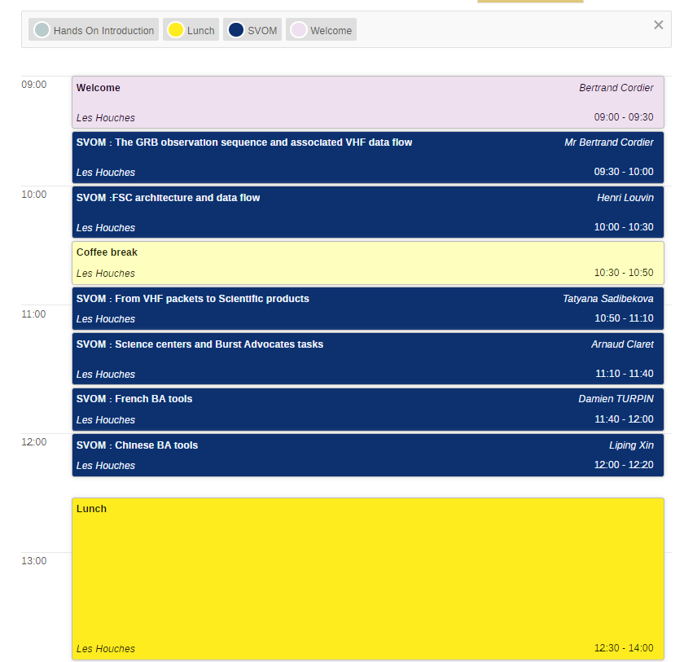
The workshop is on the web
You will find all the presentations on the indico website of the workshop :
https://indico.in2p3.fr/event/25299/
Timetable
Detailview
We ask the speakers to upload the pdf version of their talk directly on the site

Slide 3
CATERING
On the day of arrival, the first meal is dinner. On departure (Friday), the last meal is lunch, after the last lecture.
Breakfast from 7:45 to 8:45
Lunch at 12:30
Dinner at 19:30
We ask you to be on time.

Slide 4
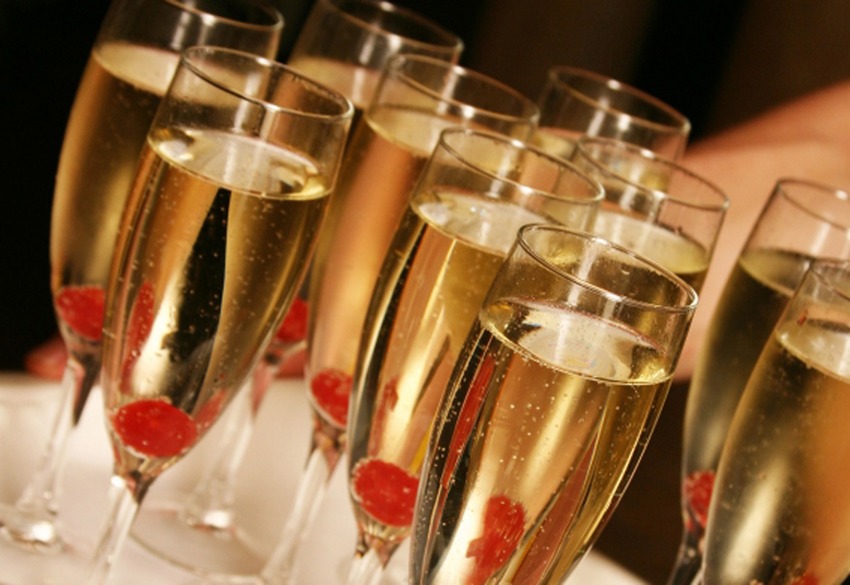
Social activities
A welcome cocktail will be offered by the School on Monday evening at 19:00

Slide 5
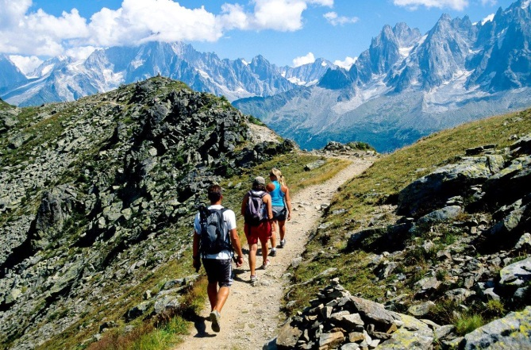
Social activities
Tuesday afternoon is free. For those who are motivated Damien and Christain have prepared some suggestions for excursions.
In case you are interested in the hike, don't forget your hiking shoes and a water bottle…

Slide 6
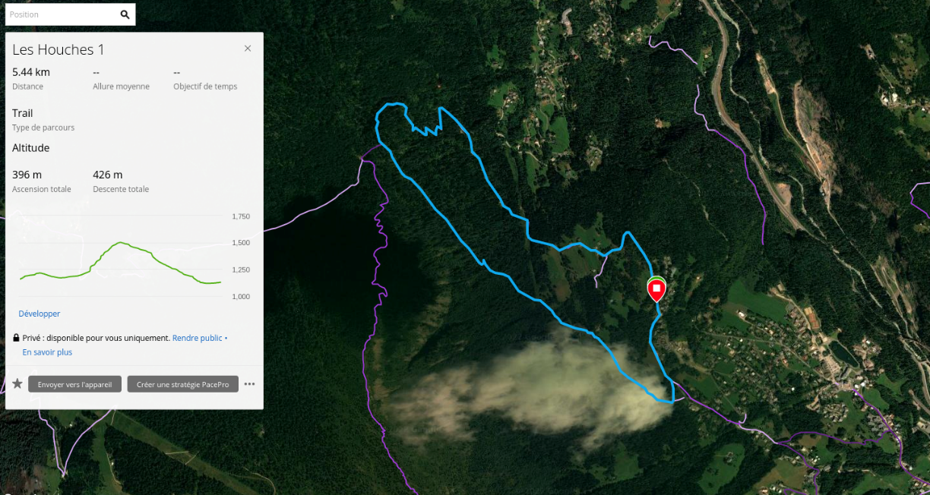
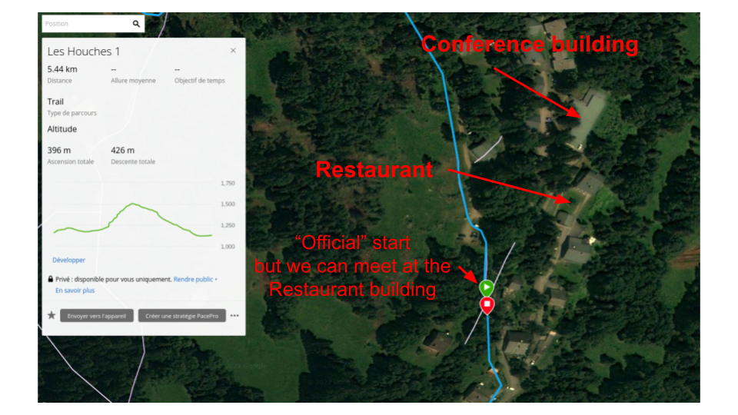

Slide 7
Goup picture
We have a group photo scheduled for Tuesday morning at the beginning of the coffee break 10:30.

Slide 8
I wish you a very good SVOM workshop!

