Slide 1


The GRB observation sequence and associated VHF data flow
Bertrand Cordier
Maxime Bocquier, Nicolas Dagoneau, Diego Götz, Henri Louvin, Yulei Qiu, Guillaume Thirion, Damien Turpin
SVOM workshop – Les Houches – 2022 May 16

Slide 2
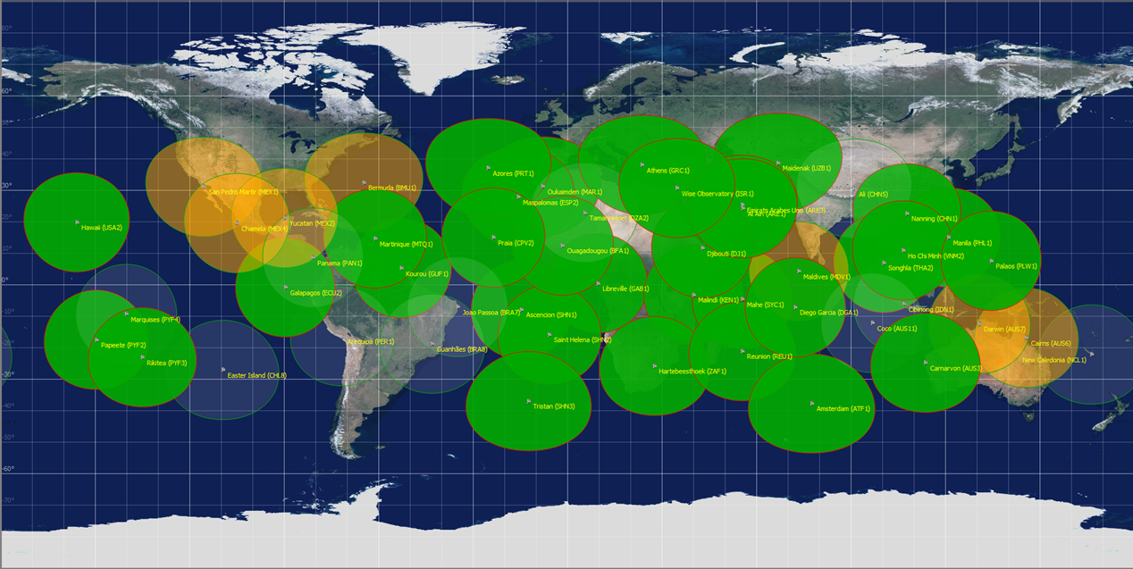
Goal: (mission spec): « to make available to ground based telescopes the measured GRB celestial coordinates in no more than 30 secondes after localization “
Solution: the SVOM alert system, consisting of a VHF emitter on the satellite, a network of VHF receivers on ground, a real-time scientific ground segment and the on-call scientists (BAs) with their tools.
Principle: send a subset of the satellite data via the VHF channel to allow scientific reactivity in near-real time and organize as soon as possible the monitoring of the GRB. The rest of the data will be sent by the X-band.
The customer is the BA
The infrastructure: the VHF network + the FSC
Monitoring tools: BA tools (French and Chinese)
See presentations from Tatyana, Henri, Arnaud, Damien and Liping

Slide 3
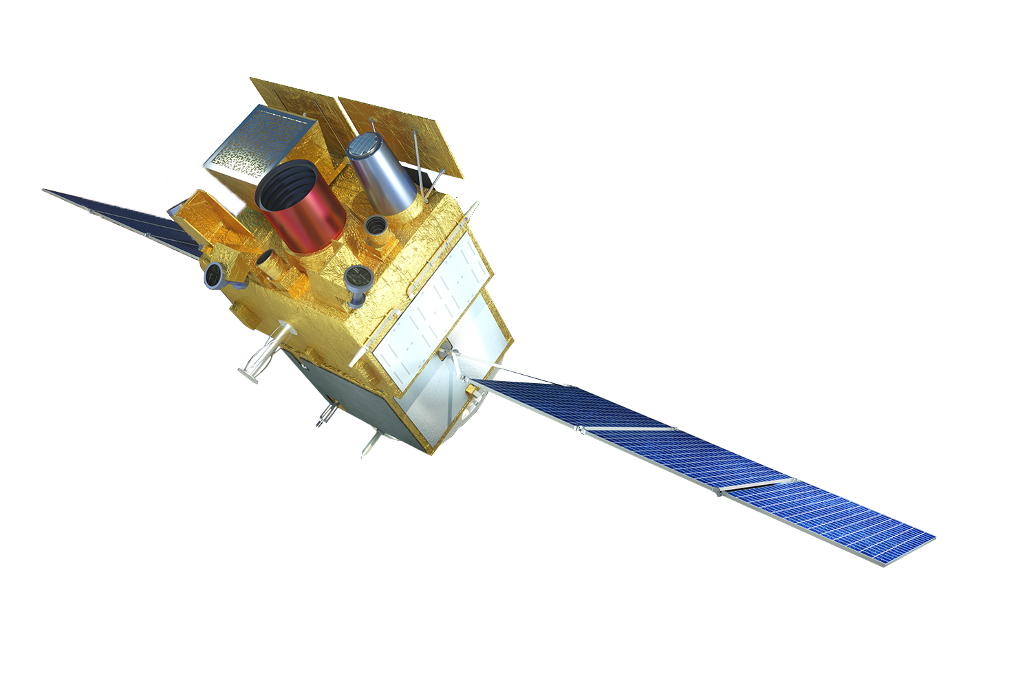

Send a subset of the satellite data via the VHF channel
ECLAIRs
Alert
HighPriorityLightCurve
LowPriorityLightCurve
AlertDescriptor
EclairsSubImage
GRM
GrmTrigger
GrmGrdSpectr
GrmHPLcurve
GrmLPLcurve
PDPU
MXT
PdpuGrb
MxtPosition
MxtPhotonL
VT
VtAttChart
VtFindChart R1 &B1
VtSubIm1 R1 & B1
VtFindChart Rn &Bn
VtSubIm1 Rn & Bn
SLEW
t

Slide 4
SEQUENCE OF INFORMATION SENT BY ECLAIRS
The GRM sequence follows almost the same logic

Slide 5
SEQUENCE OF INFORMATION SENT BY MXT and VT
If the slew is requested by ECLAIRS and accepted by the platform

Slide 6
CONNECTION BETWEEN MXT AND VT
The originality of SVOM: the instruments communicate with each other directly in real time

Slide 7
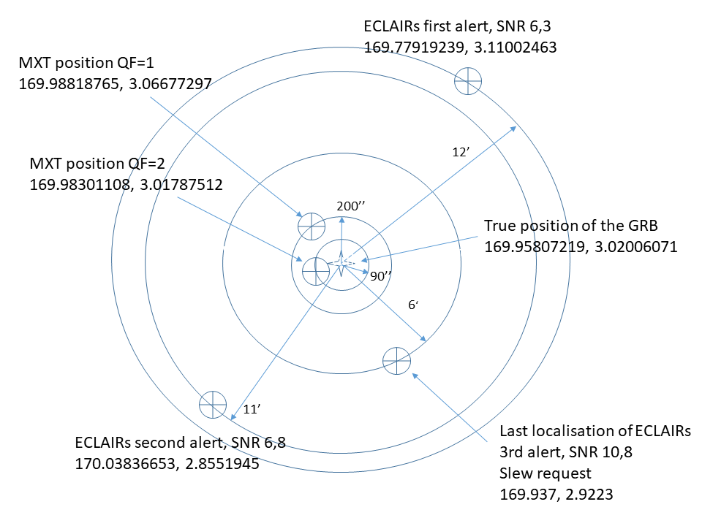
Illustration of the sequence with the hands-on scenario : the GRB 26

Slide 8
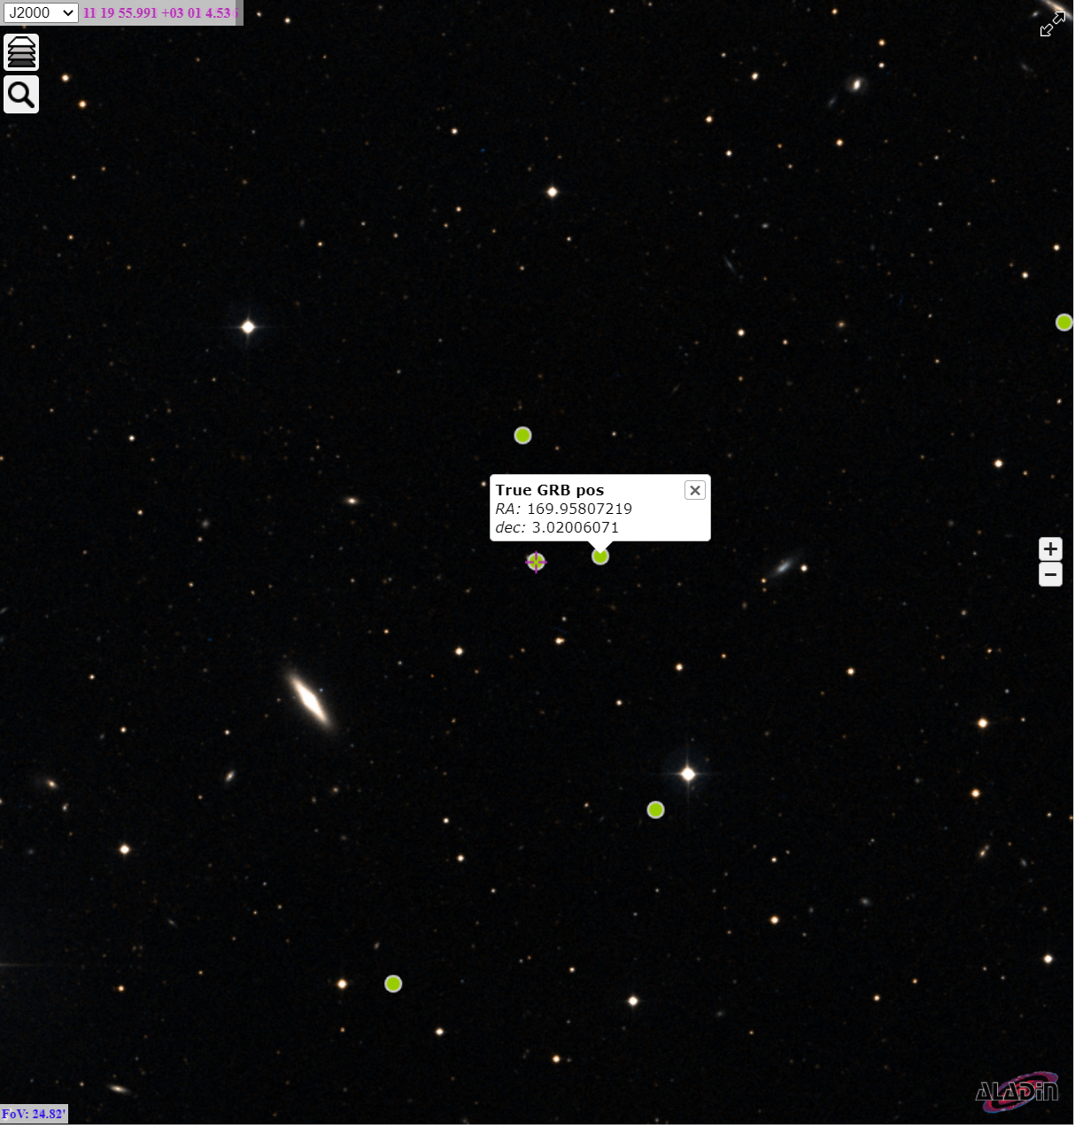
Illustration of the sequence with the hands-on scenario : the GRB 26
ECLAIRS1
MXT1
MXT2
ECLAIRS3
ECLAIRS2

Slide 9
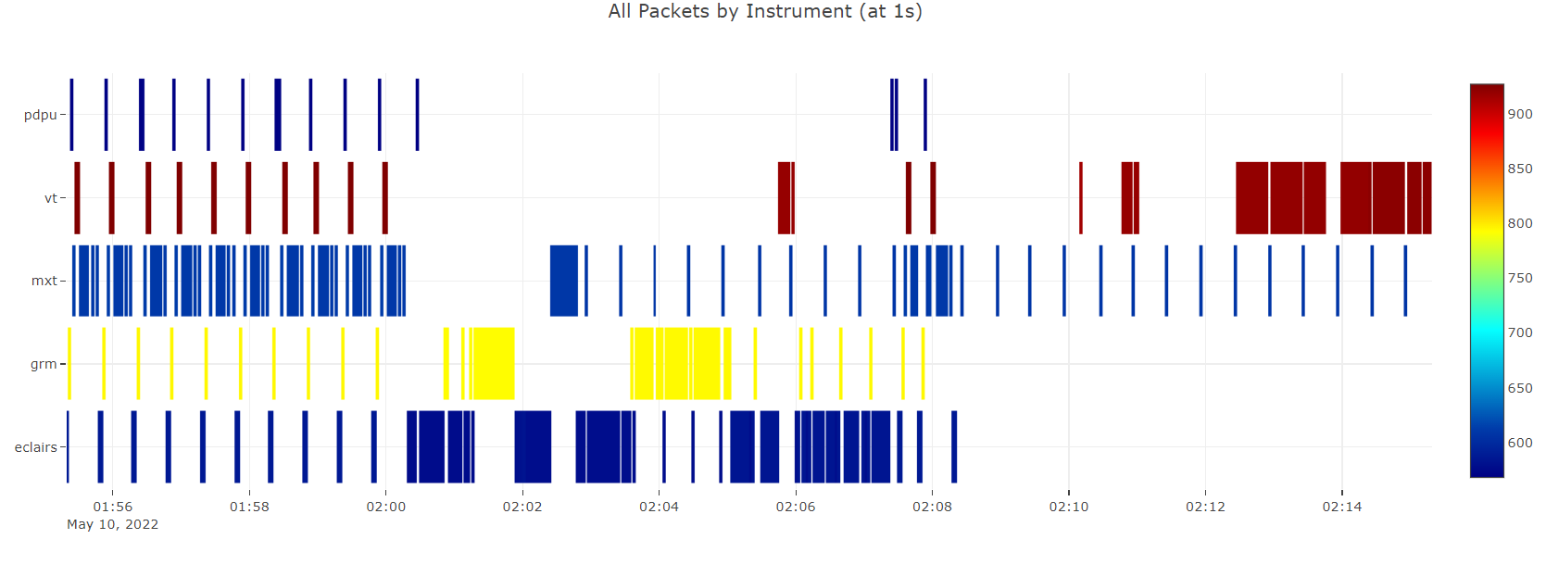
Overview of the GRB26 VHF sequence : the first 15 minutes
Classification by instrument
Slew accepted by the palteform
ECLAIRS alerts
ECLAIRS LC
GRM LC
MXT first Position
MXT Photon list
Tb0 ECLAIRS
VT attitude charts
VT finding charts

Slide 10
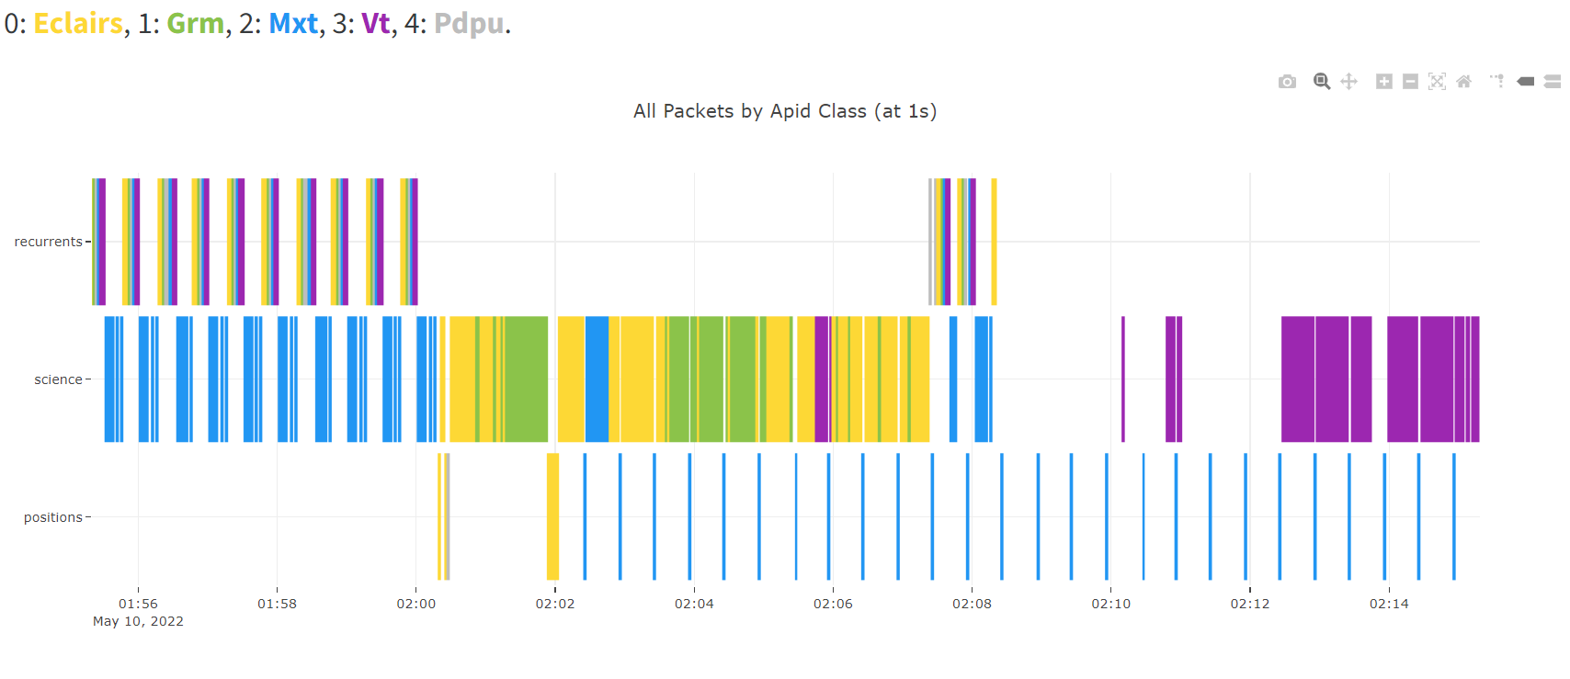
Overview of the GRB26 VHF sequence : the first 15 minutes
Classification by theme
Position : EclairsAlert, MxtPosition, PdpuGrb
Science: EclairsLCurve (HP&LP), GrmLCurve (HP &LP), MxtPhotonL, VtAttChart, VtFindCharts (R&B), VtSubIm1 (R&B)

Slide 11
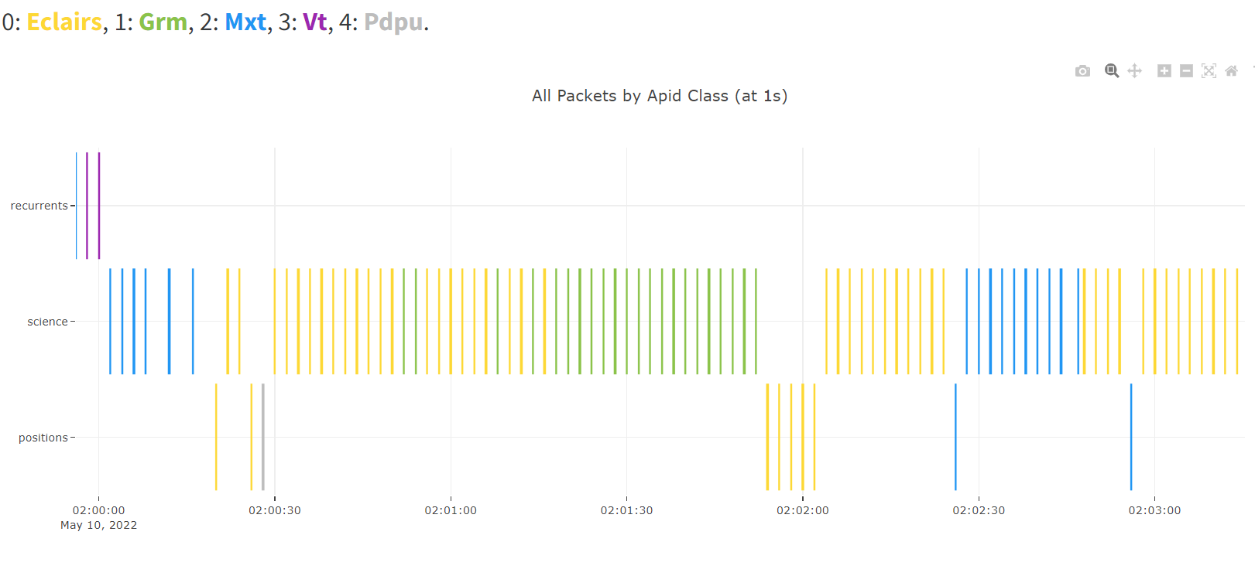
Overview of the GRB26 VHF sequence : zoom on the first 3 minutes
Classification by theme
Position : EclairsAlert, MxtPosition, PdpuGrb
Science: EclairsLCurve (HP&LP), GrmLCurve (HP &LP), MxtPhotonL, VtAttChart, VtFindCharts (R&B), VtSubIm1 (R&B)

Slide 12
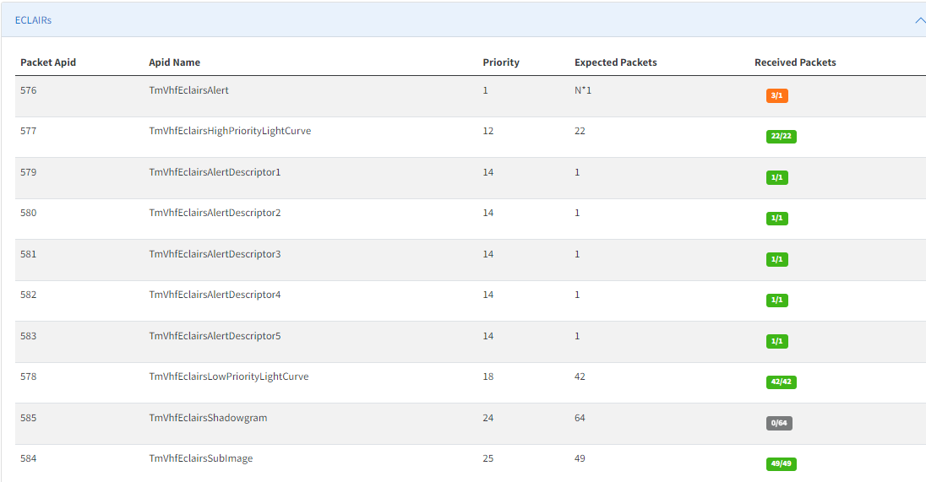
Summary of received VHF packets : 1- ECLAIRS
The VHF UI tool allows monitoring the arrival of packets by instrument
GRB 26 scenario

Slide 13
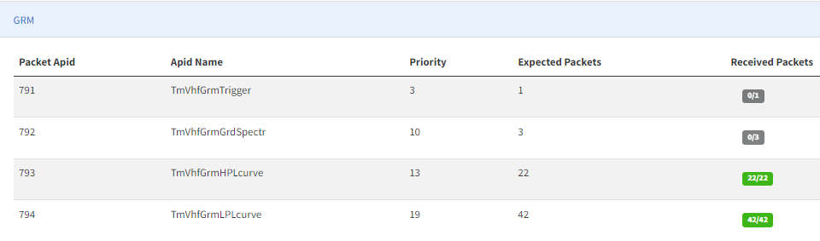
Summary of received VHF packets : 2- GRM
GRB 26 scenario

Slide 14
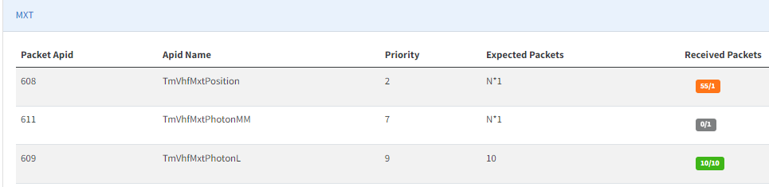
Summary of received VHF packets : 3- MXT
GRB 26 scenario

Slide 15
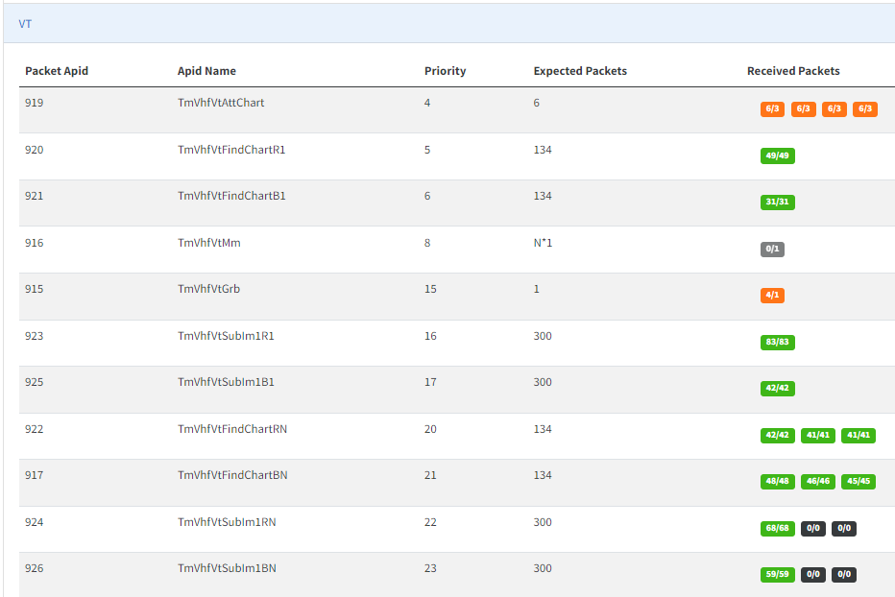
Summary of received VHF packets : 4 - VT
GRB 26 scenario

Slide 16
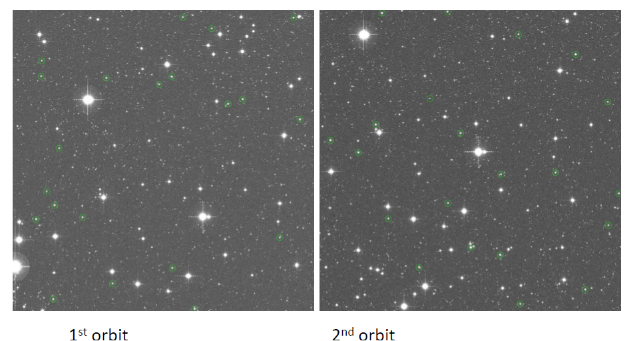
GRB 26 - Illustration of the information sent by the VT
Attitude charts
2x3 packets
2x3packets

Slide 17
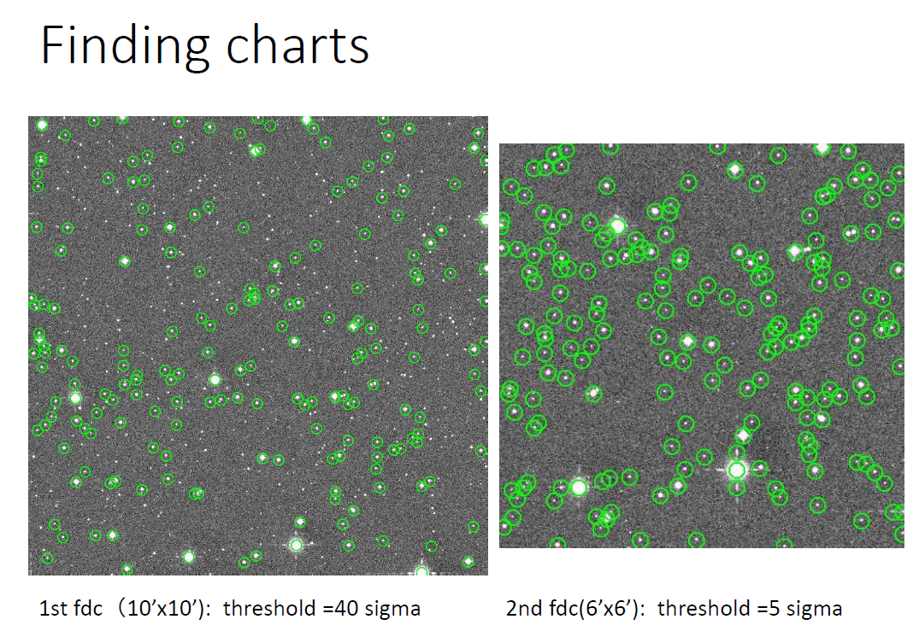
GRB 26 - Illustration of the information sent by the VT
B1 -31 packets
B2 -48 packets

Slide 18
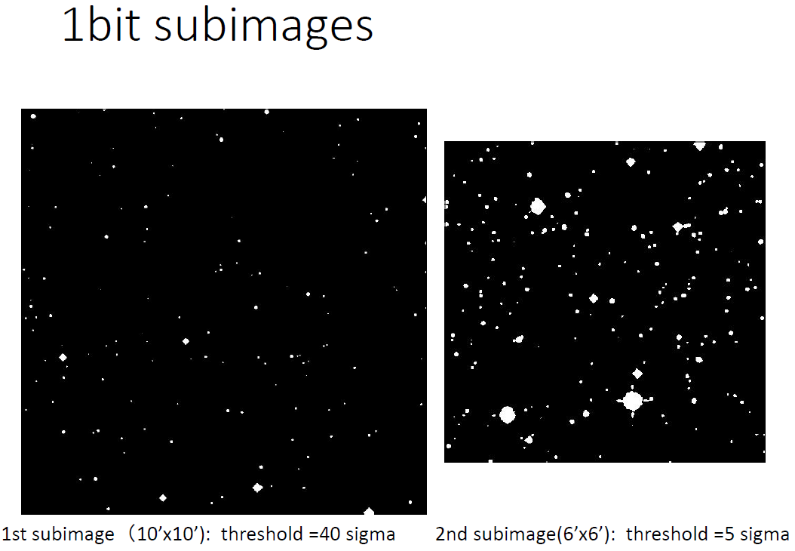
GRB 26 - Illustration of the information sent by the VT
1bit B1 – 42 packets
1bit B2 – 59 packets

Slide 19
CONCLUSIONS
This first step is only the reception of raw data
Next step : from this information we have to build scientific products (see Tatyana’s presentation)
General remarks on this first step
  The timing of the sequence is not homogeneous. It goes very fast for ECLAIRS and GRM, it is much slower for VT.
  Between the end of the ECLAIRs+ GRM light curves and the beginning of the VT findingcharts the activity is low
  Depending on the observation scenario, with our without slew, the sequence can be much shorter
The tools to be developed must allow to
  control the completeness of the packets
  control the proper functioning of the VHF network
  Understand the GRB observation scenario (ECLAIRS first, GRM first, slew accepted, slew rejected,...)

Slide 20
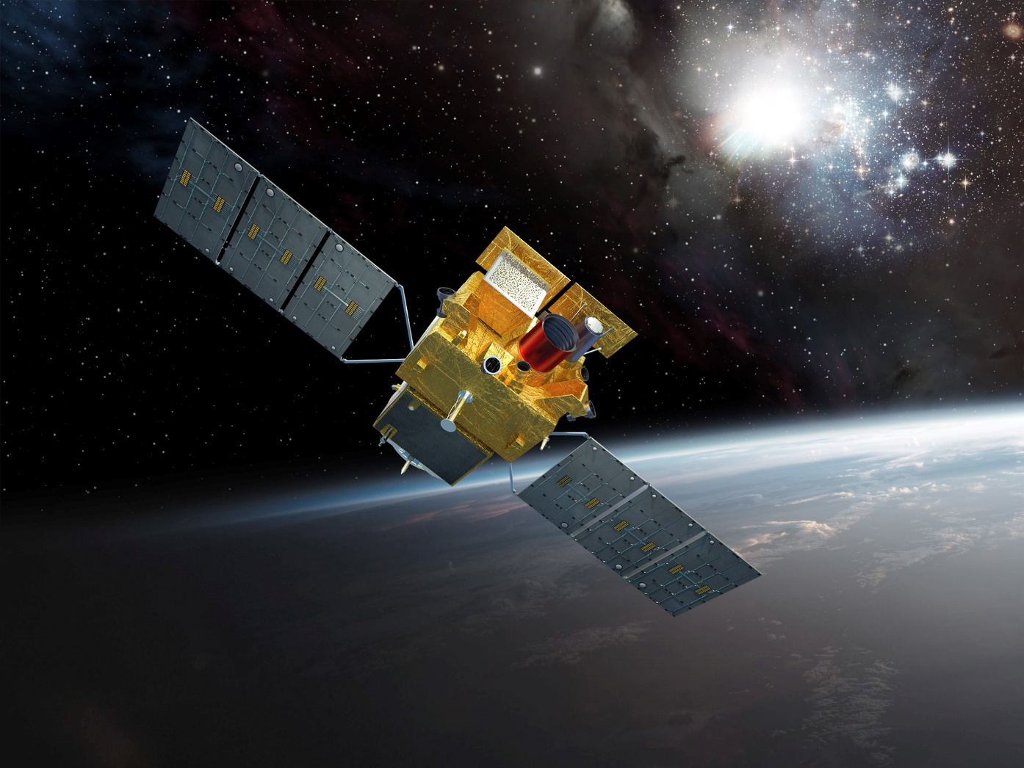
GO SVOM !
Launch 2023

Slide 21
Repetition of VHF messages
In case of station failure or unavailability of the VHF link, each message shall be repeated several times to insure that all the packets of the message can be received on ground with an availability
greater than 98% for long messages (60 packets)
99,9% for short messages

Slide 22
ECLAIRS SEQUENCE
13:00:00 ECLAIRs Alerte 1
13:00:03 ECLAIRs Alerte 2
13:00:10 ECLAIRs Alerte 3
MXT_TM_VHFPOSITION : in total 62 packets but 55 different packets
SLEW + MXT SEQUENCE
13:00:10 Start of 1st Slew
13:02:10 End of 1st Slew
13:02:10 1st MxtPposition with QF=0, pck1
13:02:40 Date of first MXT loc with QF=1, θ= 0,153249673642 φ= 184,5703650472, pck2
13:12:10, updated MXT loc with QF=2, θ= 0,106046871142 φ=178,3784673106, pck21
2nd SLEW + MXT SEQUENCE
13:44:41 2nd slew START
13:44:47 2nd slew END
14:35:00, updated MXT same position but with QF=1, pck45
+ emission of 10 MxtPosition each 300 sec
MXT_TM_VHFPHOTONL : in total 40 packets but 10 different packets repeated 3 times
2022/1/17-13:2:11 sequence of 10 packets
2022/1/17-13:10:11 first repetition
2022/1/17-13:18:47 second repetition
2022/1/17-13:25:57 third repetition

Slide 23
VT SEQUENCES 1&2
13:02:10 End of first slew
Q0 Q1 Q2 Q3
0,06902601 -0,05972856 -0,83663958 0,540094548
SEQ1 with QF=1 VT window size 10x10 arcmin
13:07:10 End of VT Seq 1 Images, Start of Seq 2
VT_TM_VHFATTCHART 6 packets (3 for B and 3 for R)
VHFFICHARTB1 31
VHFFICHARTR1 49
VHFSUBIM1BB1 42
VHFSUBIM1BR1 83
SEQ2 with QF=2 VT window size 6x6 arcmin
13:17:10 End of VT Seq 2 Images
VT_TM_VHFATTCHART 6 packets (3 for B and 3 for R)
VHFFICHARTBN 48
VHFFICHARTRN 42
VHFSUBIM1BBN 58
VHFSUBIM1BRN 68
Reminder : true position of the GRB 169.95807219, 3.02006071

Slide 24
VT SEQUENCES 3&4
13:44:41 2nd slew START
13:44:47 2nd slew END
Q0 Q1 Q2 Q3
0,06954444 -0,05889237 - 0,83632263 0,540610501
SEQ3 with QF=2 VT window size 6x6 arcmin
14:41:54 End of VT Seq 3 Images
VT_TM_VHFATTCHART 6 packets (3 for B and 3 for R)
VHFFICHARTBN 46
VHFFICHARTRN 41
SEQ4 with QF=2 VT window size 6x6 arcmin
15:11:42 Start of VT Seq 4 Images
15:21:42 Second Earth Occultation START
VT_TM_VHFATTCHART 6 packets (3 for B and 3 for R)
VHFFICHARTBN 45
VHFFICHARTRN 41

