Slide 1
The common Gravitational Wave detectors distributed cyber infrastructure supporting low-latency alerts
Franco Carbognani – EGO
on behalf of the LIGO, Virgo and KAGRA collaborations
Low-latency alerts & Data analysis for MMA Workshop | 13 Jan 2022

Slide 2
Overview
A Worldwide Network: The International Gravitational Waves observatory Network (IGWN)
Data flow schema
What we need
The common solutions and the common tools
Preparing for O4
Conclusions
Caveat: this (partial) summary focus more on Virgo side

Slide 3
IGWN
International Gravitational Waves observatory Network (IGWN)
A coordination effort aimed at jointly discussing the computing policy, management, and architecture issues of LIGO, Virgo, and KAGRA.
igwn.org will host common Virgo/LSC services, and KAGRA is joining
Migration planning for common services (GitLab, Wiki, etc.) ongoing
The effort comprises all computing domains (online, offline, LL), with different levels of engagement.
Plans for migration from legacy tools to common, mainstream tools are being implemented
Data management and transfer (CVMFS/StashCache, Rucio and Kafka)
Software management (GitLab, Cmake ,Conda, CVMFS)
The tools (and the general architecture) are chosen to be consistent with many large scale computing projects such as WLCG

Slide 4
The Data Flow Schema
Candidate events
infrastructure
Computing
Centres
Data Quality
Veto production
DQ flags
DQ Segments
Database
DAQ
Front-ends
On-line systems
Control, Data Collection, Calibrations, Data Writing,…
aLIGO Low-latency distribution
Off-line DA pipelines
Deep searches, parameter estimation
Offline DetChar
Glitch detection,…
AdV Low-latency distribution
Low-latency pipelines
Low-latency pipelines
GraceDB
Event candidate Database
Online
storage
DetChar
DQ reports
Bulk data transfer
GWCelery
Off-line data distribution and access
Data pathway
Public Alert Distribution
Low-latency transfers
Event candidate exchange
Mass storage
Mass storage
Bulk data transfer
Aggregated h(t)
Mass storage
Bulk data management
h(t)
Raw, RDS, h(t)

Slide 5
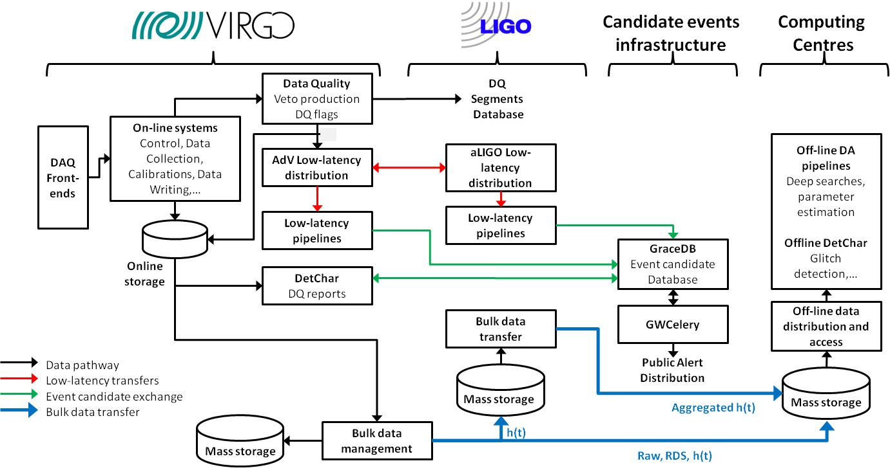
Data Flow: The O3 case
The signal arrives
Data composed into frames
Calibration of the data
Veto, DQ flags production
h(t) transfer
Low-latency matched-filter pipelines
Upload to GraceDB
Data written into on-line storage
Low-latency data quality
Low-latency sky localization
GCN Circular sent out
Data written into Cascina Mass Storage
Data transfer toward aLIGO and CCs

Slide 6
What is needed
GW data analysis (including low-latency) is performed as a joint IGWN effort.
The geographical separation of the detectors and the short timescale involved (current/O3 e2e latency from signal detection to alert generation in the order of 25 sec) imply the creation of a common distributed cyber infrastructure which must guarantee:
Adequate storage and computing resources for detector characterization, low-latency searches and alerts generation
Low-latency data distribution among the different observatories and computing clusters for low-latency searches
An ubiquitous and uniform running environment

Slide 7
Storage and Computing Resources
Low-latency storage and computing mainly provided by observatory computing centers
Low-latency alert infrastructure runs on dedicated resources with high priority to burst out into pool
Search pipelines run on dedicated or highly-prioritised resources in an HTCondor-managed resource pool
Fast, direct access to small data files / shared memory
Gradb production instance currently deployed in High Availability (HA) on AWS
Alternative HA deployment via Kubernetes is being tested on INFN CNAF Cloud

Slide 8
High Availability (HA) deployment
We are developing an High Availability deployment based on Kubernetes (de-facto standard for cloud orchestration) for the alert generation components (GraceDB, GWCelery,LVAlert) on CNAF Cloud.
To exploit support from CCs staff and achieve cloud provider independence
Resources and support for both high-availability deployment using K8S and on-demand HTCondor cluster (at least partially) funded by EGI-ACE project from the INFRAEOSC-07 EU call
Including also GWCelery in the K8S deployment, to have a fully portable setup
Performance and stress tests in progress

Slide 9
High Availability (HA) deployment
Also, a preliminary step to provide infrastructure to run low-latency searches off-site
Sara.Vallero@to.infn.it

Slide 10
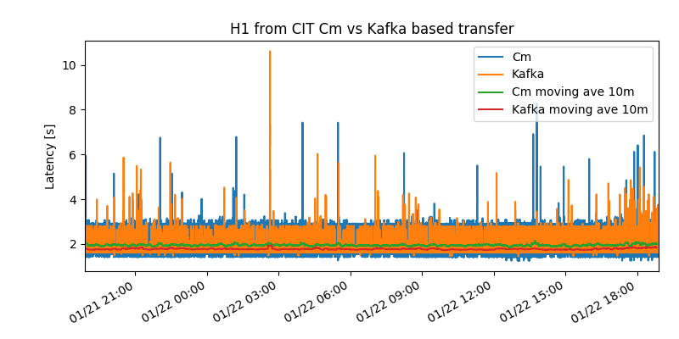
Low-latency data distribution: Kafka
Kafka is a modern high throughput stream processing software
Built in redundancy
Can survive if stream stops or Kafka broker goes down
Replication so no data loss from downed
Highly scalable and reconfigurable
Can easily add additional observatories data (KAGRA being added)
Tests well in progress in Virgo (comparing respect to former solution: Cm)

Slide 11
Running Environment: IGWN Conda
Sustainable software development and distribution
=
CVMFS
+
Conda
Conda environments hosted
in CVMFS file system available at all IGWN sites and CC
Notes:
So, to have a sustainable software development and distribution for IGWN will be to have Conda environments hosted in CVMFS file system available at most Computing centers.
But how does Virgo software fit into all this?

Slide 12
Running Environment: IGWN Conda
IGWN Conda Distribution provides pre-built, automatically-distributed environments of approved software
available via CVMFS on any machine (no authentication required)
can be replicated on any workstation
OS-independent
Leverage on CMake/Meson for software build
Provide a very effective solution for unmaintainable number of custom software builds
On large part of IGWN sites (including Cascina) the IGWN environment can be activated manually or by default at user login

Slide 13
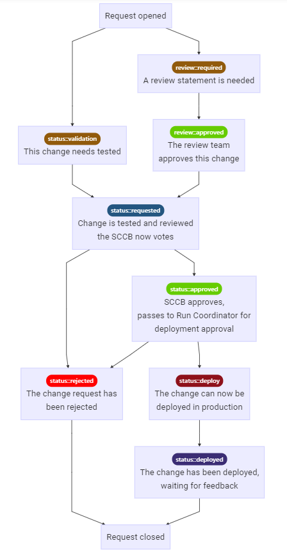
Software deployment into IGWN Conda Distribution
Software deployment is controlled via change control board (SCCB)
Software must be approved by SCCB and the relevant scientific review committee before being used for production analysis
Includes:
Packaging
Testing
Scientific review (with the package developer)
Very rarely happens.
Typically, only done if
the person requesting the
package no longer wants it
in the IGWN Conda Dist.
This stage is done by a
Run coordinator

Slide 14
Preparing for O4: The O3 End-to-End Data Replay
Scope, a truly end-to-end one:
Provide a reasonable representation of low-latency detector data in O4 (to be noted that interferometer data don’t grow with sensitivity, but only with the number of “technical” channels)
Exercise the search pipeline’s ability for finding GWs as well as the mitigation of generating event candidates from terrestrial noise; for this, a stretch of data that generated a variety of Bursts, BNS, NSBH and BBH events as well as retractions is desired
Exercise the calibration pipeline’s ability to provide calibrated h(t) in low latency
Exercise low-latency detchar services and their ability to detect and/or mitigate non-stationary/non-Gaussian noise in h(t) using h(t) and/or auxiliary channel information
Exercise the alert infrastructure’s capability in providing timely alerts and evaluate its full latency
This end-to-end setup will constitute the main testbed for O4 on rapid alerts generation and in particular for the standardization of the low latency data distribution using KAFKA

Slide 15
E2E Stage 2 @ EGO + CNAF+ Louvain
StashCacheorigin / CVMFS@ Louvain
CIT
Kafka
Rucio
Kafka
Online VPM servers:
Hrec, Om_parameters_hoft, ...
FdIO Server for data replay
Aggregated h(t) (2000 s)
Kafka
gwcelery@ CNAF
gwcelery@ CNAF
data aggregation
Low Latency Pipelines @ EGO
« Low-latency »
frames (1 s)
« New » h(t)
and online DQ
« Low-latency »
frames (1 s)
gracedb@ CNAF
Archived
raw data
(subset of)
DQR@ EGO
lvalert@ CNAF
Serving its foreseen scopes (ex: being used to test O4 targeted version of online DQ or Hrec software or for assessing/reducing latency)
Kubernetes

Slide 16
Conclusions
IGWN means a coordinated and common infrastructure between the collaborations
Making a large technological step on many tools
To provide interoperability between Virgo, LIGO and KAGRA and enable effective convergence towards IGWN
To reduce maintenance effort on proprietary/legacy solutions
Tests ongoing satisfactory, working on deployment strategy
Migration to modern software management tools well underway
Plans for O4
Most of the planned architecture should be ready for O4. In case of problem we can fall back on O3 proven solutions
Designing a common robust and scalable long term architecture

Slide 17
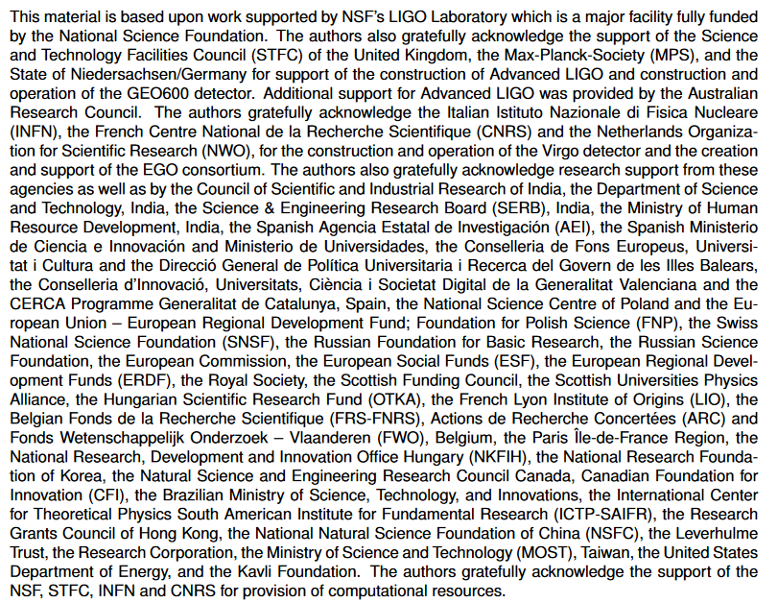
Acknowledgements

