Slide 1
TSP Overview:
Relationship to EOSC-Future
Ian Bird; LAPP
Elena Cuoco; EGO, SNS
Caterina Doglioni; Lund, Manchester
28th September 2021

Slide 2
Outline
The TSP’s in ESCAPE
Relationship to EOSC-Future
Current state of TSP planning
  Milestones
  Next Steps

Slide 3
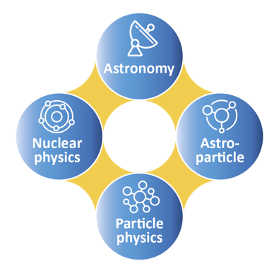
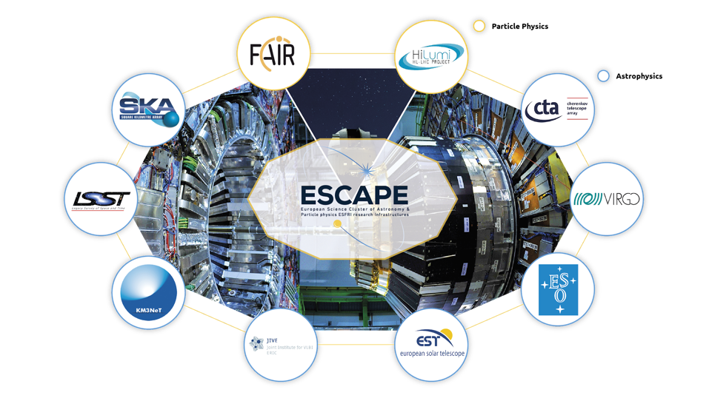
ESCAPE Science Projects - background
Two large Science Projects will be deployed with a number of high-level objectives:
  To demonstrate new cutting-edge science capabilities, in particular those involving inter-RI collaboration and science outcomes;
  To validate, that the software, tools, services, and infrastructure developed within ESCAPE are what is required by the science use cases;
The SP objectives are supported by the thematic consortia (of the national funding agencies):
  ECFA, APPEC, ASTRONET, NuPECC, and the collaboration of those bodies within JENAA.
The European Strategy for Particle Physics update in 2020 encouraged synergies between these research infrastructures, via ESCAPE.
The communities are large, global, with collaborators across all areas of the world; users are typically physicists
Many commonalities – common facilities and funding agencies
European
Science
Cluster of
Astronomy &
Particle physics
ESFRI research infrastructures

Slide 4
Science Project 1: Dark Matter
Coordinator: Caterina Doglioni

Slide 5

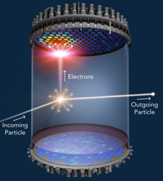
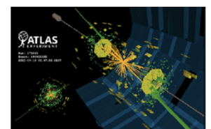
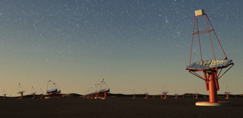
Ambition, Impact, Challenge
Dark matter makes up 85% of the matter in the universe → what is it?
Many Dark Matter searches in ESCAPE RIs: complementarity between these experiments under different theoretical hypotheses
Connecting results and potential discoveries from different
experiments requires the engagement of all scientific communities involved
Synergies in:
  interpretation of results in terms of dark matter theories,
  tools needed to produce those results, esp. data management, data analysis and computing.
This Science Project aims to:
  perform new analyses, collect all related digital objects (data, metadata and software)
  on a broad platform hosted on the EOSC Portal
    and will allow these analyses to be reproducible within the various collaborations and by the entire community wherever possible;
  exploit synergies in science & tools across different communities,
    final results of each workflow: discovery (!) / constraints of dark matter particle properties that can be displayed on the same plot, highlighting the complementarity;
  enhance the research participation in the EOSC, by providing a working example of open science that has started from a complementary effort of different experiments.
Experimental data
Credit: SLAC/LZ/ATLAS/CTA

Slide 6
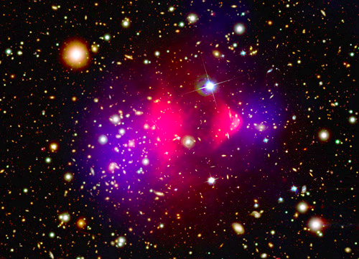
DM continued
The scientific added value
  new dark matter analyses coming from the complementary
  experiments involved (particle colliders, direct and indirection
  experiments) as well as from theory and observational constraints,
  all interpreted within the same theoretical framework and displayed
  in a summary plot that showcases their synergies.
  During the analysis design, we will identify innovative algorithms (e.g. machine learning, but also procedures to reconstruct images to distinguish signal and background) that can be individually highlighted and shared for use by other scientific communities and / or in society.
The Open Science added value
  all the digital objects within these new DM analyses will be implemented within the ESCAPE services infrastructure.
  make use of the ESCAPE Data Infrastructure to store, distribute and provide data and software access to the broad dark matter scientific community.
    This is a unique link between DM as a fundamental science question and the Open Science services needed to answer it that benefits the scientific community as a whole.

Slide 7
Science project 2:
Gravitational Waves & Extreme Universe
Coordinator: Elena Cuoco

Slide 8

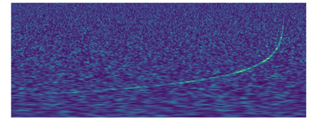

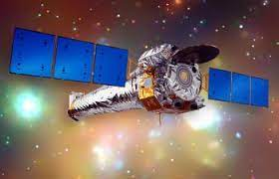
Ambition, Impact, Challenge
The Extreme Universe project intends to develop a sustainable platform within
which to enable multi-messenger/multi-probe astronomy (MMA).
There are many studies of transient astrophysical phenomena that benefit from
the combined use of many instruments at different wavelengths and different probe
types.
  Many of these are based on the trigger of one instrument generating follow-ups
  from others at different timescales from seconds to days.
The intention within ESCAPE is to build such a platform for MMA science in such a way as to make it sustainable.
Multi-messenger observations could lead to images of strong gravitational effects that are expected near a black hole. Extreme energetic astrophysical transient phenomena such as GRB, AGN, FRB are also high-energy phenomena not yet fully understood. A data sharing and open-science approach are key to adding knowledge and progressing towards an understanding.
A holistic approach to black holes and exploiting gravitational waves for fundamental physics are the main guidelines of this SP. The ‘frontier’ for multi-messenger science is to understand extreme matter and particle processes in strongly curved spacetime. The SP (also to be accessible from the EOSC portal) would implement an integrated platform for Multi-Messenger Astronomy where data from different wavelengths/messengers can be easily gathered, analyzed and modelled holistically, and not remain fragmented as at present.

Slide 9
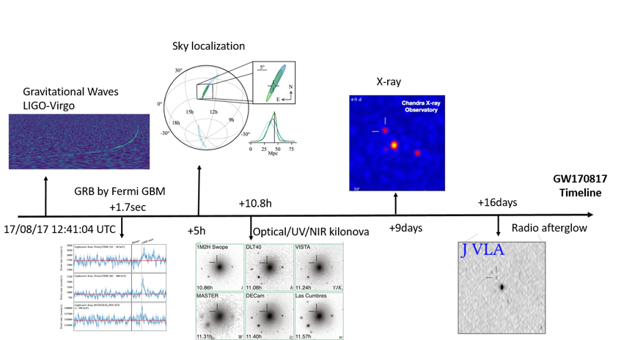
EU continued
Gw170817 trigger and EM follow-up
The scientific added value of this project
is to set up a sustainable platform for multi-
messenger astronomy that is available for
publishing and following up on interesting
“trigger” events on a range of timescales, as
well as an data analysis platform for MMA.
The Open Science added value of this project includes the possibility to perform “realistic” studies from the web driven ESCAPE/EOSC infrastructure which will lower the bar for access to scientific data and tools towards utilization of open data as made available by the ESCAPE collaborators. The technologies applied in the Extreme Universe datasets are general, and as such the SP is a showcase of the potential of Open Science research using EOSC tools.

Slide 10

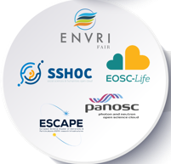

European Landscape
INFRAEOSC-07
Projects
Five thematic
Science Clusters
(80% of ESFRI RIs)
Five thematic
Science Clusters
founded under
INFRAEOSC-04-2018
(80% of ESFRI RIs)

Slide 11
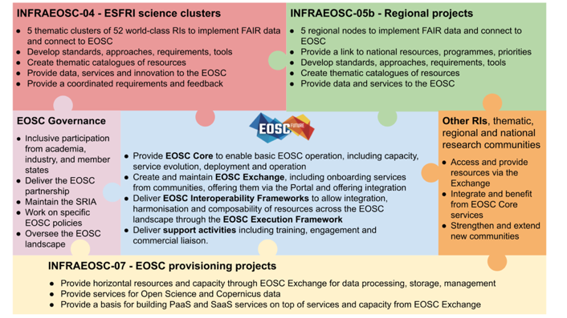
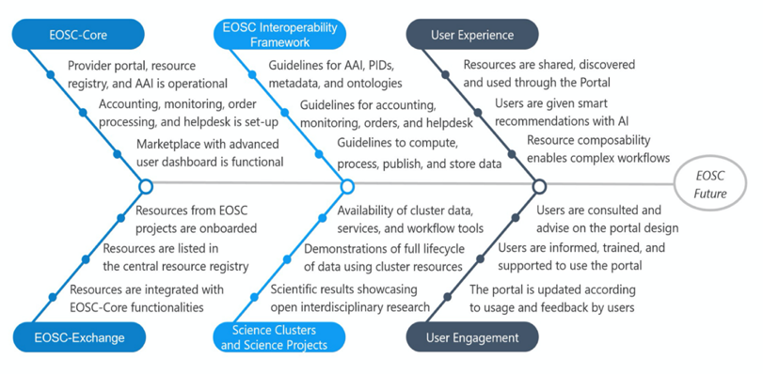
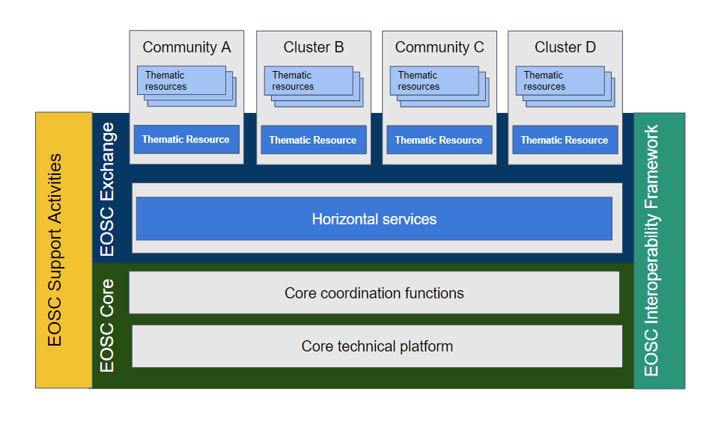
EOSC-Future
A new project – started 1st April;
Responding to EU H2020 funding call, (INFRAEOSC-03-2020): 30 months, 40 M euros
EOSC-Future is a prototype of an integrated EOSC

Slide 12
ESCAPE TSPs in EOSC-Future
EOSC-Future
WP6 (T6.3) includes 2 science projects from each of the 5 science clusters
  Several partners from ESCAPE have funding for 6 post-docs within that to work on the TSP’s
ESCAPE (with other clusters & e-infras) is also involved in overall Technical Coordination of EOSC-Future
  + specific actions around portal integration, work with HPC community, etc

Slide 13
ESCAPE Integration
Both SPs rely on the ESCAPE services infrastructure within EOSC-Future to
see their experimental data, simulations and software procedures developed
within sustainable analysis pipelines and converging into a bigger picture
ESCAPE will integrate the SPs in a proto-EOSC environment where particle physicists, astrophysicists and astronomers, experimentalists as well as theorists, with a wide range of interests, can exploit synergies and complementarities across different communities.
Unique ambition of developing a multi-probe and cross-domain Open Science Cloud environment.
  One of the objectives for ESCAPE is to develop a permanent platform where the different communities can identify cross-fertilization opportunities, integrating experimental searches, astrophysical/cosmological observations and theoretical benchmarks.
ESCAPE will ensure the inclusion of existing cooperative frameworks such as the Virtual Observatory, the CERN OpenData portal and ESO platforms

Slide 14
Integration
AAI: AAI solution following the AARC blueprint - ensure that the ESCAPE solution is fully interoperable with EOSC:
  Scientists in the SP’s should be using a single user identity for all aspects of work;
  Authorization services must enable key access controls to various data sets and resources.
Data Lake: federated storage services should be made available to the SPs, allowing all of the data sets required to be openly accessible to all participants:
  Because some of the data sets may be subject to embargo the Authorization mechanism must ensure this;
  The full set of tools that implement the DL should be available and used:
  Rucio - data location catalogue and policy engine: This may need a specific set up, the important point is that users must be able to select data across multiple experiments and infrastructures that may have their own Rucio catalogue;
  ESCAPE FTS (File Transfer Service) - key for moving data around; integrated with the AAI service and the storage endpoints;
  Caching and streaming services to deliver data to processing and analysis. These are services operational in ESCAPE; once AAI services are integrated they should be operational in the EOSC environment.
ESFRIs: Publication of data sets into the DL - required from the SP partners of the ESFRIs and the VO
ESCAPE software catalogue should publish all of the needed analysis components, and make them available for the various groups involved in the SP work:
  Integration within the EOSC catalogue services
An analysis environment, with a Jupyter notebook deployment, and access to scalable compute resources behind:
  RECAST, REANA from CERN; tools that enable reproducible analyses, essential in making the scientific outcomes FAIR
ESCAPE intends to make all of these services and tools available to other RI’s or service providers in EOSC via EOSC-Future.

Slide 15
Capacity Requirements
The needs of the ESCAPE SP’s are still being determined; in the initial phases the needs are minimal, but will increase as more sub-projects are integrated and goals expand
Resource Type | Total amount | Comment and extra requirements (dependencies)
Storage | few (~5 PB) | Distributed in the ESCAPE DL, can be in various locations, including cloud, etc.; some may need to be specific QoS (e.g. SSD), at level of few TB
Compute - cluster | TBD | Generic compute needs – via ESCAPE partners, ESCAPE cloud funding, 07 projects
Compute - HPC | TBD | Use for specific purposes – e.g. ML training, simulations; FENIX collaboration
Networking | NA | Coordination with GEANT – but no specific needs

Slide 16
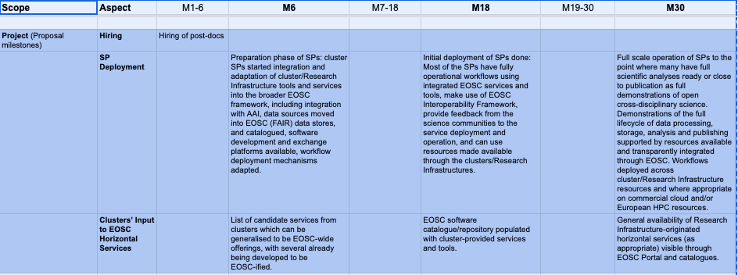
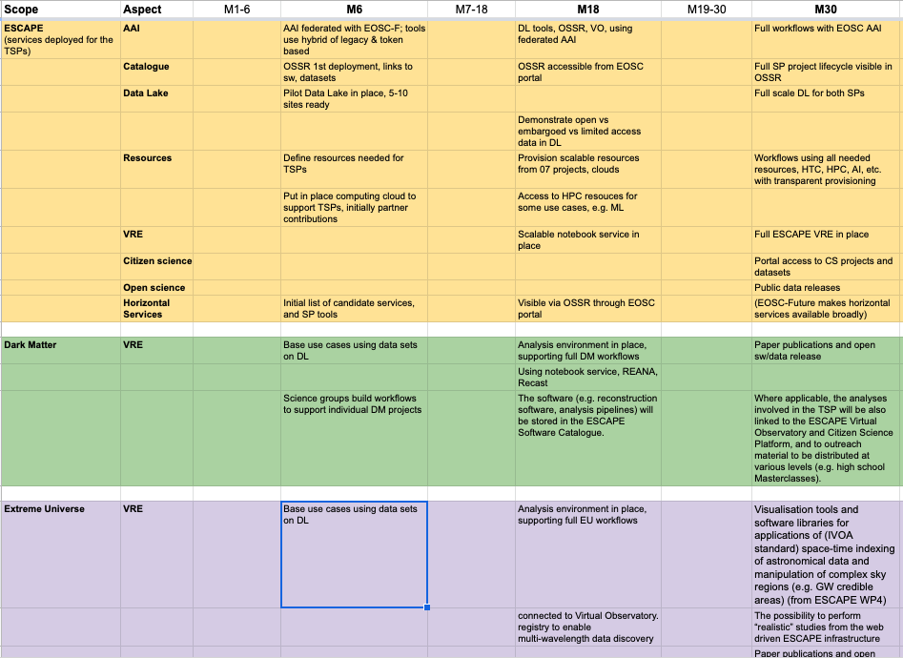

Slide 17
Next steps for ESCAPE
Firm up timelines - see spreadsheet;
  add clear and realistic milestones (that we need for ourselves)
Produce a good estimate of the resource needs for each project and sub-project:
  compute - cluster, HPC, specific needs?
  storage - with specific QoS if necessary
  other needs?
Then we need within ESCAPE to address what resources we can provide from our ESCAPE partners;
  intention is to add other resources from
    a) ESCAPE procurement funds,
    b) EOSC-Future brokered resources through INFRAEOSC-07 projects
ESCAPE will organise a meeting on the TSP’s very soon;
  we should try and have the above planning complete by then

