Slide 1
Status of the Project
Barbara ERAZMUS, Coordinator (Subatech)

Slide 2
General information
Significant events since the last STRONG-2020 Annual meeting (October 2020)
Second Amendment and main modifications to be introduced
Third Amendment to be prepared
Some future actions before the next Annual meeting

Slide 3
Grant Agreement
Project duration: from 1 June 2019 to 31 May 2023 (initial) Total Budget: 10 M €
32 Work Packages (WPs):
MAN: Management and Coordination
DISCO: Dissemination and Communication
7 Transnational Access Research Infrastructures (TA)
2 Virtual Infrastructures (VA)
Experimental /Theoretical /Instrumentation Activities:
7 Networking Activities (NA)
14 Joint Research Activities (JRA)
Web site: http://www.strong-2020.eu/

Slide 4
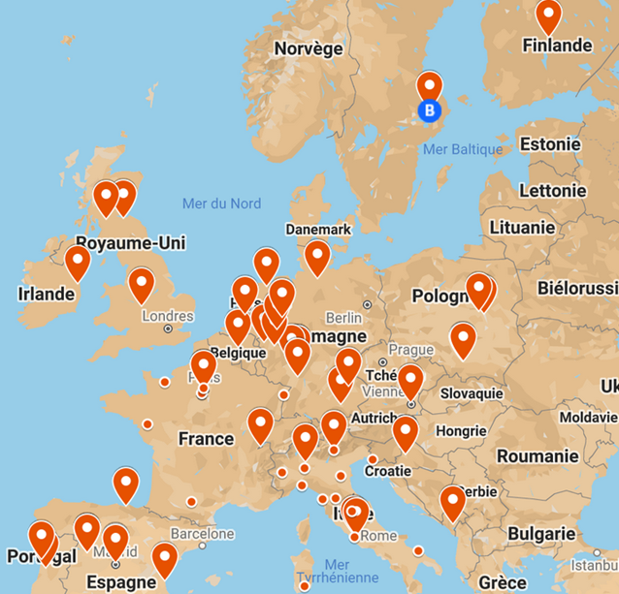
Consortium Agreement
45 participating institutions (beneficiaries) in
16 countries:
Austria, Belgium, Switzerland, Germany, Spain, Finland, France, Croatia, Ireland, Italy, Montenegro, Netherlands, Poland, Portugal, Sweden, United Kingdom
Location details can be found on online Google map
134 other Involved Institutions (not receiving EU funding)

Slide 5
WP thematic division
Research infrastructures:
Transnational Access
TA1-COSY Dieter Grzonka (Julich)
TA2-MAMI Achim Denig (Mainz)
TA3-LNF Catalina Curceanu/Carlo Guaraldo (INFN, Frascati)
TA4-FTD/ELSA Hartmut Schmieden (Bonn)
TA5-GSI Yvonne Leifels (GSI, Darmstadt)
TA6-ECT* Gert Aarts (Trento)
TA7-CERN David d'Enterria (CERN, Geneva)
Virtual Access
VA1-NLOAccess Jean-Philippe Lansberg
(CNRS, Orsay)
VA2-3DPartons Hervé Moutard (CEA, Saclay)

Slide 6
Hadron Physics:
JRA7-HaSP Marco Battaglieri (INFN, Genova), Juan Nieves (UVEG, Valencia)
NA1-FAIRnet Fritz-Herbert Heinsius (RUB, Bochum)
NA5-THEIA Josef Pochodzalla (UMainz)
NA6-LatticeHadrons Michael Peardon (TCD, Dublin)
Precision Physics:
NA4-PREN Dominique Marchand (CNRS, Orsay), Randolf Pohl (UMainz)
JRA3-PrecisionSM Mikhail Gorshteyn (UMainz), Andrzej Kupsc (University of Uppsala)

Slide 7
Heavy Ions:
JRA1-LHC-Combine Raphaël Granier de Cassagnac (CNRS, Palaiseau)
JRA2-FTE@LHC Cynthia Hadjidakis (CNRS, Orsay), Pasquale Di Nezza (INFN, Frascati)
NA3-Jet-QGP Marco van Leeuwen (Nikhef, Amsterdam), Guilherme Milano (LIP, Lisbon)
NA7-Hf-QGP Joerg Aichelin (CNRS, Nantes), Giuseppe Bruno (INFN, Bari)
GPD/TMD/PDFs:
JRA4-TMD-neXt Alessandro Bacchetta (INFN, Pavia)
JRA5-GPD-ACT Silvia Niccolai (CNRS, Orsay), Kresimir Kumericki (UNIZG, Zagreb)
JRA6-Next-DIS Daria Sokhan (UGlasgow), Francesco Bossu (CEA, Orsay)
NA2-Small-x Néstor Armesto (USC, Santiago de Compostela), Tuomas Lappi (JYU, Jyväskylä)

Slide 8
Instrumentation activities:
JRA8-ASTRA Johann Zmeskal (OeAW, Vienna)
JRA9-TIIMM Eleuterio Spiriti (INFN, Frascati)
JRA10-CryPTA Hartmut Dutz (UBO, Bonn)
JRA11-CRYOJET Alfons Khoukaz (WWU, Münster)
JRA12-SpinForFAIR Paolo Lenisa (INFN, Frascati)
JRA13-P3E Eric Voutier (CNRS, Orsay)
JRA14-MPGD_HP Bernhard Ketzer (UBO, Bonn), Fulvio Tessarotto (INFN, Frascati)

Slide 10
Management team
Executive Board
Facility Coordination Panel
Dieter GRZONKA
Scientific Coordinator:
Deputy Scientific Coordinator:
Governing Board
Chairperson:
The complete lists of members
Barbara ERAZMUS
Achim DENIG
Catalina CURCEANU
Hartmut SCHMIEDEN
Yvonne LEIFELS
Gert AARTS
David D'ENTERRIA
Jean-Philippe LANSBERG
Hervé MOUTARDE
Elena GONZALES FERREIRO
Carlo GUARALDO
Boris HIPPOLYTE
Chiara LA TESSA
Frank MAAS
Franck SABATIÉ
Carlos SALGADO
Laura TOLOS
Barbara ERAZMUS
Project Manager:
Emine AMETSHAEVA
Carlo GUARALDO
Chaired by Scientific Coordinator

Slide 11
Some important events:

Slide 12
The Amendment was launched on September 14, 2020
Main modifications:
addition of a new beneficiary (AGH UST)
addition of third parties (for UPV/EHU and FBK)
some financial transfers
structural changes in WP19 (JRA1-LHCCombine)
The Amendment was accepted by the EU and entered into force on November 18, 2020

Slide 13
With the Implementing Decision of February 12, 2021, the European Commission has created six new European Executive Agencies
The administrative management of the STRONG-2020 project was transferred to the European Research Executive Agency (EREA, former REA)
A new PO, Simona Misiti, was appointed as a result of the EU re-organization of agencies. She supervised the project from April to September 2021.
Starting September 2021, Flavius Pana becomes the new PO.

Slide 14
Starting December 1, 2020
Periodic Report module opened in the Participant Portal
Management team prepared the narrative part of the Report
February-March 2021
After the approval by the first PO, Periodic Report was submitted on March 16, 2021
April-June 2021
Two consecutive resubmissions of the Report with introduction of some modifications requested by the new PO
Beneficiaries completed their own Financial Statements in the Portal
Re-organization at the EU level and the first PO replacement: delay in evaluating the Report
Periodic Report and all declared costs were accepted by the EU on June 25, 2021

Slide 15
Two separate Amendments will be requested
Amendment for the project extension
Project extension by 6 months due to COVID-19 restrictions
Deliverables and Milestones rescheduling from month 48 to month 54
Amendment with further modifications
Modifications
Milestones, Deliverables
Mid-term Reviews
Person/months/budget
Revised work plans of WPs (if applicable as a result of new project duration)

Slide 16
Project Extension Amendment (N⁰2)
Project extension by 6 months
Easier to obtain from administrative point of view (facilitated and speedy processing by the EU)
Requires less justifications and less actions for the Amendment
Milestones/Deliverables due dates update
To demonstrate the implementation of certain tasks during the additional 6 months, it is requested to:
Reschedule a number of Deliverables/Milestones to the end of the project (month 54)
Update the Gantt Chart in Annex 1 (part B)

Slide 17
Amendment with further modifications (N⁰3)
Person/month contribution corrections
P/M modifications are due to the corrections of errors identified in the GA and to the change of work plans of concerned WPs
Mid-term reviews new dates (2 reviews during the project)
The first scheduled project review had to be cancelled (administrative complications and PO change) and the date of the second review is moved to the end of the project
Some budget transfers for the concerned WPs
Budget modifications resulting from the reassessment of needs by certain WPs
Revised work plans for the concerned WPs
A new plan of the tasks implementation according to the new duration of the project

Slide 18
Some future actions
Third Amendment
Adjustment of the WP work plans to the new project duration of 54 months (updates of Deliverables and Milestones due dates)
Budget revision for concerned WPs
Second Periodic Report
Preparation and sending of templates for narrative part (to be filled out by WP leaders)
Starting June 1, 2022, Financial Statements completion in the Portal
Project Mid-term review
Review to be organized after the end of the Periodic Report preparation (September 2022)
Other changes already reported and justified by WP leaders
Critical risks section update

Slide 19
Overall very good progress
Highlights presented
at the NuPECC meeting 100 in Venezia
17-18 September

