Slide 1
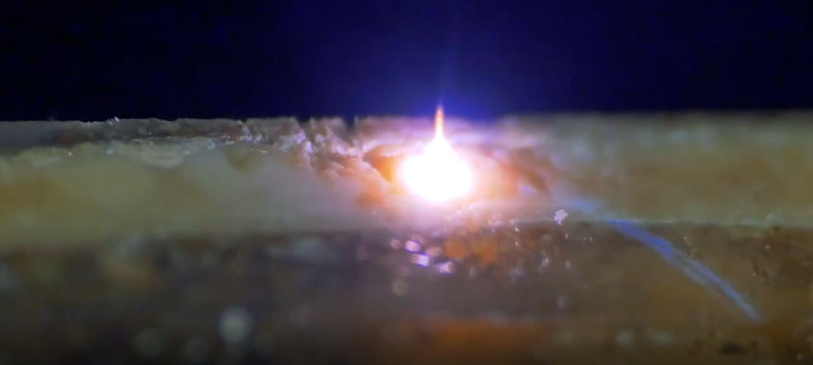


Direct ultratrace and isotopic analysis in solids by femtosecond LA-ICPMS.
Christophe Pécheyran, IPREM, Université de Pau et des Pays de l’Adour Fanny Claverie, Université de Pau et des Pays de l’Adour
Frédéric Perrot, CENBG, Gradignan
Bertrand Thomas, CENBG, Gradignan
Cédric Cerna, CENBG, Gradignan
Fabrice Piquemal, CENBG, Gradignan

Slide 2

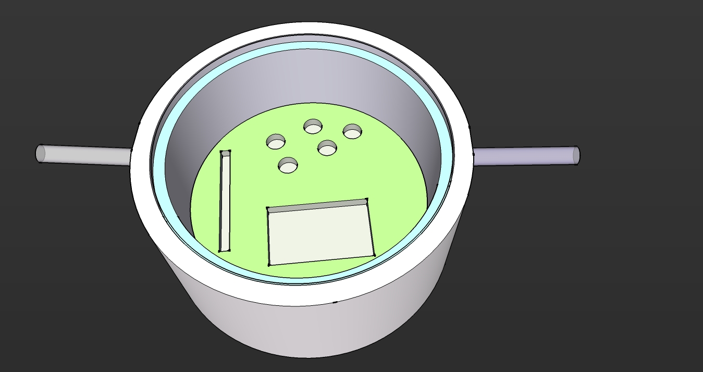
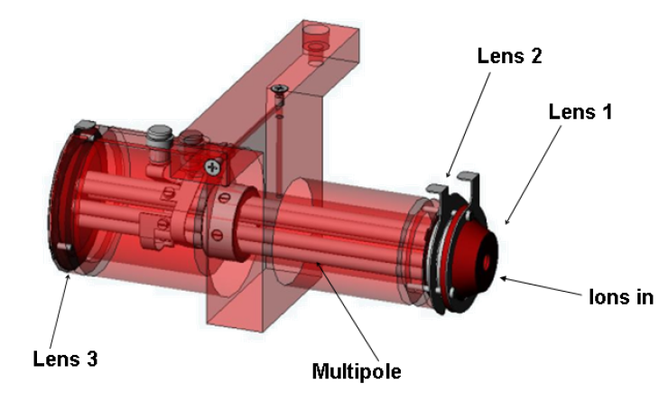
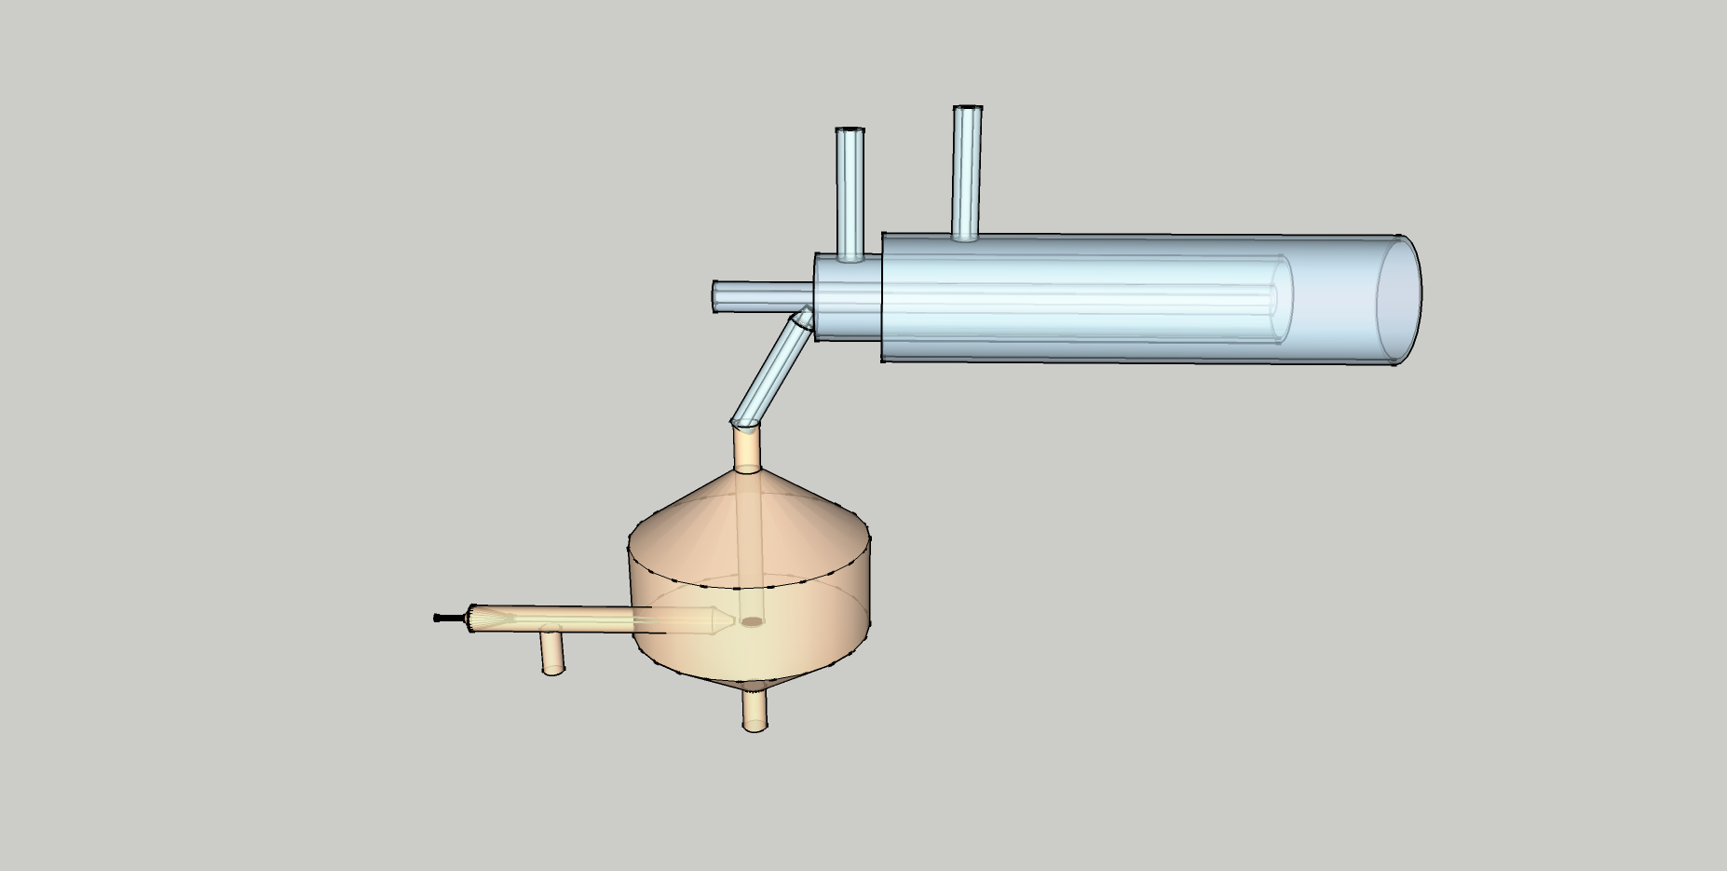

A laser to dig, an ICPMS to count…
LA-ICPMS :
  Alternative to wet chemistry:
    Direct analysis
    Very limited sample preparation
    Very limited risk of contamination
    Refractory matrices anaysis
  Tool of choice for micro-analysis:
    Quasi non destructive
    Micro analyses (µm – hundreds µm)
    Depth profiling (< µm resolution)
    High sensitivity
Laser
Inclusion analysis
Scan
He ➔
➔
Ablation Cell
ICPMS
Imaging, bulk analysis

Slide 3
LA– ICPMS applied to challenges of societyles
Environment
Health
Archaeology
Forensic science
Inter/national security
Fight against counterfeiting
Energy,
etc...
Laser
Inclusion analysis
Scan
Scan
He ➔
➔
Ablation Cell
ICPMS
Imaging, bulk analysis

Slide 4
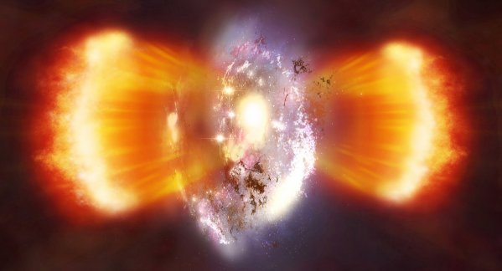
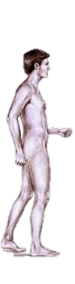
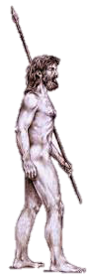
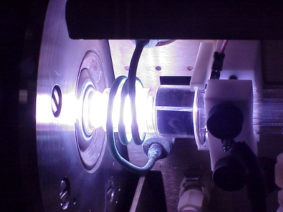
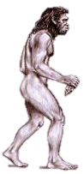
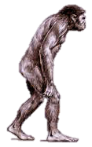
Laser ablation over time
1983
1985
1990
1995
2000
2005
2010
2015
2020
257 nm, Femto, 100 kHz, (Pécheyran et al, 2013)
1030 nm, Femto, 10 kHz (Pécheyran et al 2005)
Big Bang
(First ICPMS)
266, 196 nm, Femto, 20 Hz (Poitrasson et al 2003)
785 nm Femto, 10 Hz (Russo et al 2002)
193 nm nanoseconde , 20 Hz (Geertsen et al, 1994)
213 nm, nanoseconde, 20 Hz (Jeffries et al, 1998
266 nm, Nanoseconde, 20 Hz (Chenery et al, 1993 )
1064 nm, Nanoseconde, 10 Hz, (Arrowsmith et al, 1987)
694 nm, Nanoseconde, 10 Hz, (Gray et al,1985)

Slide 5
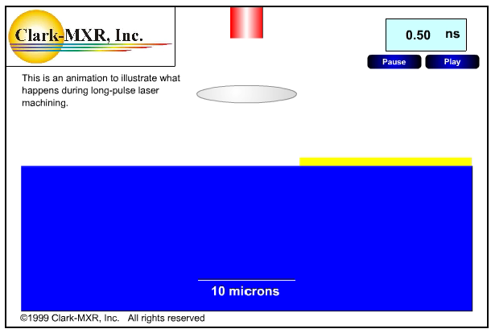
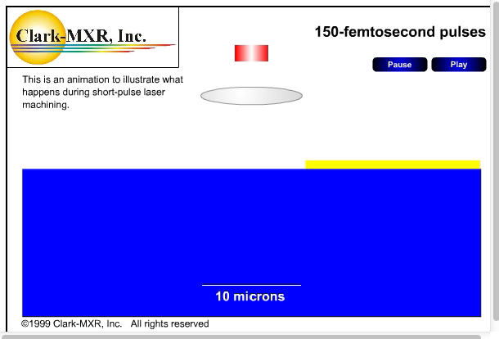


Ultra short pulses for better analytical performances
Nanosecond pulses
Femtosecond pulses
Thermal effects= accuracy bias
(preferential evaporation, large particles)
Limited termal effects =
better accuracy, precision and sensitivity

Slide 6
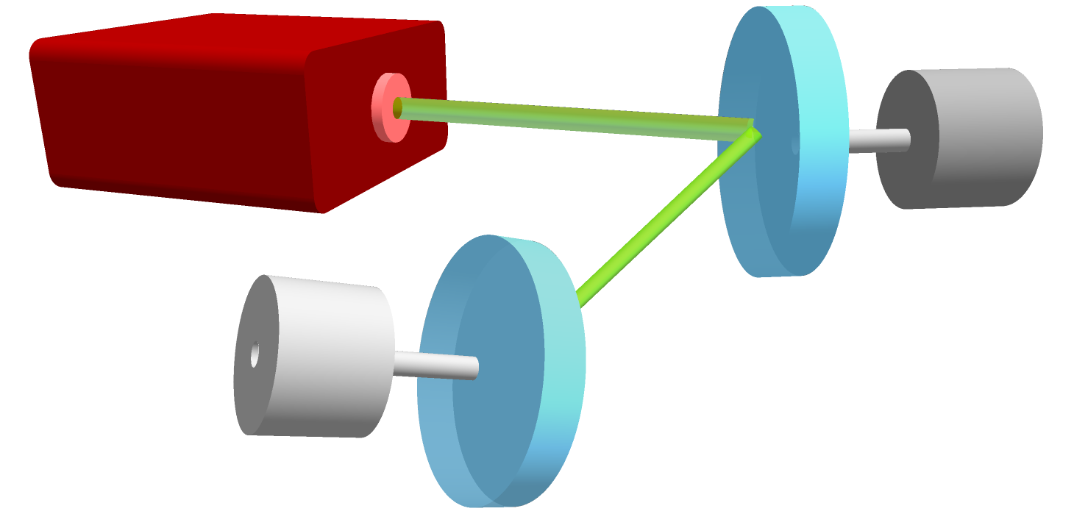
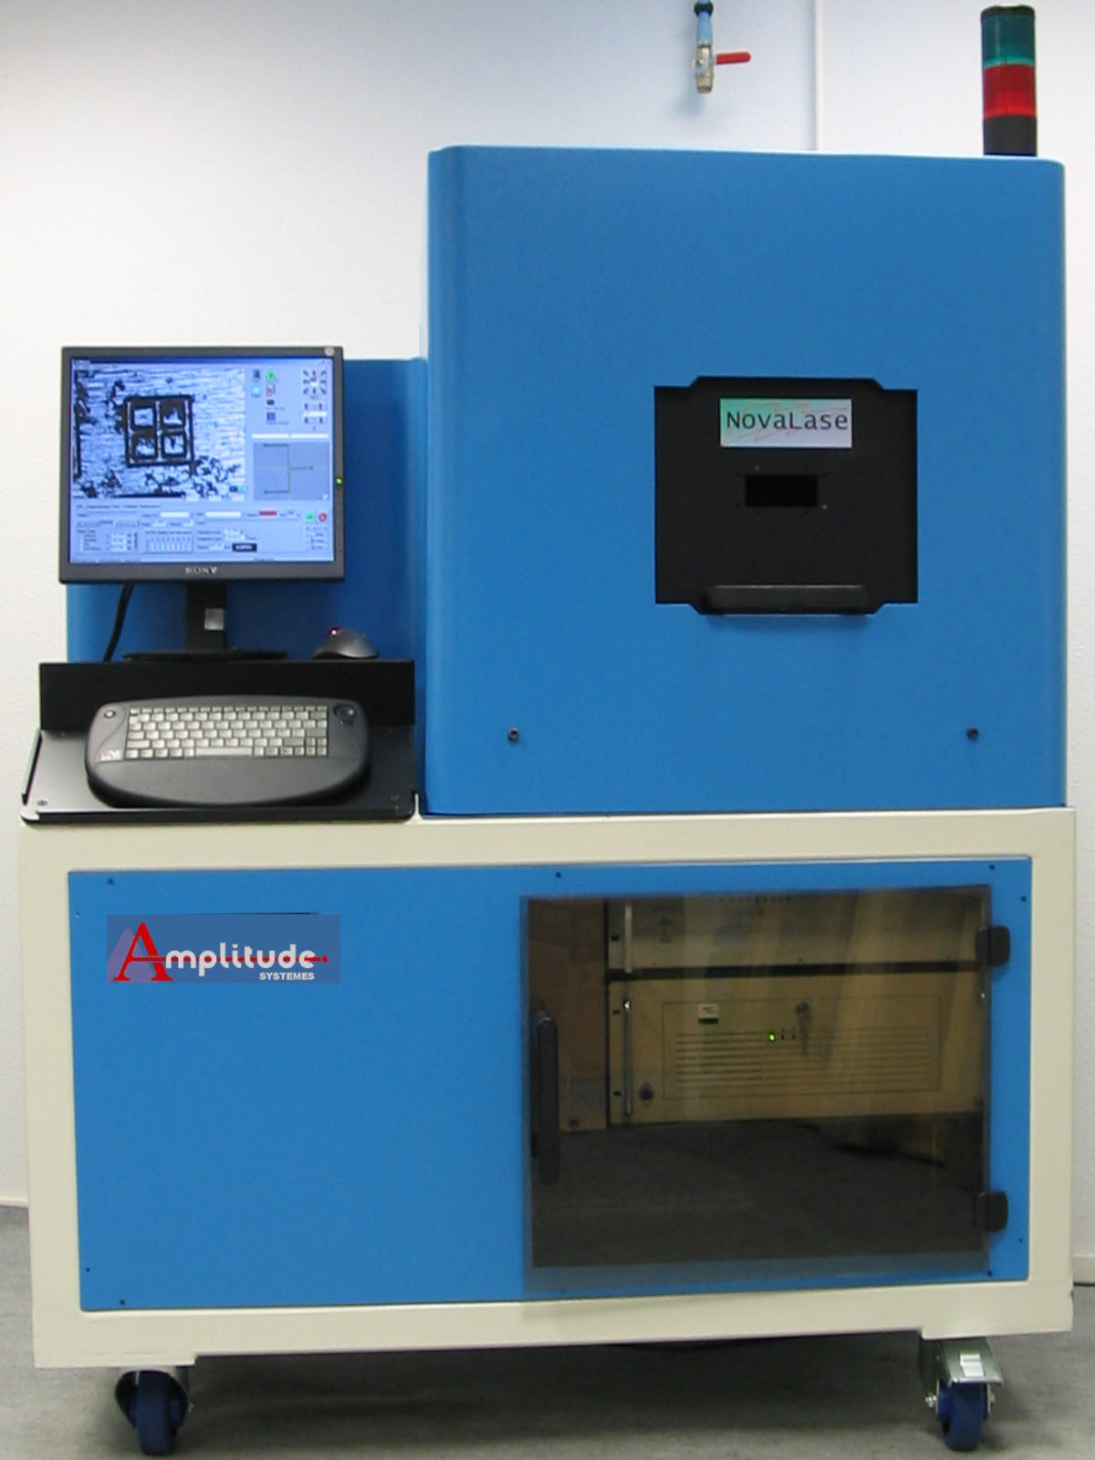
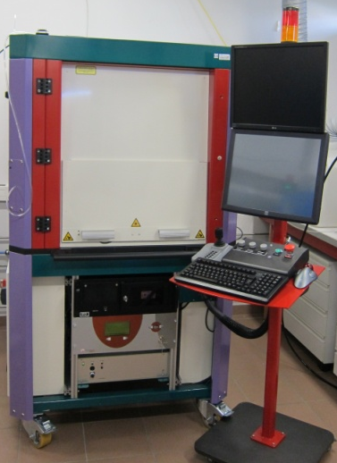
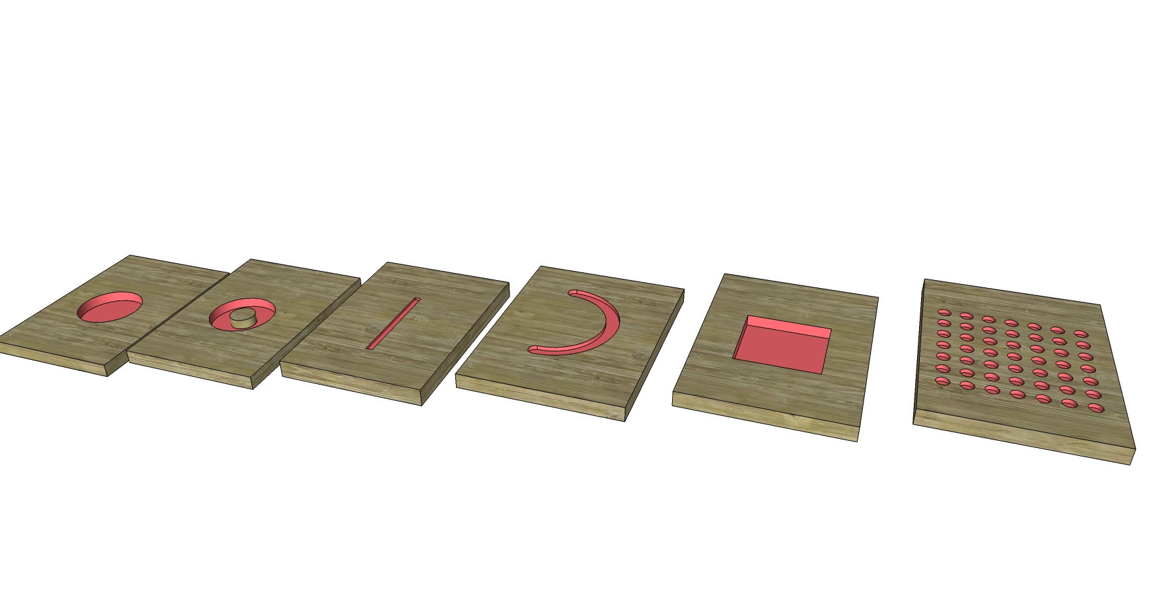
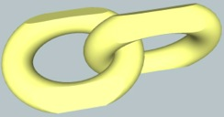
IPREM : HR femtosecond laser with virtual beam shapping
Galvanometric scanners
Adjusting the laser beam shape to the sample morphology to :
HR-fs LASER
1/ improve the detection sensitivity
2/ high spatial resolution
Small laser beam
(≈ 10 μm)
High repetition rate(<100 kHz)
Fast movement
(<2 m/s)

Slide 7

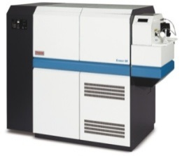
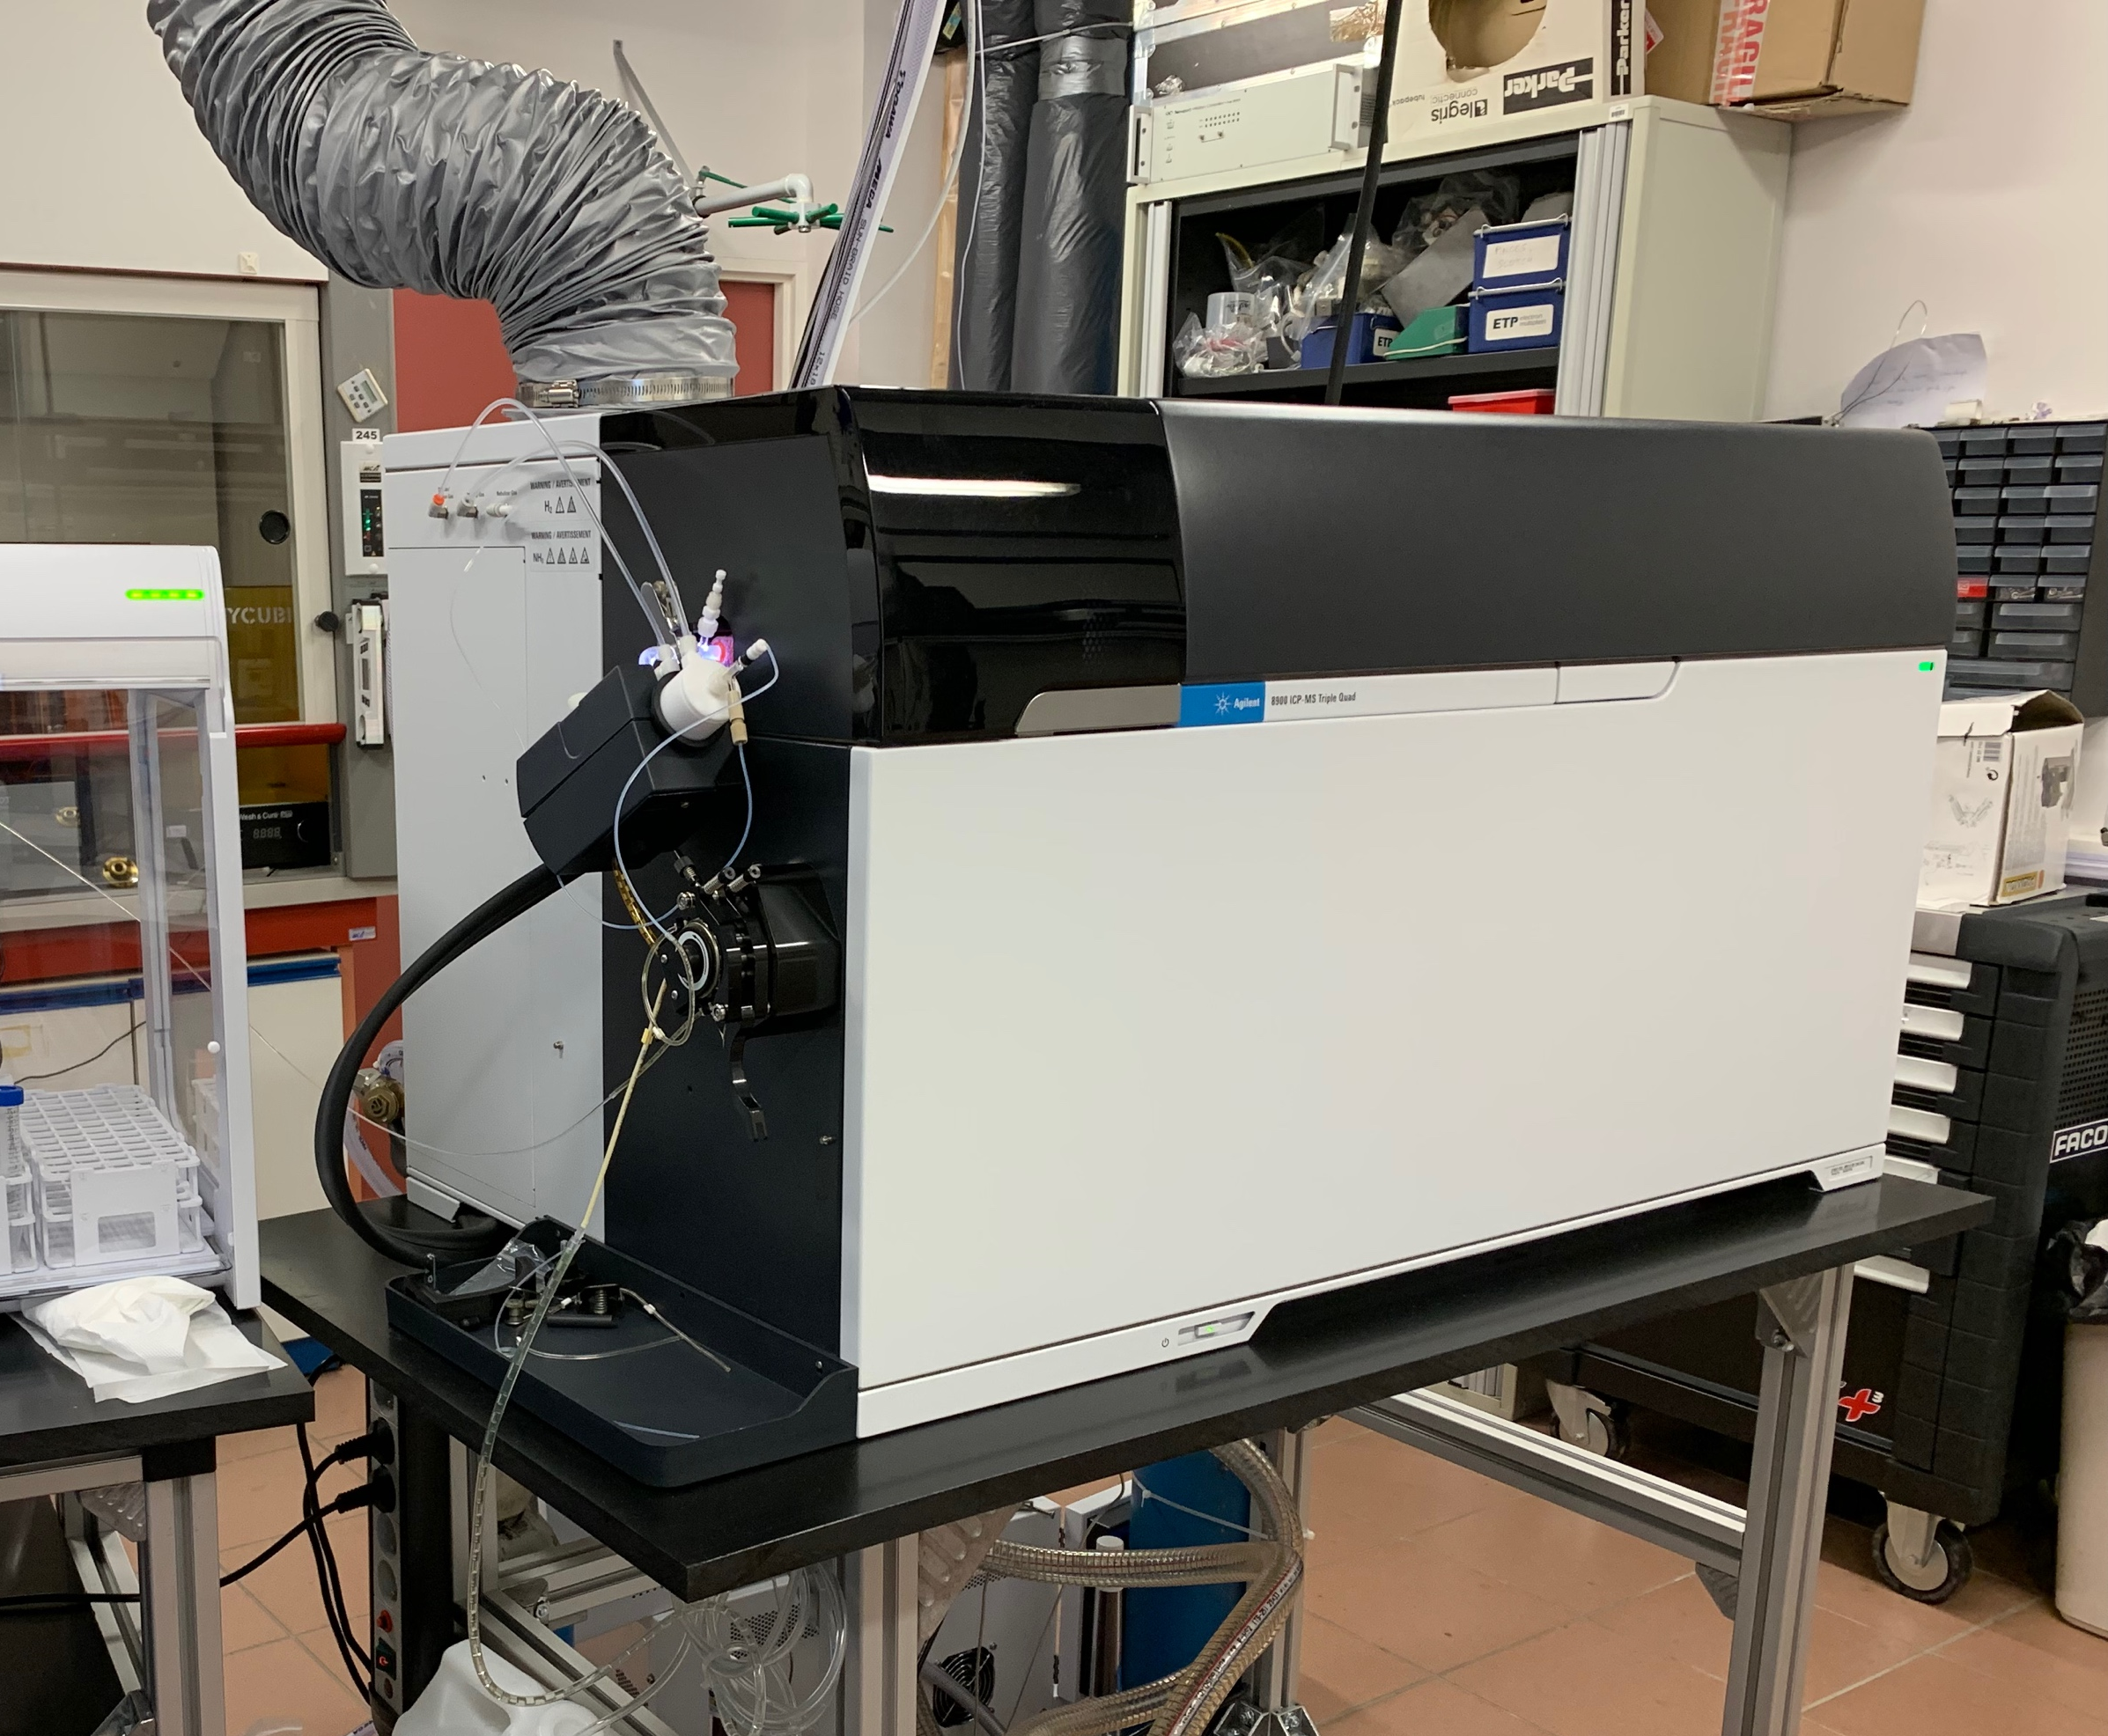
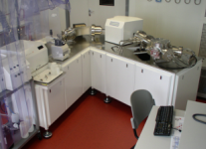
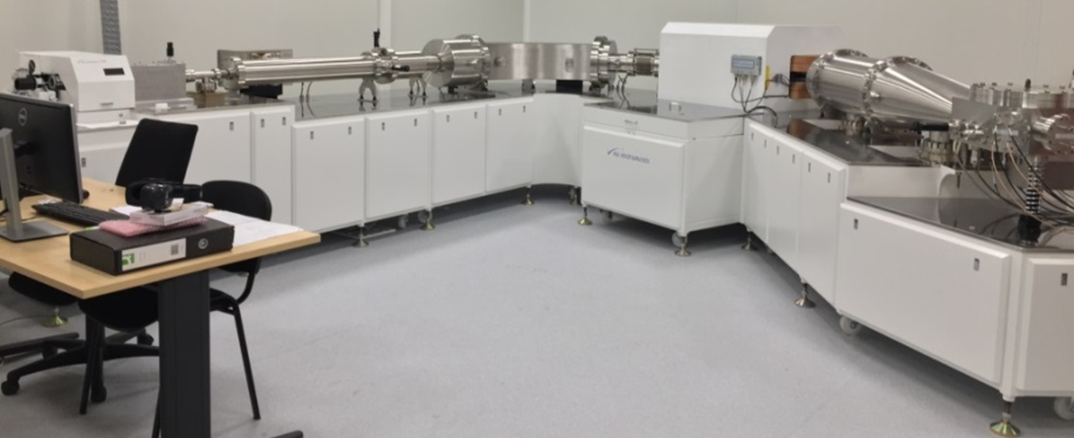
PLATEFORME PAMAL (Pau-UPPATech) : Laser-ICPMS imaging
(unsurpassed limits of detection)
(Fast and sensitive multielement imaging)
HR-ICPMS jet interface, Thermo
High Rep-
IRfs-LA
High Rep-
UVfs-LA
ICPMS/MS Agilent 8900 (semi-conductor config)
(Ultimate isotope precision)
MC-ICPMS, Nu Plasma
HR-MCICPMS Nu1700 (Nu Instruments/Cameca), EQUIPEX MARSS

Slide 8
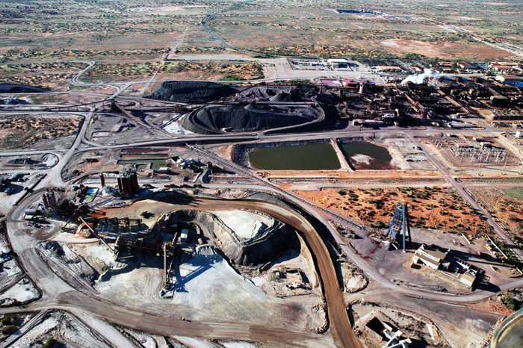

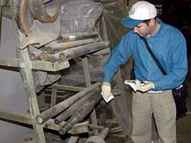
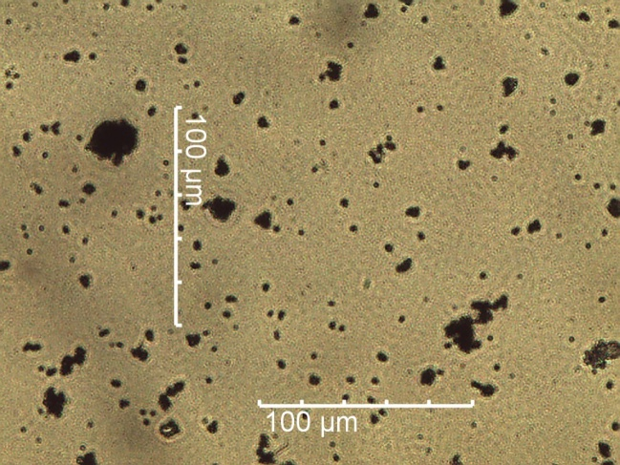
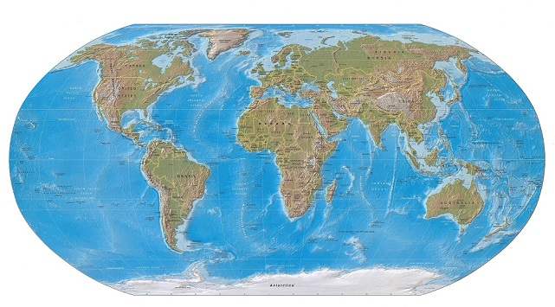
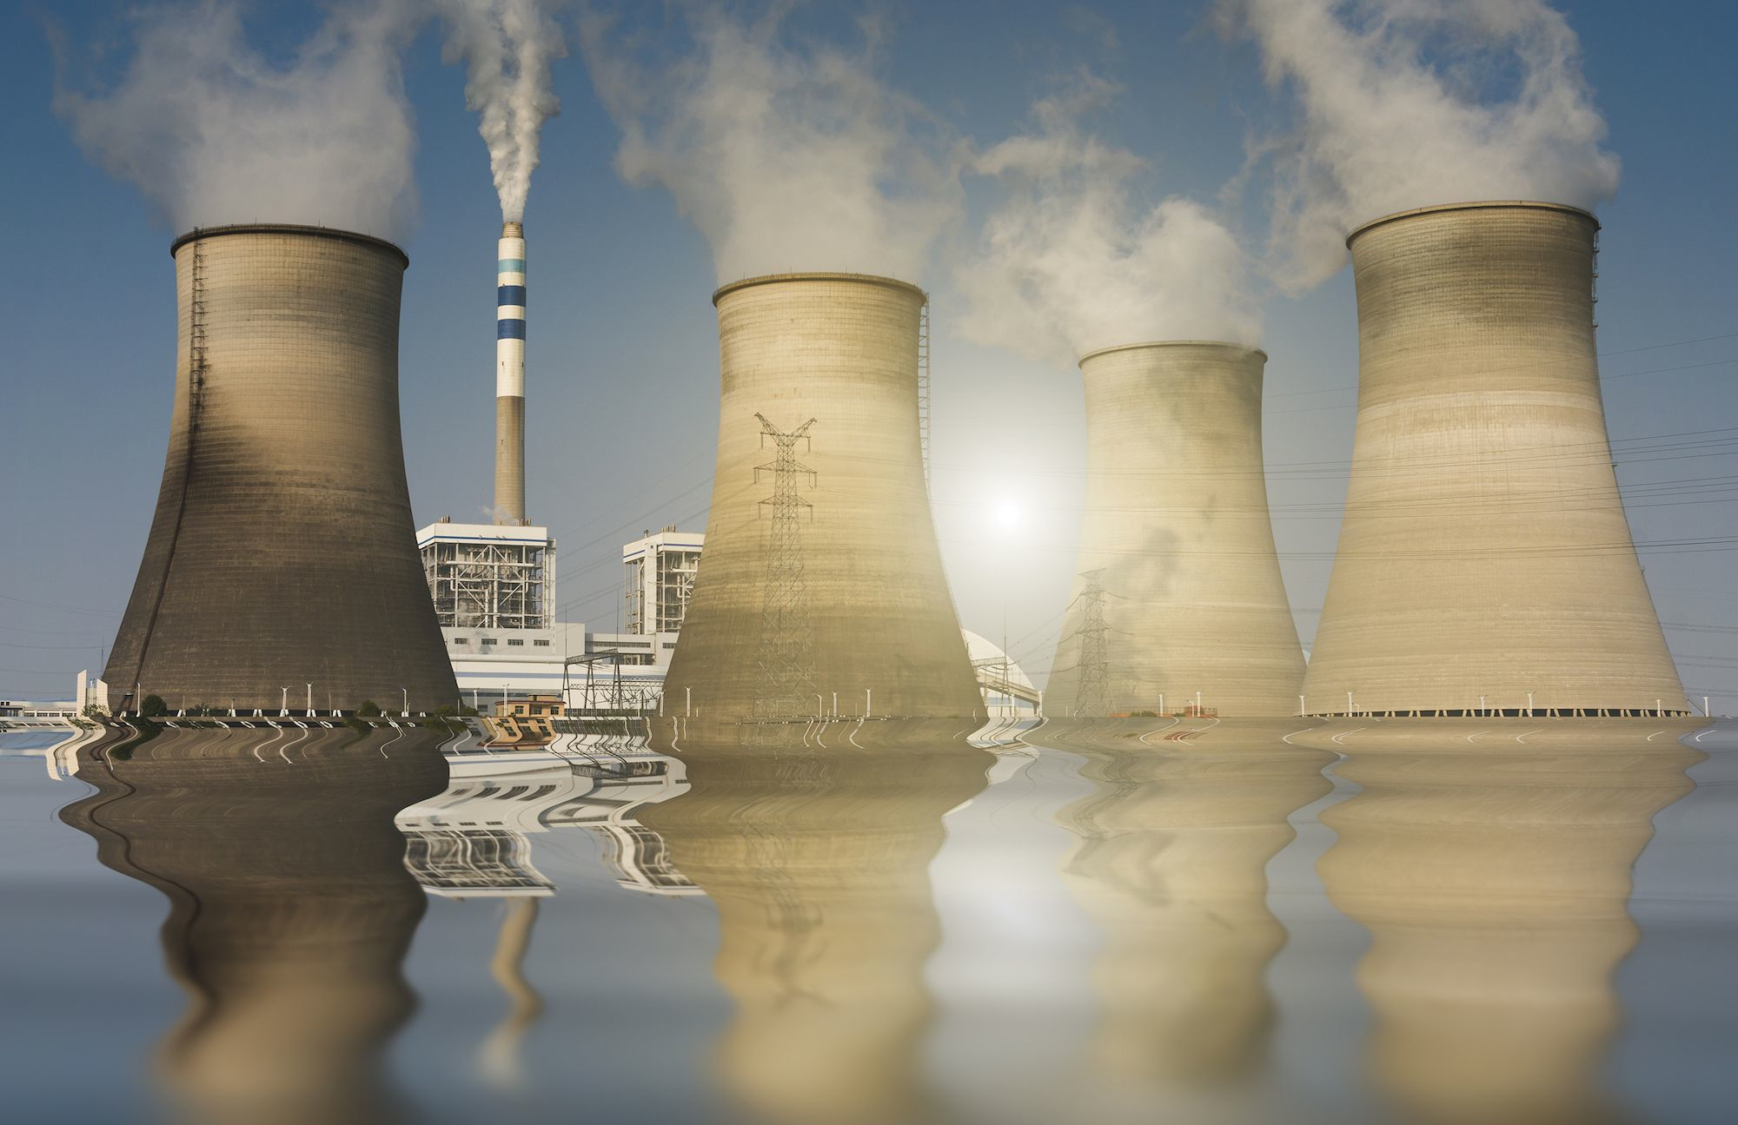
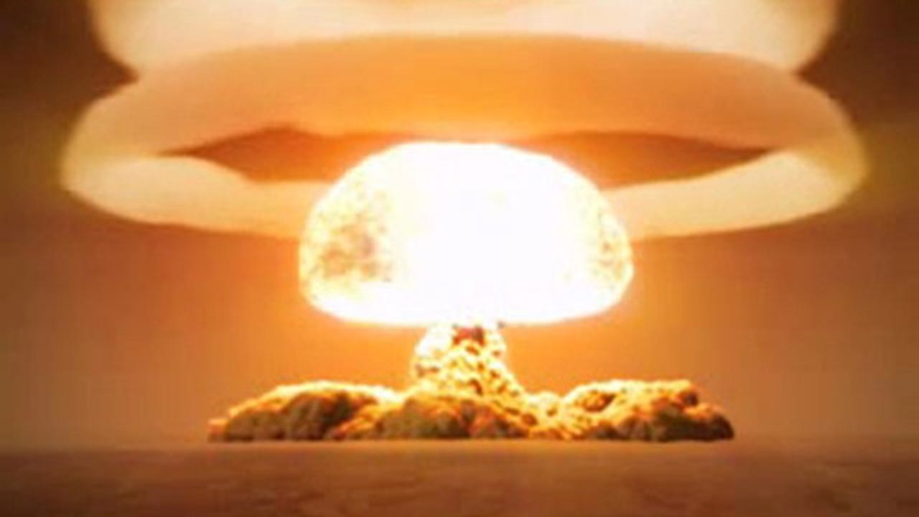
Nuclear forensic science at the particle scale
Estuaire aval
Collaboration with F. Pointurier, CEA
Extracting the most relevant information from few nanograms of matter=> detecting few pico, femto and even attograms
INTENTION
ORIGIN
U Civilian
U Military

Slide 9
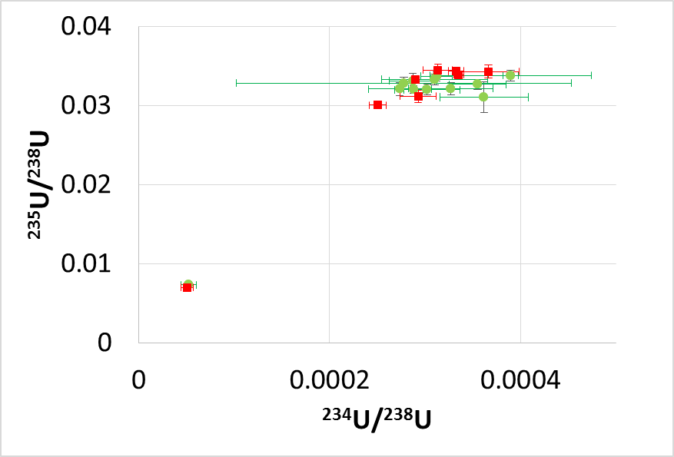
Nuclear forensic science at the particle scale
INTENTION => precise U isotope ratio
Collaboration with F. Pointurier, CEA
TIMS results
HR-ICPMS
LA-ICP-SF-MS results
HR-UVfs-LA
MC-ICPMS
 | fsLA-MCICPMS |  |  | fsLA-HRICPMS
 | ^{235/238}U | ^{234/238}U | ^{236/238}U | ^{235/238}U | ^{234/238}U | ^{236/238}U
Ecart à la valeur vraie % | 1% | -1,6% | - | 1% | 3% | 4%
Précision interne (RSD) | 0,32% | 0,68% | - | 1% | 2% | 1%
Précision externe (RSD) | 1,8 % | 2,4% | - | 5% | 13% | 12%
F. Claverie et al, Anal. Chem, 2016 – A. Donard et al, JAAS, 2016

Slide 10
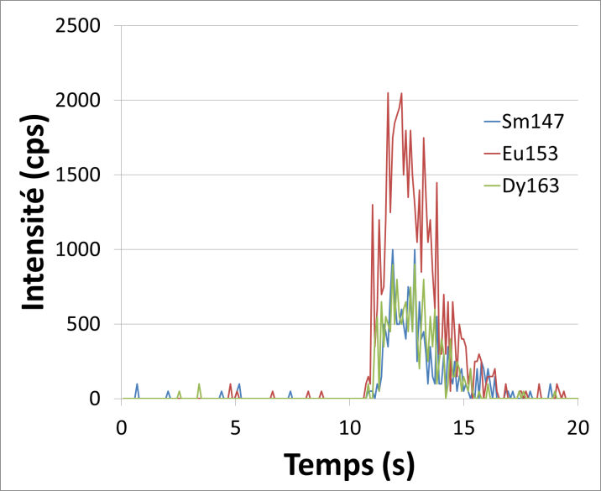

Nuclear forensic science at the particle scale
A. Donard et al, JAAS, 2015
ORIGIN => lanthanides pattern
Intensity (cps)
Collaboration with F. Pointurier, CEA
One micron particle = few hundreds nanogrammes
UvFsLA – HR-ICPMS
(jet interface)
Time (s)
Detection Limit : ∑Counts < 70 => Poisson’ s law : LD =(2,71 + 3,29√B)/S
¹³⁹La | ¹⁴⁰Ce | ¹⁴¹Pr | ¹⁴³Nd | ¹⁴⁷Sm | ¹⁵³Eu | ¹⁵⁷Gd | ¹⁵⁹Tb | ¹⁶³Dy | ¹⁶⁵Ho | ¹⁶⁶Er | ¹⁶⁹Tm | ¹⁷²YB | ¹⁷⁵Lu
105 ag (34 ag)₀ | 127 ag (35 ag)₀ | 80 ag (31 ag)₀ | 707 ag (246 ag)₀ | 388 ag (223 ag)₀ | 173 ag (173 ag)₀ | 633 ag (265 ag)₀ | 85 ag (43 ag)₀ | 276 ag (183 ag)₀ | 95 ag (48 ag)₀ | 277 ag (145 ag)₀ | 114 ag (50 ag)₀ | 555 ag (258 ag)₀ | 113 ag (61 ag)₀

Slide 11

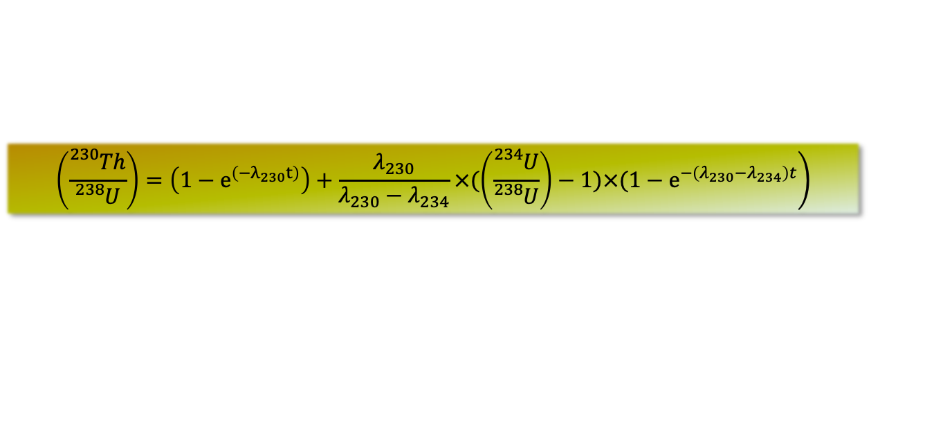
Direct dating of archaeological objects by fsLA-ICPMS imaging
²³⁸U
²³⁴U
Carbonate formation
²³⁰Th Production
²³⁴Pa
²³⁸U
²³⁸U
²³⁸U
²³⁸U
²³⁰Th
²³⁴U
²³⁰Th
²³⁴U
²³⁴Th
²³⁴U
²³⁴U
²³⁸U
²³⁸U
²²⁶Ra
time
$$\left.\left(\frac{{}_{}^{230}{Th}}{{}_{}^{238}U}\right)=\left(1−e^{\left(−λ_{230}t\right)}\right)+\frac{λ_{230}}{λ_{230}−λ_{234}}×(\left(\frac{{}_{}^{234}U}{{}_{}^{238}U}\right)−1)×(1−e^{−\left(λ_{230}−λ_{234}\right)t}\right)$$
²²²Rn
²¹⁸Po
²¹⁴Po
²¹⁰Po
²¹⁴Bi
²¹⁰Bi
Very low ²³⁸U, ²³⁴U and ²³⁰Th levels:
      If T≈ 100ky and [²³⁸U]≈1 ng/g (10⁻⁹g/g) → [²³⁰Th]≈10 fg/g (10⁻¹⁴g/g)
²¹⁴Pb
²¹⁰Pb
²⁰⁶Pb

Slide 12
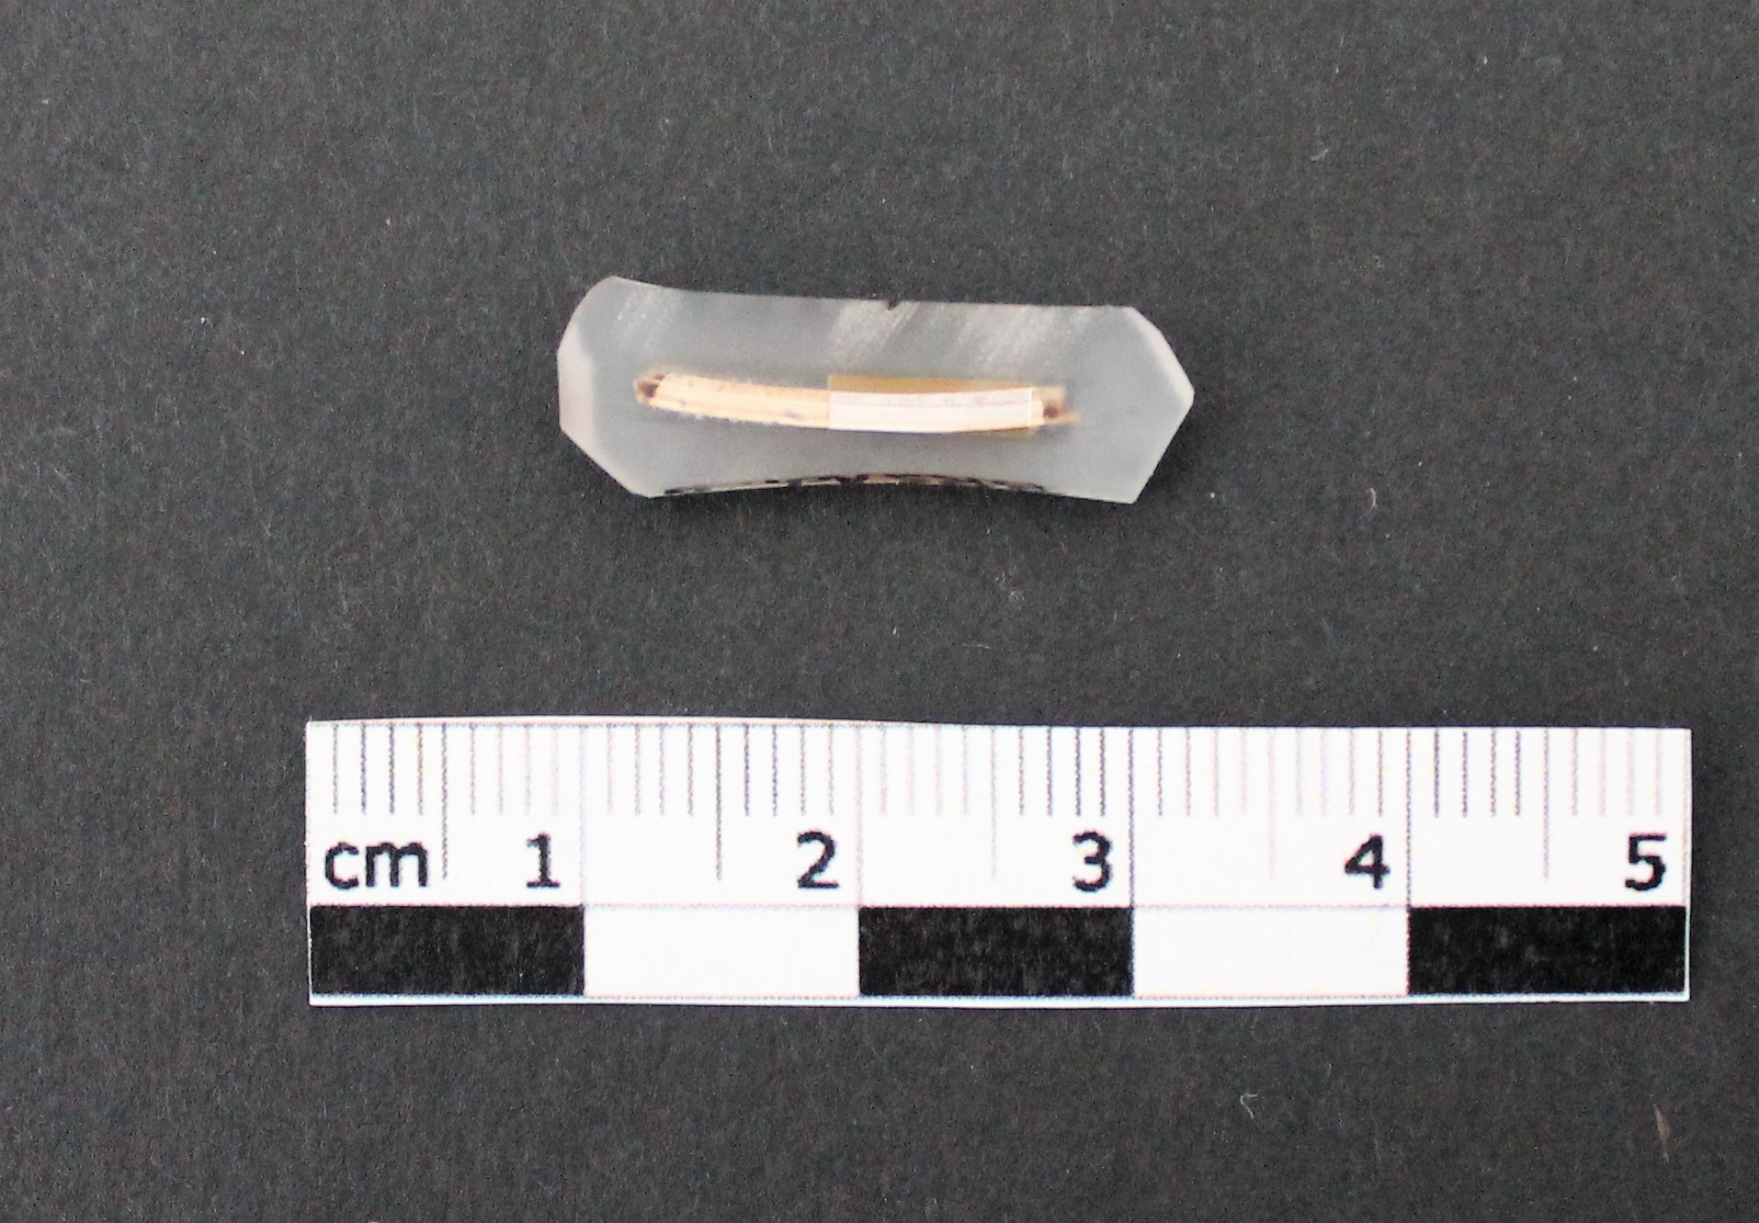
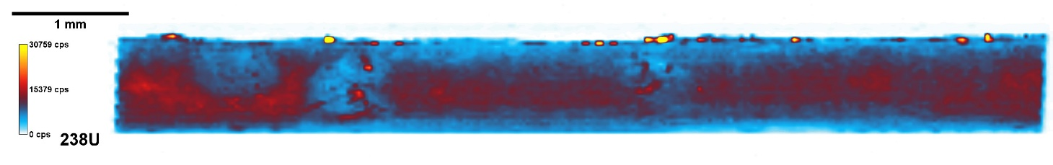
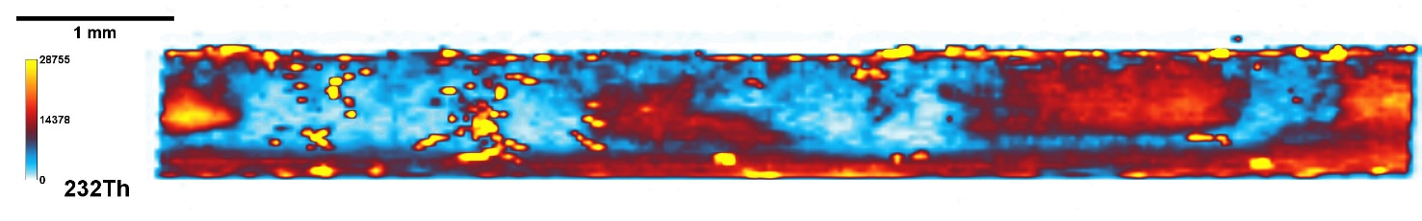
Direct dating of archaeological objects by fsLA-ICPMS imaging
Isotopic mapping shows different levels and types of alteration at the micron scale (here 1pixel = 30µm)
Allows to consider only the most relevant zones for dating.
 | LA-Fs-HR-ICP-MS Protocol
Sampling mass (6 analysis) | 1 mg (²³⁸U≈1-15 ppb)
Analysis time | 3 days (6 images accumulated)
Sample preparation | Fragments embedded in epoxy
Age | 51±16 ky (115 ions of ²³⁰Th measured → ~20 ag in the sample)
Ostrich eggshell
(cps)
(cps)
(cps)
Collab. N Mercier, C Tribolo, Univ Bx Montaigne
²³⁰Th instrumental background as low as 0,02 ion/s

Slide 13
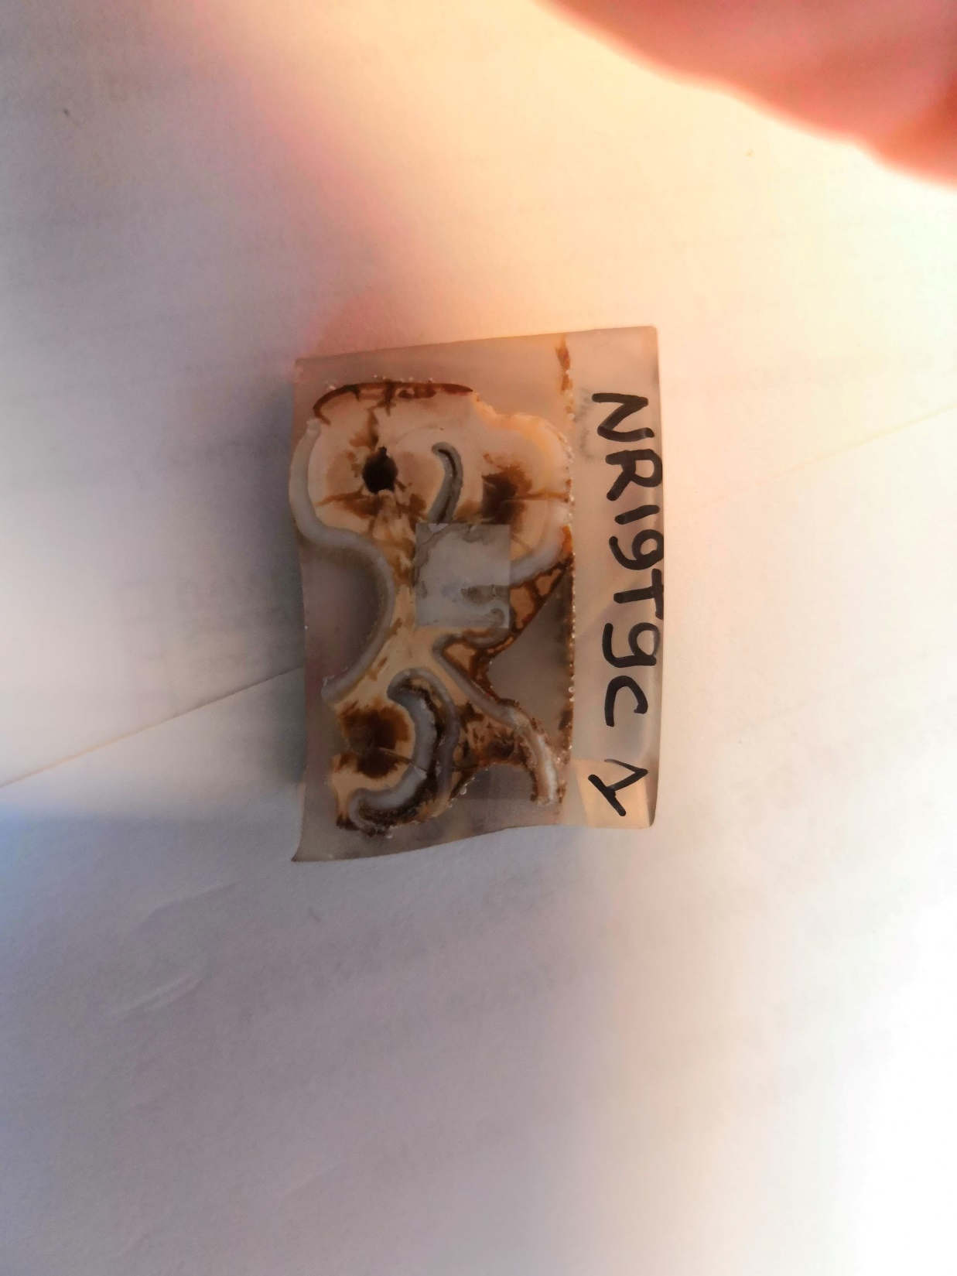
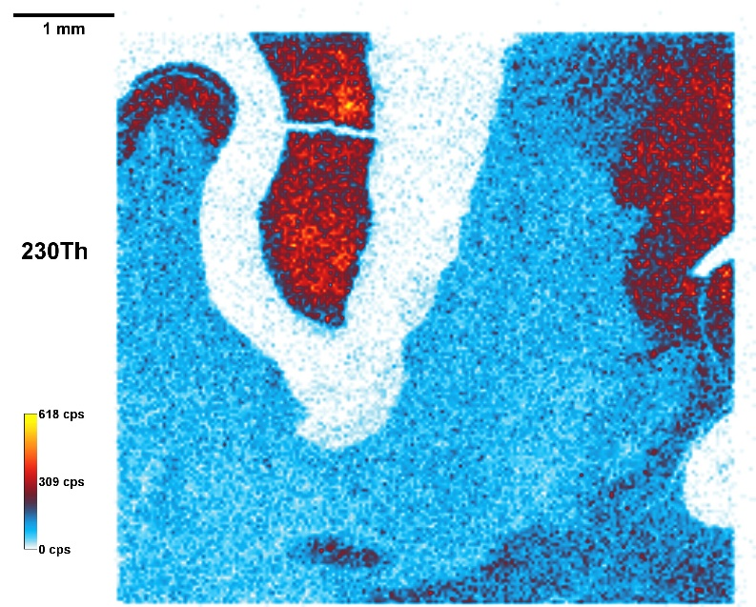
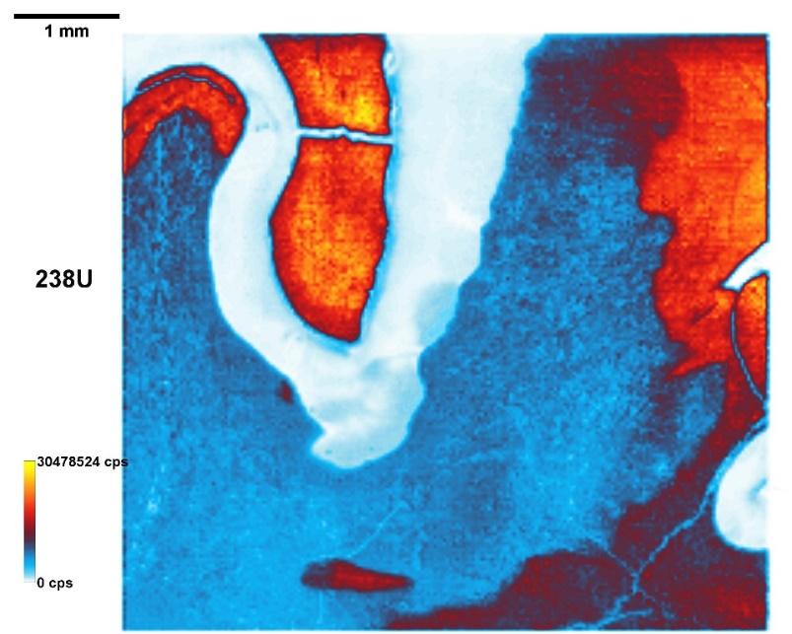
Nesher Ramla : archaic Homo
Auroch tooth
Well preserved sample
Enamel : ²³⁰Th detectable → U-series usable
Each tissue processed separately→ incorporation kinetic of U after death
Tissu | Masse ablatée | Age (ka)
Enamel | 0,86 mg | 73,4±6,5
Dentine | 6,42 mg | 86,8±3
Cement | 0,55 mg | 99,1±4,5

Slide 14
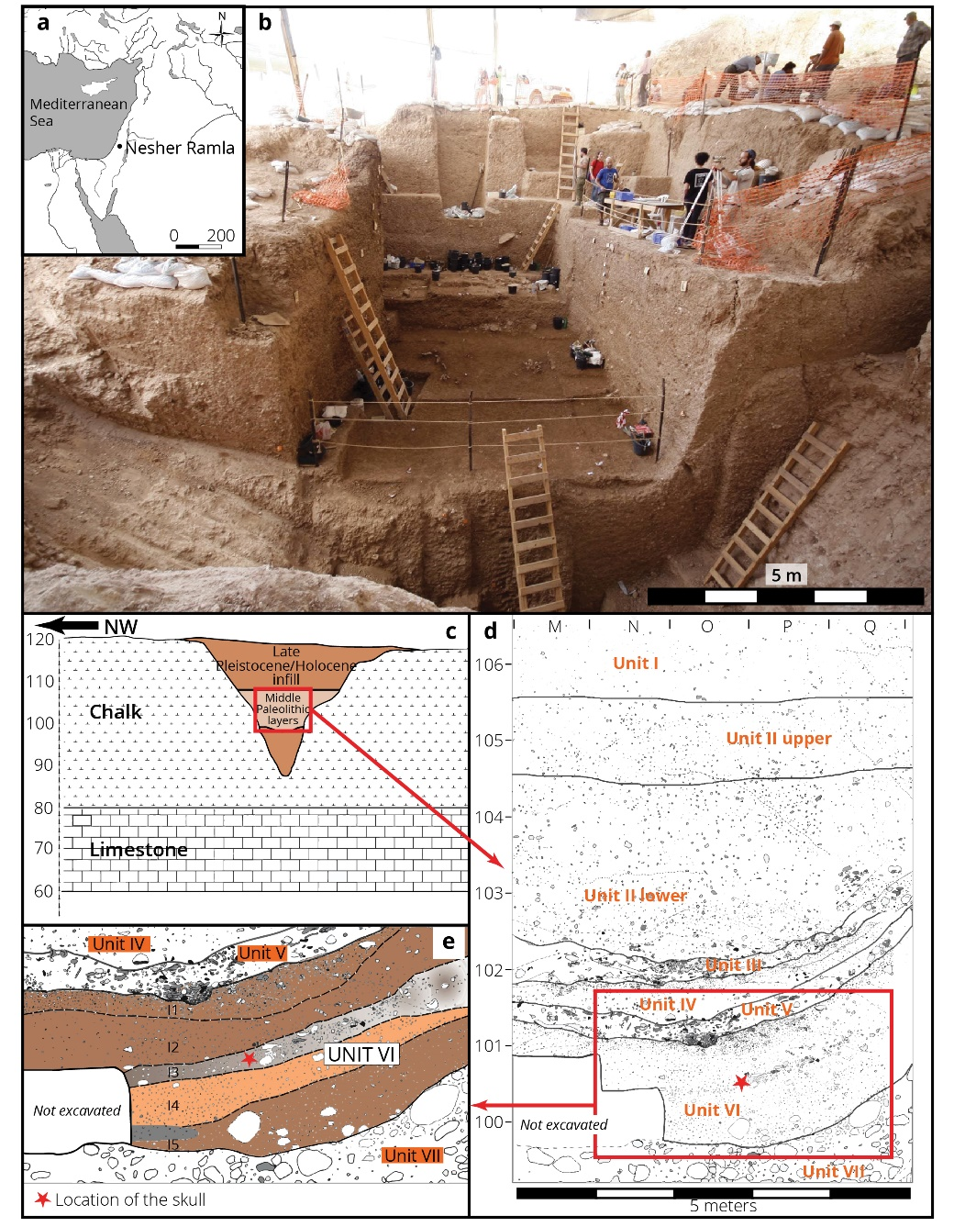
Nesher Ramla
Minimum age
= 99,06±4,5 ky
Science, 372(6549), 1429-1433, 2021

Slide 15
Application to material purity assessment for rare events experiments
CENBG is involved for many years in neutrino physics and double beta decay experiments
Using UVfsLA-ICPMS analytical methodology measurements for quantitative ultra-low background measurements and U/Th mapping of materials used in rare event experiments

Slide 16
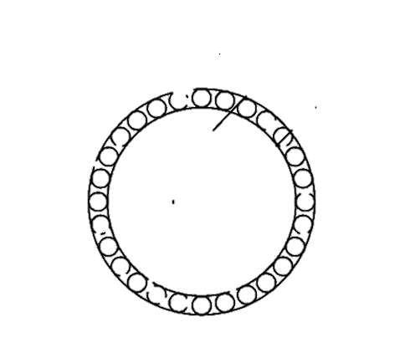
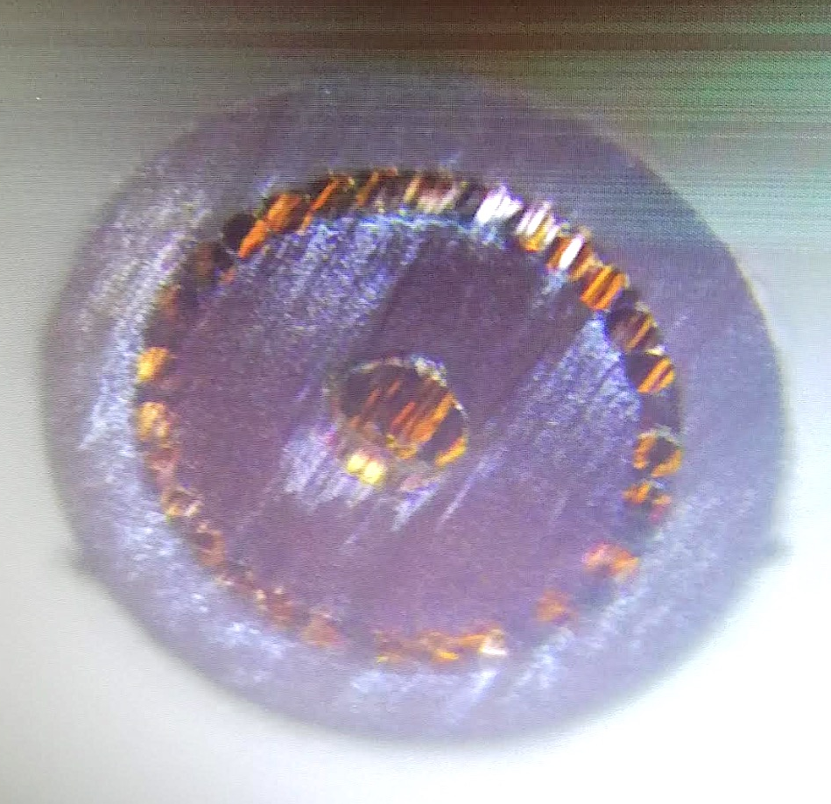
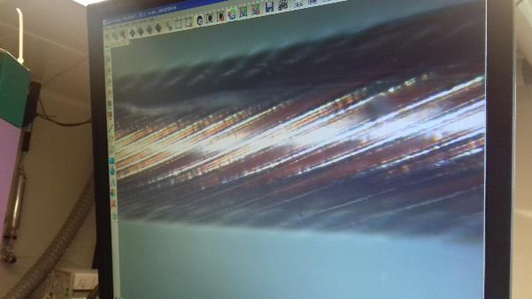
Material purity assessment for rare events experiments : µ-coaxial cable
LASER Operating Conditions for IMAGING
λ=257 ns
Pulse duration : 360 fs
Energy per pulse: 5 µJ
Repetition rate: 50 Hz
Spot size: 8 µm
Speed of the scan: 10 µm/s
Distance between 2 lines: 5 µm
D~400 µm

Slide 17
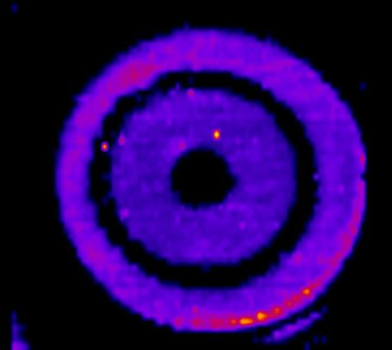
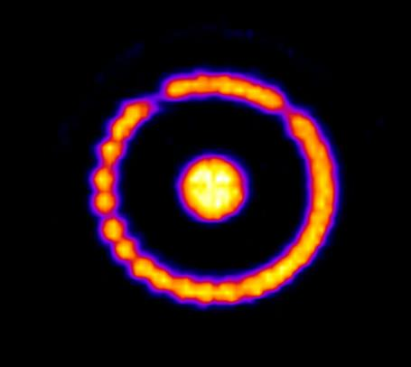
2D-FsLA-ICPMS mapping of µ-coaxial cable
Cu contamination in some of the copper wires.
Complementarity with conventional ICPMS :
  fsLA HR-ICPMS is able to locate contamination
  Quantitative analysis (with fit for purposes standards)
¹³C
⁶⁵Cu
²³⁸U

Slide 18
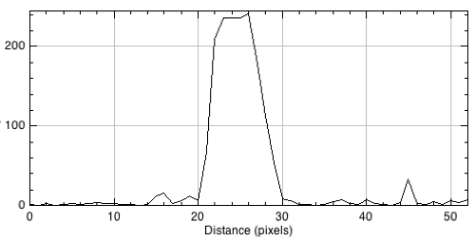
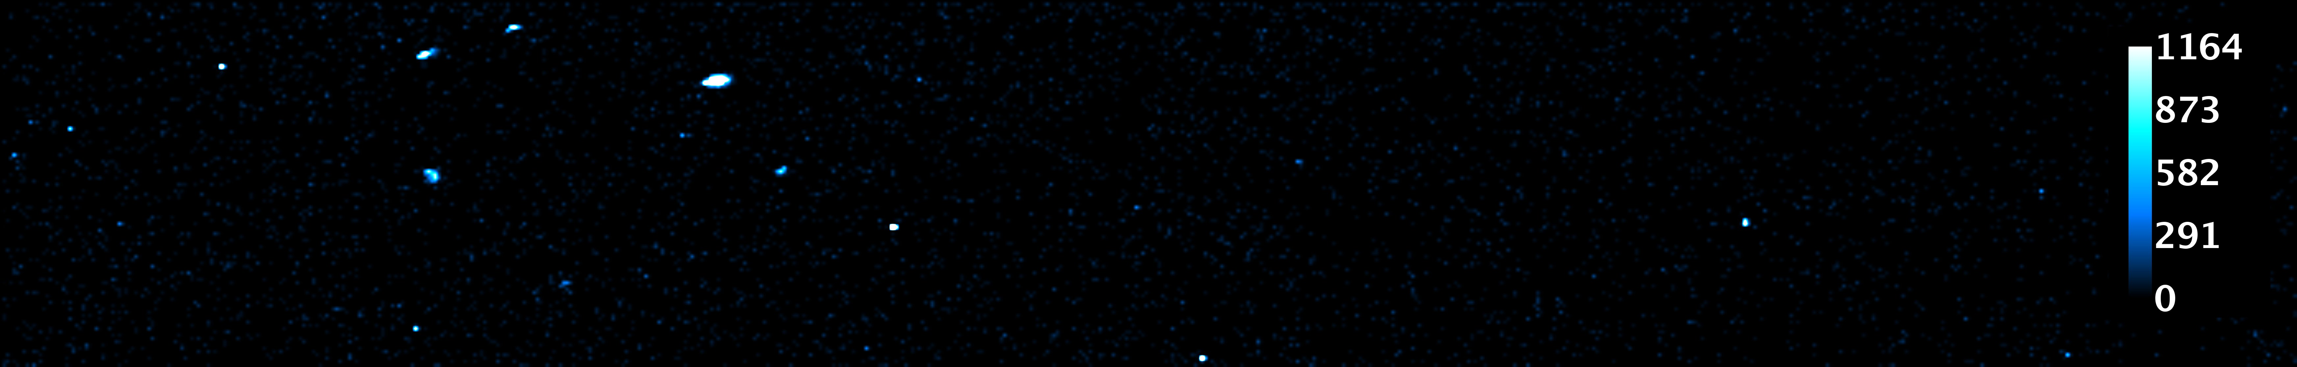
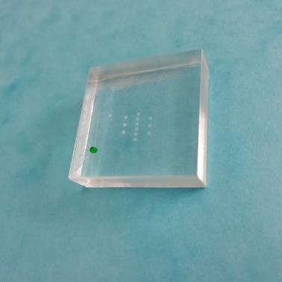
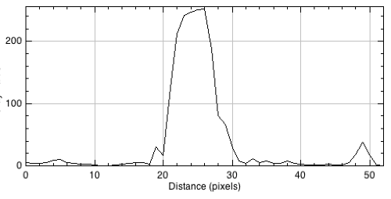
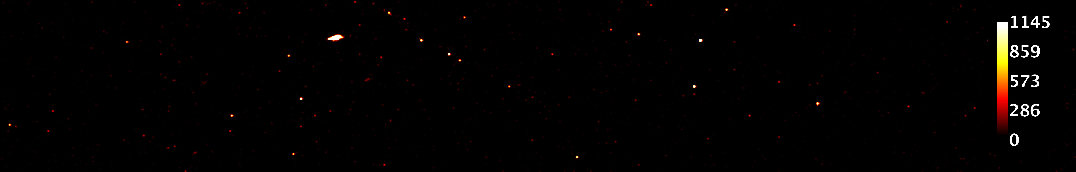

80µm
2D-FsLA-ICPMS mapping of the acrylic sample
80 µm
Acrylic sample (C₅O₂H₈)
²³⁸U
Counts/s
25 mm
²³²Th
Counts/s
25 mm
¹³C
Notes:
On a pas mesuré le socncentration sur cette image, mais la distribution spatiale.

Slide 19
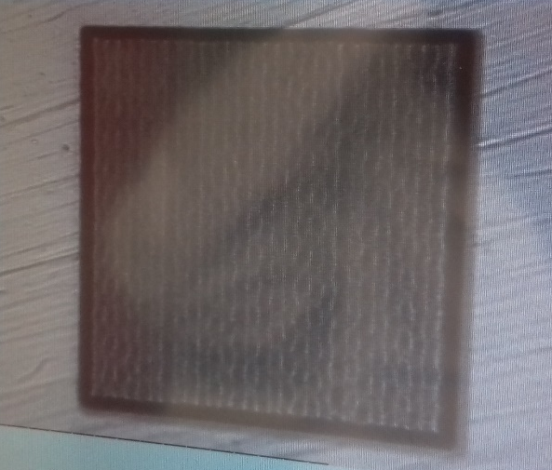
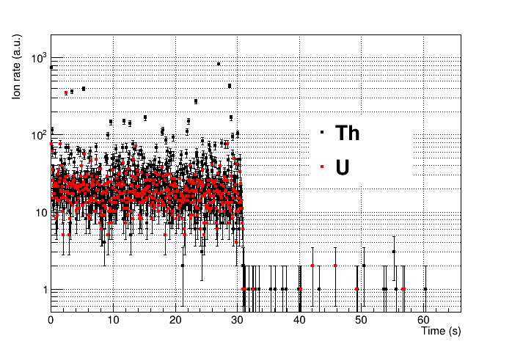
FsLA-ICPMS for FAST surface analysis of acrylic samples
Acrylic sample (C₅O₂H₈)
600 µm
25 mm
sample
background
25 mm
Laser ON
Laser OFF
UV fs laser operating conditions :
λ=257 ns
Energy: 5 µJ/pulse
Frequency: 400 Hz
Spot size: 8 µm
Scan velocity: 2 mm/s
2D scan of a square of 600x600 µm²
µm in 30 s only.

Slide 20
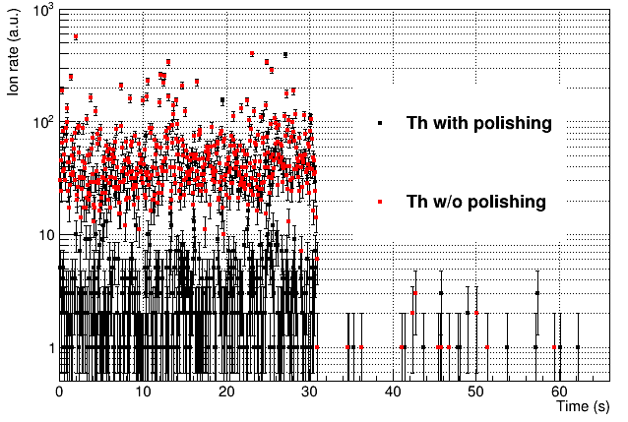
Acrylic : Polished or not polished ?
²³²Th
Two acrylic samples have been measured:
one with polishing process applied on the top surface
one without polishing
One order of magnitude!
→ Very efficient tool to measure the U/Th contamination and to choose the best surface treatment of a critical material!

Slide 21


Depth profile (Z axis) of U/Th level
Laser
shots
Surface contamination
Acrylic
600 µm
Several 2D laser scans to explore the Z-axis
Bulk contamination
3D profile
1 scan
4 µm depht
surface
2 scans
8 µm depht
Mass of ablated acrylic per scan ~1.7 μg with a 10% uncertainty
Most of U and Th contamination of the acrylic is located on the surface in the first 4 μm

Slide 22
Conclusion
→ Overall efficiency of 0.20% of the LA-ICPMS has been derived for ²³⁸U and ²³²Th (tune condition U/Th=1,00 +/- 0,01 on NIST 612)
→ Very low background
→ Detection at the ppt level (and even lower) for U and Th with less than 10 μg of sample ablated !
→ Sensitivity competitive with Neutron Activation Analysis
Need to have a reference material for U and Th concentration
A home-made acrylic standard at the ppb level has been designed (to be published/pattented)
Quantitative analysis
Notes:
La sensibilité n’est pas la limite de detction qui doit etre utilisée ici

Slide 23




L’EVÈNEMENT DE L’ANALYSE
INORGANIQUE FRANCOPHONE
Nous sommes particulièrement heureux de vous accueillir de nouveau à Pau pour l’édition 2022.
BIENVENUE !
www.spectratom2022.sciencesconf.org
Comité d’Organisation
Contact Organisation
Dr. Christophe PECHEYRAN (Président) IPREM - UMR 5254, Université de Pau et des Pays de l'Adour/CNRS
Dr. Olivier DONARD (co-président) IPREM - UMR 5254, Université de Pau et des Pays de l'Adour/CNRS
Dr. Fanny CLAVERIE UPPA-Tech, Université de Pau et des Pays de l'Adour/CNRS
Dr. Pascale LOUVAT IPREM - UMR 5254, Université de Pau et des Pays de l'Adour
Pr. Florence PANNIER IPREM - UMR 5254, Université de Pau et des Pays de l'Adour
Gaëlle BARBOTIN UPPA-Tech, Université de Pau et des Pays de l'Adour
Dr. Hugues PAUCOT UT2A formation, Université de Pau et des Pays de l'Adour
Dr. Fabienne SEBY UT2A, Université de Pau et des Pays de l'Adour
Géraldine BOURGUET UPPATECH - Université de Pau et des Pays de l'Adour
Antonia TOSKA IPREM - UMR 5254, Université de Pau et des Pays de l'Adour
Matthieu BOCCAS IPREM - UMR 5254, Université de Pau et des Pays de l'Adour
Asmodée GALY IPREM - UMR 5254, Université de Pau et des Pays de l'Adour
Nicolas TASTET
Tél. 07 82 45 08 27
contact@spectratom.fr

