Slide 1

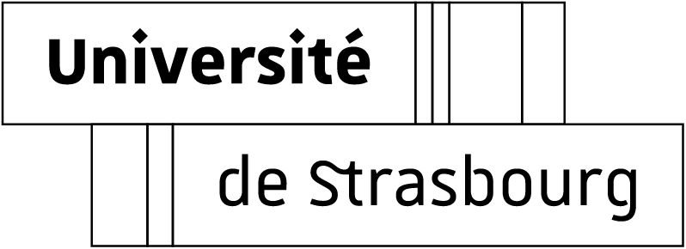
Radiolysis of biomolecules by accelerated ions
Quentin Raffy
Associate professor
DRS/Radiochimie
IPHC – CNRS

Slide 2
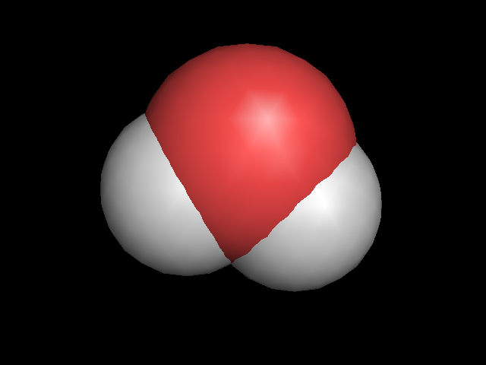
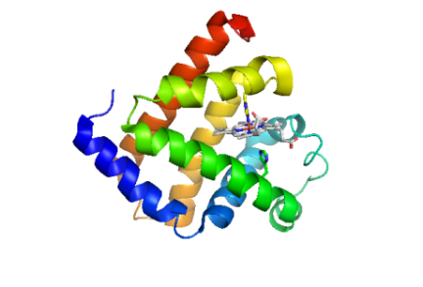
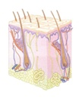
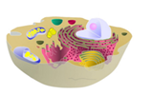
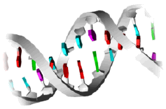
Studies at the molecular level
Systematic Physico-Chemical study of radiolysis of biomolecules
Molecular scale : composition of the cell
Context: Hadrontherapy
Proportions in weight
O
Water
H₂O
65%
H
H
Amino-acids
Proteins
20%
Proteins and amino acids:
Lack of information
Tissues
Cell
DNA
> 0,1%

Slide 3
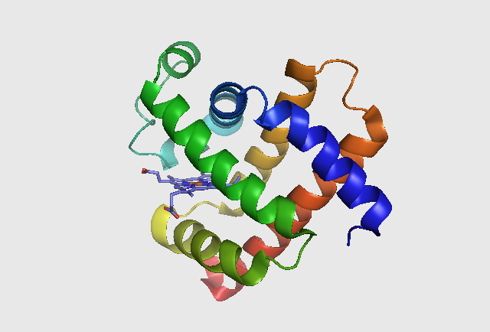
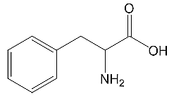
Studies at the molecular level
Systematic Physico-Chemical study of radiolysis of biomolecules
H₂O
Water
Amino acids
Peptides
  Proteins
Ion
Direct effects
Water Radiolysis
Ion
HO•, e⁻_{aq}, H•, H₂O₂
Diluted solutions : Indirect effects

Slide 4
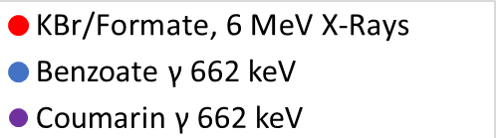
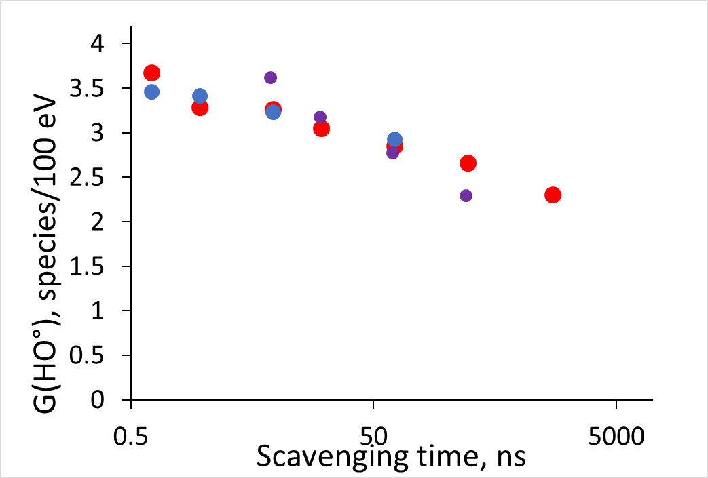
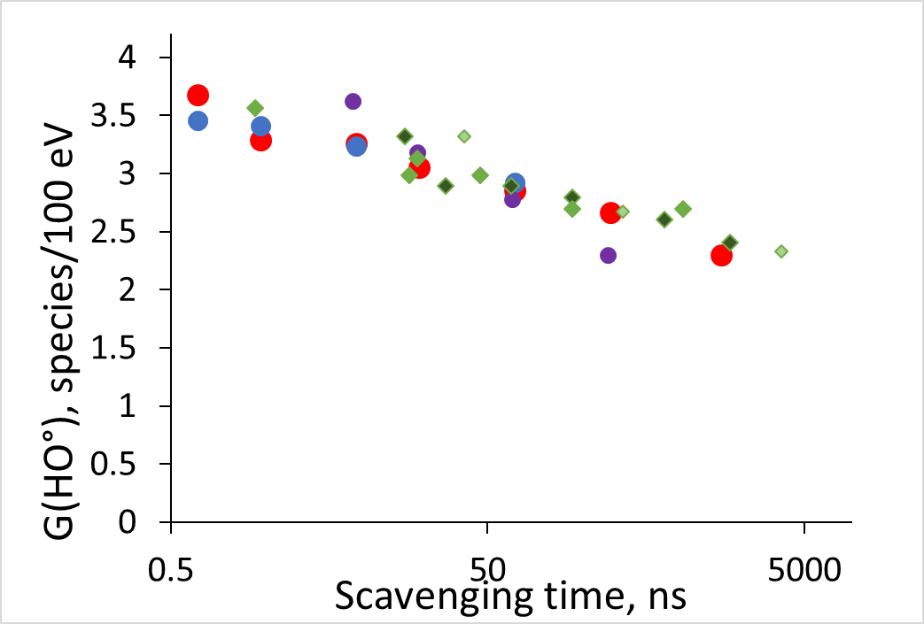
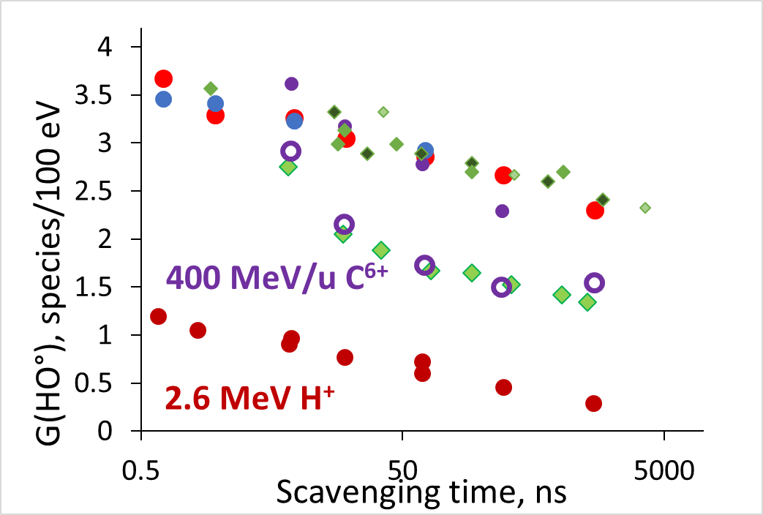
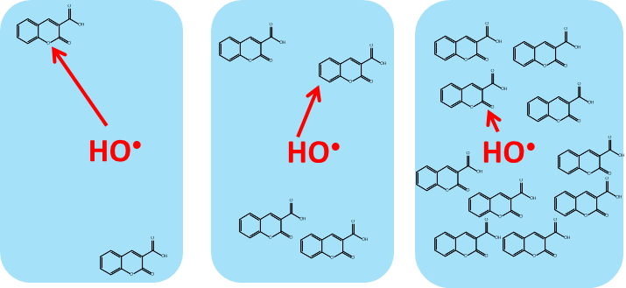
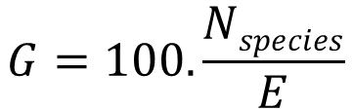
Water Radiolysis
Measurement of hydroxyl radical: Chemical probes
k₁ = 6.8.10⁹ M⁻¹.s⁻¹
KBr/Formate
Benzoate
+ HO•
3-Carboxylic acid coumarin
7 Hydroxy-3-carboxylic acid coumarin
$$G=100.\frac{Nspecies}{E}$$
Radiolytic yield
γ-Rays / X Rays
Higher probe concentration
µs
ns
Lower scavenging time
Green diamonds: Lit. (Baldacchino et al., 2009; Draganic and Draganic, 1977, Burns and Sims, 1981

Slide 5
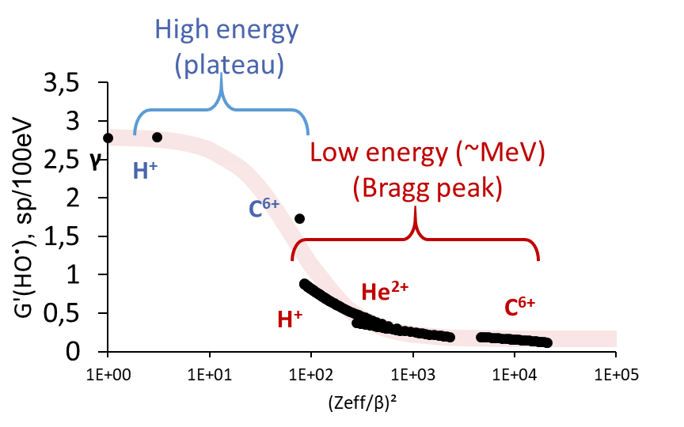
Water Radiolysis
Measurement of hydroxyl radical: Chemical probes
k₁ = 6.8.10⁹ M⁻¹.s⁻¹
KBr/Formate
Benzoate
+ HO•
3-Carboxylic acid coumarin
7 Hydroxy-3-carboxylic acid coumarin
Evolution with energy/nature of ions
« Chemical dose », between physical and biological effects
Other species (e⁻_{aq}, H₂O₂)
Dose-rate effects
Simulations Geant4-DNA
(N. Arbor, IPHC)

Slide 6
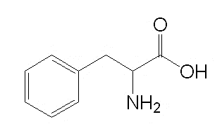
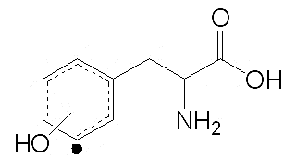
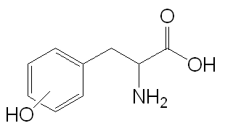
Amino Acids: Mechanisms of Radiolysis
Radiolysis of phenylalanine
Mechanisms described with gamma rays/e⁻
HO₂·
O₂
HO·
or
+ Phe·OH
Phenylalanine
Phe•OH
o-, m-, p-Tyrosine
S. Solar, Radiat. Phys. Chem., 1985, 26, 103–108
W. M. Garrison, Chem. Rev., 1987, 87, 381–398

Slide 7
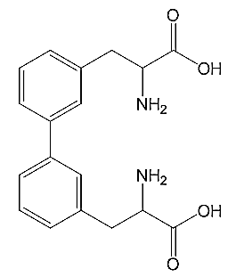


Amino Acids: Mechanisms of Radiolysis
Products specific to ions
Dimers
2,5-DOPA
$$\frac{G(dimers)}{G({HO}^{•})}$$
$$\frac{G(2,5 dopa)}{G({HO}^{•})}$$
He²⁺
C⁶⁺
He²⁺
H⁺, C⁶⁺ 400 MeV/Nu
H⁺, C⁶⁺ 400 MeV/Nu
C⁶⁺
Gamma, H⁺ 210 MeV
Gamma, H⁺ 210 MeV
N. Ludwig et al., Radiat. Meas., 2018, 116, pp 55-59

Slide 8
Peptides: Mechanisms of Radiolysis
Do we have similar mechanisms with peptides ?
Ion specific
Aspartame
Magainin 2 (23 residues, 3 phenylalanines)

Slide 9
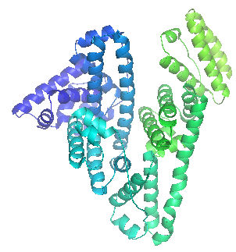
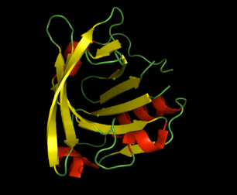
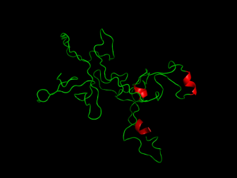
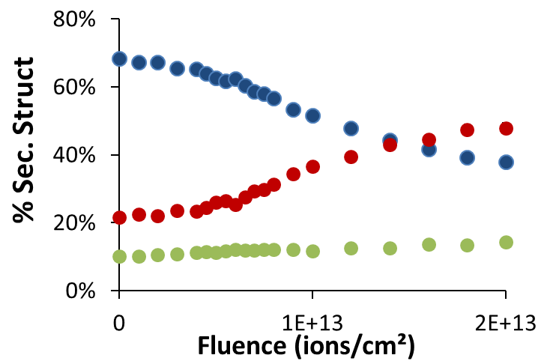
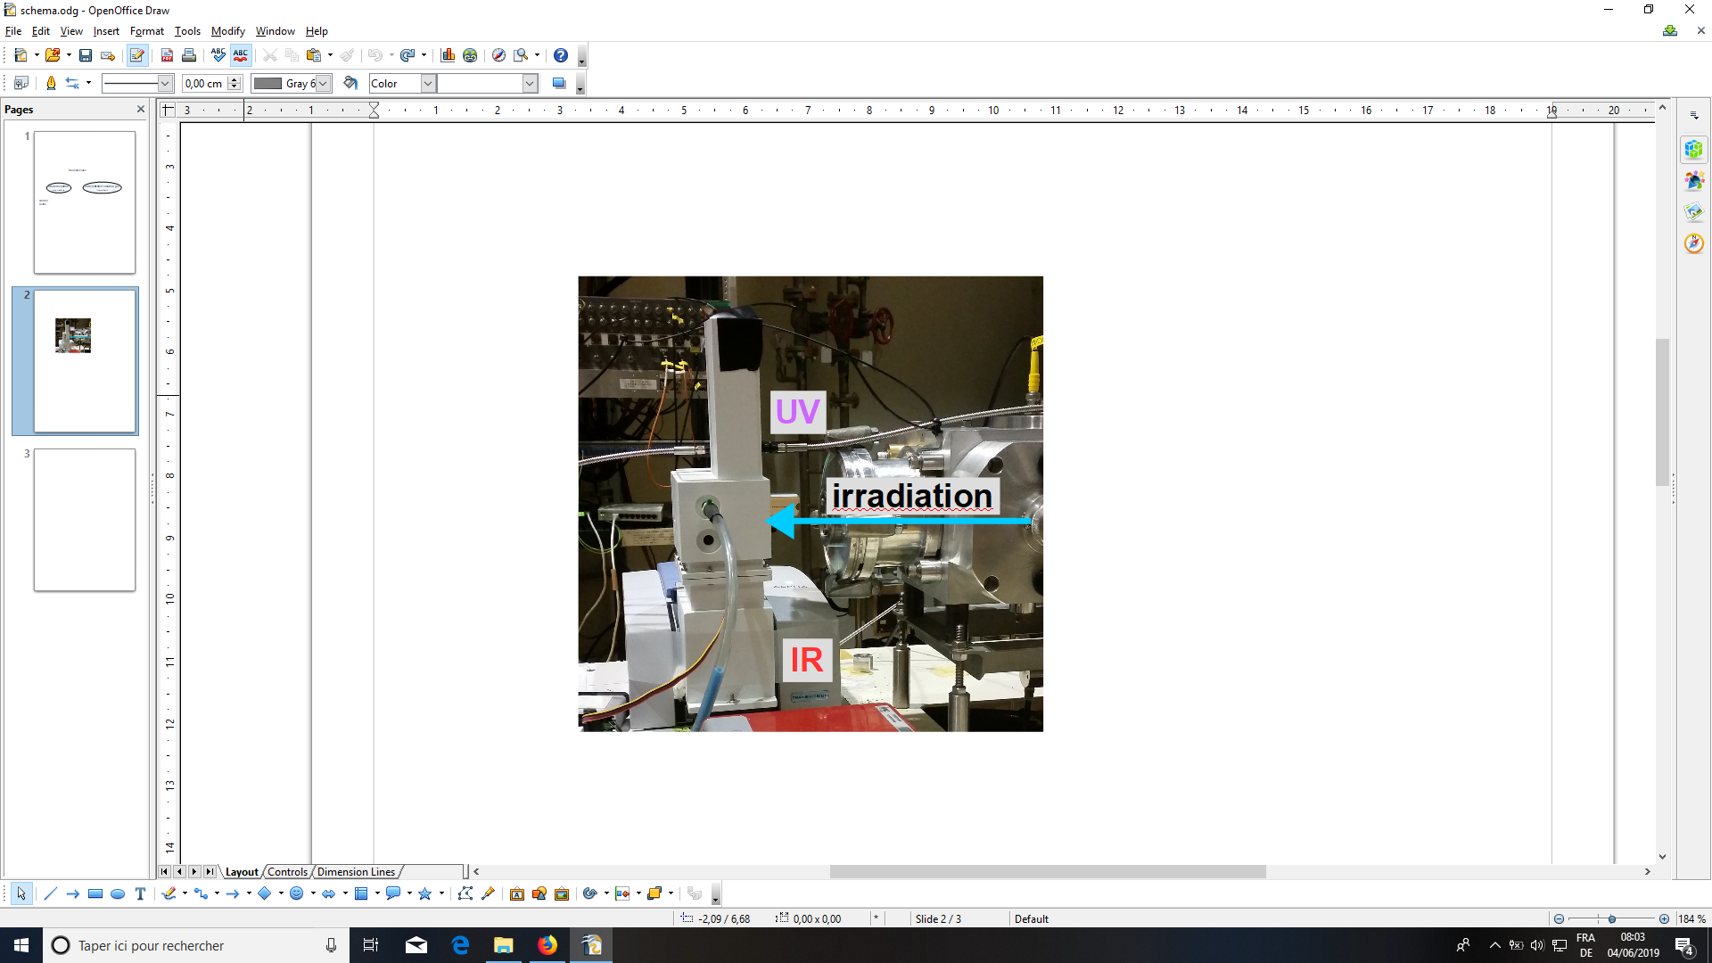
Proteins
Proteins: Model proteins chosen for their secondary structures
α helices
β structure
Random
Myoglobin
Human Serum Albumin
β-Lactoglobulin
β-Casein
Diluted solutions
(Indirect effects)
Concentrated gels
(→ direct effects)
Effect on secondary structure
α helices
Secondary structure
Peptides damaged
β structures
Random

Slide 10
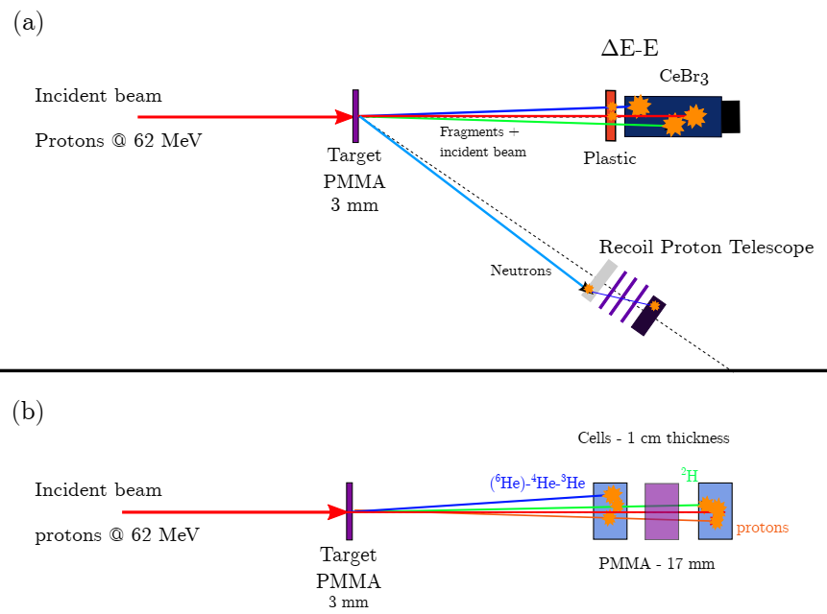
Ion fragments
Impact of the ion fragments on Radiolysis
Part of Foot-Xn project: CLINM
M. Vanstalle, C. Finck, Q. Raffy, N. Arbor (IPHC)
D. Cussol, S. Salvador (LPCC)
Simultaneous
- Measurements of secondary particles (gamma, neutrons, charged particles)
- Measurements of water and biomolecules radiolysis species

Slide 11
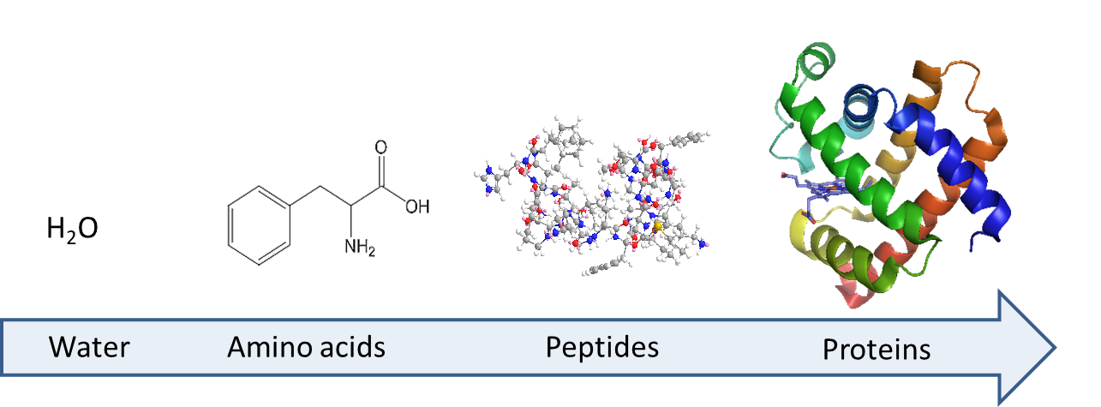
Conclusion / Prospectives
Basic physico-chemical study at molecular scale
Systematic: Radiolysis from water to proteins with various ions and energies. Comparisons with e⁻/γ-rays
Water Radiolysis: Hydrated electron e⁻_{aq} and H₂O₂
Simulations (Geant4-DNA)
Amino acids and peptides: new targets
All:
Dose-rate effects
Impact of ion fragments (Foot-Xn project: CLINM)

Slide 12

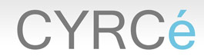



Thank you for your attention !
Antoine Danvin (PhD Student)
Séverine Chefson (PhD Student)
Catherine Galindo (IR)
Philippe Peaupardin (IR)
Rémi Barillon (Pr.)
Quentin Raffy (Ass. Prof.)
Jacky Schuler
Michel Pellicioli
Marc Rousseau
Satoshi Kodaira
Tamon Kusumoto
Dominique Muller
Yann Le Gall
Abbas Nasreddine
Nicolas Ludwig
Florent Kuntz
Delphine Jarnet
Laurent Bartolucci

Slide 13
Thank you for your attention !
Antoine Danvin (PhD Student)
Séverine Chefson (PhD Student)
Catherine Galindo (IR)
Philippe Peaupardin (IR)
Rémi Barillon (Pr.)
Quentin Raffy (Ass. Prof.)
Jacky Schuler
Michel Pellicioli
Marc Rousseau
Satoshi Kodaira
Tamon Kusumoto
Dominique Muller
Yann Le Gall
Abbas Nasreddine
Nicolas Ludwig
Florent Kuntz
Delphine Jarnet
Laurent Bartolucci

