Slide 1
CNAO accelerators and experimental room
Pullia M.

Slide 2
Comparison of the depth dose profiles
Protons/Carbon
Electrons
Photons
Tumour
Beam

Slide 3
Spread Out Bragg Peak
To treat thick tumours
a "spread out Bragg peak"
is created by overlapping
many pristine Bragg peak
at different depths,
corresponding to different
energies

Slide 4
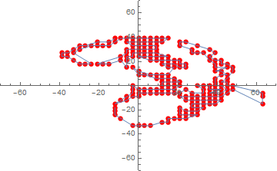
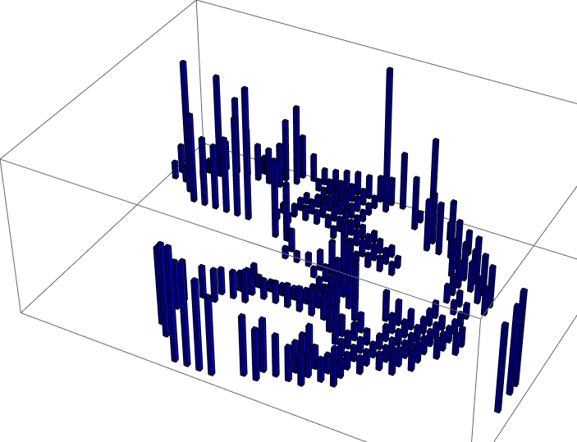
Treatment delivery
(courtesy of Siemens Medical)

Slide 5
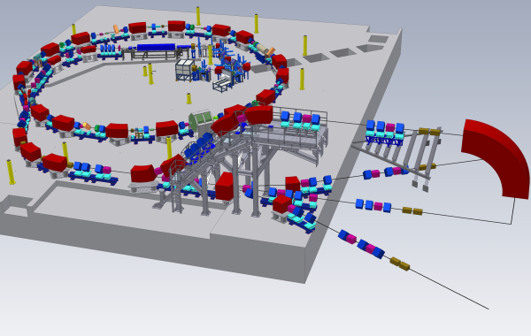
CNAO dual (multi) particle accelerator system
2 ECR sources
1 RFQ + LINAC
1 synchrotron
Slow extraction
Carbon
120-400 MeV/u
< 4 x 10⁸ C/spill
Protons
60-250 MeV
< 10¹⁰ p/spill

Slide 6
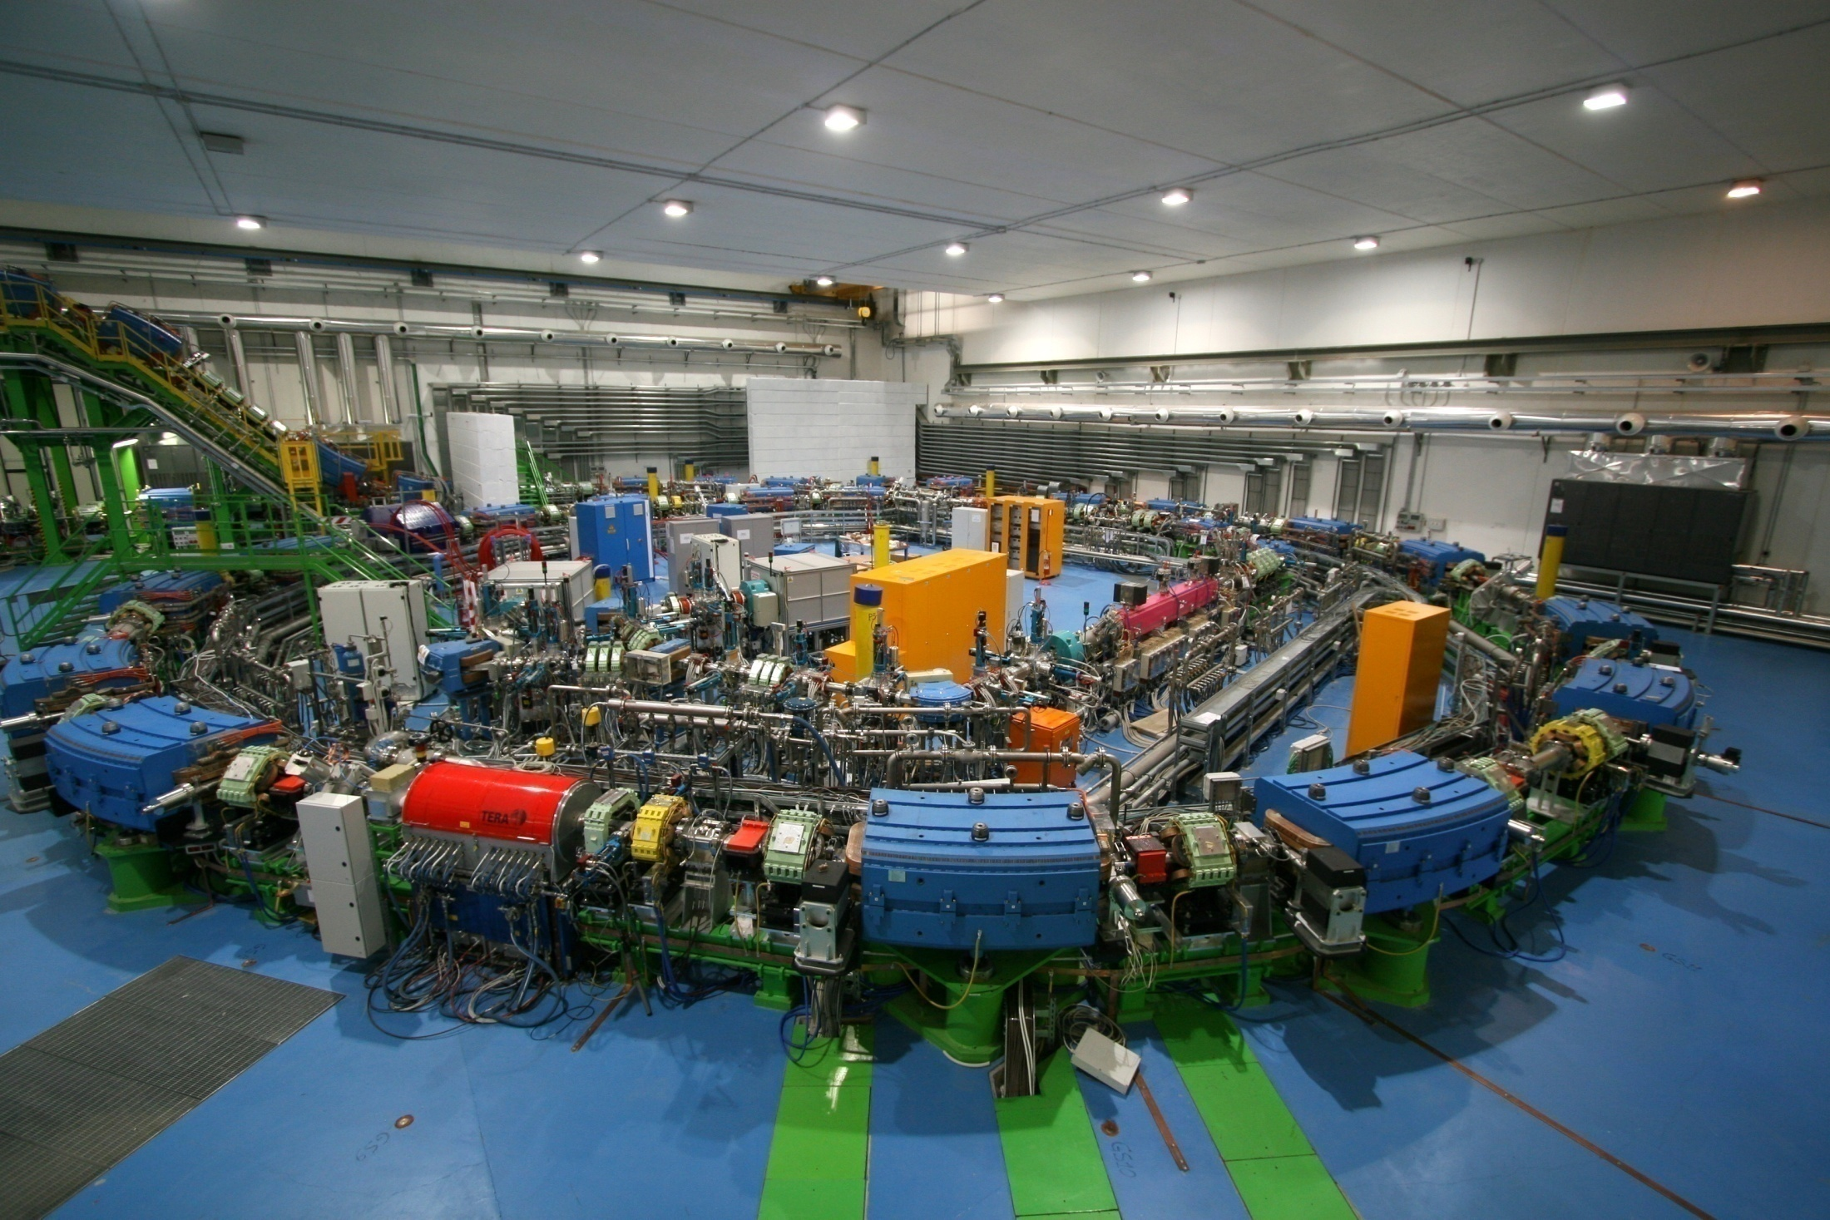

Slide 7
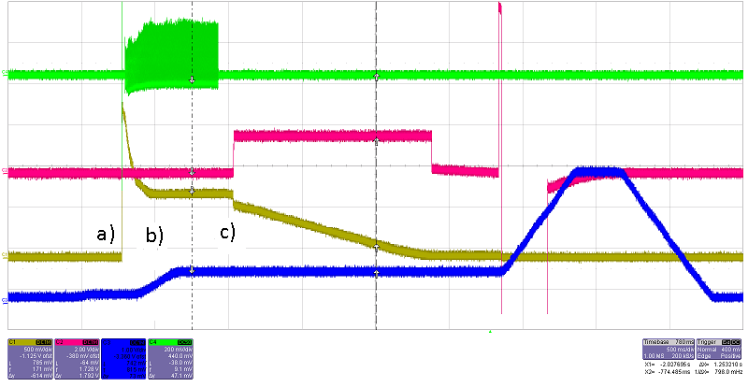
Machine cycle
BPM signal
Start cycle
Multiturn
Rf trapping
Acceleration
Rf jump
Rf off
Start betatron
Stop betatron
Start hysterestis
End cycle
Hysteresis cycle
BETATRON
B_{max}
# PARTICLES
B_{extr}
B_{min}
B_{inj}
DIPOLE field

Slide 8
Treatment execution
1 s
Sync
Extraction magnets
Injection magnets
Extracted beam

Slide 9
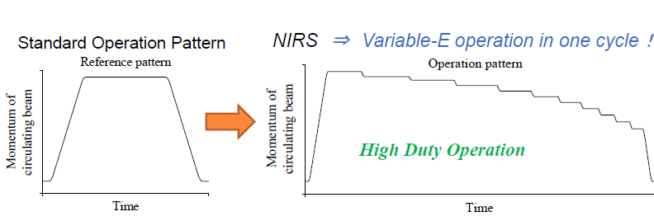
Multi Energy Extraction in progress
Use remaining beam after slice completion
(Courtesy K. Noda – CAS Medical)
Saved
time
Saved
time
1 s
Sync

Slide 10
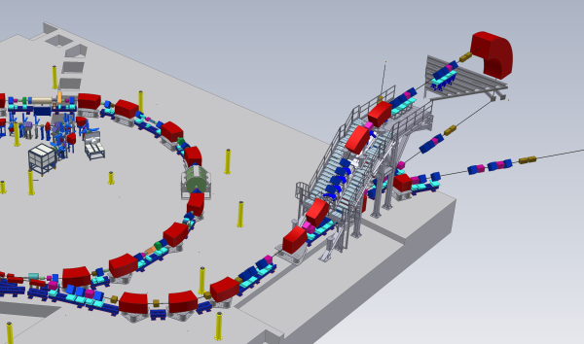
HEBT
60-250 MeV p
120-400 MeV/u C
10¹⁰ p/spill (~2nA)
4 10⁸ C/spill (~0.4nA)
3 Treatment rooms
2 H
1 H+V

Slide 11
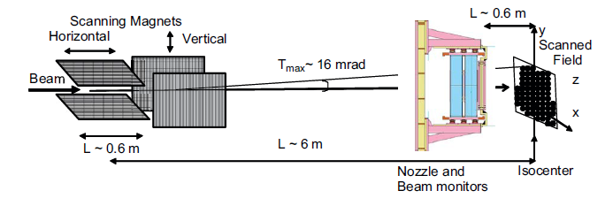
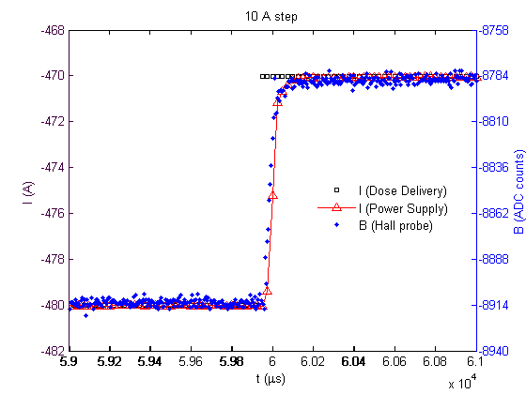
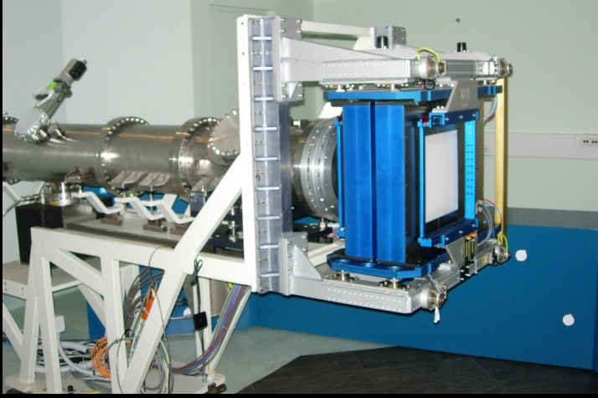
Dose delivery
Dose driven
Real time measurement
Feedback on scanning magnets
Giordanengo et al.,NIM A613
< Δt > = 35.1 ± 3.5 µs between 20% to 80%
ΔI /Δt ~ 170 kA/s or ~ 85 T/sec
In House developed
certified medical product
=> Continuous development

Slide 12
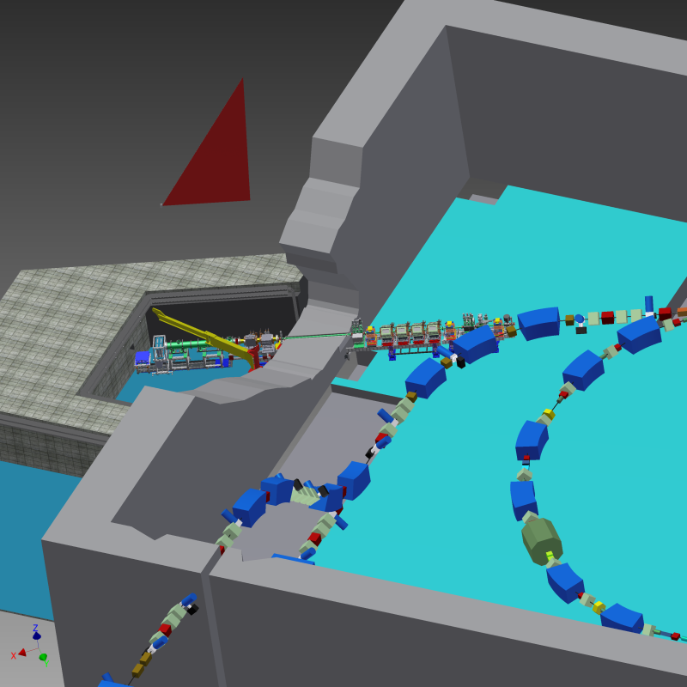
Experimental room
60-250 MeV p
120-400 MeV/u C
10¹⁰ p/spill (~2nA)
4 10⁸ C/spill (~0.4nA)
3 Treatment rooms
2 H
1 H+V
+1 Experimental Room

Slide 13
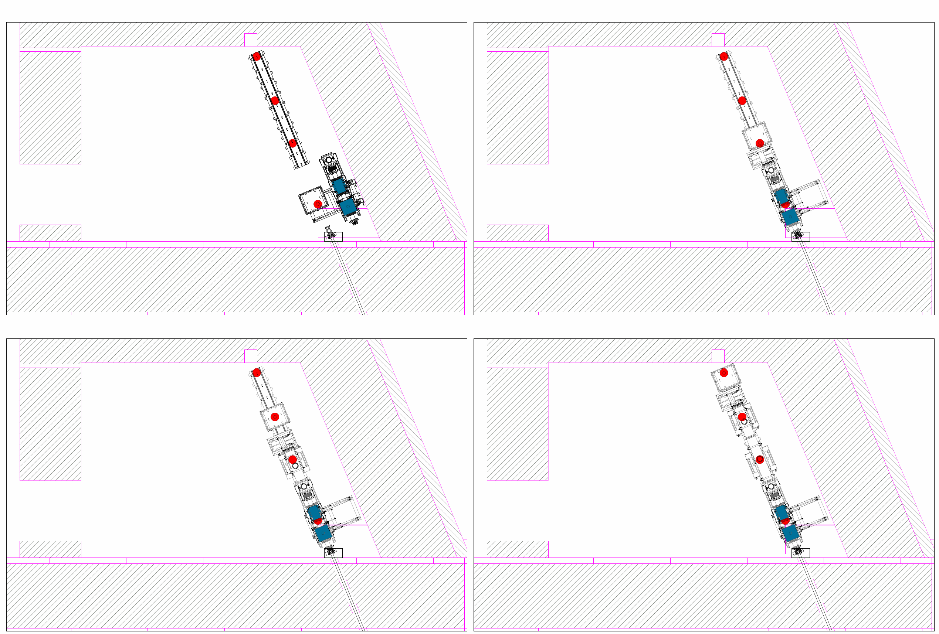
Experimental room
Isocenter 2
60-250 MeV p
120-400 MeV/u C
Fixed beam (single spot)
Fixed beam (single spot)
Beam measured and controlled
Isocenter 1
10¹⁰ p/spill (~2nA)
4 10⁸ C/spill (~0.4nA)
Isocenter 4
Isocenter 3
3 Treatment rooms
2 H
1 H+V
200 x 200 mm²
Scanned beam
135 x 135 mm²
Scanned beam
+1 Experimental Room

Slide 14
Available beams
FWHM ~10 mm
(particle and energy
dependent)
Irradiation field
< 200 x 200 mm²
[iso4]
Max distance
downstream target
< 5.5 m
[iso1]
Protons
60-250 MeV
< 10¹⁰ p/spill
Carbon
120-400 MeV/u
< 4 x 10⁸ C/spill
I
~1s
~2s
En.1
En.2
En.3
t
Low intensities (10³ part/s) possible

Slide 15
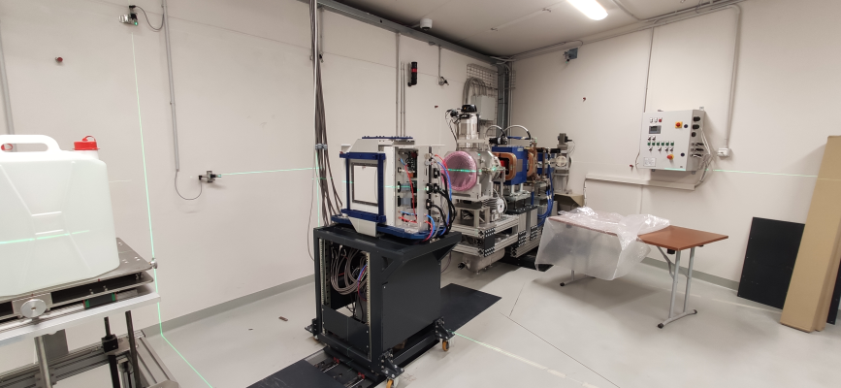
Scanning magnets and DDS on rail

Slide 16
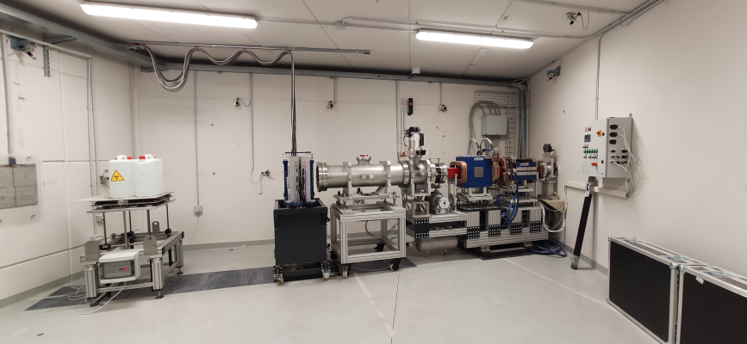
Isocenter 3

Slide 17
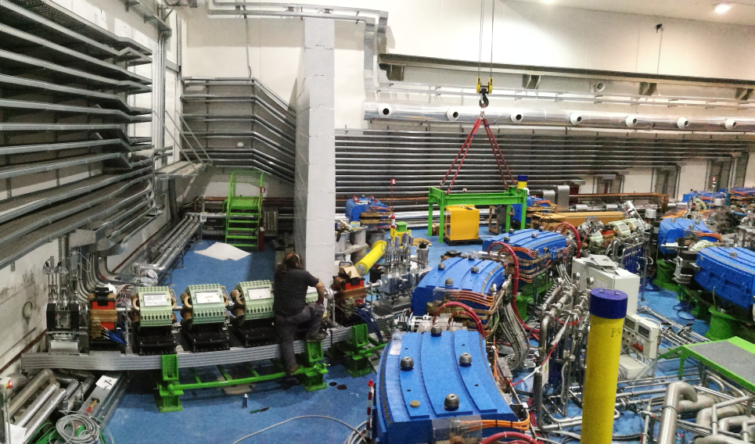
The CNAO experimental facility: a unique opportunity to perform research activities at 360°
Developed and built in collaboration with INFN
CNAO is also a Centre of Research and Development, whose activities range from clinical and radiobiological research to translational research with the objective of providing continual improvements in the capacity to cure.
For researchers a dedicated experimental irradiation room is available, using the CNAO beams, in time slots not impacting on patients treatment, but specifically devoted to research purposes: i.e. some night shifts (22:00 - 4:00) during the week and some full shifts (8h) during weekends.

Slide 18
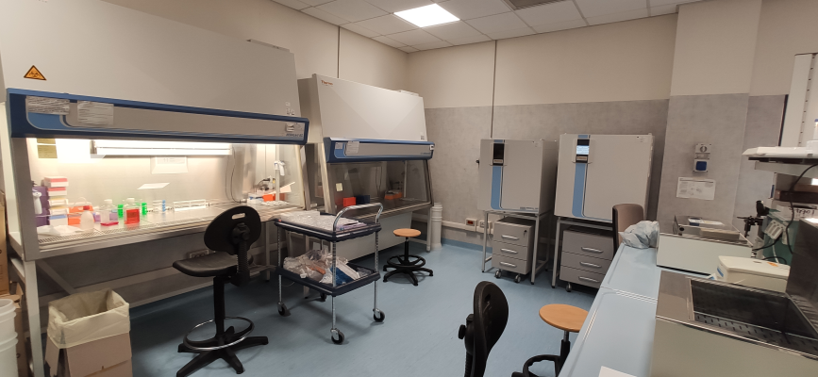
CNAO radiobiology laboratory
Biological laboratory with all the necessary equipment including biological laminar flows, incubators, centrifuges, fluorescence microscope, cell counters is provided. Furthermore, in the next 2 years the research area will be expanded and rooms dedicated to microscopy, cell handling, cytology/histology and small animals preparation will be accessible
Nearby university:
Animal house
Centro grandi strumenti

Slide 19
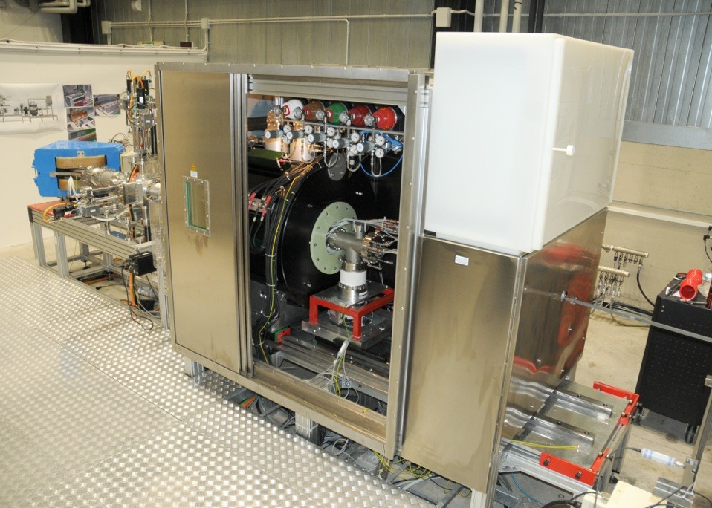
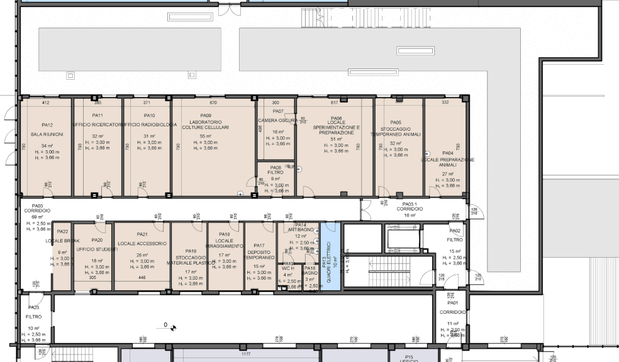
Upgrades in progress
From 2023 at CNAO will be available
Third source/new ions:
He, Li, O (and Fe)
New research area and bio-lab

Slide 20
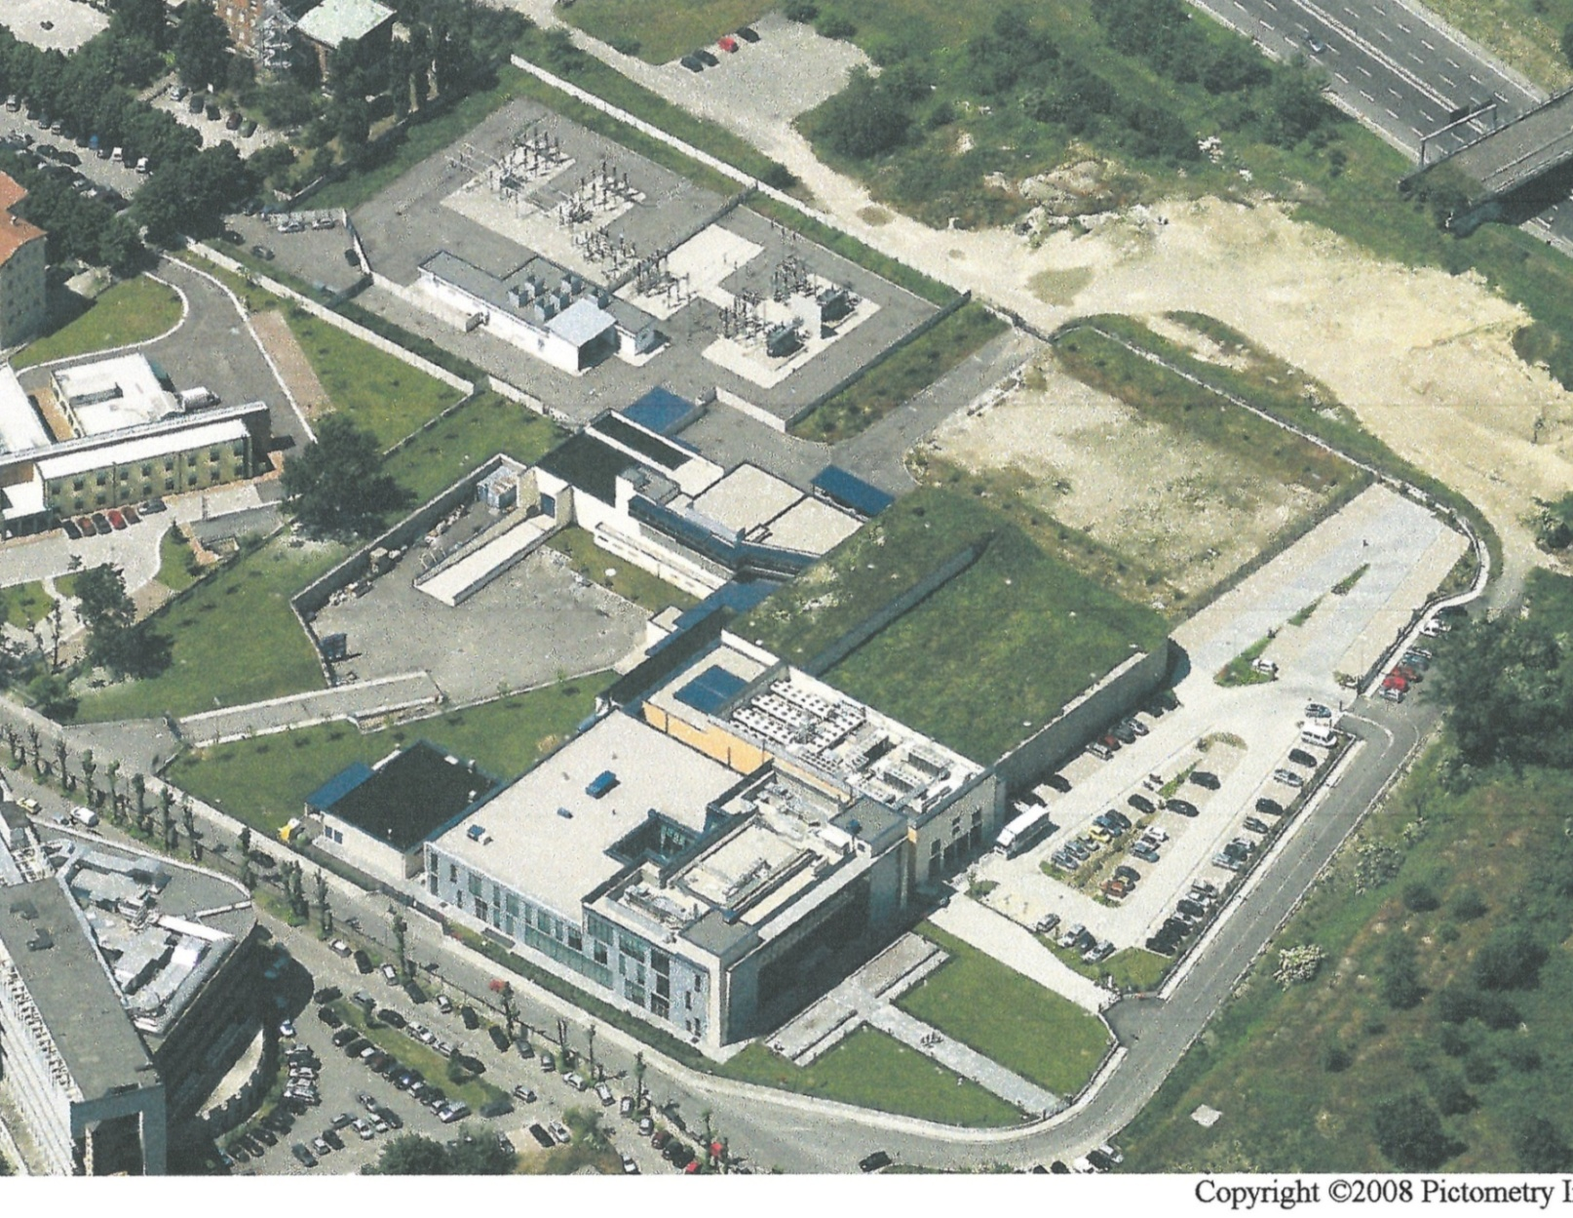
CNAO expansion project
Expansion Area A
Project approved and financed in 2019 by
Ministry of Health

Slide 21
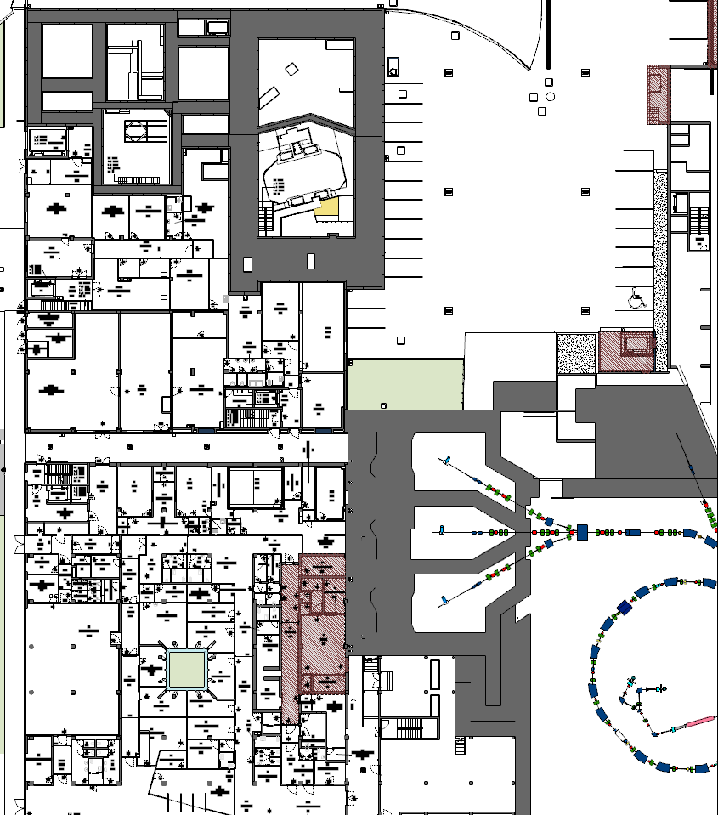
PROTONTHERAPY

Slide 22
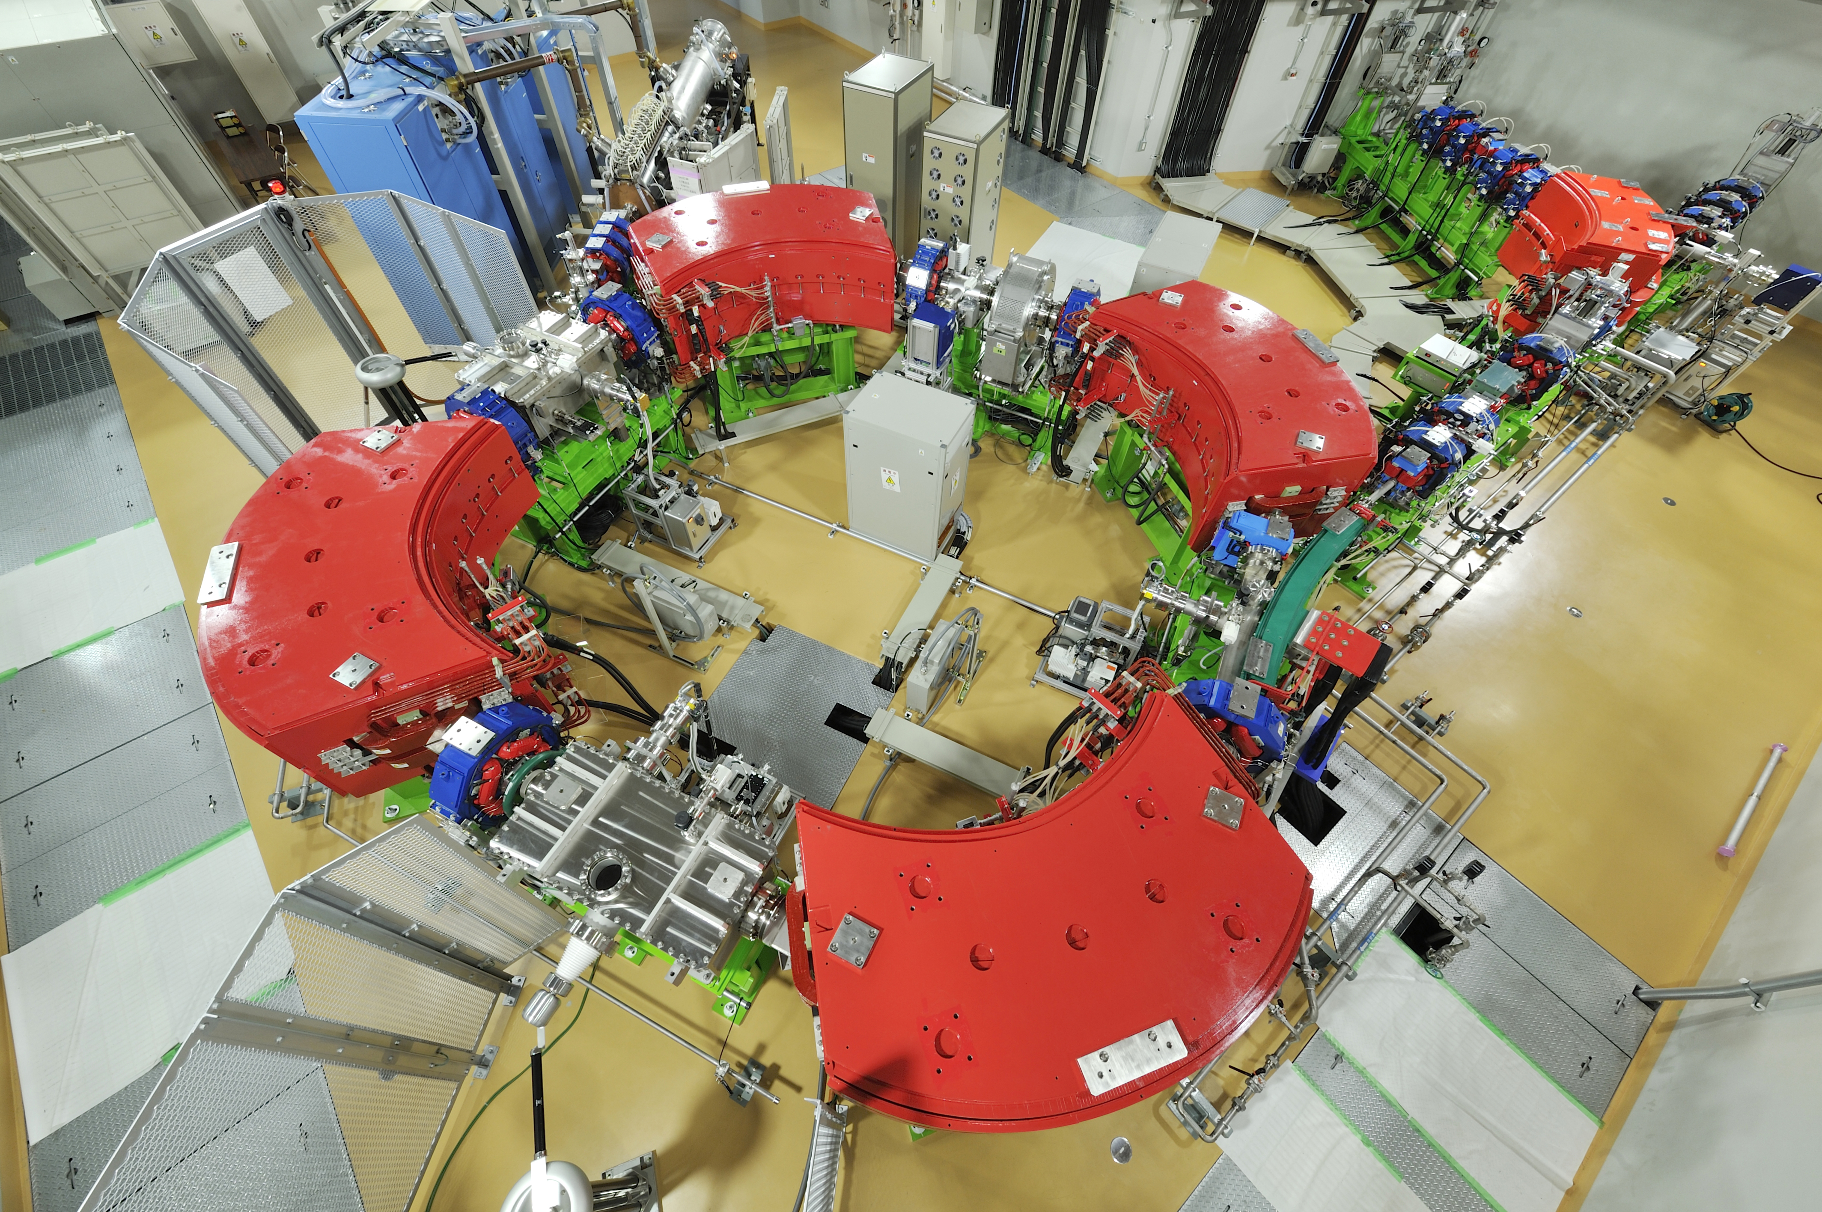
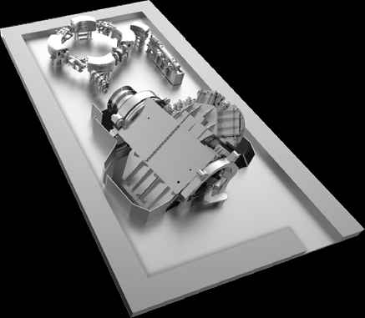
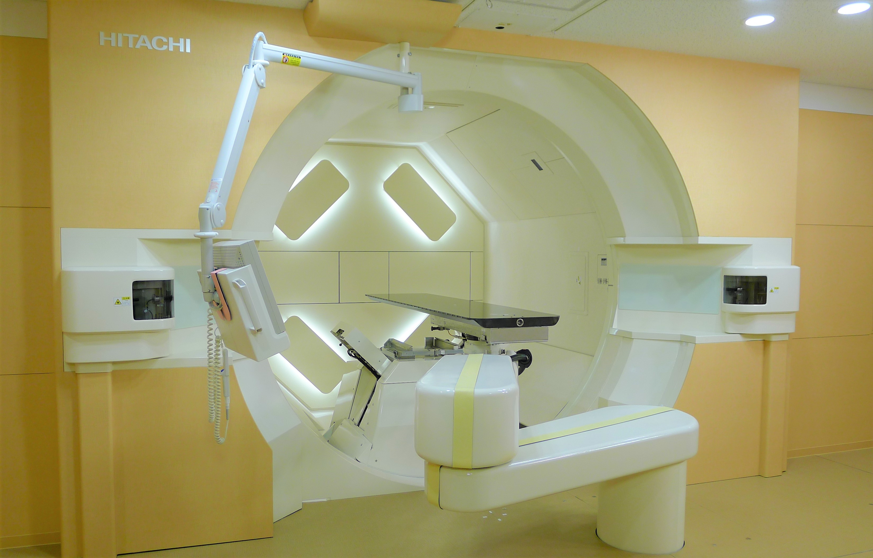
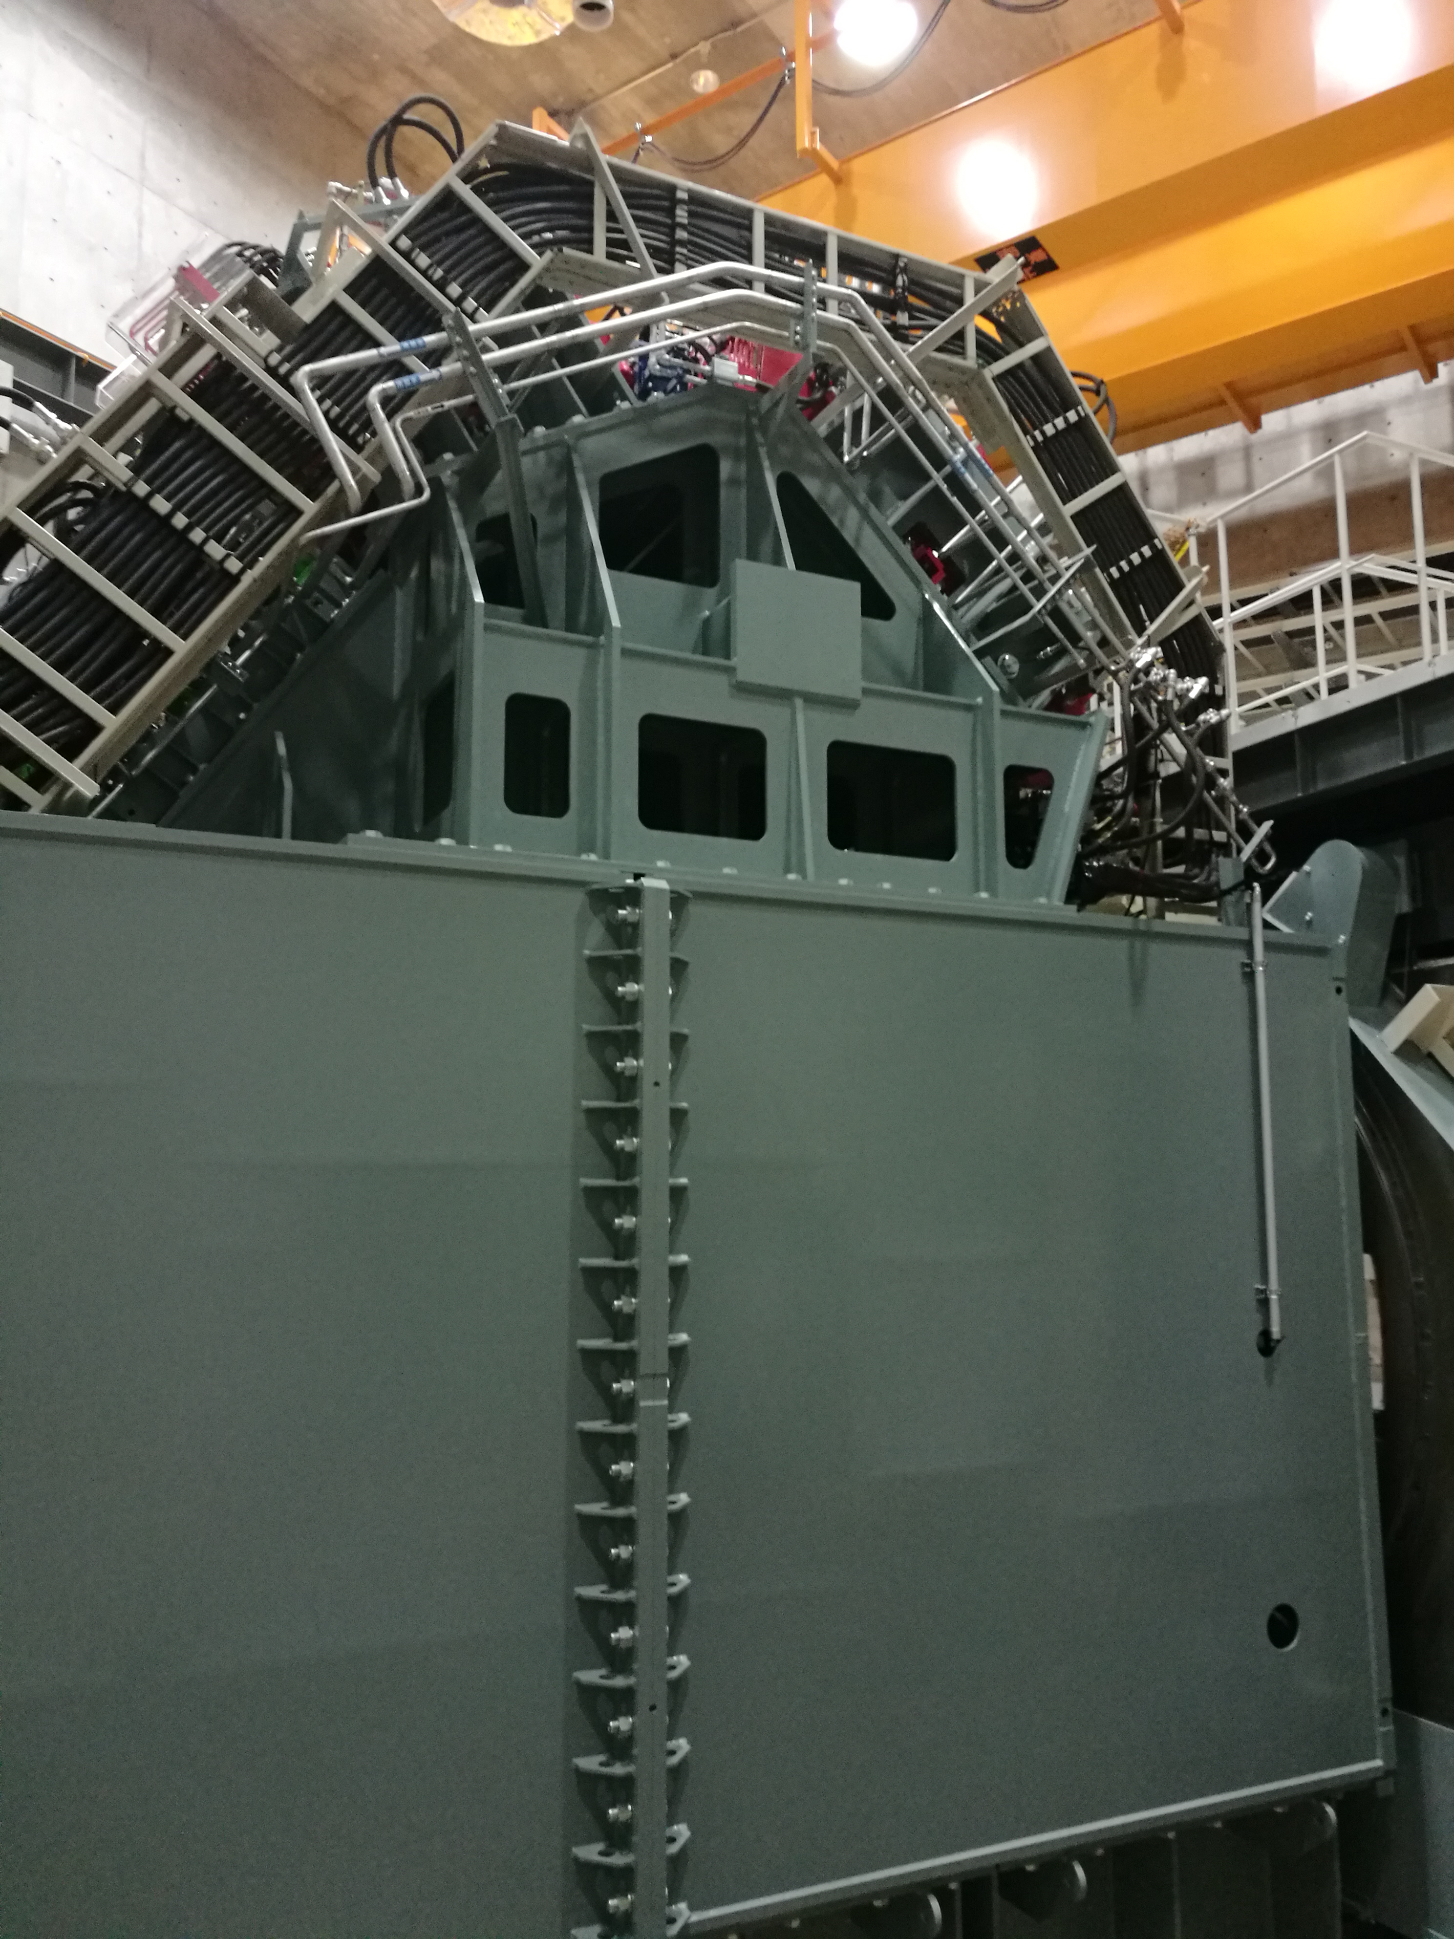
Single room facility with gantry for protons
Synchrotron room
Contract signed with Hitachi:
December 5th, 2019
Operational end 2023
Treatment room
360°isocentric gantry
(Field size: 30x40 cm²)

Slide 23
BNCT
BNCT AREA

Slide 24
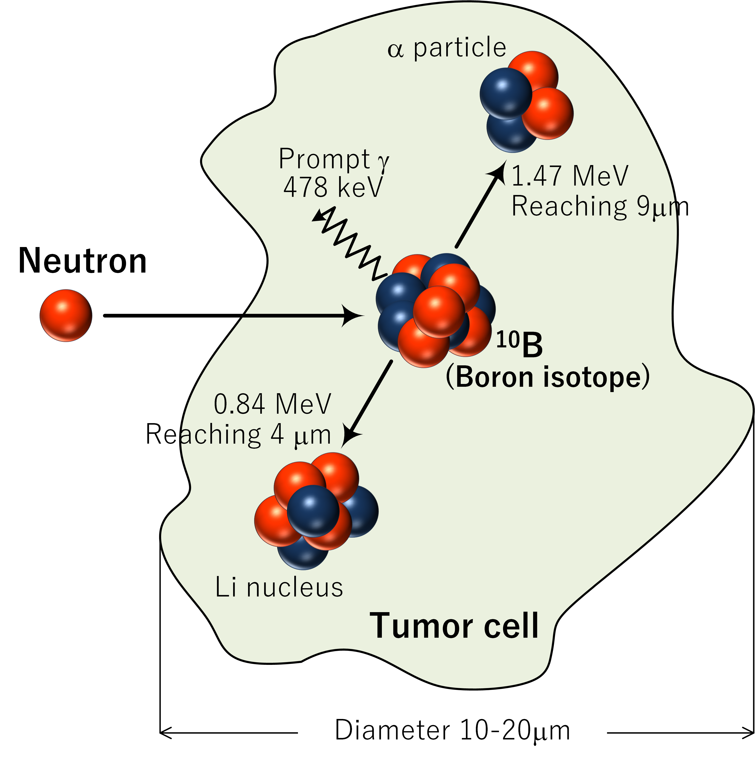
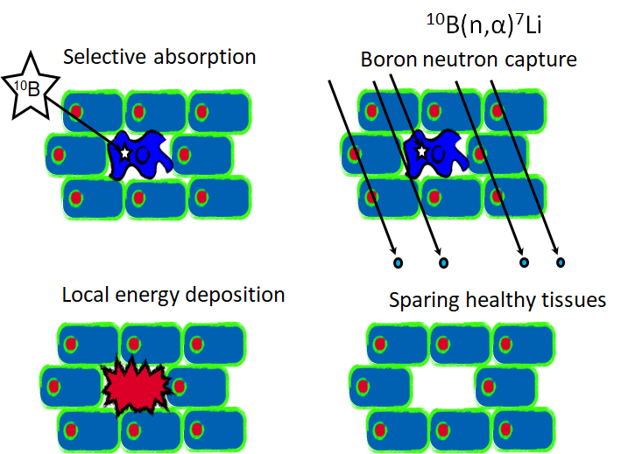
BNCT
Boronated drug that selectively reaches the tumour cells and avoids the healthy tissues
Accelerator driven neutron production
First Approved BNCT Drug (in Japan), May 2020
Notes:
STELLA PHARMA will launch
Steboronine®, the World's First BNCT Drug,
on May 20, 2020

Slide 25
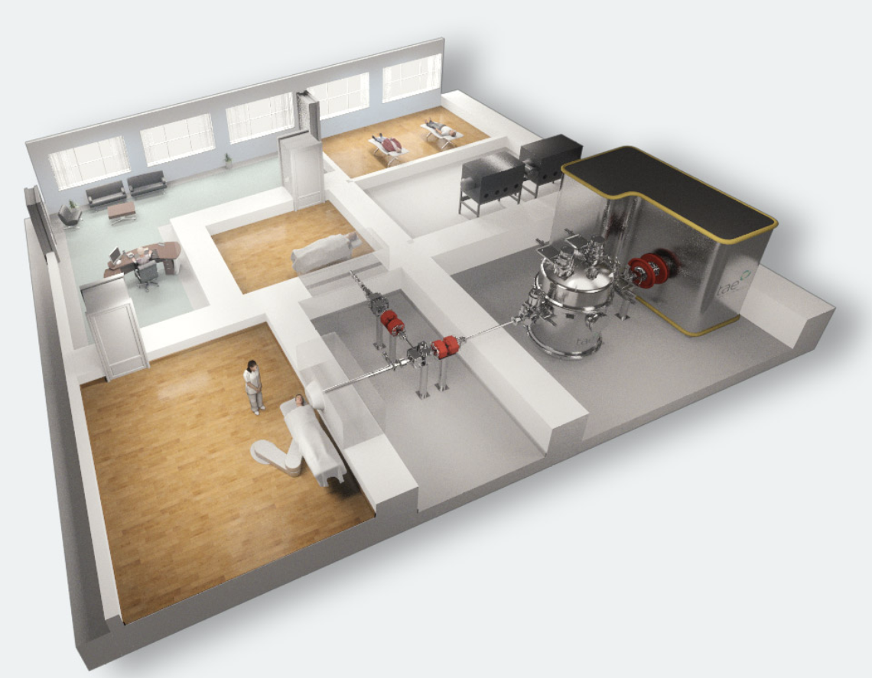


Similar installation, Clinic in Xiamen (Fujian, China)
(Sergey Taskaev, Frascati 2019)
Notes:
https://agenda.infn.it/event/19830/

Slide 26
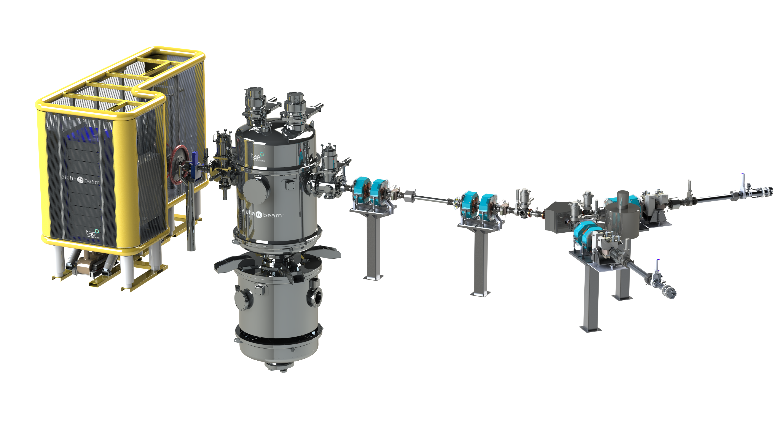

Accelerator based BNCT
Collaboration agreement signed September 2020
Operational end 2023
Proton energy 2.5 MeV
Intensity 10-15 mA
p-Li reaction
Notes:
neutron yield at 10 mA
8.9 × 10¹² [s⁻¹]
Avg neutron energy 0.55 MeV at 0°
$N={10}^{9}$[/cell], $Φ=1.8×{10}^{16}$ [m⁻²] (30 minutes irradiation by flux ${10}^{9}$[n/cm²/s ]):
$P(0)=e^{−6.84}=0.001$ (mostly fired)
$P\left(0\right)=\frac{{\left\langle n\right\rangle }^{0}e^{−\left\langle n\right\rangle }}{0!}=e^{−\left\langle n\right\rangle }$ $= e^{−NσΦ}$
$N={10}^{9} \text{[/}\text{cell}\text{], }Φ=1.8×{10}^{15}\text{ [}\text{m}\text{−2}\text{] }\text{(30 }\text{minutes} \text{irradiation} \text{by} \text{flux} {10}^{8}\text{[}\text{n}\text{/}\text{cm}\text{2}\text{/}\text{s}\text{ ])}\text{:}$
$P(0)=e^{−0.684}=0.505$ (the half is not fired)

Slide 27
Research and development are fundamental
Research and development on many subjects
  Machine operation improvement (RFKO, MultiEnergy)
  Improved dose delivery (organ motion management, 4D DDS)
  Improved treatment delivery (new ions, LET painting)
  Dose delivery and range verification (Online PET, prompt particles and gamma monitoring, improved beam monitoring)
  Improved research facility (XPR, new ions, new lab)
  Center upgrade (proton SRF, BNCT, ion gantry)
  …

Slide 28
Thank you for your attention
“Physics is like sex: sure, it may give some practical results, but that's not why we do it. ”
R. Feynmann

